Slide 1
Spec to RTL
Before you write bit-level logic, translate the spec into structure
learn_uart — spec to rtl
Notes:
Before you write bit-level logic, translate the spec into structure. List clock and reset ports, then bus-facing pins. Capture parameters—baud divider, mode bits, address width. Name the blocks: baud generator, shifter, byte FSM. Only then stub a module skeleton with TODO comments. This lab is that checklist—not finished synthesizable RTL.

Slide 2
UART TX starter
Starter preset: UART transmit eight-N-one
Tx busy, plus baud parameter BAUD_DIV
Required blocks still waiting
Check the block rows, then click Generate skeleton to grow a uart_tx module outline
learn_uart — spec to rtl
Notes:
Starter preset: UART transmit eight-N-one. Three items already checked—clock and reset ports, host and line ports with tx valid, tx data, tx, and tx busy, plus baud parameter BAUD_DIV. Required blocks still waiting: baud generator, shift serializer, and byte FSM for idle, start, data, stop. Check the block rows, then click Generate skeleton to grow a uart_tx module outline.

Slide 3
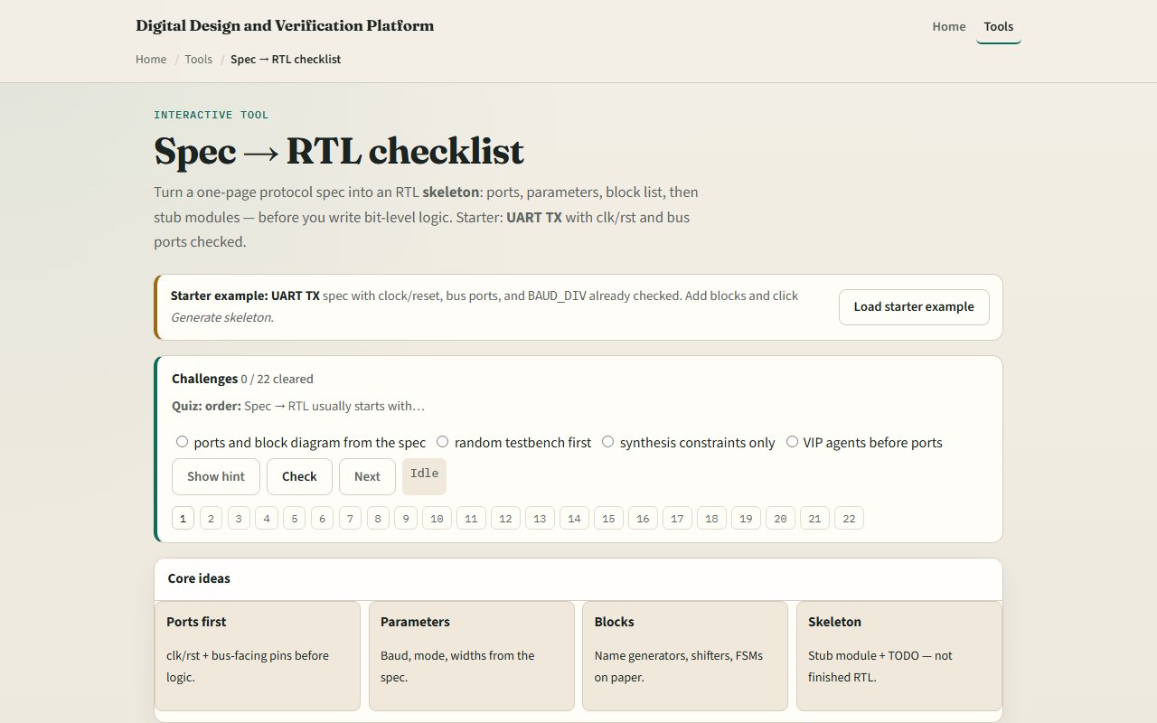
Browser lab
Spec to RTL starter
learn_uart — spec to rtl
Notes:
In the browser lab, load the starter example and read the spec bullets on the left. Each checklist row adds a snippet to the skeleton panel on the right. Try Check required to see all mandatory UART items, or switch the preset to SPI mode zero or I²C byte write. Demo UART skeleton walks a complete minimal outline. Challenges ask for three starter checks and a generated module header.

Slide 4
Real RTL/TB practice
In Track A, from the UART TX spec list every port name and one parameter
Name three blocks you would draw on paper before coding
Optional: compare your list to a UART sketch in the legacy combined materials
Write one sentence on what belongs in the skeleton versus what belongs in the FSM
learn_uart — spec to rtl
Notes:
In Track A, from the UART TX spec list every port name and one parameter. Name three blocks you would draw on paper before coding. Optional: compare your list to a UART sketch in the legacy combined materials. Write one sentence on what belongs in the skeleton versus what belongs in the FSM implementation.

Slide 5
Pitfalls to watch
Do not skip ports and jump straight to the FSM
Parameters are not optional when baud or mode defines behavior
A skeleton with TODO is not done RTL, this lab separates planning from implementation
And remember
learn_uart — spec to rtl
Notes:
Do not skip ports and jump straight to the FSM—reviewers catch missing busy or valid first. Parameters are not optional when baud or mode defines behavior. A skeleton with TODO is not done RTL—this lab separates planning from implementation. And remember: the SPI and I²C presets use the same workflow; UART is just the course default.

Slide 6
Your turn
Complete the checklist for at least one track, preferably both
In the browser, finish required UART checks and generate the skeleton once
On paper, list ports, parameters, and three blocks for UART TX
When you are ready, take the short quiz, then continue to baud divider
learn_uart — spec to rtl
Notes:
Complete the checklist for at least one track—preferably both. In the browser, finish required UART checks and generate the skeleton once. On paper, list ports, parameters, and three blocks for UART TX. When you are ready, take the short quiz, then continue to baud divider.

