Slide 1
UART error flags
A real UART RX does not just deliver bytes, it reports when something went wrong
learn_uart — uart errors
Notes:
A real UART RX does not just deliver bytes—it reports when something went wrong. Three classic flags: framing, parity, and overrun. Framing means the sampled stop bit was not one—noise, baud mismatch, or a break held low too long. Parity means the check bit does not match the even or odd rule over the data bits. Overrun means a new frame finished while software still has not read the holding register—the prior byte is lost. This lab walks those three cases on one frame at a time.

Slide 2
Starter clean A5 eight-E-one
Starter preset
All three flags start at zero
Byte A5 has four ones in its eight bits, so the expected even parity bit Pe is zero
Step bit through idle, start, D0 through D7, Pe, stop, and trailing idle
Play to end and the verdict should read RX OK with flags clear
The RHR panel shows the latched byte unread until you click Read RHR
learn_uart — uart errors
Notes:
Starter preset: clean frame hex A5 with eight data bits, even parity, one stop bit—eight-E-one. All three flags start at zero. Byte A5 has four ones in its eight bits, so the expected even parity bit Pe is zero. Step bit through idle, start, D0 through D7, Pe, stop, and trailing idle. Play to end and the verdict should read RX OK with flags clear. The RHR panel shows the latched byte unread until you click Read RHR.

Slide 3
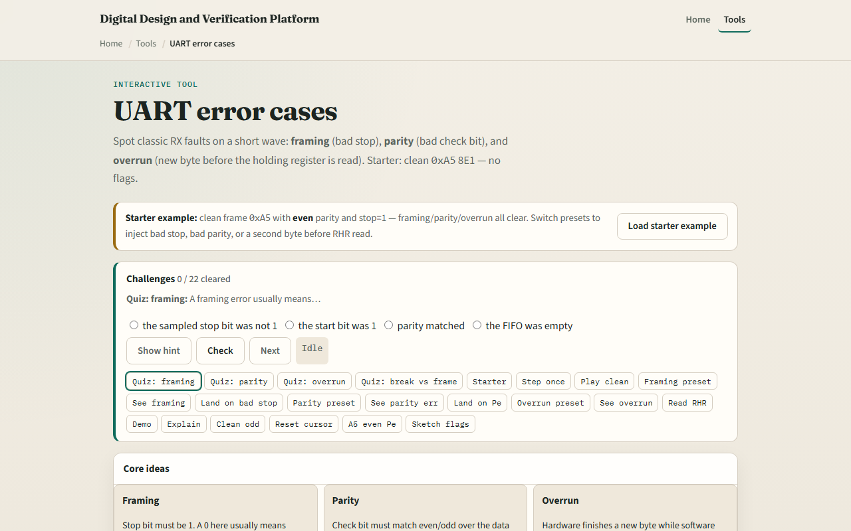
Browser lab
UART errors starter
learn_uart — uart errors
Notes:
In the browser lab, load the starter example and read the three idea cards—framing, parity, overrun. Switch the scenario dropdown to inject errors: Framing stop equals zero highlights a bad stop slot. Parity bad Pe flips the check bit while stop stays good. Overrun delivers a second byte hex five-A before you read—play to end without Read RHR and overrun fires. Demo clean walks a full good frame. Explain summarizes all three flags in one trace line.

Slide 4
Real RTL/TB practice
In Track A, name the three UART RX status flags and what each one means in one line
For hex A5 eight-E-one, compute the expected even parity bit
Sketch what software should do when framing is set versus parity only
Optional: peek at UART status-register examples in the legacy combined materials
This lab is error literacy, your TB should still inject and check these flags explicitly
learn_uart — uart errors
Notes:
In Track A, name the three UART RX status flags and what each one means in one line. For hex A5 eight-E-one, compute the expected even parity bit. Sketch what software should do when framing is set versus parity only. Optional: peek at UART status-register examples in the legacy combined materials. This lab is error literacy—your TB should still inject and check these flags explicitly.

Slide 5
Pitfalls to watch
Framing and parity are sampled at the end of the frame
A parity error can still latch data into RHR; framing often means the byte is suspect
Overrun is a software-timing problem
A line held low longer than a frame looks like repeated framing errors or break
And remember
learn_uart — uart errors
Notes:
Framing and parity are sampled at the end of the frame—do not confuse them with start-bit detection from the last module. A parity error can still latch data into RHR; framing often means the byte is suspect. Overrun is a software-timing problem—read the holding register before the next byte arrives, or add a FIFO in the next module. A line held low longer than a frame looks like repeated framing errors or break, not overrun alone. And remember: this lab uses preset corrupted frames; real noise needs oversampling and filters you already studied.

Slide 6
Your turn
Complete the checklist for at least one track, preferably both
In the browser
On paper, list framing, parity, and overrun and one cause for each
When you are ready, take the short quiz, then continue to FIFO in the datapath
learn_uart — uart errors
Notes:
Complete the checklist for at least one track—preferably both. In the browser, play clean A5 eight-E-one with all flags zero, then try framing and overrun presets once each. On paper, list framing, parity, and overrun and one cause for each. When you are ready, take the short quiz, then continue to FIFO in the datapath.

