Slide 1
What a VIP package is
Module eleven mapped classic testbench habits onto UVM roles
learn_uart — vip anatomy
Notes:
Module eleven mapped classic testbench habits onto UVM roles. A verification IP package is the reusable unit you hand to another team: not just an agent, but agent plus checker plus coverage plus docs. The agent drives and observes one protocol interface—sequencer, driver, monitor, and virtual interface around one bus. A checker watches bus rules passively—handshake legality, not payload scoreboard compares. Coverage proves which scenarios ran through covergroups and bins. Docs close the loop—API notes, README, examples, and a self-test path so consumers can integrate without guessing. Agent alone is a scaffold. Complete means all four pieces assembled and ready for handoff.

Slide 2
Starter and incomplete presets
Starter loads a complete UART VIP
Scenario presets show what breaks handoff
Missing checker keeps agent, coverage, and docs but drops protocol rules, INCOMPLETE
Missing coverage drops bins while stimulus and checks remain, INCOMPLETE
Missing docs drops the self-test handoff even when code pieces exist, INCOMPLETE
Agent only is useful scaffolding, not a VIP yet
learn_uart — vip anatomy
Notes:
Starter loads a complete UART VIP: agent, checker, coverage, and docs all included—the verdict reads COMPLETE and the package tree shows every folder checked. Scenario presets show what breaks handoff. Missing checker keeps agent, coverage, and docs but drops protocol rules—INCOMPLETE. Missing coverage drops bins while stimulus and checks remain—INCOMPLETE. Missing docs drops the self-test handoff even when code pieces exist—INCOMPLETE. Agent only is useful scaffolding, not a VIP yet. Empty package waits for you to toggle pieces in and click Assemble. Click a piece card once to select it; click again on the selected card to toggle it in or out of the package.

Slide 3
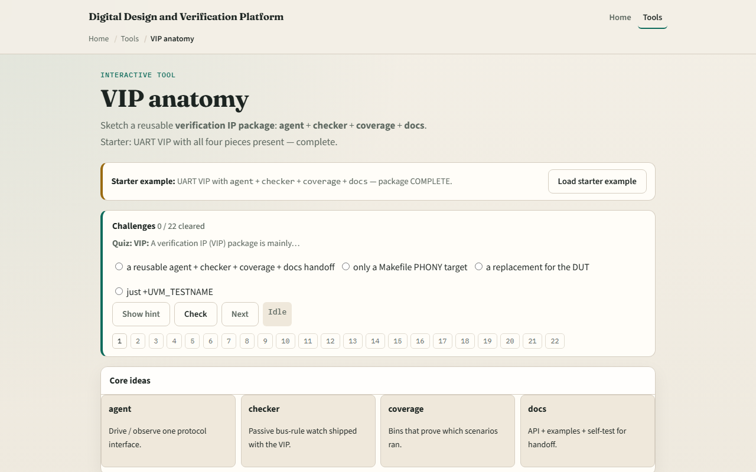
Browser lab
Browser lab starter
learn_uart — vip anatomy
Notes:
In the browser lab, load the starter example and read the handoff checklist—four OK rows and a COMPLETE verdict. Explore the package tree: agent folder for sequencer, driver, monitor, and interface; checker for protocol rules; coverage for bins; docs for API and self-test. Load missing checker and watch the verdict flip to INCOMPLETE with checker in the missing list. Demo incomplete jumps to that preset in one click. From empty, toggle all four pieces in and Assemble to rebuild COMPLETE. Challenges quiz you on agent, checker, and docs roles, then ask you to assemble complete and incomplete packages. This is literacy—not a commercial UART VIP you drop into synthesis.

Slide 4
Real RTL/TB practice
In Track A, restate the four VIP deliverables in one sentence each
Docs should stay blank
Optional: peek at the linked UART RTL or TB sketch and label which folders would hold
Remember: scoreboard payload compare often lives in the environment
Your job is to read a block diagram and know what a consumer still has to wire in the env
learn_uart — vip anatomy
Notes:
In Track A, restate the four VIP deliverables in one sentence each: agent, checker, coverage, docs. Sketch a UART VIP package tree and mark what is missing if you only ship an agent—checker, coverage, and docs should stay blank. Optional: peek at the linked UART RTL or TB sketch and label which folders would hold driver versus monitor versus protocol checker. Remember: scoreboard payload compare often lives in the environment; the VIP typically ships checker and coverage with the agent. Your job is to read a block diagram and know what a consumer still has to wire in the env.

Slide 5
Pitfalls to watch
Do not call an agent folder a finished VIP, handoff needs checker, coverage, and docs too
Do not confuse checker with scoreboard, the checker flags protocol legality
Coverage is not optional decoration, it proves which bins your VIP scenarios actually hit
Docs are not README fluff, they include a self-test so integration does not stall
And remember: this lab teaches package anatomy
Factory overrides, RAL, and full UVM env wiring come in later courses, not here
learn_uart — vip anatomy
Notes:
Do not call an agent folder a finished VIP—handoff needs checker, coverage, and docs too. Do not confuse checker with scoreboard—the checker flags protocol legality; the scoreboard compares predicted versus observed data. Coverage is not optional decoration—it proves which bins your VIP scenarios actually hit. Docs are not README fluff—they include a self-test so integration does not stall. And remember: this lab teaches package anatomy. Factory overrides, RAL, and full UVM env wiring come in later courses—not here.

Slide 6
Your turn
Complete the checklist for at least one track, preferably both
In the browser, load starter, then Demo incomplete and name the missing piece
On paper, draw uart_vip with four subfolders and mark which are empty for agent-only
When you are ready
learn_uart — vip anatomy
Notes:
Complete the checklist for at least one track—preferably both. In the browser, load starter, then Demo incomplete and name the missing piece. On paper, draw uart_vip with four subfolders and mark which are empty for agent-only. When you are ready, take the short quiz, then continue to UART complete—the course wrap module.

