Slide 1
Module 1
Design & Verification Methodology (Part 1)
learn_uart_spi_i2c / Module 1

Slide 2
Learning objectives
• Spec-to-RTL flow: From SPEC.md (or equivalent) to
synthesizable Verilog/SystemVerilog.
• Why verify: The cost of bugs, and how directed tests
(and later UVM) reduce risk.
• Minimal toolchain: Verilator + Make + C++ harness
for RTL simulation (no UVM in this module).
learn_uart_spi_i2c / Module 1

Slide 3
Prerequisites
• Linux/macOS/WSL2 with a terminal
• Verilator (5.x recommended)
• GNU Make
• C++ compiler (GCC or Clang)
learn_uart_spi_i2c / Module 1

Slide 4
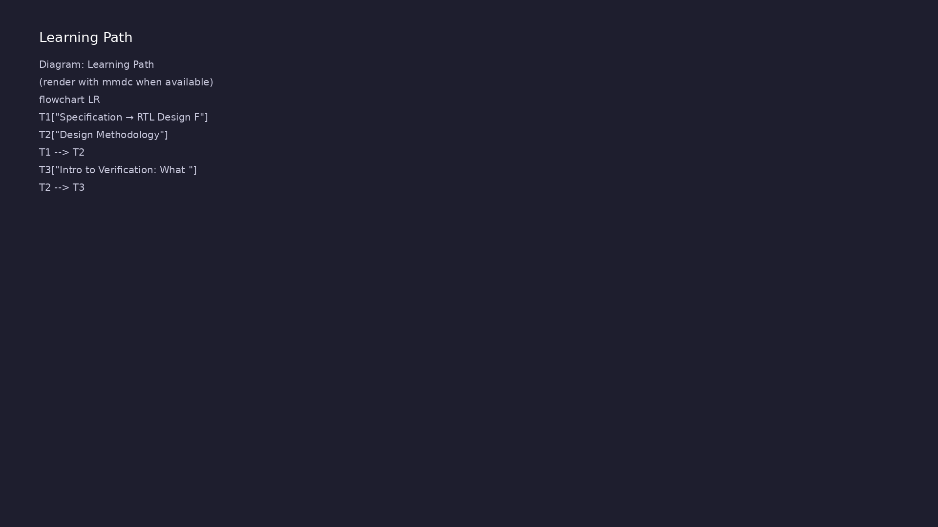
Learning path
Understand the specification → RTL design flow, design methodology, and why we verify.
learn_uart_spi_i2c / Module 1

Slide 5
Overview
• Module 1 establishes the **design and verification
mindset** you will use for UART, SPI, and I²C in…
learn_uart_spi_i2c / Module 1

Slide 6
How to learn this module
learn_uart_spi_i2c / Module 1

Slide 7
Suggested learning path
• Read UNDERSTANDING_THE_SPEC.md — how to read
interface, behavior, and timing in a spec.
• Read SPEC_TO_RTL_GUIDE.md — mapping spec sections to
RTL structure.
• Skim Design Architecture and Verification sections
below, then run the spec_to_rtl example.
• Trace one requirement in SPEC.md to a line in
`dut/counter.v` and to a check in `sim_main.cpp`.
learn_uart_spi_i2c / Module 1
Notes:
From docs/MODULE1.md — read guides before running demos.

Slide 8
Design architecture
learn_uart_spi_i2c / Module 1

Slide 9
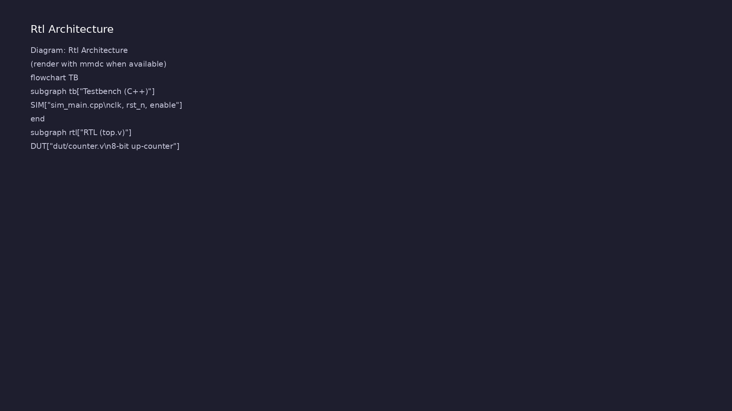
1. Artifact flow (spec_to_rtl)
• SPEC.md → requirements in plain
language (interface, behavior,
timing).
• dut/counter.v → synthesizable
RTL implementing the spec.
• top.v → wrapper connecting DUT
pins to the simulation harness.
• sim_main.cpp → clock, reset,
stimulus, and result checking
outside RTL.
learn_uart_spi_i2c / Module 1
Notes:
From MODULE1 Design Architecture.

Slide 10
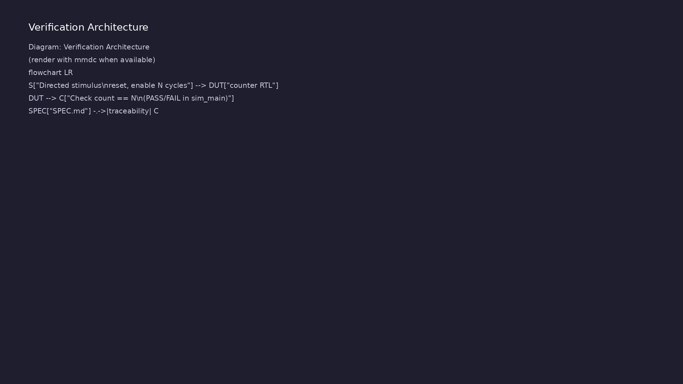
2. Counter DUT structure
• 8-bit up-counter: increments
when `enable` is high; holds
when disabled.
• Reset: synchronous active-low
`rst_n` clears `count` to zero.
• Ports: `clk`, `rst_n`, `enable`,
`count[7:0]` — map directly from
the spec interface table.
learn_uart_spi_i2c / Module 1
Notes:
From MODULE1 Design Architecture.

Slide 11
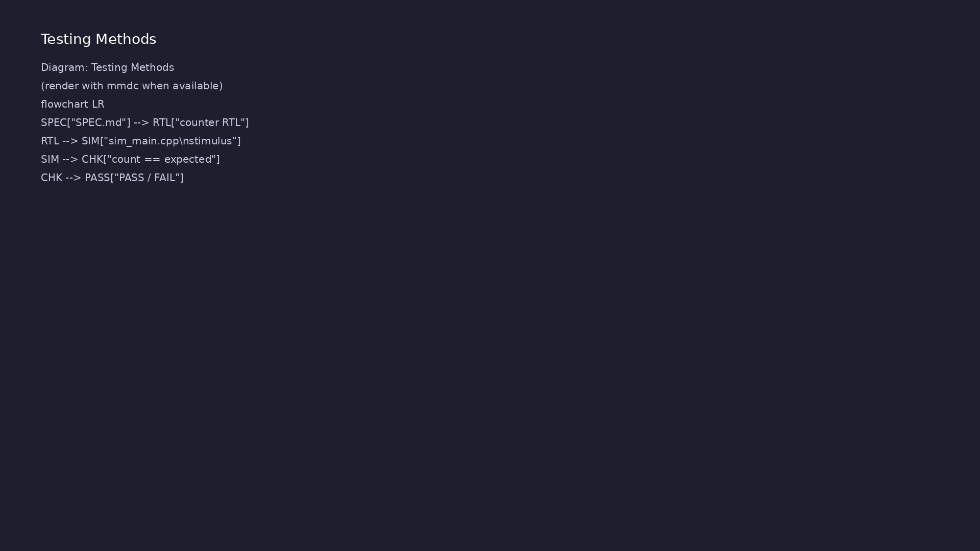
3. Simulation harness attachment
• C++ generates `clk` and drives
`rst_n` / `enable`; reads
`count` each cycle.
• No SystemVerilog testbench yet —
you will add structured TB/UVM
in Module 2.
learn_uart_spi_i2c / Module 1
Notes:
From MODULE1 Design Architecture.

Slide 12
RTL block diagram (reference)
Module 1: DUT hierarchy and signal flow.
learn_uart_spi_i2c / Module 1

Slide 13
counter.v — spec in RTL
// 8-bit up-counter — RTL implementation per SPEC.md
// Module 1: Spec → RTL methodology example.
`timescale 1ns/1ps
module counter (
input wire clk,
input wire rst_n,
input wire enable,
output reg [7:0] count
);
always @(posedge clk) begin
if (!rst_n)
count <= 8'h00;
else if (enable)
count <= count + 8'd1;
# ...
learn_uart_spi_i2c / Module 1

Slide 14
Execution & simulation flow
learn_uart_spi_i2c / Module 1

Slide 15
How the example runs (toolchain)
• Makefile: Verilator compiles RTL + SystemVerilog
testbench into a C++ model
• sim_main.cpp: generates clk/rst_n, calls eval()
until $finish
• Directed test (initial block or C++): drive
stimulus, wait for DUT flags
• Self-check: compare outputs; print PASS/FAIL (see
terminal demo slide)
• Repo path: module1/examples/<example>/ — run make
run from that directory
learn_uart_spi_i2c / Module 1
Notes:
From MODULE1 — execution and artifact layout.

Slide 16
Makefile — Verilator build & run
# Makefile for Module 1 spec_to_rtl example
# Spec → RTL → basic simulation (no UVM).
#
# Usage:
# make run Build and run (default)
# make run TRACE=1 Build with VCD tracing, then run
# make clean Remove obj_dir and VCD
TRACE ?= 0
VERILATOR ?= verilator
TOPLEVEL ?= top
DUT_SRC = dut/*.v
RTL_SRC = top.v $(DUT_SRC)
HARNESS = sim_main.cpp
VERILATOR_FLAGS = -cc --exe -Wall
# ...
learn_uart_spi_i2c / Module 1

Slide 17
Key files to study
learn_uart_spi_i2c / Module 1

Slide 18
Open these in the repo
• `module1/examples/spec_to_rtl/SPEC.md` —
requirements document
• `module1/examples/spec_to_rtl/dut/counter.v` — RTL
implementation
• `module1/examples/spec_to_rtl/top.v` — DUT wrapper
• `module1/examples/spec_to_rtl/sim_main.cpp` —
stimulus and checking
learn_uart_spi_i2c / Module 1
Notes:
Trace while running module1/EXAMPLES.md labs.

Slide 19
Verification & testing methods
learn_uart_spi_i2c / Module 1

Slide 20
1. What we verify in Module 1
• RTL behavior matches SPEC.md
(reset, enable gating, count
progression).
• Directed scenario: release
reset, enable for N cycles,
expect `count == N`.
learn_uart_spi_i2c / Module 1
Notes:
From MODULE1 Verification & Testing Methods.

Slide 21
2. Stimulus and checking
• Stimulus: C++ toggles `enable`
for a known number of clock
cycles.
• Check: compare `count` to
expected value; print PASS/FAIL.
• Traceability: each check should
cite the spec sentence it
proves.
learn_uart_spi_i2c / Module 1
Notes:
From MODULE1 Verification & Testing Methods.

Slide 22
3. What is not covered yet
• Random stimulus, functional
coverage, scoreboards — Module 2
(UVM) and protocol modules.
• Use [UNDERSTANDING_THE_SPEC.md](
../module1/UNDERSTANDING_THE_SPE
C.md) and
[SPEC_TO_RTL_GUIDE.md](..…
learn_uart_spi_i2c / Module 1
Notes:
From MODULE1 Verification & Testing Methods.

Slide 23
sim_main.cpp — directed check
// C++ test harness for spec_to_rtl (8-bit counter).
// Drives clk, rst_n, enable and checks count behavior.
// Module 1: basic directed test — no UVM.
#include <cstdint>
#include <cstdlib>
#include <iostream>
#include <verilated.h>
#include "Vtop.h"
#if VM_TRACE
# include <verilated_vcd_c.h>
#endif
static constexpr int kClockHalfPeriod = 5;
# ...
learn_uart_spi_i2c / Module 1

Slide 24
Syllabus topics
learn_uart_spi_i2c / Module 1

Slide 25
1. Specification → RTL Design Flow
• Specification: Document interface (ports, widths,
direction), behavior (reset, enable, state transi…
• RTL: Implement the spec in Verilog/SystemVerilog;
each requirement in the spec should map to clear…
• Traceability: Being able to point from a line in the
spec to the RTL that implements it (and vice v…
learn_uart_spi_i2c / Module 1
Notes:
From MODULE1 Topics Covered.

Slide 26
2. Design Methodology
• Single block: One spec, one (or a few) RTL files,
one testbench.
• Reuse: The same flow (spec → RTL → testbench) scales
to protocol blocks (UART, SPI, I²C) in Modules…
• Documentation: Keep SPEC.md (or similar) next to the
RTL so that reviewers and verification can che…
learn_uart_spi_i2c / Module 1
Notes:
From MODULE1 Topics Covered.

Slide 27
3. Intro to Verification: What We Verify, and Why
• What we verify: That the RTL matches the
specification (correct function, reset, enable,
boundaries…
• Why we verify: Finding bugs in RTL is far cheaper
than finding them in silicon or in system integra…
• Directed test: A simple test that drives specific
inputs (e.g., reset, then 10 enabled cycles) and…
learn_uart_spi_i2c / Module 1
Notes:
From MODULE1 Topics Covered.

Slide 28
Command reference highlights
learn_uart_spi_i2c / Module 1

Slide 29
Environment checks
• verilator --version
learn_uart_spi_i2c / Module 1
Notes:
Full detail in docs/MODULE1.md command reference.

Slide 30
Build and run spec_to_rtl
• cd module1/examples/spec_to_rtl
learn_uart_spi_i2c / Module 1
Notes:
Full detail in docs/MODULE1.md command reference.

Slide 31
Module script (from repo root)
• ./scripts/module1.sh --check # Environment only
learn_uart_spi_i2c / Module 1
Notes:
Full detail in docs/MODULE1.md command reference.

Slide 32
Hands-on examples
learn_uart_spi_i2c / Module 1

Slide 33
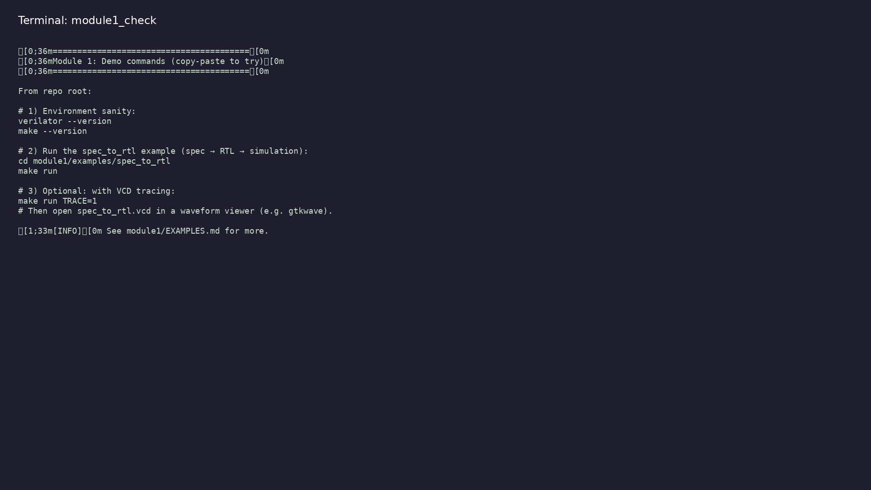
Module 1 self-check
$ ./scripts/module1.sh --help
learn_uart_spi_i2c / Module 1
Notes:
Run from course repository root.

Slide 34
Example 1: Spec to RTL counter
• Reading SPEC.md and mapping each requirement to RTL
in `dut/counter.v`
• Building a minimal top and C++ harness (clock,
reset, enable)
• Directed verification: enable for N cycles and check
`count == N`
learn_uart_spi_i2c / Module 1
Notes:
module1/examples/spec_to_rtl/README.md

Slide 35
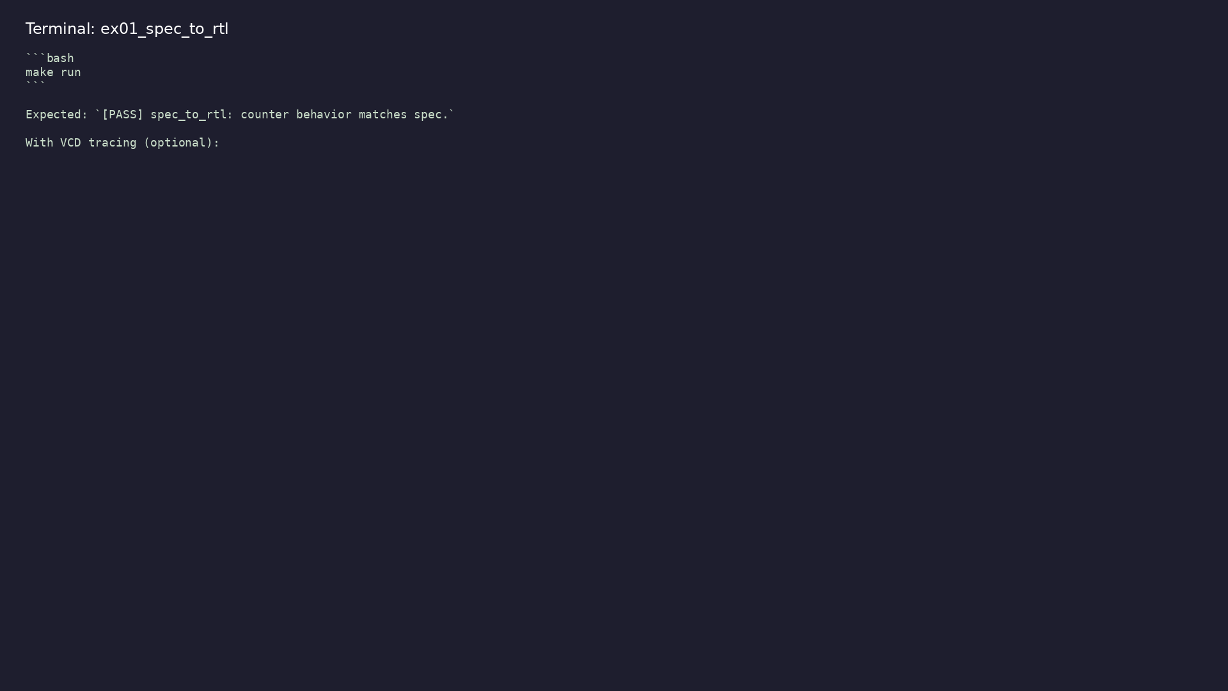
Demo: Spec to RTL counter
$ cd module1/examples/spec_to_rtl && make run
learn_uart_spi_i2c / Module 1
Notes:
Hands-on: module1/examples/spec_to_rtl/

Slide 36
Key concepts
learn_uart_spi_i2c / Module 1

Slide 37
1. Specification first
• Interface, behavior, and timing live in SPEC.md
before RTL.
• Every check in the testbench should trace to a spec
sentence.
learn_uart_spi_i2c / Module 1
Notes:
From MODULE1 Key Concepts.

Slide 38
2. Traceability
• Spec line ↔ RTL line ↔ test expectation — practice
for UART/SPI/I²C later.
learn_uart_spi_i2c / Module 1
Notes:
From MODULE1 Key Concepts.

Slide 39
Common pitfalls
learn_uart_spi_i2c / Module 1

Slide 40
RTL before spec
• Mistake: Coding counters or FSMs without a written
spec.
• Correct: Complete SPEC.md (or equivalent) first.
• Why: Reviewers and tests have no golden reference.
learn_uart_spi_i2c / Module 1
Notes:
From MODULE1 Common Pitfalls.

Slide 41
Weak checks
• Mistake: Only printing values without comparing to
expected results.
• Correct: Explicit PASS/FAIL when `count !=
expected`.
• Why: Simulation can run without verifying
correctness.
learn_uart_spi_i2c / Module 1
Notes:
From MODULE1 Common Pitfalls.

Slide 42
Practice & assessment
learn_uart_spi_i2c / Module 1

Slide 43
What you should know
• Describe the specification → RTL flow and why a
written spec matters.
• Explain what we verify (RTL vs spec) and why (cost
of bugs, repeatability).
• Run the spec_to_rtl example (make run) and relate
SPEC.md, counter.v, and sim_main.cpp.
• Be ready for Module 2: basic testbench patterns and
UVM+SV (agents, sequences, drivers, monitors, s…
learn_uart_spi_i2c / Module 1
Notes:
From MODULE1 Learning Outcomes.

Slide 44
Exercises
• Read the spec and RTL
• Run and extend the test
• Optional: Trace
learn_uart_spi_i2c / Module 1

Slide 45
Assessment checklist
• Can explain the spec → RTL flow and the role of a
written specification.
• Can explain what we verify (RTL vs spec) and why
verification is done.
• Can run the spec_to_rtl example and describe what
SPEC.md, counter.v, and sim_main.cpp do.
• Ready to move to Module 2 (basic TB, UVM+SV,
toolchain).
learn_uart_spi_i2c / Module 1

Slide 46
Summary & next steps
• Understand the specification → RTL design flow,
design methodology, and why we verify.
• Complete module1/CHECKLIST.md
• Review module1/EXAMPLES.md and run each lab
• Next: Design & Verification Methodology (Part 2)
learn_uart_spi_i2c / Module 1

