Slide 1
Module 2
Design & Verification Methodology (Part 2)
learn_uart_spi_i2c / Module 2

Slide 2
Learning objectives
• Basic TB vs UVM: From “wiggle pins and check” to
“transaction → sequence → driver/monitor → scorebo…
• UVM building blocks: Transaction (sequence item),
sequence, driver, monitor, scoreboard, agent, env…
• Toolchain: UVM_HOME, include paths, Verilator flags
(`-sv`, `--timing`, `--trace`), and `make SIM=v…
learn_uart_spi_i2c / Module 2

Slide 3
Prerequisites
• Module 1 completed (spec → RTL flow, spec_to_rtl
example run).
• Verilator (5.036+)
• GNU Make and C++ compiler
• UVM: UVM_HOME set (must contain `src/uvm_pkg.sv`) or
vendored UVM in the repo (see uvm_smoke Makefi…
learn_uart_spi_i2c / Module 2

Slide 4
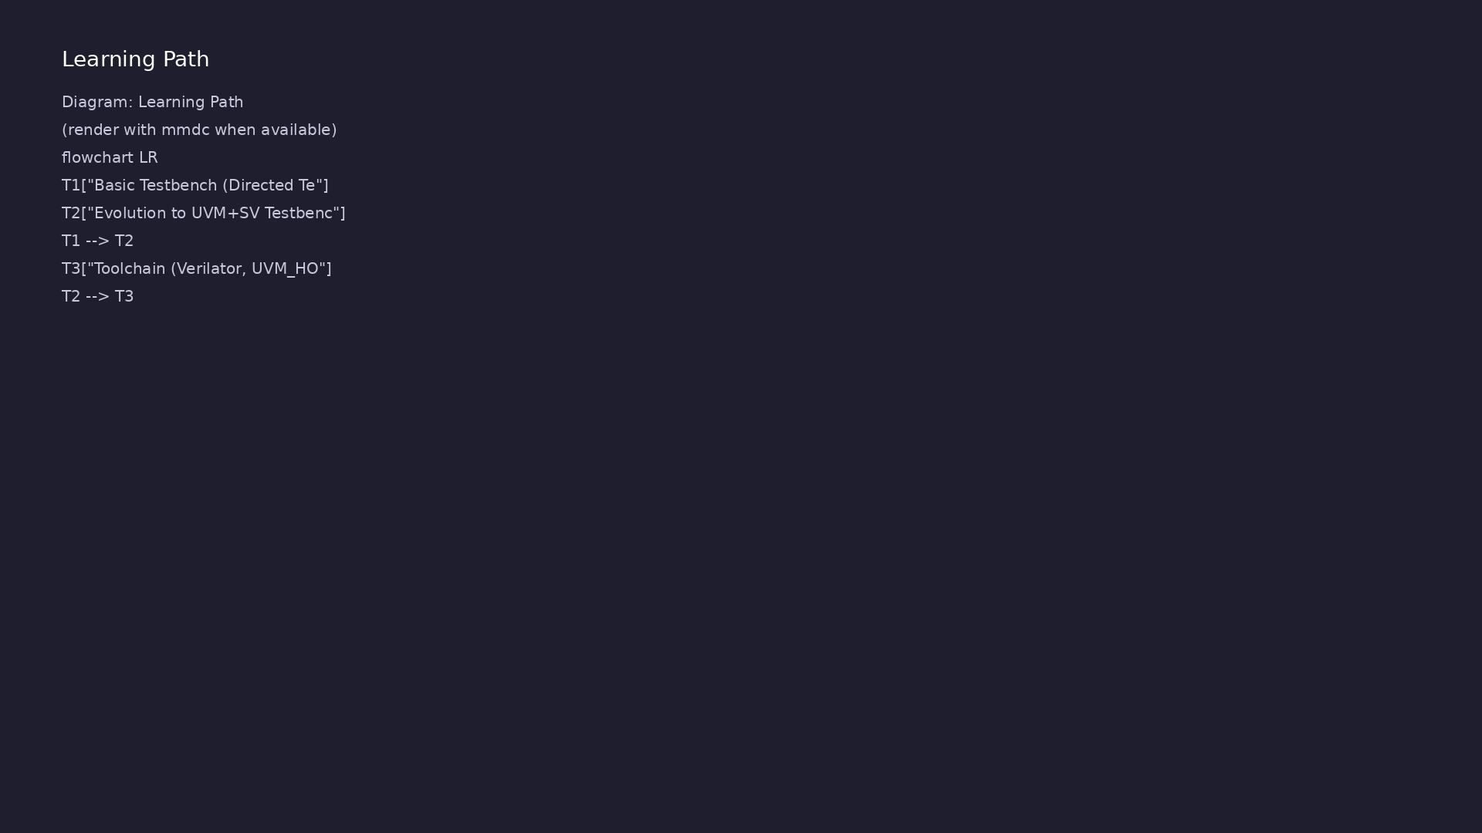
Learning path
Understand basic testbench patterns (directed tests, pin wiggling), the evolution to a UVM+SV testbench (agents, sequences, drivers, monito…
learn_uart_spi_i2c / Module 2

Slide 5
Overview
• Module 2 builds on Module 1 (spec → RTL) by focusing
on **how we verify**:
learn_uart_spi_i2c / Module 2

Slide 6
How to learn this module
learn_uart_spi_i2c / Module 2

Slide 7
Suggested learning path
• Complete Module 1 — run `spec_to_rtl` and understand
spec → RTL → directed check.
• Read this module’s Design Architecture and
Verification sections before `uvm_smoke`.
• Set UVM_HOME (or use vendored UVM under `tools/`) —
see Command Reference.
• Run `uvm_smoke` and trace one transaction from
sequence → driver → DUT → monitor → scoreboard.
learn_uart_spi_i2c / Module 2
Notes:
From docs/MODULE2.md — read guides before running demos.

Slide 8
Design architecture
learn_uart_spi_i2c / Module 2

Slide 9
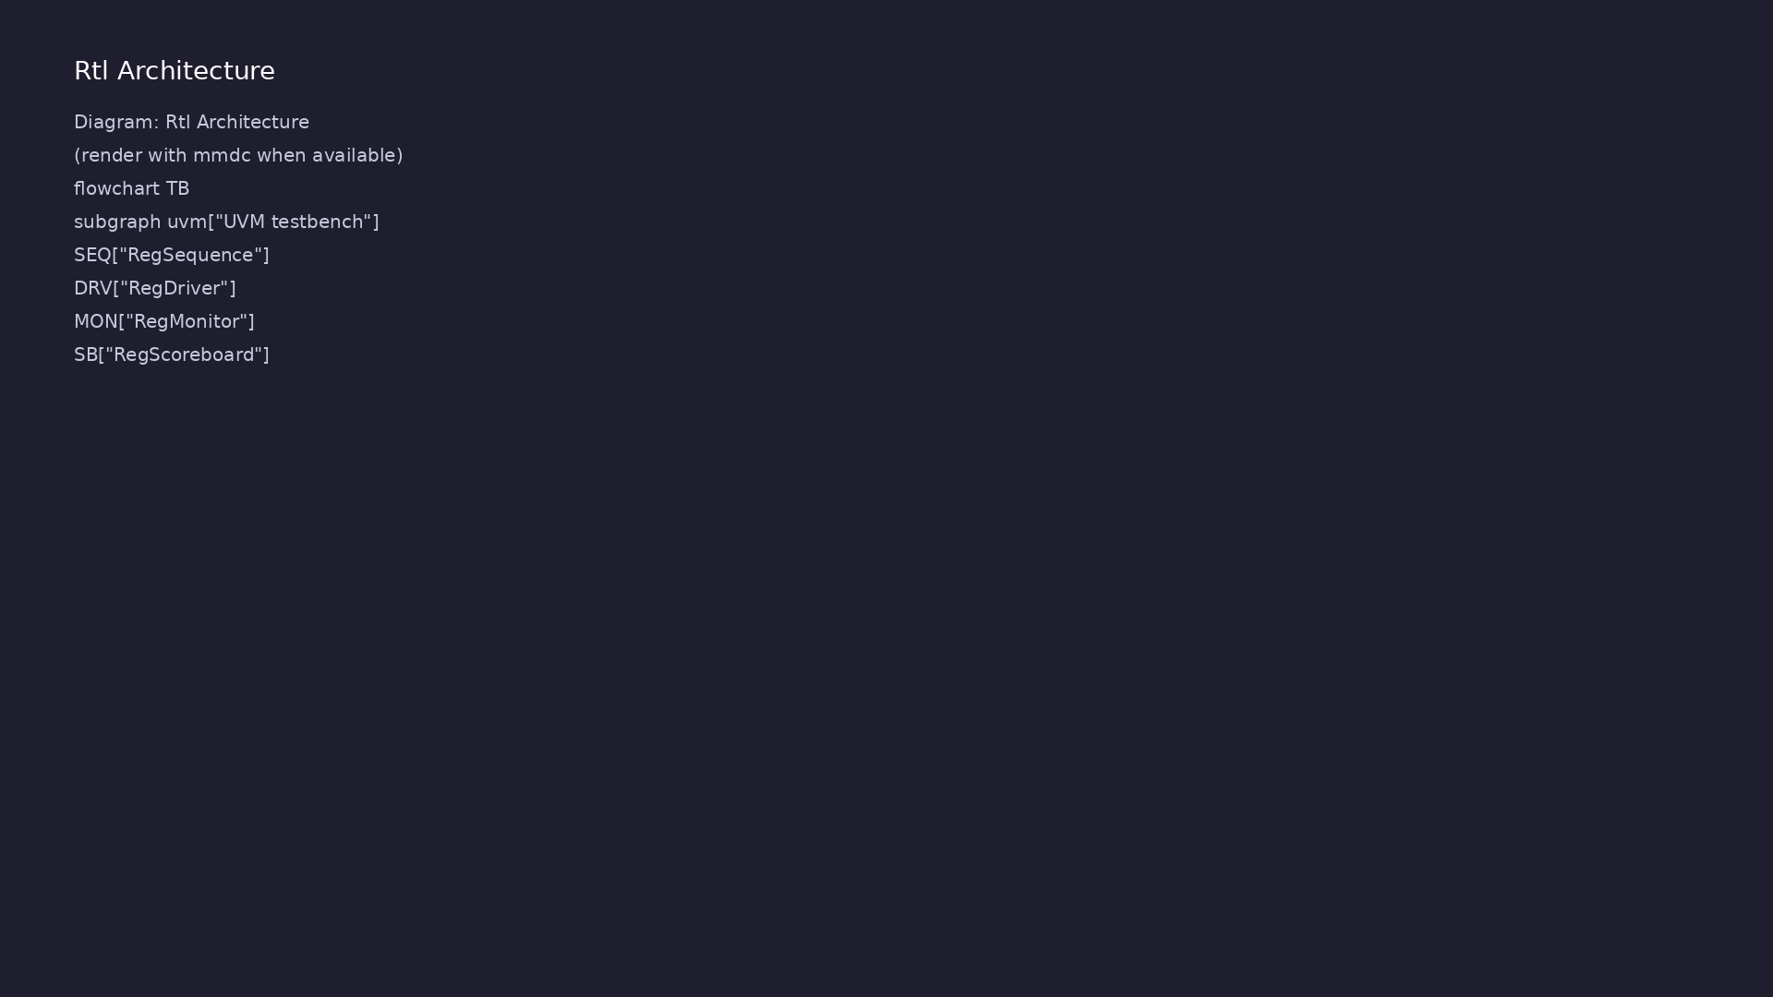
1. DUT and interface
• simple_register.v: `enable`,
`d`, `q` — minimal storage for
learning UVM data flow.
• reg_if: virtual interface
bundling `clk`, `rst_n`,
`enable`, `d`, `q` for the
agent.
learn_uart_spi_i2c / Module 2
Notes:
From MODULE2 Design Architecture.

Slide 10
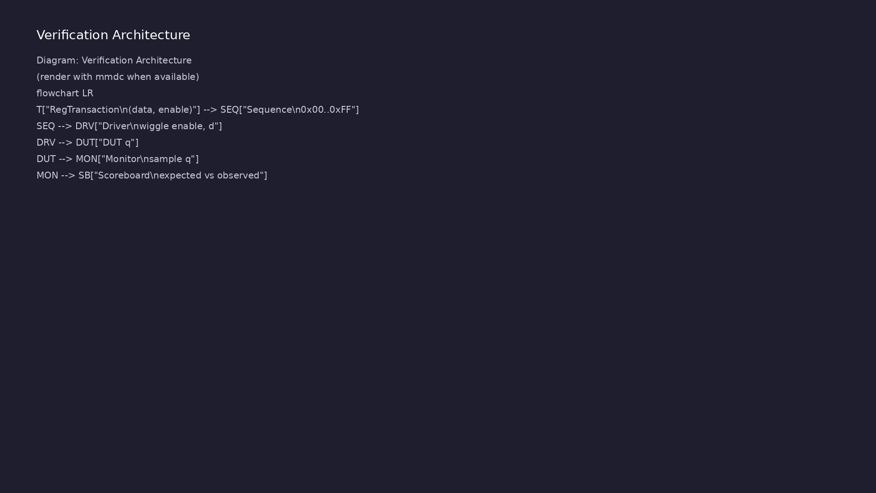
2. UVM component hierarchy (1/2)
• RegTransaction → one write
operation (data + enable +
observed q).
• RegSequence → stream of directed
transactions.
• RegDriver / RegMonitor → drive
pins / sample pins each cycle.
• RegScoreboard → expected queue
vs observed.
learn_uart_spi_i2c / Module 2
Notes:
From MODULE2 Design Architecture.

Slide 11
2. UVM component hierarchy (2/2)
• RegAgent, RegEnv, RegTest — standard UVM layering
used again in Modules 4, 6, 8.
learn_uart_spi_i2c / Module 2
Notes:
From MODULE2 Design Architecture.

Slide 12
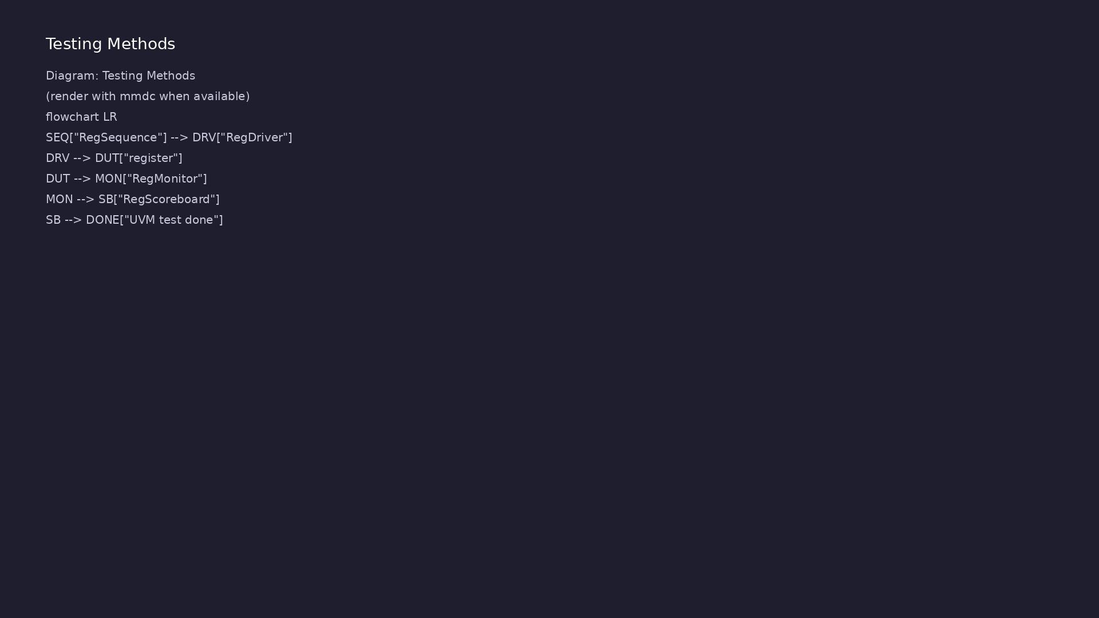
3. Build and simulation flow
• Verilator compiles SV + UVM +
C++; `+UVM_TESTNAME` selects the
test.
• Phases: build → connect → run
(objections hold simulation
until sequence completes).
learn_uart_spi_i2c / Module 2
Notes:
From MODULE2 Design Architecture.

Slide 13
RTL block diagram (reference)
Module 2: DUT hierarchy and signal flow.
learn_uart_spi_i2c / Module 2

Slide 14
Verification / testbench diagram (reference)
Module 2: stimulus, observation, and checking.
learn_uart_spi_i2c / Module 2

Slide 15
RegTransaction — UVM item
/**
* Module 2: UVM smoke test (Verilator)
*
* Purpose:
* - Provide a *self-contained* UVM test that compiles and runs on
Verilator
* - Demonstrate the core UVM structure used later for UART/SPI/I²C:
* transaction → sequence → driver/monitor → scoreboard
*/
`include "uvm_macros.svh"
import uvm_pkg::*;
`timescale 1ns/1ps
// ---------------------------------------------------------------------
--------
// Interface
learn_uart_spi_i2c / Module 2

Slide 16
Execution & simulation flow
learn_uart_spi_i2c / Module 2

Slide 17
How the example runs (toolchain)
• Makefile: Verilator + UVM_HOME compile RTL,
interface, and test_*.sv
• UVM phases: build → connect → run_test → report
(same pattern as Module 2)
• Sequence → driver → DUT → monitor → scoreboard (read
SCOREBOARD at end)
• Typical command: make SIM=verilator TEST=test_* (see
module2 demo slide)
• Loopback / hooks connect monitor observations to
scoreboard checks
learn_uart_spi_i2c / Module 2
Notes:
From MODULE2 — execution and artifact layout.

Slide 18
Example directory layout (1)
• DUT: dut/simple_register.v — tiny register (clk,
rst_n, enable, d, q).
• Interface: reg_if — connects testbench to DUT.
• Transaction: RegTransaction — data + enable +
observed_q.
• Sequence: RegSequence — produces 5 directed
transactions (0x00, 0x01, 0x55, 0xAA, 0xFF).
• Driver: RegDriver — drives enable and d from
transaction; waits for clock.
learn_uart_spi_i2c / Module 2
Notes:
Match each path to files under module/examples/.

Slide 19
Example directory layout (2)
• Monitor: RegMonitor — samples enable, d, q each
cycle; writes transaction to scoreboard.
• Scoreboard: RegScoreboard — compares expected vs
observed; reports matches/mismatches.
• Test: RegTest — builds env, queues expected values,
starts sequence, objections.
learn_uart_spi_i2c / Module 2
Notes:
Match each path to files under module/examples/.

Slide 20
Makefile — UVM + Verilator
# Makefile for Module 2 UVM smoke test
#
# Mirrors the style used in:
# - tools/learn_uvm2017_sv_verilator/module3/tests/uvm_tests/Makefile
#
# Usage:
# make SIM=verilator TEST=test_uvm_smoke
#
SIM ?= verilator
TEST ?= test_uvm_smoke
# Prefer an externally-installed UVM, but fall back to the repo's
vendored UVM.
UVM_HOME ?= $(shell echo $$UVM_HOME)
# From module2/examples/uvm_smoke, repo root is ../../..
UVM_HOME_FALLBACK := ../../../tools/uvm-2017/1800.2-2017-1.0
# ...
learn_uart_spi_i2c / Module 2

Slide 21
Key files to study
learn_uart_spi_i2c / Module 2

Slide 22
Open these in the repo
• `module2/examples/uvm_smoke/dut/simple_register.v` —
tiny DUT
• `module2/examples/uvm_smoke/test_uvm_smoke.sv` —
transaction, agent, scoreboard
• `module2/examples/uvm_smoke/Makefile` — Verilator +
UVM build
learn_uart_spi_i2c / Module 2
Notes:
Trace while running module2/EXAMPLES.md labs.

Slide 23
Verification & testing methods
learn_uart_spi_i2c / Module 2

Slide 24
1. Transaction-level verification
• Stimulus is a transaction (what
to write), not raw pin wiggles
in `initial` blocks.
• The monitor reconstructs what
happened on the bus; the
scoreboard compares to expected.
learn_uart_spi_i2c / Module 2
Notes:
From MODULE2 Verification & Testing Methods.

Slide 25
2. Directed regression in uvm_smoke
• Fixed sequence: 0x00, 0x01,
0x55, 0xAA, 0xFF — repeatable,
easy to debug.
• Pass criteria: scoreboard
reports matches, zero
mismatches.
learn_uart_spi_i2c / Module 2
Notes:
From MODULE2 Verification & Testing Methods.

Slide 26
3. Skills you reuse on UART/SPI/I²C
• Same agent pattern; only the
transaction and protocol timing
in driver/monitor change.
• Read UVM log lines: DRIVER,
MONITOR, SCOREBOARD, final
summary.
learn_uart_spi_i2c / Module 2
Notes:
From MODULE2 Verification & Testing Methods.

Slide 27
Syllabus topics
learn_uart_spi_i2c / Module 2

Slide 28
1. Basic Testbench (Directed Tests, Pin Wiggling)
• Directed test: Drive specific inputs (e.g., reset,
then a fixed sequence of data) and check expecte…
• Pin wiggling: The testbench directly drives and
samples DUT pins (clock, reset, data, enable) — no…
• Relation to Module 1: The spec_to_rtl example used a
C++ harness to drive clk/rst_n/enable and chec…
learn_uart_spi_i2c / Module 2
Notes:
From MODULE2 Topics Covered.

Slide 29
2. Evolution to UVM+SV Testbench
• Transaction (`uvm_sequence_item`): Represents “one
operation” (e.g., one write to a register: data…
• Sequence: Produces a stream of transactions (e.g., a
few directed values: 0x00, 0x01, 0x55, 0xAA, 0…
• Driver: Gets transactions from the sequencer and
drives the DUT interface (e.g., set enable and d o…
• Monitor: Observes the DUT interface and turns pin
activity into transactions, then sends them to th…
• Scoreboard: Compares “expected” (what we sent) vs
“observed” (what the monitor saw). Reports matche…
• Agent: Groups driver, monitor, and sequencer for one
interface. Env: Contains agent(s) and scoreboa…
learn_uart_spi_i2c / Module 2
Notes:
From MODULE2 Topics Covered.

Slide 30
3. Toolchain (Verilator, UVM_HOME, Make)
• Verilator: Compiles SystemVerilog (including UVM) +
C++ into an executable. Key flags: `-sv`, `--ti…
• UVM_HOME: Points to the UVM library root; the build
uses `$(UVM_HOME)/src/uvm_pkg.sv` and `+incdir+…
• Make: One target to compile (Verilator + make in
obj_dir), one to run (`./obj_dir/Vtest_uvm_smoke +…
learn_uart_spi_i2c / Module 2
Notes:
From MODULE2 Topics Covered.

Slide 31
Command reference highlights
learn_uart_spi_i2c / Module 2

Slide 32
Environment checks
• verilator --version
learn_uart_spi_i2c / Module 2
Notes:
Full detail in docs/MODULE2.md command reference.

Slide 33
Build and run uvm_smoke
• cd module2/examples/uvm_smoke
learn_uart_spi_i2c / Module 2
Notes:
Full detail in docs/MODULE2.md command reference.

Slide 34
Module script (from repo root)
• ./scripts/module2.sh --check # Environment + UVM +
example dirs
learn_uart_spi_i2c / Module 2
Notes:
Full detail in docs/MODULE2.md command reference.

Slide 35
Hands-on examples
learn_uart_spi_i2c / Module 2

Slide 36
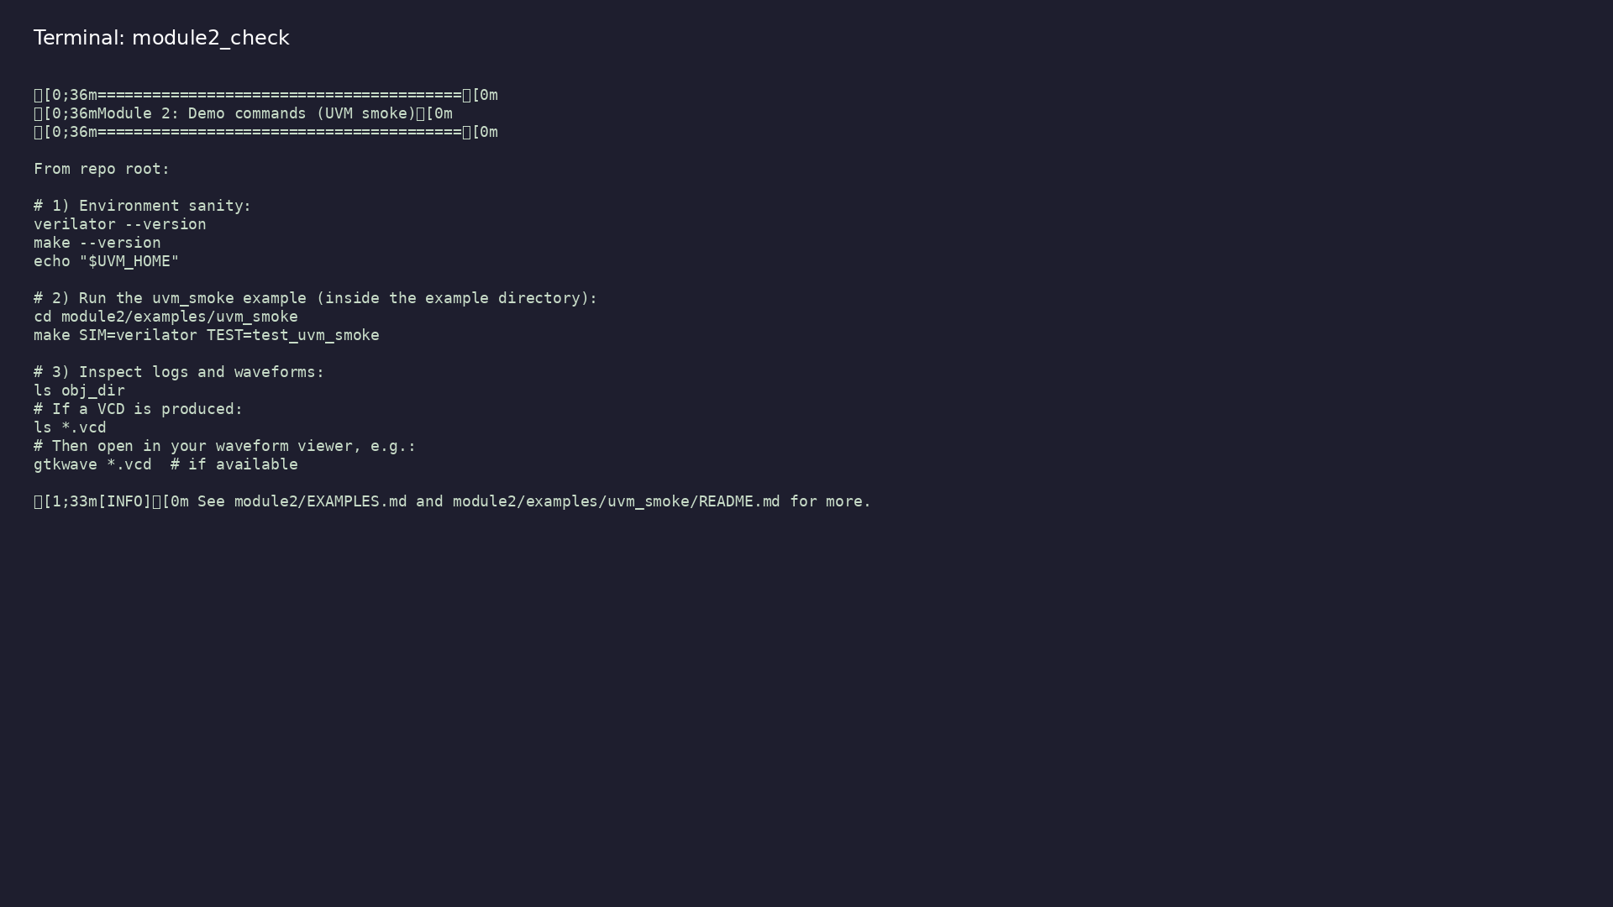
Module 2 self-check
$ ./scripts/module2.sh --help
learn_uart_spi_i2c / Module 2
Notes:
Run from course repository root.

Slide 37
Example 1: UVM smoke test
• UVM transaction, sequence, driver, monitor, and
scoreboard on a tiny register DUT
• How objections start and end the test in `run_phase`
• Interpreting DRIVER / MONITOR / SCOREBOARD messages
and match counts
learn_uart_spi_i2c / Module 2
Notes:
module2/examples/uvm_smoke/README.md

Slide 38
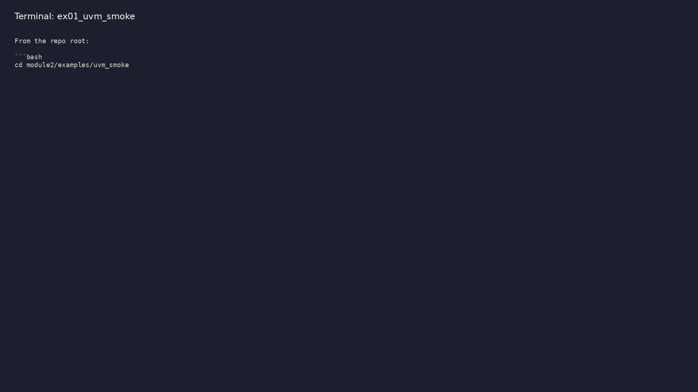
Demo: UVM smoke test
$ cd module2/examples/uvm_smoke && make SIM=verilator
TEST=test_uvm_smoke
learn_uart_spi_i2c / Module 2
Notes:
Hands-on: module2/examples/uvm_smoke/

Slide 39
Key concepts
learn_uart_spi_i2c / Module 2

Slide 40
1. Transaction-level TB
• Stimulus is a transaction (what to do), not raw pin
toggles in one big `initial` block.
• Driver converts transactions to pin activity;
monitor converts pins back to transactions.
learn_uart_spi_i2c / Module 2
Notes:
From MODULE2 Key Concepts.

Slide 41
2. Scoreboard closure
• Expected queue vs observed values — same pattern for
UART/SPI/I²C UVM modules.
learn_uart_spi_i2c / Module 2
Notes:
From MODULE2 Key Concepts.

Slide 42
Common pitfalls
learn_uart_spi_i2c / Module 2

Slide 43
Skipping monitor or scoreboard
• Mistake: Only driving the DUT and eyeballing waves.
• Correct: Monitor + scoreboard automate expected vs
observed.
• Why: Scales when you add dozens of tests.
learn_uart_spi_i2c / Module 2
Notes:
From MODULE2 Common Pitfalls.

Slide 44
UVM_HOME not set
• Mistake: Build fails with missing `uvm_pkg.sv`.
• Correct: Export UVM_HOME or use vendored UVM under
`tools/`.
• Why: Compiler cannot find UVM includes.
learn_uart_spi_i2c / Module 2
Notes:
From MODULE2 Common Pitfalls.

Slide 45
Practice & assessment
learn_uart_spi_i2c / Module 2

Slide 46
What you should know
• Explain basic testbench (directed tests, pin
wiggling) and how it evolves into UVM (transaction,
se…
• Describe the role of transaction, sequence, driver,
monitor, scoreboard, agent, env, and test in a…
• Run the uvm_smoke example (make SIM=verilator
TEST=test_uvm_smoke) and interpret UVM output.
• Use the toolchain: Verilator, UVM_HOME, Make; know
why `-sv`, `--timing`, and include paths are nee…
• Be ready for Module 3: UART protocol + RTL + basic
(non-UVM) testbench.
learn_uart_spi_i2c / Module 2
Notes:
From MODULE2 Learning Outcomes.

Slide 47
Exercises
• Run uvm_smoke
• Traceability
• Change the sequence
• Optional: Waveforms
learn_uart_spi_i2c / Module 2

Slide 48
Assessment checklist
• Can explain basic TB vs UVM (transaction, sequence,
driver, monitor, scoreboard).
• Can describe the role of UVM_HOME, Verilator flags,
and Make in building/running a UVM test.
• Can run uvm_smoke and interpret the output.
• Ready to move to Module 3 (UART protocol + RTL +
basic testbench).
learn_uart_spi_i2c / Module 2

Slide 49
Summary & next steps
• Understand basic testbench patterns (directed tests,
pin wiggling), the evolution to a UVM+SV testb…
• Complete module2/CHECKLIST.md
• Review module2/EXAMPLES.md and run each lab
• Next: UART
learn_uart_spi_i2c / Module 2

