Slide 1
Module 3
UART — Protocol + RTL + Basic Testbench
learn_uart_spi_i2c / Module 3

Slide 2
Learning objectives
• UART 8N1: Start bit (0), 8 data bits (LSB first),
stop bit (1); idle high.
• Baud rate: Role of a baud generator (clock divider →
baud_tick).
• RTL architecture: TX (parallel→serial, shift per
baud_tick), RX (start detect, sample, data_valid),…
• Basic TB: Loopback, directed stimulus, and checking
without UVM.
learn_uart_spi_i2c / Module 3

Slide 3
Prerequisites
• Module 1 (spec → RTL) and Module 2 (basic TB → UVM,
toolchain).
• Verilator, Make, C++ compiler. No UVM required for
the uart_baseline example.
learn_uart_spi_i2c / Module 3

Slide 4
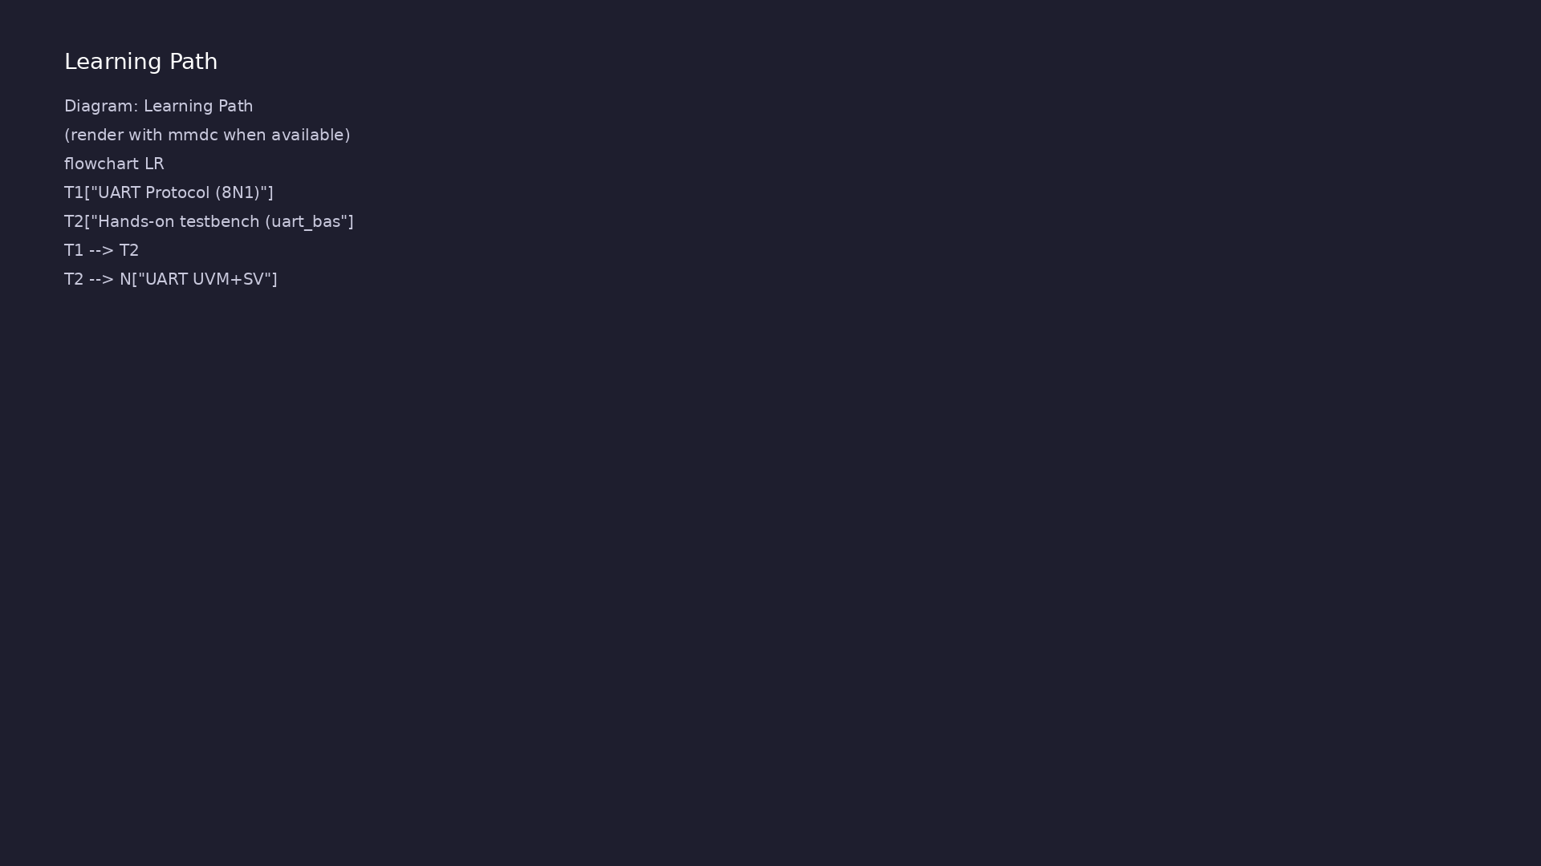
Learning path
Understand the UART protocol (8N1, baud), translate it to RTL (TX, RX, baud gen), and verify with a **basic** (non-UVM) directed testbench.
learn_uart_spi_i2c / Module 3

Slide 5
Overview
• Module 3 is the first **protocol** module:
learn_uart_spi_i2c / Module 3

Slide 6
How to learn this module
learn_uart_spi_i2c / Module 3

Slide 7
Suggested learning path
• Read the detailed UART learning guide:
UART_LEARNING_GUIDE.md — what UART is, what kind of
protocol…
• Read the protocols + UVM overview:
LEARNING_GUIDE_PROTOCOLS_AND_UVM.md — Part B § 4.
When to Use Ba…
learn_uart_spi_i2c / Module 3
Notes:
From docs/MODULE3.md — read guides before running demos.

Slide 8
Design architecture
learn_uart_spi_i2c / Module 3

Slide 9
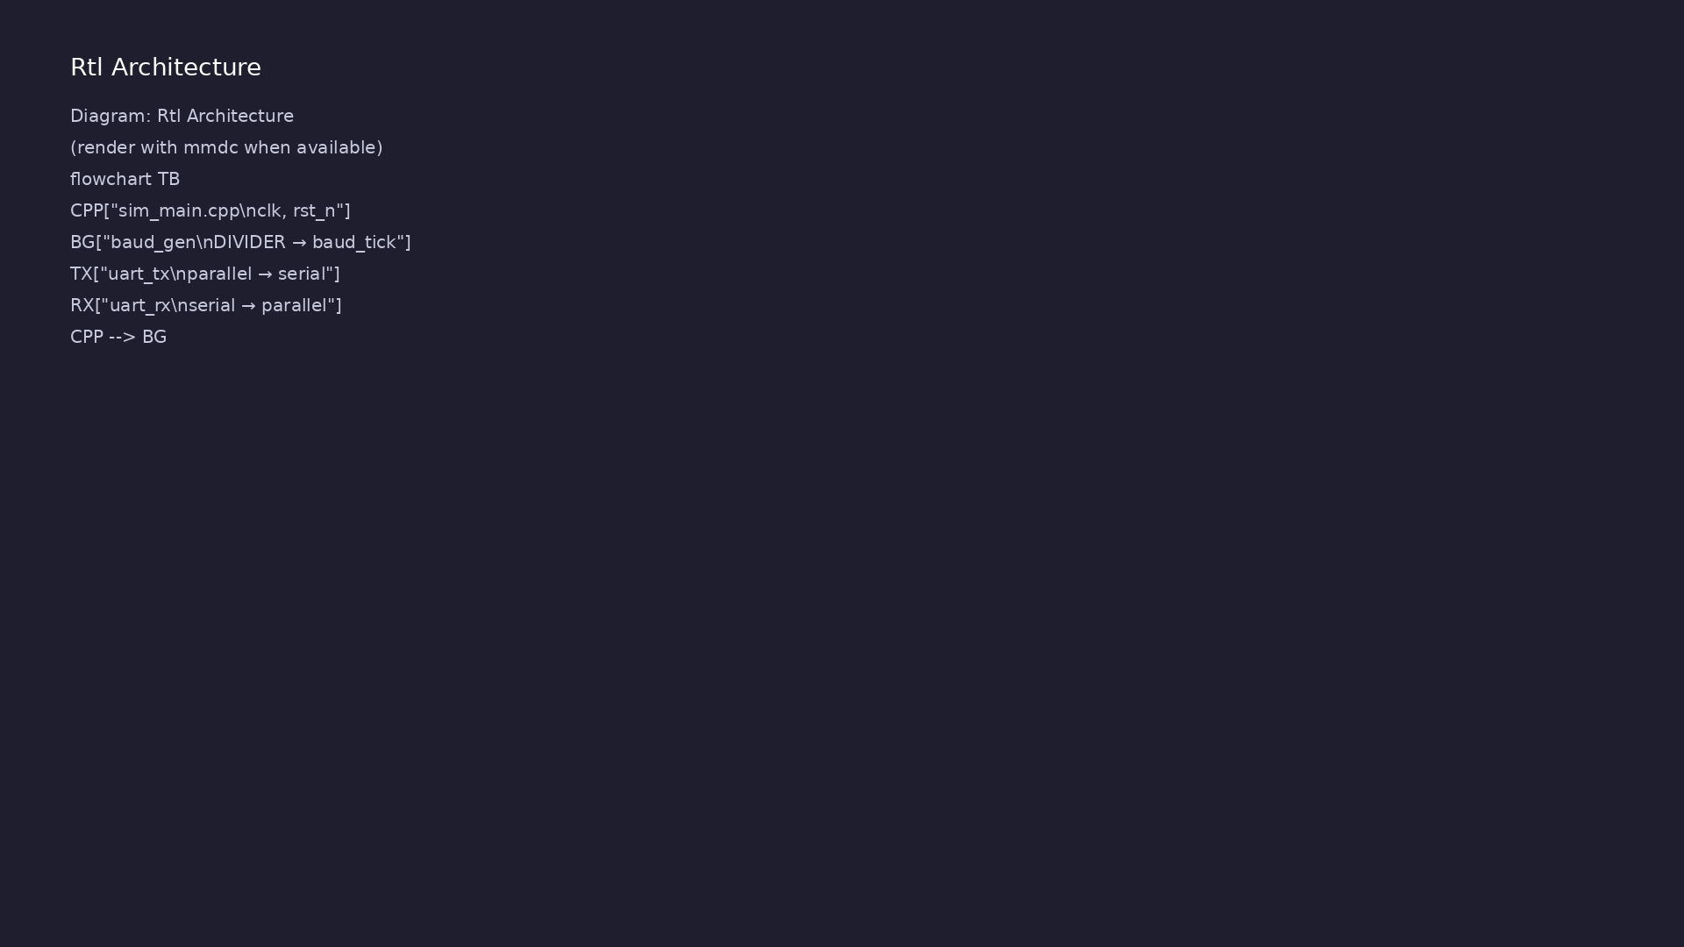
1. Block hierarchy
• top_uart_baseline → `baud_gen`,
`uart_tx`, `uart_rx`;
sim_main.cpp drives
`clk`/`rst_n` only.
• Loopback: `assign rx = tx` — one
wire connects transmitter to
receiver.
learn_uart_spi_i2c / Module 3
Notes:
From MODULE3 Design Architecture.

Slide 10
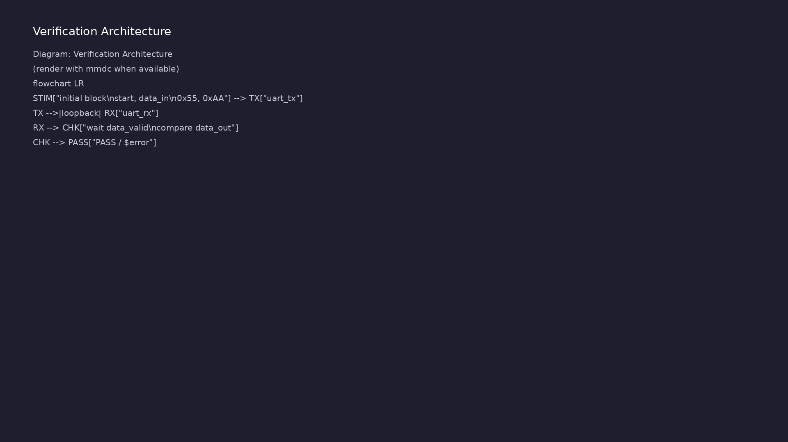
2. RTL blocks
• baud_gen: `DIVIDER` →
`baud_tick` every N clocks;
shared by TX and RX.
• uart_tx: parallel-in / serial-
out; start + 8 data (LSB first)
+ stop; `busy` during frame.
• uart_rx: start detect, sample
per `baud_tick`, `data_valid` +
optional `framing_error`.
learn_uart_spi_i2c / Module 3
Notes:
From MODULE3 Design Architecture.

Slide 11
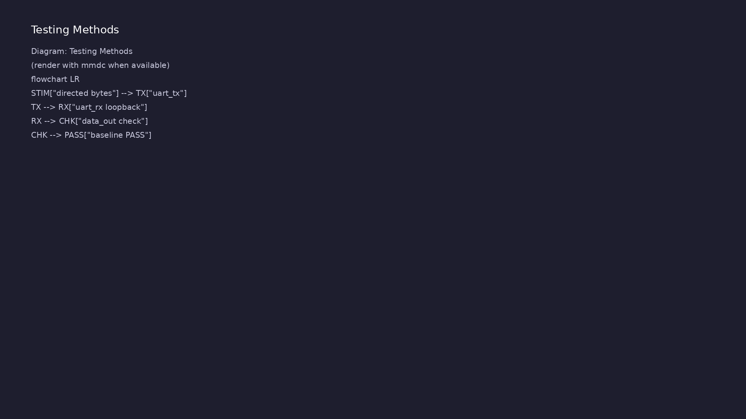
3. Timing and clocking
• Single `clk` domain; async
`rst_n`; all bit times
referenced to `baud_tick`.
learn_uart_spi_i2c / Module 3
Notes:
From MODULE3 Design Architecture.

Slide 12
RTL block diagram (reference)
Module 3: DUT hierarchy and signal flow.
learn_uart_spi_i2c / Module 3

Slide 13
Verification / testbench diagram (reference)
Module 3: stimulus, observation, and checking.
learn_uart_spi_i2c / Module 3

Slide 14
uart_tx — 8N1 frame FSM
// Simple UART transmitter (8N1, no parity) for teaching.
// This version uses an external baud_tick enable (from baud_gen)
// so that each bit lasts many clk cycles in real time, while the
// internal state machine still advances once per baud_tick.
`timescale 1ns/1ps
module uart_tx (
input wire clk,
input wire rst_n, // Active-low async reset
input wire baud_tick, // One-cycle pulse at baud rate
input wire start, // Pulse high for one cycle to start
transmit
input wire [7:0] data_in, // Byte to transmit, LSB first on the
line
output reg tx, // UART TX line (idle high)
output reg busy // High while frame is in progress
);
learn_uart_spi_i2c / Module 3

Slide 15
uart_rx — start detect & sample
// Simple UART receiver (8N1, no parity) for teaching.
// This version uses an external baud_tick enable (from baud_gen)
// so that each bit lasts many clk cycles in real time, while the
// RX state machine advances once per baud_tick.
//
// Protocol:
// - Idle line is high.
// - Start bit is a single low bit.
// - 8 data bits follow, LSB first, one per clock.
// - Stop bit is a single high bit.
//
// This RX block watches the serial line for a start bit, then samples
// one bit per clock to reconstruct the byte. When a full frame has
// been received, it pulses `data_valid` for one cycle with `data_out`.
`timescale 1ns/1ps
# ...
learn_uart_spi_i2c / Module 3

Slide 16
baud_gen — divider → baud_tick
// Simple baud-rate generator for teaching.
// Divides the input clock down to a 1-cycle-wide baud_tick pulse.
//
// Example: For a 50 MHz system clock and 115200 baud target,
// DIVIDER ≈ 50_000_000 / 115200 ≈ 434.
`timescale 1ns/1ps
module baud_gen #(
parameter int DIVIDER = 434 // Default divider, can be overridden
) (
input wire clk,
input wire rst_n, // Active-low async reset
output reg baud_tick // One-cycle pulse at baud rate
);
int count;
# ...
learn_uart_spi_i2c / Module 3

Slide 17
Execution & simulation flow
learn_uart_spi_i2c / Module 3

Slide 18
How the example runs (toolchain)
• Makefile: Verilator compiles RTL + SystemVerilog
testbench into a C++ model
• sim_main.cpp: generates clk/rst_n, calls eval()
until $finish
• Directed test (initial block or C++): drive
stimulus, wait for DUT flags
• Self-check: compare outputs; print PASS/FAIL (see
terminal demo slide)
• Repo path: module3/examples/<example>/ — run make
run from that directory
learn_uart_spi_i2c / Module 3
Notes:
From MODULE3 — execution and artifact layout.

Slide 19
Example directory layout
• dut/: uart_tx.v, uart_rx.v, baud_gen.v
• top_uart_baseline.sv: Loopback (rx=tx), baud_gen,
uart_tx, uart_rx; directed test in initial block
• sim_main.cpp: Clock, reset; run until $finish
learn_uart_spi_i2c / Module 3
Notes:
Match each path to files under module/examples/.

Slide 20
Directed test execution sequence (1)
• wait(rst_n)
• pulse start/data_in
• wait(!busy)
• wait(data_valid)
• compare data_out
learn_uart_spi_i2c / Module 3
Notes:
Follow this order when tracing waveforms or debugging.

Slide 21
Directed test execution sequence (2)
• repeat
• $finish.
learn_uart_spi_i2c / Module 3
Notes:
Follow this order when tracing waveforms or debugging.

Slide 22
Makefile — uart_baseline run
# Makefile for Module 3 UART baseline (basic testbench, no UVM)
#
# Usage:
# make run
#
VERILATOR ?= verilator
TOPLEVEL ?= top_uart_baseline
DUT_SRC = dut/*.v
RTL_SRC = top_uart_baseline.sv $(DUT_SRC)
HARNESS = sim_main.cpp
VERILATOR_FLAGS = -sv --timing -Wall -Wno-fatal -Wno-TIMESCALEMOD -Wno-
WIDTHTRUNC
.PHONY: run compile clean
# ...
learn_uart_spi_i2c / Module 3

Slide 23
Key files to study
learn_uart_spi_i2c / Module 3

Slide 24
Open these in the repo
• `module3/examples/uart_baseline/dut/baud_gen.v` —
divider → `baud_tick`
• `module3/examples/uart_baseline/dut/uart_tx.v` — 8N1
transmit
• `module3/examples/uart_baseline/dut/uart_rx.v` —
receive and `data_valid`
• `module3/examples/uart_baseline/top_uart_baseline.sv
` — loopback + directed test
• `docs/UART_LEARNING_GUIDE.md` — protocol reference
learn_uart_spi_i2c / Module 3
Notes:
Trace while running module3/EXAMPLES.md labs.

Slide 25
Verification & testing methods
learn_uart_spi_i2c / Module 3

Slide 26
1. Verification goals
• Prove RTL implements UART 8N1
before UVM (Module 4).
• Happy-path loopback: bytes sent
on TX appear correctly on RX.
learn_uart_spi_i2c / Module 3
Notes:
From MODULE3 Verification & Testing Methods.

Slide 27
2. Baseline directed test
• Stimulus: `initial` block —
`start`, `data_in` (0x55, 0xAA).
• Check: `wait(data_valid)`;
compare `data_out`; `$error` /
`$display`.
• No UVM: pin wiggling only —
fastest way to learn the
protocol on real RTL.
learn_uart_spi_i2c / Module 3
Notes:
From MODULE3 Verification & Testing Methods.

Slide 28
3. Coverage gaps (defer to Module 4)
• Random baud, framing errors,
`busy` back-to-back, functional
coverage.
• Map checks to [UART_LEARNING_GUI
DE.md](UART_LEARNING_GUIDE.md)
spec bullets.
learn_uart_spi_i2c / Module 3
Notes:
From MODULE3 Verification & Testing Methods.

Slide 29
Loopback directed test
// Basic directed test: wait for reset release, send bytes, check RX
initial begin
start = 1'b0;
data_in = 8'h00;
wait (rst_n === 1'b1);
repeat (10) @(posedge clk);
// Send 0x55
@(posedge clk);
start = 1'b1;
data_in = 8'h55;
@(posedge clk);
start = 1'b0;
wait (busy === 1'b0);
wait (data_valid === 1'b1);
# ...
learn_uart_spi_i2c / Module 3

Slide 30
Syllabus topics
learn_uart_spi_i2c / Module 3

Slide 31
Protocol & design details
learn_uart_spi_i2c / Module 3

Slide 32
Detail: UART quick reference (8N1) (1)
• Framing: `idle=1` → `start=0` → 8 data bits (LSB
first) → `stop=1`.
• Baud math: `DIVIDER = round(clk_hz / baud)`.
Example: 50 MHz clock, 115200 baud → divider ≈ 434.
• Sampling: Basic design samples once per bit at the
`baud_tick`. Production UARTs often oversample (…
• Reset state: Line idles high, TX not busy, RX clears
internal shift register, `data_valid` low.
learn_uart_spi_i2c / Module 3
Notes:
From MODULE3 Topics Covered — protocol/design depth.

Slide 33
Detail: UART quick reference (8N1) (2)
• Errors: `framing_error` when stop bit is not high at
expected sample; optional `parity_error` if pa…
learn_uart_spi_i2c / Module 3
Notes:
From MODULE3 Topics Covered — protocol/design depth.

Slide 34
Detail: TX design checklist
• Inputs: `clk`, `rst_n`, `baud_tick`, `start`,
`data_in[7:0]`.
• Outputs: `tx`, `busy`.
• Behavior: On `start`, latch `data_in`, drive start
bit low, then shift out bits [0:7] each `baud_ti…
• Edge cases: Ignore `start` while `busy` (or queue it
in a FIFO if you extend the design).
learn_uart_spi_i2c / Module 3
Notes:
From MODULE3 Topics Covered — protocol/design depth.

Slide 35
Detail: RX design checklist
• Inputs: `clk`, `rst_n`, `baud_tick`, `rx`.
• Outputs: `data_out[7:0]`, `data_valid` (pulse),
`framing_error`.
• Behavior: Detect falling edge for start; wait one
`baud_tick` to sample mid-start; sample 8 bits on…
• Robustness options: Add metastability sync on `rx`;
add oversampling + majority vote; add `rx_ready…
learn_uart_spi_i2c / Module 3
Notes:
From MODULE3 Topics Covered — protocol/design depth.

Slide 36
Detail: Baud generator notes
• Inputs: `clk`, `rst_n`, `divisor` (constant
parameter in the baseline).
• Output: `baud_tick` high for one cycle every
`divisor` clocks.
• For synthesis, keep the counter simple (`divisor-1`
down-counter or up-counter compare). For sim, y…
learn_uart_spi_i2c / Module 3
Notes:
From MODULE3 Topics Covered — protocol/design depth.

Slide 37
Detail: Protocol extensions (not in baseline example) (1)
• Data bits: 5–9 data bits are common.
• Parity: Even/odd/mark/space; adds a parity bit
before stop.
• Stop bits: 1 or 2 stop bits.
• Flow control: RTS/CTS hardware pins (outside the
serial line) to throttle traffic.
learn_uart_spi_i2c / Module 3
Notes:
From MODULE3 Topics Covered — protocol/design depth.

Slide 38
Detail: Protocol extensions (not in baseline example) (2)
• The baseline RTL assumes 8N1 with no parity and no
flow control.
learn_uart_spi_i2c / Module 3
Notes:
From MODULE3 Topics Covered — protocol/design depth.

Slide 39
Verification flow (reference)
Stimulus, DUT response, and check points for this module.
learn_uart_spi_i2c / Module 3

Slide 40
1. UART Protocol (8N1) (1/4)
• Signals: Serial line (tx/rx), idle high; system
clock; baud_tick (one pulse per bit time).
• Frame: 1 start bit (0), 8 data bits (LSB first), 1
stop bit (1).
• Timing: One bit per baud_tick; baud_tick derived
from system clock via a divider (e.g. DIVIDER = cl…
• Framing: `idle=1` → `start=0` → 8 data bits (LSB
first) → `stop=1`.
• Baud math: `DIVIDER = round(clk_hz / baud)`.
Example: 50 MHz clock, 115200 baud → divider ≈ 434.
• Sampling: Basic design samples once per bit at the
`baud_tick`. Production UARTs often oversample (…
learn_uart_spi_i2c / Module 3
Notes:
From MODULE3 Topics Covered.

Slide 41
1. UART Protocol (8N1) (2/4)
• Reset state: Line idles high, TX not busy, RX clears
internal shift register, `data_valid` low.
• Errors: `framing_error` when stop bit is not high at
expected sample; optional `parity_error` if pa…
• Inputs: `clk`, `rst_n`, `baud_tick`, `start`,
`data_in[7:0]`.
• Outputs: `tx`, `busy`.
• Behavior: On `start`, latch `data_in`, drive start
bit low, then shift out bits [0:7] each `baud_ti…
• Edge cases: Ignore `start` while `busy` (or queue it
in a FIFO if you extend the design).
learn_uart_spi_i2c / Module 3
Notes:
From MODULE3 Topics Covered.

Slide 42
1. UART Protocol (8N1) (3/4)
• Inputs: `clk`, `rst_n`, `baud_tick`, `rx`.
• Outputs: `data_out[7:0]`, `data_valid` (pulse),
`framing_error`.
• Behavior: Detect falling edge for start; wait one
`baud_tick` to sample mid-start; sample 8 bits on…
• Robustness options: Add metastability sync on `rx`;
add oversampling + majority vote; add `rx_ready…
• Inputs: `clk`, `rst_n`, `divisor` (constant
parameter in the baseline).
• Output: `baud_tick` high for one cycle every
`divisor` clocks.
learn_uart_spi_i2c / Module 3
Notes:
From MODULE3 Topics Covered.

Slide 43
1. UART Protocol (8N1) (4/4)
• For synthesis, keep the counter simple (`divisor-1`
down-counter or up-counter compare). For sim, y…
• Data bits: 5–9 data bits are common.
• Parity: Even/odd/mark/space; adds a parity bit
before stop.
• Stop bits: 1 or 2 stop bits.
• Flow control: RTS/CTS hardware pins (outside the
serial line) to throttle traffic.
• The baseline RTL assumes 8N1 with no parity and no
flow control.
learn_uart_spi_i2c / Module 3
Notes:
From MODULE3 Topics Covered.

Slide 44
2. Hands-on testbench (uart_baseline)
• Loopback: Connect TX output to RX input; send bytes
from TX, check they appear on RX.
• Directed test: Reset release, send 0x55 and 0xAA,
wait for `data_valid`, check `data_out`. Implemen…
• Self-check flow: `wait(rst_n)` → pulse
`start`/`data_in` → `wait(!busy)` →
`wait(data_valid)` → com…
learn_uart_spi_i2c / Module 3
Notes:
From MODULE3 Topics Covered.

Slide 45
Hands-on examples
learn_uart_spi_i2c / Module 3

Slide 46
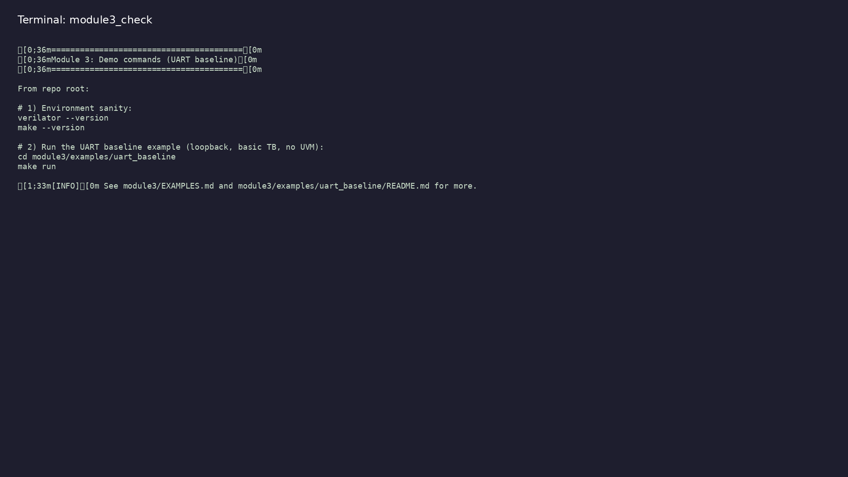
Module 3 self-check
$ ./scripts/module3.sh --help
learn_uart_spi_i2c / Module 3
Notes:
Run from course repository root.

Slide 47
Example 1: UART baseline loopback
• UART 8N1 TX/RX RTL with shared `baud_gen`
• Loopback wiring (`rx = tx`) and directed bytes 0x55
/ 0xAA
• Baseline self-check without UVM (wait for
`data_valid`, compare `data_out`)
learn_uart_spi_i2c / Module 3
Notes:
module3/examples/uart_baseline/README.md

Slide 48
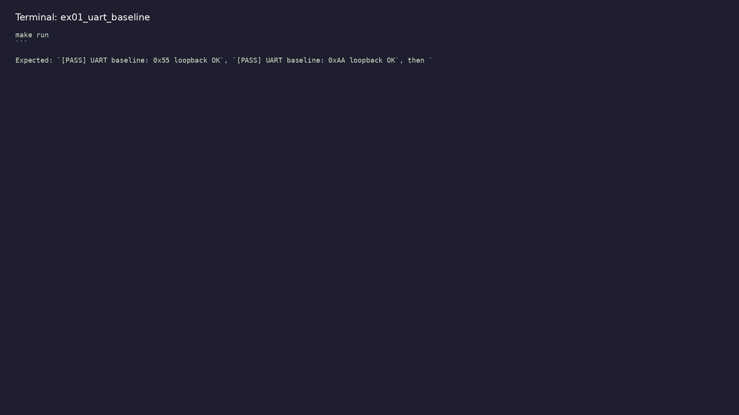
Demo: UART baseline loopback
$ cd module3/examples/uart_baseline && make run
learn_uart_spi_i2c / Module 3
Notes:
Hands-on: module3/examples/uart_baseline/

Slide 49
Key concepts
learn_uart_spi_i2c / Module 3

Slide 50
1. Asynchronous serial
• No dedicated clock wire; TX and RX must share the
same bit time (`baud_tick`).
• Loopback (`rx = tx`) proves TX serialization and RX
deserialization together.
learn_uart_spi_i2c / Module 3
Notes:
From MODULE3 Key Concepts.

Slide 51
2. 8N1 frame
• Idle high → start (0) → 8 data bits LSB first → stop
(1).
• `busy` on TX; `data_valid` pulse on RX when a byte
is ready.
learn_uart_spi_i2c / Module 3
Notes:
From MODULE3 Key Concepts.

Slide 52
Common pitfalls
learn_uart_spi_i2c / Module 3

Slide 53
Mismatched baud timing
• Mistake: Different dividers on TX and RX in a
loopback test.
• Correct: One `baud_gen` drives both (as in
uart_baseline).
• Why: RX samples at the wrong bit times.
learn_uart_spi_i2c / Module 3
Notes:
From MODULE3 Common Pitfalls.

Slide 54
Only checking `busy`
• Mistake: Assuming success when TX finishes.
• Correct: Wait for `data_valid` and compare
`data_out` to the sent byte.
• Why: `busy` does not prove the loopback byte is
correct.
learn_uart_spi_i2c / Module 3
Notes:
From MODULE3 Common Pitfalls.

Slide 55
Practice & assessment
learn_uart_spi_i2c / Module 3

Slide 56
What you should know
• Describe UART 8N1 frame and baud timing.
• Explain the role of uart_tx, uart_rx, and baud_gen.
• Run the uart_baseline example and interpret the
loopback test.
• Ready for Module 4: UART UVM+SV verification.
learn_uart_spi_i2c / Module 3
Notes:
From MODULE3 Learning Outcomes.

Slide 57
Exercises
• Run uart_baseline
• Trace one byte
• Baud and divider
• Optional: Waveforms
learn_uart_spi_i2c / Module 3

Slide 58
Assessment checklist
• Can describe UART 8N1 (start bit, 8 data LSB first,
stop bit) and the role of baud_tick.
• Can explain the role of uart_tx, uart_rx, and
baud_gen in the RTL.
• Can run uart_baseline and interpret the loopback
test result.
• Ready for Module 4: UART UVM+SV verification.
learn_uart_spi_i2c / Module 3

Slide 59
Summary & next steps
• Understand the UART protocol (8N1, baud), translate
it to RTL (TX, RX, baud gen), and verify with a…
• Complete module3/CHECKLIST.md
• Review module3/EXAMPLES.md and run each lab
• Next: UART UVM+SV
learn_uart_spi_i2c / Module 3

