Slide 1
Module 4
UART — UVM+SV Verification
learn_uart_spi_i2c / Module 4

Slide 2
Learning objectives
• UART UVM agent: Transaction (UartTxTransaction),
sequence (UartTxSequence), driver (UartTxDriver),…
• Interface: uart_tx_if (clk, rst_n, start, data, tx,
baud_tick) connects UVM to DUT.
• Loopback check: TX path (driver → DUT → monitor →
scoreboard) and RX path (DUT rx_valid/rx_data → s…
learn_uart_spi_i2c / Module 4

Slide 3
Prerequisites
• Module 1 (spec → RTL), Module 2 (UVM+SV, uvm_smoke),
Module 3 (UART protocol + RTL + basic TB).
• Verilator, Make, C++ compiler, UVM (UVM_HOME or
vendored UVM).
learn_uart_spi_i2c / Module 4

Slide 4
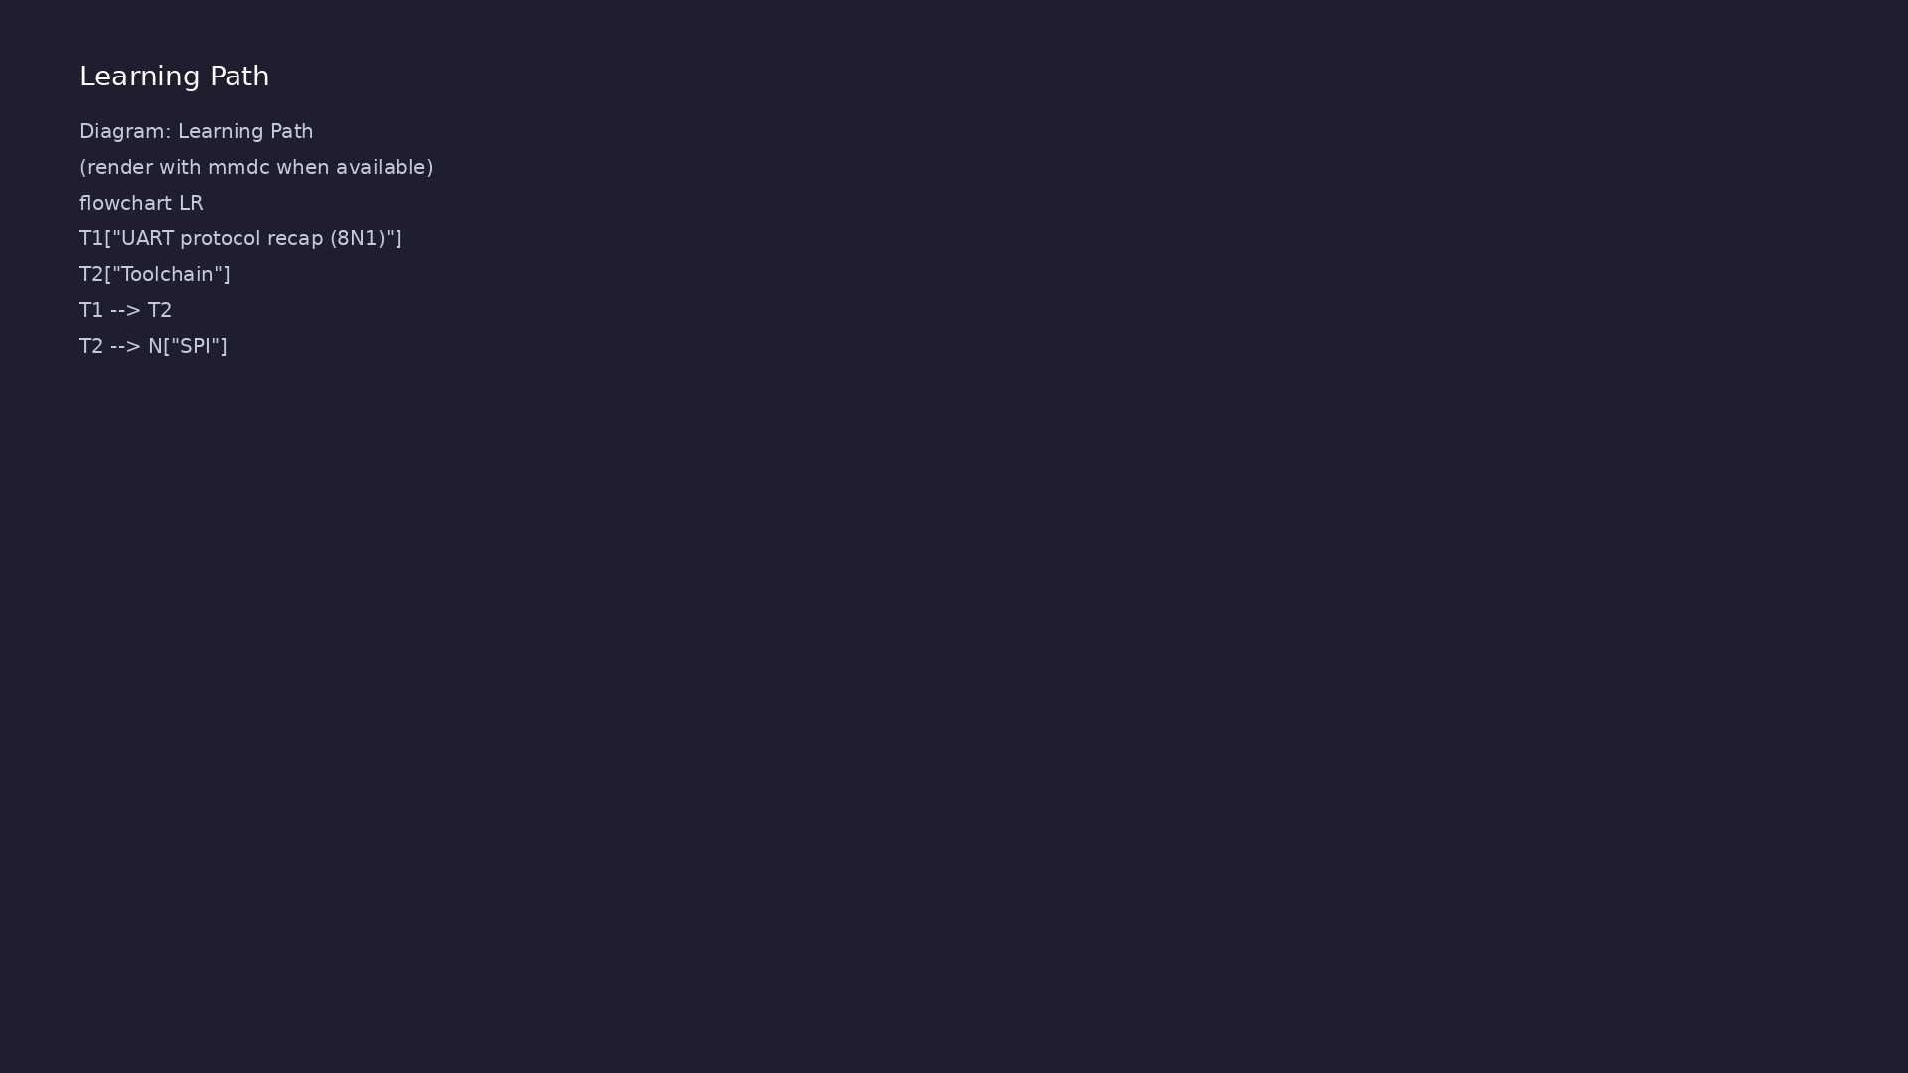
Learning path
Extend UART verification to **UVM+SV** — UART agent (transaction, sequence, driver, monitor, scoreboard); run on Verilator.
learn_uart_spi_i2c / Module 4

Slide 5
Overview
• Module 4 builds on Module 3 (UART protocol + RTL +
basic testbench):
learn_uart_spi_i2c / Module 4

Slide 6
How to learn this module
learn_uart_spi_i2c / Module 4

Slide 7
Suggested learning path
• Read the detailed UART learning guide:
UART_LEARNING_GUIDE.md — what UART is, how it works
(frame,…
• Read the protocols + UVM overview:
LEARNING_GUIDE_PROTOCOLS_AND_UVM.md — Part B § 5.
How UVM Maps t…
learn_uart_spi_i2c / Module 4
Notes:
From docs/MODULE4.md — read guides before running demos.

Slide 8
Design architecture
learn_uart_spi_i2c / Module 4

Slide 9
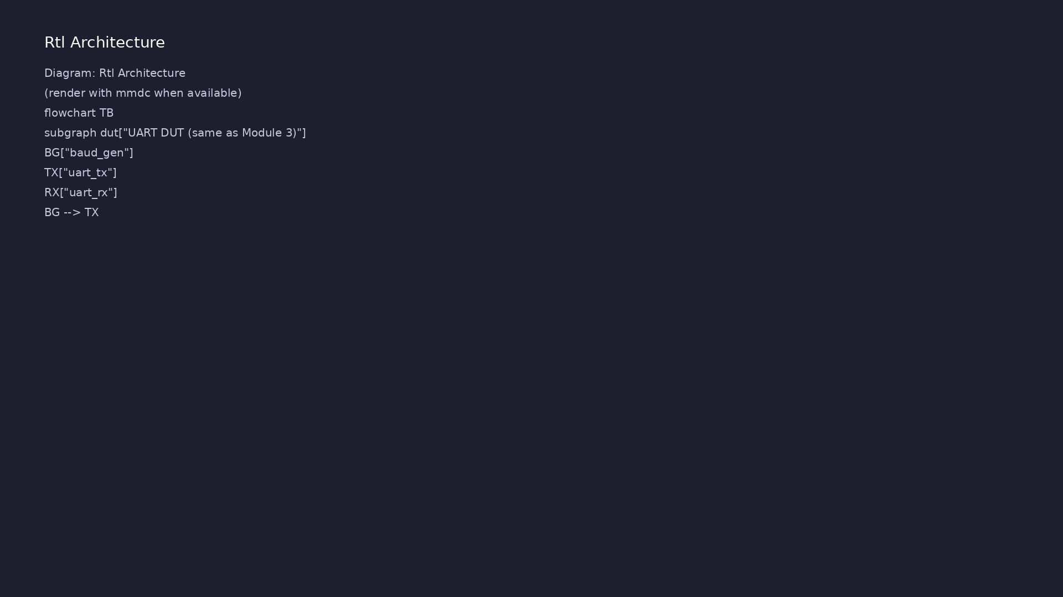
1. UART DUT (reused from Module 3)
• dut/: `uart_tx`, `uart_rx`,
`baud_gen` — identical RTL to
`uart_baseline`.
• Loopback in top: `rx = tx` for
closed-loop checking.
• Why reuse: Upgrade verification
(UVM) without touching proven
RTL.
learn_uart_spi_i2c / Module 4
Notes:
From MODULE4 Design Architecture.

Slide 10
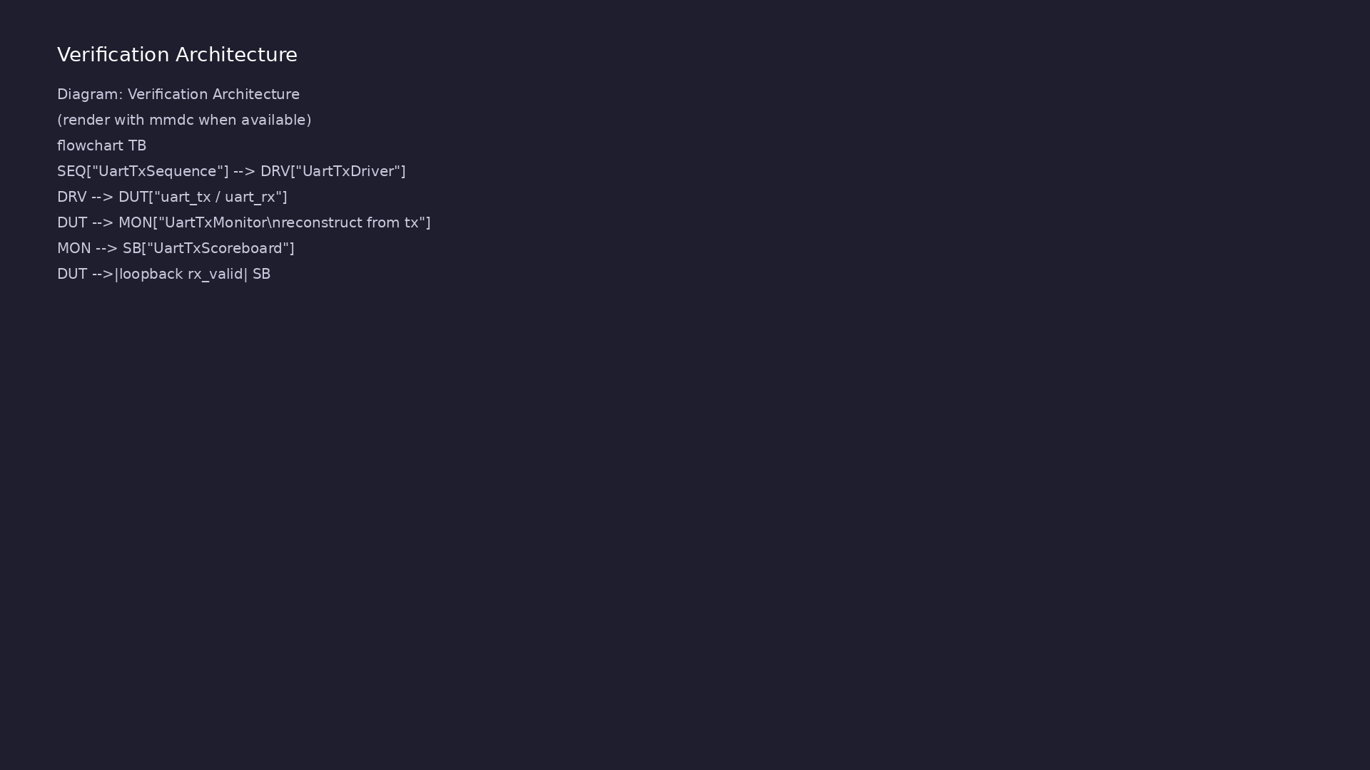
2. UVM testbench hierarchy
• uart_tx_if: virtual interface
for driver/monitor.
• UartTxTransaction / Sequence /
Driver / Monitor / Scoreboard /
Agent / Env / Test — same
pattern as…
• Monitor reconstructs bytes from
the serial `tx` line using UART
8N1 rules.
learn_uart_spi_i2c / Module 4
Notes:
From MODULE4 Design Architecture.

Slide 11
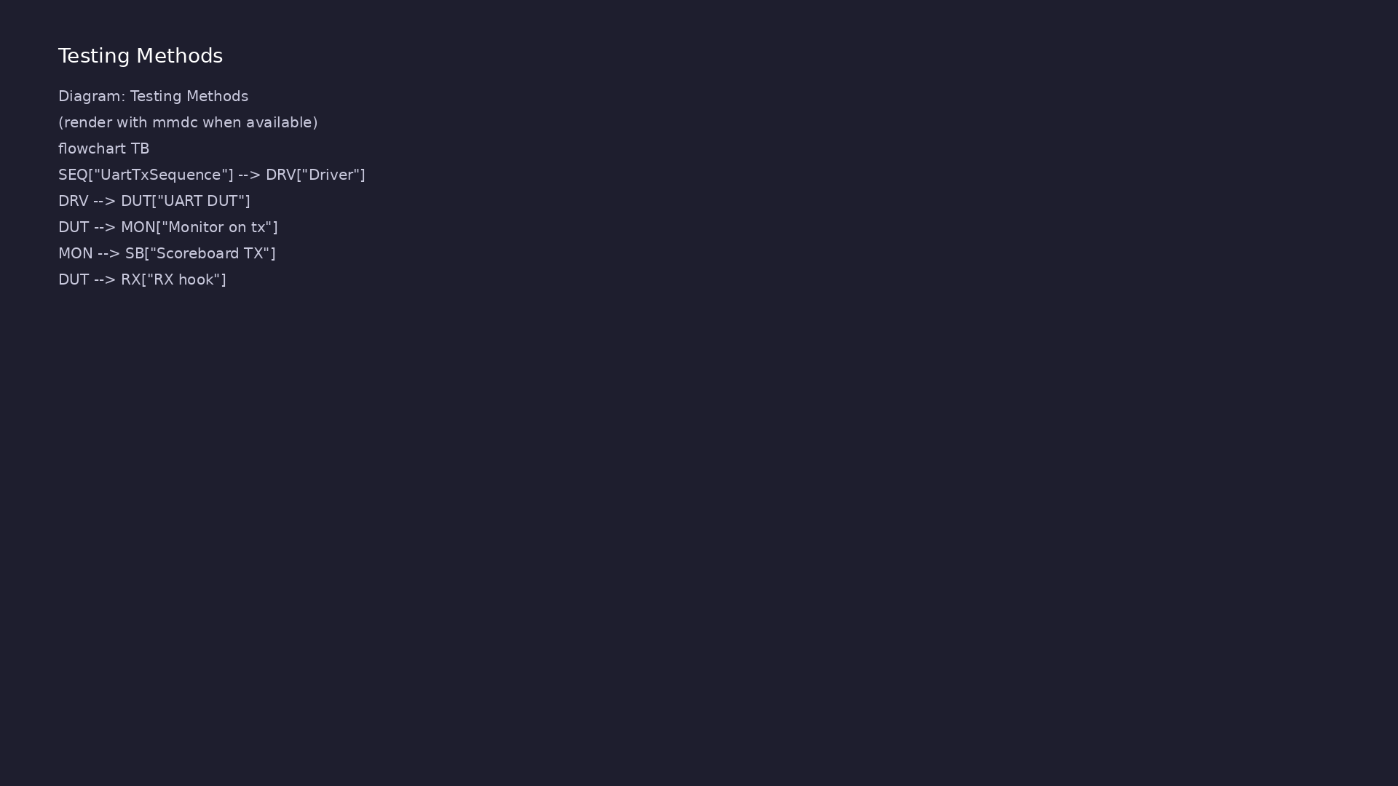
3. Dual check paths
• TX path: sequence → driver → DUT
→ monitor → scoreboard
(`observed_tx`).
• RX path: loopback into
`uart_rx`; `check_rx_byte()`
when `data_valid` asserts.
learn_uart_spi_i2c / Module 4
Notes:
From MODULE4 Design Architecture.

Slide 12
RTL block diagram (reference)
Module 4: DUT hierarchy and signal flow.
learn_uart_spi_i2c / Module 4

Slide 13
Verification / testbench diagram (reference)
Module 4: stimulus, observation, and checking.
learn_uart_spi_i2c / Module 4

Slide 14
UartTxDriver — bit timing
txn.data = 8'hFF;
start_item(txn);
finish_item(txn);
endtask
endclass
// ---------------------------------------------------------------------
--------
// Driver
// ---------------------------------------------------------------------
--------
class UartTxDriver extends uvm_driver #(UartTxTransaction);
virtual uart_tx_if vif;
`uvm_component_utils(UartTxDriver)
function new(string name, uvm_component parent);
super.new(name, parent);
learn_uart_spi_i2c / Module 4

Slide 15
UartTxTransaction & agent
/**
* Module 4: UART TX/RX UVM test (Verilator)
*
* UART agent: transaction, sequence, driver, monitor, scoreboard.
* Loopback: TX output -> RX input; scoreboard checks TX (monitor) and
RX (hook).
*/
`include "uvm_macros.svh"
import uvm_pkg::*;
`timescale 1ns/1ps
// ---------------------------------------------------------------------
--------
// Interface
// ---------------------------------------------------------------------
--------
learn_uart_spi_i2c / Module 4

Slide 16
Execution & simulation flow
learn_uart_spi_i2c / Module 4

Slide 17
How the example runs (toolchain)
• Makefile: Verilator + UVM_HOME compile RTL,
interface, and test_*.sv
• UVM phases: build → connect → run_test → report
(same pattern as Module 2)
• Sequence → driver → DUT → monitor → scoreboard (read
SCOREBOARD at end)
• Typical command: make SIM=verilator TEST=test_* (see
module4 demo slide)
• Loopback / hooks connect monitor observations to
scoreboard checks
learn_uart_spi_i2c / Module 4
Notes:
From MODULE4 — execution and artifact layout.

Slide 18
Example directory layout
• dut/: uart_tx.v, uart_rx.v, baud_gen.v (same as
Module 3)
• test_uart_uvm.sv: Interface, UartTxTransaction,
UartTxSequence, UartTxDriver, UartTxMonitor, UartTx…
learn_uart_spi_i2c / Module 4
Notes:
Match each path to files under module/examples/.

Slide 19
Makefile — UVM UART sim
# Makefile for Module 4 UART UVM test
#
# Usage:
# make SIM=verilator TEST=test_uart_uvm
#
SIM ?= verilator
TEST ?= test_uart_uvm
# Prefer externally-set UVM_HOME, but fall back to vendored UVM.
# From module4/examples/uart_uvm, repo root is ../../..
UVM_HOME ?= $(shell echo $$UVM_HOME)
UVM_HOME_FALLBACK := ../../../tools/uvm-2017/1800.2-2017-1.0
UVM_HOME_FALLBACK_ALT :=
../../../tools/learn_uvm2017_sv_verilator/tools/uvm-2017/1800.2-2017-1.0
ifeq ($(UVM_HOME),)
# ...
learn_uart_spi_i2c / Module 4

Slide 20
Key files to study
learn_uart_spi_i2c / Module 4

Slide 21
Open these in the repo
• `module4/examples/uart_uvm/dut/` — same UART RTL as
Module 3
• `module4/examples/uart_uvm/test_uart_uvm.sv` —
agent, env, loopback hooks
• `docs/LEARNING_GUIDE_PROTOCOLS_AND_UVM.md` — § 6
UART UVM mapping
learn_uart_spi_i2c / Module 4
Notes:
Trace while running module4/EXAMPLES.md labs.

Slide 22
Verification & testing methods
learn_uart_spi_i2c / Module 4

Slide 23
1. Directed UART regression
• Sequence sends 0x00, 0x01, 0x55,
0xAA, 0xFF — repeatable
regression before randomization.
learn_uart_spi_i2c / Module 4
Notes:
From MODULE4 Verification & Testing Methods.

Slide 24
2. Scoreboard strategy
• Expected queue loaded in test;
compare to monitor-reconstructed
TX and to RX hook data.
• Fail fast on mismatch; read UVM
SCOREBOARD summary at end of
run.
learn_uart_spi_i2c / Module 4
Notes:
From MODULE4 Verification & Testing Methods.

Slide 25
3. What to add next
• Random baud, framing-error
injection, coverage on `busy` /
`data_valid`.
• See [LEARNING_GUIDE_PROTOCOLS_AN
D_UVM.md § 6](LEARNING_GUIDE_PRO
TOCOLS_AND_UVM.md#6-uart-uvm-
mappin…
learn_uart_spi_i2c / Module 4
Notes:
From MODULE4 Verification & Testing Methods.

Slide 26
Scoreboard — TX/RX check
imp = new("imp", this);
endfunction
function void add_expected(UartTxTransaction txn);
expected_queue.push_back(txn);
endfunction
function void write(UartTxTransaction txn);
UartTxTransaction exp;
if (expected_queue.size() == 0) begin
`uvm_warning("SCOREBOARD", "No expected transaction
available")
return;
end
exp = expected_queue.pop_front();
# ...
learn_uart_spi_i2c / Module 4

Slide 27
Syllabus topics
learn_uart_spi_i2c / Module 4

Slide 28
1. UART protocol recap (8N1)
• One byte = start (0) + 8 data (LSB first) + stop
(1); `baud_tick` times each bit.
• Driver/monitor must follow the same rules as the
RTL.
learn_uart_spi_i2c / Module 4
Notes:
From MODULE4 Topics Covered.

Slide 29
2. Toolchain
• Verilator `-sv`, `--timing`, UVM includes; `make
SIM=verilator TEST=test_uart_uvm`; `+UVM_TESTNAME=…
learn_uart_spi_i2c / Module 4
Notes:
From MODULE4 Topics Covered.

Slide 30
Hands-on examples
learn_uart_spi_i2c / Module 4

Slide 31
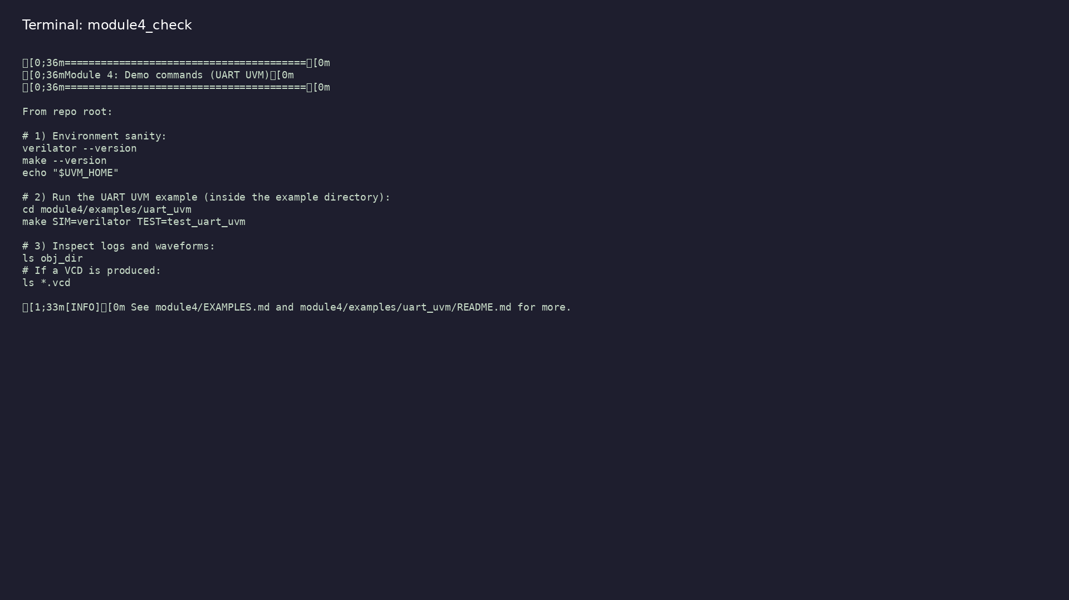
Module 4 self-check
$ ./scripts/module4.sh --help
learn_uart_spi_i2c / Module 4
Notes:
Run from course repository root.

Slide 32
Example 1: UART UVM agent
• Same UART DUT as Module 3 with a full UVM agent
(sequence, driver, monitor, scoreboard)
• Monitor reconstructs bytes from the serial `tx` line
• Loopback RX checking via `check_rx_byte` in the
scoreboard
learn_uart_spi_i2c / Module 4
Notes:
module4/examples/uart_uvm/README.md

Slide 33
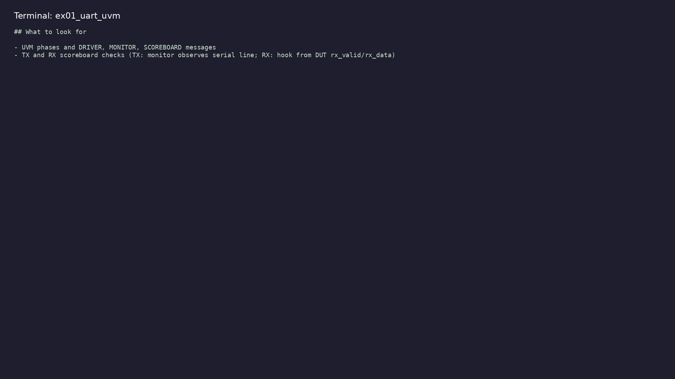
Demo: UART UVM agent
$ cd module4/examples/uart_uvm && make SIM=verilator
TEST=test_uart_uvm
learn_uart_spi_i2c / Module 4
Notes:
Hands-on: module4/examples/uart_uvm/

Slide 34
Key concepts
learn_uart_spi_i2c / Module 4

Slide 35
1. Reuse DUT, upgrade TB
• RTL unchanged from baseline; UVM replaces directed
`initial` stimulus.
learn_uart_spi_i2c / Module 4
Notes:
From MODULE4 Key Concepts.

Slide 36
2. Dual path checking
• TX monitor reconstructs serial bytes; RX hook checks
loopback `data_valid`.
learn_uart_spi_i2c / Module 4
Notes:
From MODULE4 Key Concepts.

Slide 37
Common pitfalls
learn_uart_spi_i2c / Module 4

Slide 38
Monitor baud mismatch
• Mistake: Sampling `tx` at system clock instead of
`baud_tick` times.
• Correct: One sample per `baud_tick` per UART rules
(as in UartTxMonitor).
• Why: Reconstructed byte will not match driven data.
learn_uart_spi_i2c / Module 4
Notes:
From MODULE4 Common Pitfalls.

Slide 39
Forgetting loopback RX check
• Mistake: Scoreboard only compares TX monitor output.
• Correct: Also call `check_rx_byte` when `data_valid`
asserts.
• Why: TX path can pass while RX is broken.
learn_uart_spi_i2c / Module 4
Notes:
From MODULE4 Common Pitfalls.

Slide 40
Practice & assessment
learn_uart_spi_i2c / Module 4

Slide 41
What you should know
• Describe the UART UVM agent (transaction, sequence,
driver, monitor, scoreboard).
• Explain loopback (TX→RX) and how TX and RX are both
checked in the scoreboard.
• Run the uart_uvm example and interpret UVM output.
• Ready for Module 5: SPI protocol + RTL + basic
testbench.
learn_uart_spi_i2c / Module 4
Notes:
From MODULE4 Learning Outcomes.

Slide 42
Exercises
• Run uart_uvm
• Trace one transaction
• Change the sequence
• Optional: Loopback path
learn_uart_spi_i2c / Module 4

Slide 43
Assessment checklist
• Can describe the UART UVM agent: transaction (one
byte), sequence, driver, monitor, scoreboard.
• Can explain loopback and how TX and RX are both
checked.
• Can run uart_uvm and interpret UVM output (phases,
scoreboard summary).
• Ready for Module 5: SPI protocol + RTL + basic
testbench.
learn_uart_spi_i2c / Module 4

Slide 44
Summary & next steps
• Extend UART verification to **UVM+SV** — UART agent
(transaction, sequence, driver, monitor, scoreb…
• Complete module4/CHECKLIST.md
• Review module4/EXAMPLES.md and run each lab
• Next: SPI
learn_uart_spi_i2c / Module 4

