Slide 1
Module 5
SPI — Protocol + RTL + Basic Testbench
learn_uart_spi_i2c / Module 5

Slide 2
Learning objectives
• SPI mode 0: SCLK idle low; capture on rising edge;
change on falling edge; CS_N active low for fram…
• RTL block architecture: `clk_div` + `spi_master`
hierarchy, FSM, and Mode 0 timing on the wire.
• Baseline verification: Directed stimulus,
`done`-based checks, and optional waveform review (8
SCLK…
• Path to Module 6: Same DUT, UVM agent with bus
monitor on SCLK/MOSI/CS_N.
learn_uart_spi_i2c / Module 5

Slide 3
Prerequisites
• Modules 1–4 (spec→RTL, UVM, UART baseline, UART
UVM).
• Verilator, Make, C++ compiler. No UVM required for
spi_baseline.
learn_uart_spi_i2c / Module 5

Slide 4
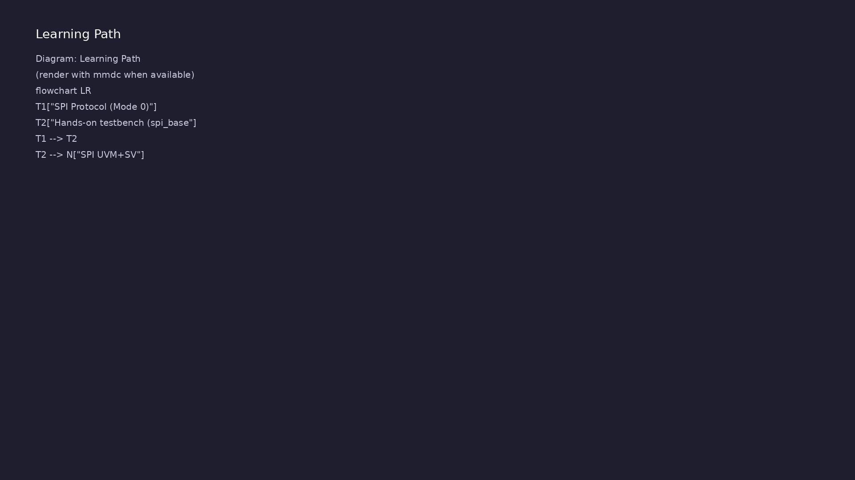
Learning path
Understand the SPI protocol (mode 0, signals), translate it to RTL (SPI master, clk_div), and verify with a **basic** (non-UVM) directed te…
learn_uart_spi_i2c / Module 5

Slide 5
Overview
• Module 5 is the second **protocol** module (after
UART):
learn_uart_spi_i2c / Module 5

Slide 6
How to learn this module
learn_uart_spi_i2c / Module 5

Slide 7
Suggested learning path
• Read the detailed SPI learning guide:
SPI_LEARNING_GUIDE.md — what SPI is, what kind of
protocol (s…
• Read the protocols + UVM overview:
LEARNING_GUIDE_PROTOCOLS_AND_UVM.md — Part B § 4.
When to Use Ba…
learn_uart_spi_i2c / Module 5
Notes:
From docs/MODULE5.md — read guides before running demos.

Slide 8
Design architecture
learn_uart_spi_i2c / Module 5

Slide 9
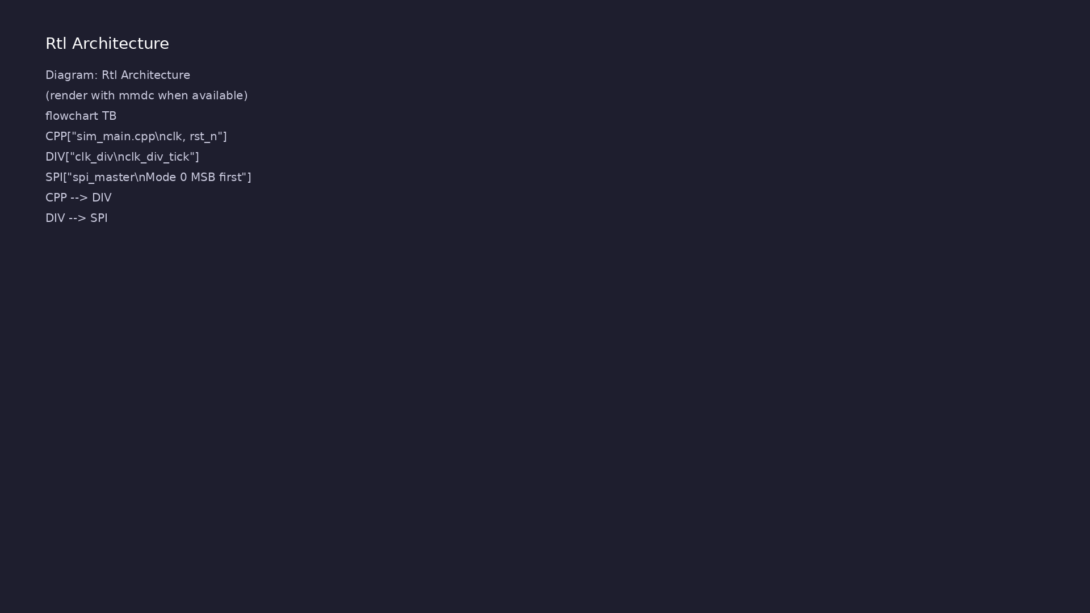
1. Block hierarchy
• top_spi_baseline → `clk_div` +
`spi_master`; C++ supplies
`clk`/`rst_n`.
learn_uart_spi_i2c / Module 5
Notes:
From MODULE5 Design Architecture.

Slide 10
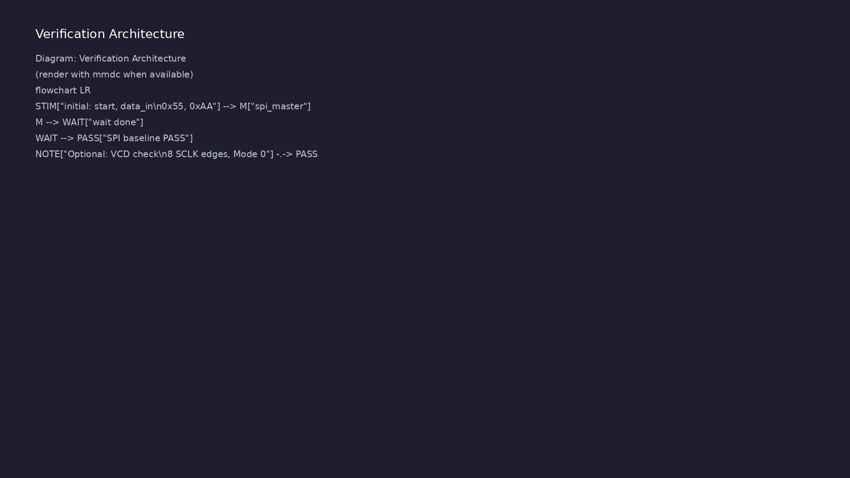
2. SPI master RTL
• clk_div: `clk_div_tick` every
`DIVIDER` clocks.
• spi_master: Mode 0; `cs_n`
frames; MSB-first on `mosi`;
`done` when complete.
• Outputs: `sclk` (idle low),
`mosi`, `cs_n` — no `miso` in
baseline.
learn_uart_spi_i2c / Module 5
Notes:
From MODULE5 Design Architecture.

Slide 11
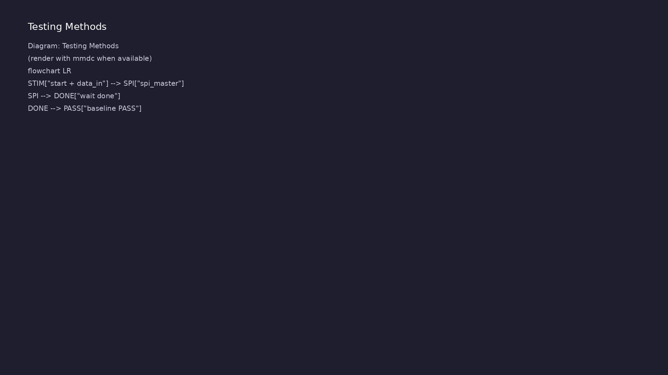
3. Mode 0 timing on the wire
• Capture on rising SCLK; change
MOSI on falling SCLK; 8 edges
per byte.
learn_uart_spi_i2c / Module 5
Notes:
From MODULE5 Design Architecture.

Slide 12
RTL block diagram (reference)
Module 5: DUT hierarchy and signal flow.
learn_uart_spi_i2c / Module 5

Slide 13
Verification / testbench diagram (reference)
Module 5: stimulus, observation, and checking.
learn_uart_spi_i2c / Module 5

Slide 14
spi_master — Mode 0 shift
// Simple SPI master (mode 0, single slave, 8-bit transfers).
// This is a teaching example: it assumes a clean clk_div_tick input
that
// controls SCLK edges and bit timing.
//
// Mode 0 (CPOL=0, CPHA=0):
// - SCLK idles low.
// - Data is captured on the rising edge of SCLK.
// - Data is changed on the falling edge of SCLK.
`timescale 1ns/1ps
module spi_master (
input wire clk,
input wire rst_n, // Active-low async reset
input wire clk_div_tick,// Divider pulse controlling SCLK
toggling
input wire start, // Pulse high for one cycle to start
learn_uart_spi_i2c / Module 5

Slide 15
clk_div — SPI clock
// Simple clock divider for SPI SCLK timing.
// Generates a 1-cycle-wide clk_div_tick pulse every DIVIDER cycles of
clk.
`timescale 1ns/1ps
module clk_div #(
parameter int DIVIDER = 8
) (
input wire clk,
input wire rst_n, // Active-low async reset
output reg clk_div_tick // One-cycle pulse at divided rate
);
int count;
always @(posedge clk or negedge rst_n) begin
if (!rst_n) begin
# ...
learn_uart_spi_i2c / Module 5

Slide 16
Execution & simulation flow
learn_uart_spi_i2c / Module 5

Slide 17
How the example runs (toolchain)
• Makefile: Verilator compiles RTL + SystemVerilog
testbench into a C++ model
• sim_main.cpp: generates clk/rst_n, calls eval()
until $finish
• Directed test (initial block or C++): drive
stimulus, wait for DUT flags
• Self-check: compare outputs; print PASS/FAIL (see
terminal demo slide)
• Repo path: module5/examples/<example>/ — run make
run from that directory
learn_uart_spi_i2c / Module 5
Notes:
From MODULE5 — execution and artifact layout.

Slide 18
Example directory layout
• dut/: spi_master.v, clk_div.v
• top_spi_baseline.sv: clk_div, spi_master; directed
test in initial block
• sim_main.cpp: Clock, reset; run until $finish
learn_uart_spi_i2c / Module 5
Notes:
Match each path to files under module/examples/.

Slide 19
Makefile — spi_baseline run
# Makefile for Module 5 SPI baseline (basic testbench, no UVM)
#
# Usage:
# make run
#
VERILATOR ?= verilator
TOPLEVEL ?= top_spi_baseline
DUT_SRC = dut/*.v
RTL_SRC = top_spi_baseline.sv $(DUT_SRC)
HARNESS = sim_main.cpp
VERILATOR_FLAGS = -sv --timing -Wall -Wno-fatal -Wno-TIMESCALEMOD -Wno-
WIDTHTRUNC
.PHONY: run compile clean
# ...
learn_uart_spi_i2c / Module 5

Slide 20
Key files to study
learn_uart_spi_i2c / Module 5

Slide 21
Open these in the repo
• `module5/examples/spi_baseline/dut/spi_master.v` —
Mode 0 master
• `module5/examples/spi_baseline/dut/clk_div.v` —
`clk_div_tick`
• `module5/examples/spi_baseline/top_spi_baseline.sv`
— directed test
• `docs/SPI_LEARNING_GUIDE.md` — protocol reference
learn_uart_spi_i2c / Module 5
Notes:
Trace while running module5/EXAMPLES.md labs.

Slide 22
Verification & testing methods
learn_uart_spi_i2c / Module 5

Slide 23
1. Baseline goals
• Confirm Mode 0 serialization
before SPI UVM (Module 6).
learn_uart_spi_i2c / Module 5
Notes:
From MODULE5 Verification & Testing Methods.

Slide 24
2. Directed test flow
• Pulse `start` + `data_in` (0x55,
0xAA); `wait(done)`; read
`[PASS]` messages.
learn_uart_spi_i2c / Module 5
Notes:
From MODULE5 Verification & Testing Methods.

Slide 25
3. Waveform learning (optional)
• Count 8 SCLK cycles per frame;
verify MSB-first bit order on
MOSI.
• Defer MISO, multi-slave CS, and
random data to Module 6.
learn_uart_spi_i2c / Module 5
Notes:
From MODULE5 Verification & Testing Methods.

Slide 26
Directed SPI test
start = 1'b0;
data_in = 8'h00;
wait (rst_n === 1'b1);
repeat (10) @(posedge clk);
// Send 0x55
@(posedge clk);
start = 1'b1;
data_in = 8'h55;
@(posedge clk);
start = 1'b0;
wait (done === 1'b1);
$display("[PASS] SPI baseline: 0x55 transfer done");
repeat (20) @(posedge clk);
# ...
learn_uart_spi_i2c / Module 5

Slide 27
Syllabus topics
learn_uart_spi_i2c / Module 5

Slide 28
1. SPI Protocol (Mode 0)
• Signals: sclk (serial clock), mosi (master out,
slave in), cs_n (active-low chip select). Optional:…
• Mode 0 (CPOL=0, CPHA=0): SCLK idles low; data
captured on rising edge; data changed on falling
edge.
• Timing: One bit per clk_div_tick; clk_div_tick
derived from system clock via divider (e.g.
DIVIDER=…
learn_uart_spi_i2c / Module 5
Notes:
From MODULE5 Topics Covered.

Slide 29
2. Hands-on testbench (spi_baseline)
• Directed test in `top_spi_baseline.sv`: `start`,
`data_in`, `wait(done)`.
• Pass: `[PASS]` lines and `SPI baseline test PASS`.
learn_uart_spi_i2c / Module 5
Notes:
From MODULE5 Topics Covered.

Slide 30
Hands-on examples
learn_uart_spi_i2c / Module 5

Slide 31
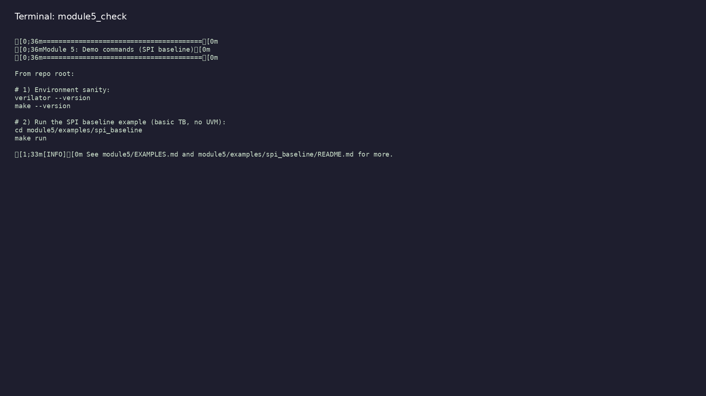
Module 5 self-check
$ ./scripts/module5.sh --help
learn_uart_spi_i2c / Module 5
Notes:
Run from course repository root.

Slide 32
Example 1: SPI baseline master
• SPI Mode 0 master RTL (`spi_master` + `clk_div`)
• Directed writes 0x55 and 0xAA with `start` /
`wait(done)`
• Observing SCLK, MOSI, and CS_N timing in simulation
(optional VCD)
learn_uart_spi_i2c / Module 5
Notes:
module5/examples/spi_baseline/README.md

Slide 33
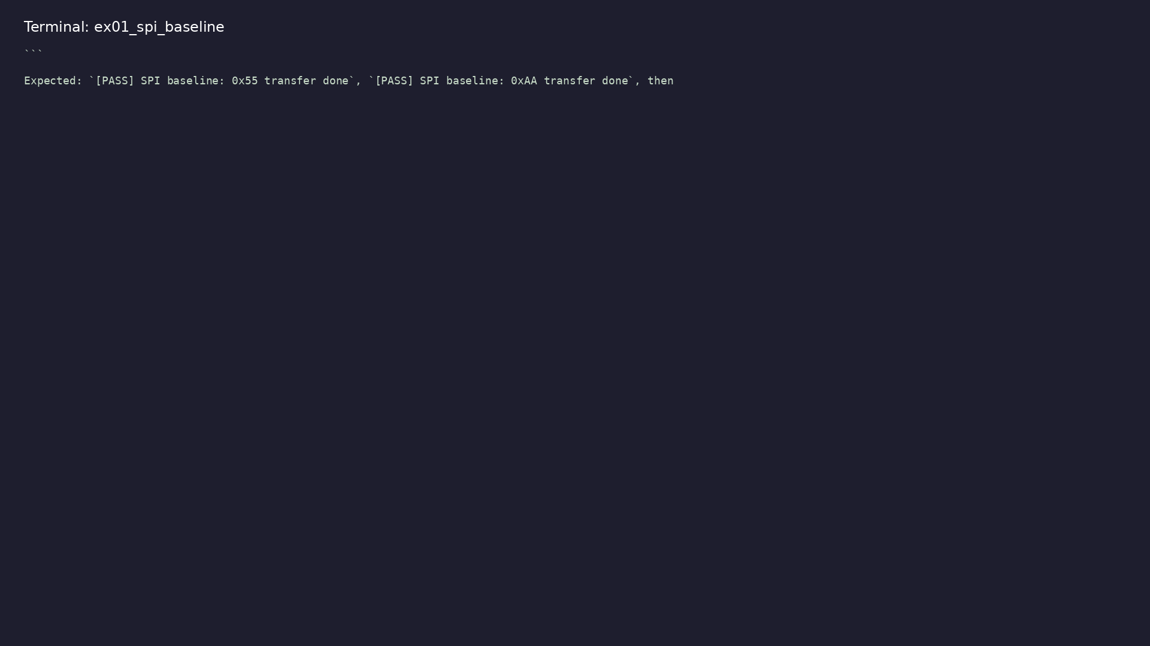
Demo: SPI baseline master
$ cd module5/examples/spi_baseline && make run
learn_uart_spi_i2c / Module 5
Notes:
Hands-on: module5/examples/spi_baseline/

Slide 34
Key concepts
learn_uart_spi_i2c / Module 5

Slide 35
1. Synchronous serial (SPI)
• `sclk` defines bit times; unlike UART there is an
explicit clock line.
• Mode 0: idle low, sample MOSI on rising edge, change
on falling edge.
learn_uart_spi_i2c / Module 5
Notes:
From MODULE5 Key Concepts.

Slide 36
2. Chip select frames
• `cs_n` low defines one transfer; typically 8 SCLK
cycles per byte.
learn_uart_spi_i2c / Module 5
Notes:
From MODULE5 Key Concepts.

Slide 37
Common pitfalls
learn_uart_spi_i2c / Module 5

Slide 38
Wrong SPI mode in head
• Mistake: Sampling on falling edge when using Mode 0.
• Correct: Rising edge capture, falling edge change
for CPOL=0, CPHA=0.
• Why: Bits will be shifted and MSB/LSB order will
look wrong.
learn_uart_spi_i2c / Module 5
Notes:
From MODULE5 Common Pitfalls.

Slide 39
Trusting `done` only
• Mistake: No waveform or bus check on MOSI/SCLK.
• Correct: Optional VCD review or Module 6 monitor-
based check.
• Why: `done` only means the FSM finished, not that
bits were correct.
learn_uart_spi_i2c / Module 5
Notes:
From MODULE5 Common Pitfalls.

Slide 40
Practice & assessment
learn_uart_spi_i2c / Module 5

Slide 41
What you should know
• Describe SPI mode 0 and the role of sclk, mosi,
cs_n, clk_div_tick.
• Explain the role of spi_master and clk_div.
• Run the spi_baseline example and interpret the
directed test.
• Ready for Module 6: SPI UVM+SV verification.
learn_uart_spi_i2c / Module 5
Notes:
From MODULE5 Learning Outcomes.

Slide 42
Exercises
• Run spi_baseline
• Trace one transfer
• Mode 0 timing
• Optional: Waveforms
learn_uart_spi_i2c / Module 5

Slide 43
Assessment checklist
• Can describe SPI mode 0 (idle low, capture on
rising, change on falling) and signals sclk, mosi,
cs…
• Can explain the role of spi_master and clk_div in
the RTL.
• Can run spi_baseline and interpret the directed test
result.
• Ready for Module 6: SPI UVM+SV verification.
learn_uart_spi_i2c / Module 5

Slide 44
Summary & next steps
• Understand the SPI protocol (mode 0, signals),
translate it to RTL (SPI master, clk_div), and
verif…
• Complete module5/CHECKLIST.md
• Review module5/EXAMPLES.md and run each lab
• Next: SPI UVM+SV
learn_uart_spi_i2c / Module 5

