Slide 1
Module 6
SPI — UVM+SV Verification
learn_uart_spi_i2c / Module 6

Slide 2
Learning objectives
• SPI UVM agent: Transaction (SpiTransaction),
sequence (SpiSequence), driver (SpiDriver), monitor
(S…
• Interface: spi_master_if (clk, rst_n, clk_div_tick,
start, data_in, sclk, mosi, cs_n, busy, done) c…
• Mode 0 monitoring: SCLK idle low; capture on rising
edge; monitor samples MOSI on each rising SCLK,…
learn_uart_spi_i2c / Module 6

Slide 3
Prerequisites
• Module 1 (spec → RTL), Module 2 (UVM+SV, uvm_smoke),
Module 5 (SPI protocol + RTL + basic TB).
• Verilator, Make, C++ compiler, UVM (UVM_HOME or
vendored UVM).
learn_uart_spi_i2c / Module 6

Slide 4
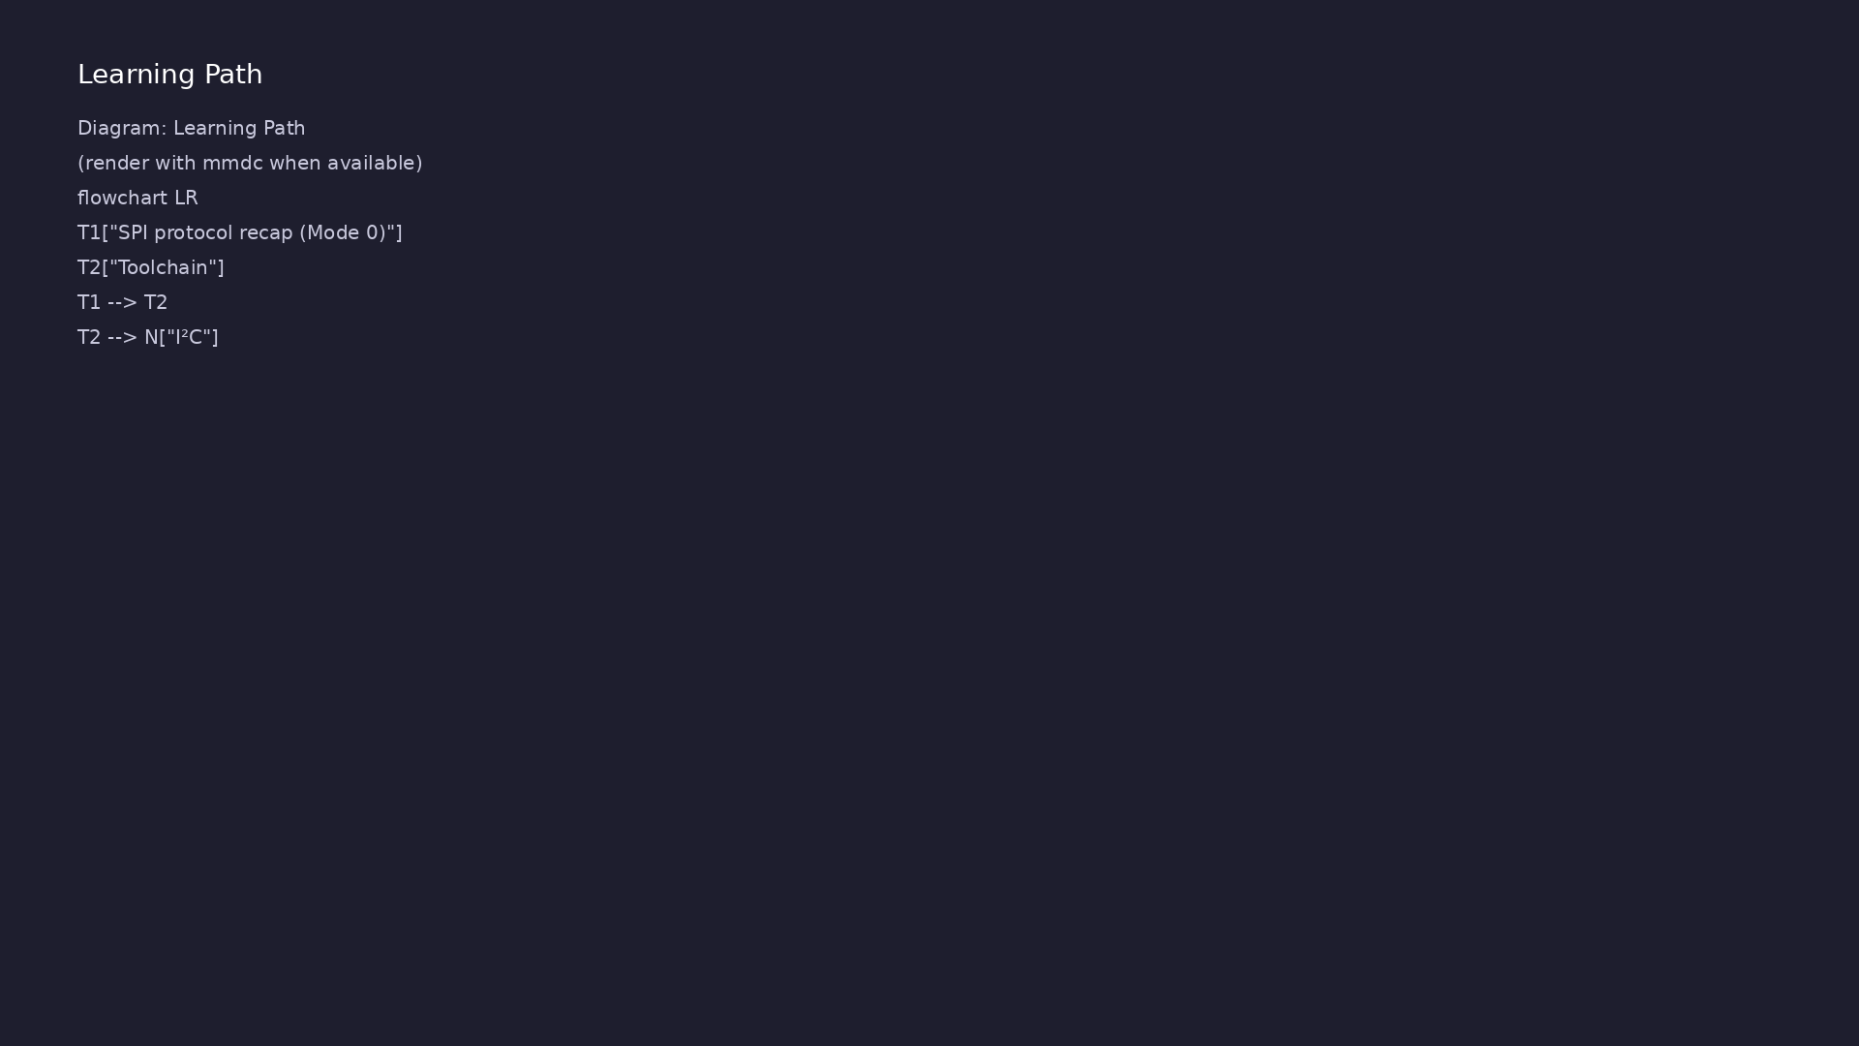
Learning path
Extend SPI verification to **UVM+SV** — SPI agent (transaction, sequence, driver, monitor, scoreboard); run on Verilator.
learn_uart_spi_i2c / Module 6

Slide 5
Overview
• Module 6 builds on Module 5 (SPI protocol + RTL +
basic testbench):
learn_uart_spi_i2c / Module 6

Slide 6
How to learn this module
learn_uart_spi_i2c / Module 6

Slide 7
Suggested learning path
• Read the detailed SPI learning guide:
SPI_LEARNING_GUIDE.md — what SPI is, how it works
(signals, M…
• Read the protocols + UVM overview:
LEARNING_GUIDE_PROTOCOLS_AND_UVM.md — Part B § 5.
How UVM Maps t…
learn_uart_spi_i2c / Module 6
Notes:
From docs/MODULE6.md — read guides before running demos.

Slide 8
Design architecture
learn_uart_spi_i2c / Module 6

Slide 9
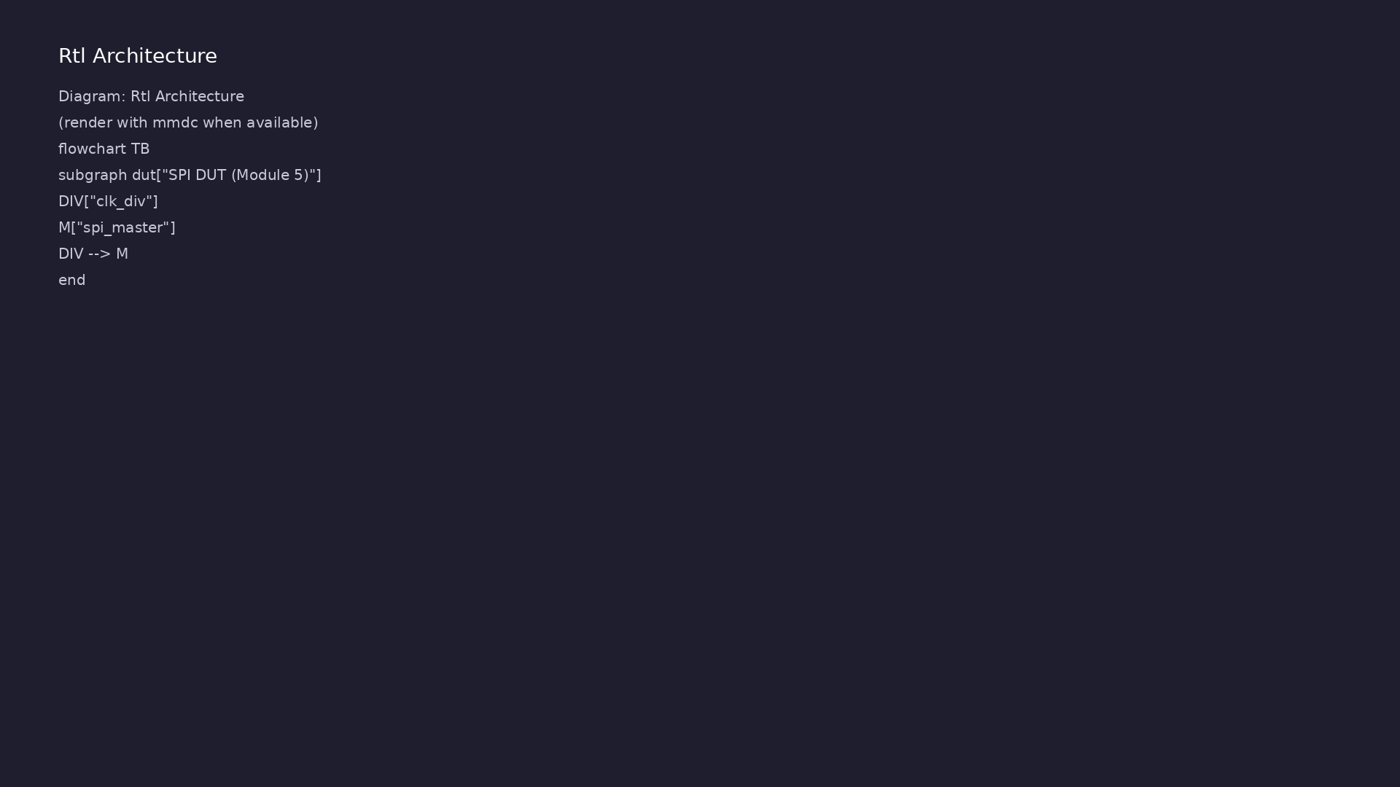
1. SPI DUT (reused from Module 5)
• spi_master + clk_div in
`module6/examples/spi_uvm/dut/`.
• spi_master_if connects UVM to
DUT pins.
learn_uart_spi_i2c / Module 6
Notes:
From MODULE6 Design Architecture.

Slide 10
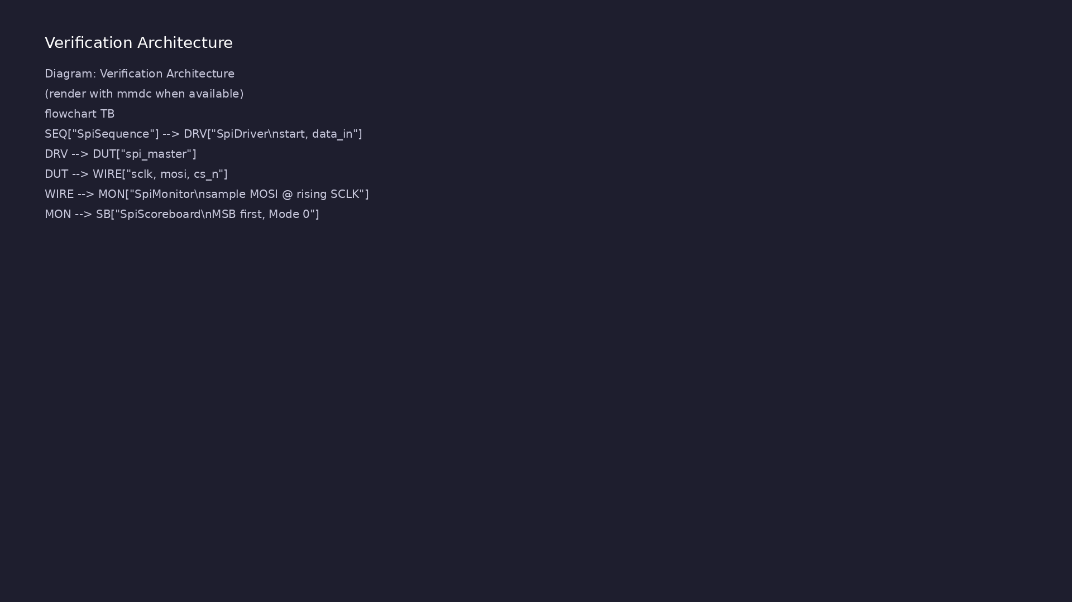
2. UVM agent structure
• SpiTransaction = one byte;
SpiSequence = directed list;
SpiDriver waits on `done`.
• SpiMonitor samples MOSI on
rising SCLK while `cs_n` is low
(Mode 0, MSB first).
• SpiScoreboard compares expected
vs `observed_mosi`.
learn_uart_spi_i2c / Module 6
Notes:
From MODULE6 Design Architecture.

Slide 11
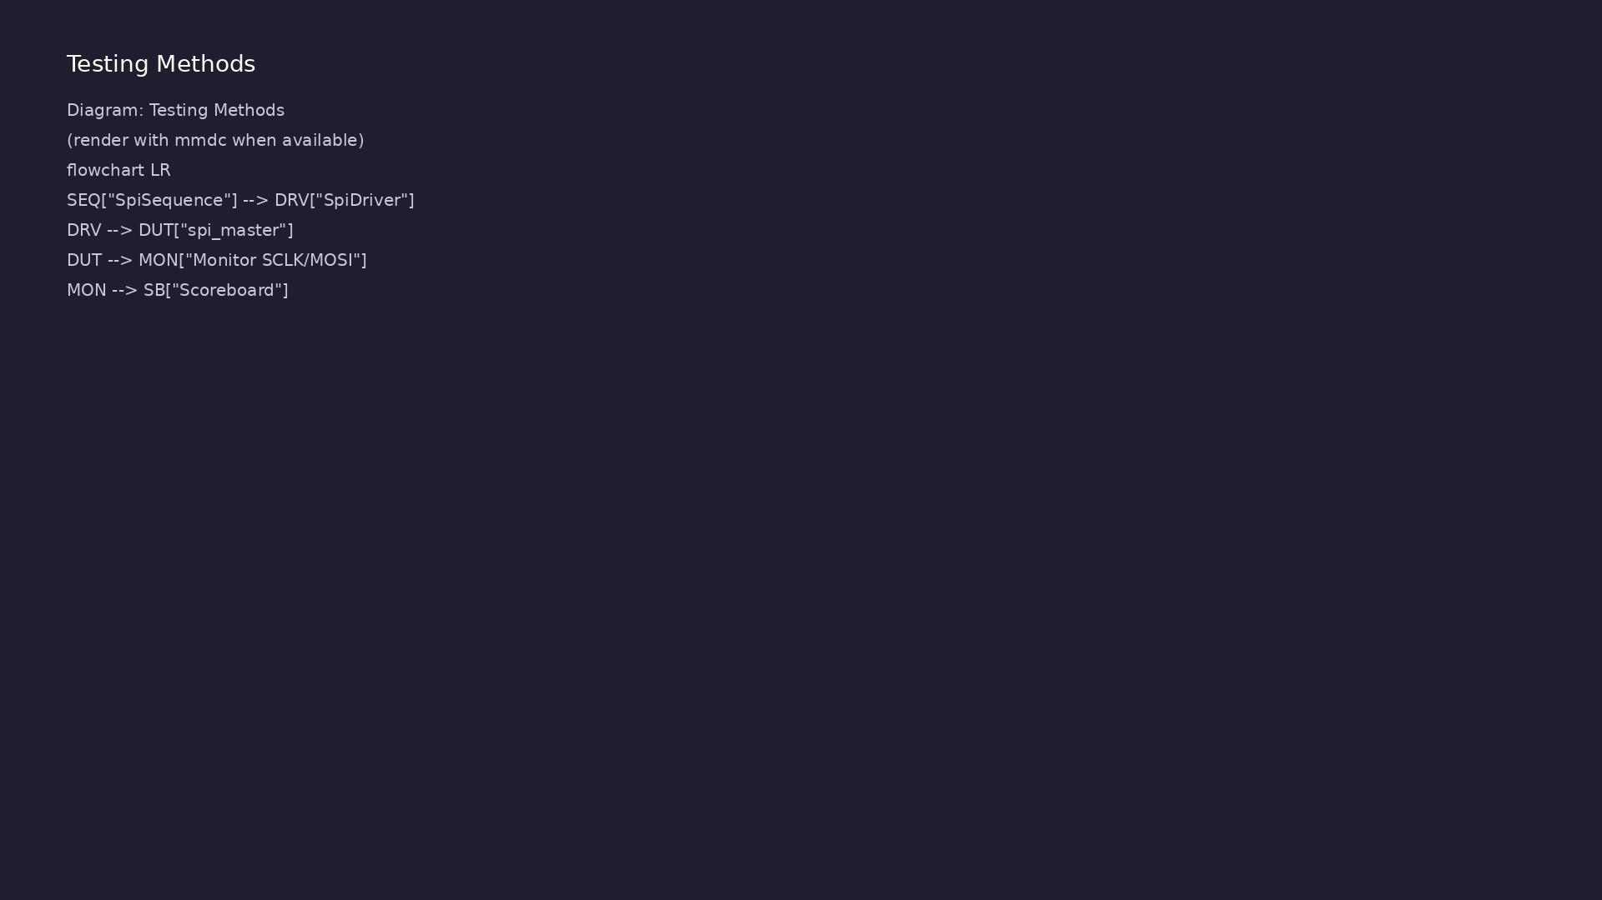
3. Bus vs DUT checking
• Monitor validates wire behavior;
`done` alone is not sufficient
for sign-off.
learn_uart_spi_i2c / Module 6
Notes:
From MODULE6 Design Architecture.

Slide 12
RTL block diagram (reference)
Module 6: DUT hierarchy and signal flow.
learn_uart_spi_i2c / Module 6

Slide 13
Verification / testbench diagram (reference)
Module 6: stimulus, observation, and checking.
learn_uart_spi_i2c / Module 6

Slide 14
SpiTransaction & agent
/**
* Module 6: SPI master UVM test (Verilator)
*
* SPI agent: transaction, sequence, driver, monitor, scoreboard.
* Driver sends bytes via start/data_in; monitor samples MOSI on SCLK
(mode 0);
* scoreboard checks expected vs observed.
*/
`include "uvm_macros.svh"
import uvm_pkg::*;
`timescale 1ns/1ps
// ---------------------------------------------------------------------
--------
// Interface
// ---------------------------------------------------------------------
learn_uart_spi_i2c / Module 6

Slide 15
Execution & simulation flow
learn_uart_spi_i2c / Module 6

Slide 16
How the example runs (toolchain)
• Makefile: Verilator + UVM_HOME compile RTL,
interface, and test_*.sv
• UVM phases: build → connect → run_test → report
(same pattern as Module 2)
• Sequence → driver → DUT → monitor → scoreboard (read
SCOREBOARD at end)
• Typical command: make SIM=verilator TEST=test_* (see
module6 demo slide)
• Loopback / hooks connect monitor observations to
scoreboard checks
learn_uart_spi_i2c / Module 6
Notes:
From MODULE6 — execution and artifact layout.

Slide 17
Example directory layout
• dut/: spi_master.v, clk_div.v (same as Module 5)
• test_spi_uvm.sv: Interface, SpiTransaction,
SpiSequence, SpiDriver, SpiMonitor, SpiScoreboard,
SpiA…
learn_uart_spi_i2c / Module 6
Notes:
Match each path to files under module/examples/.

Slide 18
Makefile — UVM SPI sim
# Makefile for Module 6 SPI UVM test
#
# Usage:
# make SIM=verilator TEST=test_spi_uvm
#
SIM ?= verilator
TEST ?= test_spi_uvm
# Prefer externally-set UVM_HOME, but fall back to vendored UVM.
# From module6/examples/spi_uvm, repo root is ../../..
UVM_HOME ?= $(shell echo $$UVM_HOME)
UVM_HOME_FALLBACK := ../../../tools/uvm-2017/1800.2-2017-1.0
UVM_HOME_FALLBACK_ALT :=
../../../tools/learn_uvm2017_sv_verilator/tools/uvm-2017/1800.2-2017-1.0
ifeq ($(UVM_HOME),)
# ...
learn_uart_spi_i2c / Module 6

Slide 19
Key files to study
learn_uart_spi_i2c / Module 6

Slide 20
Open these in the repo
• `module6/examples/spi_uvm/dut/spi_master.v` — reused
from Module 5
• `module6/examples/spi_uvm/test_spi_uvm.sv` —
SpiMonitor samples MOSI on SCLK
• `docs/LEARNING_GUIDE_PROTOCOLS_AND_UVM.md` — § 7 SPI
UVM mapping
learn_uart_spi_i2c / Module 6
Notes:
Trace while running module6/EXAMPLES.md labs.

Slide 21
Verification & testing methods
learn_uart_spi_i2c / Module 6

Slide 22
1. Mode 0 in the testbench
• Monitor must use rising-edge
capture and falling-edge change
— matches CPOL/CPHA=0.
learn_uart_spi_i2c / Module 6
Notes:
From MODULE6 Verification & Testing Methods.

Slide 23
2. Directed regression
• Same byte pattern as UART UVM
(0x00 … 0xFF) for apples-to-
apples learning.
learn_uart_spi_i2c / Module 6
Notes:
From MODULE6 Verification & Testing Methods.

Slide 24
3. Extensions
• MISO reads, random data, mode
parameters — see [LEARNING_GUIDE
§ 7](LEARNING_GUIDE_PROTOCOLS_AN
D_UV…
learn_uart_spi_i2c / Module 6
Notes:
From MODULE6 Verification & Testing Methods.

Slide 25
Syllabus topics
learn_uart_spi_i2c / Module 6

Slide 26
1. SPI protocol recap (Mode 0)
• `cs_n` frames; 8 SCLK cycles per byte; MSB first on
MOSI.
learn_uart_spi_i2c / Module 6
Notes:
From MODULE6 Topics Covered.

Slide 27
2. Toolchain
• `make SIM=verilator TEST=test_spi_uvm`;
`+UVM_TESTNAME=SpiTest`.
learn_uart_spi_i2c / Module 6
Notes:
From MODULE6 Topics Covered.

Slide 28
Hands-on examples
learn_uart_spi_i2c / Module 6

Slide 29
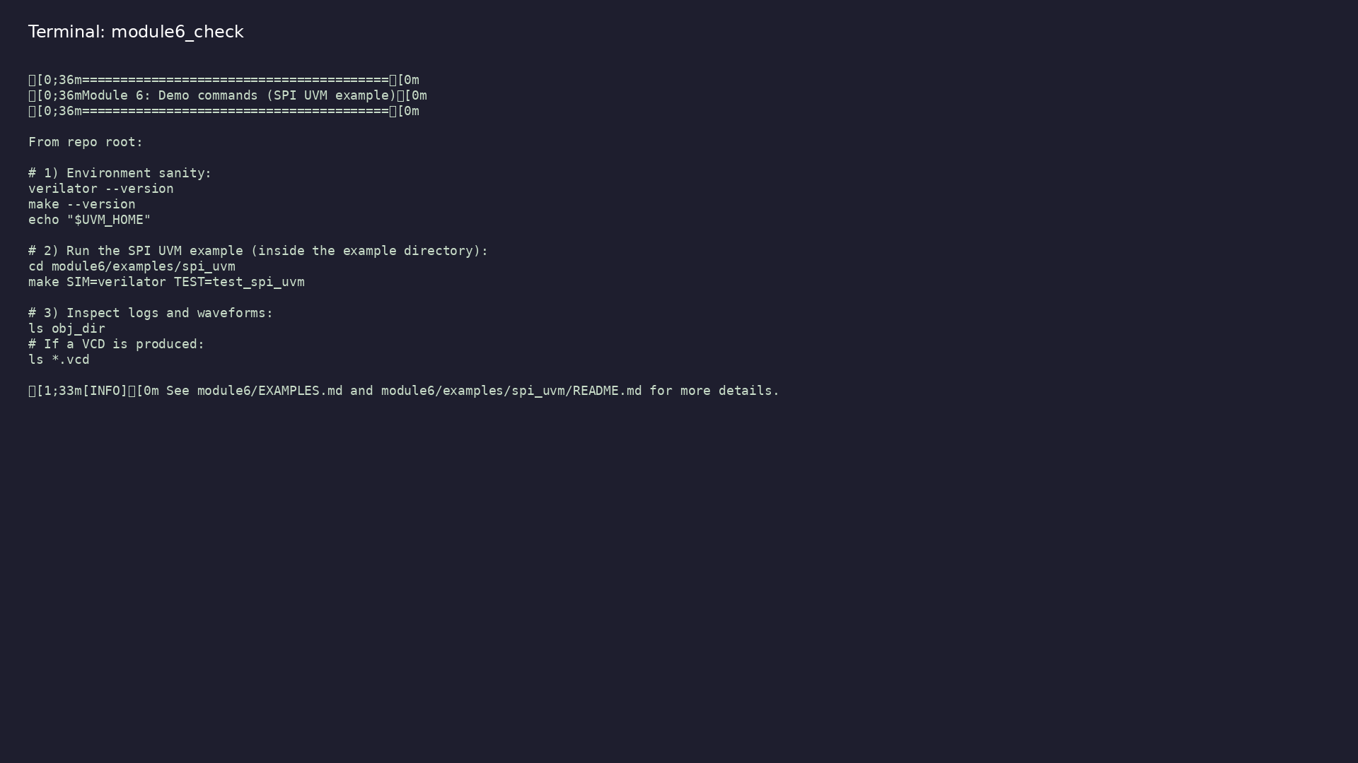
Module 6 self-check
$ ./scripts/module6.sh --help
learn_uart_spi_i2c / Module 6
Notes:
Run from course repository root.

Slide 30
Example 1: SPI UVM agent
• SPI DUT from Module 5 with UVM driver, monitor, and
scoreboard
• Monitor samples MOSI on rising SCLK (Mode 0, MSB
first)
• Bus-centric checking vs relying only on the DUT
`done` flag
learn_uart_spi_i2c / Module 6
Notes:
module6/examples/spi_uvm/README.md

Slide 31
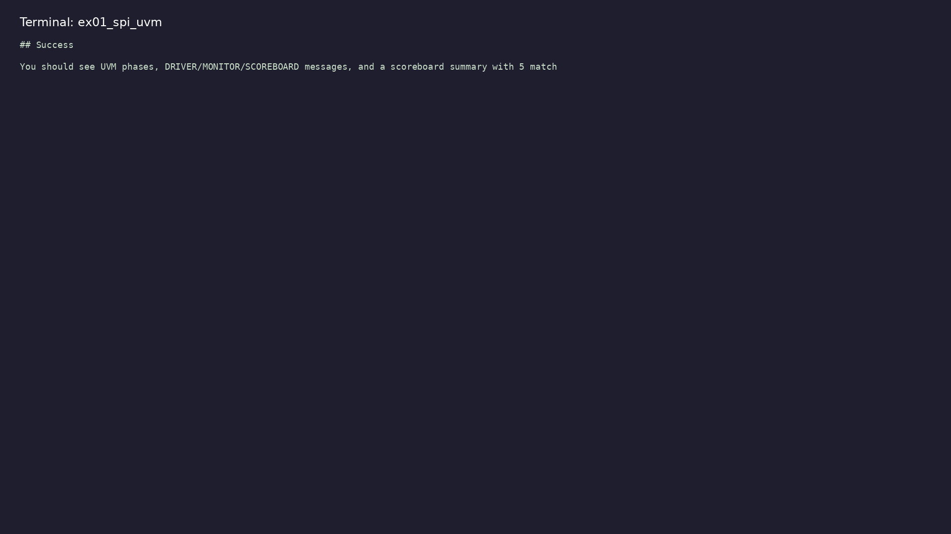
Demo: SPI UVM agent
$ cd module6/examples/spi_uvm && make SIM=verilator TEST=test_spi_uvm
learn_uart_spi_i2c / Module 6
Notes:
Hands-on: module6/examples/spi_uvm/

Slide 32
Key concepts
learn_uart_spi_i2c / Module 6

Slide 33
1. Bus-centric verification
• Monitor rebuilds the byte from SCLK/MOSI/CS_N, not
only the DUT status flag.
learn_uart_spi_i2c / Module 6
Notes:
From MODULE6 Key Concepts.

Slide 34
2. Mode 0 in the monitor
• Wait for `cs_n` low, then 8 rising edges, MSB first
into `observed_mosi`.
learn_uart_spi_i2c / Module 6
Notes:
From MODULE6 Key Concepts.

Slide 35
Common pitfalls
learn_uart_spi_i2c / Module 6

Slide 36
Sampling MOSI on wrong edge
• Mistake: Using falling SCLK for Mode 0 capture.
• Correct: Rising-edge samples in SpiMonitor.
• Why: Scoreboard mismatches even when `done` pulses.
learn_uart_spi_i2c / Module 6
Notes:
From MODULE6 Common Pitfalls.

Slide 37
Ignoring CS framing
• Mistake: Counting SCLK edges across multiple frames.
• Correct: Reset bit index when `cs_n` deasserts and a
new frame starts.
• Why: Bytes merge or split incorrectly.
learn_uart_spi_i2c / Module 6
Notes:
From MODULE6 Common Pitfalls.

Slide 38
Practice & assessment
learn_uart_spi_i2c / Module 6

Slide 39
What you should know
• Describe the SPI UVM agent (transaction, sequence,
driver, monitor, scoreboard) and mode 0 monitori…
• Run spi_uvm and interpret UVM output.
• Ready for Module 7: I²C protocol + RTL + basic
testbench.
learn_uart_spi_i2c / Module 6
Notes:
From MODULE6 Learning Outcomes.

Slide 40
Exercises
• Run spi_uvm
• Trace one transaction
• Change the sequence
• Optional: Compare to UART UVM
learn_uart_spi_i2c / Module 6

Slide 41
Assessment checklist
• Can describe the SPI UVM agent and how it maps to
SPI (one byte, mode 0 monitoring).
• Can run spi_uvm and interpret UVM output.
• Ready for Module 7: I²C protocol + RTL + basic
testbench.
learn_uart_spi_i2c / Module 6

Slide 42
Summary & next steps
• Extend SPI verification to **UVM+SV** — SPI agent
(transaction, sequence, driver, monitor, scoreboa…
• Complete module6/CHECKLIST.md
• Review module6/EXAMPLES.md and run each lab
• Next: I²C
learn_uart_spi_i2c / Module 6

