Slide 1
Module 7
I²C — Protocol + RTL + Basic Testbench
learn_uart_spi_i2c / Module 7

Slide 2
Learning objectives
• RTL block architecture: `clk_div` + `i2c_master` FSM
(START → addr → data → STOP).
• Baseline verification: Directed writes plus inline
bus monitor (sample SDA on rising SCL).
• Protocol vs simplification: Real open-drain/ACK vs
this repo’s push-pull teaching model.
• Path to Module 8: Same DUT with UVM
monitor/scoreboard on address and data phases.
learn_uart_spi_i2c / Module 7

Slide 3
Prerequisites
• Modules 1–6.
• Verilator, Make, C++ compiler. No UVM required for
this baseline.
learn_uart_spi_i2c / Module 7

Slide 4
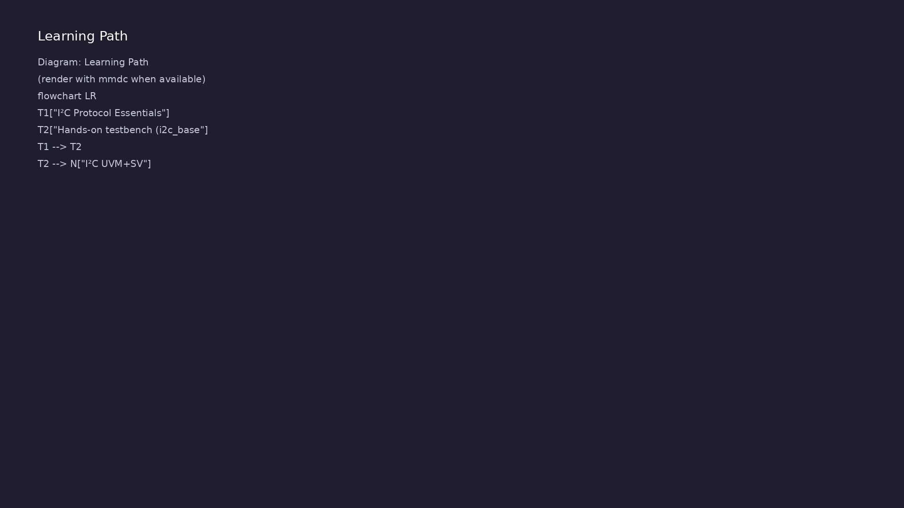
Learning path
Understand the I²C protocol (start/stop, addressing, ACK/NACK), translate it to RTL (simple master + timing), and verify with a **basic** (…
learn_uart_spi_i2c / Module 7

Slide 5
Overview
• Module 7 is the I²C **protocol + RTL + basic
testbench** module (UVM comes in Module 8).
learn_uart_spi_i2c / Module 7

Slide 6
How to learn this module
learn_uart_spi_i2c / Module 7

Slide 7
Suggested learning path
• Read the detailed I²C learning guide:
I2C_LEARNING_GUIDE.md — what I²C is, what kind of
protocol (s…
• Read the protocols + UVM overview:
LEARNING_GUIDE_PROTOCOLS_AND_UVM.md — Part B § 4.
When to Use Ba…
learn_uart_spi_i2c / Module 7
Notes:
From docs/MODULE7.md — read guides before running demos.

Slide 8
Design architecture
learn_uart_spi_i2c / Module 7

Slide 9
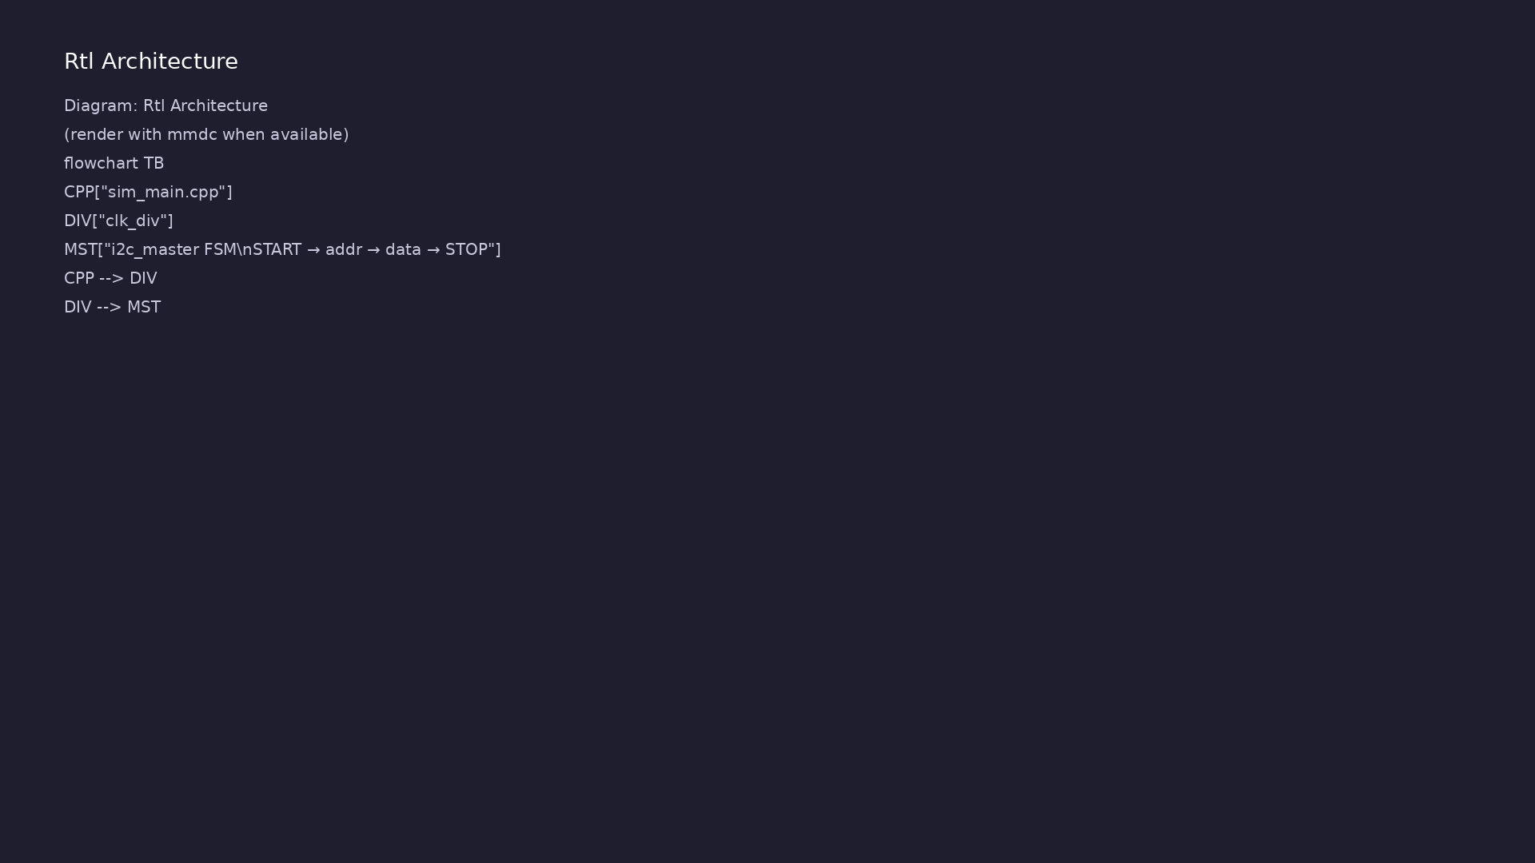
1. Block hierarchy
• top_i2c_baseline → `clk_div` +
`i2c_master`; C++ drives
`clk`/`rst_n`.
learn_uart_spi_i2c / Module 7
Notes:
From MODULE7 Design Architecture.

Slide 10
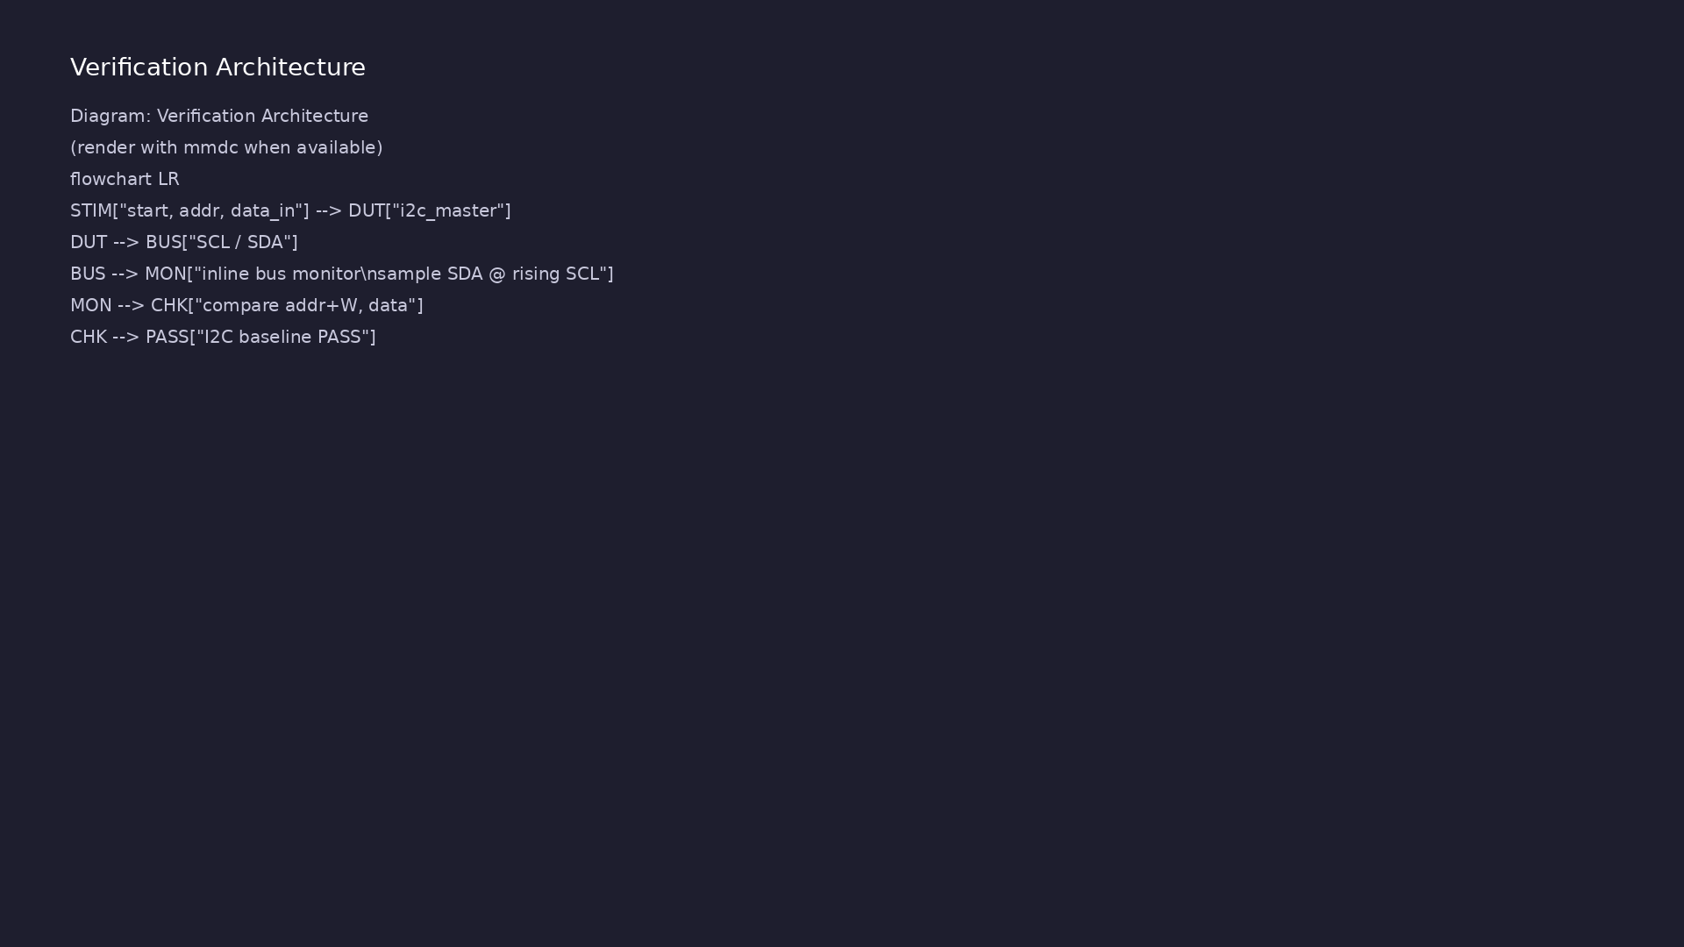
2. I²C master FSM
• States: IDLE → START → ADDR_BITS
→ DATA_BITS → STOP.
• One teaching write: 7-bit `addr`
+ data byte on `scl`/`sda`
(push-pull model).
learn_uart_spi_i2c / Module 7
Notes:
From MODULE7 Design Architecture.

Slide 11
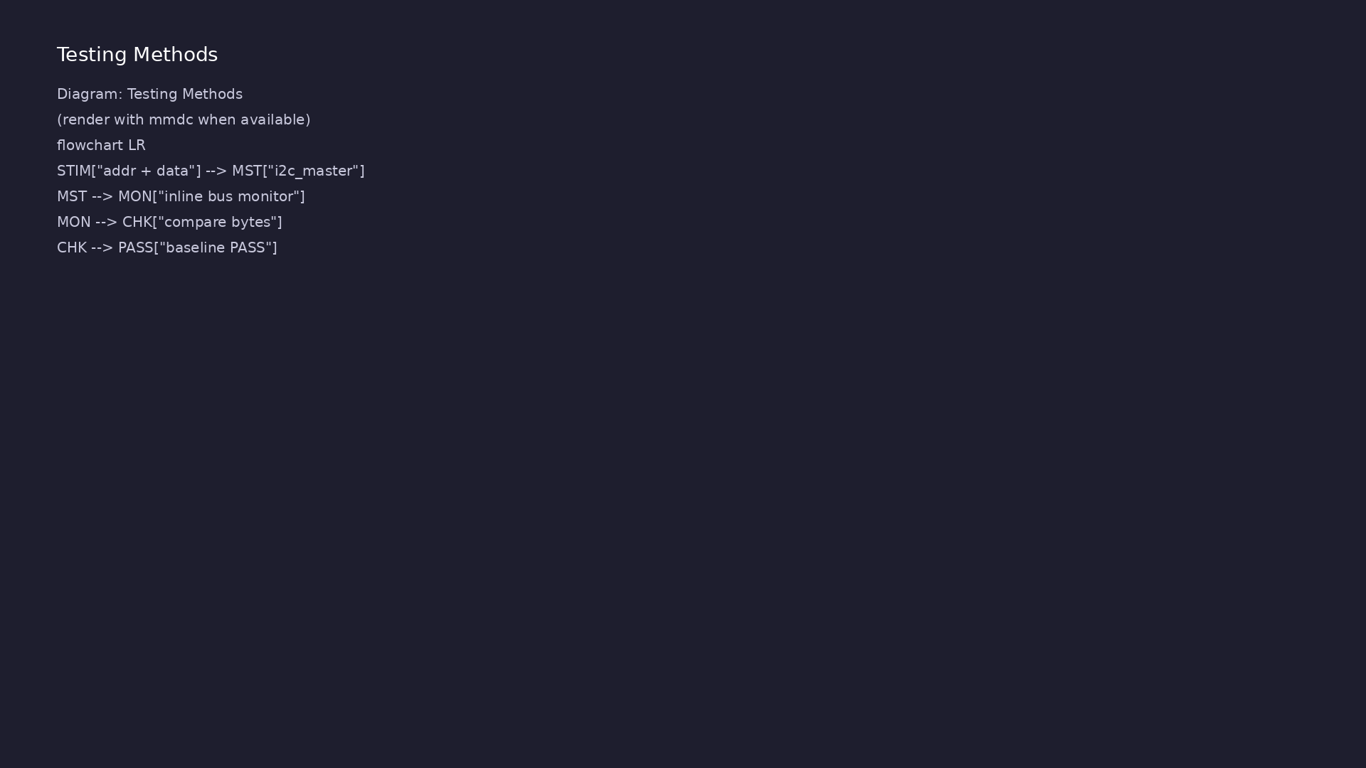
3. Teaching vs real I²C
• No open-drain, ACK/NACK, or
arbitration in baseline — learn
sequencing first.
learn_uart_spi_i2c / Module 7
Notes:
From MODULE7 Design Architecture.

Slide 12
RTL block diagram (reference)
Module 7: DUT hierarchy and signal flow.
learn_uart_spi_i2c / Module 7

Slide 13
Verification / testbench diagram (reference)
Module 7: stimulus, observation, and checking.
learn_uart_spi_i2c / Module 7

Slide 14
i2c_master FSM
// Simple I2C master (baseline write-only, single target).
// Teaching example: we treat SCL/SDA as simple push-pull signals, not
full
// open-drain with multi-master arbitration. Focus is on bit timing and
// start/address/data/stop sequencing.
//
// One transaction:
// - START
// - 7-bit address + write bit (0)
// - 8-bit data byte
// - STOP
`timescale 1ns/1ps
module i2c_master (
input wire clk,
input wire rst_n, // Active-low async reset
# ...
learn_uart_spi_i2c / Module 7

Slide 15
clk_div — SCL timing
// Simple clock divider for I2C SCL timing (teaching example).
// Generates a 1-cycle-wide clk_div_tick pulse every DIVIDER cycles of
clk.
`timescale 1ns/1ps
module clk_div #(
parameter int DIVIDER = 8
) (
input wire clk,
input wire rst_n, // Active-low async reset
output reg clk_div_tick // One-cycle pulse at divided rate
);
int count;
always @(posedge clk or negedge rst_n) begin
if (!rst_n) begin
# ...
learn_uart_spi_i2c / Module 7

Slide 16
Execution & simulation flow
learn_uart_spi_i2c / Module 7

Slide 17
How the example runs (toolchain)
• Makefile: Verilator compiles RTL + SystemVerilog
testbench into a C++ model
• sim_main.cpp: generates clk/rst_n, calls eval()
until $finish
• Directed test (initial block or C++): drive
stimulus, wait for DUT flags
• Self-check: compare outputs; print PASS/FAIL (see
terminal demo slide)
• Repo path: module7/examples/<example>/ — run make
run from that directory
learn_uart_spi_i2c / Module 7
Notes:
From MODULE7 — execution and artifact layout.

Slide 18
Example directory layout
• dut/: i2c_master.v, clk_div.v
• top_i2c_baseline.sv: Instantiates DUT + directed
test + monitor/self-check
• sim_main.cpp: Clock/reset harness; simulation runs
until $finish
learn_uart_spi_i2c / Module 7
Notes:
Match each path to files under module/examples/.

Slide 19
Makefile — i2c_baseline run
# Makefile for Module 7 I2C baseline (basic testbench, no UVM)
#
# Usage:
# make run
#
VERILATOR ?= verilator
TOPLEVEL ?= top_i2c_baseline
DUT_SRC = dut/*.v
RTL_SRC = top_i2c_baseline.sv $(DUT_SRC)
HARNESS = sim_main.cpp
VERILATOR_FLAGS = -sv --timing -Wall -Wno-fatal -Wno-TIMESCALEMOD -Wno-
WIDTHTRUNC
.PHONY: run compile clean
# ...
learn_uart_spi_i2c / Module 7

Slide 20
Key files to study
learn_uart_spi_i2c / Module 7

Slide 21
Open these in the repo
• `module7/examples/i2c_baseline/dut/i2c_master.v` —
START/addr/data/STOP FSM
• `module7/examples/i2c_baseline/top_i2c_baseline.sv`
— stimulus + inline bus monitor
• `docs/I2C_LEARNING_GUIDE.md` — protocol reference
learn_uart_spi_i2c / Module 7
Notes:
Trace while running module7/EXAMPLES.md labs.

Slide 22
Verification & testing methods
learn_uart_spi_i2c / Module 7

Slide 23
1. Inline bus monitor
• Top module detects START;
samples SDA on rising SCL;
rebuilds addr+W and data.
learn_uart_spi_i2c / Module 7
Notes:
From MODULE7 Verification & Testing Methods.

Slide 24
2. Self-check flow
• Compare captured bytes to driven
`addr`/`data_in`; print `I2C
baseline test PASS`.
learn_uart_spi_i2c / Module 7
Notes:
From MODULE7 Verification & Testing Methods.

Slide 25
3. Path to Module 8
• Move monitor into I2cMonitor;
scoreboard splits address and
data phases.
learn_uart_spi_i2c / Module 7
Notes:
From MODULE7 Verification & Testing Methods.

Slide 26
Directed I2C test
.data_in (data_in),
.scl (scl),
.sda (sda),
.busy (busy),
.done (done)
);
// Monitor: detect START, then sample 8 address bits and 8 data
bits.
initial begin : i2c_monitor
int i;
captured_addr_w = 8'h00;
captured_data = 8'h00;
wait (rst_n === 1'b1);
// START: SDA falls while SCL high
# ...
learn_uart_spi_i2c / Module 7

Slide 27
Syllabus topics
learn_uart_spi_i2c / Module 7

Slide 28
1. I²C Protocol Essentials
• Bus idle: SCL=1, SDA=1.
• START: SDA goes 1→0 while SCL is 1.
• STOP: SDA goes 0→1 while SCL is 1.
• Address phase: 7-bit address + R/W bit (0=write,
1=read) sent MSB first.
• Data phase: 8-bit data bytes sent MSB first.
• ACK/NACK (concept): receiver pulls SDA low for ACK
on the 9th clock; high means NACK.
learn_uart_spi_i2c / Module 7
Notes:
From MODULE7 Topics Covered.

Slide 29
2. Hands-on testbench (i2c_baseline)
• Stimulus: `start`, `addr`, `data_in`, `wait(done)`.
• Monitor/self-check: reconstruct address+W and data
from SCL/SDA; compare to expected.
learn_uart_spi_i2c / Module 7
Notes:
From MODULE7 Topics Covered.

Slide 30
Hands-on examples
learn_uart_spi_i2c / Module 7

Slide 31
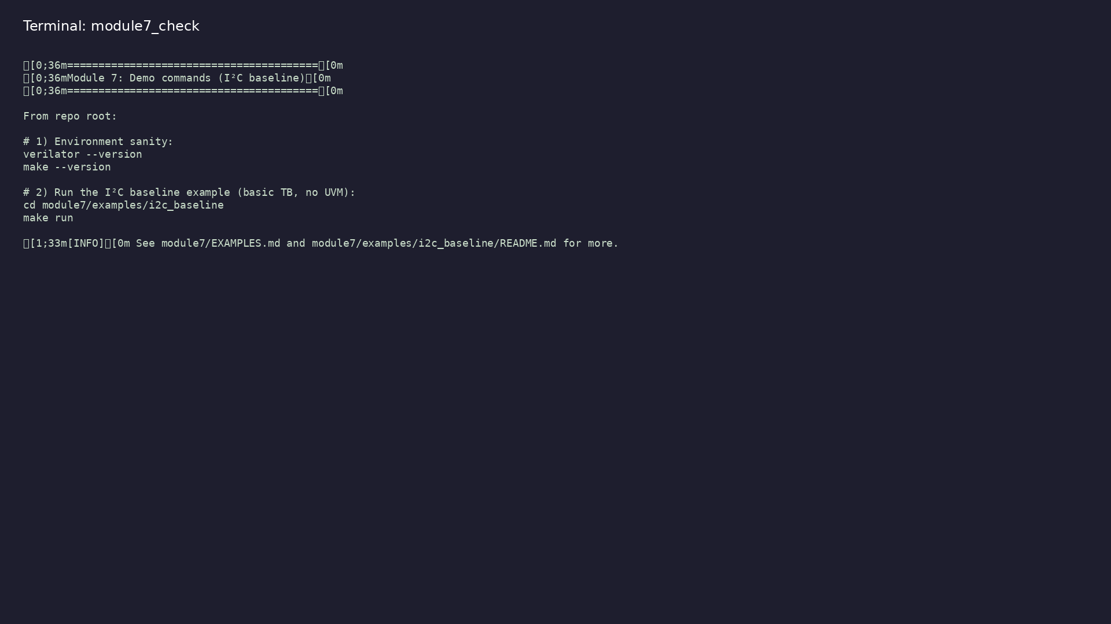
Module 7 self-check
$ ./scripts/module7.sh --help
learn_uart_spi_i2c / Module 7
Notes:
Run from course repository root.

Slide 32
Example 1: I²C baseline master
• I²C master FSM: START → address+W → data → STOP
• Inline bus monitor sampling SDA on rising SCL
• Comparing reconstructed address and data bytes to
stimulus
learn_uart_spi_i2c / Module 7
Notes:
module7/examples/i2c_baseline/README.md

Slide 33
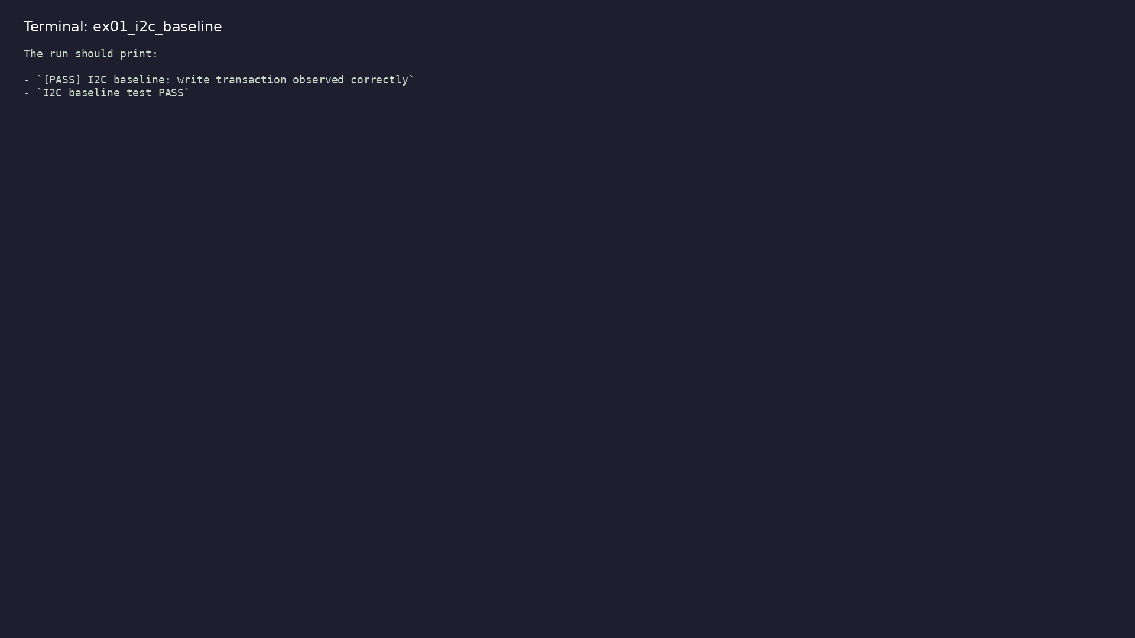
Demo: I²C baseline master
$ cd module7/examples/i2c_baseline && make run
learn_uart_spi_i2c / Module 7
Notes:
Hands-on: module7/examples/i2c_baseline/

Slide 34
Key concepts
learn_uart_spi_i2c / Module 7

Slide 35
1. Two-wire bus
• SCL + SDA; START/STOP when SCL is high; data changed
when SCL is low (simplified model).
learn_uart_spi_i2c / Module 7
Notes:
From MODULE7 Key Concepts.

Slide 36
2. Address + data phases
• 8 bits address+R/W (MSB first), then 8 bits data —
monitor both separately.
learn_uart_spi_i2c / Module 7
Notes:
From MODULE7 Key Concepts.

Slide 37
Common pitfalls
learn_uart_spi_i2c / Module 7

Slide 38
Ignoring START detection
• Mistake: Sampling bits before a valid START
condition.
• Correct: Detect SDA 1→0 while SCL high, then sample
on rising SCL.
• Why: Reconstructed bytes align to wrong frame
boundary.
learn_uart_spi_i2c / Module 7
Notes:
From MODULE7 Common Pitfalls.

Slide 39
Expecting full-spec ACK
• Mistake: Assuming teaching RTL models open-drain
ACK/NACK.
• Correct: Treat baseline as sequencing practice; ACK
comes in extensions.
• Why: Our push-pull teaching DUT simplifies the bus.
learn_uart_spi_i2c / Module 7
Notes:
From MODULE7 Common Pitfalls.

Slide 40
Practice & assessment
learn_uart_spi_i2c / Module 7

Slide 41
Exercises
• Run i2c_baseline
• Trace one transfer
• Bus monitor
• Optional: Waveforms
learn_uart_spi_i2c / Module 7

Slide 42
Assessment checklist
• Can describe I²C START, STOP, address+R/W, and data
phase (and ACK/NACK concept).
• Can explain the role of i2c_master and clk_div; know
the baseline uses push-pull (simplified).
• Can run i2c_baseline and interpret the test result.
• Ready for Module 8: I²C UVM+SV verification.
learn_uart_spi_i2c / Module 7

Slide 43
Summary & next steps
• Understand the I²C protocol (start/stop, addressing,
ACK/NACK), translate it to RTL (simple master…
• Complete module7/CHECKLIST.md
• Review module7/EXAMPLES.md and run each lab
• Next: I²C UVM+SV
learn_uart_spi_i2c / Module 7

