Slide 1
Module 8
I²C — UVM+SV Verification
learn_uart_spi_i2c / Module 8

Slide 2
Learning objectives
• I²C UVM agent: I2cTransaction, I2cSequence,
I2cDriver, I2cMonitor, I2cScoreboard.
• Interface: i2c_if (clk, rst_n, start, addr, data_in,
scl, sda, clk_div_tick, busy, done) connects U…
• How to hook up a UVM monitor and scoreboard to a
bus-oriented DUT.
learn_uart_spi_i2c / Module 8

Slide 3
Prerequisites
• Module 7 (I²C protocol + RTL + basic TB).
• Verilator, Make, C++ compiler, UVM (UVM_HOME or
vendored UVM).
learn_uart_spi_i2c / Module 8

Slide 4
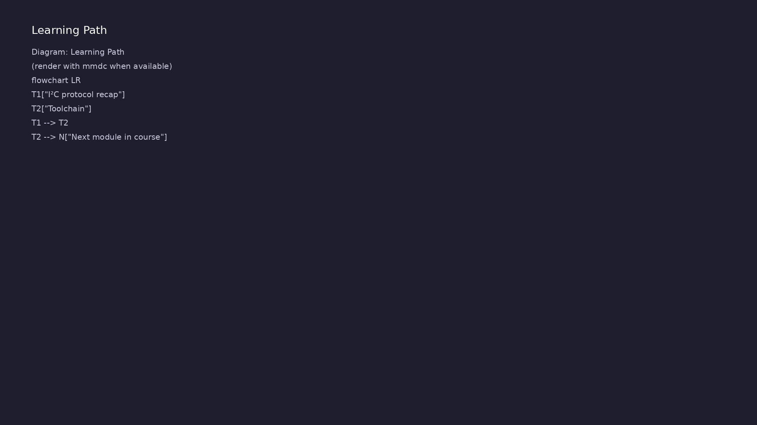
Learning path
Extend I²C verification to **UVM+SV** — I²C agent (transaction, sequence, driver, monitor, scoreboard); run on Verilator.
learn_uart_spi_i2c / Module 8

Slide 5
Overview
• Module 8 builds on Module 7 (I²C protocol + RTL +
basic testbench):
learn_uart_spi_i2c / Module 8

Slide 6
How to learn this module
learn_uart_spi_i2c / Module 8

Slide 7
Suggested learning path
• Read the detailed I²C learning guide:
I2C_LEARNING_GUIDE.md — what I²C is, how it works
(START/STOP…
• Read the protocols + UVM overview:
LEARNING_GUIDE_PROTOCOLS_AND_UVM.md — Part B § 5.
How UVM Maps t…
learn_uart_spi_i2c / Module 8
Notes:
From docs/MODULE8.md — read guides before running demos.

Slide 8
Design architecture
learn_uart_spi_i2c / Module 8

Slide 9
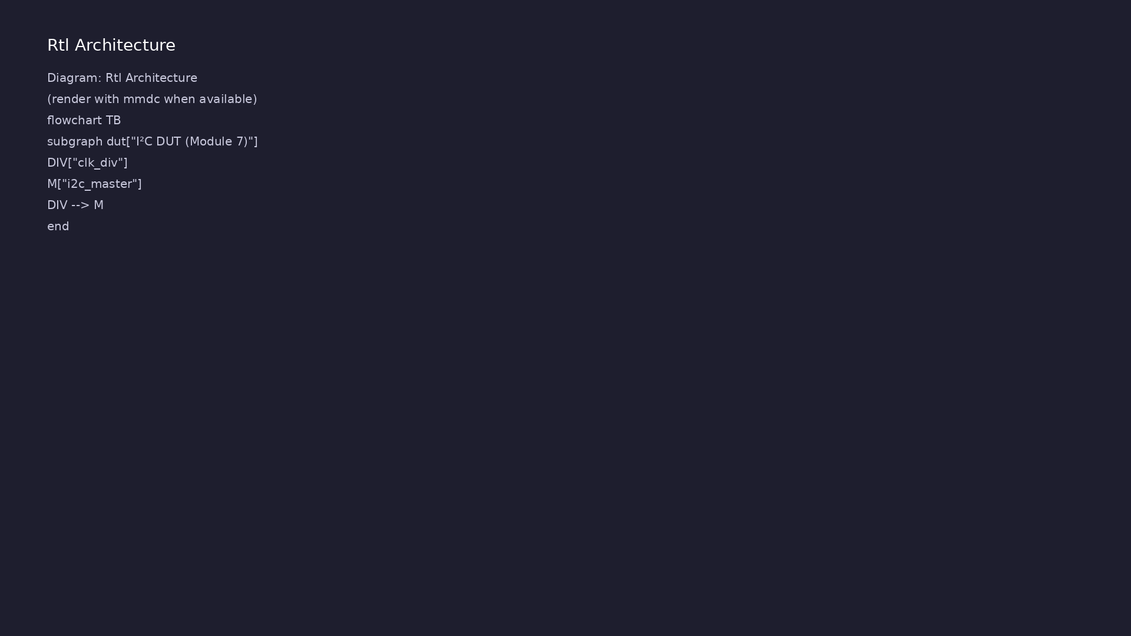
1. I²C DUT (reused from Module 7)
• i2c_master + clk_div; i2c_if for
UVM connection.
• Wire sequence: START → address+W
→ data → STOP.
learn_uart_spi_i2c / Module 8
Notes:
From MODULE8 Design Architecture.

Slide 10
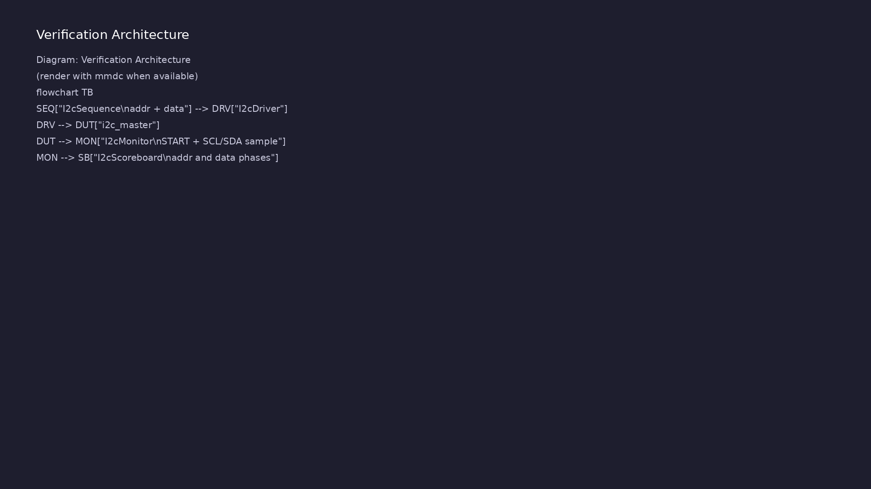
2. UVM agent
• I2cTransaction holds `addr` +
`data`; monitor fills
`observed_*`.
• I2cMonitor reimplements baseline
bus sampling inside UVM.
• I2cScoreboard checks address and
data phases independently.
learn_uart_spi_i2c / Module 8
Notes:
From MODULE8 Design Architecture.

Slide 11
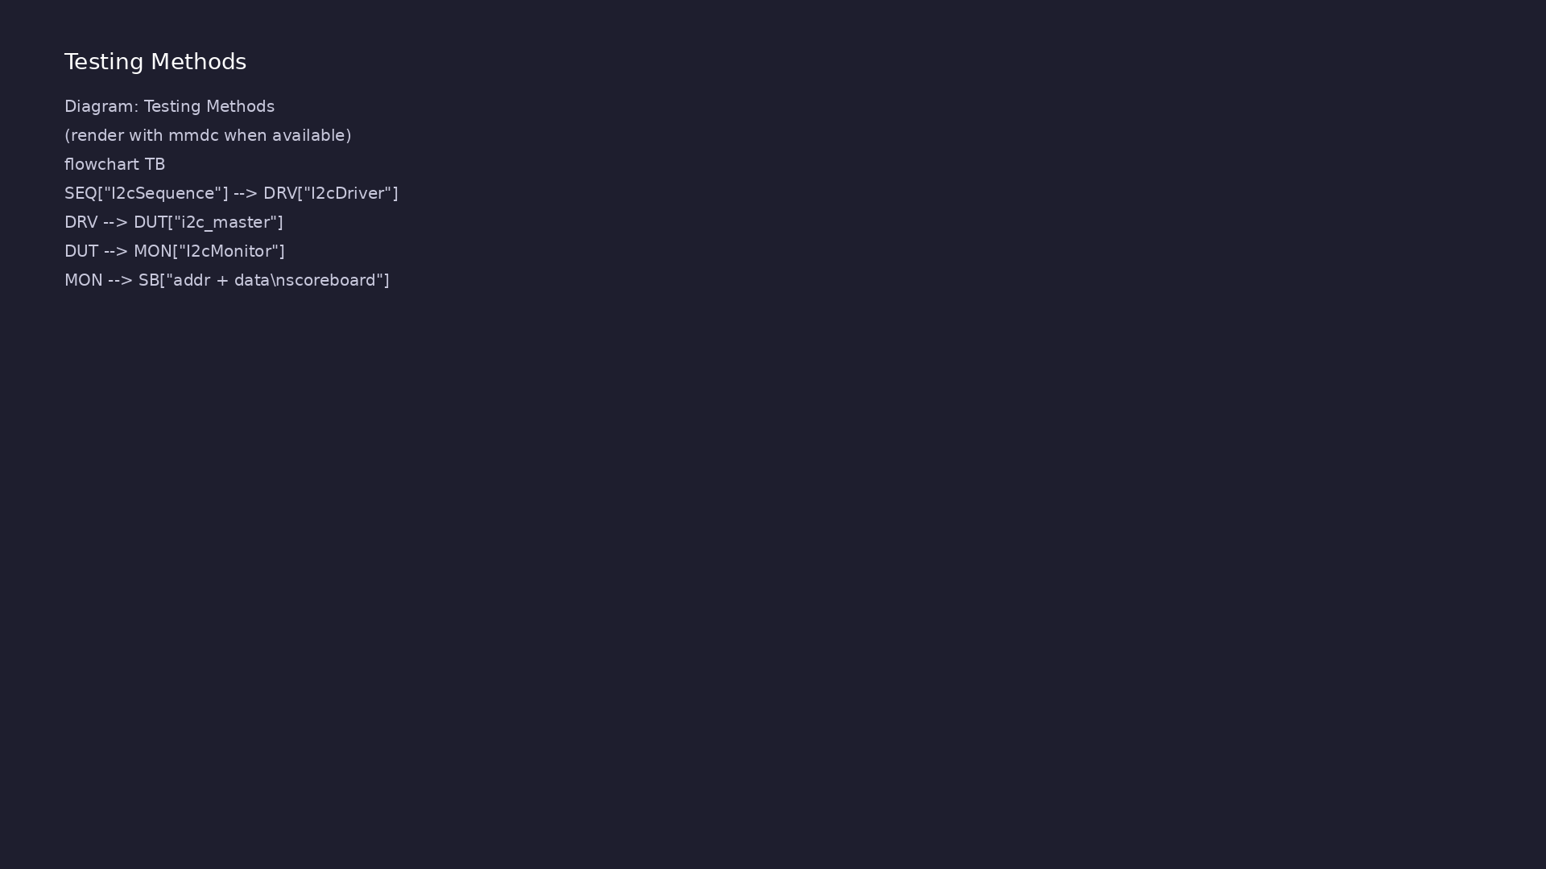
3. Course capstone
• Compare UART (async), SPI
(SCLK+CS), I²C (shared bus) —
same UVM skeleton, different
monitors.
learn_uart_spi_i2c / Module 8
Notes:
From MODULE8 Design Architecture.

Slide 12
RTL block diagram (reference)
Module 8: DUT hierarchy and signal flow.
learn_uart_spi_i2c / Module 8

Slide 13
Verification / testbench diagram (reference)
Module 8: stimulus, observation, and checking.
learn_uart_spi_i2c / Module 8

Slide 14
I2cTransaction & agent
/**
* Module 4: I2C master UVM test (simplified, single write transaction).
*
* Teaching example:
* - Simplified I2C master (no real open-drain or ACK handling).
* - UVM agent requests address+data writes and a monitor reconstructs
them
* from SDA/SCL activity under a single START/STOP frame.
*/
`include "uvm_macros.svh"
import uvm_pkg::*;
`timescale 1ns/1ps
// ---------------------------------------------------------------------
--------
// Interface
learn_uart_spi_i2c / Module 8

Slide 15
Execution & simulation flow
learn_uart_spi_i2c / Module 8

Slide 16
How the example runs (toolchain)
• Makefile: Verilator + UVM_HOME compile RTL,
interface, and test_*.sv
• UVM phases: build → connect → run_test → report
(same pattern as Module 2)
• Sequence → driver → DUT → monitor → scoreboard (read
SCOREBOARD at end)
• Typical command: make SIM=verilator TEST=test_* (see
module8 demo slide)
• Loopback / hooks connect monitor observations to
scoreboard checks
learn_uart_spi_i2c / Module 8
Notes:
From MODULE8 — execution and artifact layout.

Slide 17
Example directory layout
• dut/: i2c_master.v, clk_div.v (same as Module 7)
• test_i2c_uvm.sv: Interface, I2cTransaction,
I2cSequence, I2cDriver, I2cMonitor, I2cScoreboard,
I2cA…
learn_uart_spi_i2c / Module 8
Notes:
Match each path to files under module/examples/.

Slide 18
Makefile — UVM I2C sim
# Makefile for Module 8 I2C UVM test
#
# Usage:
# make SIM=verilator TEST=test_i2c_uvm
#
SIM ?= verilator
TEST ?= test_i2c_uvm
# Prefer externally-set UVM_HOME, but fall back to vendored UVM.
# From module8/examples/i2c_uvm, repo root is ../../..
UVM_HOME ?= \\$(shell echo \\$UVM_HOME)
UVM_HOME_FALLBACK := ../../../tools/uvm-2017/1800.2-2017-1.0
UVM_HOME_FALLBACK_ALT :=
../../../tools/learn_uvm2017_sv_verilator/tools/uvm-2017/1800.2-2017-1.0
ifeq (\\$(UVM_HOME),)
# ...
learn_uart_spi_i2c / Module 8

Slide 19
Key files to study
learn_uart_spi_i2c / Module 8

Slide 20
Open these in the repo
• `module8/examples/i2c_uvm/dut/i2c_master.v` — reused
from Module 7
• `module8/examples/i2c_uvm/test_i2c_uvm.sv` —
I2cMonitor + two-field scoreboard
• `docs/LEARNING_GUIDE_PROTOCOLS_AND_UVM.md` — § 8 I²C
UVM mapping
learn_uart_spi_i2c / Module 8
Notes:
Trace while running module8/EXAMPLES.md labs.

Slide 21
Verification & testing methods
learn_uart_spi_i2c / Module 8

Slide 22
1. Two-phase scoreboard
• Separate checks for address+W
byte and data byte — catches
shifted or merged fields.
learn_uart_spi_i2c / Module 8
Notes:
From MODULE8 Verification & Testing Methods.

Slide 23
2. Reuse baseline monitor logic
• Module 7 inline monitor → Module
8 I2cMonitor for scalable tests.
learn_uart_spi_i2c / Module 8
Notes:
From MODULE8 Verification & Testing Methods.

Slide 24
3. Extensions
• ACK/NACK, reads, multi-master —
[LEARNING_GUIDE § 8](LEARNING_GU
IDE_PROTOCOLS_AND_UVM.md#8-i2c-
uvm-…
learn_uart_spi_i2c / Module 8
Notes:
From MODULE8 Verification & Testing Methods.

Slide 25
Syllabus topics
learn_uart_spi_i2c / Module 8

Slide 26
1. I²C protocol recap
• START/STOP on SCL high; MSB-first address and data
on SDA.
learn_uart_spi_i2c / Module 8
Notes:
From MODULE8 Topics Covered.

Slide 27
2. Toolchain
• `make SIM=verilator TEST=test_i2c_uvm`;
`+UVM_TESTNAME=test_i2c_uvm`.
learn_uart_spi_i2c / Module 8
Notes:
From MODULE8 Topics Covered.

Slide 28
Hands-on examples
learn_uart_spi_i2c / Module 8

Slide 29
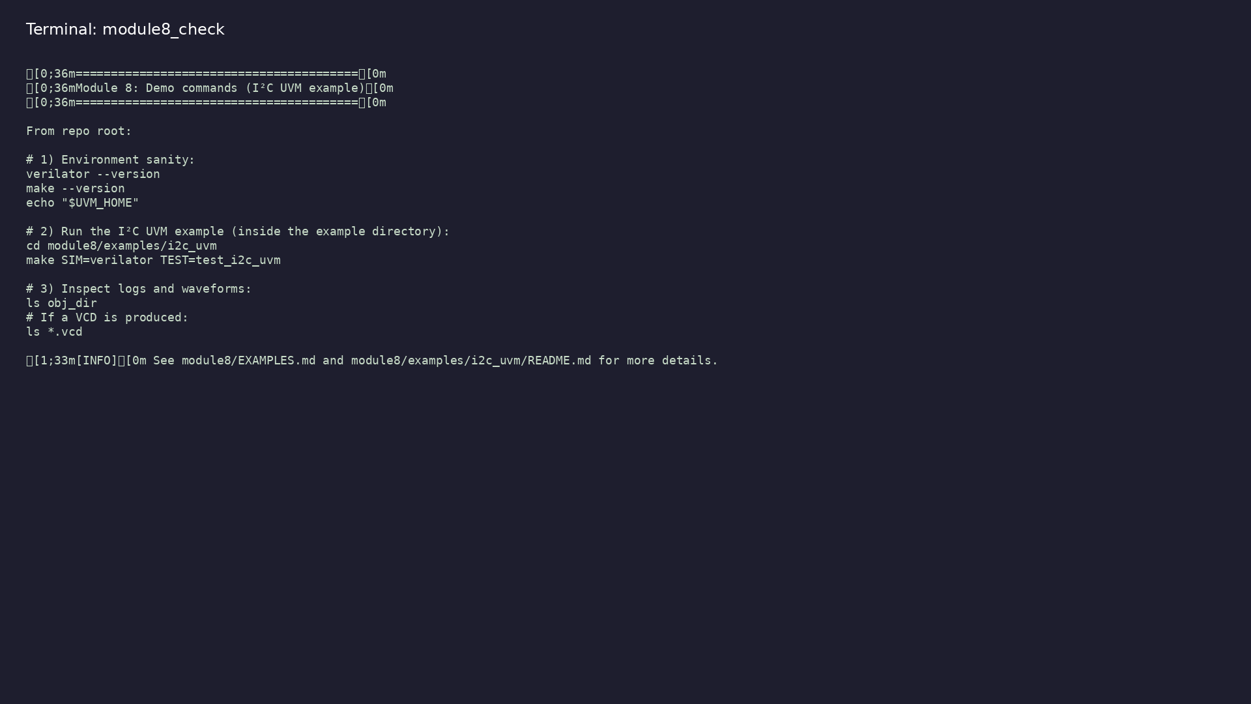
Module 8 self-check
$ ./scripts/module8.sh --help
learn_uart_spi_i2c / Module 8
Notes:
Run from course repository root.

Slide 30
Example 1: I²C UVM agent
• I²C DUT from Module 7 with UVM agent and two-phase
scoreboard (addr + data)
• `I2cMonitor` reuses baseline bus-sampling ideas in
reusable form
• Course capstone: compare UART, SPI, and I²C
verification patterns
learn_uart_spi_i2c / Module 8
Notes:
module8/examples/i2c_uvm/README.md

Slide 31
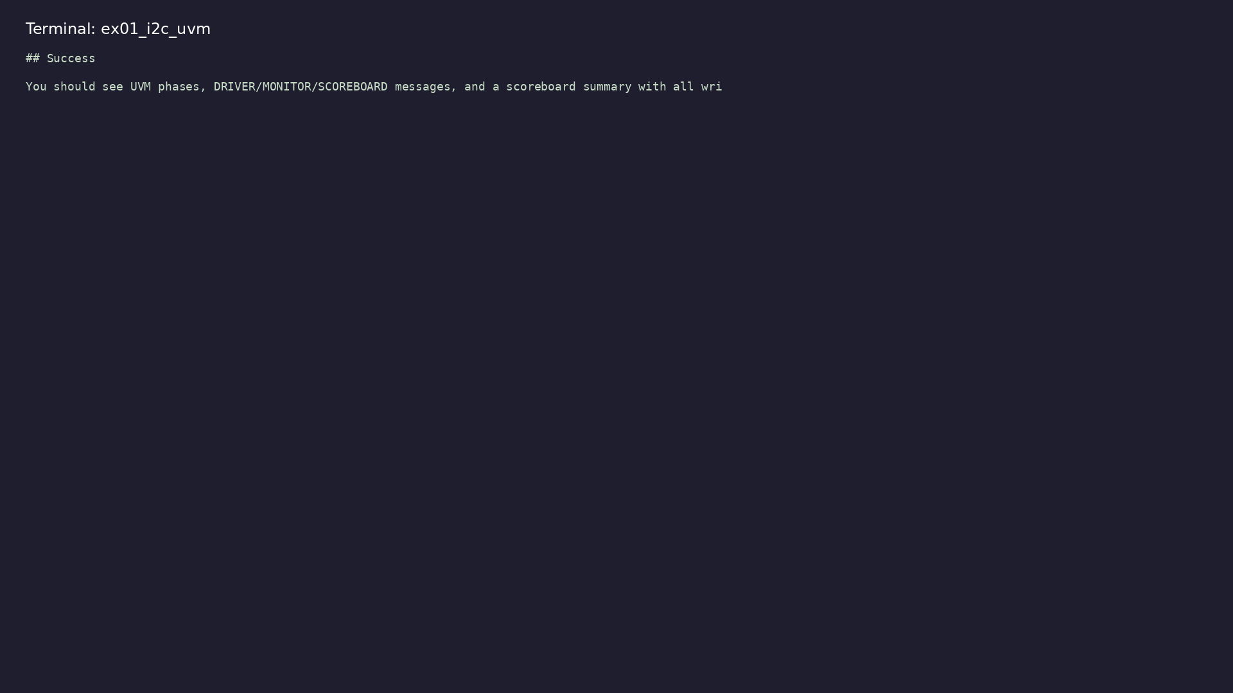
Demo: I²C UVM agent
$ cd module8/examples/i2c_uvm && make SIM=verilator TEST=test_i2c_uvm
learn_uart_spi_i2c / Module 8
Notes:
Hands-on: module8/examples/i2c_uvm/

Slide 32
Key concepts
learn_uart_spi_i2c / Module 8

Slide 33
1. Two-phase scoreboard
• Compare `observed_addr` and `observed_data`
separately from one transaction.
learn_uart_spi_i2c / Module 8
Notes:
From MODULE8 Key Concepts.

Slide 34
2. Course capstone
• Same UVM skeleton as UART/SPI; only monitor protocol
rules differ.
learn_uart_spi_i2c / Module 8
Notes:
From MODULE8 Key Concepts.

Slide 35
Common pitfalls
learn_uart_spi_i2c / Module 8

Slide 36
Merging address and data checks
• Mistake: One expected byte for the whole
transaction.
• Correct: Separate expected/observed for address+W
and data phases.
• Why: Off-by-one bit in address can hide behind a
correct data byte.
learn_uart_spi_i2c / Module 8
Notes:
From MODULE8 Common Pitfalls.

Slide 37
Skipping baseline Module 7
• Mistake: Jumping to UVM without understanding inline
bus monitor logic.
• Correct: Run i2c_baseline first; then map monitor to
I2cMonitor.
• Why: UVM monitor is the same idea in a reusable
component.
learn_uart_spi_i2c / Module 8
Notes:
From MODULE8 Common Pitfalls.

Slide 38
Practice & assessment
learn_uart_spi_i2c / Module 8

Slide 39
What you should know
• Describe the I²C UVM agent and how I2cMonitor maps
to SCL/SDA behavior.
• Explain two-phase scoreboard checking (address vs
data).
• Run `i2c_uvm` and interpret UVM / scoreboard output.
• Compare verification architecture across UART, SPI,
and I²C modules in this course.
learn_uart_spi_i2c / Module 8
Notes:
From MODULE8 Learning Outcomes.

Slide 40
Exercises
• Run i2c_uvm
• Trace one transaction
• Change the sequence
• Compare across protocols
learn_uart_spi_i2c / Module 8

Slide 41
Assessment checklist
• Can describe the I²C UVM agent and how it maps to
I²C (addr+data, monitor on SCL/SDA).
• Can run i2c_uvm and interpret UVM output.
• Can compare UVM structure across UART, SPI, and I²C.
learn_uart_spi_i2c / Module 8

Slide 42
Summary & next steps
• Extend I²C verification to **UVM+SV** — I²C agent
(transaction, sequence, driver, monitor, scoreboa…
• Complete module8/CHECKLIST.md
• Review module8/EXAMPLES.md and run each lab
• Next: Next module in course
learn_uart_spi_i2c / Module 8

