Slide 1
Virtual filesystem terminal
This module is your first real practice: moving around a directory tree and listing what is there
learn_unix — vfs terminal
Notes:
This module is your first real practice: moving around a directory tree and listing what is there. In design work you will do this constantly—open a project, find the RTL folder, peek at a testbench, then jump back. We will use the browser lab for intuition, then the same ideas on a real shell.

Slide 2
The shell has a current directory
A terminal session always has a current working directory
Print it with pwd, print working directory
Change it with cd, change directory
List what is here with ls, list
Relative paths are resolved against where you are now
learn_unix — vfs terminal
Notes:
A terminal session always has a current working directory. Print it with pwd—print working directory. Change it with cd—change directory. List what is here with ls—list. Relative paths are resolved against where you are now; that is why the same short path can succeed in one place and fail after you move.

Slide 3
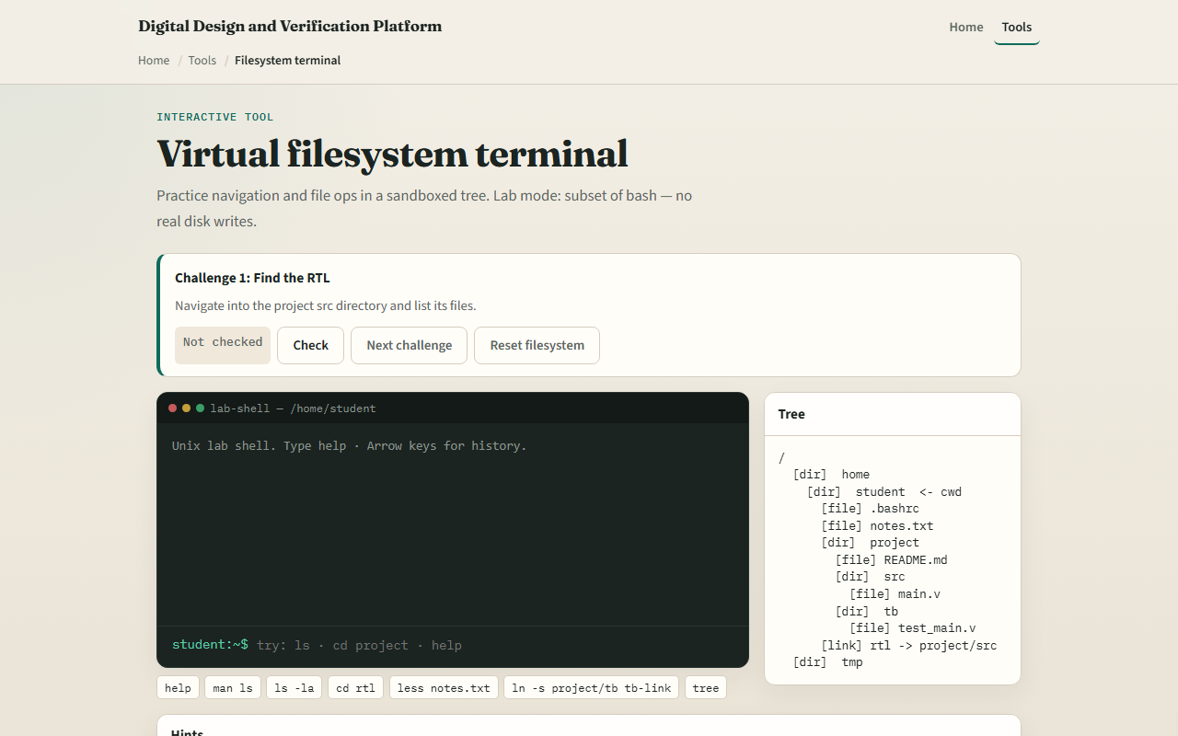
Browser lab
Virtual filesystem terminal starter
learn_unix — vfs terminal
Notes:
In the browser lab, look at three pieces: the challenge card, the sandboxed prompt, and the tree on the side. Start the first challenge: try ls to list names, or cd to change directory, then use Check when you think you are done. You do not need a full tour here—the lab itself guides the rest. Explore a few challenges, then come back for the real shell track.

Slide 4
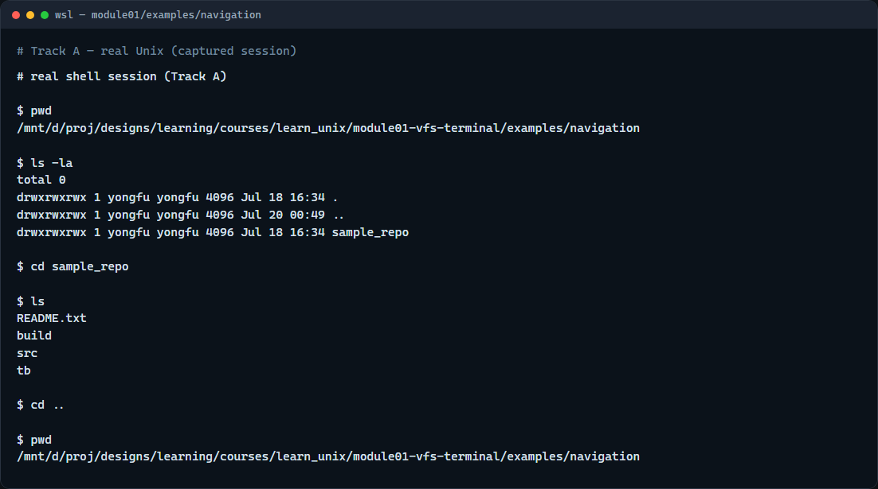
Real shell practice
Real WSL shell — navigation example
learn_unix — vfs terminal
Notes:
In the real Unix track, open this module’s navigation example in your terminal. First run pwd to print the working directory—so you know where you are. Then run ls with minus ell ay: long format, and include hidden files that start with a dot. Next, cd into sample_repo to change into that folder, run ls again for a short name list, then cd with two dots to move up one level. Those three moves—where am I, what is here, go somewhere—are the muscle you will reuse in every later module, including when you run simulators like Icarus and Verilator.

Slide 5
Real shell practice — try these
# pwd — print working directory (where am I?)
pwd
# ls -la — list all entries, long format (what is here?)
ls -la
# cd sample_repo — change into this directory
cd sample_repo
# ls — list names only
ls
# cd .. — go up one directory
cd ..
learn_unix — vfs terminal

Slide 6
Pitfalls to watch
Do not confuse a directory name with a file name when you change directories
Remember that a leading slash starts from the filesystem root
Hidden files start with a dot and may not show unless you ask for them with a flag like
And remember
learn_unix — vfs terminal
Notes:
Do not confuse a directory name with a file name when you change directories. Remember that a leading slash starts from the filesystem root, while a plain name is relative to where you are. Hidden files start with a dot and may not show unless you ask for them with a flag like minus ay. And remember: the browser lab is for literacy—scripts you keep still belong on a real shell.

Slide 7
Your turn
Complete the checklist for at least one track, preferably both
In the browser, finish a few challenges after the starter
On the real shell
When you are ready
learn_unix — vfs terminal
Notes:
Complete the checklist for at least one track—preferably both. In the browser, finish a few challenges after the starter. On the real shell, work through the navigation example, then try listing and a short peek at one of the viewing sample files. When you are ready, take the short quiz, then continue to the next module on discovering help with man and help flags.

