Slide 1
Process list & signals
When a build or simulation hangs, you need to see what is running and how to stop it
learn_unix — ps kill lab
Notes:
When a build or simulation hangs, you need to see what is running and how to stop it. Every running program is a process with an ID. You list processes, send signals to ask them to exit, and read exit status to know whether a command succeeded. This module makes those habits concrete.

Slide 2
PID, exit status, and signals
A process ID uniquely names a running program
When a command finishes, it leaves an exit status, zero usually means success
Signals are how you interrupt or stop a process
Background jobs need kill with a PID, Control-C alone will not stop them
learn_unix — ps kill lab
Notes:
A process ID uniquely names a running program. When a command finishes, it leaves an exit status—zero usually means success; anything else means failure. Signals are how you interrupt or stop a process: interrupt is what Control-C sends in the foreground; terminate asks politely; kill nine is the last resort that cannot be caught. Background jobs need kill with a PID—Control-C alone will not stop them.

Slide 3
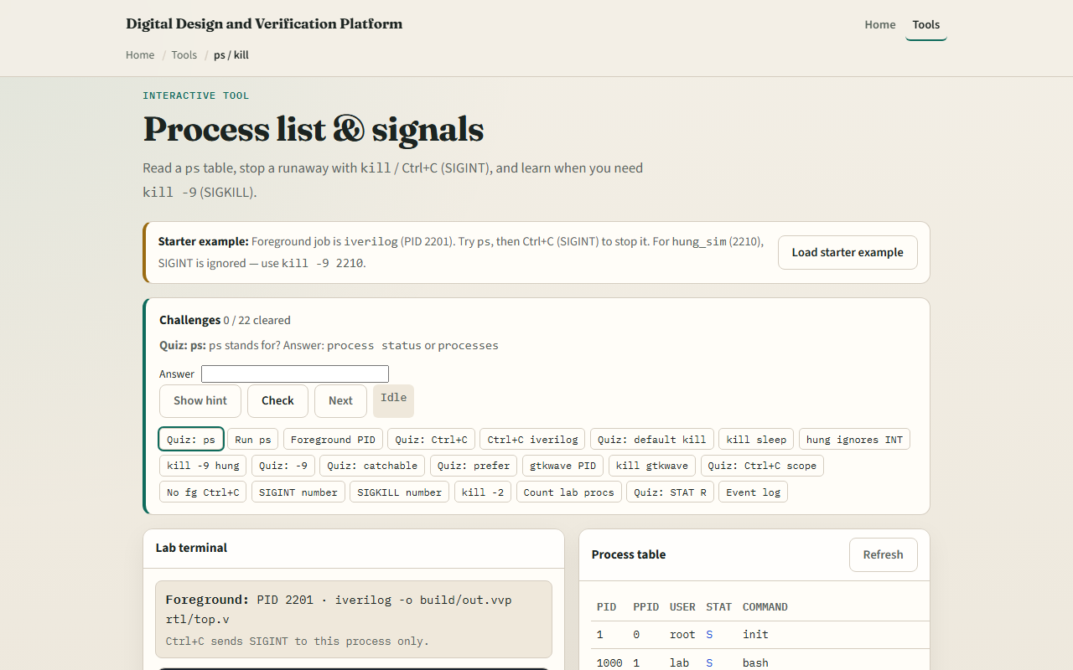
Browser lab
Process list and signals lab
learn_unix — ps kill lab
Notes:
In the browser lab, load the starter example. List the fake process table. Try Control-C on a catchable job, then use kill nine on the hung simulation that ignores interrupt. Orient yourself with the process list and the signal cards, try a few challenges, then practice on a real shell.

Slide 4
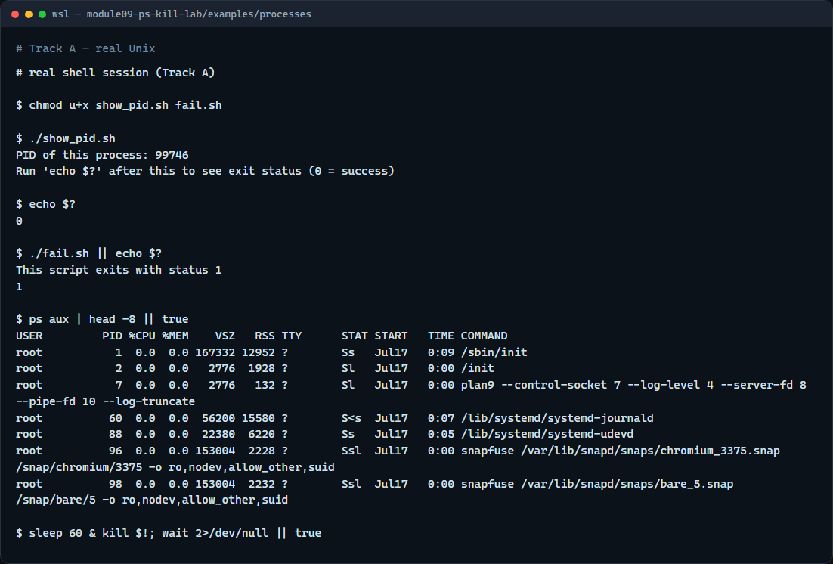
Real shell practice
Real shell — processes and signals
learn_unix — ps kill lab
Notes:
In the real Unix track, open this module’s processes example. Make the scripts executable if needed. Run the show-PID script and print the exit status—you should see success. Run the fail script and print the status again—you should see failure. List a few system processes with ps. Start a short sleep in the background, note its PID, then kill it so you practice stopping a background job safely.

Slide 5
Real shell practice — try these
# chmod u+x … — ensure the demo scripts are executable
chmod u+x show_pid.sh fail.sh
# ./show_pid.sh — run a script that prints its PID and exits
successfully
./show_pid.sh
# echo $? — print the last exit status (0 = success)
echo $?
# ./fail.sh — run a script that exits with status 1
./fail.sh
# echo $? — confirm a non-zero failure status
echo $?
# ps aux | head -8 — list a few processes (USER, PID, COMMAND, …)
ps aux | head -8
# sleep 60 & — start a background job; kill it by PID (safe practice)
sleep 60 &
kill $!
learn_unix — ps kill lab

Slide 6
Pitfalls to watch
Do not kill processes you do not own or understand
Prefer terminate, then escalate only if needed
Remember that Control-C stops the foreground job, not an arbitrary background PID
And remember
learn_unix — ps kill lab
Notes:
Do not kill processes you do not own or understand—especially not with kill nine as a first move. Prefer terminate, then escalate only if needed. Remember that Control-C stops the foreground job, not an arbitrary background PID. And remember: the browser lab shows the idea; stuck simulators and builds still need real ps and kill on a real shell.

Slide 7
Your turn
Complete the checklist for at least one track, preferably both
In the browser, finish a few challenges after the starter
On the real shell, practice exit status, listing processes
When you are ready, take the short quiz, then continue to job control
learn_unix — ps kill lab
Notes:
Complete the checklist for at least one track—preferably both. In the browser, finish a few challenges after the starter. On the real shell, practice exit status, listing processes, and killing a background sleep you started yourself. When you are ready, take the short quiz, then continue to job control.

