Slide 1
Job control
Long builds and simulations should not lock your terminal forever
learn_unix — job control lab
Notes:
Long builds and simulations should not lock your terminal forever. Job control lets you start work in the background, list what this shell is running, suspend with Control-Z, and bring a job back with foreground or background. This module connects ampersand, jobs, fg, and bg to habits you will use on real projects.

Slide 2
Background, stop, and resume
An ampersand at the end of a command starts it in the background, you get the prompt back
Jobs lists this shell’s jobs
Control-Z suspends the foreground job; it is stopped, not killed
Bg resumes a stopped job in the background
Redirect output to a log, then tail the log while the job runs
learn_unix — job control lab
Notes:
An ampersand at the end of a command starts it in the background—you get the prompt back. jobs lists this shell’s jobs. Control-Z suspends the foreground job; it is stopped, not killed. bg resumes a stopped job in the background; fg brings a job to the foreground so you can interact or interrupt with Control-C. Redirect output to a log, then tail the log while the job runs.

Slide 3
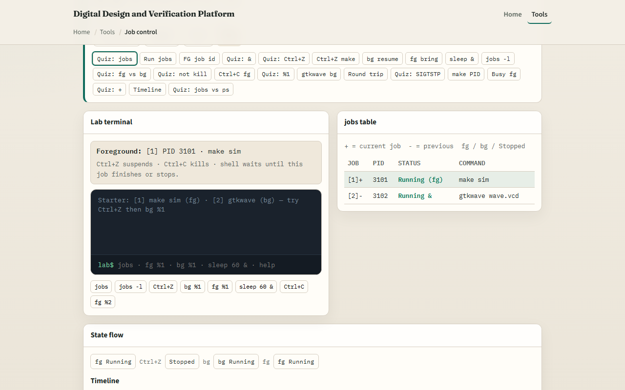
Browser lab
Job control lab
learn_unix — job control lab
Notes:
In the browser lab, load the starter example. Watch the jobs table and the foreground banner. Try Control-Z on a running foreground job, then bg or fg. Start something with ampersand and list jobs. Orient yourself with the state diagram, try a few challenges, then practice on a real shell.

Slide 4
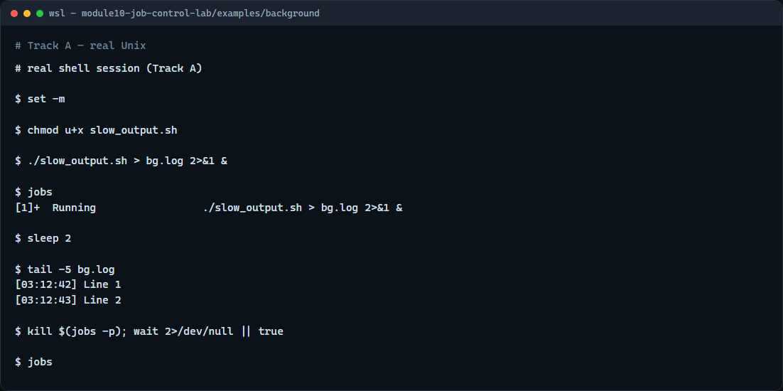
Real shell practice
Real shell — job control
learn_unix — job control lab
Notes:
In the real Unix track, open this module’s background example. Make the slow script executable. Start it in the background with output redirected to a log. List jobs so you see the job number and PID. Wait a moment, then show the last lines of the log. Stop the background job when you are done practicing. You will reuse this pattern for long sims and builds.

Slide 5
Real shell practice — try these
# chmod u+x slow_output.sh — make the demo script executable
chmod u+x slow_output.sh
# ./slow_output.sh > bg.log 2>&1 & — run in background; stdout/stderr to
a log
./slow_output.sh > bg.log 2>&1 &
# jobs — list this shell’s background jobs
jobs
# sleep 2 — give the script a moment to write lines
sleep 2
# tail -5 bg.log — show the latest log lines while the job runs
tail -5 bg.log
# kill %1 — stop job 1 (or: kill $(jobs -p))
kill %1
learn_unix — job control lab

Slide 6
Pitfalls to watch
Control-Z stops
Jobs only lists jobs for this shell, not every process on the machine
Closing the terminal can hang or kill background jobs unless you plan for that
And remember
learn_unix — job control lab
Notes:
Control-Z stops; it does not terminate—use Control-C or kill when you want the process gone. jobs only lists jobs for this shell, not every process on the machine. Closing the terminal can hang or kill background jobs unless you plan for that. And remember: the browser lab shows the idea; real sims still need background jobs and logs on a real shell.

Slide 7
Your turn
Complete the checklist for at least one track, preferably both
In the browser, finish a few challenges after the starter
On the real shell, practice ampersand, jobs, and tailing a log
When you are ready, take the short quiz, then continue to pipes, redirection, and xargs
learn_unix — job control lab
Notes:
Complete the checklist for at least one track—preferably both. In the browser, finish a few challenges after the starter. On the real shell, practice ampersand, jobs, and tailing a log. When you are ready, take the short quiz, then continue to pipes, redirection, and xargs.

