Slide 1
Exit status and conditional chaining
Every command leaves an exit status
learn_unix — exit status lab
Notes:
Every command leaves an exit status. Zero means success; anything else means failure. Scripts set that with exit. You read the last status with dollar-question-mark—check it right away before the next command overwrites it. Double ampersand runs the next command only on success; double pipe runs the next only on failure. This module makes those conventions feel automatic.

Slide 2
Zero, non-zero, and short-circuit
Exit zero is the success convention Make, CI, and other scripts rely on
Non-zero signals an error, often one for a generic fail, two for bad usage
Dollar-question-mark is the last command’s code
True and false are tiny commands that exit zero or one so you can practice chaining
Prefer if for real branches
learn_unix — exit status lab
Notes:
Exit zero is the success convention Make, CI, and other scripts rely on. Non-zero signals an error—often one for a generic fail, two for bad usage. Dollar-question-mark is the last command’s code. True and false are tiny commands that exit zero or one so you can practice chaining. Prefer if for real branches; remember that mixing ampersand-ampersand with pipe-pipe on one line is not a clean if-else.

Slide 3
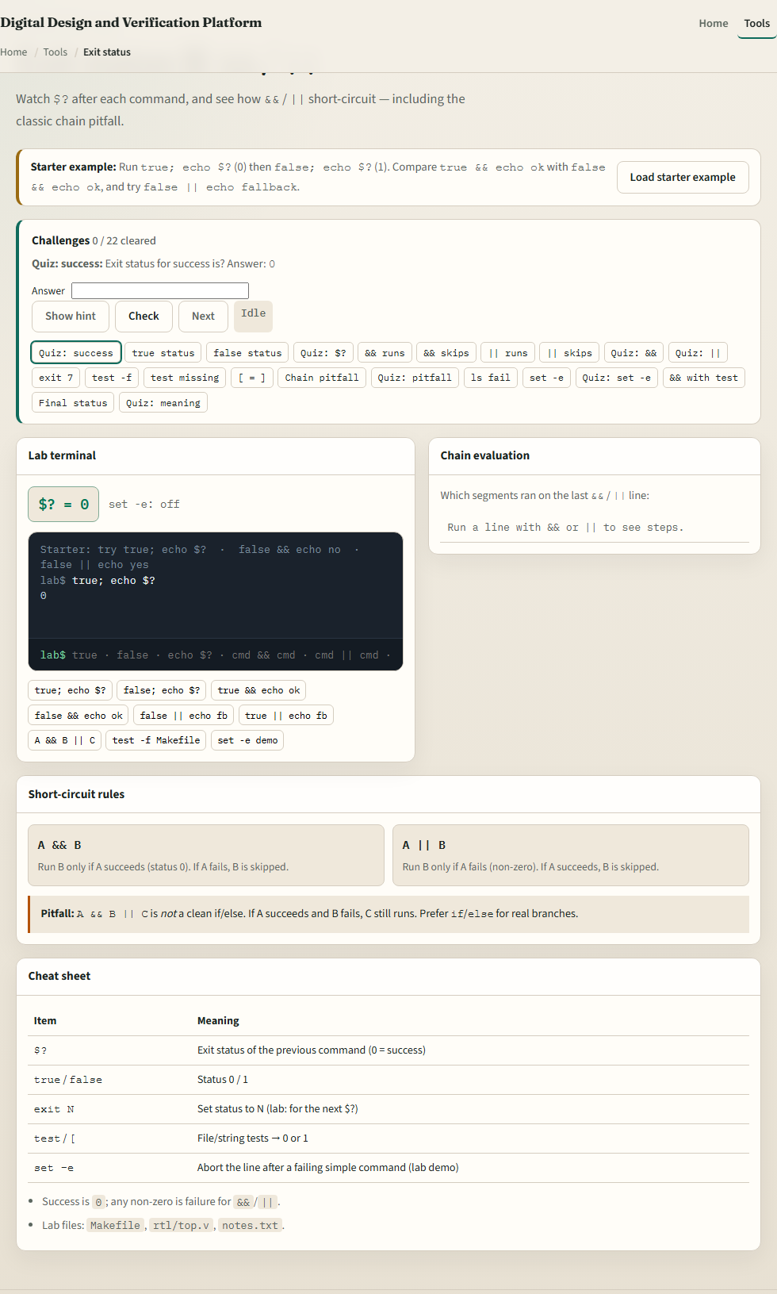
Browser lab
Exit status lab
learn_unix — exit status lab
Notes:
In the browser lab, load the starter example. Run true and print the status, try false with double ampersand so the echo is skipped, then false with double pipe so a fallback runs. Orient yourself with the terminal, the chain trace, and the and-versus-or cards, try a few challenges, then practice on a real shell.

Slide 4
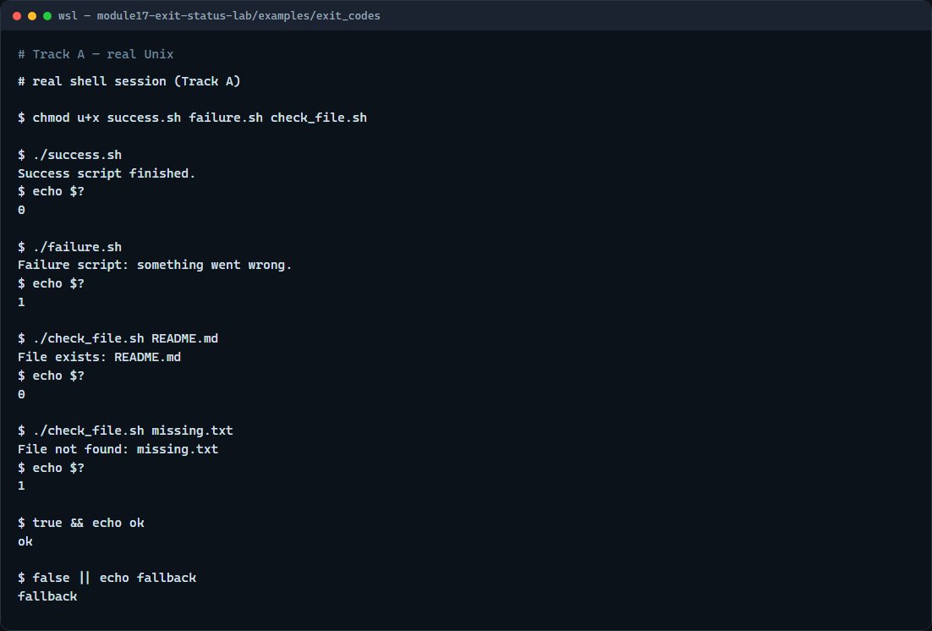
Real shell practice
Real shell — exit codes
learn_unix — exit status lab
Notes:
In the real Unix track, open this module’s exit-codes example. Make the three scripts executable. Run the success script and print dollar-question-mark—you should see zero. Run the failure script and print the status—you should see one. Check a file that exists, then a missing path, and watch the status flip. Finish with true double-ampersand echo, and false double-pipe echo, to feel short-circuit chaining. You will reuse this whenever a build step must stop or fall back.

Slide 5
Real shell practice — try these
# chmod u+x … — make the demo scripts executable
chmod u+x success.sh failure.sh check_file.sh
# ./success.sh — script exits 0 (success)
./success.sh
# echo $? — print exit status of the last command (expect 0)
echo $?
# ./failure.sh — script exits 1 (failure); status still printable after
./failure.sh
echo $?
# ./check_file.sh README.md — exit 0 if the file exists
./check_file.sh README.md
echo $?
# ./check_file.sh missing.txt — exit 1 when the file is absent
./check_file.sh missing.txt
# ...
learn_unix — exit status lab

Slide 6
Pitfalls to watch
Check dollar-question-mark immediately, any command, even echo, replaces it
Do not treat ampersand-ampersand pipe-pipe as a full if-else
And remember
learn_unix — exit status lab
Notes:
Check dollar-question-mark immediately—any command, even echo, replaces it. Do not treat ampersand-ampersand pipe-pipe as a full if-else. And remember: the browser lab shows the idea; real scripts and Make still key off exit status on a real shell.

Slide 7
Your turn
Complete the checklist for at least one track, preferably both
In the browser, finish a few challenges after the starter
On the real shell
When you are ready, take the short quiz, then continue to safe scripting
learn_unix — exit status lab
Notes:
Complete the checklist for at least one track—preferably both. In the browser, finish a few challenges after the starter. On the real shell, run success and failure scripts and practice double ampersand and double pipe. When you are ready, take the short quiz, then continue to safe scripting.

