Slide 1
Project layout, archives, sed and diff
A design project needs a clear tree, source, testbench, docs, scripts, and a build folder for generated noise
learn_unix — project archives
Notes:
A design project needs a clear tree—source, testbench, docs, scripts, and a build folder for generated noise. Archives should pack the useful files and skip build and logs. Sed does quick stream edits; diff shows what changed so you can review or make a patch. This module ties layout, search, and text tools together before the next module compares tar and zip in depth.

Slide 2
Tree, search, edit, compare
Keep RTL under src, tests under tb, notes under docs, helpers under scripts
Find locates files by name; recursive grep finds a signal across the tree
Sed substitutes on a stream, test without in-place first
Unified diff is the same shape as git diff and feeds patch
When you archive, ignore build and logs so the tarball stays small and shareable
learn_unix — project archives
Notes:
Keep RTL under src, tests under tb, notes under docs, helpers under scripts, and generated output under build. Find locates files by name; recursive grep finds a signal across the tree. Sed substitutes on a stream—test without in-place first. Unified diff is the same shape as git diff and feeds patch. When you archive, ignore build and logs so the tarball stays small and shareable.

Slide 3
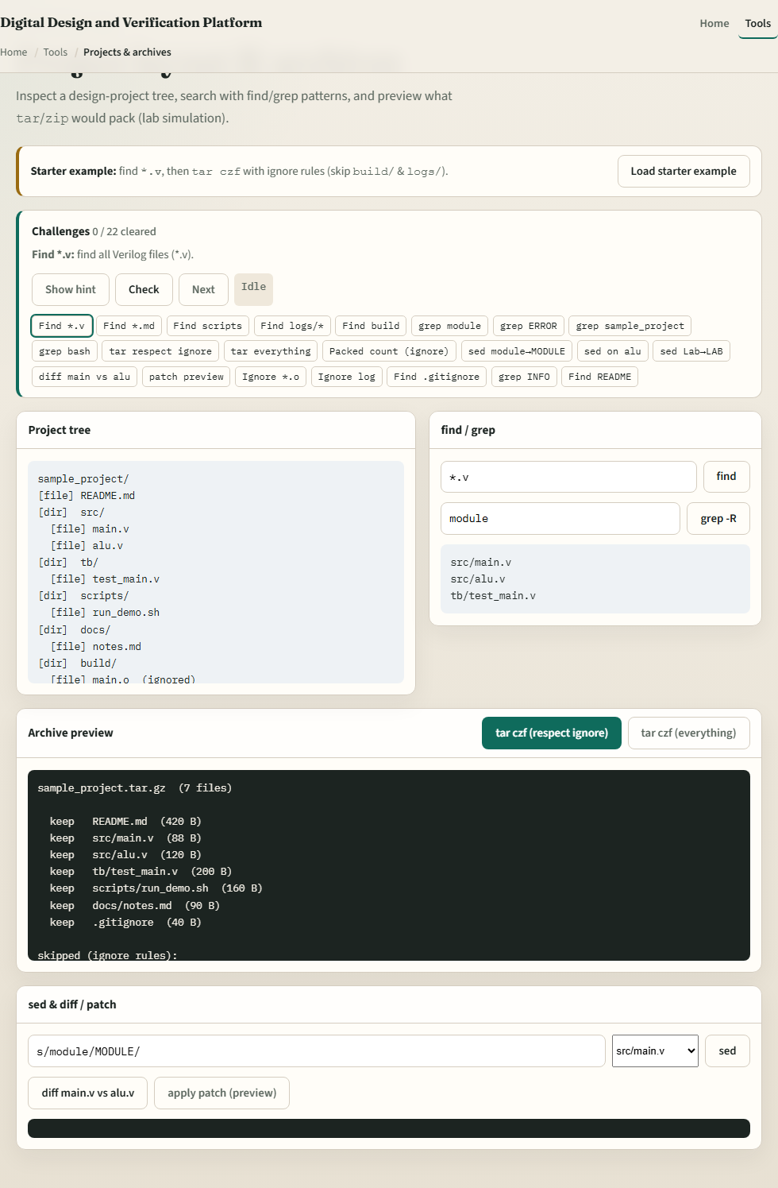
Browser lab
Project archives lab
learn_unix — project archives
Notes:
In the browser lab, load the starter example. Find Verilog files, then pack with tar while respecting ignore rules so build and logs are skipped. Try a sed substitution and a diff between two modules. Orient yourself with the project tree, the archive buttons, and the sed-diff panel, then practice on a real shell.

Slide 4
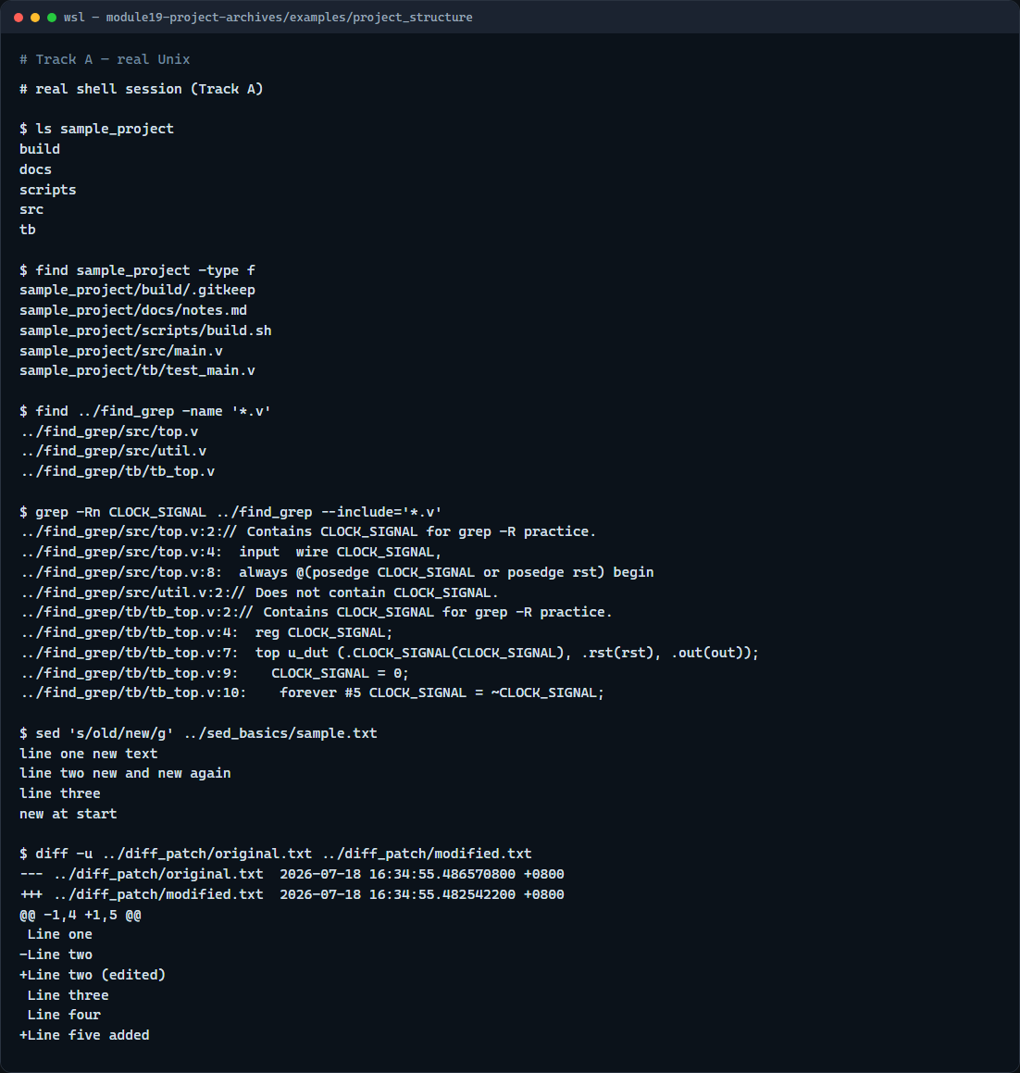
Real shell practice
Real shell — layout find sed diff
learn_unix — project archives
Notes:
In the real Unix track, open the sample project and list its folders, then find every file in the tree. In the find-grep example, list Verilog files and search recursively for a clock signal name. In sed basics, substitute old with new globally on the sample text. Finish with a unified diff between original and modified. You will reuse this loop—navigate, search, edit, compare—on every chip project.

Slide 5
Real shell practice — try these
# ls / find — inspect sample_project layout
ls sample_project
find sample_project -type f
# find *.v — Verilog files under find_grep
find ../find_grep -name '*.v'
# grep -Rn — recursive content search with line numbers (Verilog only
here)
grep -Rn CLOCK_SIGNAL ../find_grep --include='*.v'
# sed 's/old/new/g' — global substitute (stdout only; file unchanged)
sed 's/old/new/g' ../sed_basics/sample.txt
# diff -u — unified diff (patch-friendly)
diff -u ../diff_patch/original.txt ../diff_patch/modified.txt
learn_unix — project archives

Slide 6
Pitfalls to watch
Do not archive build and logs by default, they bloat shares and hide the real sources
Always dry-run sed without in-place before you rewrite a file
And remember
learn_unix — project archives
Notes:
Do not archive build and logs by default—they bloat shares and hide the real sources. Always dry-run sed without in-place before you rewrite a file. And remember: the browser lab shows the idea; lasting project hygiene still lives on a real filesystem.

Slide 7
Your turn
Complete the checklist for at least one track, preferably both
In the browser, finish a few challenges after the starter
On the real shell, walk the sample project, practice find and grep, then sed and diff
When you are ready, take the short quiz, then continue to tar versus zip
learn_unix — project archives
Notes:
Complete the checklist for at least one track—preferably both. In the browser, finish a few challenges after the starter. On the real shell, walk the sample project, practice find and grep, then sed and diff. When you are ready, take the short quiz, then continue to tar versus zip.

