Slide 1
Backup and clean-build
Build folders and logs grow fast, waveforms, object files, run logs
learn_unix — backup clean
Notes:
Build folders and logs grow fast—waveforms, object files, run logs. Before you wipe them, take a timestamped backup of the sources you care about. Then list what a clean would remove, and only then delete. This module is the backup-first, clean-second habit for every chip project tree.

Slide 2
Timestamp, exclude, then clean
Name archives with a date stamp so versions do not overwrite each other
Exclude build and logs from the backup when you only need sources, docs, and scripts
For clean: list files under build and logs first
Align exclude patterns with your ignore file so archives and Git stay consistent
learn_unix — backup clean
Notes:
Name archives with a date stamp so versions do not overwrite each other. Exclude build and logs from the backup when you only need sources, docs, and scripts. For clean: list files under build and logs first, then remove—never start with a blind recursive delete. Align exclude patterns with your ignore file so archives and Git stay consistent.

Slide 3
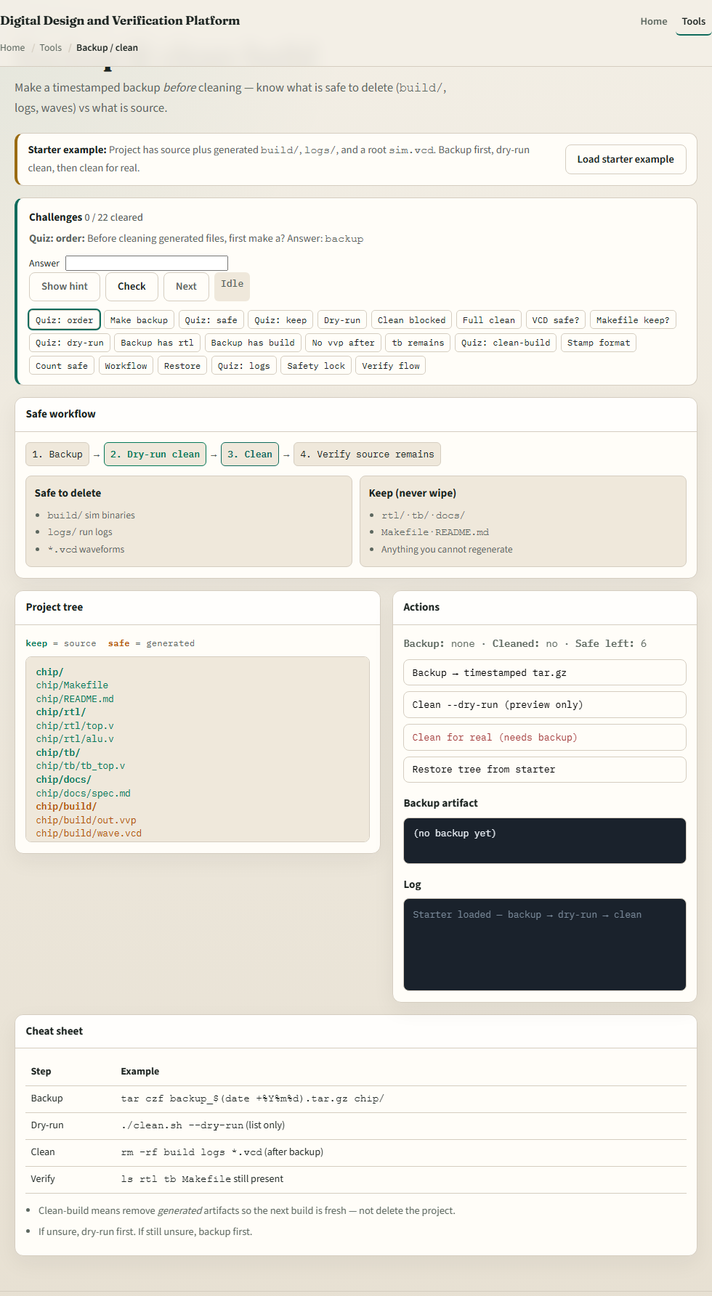
Browser lab
Backup and clean lab
learn_unix — backup clean
Notes:
In the browser lab, load the starter example. Follow the steps: backup to a timestamped tar, dry-run clean, then clean for real—the lab refuses clean until you back up. Orient yourself with the step strip, the project tree, and the action buttons, try a few challenges, then practice on a real shell.

Slide 4
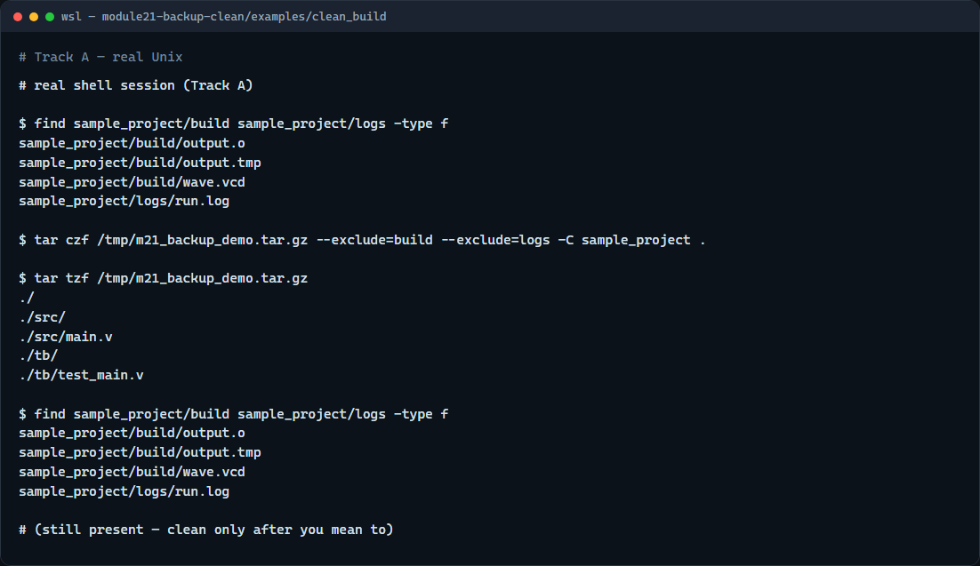
Real shell practice
Real shell — backup then list clean targets
learn_unix — backup clean
Notes:
In the real Unix track, open the clean-build sample project. List the generated files under build and logs. Create a timestamped tar of the project while excluding those generated dirs, then list the archive. Run find again as a dry-run of what a clean would remove—only run the clean script when you mean to empty those folders. You will reuse backup-then-clean before every big rebuild or share.

Slide 5
Real shell practice — try these
# find … -type f — list generated files under build/ and logs/
find sample_project/build sample_project/logs -type f
# tar czf backup_….tar.gz — timestamped archive excluding build and logs
tar czf /tmp/m21_backup_demo.tar.gz \
--exclude='build' --exclude='logs' \
-C sample_project .
# tar tzf … — list what was backed up (no build/logs)
tar tzf /tmp/m21_backup_demo.tar.gz
# find again — dry-run view of clean targets (do not delete yet)
find sample_project/build sample_project/logs -type f
# ./clean.sh — only when ready: delete files in build/ and logs/
# chmod u+x clean.sh && ./clean.sh
learn_unix — backup clean

Slide 6
Pitfalls to watch
Never clean before you have a backup you can restore
Do not run recursive delete on a path you have not listed
And remember
learn_unix — backup clean
Notes:
Never clean before you have a backup you can restore. Do not run recursive delete on a path you have not listed. And remember: the browser lab shows the idea; lasting project hygiene still means real archives and careful cleans on a real shell.

Slide 7
Your turn
Complete the checklist for at least one track, preferably both
In the browser, finish the backup → dry-run → clean flow
On the real shell, make a timestamped archive and list clean targets before you delete
When you are ready, take the short quiz, then continue to relative symlink pitfalls
learn_unix — backup clean
Notes:
Complete the checklist for at least one track—preferably both. In the browser, finish the backup → dry-run → clean flow. On the real shell, make a timestamped archive and list clean targets before you delete. When you are ready, take the short quiz, then continue to relative symlink pitfalls.

