Slide 1
Dry-run mindset
Before a clean deletes build junk, preview what would change
learn_unix — dry run lab
Notes:
Before a clean deletes build junk, preview what would change. Dry-run—Make’s dash-n, script flags like dry-run, or echo-first—lets you read the list, then run live only when it looks right. This module builds that habit for Make, rm, and cleanup scripts.

Slide 2
Preview, read, then live
Prefer preview first
Read every path on the list
Live run only after the list matches what you meant to remove
Echo-first is the same idea, print the command before you paste the real one
learn_unix — dry run lab
Notes:
Prefer preview first: make dash-n clean, git clean with dry flags, or a script’s dry-run switch. Read every path on the list. Live run only after the list matches what you meant to remove. Echo-first is the same idea—print the command before you paste the real one.

Slide 3
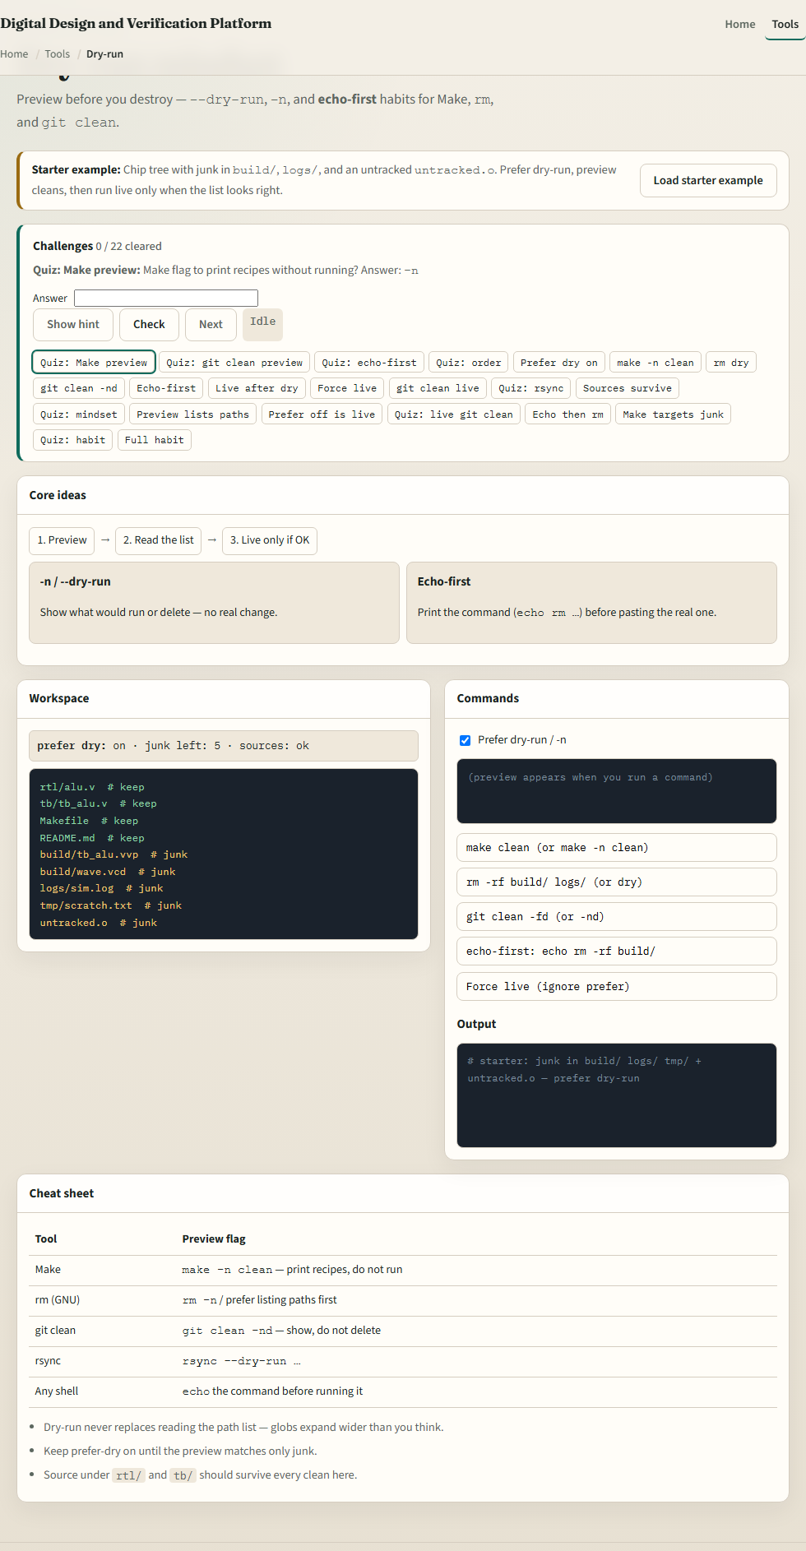
Browser lab
Dry-run lab
learn_unix — dry run lab
Notes:
In the browser lab, load the starter example. You will see a chip tree with junk in build and logs, dry versus live buttons, and a preview list. Prefer dry-run, scan the targets, then try a live clean only when the list looks right. Orient yourself with the habit flow and the challenge strip, then practice on a real shell.

Slide 4
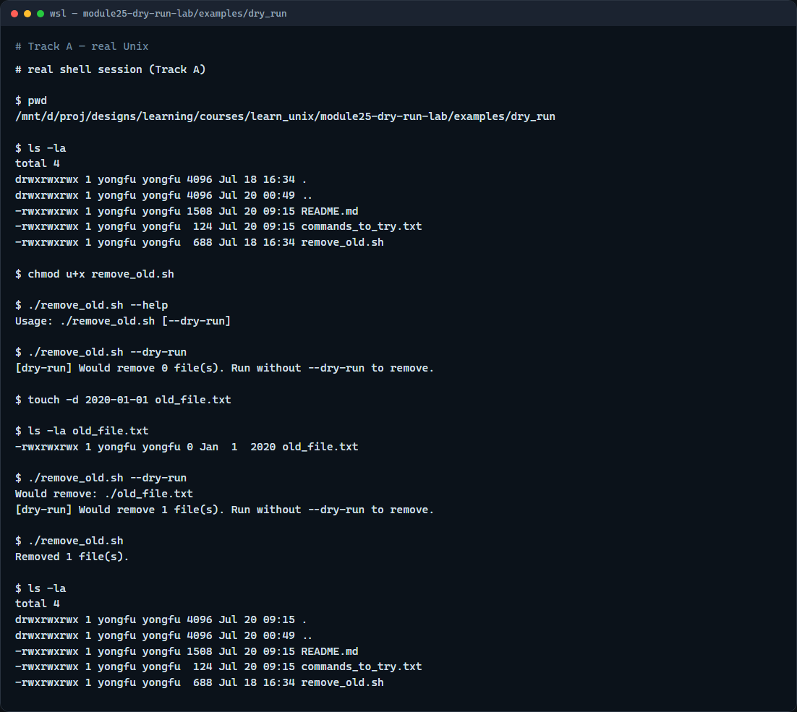
Real shell practice
Real shell — dry-run remove
learn_unix — dry run lab
Notes:
In the real Unix track, open this module’s dry-run example. Make the remove script executable and ask for help. Run dry-run first—it may report zero files. Create an intentionally old file, dry-run again to see would-remove lines, then run without the flag to delete for real and list the directory. You will reuse dry-run-first whenever a script deletes or overwrites.

Slide 5
Real shell practice — try these
# pwd — print working directory (where am I?)
pwd
# ls -la — list all entries, long format (what is here?)
ls -la
# chmod u+x remove_old.sh — make the cleanup script executable
chmod u+x remove_old.sh
# ./remove_old.sh --help — show usage (dry-run flag)
./remove_old.sh --help
# ./remove_old.sh --dry-run — preview only; no deletes yet
./remove_old.sh --dry-run
# touch -d 2020-01-01 old_file.txt — create a file older than 365 days
touch -d 2020-01-01 old_file.txt
# ls -la old_file.txt — confirm the stamped file exists
ls -la old_file.txt
# ./remove_old.sh --dry-run — preview would-remove for the old file
# ...
learn_unix — dry run lab

Slide 6
Pitfalls to watch
Do not run a live clean because dry-run felt slow
Do not ignore paths you do not recognize on the preview list
And remember
learn_unix — dry run lab
Notes:
Do not run a live clean because dry-run felt slow. Do not ignore paths you do not recognize on the preview list. And remember: the browser lab trains the habit; lasting safety means dry-run on a real shell before deletes.

Slide 7
Your turn
Complete the checklist for at least one track, preferably both
In the browser, clear a few challenges after the starter
On the real shell, dry-run the remove script, then live-run only when the list looks right
When you are ready, take the short quiz, then continue to log and failure triage
learn_unix — dry run lab
Notes:
Complete the checklist for at least one track—preferably both. In the browser, clear a few challenges after the starter. On the real shell, dry-run the remove script, then live-run only when the list looks right. When you are ready, take the short quiz, then continue to log and failure triage.

