Slide 1
Module 1
Linux & Shell Basics
learn_unix_git / Module 1

Slide 2
Learning objectives
• Open a terminal and identify your working directory
• Navigate with cd, pwd, and ls
• Create, copy, move, and delete files safely
• View text with cat, less, head, and tail
• Use man and --help to explore commands
learn_unix_git / Module 1

Slide 3
Prerequisites
• Unix-like environment (Linux, macOS, or WSL2)
• Ability to open a terminal and type commands
• No prior shell experience required
learn_unix_git / Module 1

Slide 4
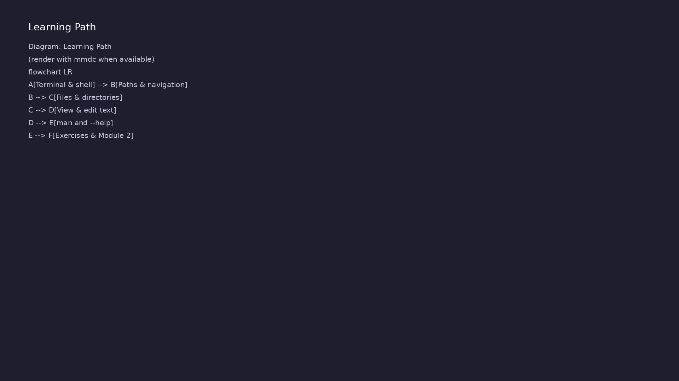
Module learning path
Topics build from terminal basics toward project navigation
learn_unix_git / Module 1

Slide 5
Why this matters for verification
• Run simulators, scripts, and makefiles from the
shell
• Move between src/, tb/, and build/ directories
• Inspect logs, RTL, and test output as text files
learn_unix_git / Module 1

Slide 6
Terminal & navigation
learn_unix_git / Module 1

Slide 7
Shell vs terminal
• Terminal emulator — the window you type in
• Shell (bash, zsh) — interprets commands
• Prompt shows user, host, and current directory
learn_unix_git / Module 1

Slide 8
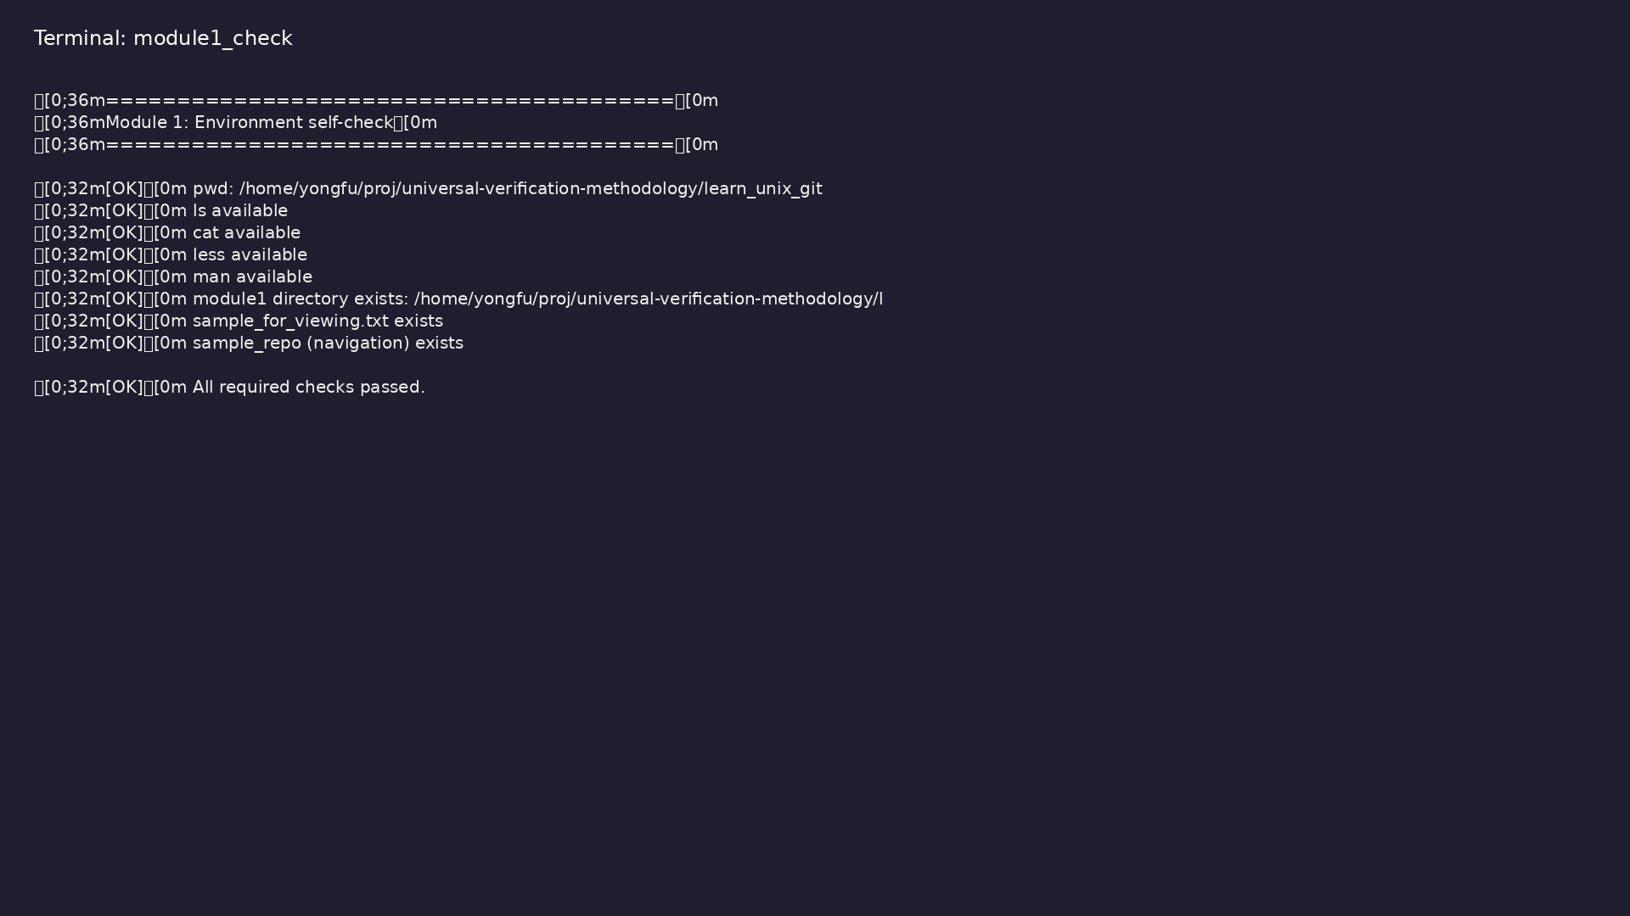
Module 1 self-check
$ ./scripts/module1.sh --check
learn_unix_git / Module 1
Notes:
Run from learn_unix_git repo root.

Slide 9
Navigation commands
pwd
ls
ls -la
cd ~/projects
cd ..
cd -
learn_unix_git / Module 1

Slide 10
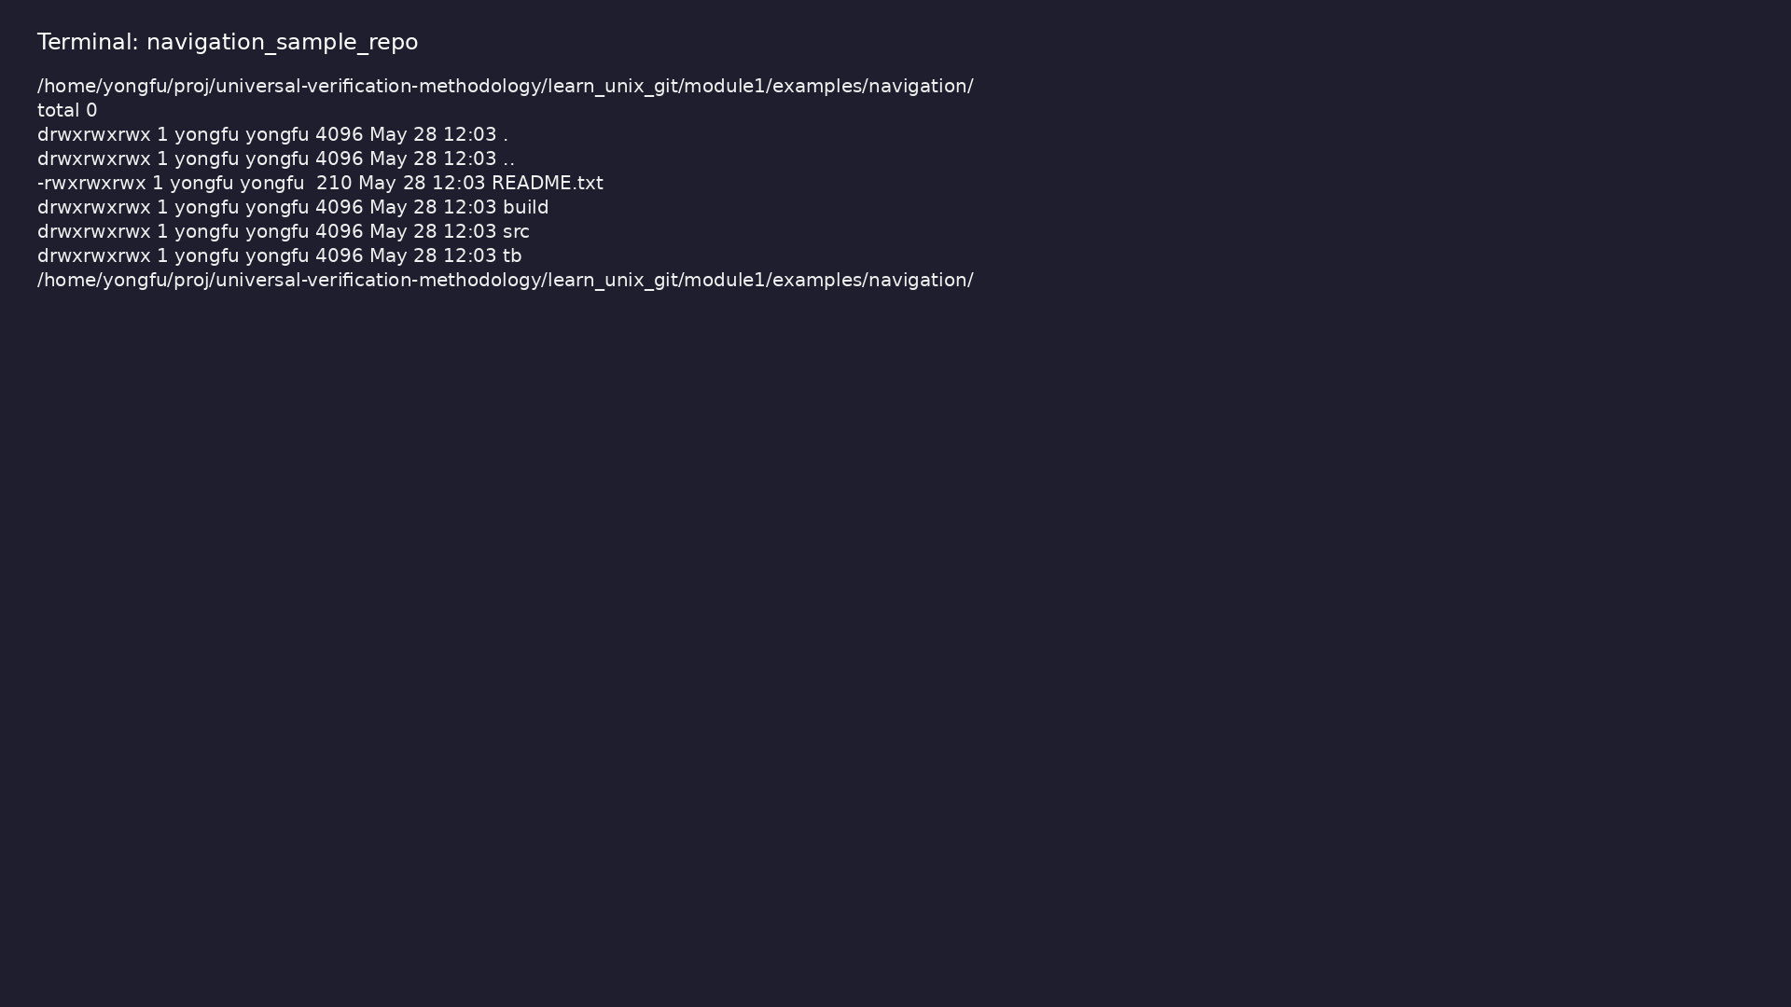
RTL-style project layout
$ cd module1/examples/navigation/sample_repo && pwd && ls -la && cd
src && pwd && ls
learn_unix_git / Module 1
Notes:
Sample src/ and tb/ layout for verification repos.

Slide 11
Files & viewing
learn_unix_git / Module 1

Slide 12
Files and directories
• mkdir -p for nested directories
• cp and mv for copy and rename
• rm and rm -r — use carefully; avoid rm -rf mistakes
learn_unix_git / Module 1

Slide 13
Exercise scaffold
mkdir ~/unix_practice
mkdir ~/unix_practice/notes ~/unix_practice/projects
cd ~/unix_practice && pwd
learn_unix_git / Module 1

Slide 14
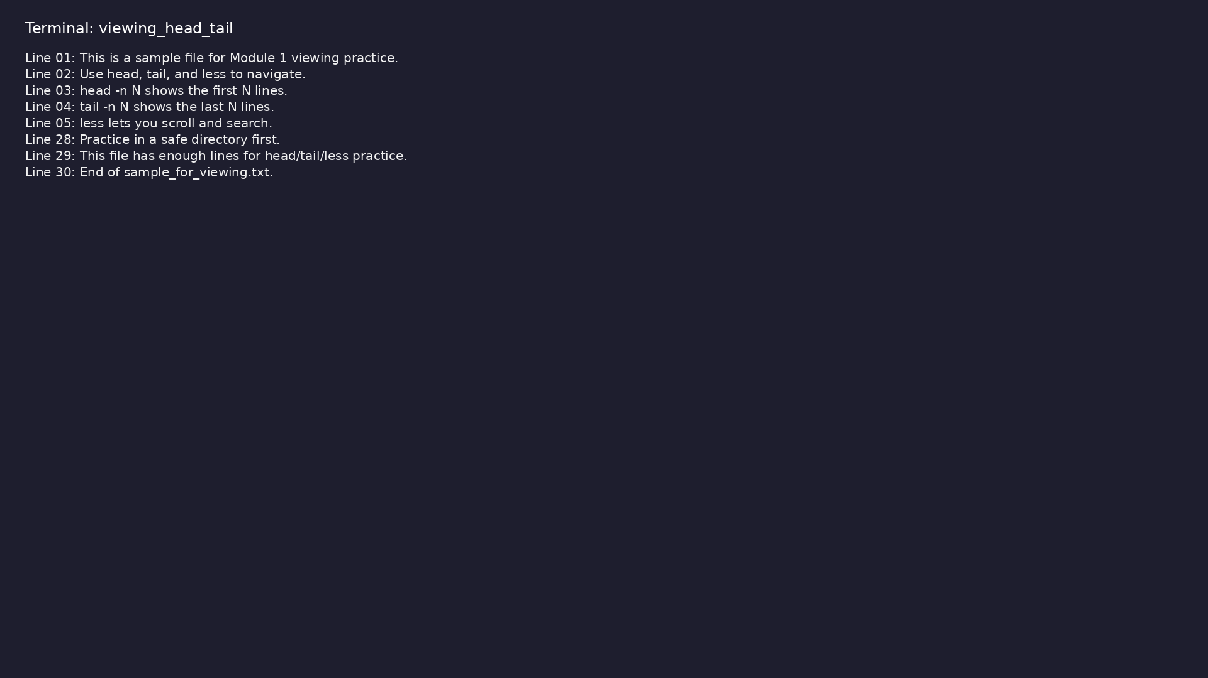
Viewing files
$ head -n 5 module1/examples/viewing/sample_for_viewing.txt && tail -n
3 module1/examples/viewing/sample_for_viewing.txt
learn_unix_git / Module 1
Notes:
Use less for interactive scroll and search (/word).

Slide 15
Create practice dirs (script)
./scripts/module1.sh --scaffold
learn_unix_git / Module 1

Slide 16
Help & practice
learn_unix_git / Module 1

Slide 17
Getting help
• man ls — full manual (Space, q to quit)
• ls --help — short option summary
• Tab completion for commands and paths
• History with ↑ and ↓ (Ctrl+R in bash)
learn_unix_git / Module 1

Slide 18
Repo resources
• module1/examples/ — hands-on
labs
• module1/CHECKLIST.md — exercises
• ./scripts/module1.sh — check &
demo
learn_unix_git / Module 1

Slide 19
Exercises (your turn)
• Hello terminal — pwd, ls, ls -la
• Directory navigation — unix_practice/
• File operations — cp, mv, rm with nano
• Viewing — head, tail, less on a long file
• Help — man ls, tab completion
learn_unix_git / Module 1

Slide 20
Summary & next steps
• You can navigate and manage files from the shell
• Run ./scripts/module1.sh --check before Module 2
• Next — Module 2: Filesystem, Permissions &
Environment
learn_unix_git / Module 1

