Slide 1
Module 2
Filesystem, Permissions & Environment
learn_unix_git / Module 2

Slide 2
Learning objectives
• Read ls -l output (types, permissions, owner)
• Use chmod to make scripts executable safely
• Explain HOME, PATH, and which
• Fix common permission denied and command not found
errors
learn_unix_git / Module 2

Slide 3
Prerequisites
• Module 1 complete (cd, ls, pwd, basic files)
learn_unix_git / Module 2

Slide 4
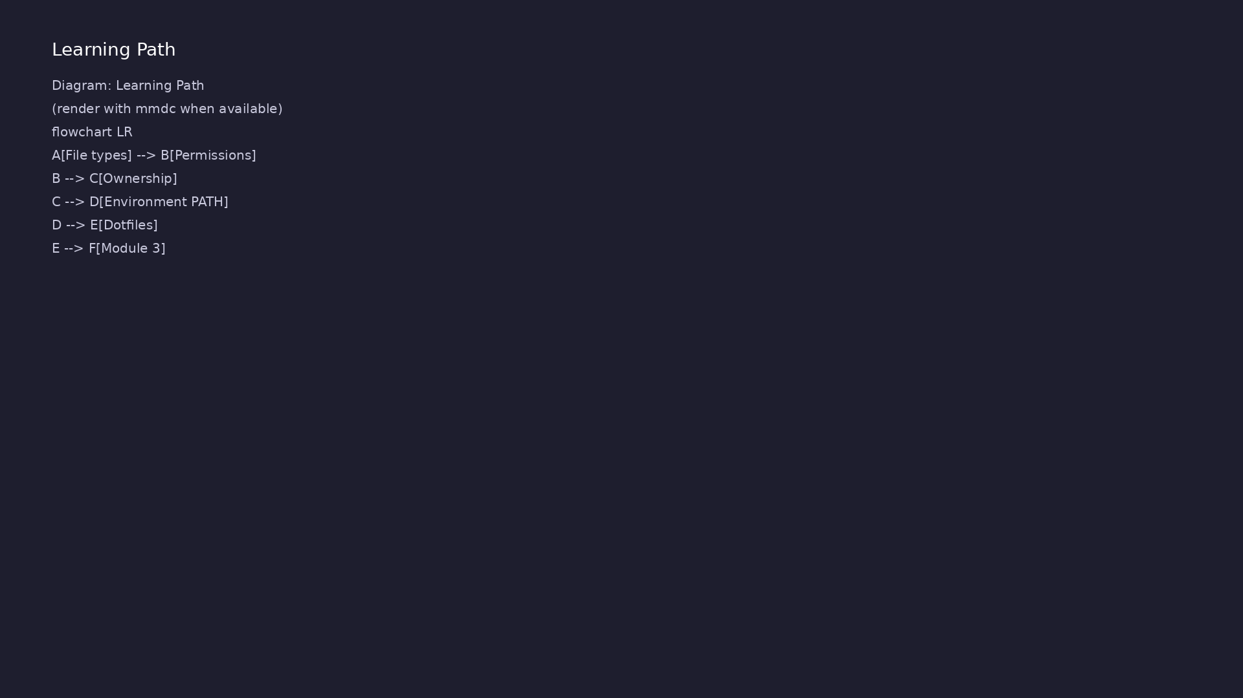
Learning path
learn_unix_git / Module 2

Slide 5
Course context
• Simulators and tools depend on PATH
• Scripts in projects need chmod +x
• Dotfiles like .gitignore appear in every repo
learn_unix_git / Module 2

Slide 6
Core topics
learn_unix_git / Module 2

Slide 7
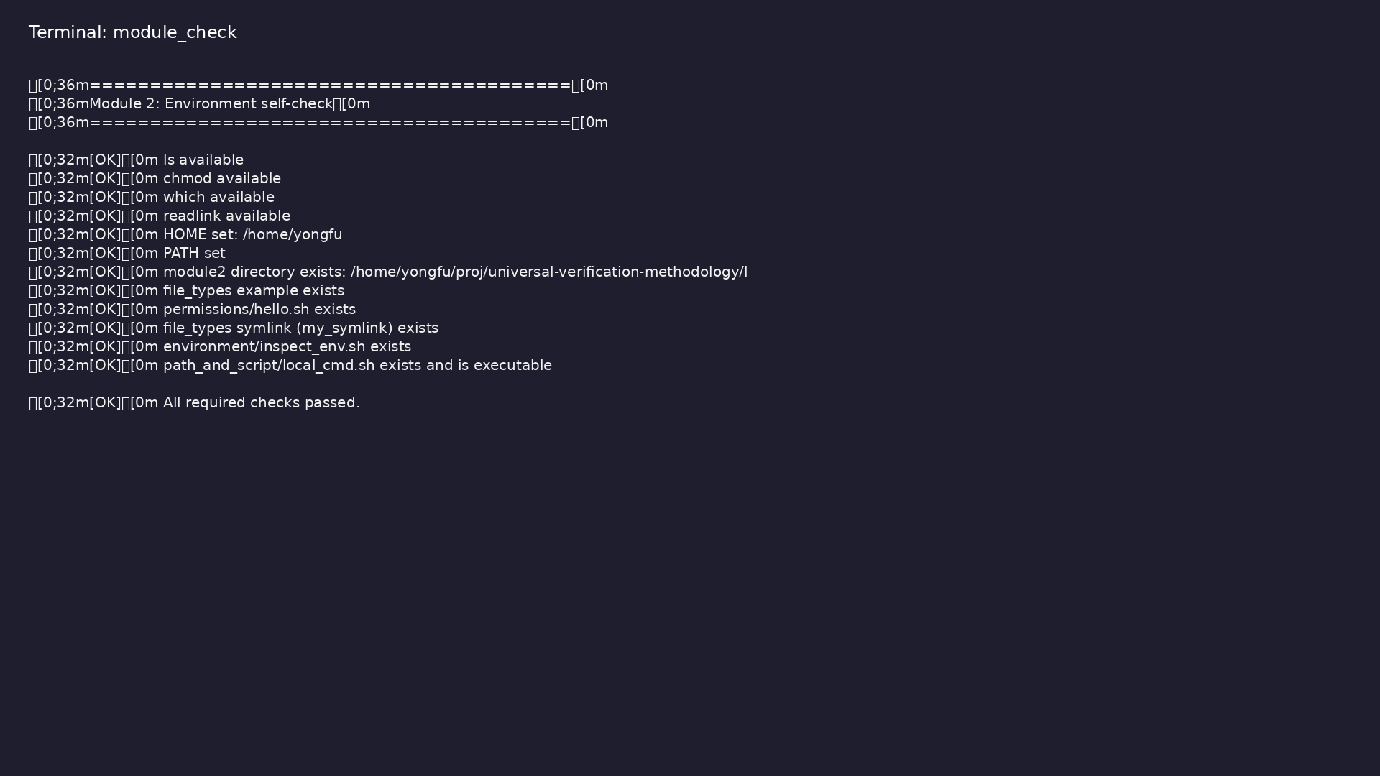
Self-check
$ ./scripts/module2.sh --check
learn_unix_git / Module 2

Slide 8
Make a script executable
chmod u+x hello.sh
./hello.sh
learn_unix_git / Module 2

Slide 9

ls -l and permissions
$ cd module2/examples/permissions && ls -l hello.sh config.txt
learn_unix_git / Module 2

Slide 10

Finding commands on PATH
$ which bash && which git
learn_unix_git / Module 2

Slide 11
Practice
learn_unix_git / Module 2

Slide 12
Exercise scaffold
./scripts/module2.sh --scaffold
learn_unix_git / Module 2

Slide 13
Exercises
• chmod on ~/unix_practice/hello.sh
• echo $PATH and which for git
• ls -la to see dotfiles in examples/dotfiles
learn_unix_git / Module 2

Slide 14
Summary & next steps
• File types and rwx permissions
• PATH and environment
• Next: Module 3 — processes & pipes
• Next: Module 3: Processes, Pipes & Redirection
learn_unix_git / Module 2

