Slide 1
Module 3
Processes, Pipes & Redirection
learn_unix_git / Module 3

Slide 2
Learning objectives
• Stop foreground jobs with Ctrl+C
• Redirect stdout/stderr to log files
• Chain commands with pipes
• Search simulator logs with grep
learn_unix_git / Module 3

Slide 3
Prerequisites
• Module 2 (permissions, executable scripts)
learn_unix_git / Module 3

Slide 4

Learning path
learn_unix_git / Module 3

Slide 5
Course context
• Save build/sim output: command > run.log 2>&1
• Filter errors: grep -i error run.log
• Exit status $? indicates success or failure
learn_unix_git / Module 3

Slide 6
Core topics
learn_unix_git / Module 3

Slide 7
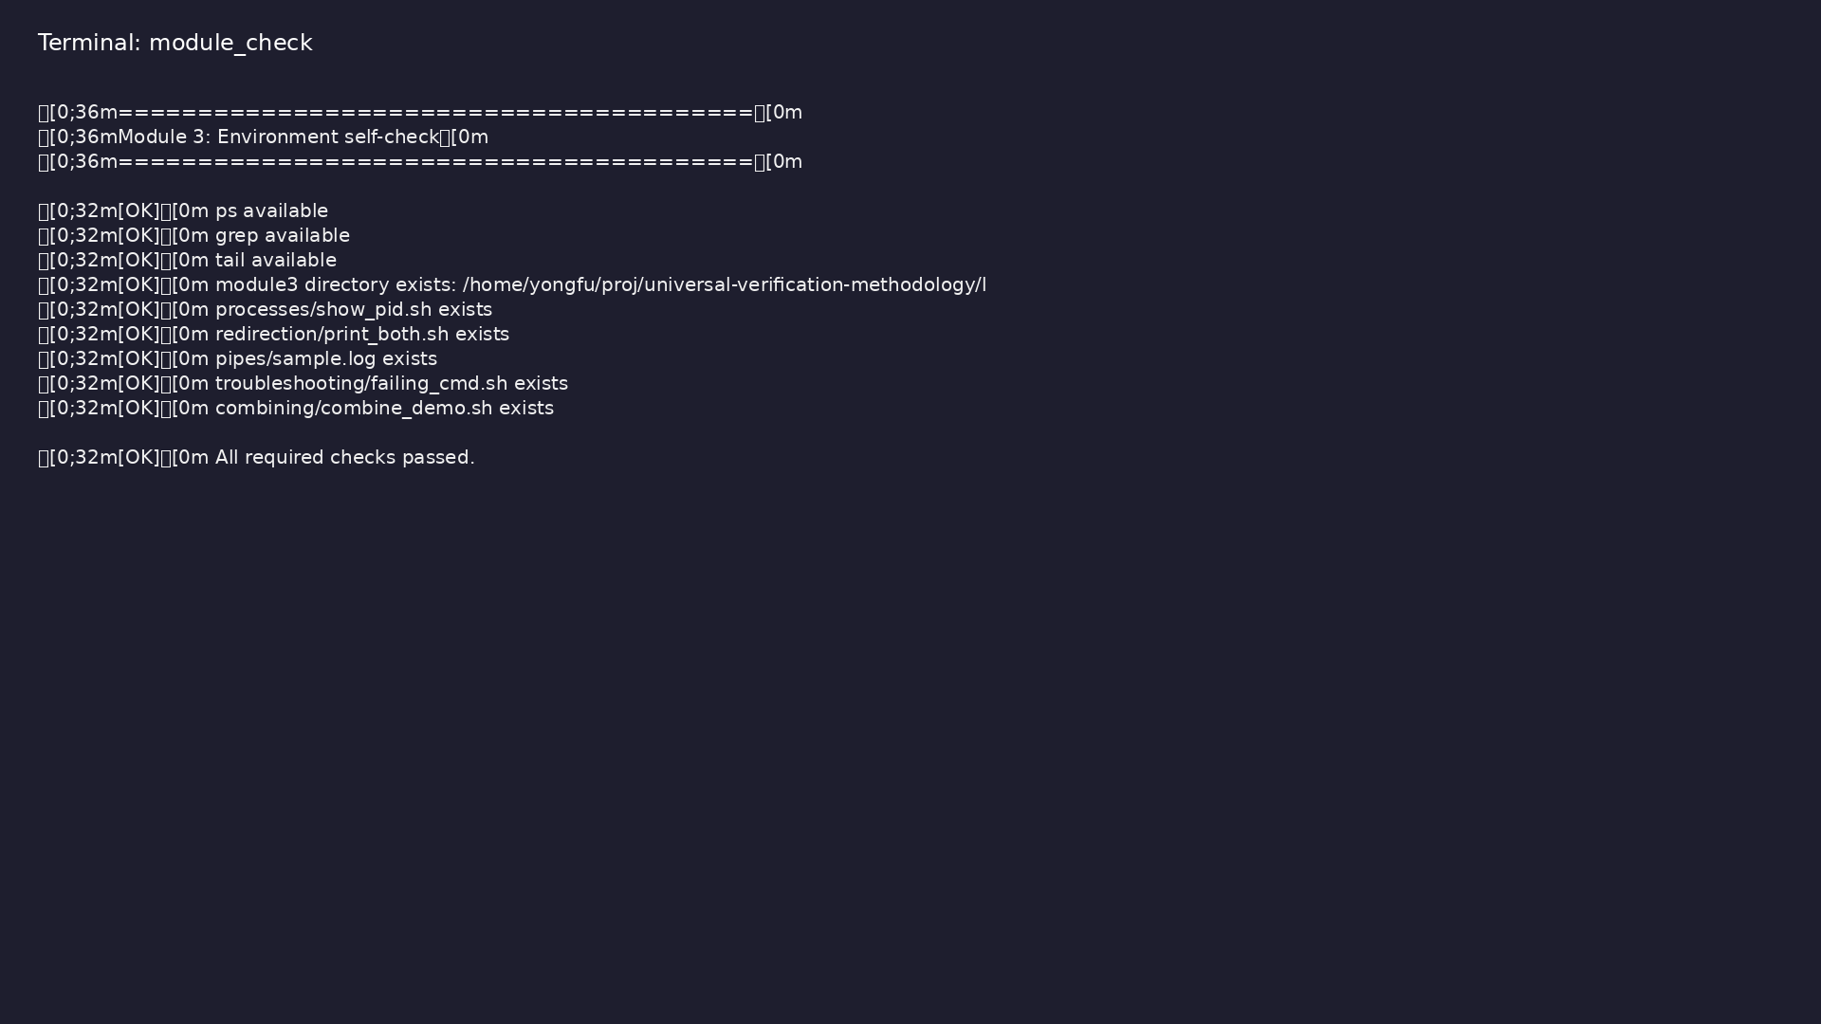
Self-check
$ ./scripts/module3.sh --check
learn_unix_git / Module 3

Slide 8
Capture full log
./scripts/run_tests.sh > logs/run.log 2>&1
tail -f logs/run.log
learn_unix_git / Module 3

Slide 9

Searching logs
$ cd module3/examples/pipes && grep ERROR sample.log
learn_unix_git / Module 3

Slide 10

Redirection demo
$ cd module3/examples/redirection && chmod u+x print_both.sh &&
./print_both.sh > /tmp/m3_out.log 2> /tmp/m3_err.log && head -2
/tmp/m3_out.log
learn_unix_git / Module 3

Slide 11
Practice
learn_unix_git / Module 3

Slide 12
Exercise scaffold
./scripts/module3.sh --scaffold
learn_unix_git / Module 3

Slide 13
Exercises
• grep ERROR on ~/unix_practice/sample.log
• Try 2>&1 | tee debug.log
• Check echo $? after a command
learn_unix_git / Module 3

Slide 14
Summary & next steps
• Processes and exit status
• Redirection and pipes
• Next: Module 4 — shell scripting
• Next: Module 4: Shell Productivity & Basic Scripting
learn_unix_git / Module 3

