Slide 1
Module 4
Shell Productivity & Basic Scripting
learn_unix_git / Module 4

Slide 2
Learning objectives
• Use history and Ctrl+R effectively
• Write scripts with shebang and chmod +x
• Pass arguments with $1 and $@
• Apply set -e and quoted variables
learn_unix_git / Module 4

Slide 3
Prerequisites
• Module 3 (redirection, pipes)
learn_unix_git / Module 4

Slide 4

Learning path
learn_unix_git / Module 4

Slide 5
Course context
• Wrap compile/sim steps in scripts/
• Course module scripts are the pattern to follow
• Quote variables to avoid word-splitting bugs
learn_unix_git / Module 4

Slide 6
Core topics
learn_unix_git / Module 4

Slide 7
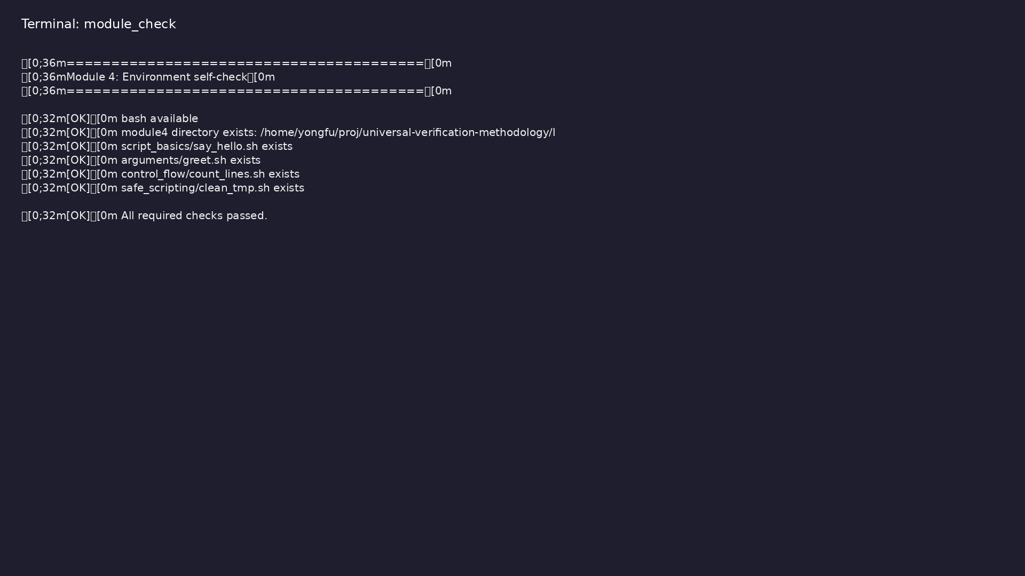
Self-check
$ ./scripts/module4.sh --check
learn_unix_git / Module 4

Slide 8
Minimal script
#!/usr/bin/env bash
echo "Hello from script"
learn_unix_git / Module 4

Slide 9

First bash script
$ cd module4/examples/script_basics && chmod u+x say_hello.sh &&
./say_hello.sh
learn_unix_git / Module 4

Slide 10

Positional parameters
$ cd module4/examples/arguments && chmod u+x greet.sh && ./greet.sh
Student
learn_unix_git / Module 4

Slide 11
Practice
learn_unix_git / Module 4

Slide 12
Exercise scaffold
./scripts/module4.sh --scaffold
learn_unix_git / Module 4

Slide 13
Exercises
• Run say_hello.sh and greet.sh from scaffold
• Add an alias ll='ls -alF'
• Write a loop over *.log
learn_unix_git / Module 4

Slide 14
Summary & next steps
• Scripts automate design flows
• History and aliases save time
• Next: Module 5 — projects & archives
• Next: Module 5: Editors, Projects & Archives
learn_unix_git / Module 4

