Slide 1
Module 5
Editors, Projects & Archives
learn_unix_git / Module 5

Slide 2
Learning objectives
• Use a consistent src/tb/scripts/build layout
• Find files and search with grep -R
• Create and extract tar.gz archives
• Back up projects before major changes
learn_unix_git / Module 5

Slide 3
Prerequisites
• Module 4 (basic scripts)
learn_unix_git / Module 5

Slide 4

Learning path
learn_unix_git / Module 5

Slide 5
Course context
• RTL projects mirror course repo structure
• Exclude build/ from archives and Git
• grep -R finds signals across a tree
learn_unix_git / Module 5

Slide 6
Core topics
learn_unix_git / Module 5

Slide 7
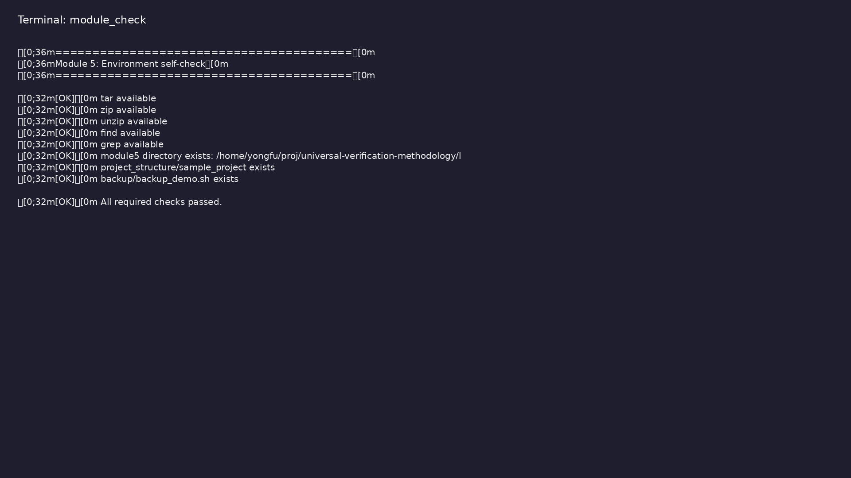
Self-check
$ ./scripts/module5.sh --check
learn_unix_git / Module 5

Slide 8
Create archive
tar czf project_$(date +%Y%m%d).tar.gz project_dir/
tar xzf project.tar.gz
learn_unix_git / Module 5

Slide 9

Project structure
$ cd module5/examples/project_structure/sample_project && find . -type
f | head -8
learn_unix_git / Module 5

Slide 10

tar archives
$ cd module5/examples/tar_archives && tar czf /tmp/m5_demo.tar.gz
demo_dir/ && tar tzf /tmp/m5_demo.tar.gz | head -5
learn_unix_git / Module 5

Slide 11
Practice
learn_unix_git / Module 5

Slide 12
Exercise scaffold
./scripts/module5.sh --scaffold
learn_unix_git / Module 5

Slide 13
Exercises
• Scaffold unix_course_project/
• grep -R in sample_project
• Create a tar.gz backup
learn_unix_git / Module 5

Slide 14
Summary & next steps
• Organize src/tb/scripts/build
• Archives for sharing
• Next: Module 6 — Git basics
• Next: Module 6: Git Basics for Course Work
learn_unix_git / Module 5

