Slide 1
Module 6
Git Basics for Course Work
learn_unix_git / Module 6

Slide 2
Learning objectives
• Explain working tree, staging, and commits
• Use status, add, commit, log, diff
• Clone and push to GitHub
• Write a useful .gitignore for build artifacts
learn_unix_git / Module 6

Slide 3
Prerequisites
• Module 5 (project structure)
• git installed
learn_unix_git / Module 6

Slide 4

Learning path
learn_unix_git / Module 6

Slide 5
Course context
• Course work is submitted via Git
• Never commit build/ or large waveforms
• Small focused commits are easier to review
learn_unix_git / Module 6

Slide 6
Core topics
learn_unix_git / Module 6

Slide 7
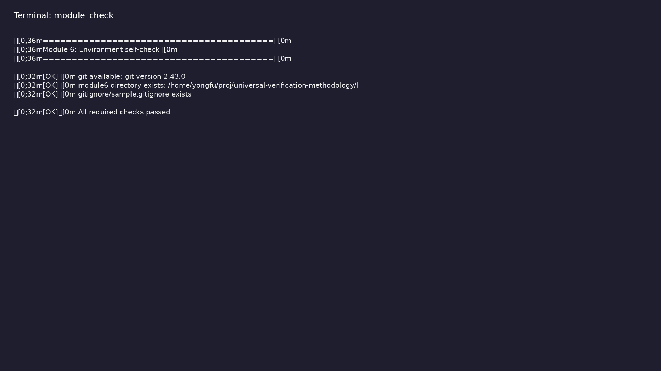
Self-check
$ ./scripts/module6.sh --check
learn_unix_git / Module 6

Slide 8
Basic workflow
git status
git add file.sv
git commit -m "Add counter testbench"
learn_unix_git / Module 6

Slide 9

Git installation
$ git --version
learn_unix_git / Module 6

Slide 10

Exploring git help
$ git help -a 2>/dev/null | head -5
learn_unix_git / Module 6

Slide 11
Practice
learn_unix_git / Module 6

Slide 12
Exercise scaffold
./scripts/module6.sh --scaffold
learn_unix_git / Module 6

Slide 13
Exercises
• Scaffold git_demo and make a commit
• Write .gitignore for build/
• git log --oneline
learn_unix_git / Module 6

Slide 14
Summary & next steps
• Local Git workflow
• Remotes and GitHub
• Next: Module 7 — collaboration
• Next: Module 7: Advanced Git for Collaboration
learn_unix_git / Module 6

