Slide 1
Module 7
Advanced Git for Collaboration
learn_unix_git / Module 7

Slide 2
Learning objectives
• Create and switch feature branches
• Merge branches and resolve conflicts
• Understand submodules for shared IP
• Use git blame and bisect conceptually
learn_unix_git / Module 7

Slide 3
Prerequisites
• Module 6 (add, commit, push)
learn_unix_git / Module 7

Slide 4

Learning path
learn_unix_git / Module 7

Slide 5
Course context
• Team labs use branches per feature
• Conflicts happen when two people edit same lines
• Verification IP may live in submodules
learn_unix_git / Module 7

Slide 6
Core topics
learn_unix_git / Module 7

Slide 7
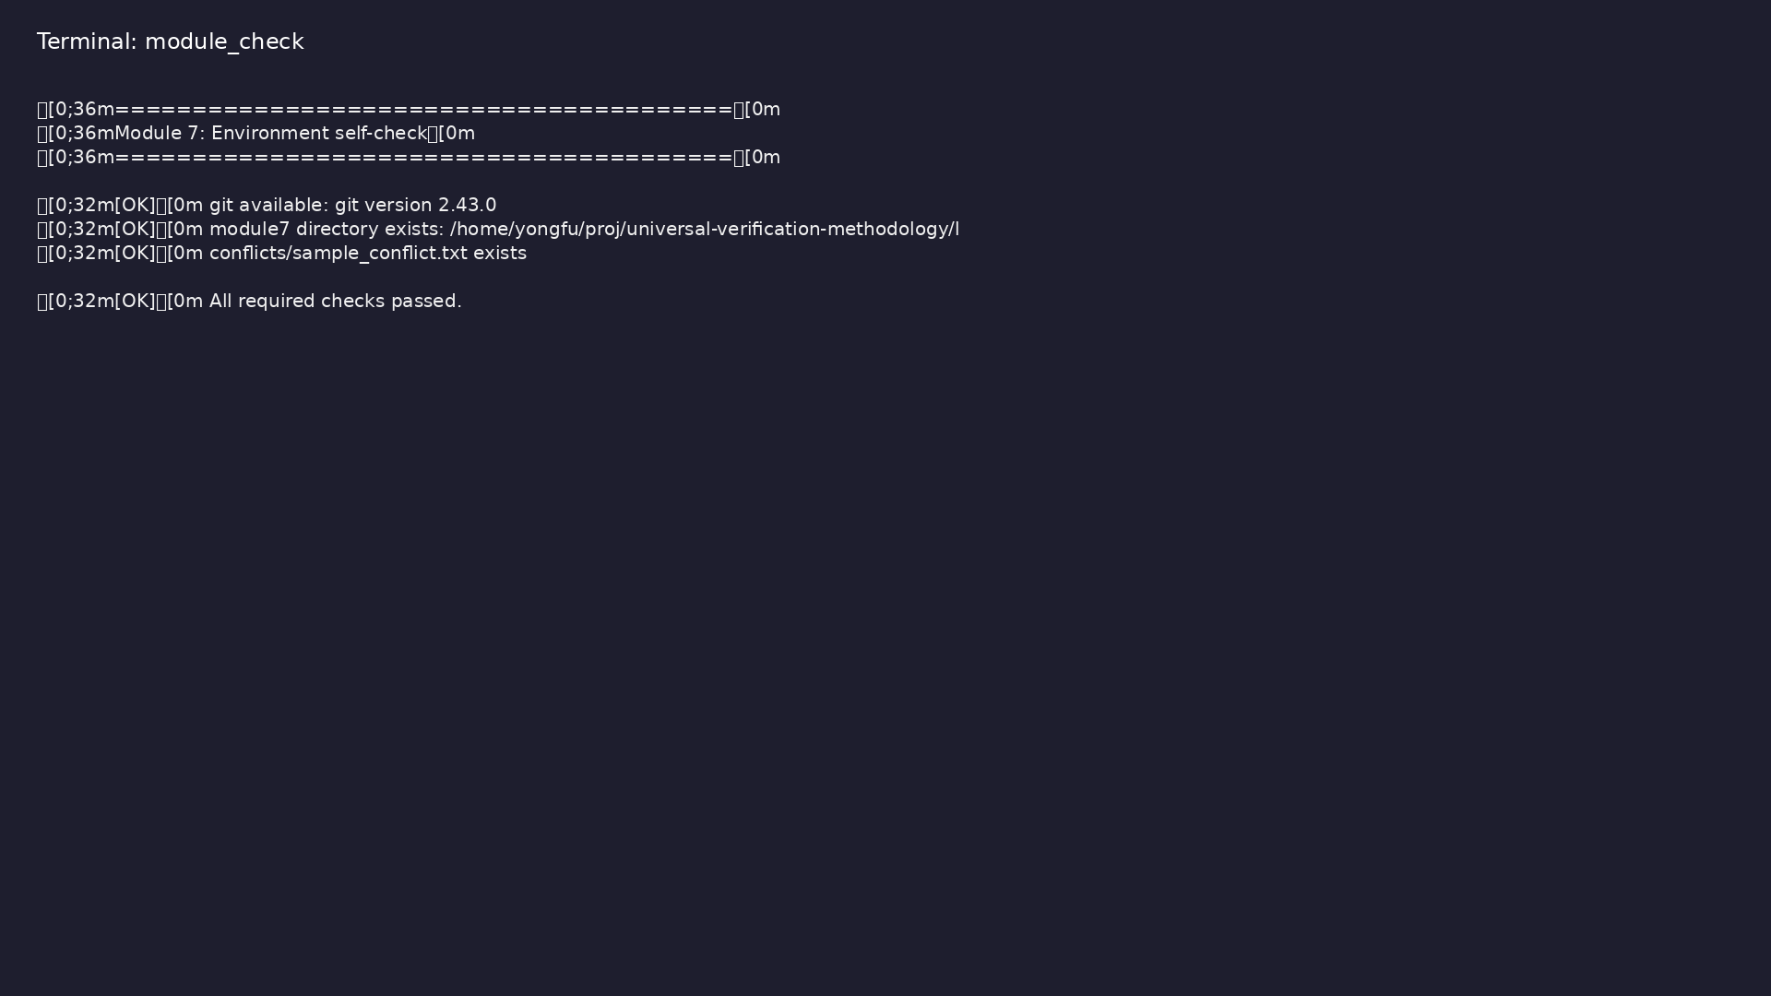
Self-check
$ ./scripts/module7.sh --check
learn_unix_git / Module 7

Slide 8
Feature branch
git checkout -b feature/lab2
git merge main
learn_unix_git / Module 7

Slide 9
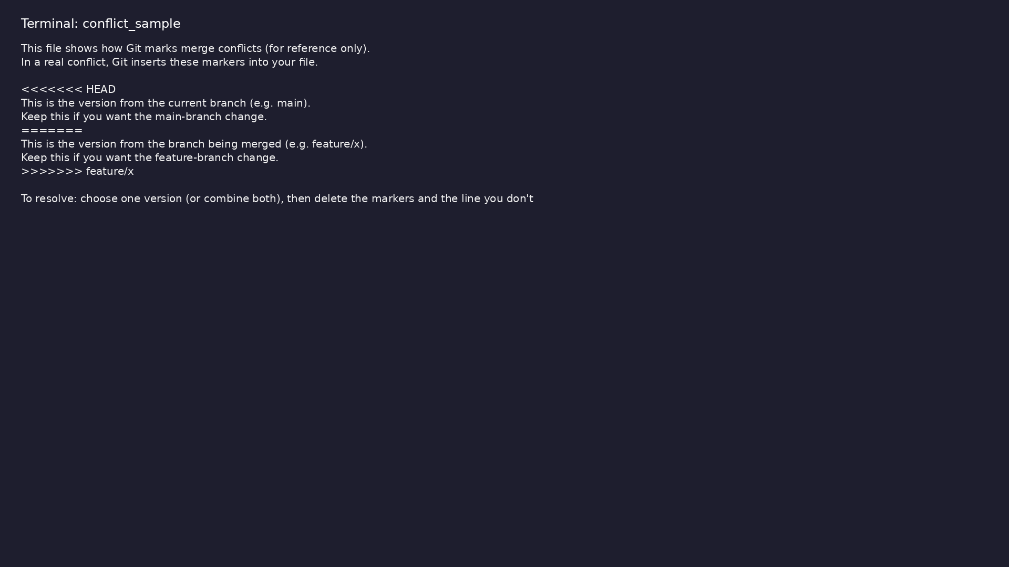
Merge conflict format
$ head -15 module7/examples/conflicts/sample_conflict.txt
learn_unix_git / Module 7

Slide 10

Branches
$ git help branch 2>/dev/null | head -8
learn_unix_git / Module 7

Slide 11
Practice
learn_unix_git / Module 7

Slide 12
Exercises
• Create branch in git_demo
• Resolve sample_conflict.txt on paper
• Try git submodule update --init
learn_unix_git / Module 7

Slide 13
Summary & next steps
• Branching and merging
• Conflicts and submodules
• Next: Module 8 — end-to-end workflow
• Next: Module 8: End-to-End Project Workflow
learn_unix_git / Module 7

