Slide 1
Module 8
End-to-End Project Workflow
learn_unix_git / Module 8

Slide 2
Learning objectives
• Bootstrap a project from a template repo
• Run scripted build/test flows
• Capture and analyze logs
• Commit milestones and push for submission
learn_unix_git / Module 8

Slide 3
Prerequisites
• Modules 1–7 or equivalent experience
learn_unix_git / Module 8

Slide 4
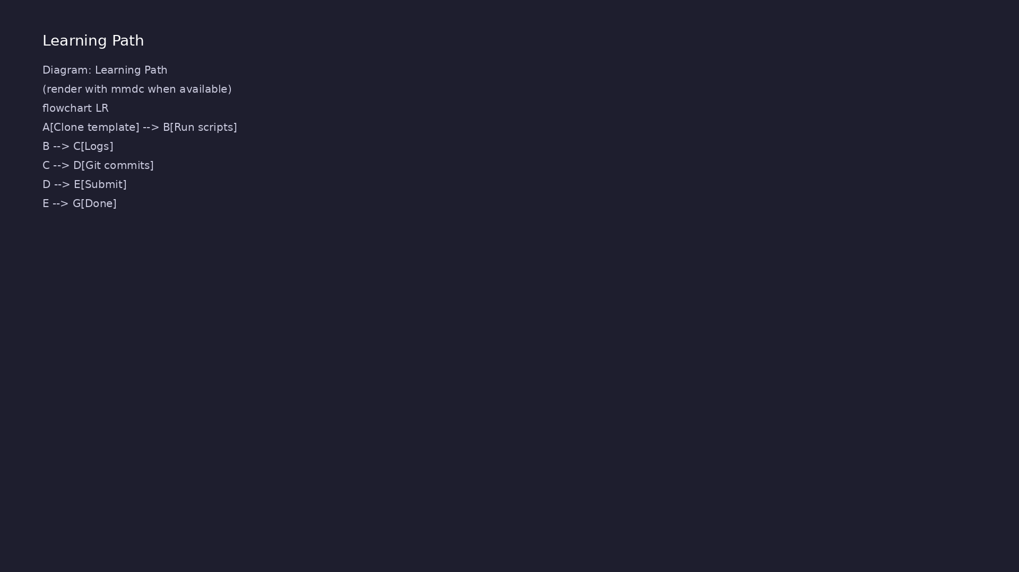
Learning path
learn_unix_git / Module 8

Slide 5
Course context
• Full loop: edit → run → inspect → commit → push
• Reproducibility matters for grading and debug
• Pre-push checks catch common mistakes
learn_unix_git / Module 8

Slide 6
Core topics
learn_unix_git / Module 8

Slide 7
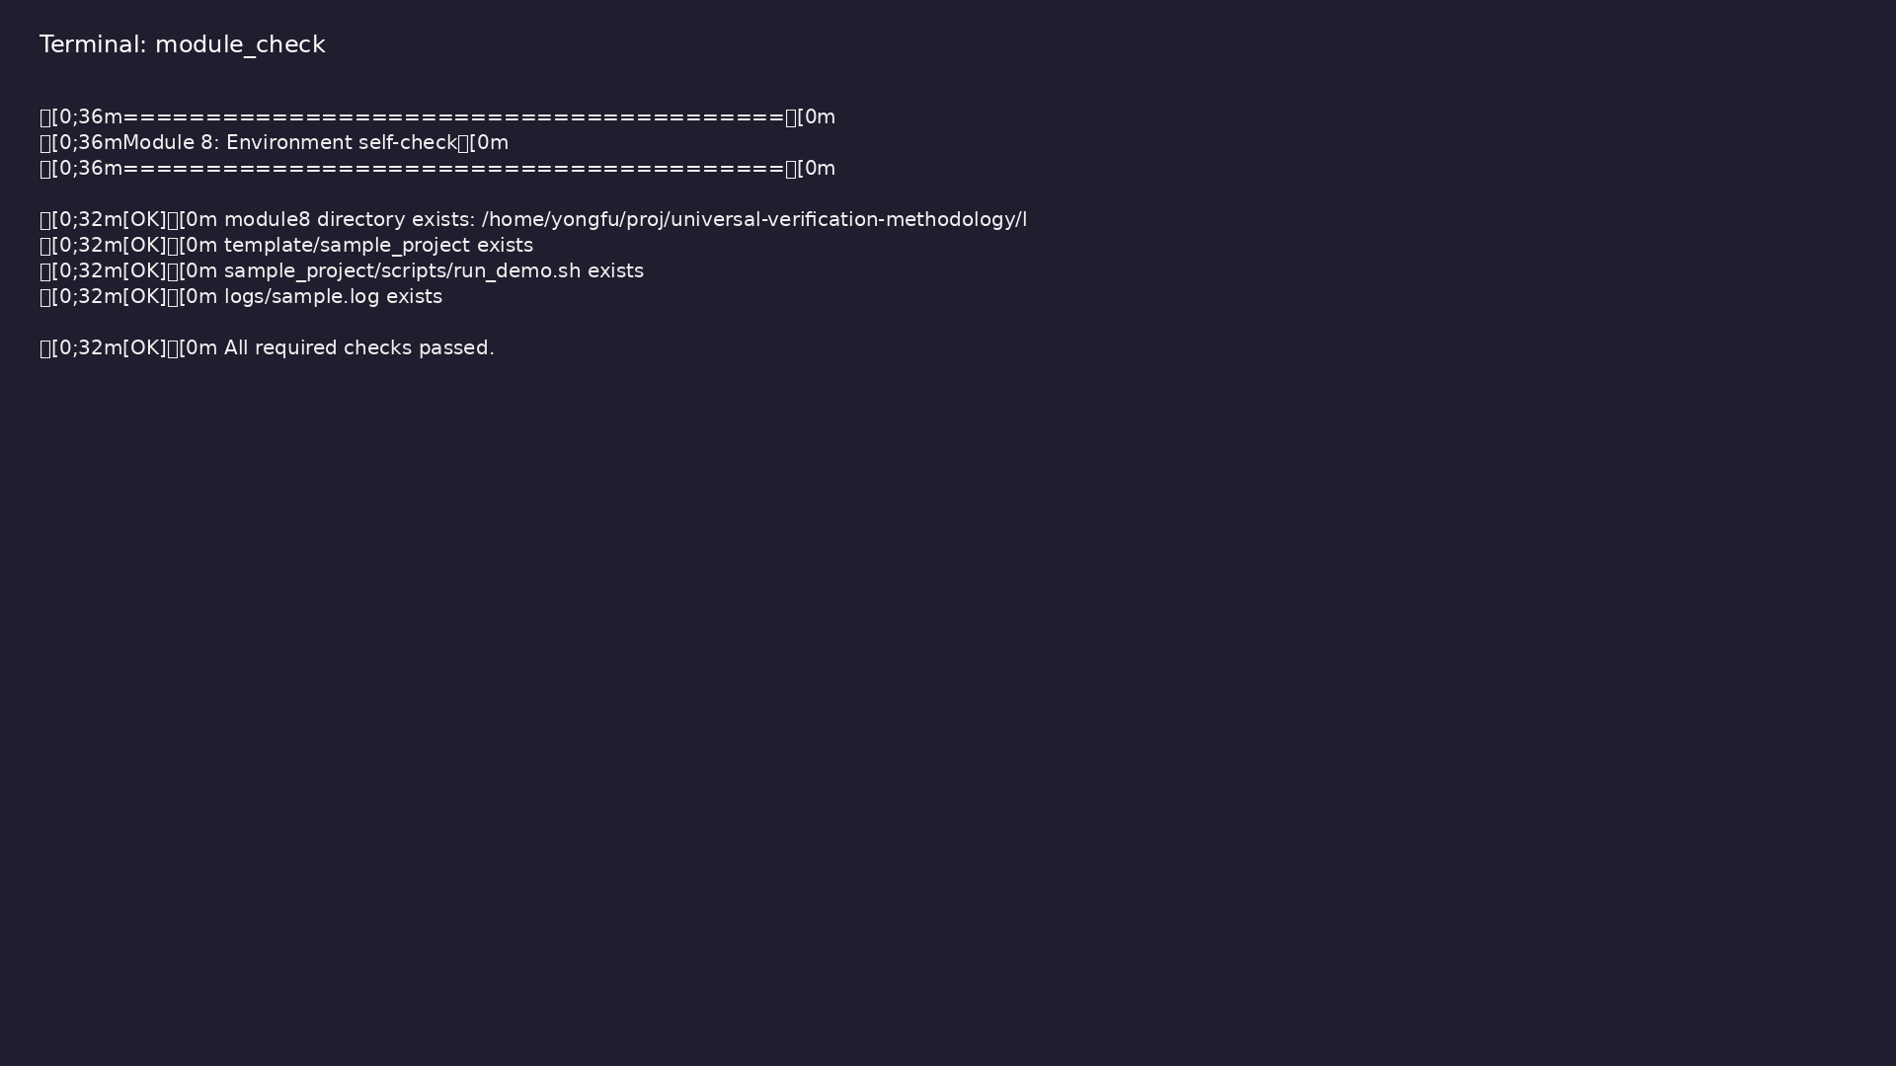
Self-check
$ ./scripts/module8.sh --check
learn_unix_git / Module 8

Slide 8
Run with log capture
./scripts/run_demo.sh > logs/run.log 2>&1
grep -i error logs/run.log
learn_unix_git / Module 8

Slide 9
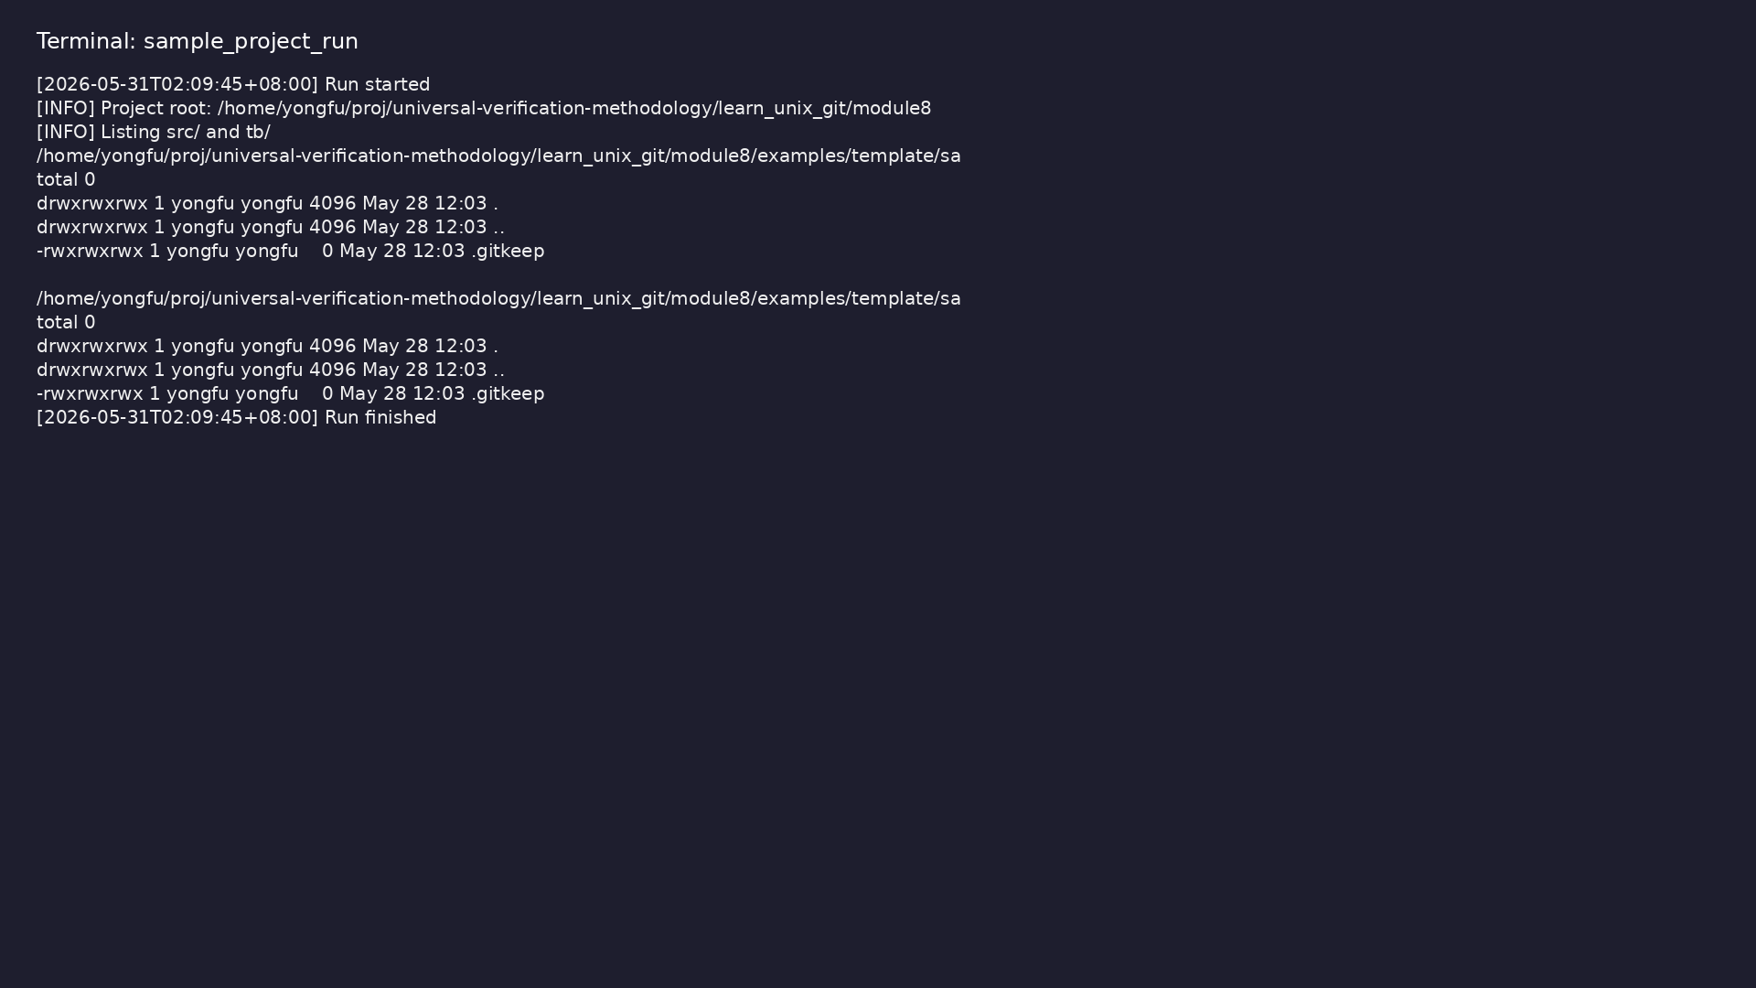
Scripted workflow
$ cd module8/examples/template/sample_project && chmod u+x
scripts/run_demo.sh && ./scripts/run_demo.sh
learn_unix_git / Module 8

Slide 10
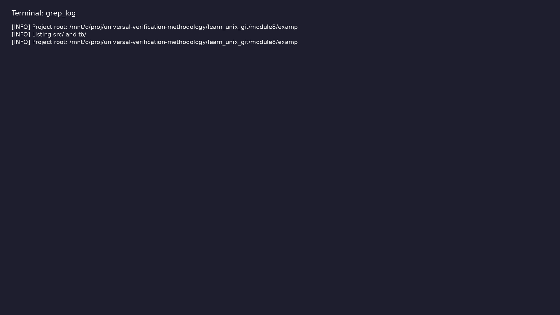
Log inspection
$ grep INFO module8/examples/template/sample_project/logs/run.log
2>/dev/null | head -3
learn_unix_git / Module 8

Slide 11
Practice
learn_unix_git / Module 8

Slide 12
Exercises
• Walk through sample_project/
• Make a commit after a script run
• Review pre-push checklist in module8
learn_unix_git / Module 8

Slide 13
Summary & next steps
• Unix + Git + scripts together
• You are ready for design courses
• Course complete — keep practicing
• Next: Digital design & verification courses
learn_unix_git / Module 8

