Slide 1
Objections
Run phase is where your test actually runs, but UVM needs to know when work is still in flight
learn_uvm2017 — uvm objections
Notes:
Run phase is where your test actually runs—but UVM needs to know when work is still in flight. Objections are the hold counter: raise keeps run open, drop releases your hold, and when the total hits zero run can end. This module shows who is holding and why balance matters. We will watch the counter in the browser lab, then read the same pattern in offline notes.

Slide 2
Raise, drop, and the total count
In run phase you call raise objection on the phase object
When your task finishes, call drop objection to release your hold
Multiple components can raise at once, test, sequence, env
Forget to drop and run hangs with objections stuck above zero
Drop too early and your test ends before sequences or drivers finish
The rule is simple: whoever raises should drop
learn_uvm2017 — uvm objections
Notes:
In run phase you call raise objection on the phase object—that increments the total and keeps simulation time alive. When your task finishes, call drop objection to release your hold. Multiple components can raise at once—test, sequence, env—and every raise needs a matching drop before the total reaches zero. Forget to drop and run hangs with objections stuck above zero. Drop too early and your test ends before sequences or drivers finish. The rule is simple: whoever raises should drop.

Slide 3
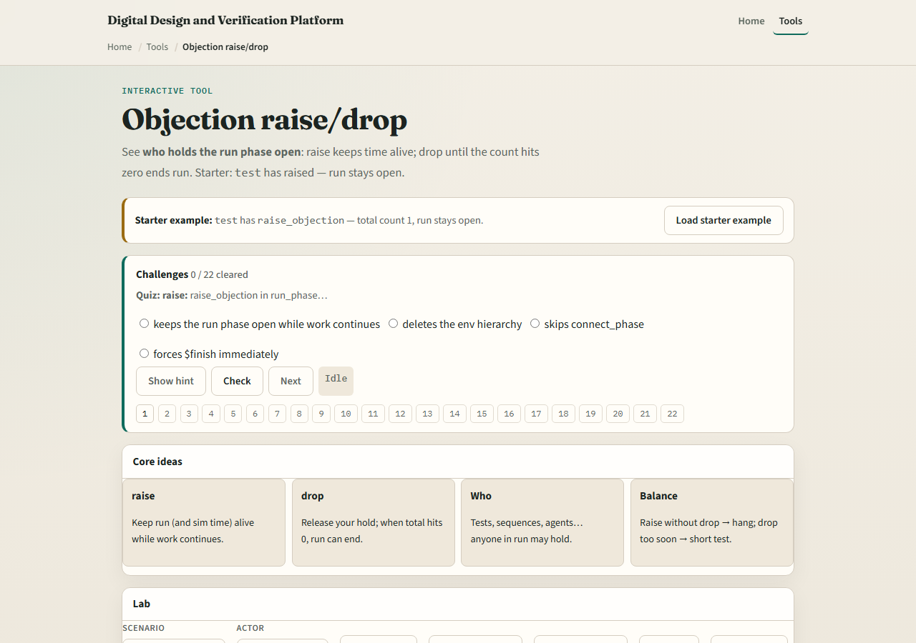
Browser lab
Objections lab starter
learn_uvm2017 — uvm objections
Notes:
In the browser lab track, open the objections lab. The starter shows test holding one raise—run stays open, total count is one. Try raise and drop with different actors and watch the total. Load the multi preset—test and sequence both hold—and drop one to see run still blocked. Drop all to hit zero and watch the phase pill flip to ended. Work a few challenges, then Check. The lab is literacy; real UVM uses the same calls in your run phase tasks.

Slide 4
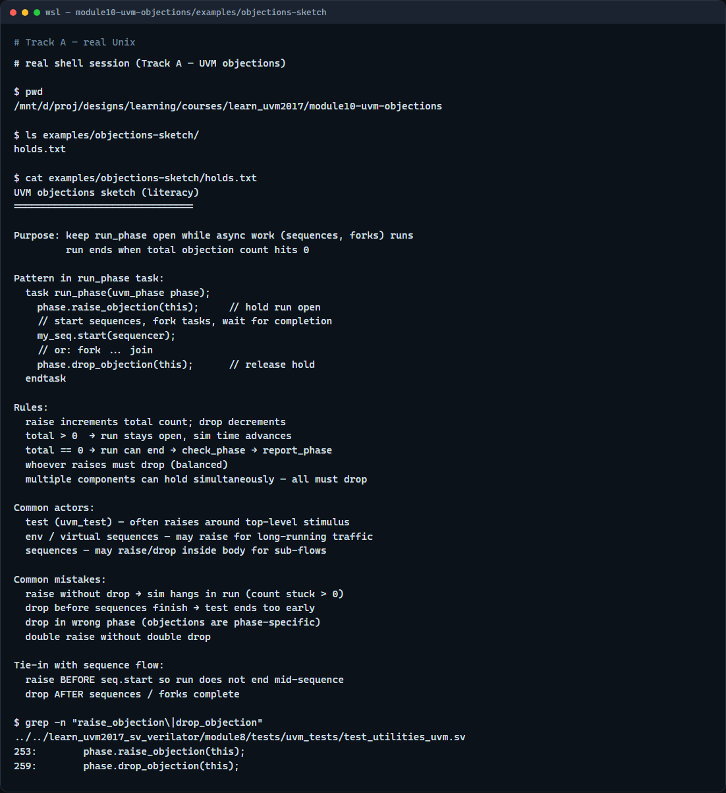
Real UVM literacy
Real shell — objections sketch
learn_uvm2017 — uvm objections
Notes:
In the real UVM track, open this module’s objections sketch—it shows raise and drop around sequence start in plain language. Trace the pattern: raise before work, start sequences or fork tasks, wait for completion, then drop. If the legacy offline course is checked out, grep for raise objection in any run phase task—you will see the same bracket around stimulus. Objections tie directly to the sequence flow from the last module—without a raise, run might end before your sequence runs.

Slide 5
Pitfalls to watch
Do not raise in build and forget run phase, that is the wrong phase for time advancement
Do not drop before your sequences finish or run ends too soon
Do not assume one component’s drop clears everyone, each holder must drop
Double raises need double drops
And remember
learn_uvm2017 — uvm objections
Notes:
Do not raise in build and forget run phase—that is the wrong phase for time advancement. Do not drop before your sequences finish or run ends too soon. Do not assume one component’s drop clears everyone—each holder must drop. Double raises need double drops. And remember: the browser counter is a sketch; real sim hangs show up as run phase never ending in the log.

Slide 6
Your turn
Complete the checklist for at least one track, preferably both
In the browser, load multi and explain why one drop is not enough
On real UVM, sketch a run phase task with raise, sequence start, and drop
When you are ready, take the short quiz, then continue to plusargs in the next module
learn_uvm2017 — uvm objections
Notes:
Complete the checklist for at least one track—preferably both. In the browser, load multi and explain why one drop is not enough. On real UVM, sketch a run phase task with raise, sequence start, and drop. When you are ready, take the short quiz, then continue to plusargs in the next module.

