Slide 1
SVA timeline lite
Assertions check protocol rules on the timeline, not just at end of test
learn_uvm2017 — sva timeline
Notes:
Assertions check protocol rules on the timeline—not just at end of test. SystemVerilog assertions use properties over clock cycles; implication says when antecedent a is true, consequent b must follow. This module is lite literacy—overlap versus next cycle, pass, fail, and vacuous. We will read waves in the browser lab, then anchor the same syntax in offline notes.

Slide 2
Overlap, next cycle, and vacuous
Pipe arrow overlap means when a is true, check b in the same cycle
Double pipe arrow non-overlap means when a is true, check b on the next cycle
An attempt starts when the antecedent fires, a high on that clock edge
Pass means the consequent matched; fail means a fired but b did not
Vacuous success means a never went high
Real SVA wraps this in a property and assert property on posedge clock
learn_uvm2017 — sva timeline
Notes:
Pipe arrow overlap means when a is true, check b in the same cycle. Double pipe arrow non-overlap means when a is true, check b on the next cycle. An attempt starts when the antecedent fires—a high on that clock edge. Pass means the consequent matched; fail means a fired but b did not. Vacuous success means a never went high—no failing attempt, but also nothing was really checked. Real SVA wraps this in a property and assert property on posedge clock.

Slide 3
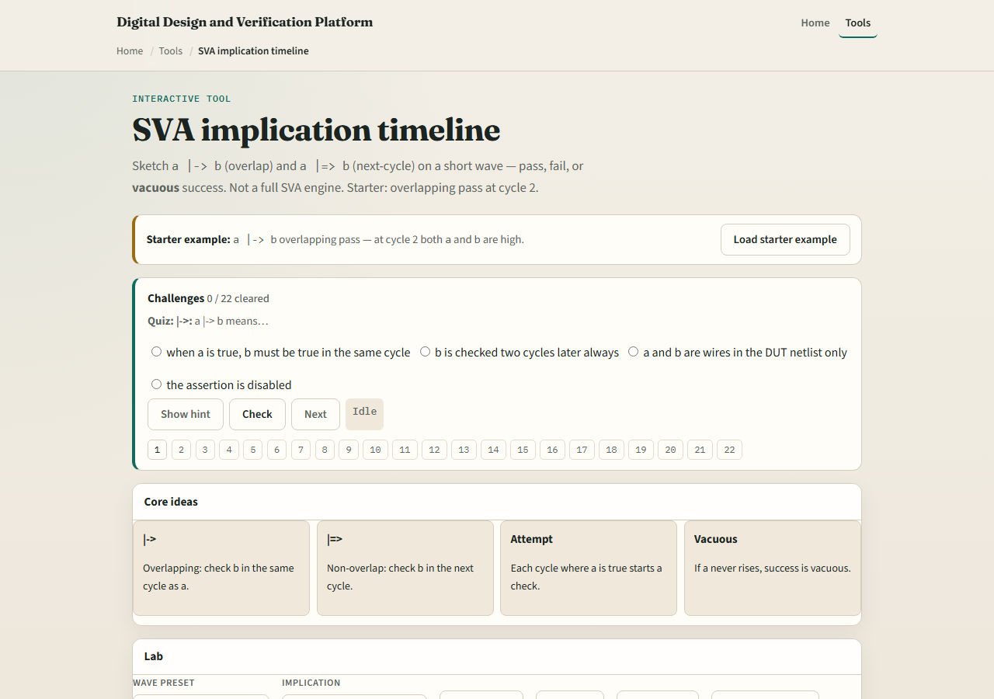
Browser lab
SVA timeline lab starter
learn_uvm2017 — sva timeline
Notes:
In the browser lab track, open the SVA implication timeline lab. The starter shows a pipe arrow b overlapping pass—at cycle two both a and b are high. Hit Evaluate for pass. Load fail preset to see a high but b low same cycle. Try non-overlap pass and fail presets for next-cycle checking. Load vacuous to see a never high. Step the cursor and watch status change. Work a few challenges, then Check. The lab is not a full assertion engine—it teaches the timeline idea.

Slide 4
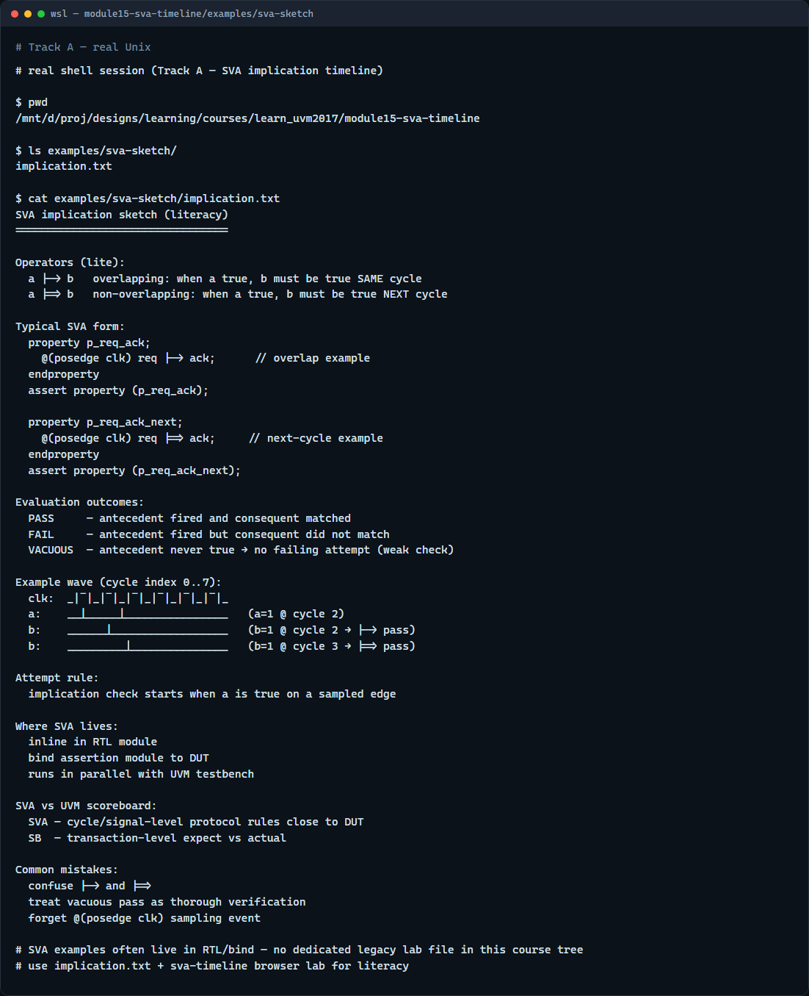
Real UVM literacy
Real shell — SVA implication sketch
learn_uvm2017 — sva timeline
Notes:
In the real UVM track, open this module’s implication sketch—it shows property and assert property syntax in plain language. Trace one overlap rule on paper: mark cycles where a and b must align. Assertions live in RTL or bind modules—they run in parallel with your UVM test, catching bugs closer to the signal. UVM still needs scoreboards for transaction-level checks; SVA catches cycle-level protocol rules.

Slide 5
Pitfalls to watch
Do not confuse overlap and next-cycle operators, they check different cycles
Do not treat vacuous pass as strong coverage, if a never fires, the rule never exercised
Do not write assertions without clocking, posedge clk is the usual sampling event
And remember
learn_uvm2017 — sva timeline
Notes:
Do not confuse overlap and next-cycle operators—they check different cycles. Do not treat vacuous pass as strong coverage—if a never fires, the rule never exercised. Do not write assertions without clocking—posedge clk is the usual sampling event. And remember: the browser wave is eight cycles; real designs need complete properties with disable iff and covers too.

Slide 6
Your turn
Complete the checklist for at least one track, preferably both
In the browser, load overlap fail and explain the verdict
On paper, sketch a pipe arrow b pass and a double-pipe b pass on the same wave
When you are ready
learn_uvm2017 — sva timeline
Notes:
Complete the checklist for at least one track—preferably both. In the browser, load overlap fail and explain the verdict. On paper, sketch a pipe arrow b pass and a double-pipe b pass on the same wave. When you are ready, take the short quiz, then continue to multi-agent env in the next module.

