Slide 1
UVM path complete
Objections, to scoreboards, RAL, multi-agent coordination, VIP packages, and one offline Makefile run
learn_uvm2017 — wrap
Notes:
You have walked the UVM twenty seventeen path—from layered testbench roles and anatomy, through phases, factory, ConfigDB, agents, TLM, sequences, and objections, to scoreboards, RAL, multi-agent coordination, VIP packages, and one offline Makefile run. This short wrap names what you can do now and points you to the next courses on the ladder.

Slide 2
What you can do now
You can explain layered testbench roles and how UVM maps onto them
You can navigate phases, factory overrides, ConfigDB, agent anatomy
VIP handoff pieces
You have run, or rehearsed, at least one offline UVM example with a real simulator
That is the methodology literacy later VIP and planning courses expect
learn_uvm2017 — wrap
Notes:
You can explain layered testbench roles and how UVM maps onto them. You can navigate phases, factory overrides, ConfigDB, agent anatomy, and sequence-to-driver flow in your own words. You can point at scoreboard, RAL, multi-agent, virtual sequences, callbacks, reporting, protocol checkers, and VIP handoff pieces. You have run—or rehearsed—at least one offline UVM example with a real simulator. That is the methodology literacy later VIP and planning courses expect.

Slide 3
Close the track gaps
Run so Accellera UVM feels real
If you mainly used offline UVM
Either track works for self-study; both together stick best before you move on
Browser tools are literacy sketches, not a substitute for Accellera UVM on a simulator
learn_uvm2017 — wrap
Notes:
If you mainly waited on browser labs, prioritize Track A and module twenty-two—set UVM home, make, and run so Accellera UVM feels real. If you mainly used offline UVM, skim any skipped browser sketches for visual literacy on anatomy, phases, and agents. Either track works for self-study; both together stick best before you move on. Remember: browser tools are literacy sketches, not a substitute for Accellera UVM on a simulator.

Slide 4
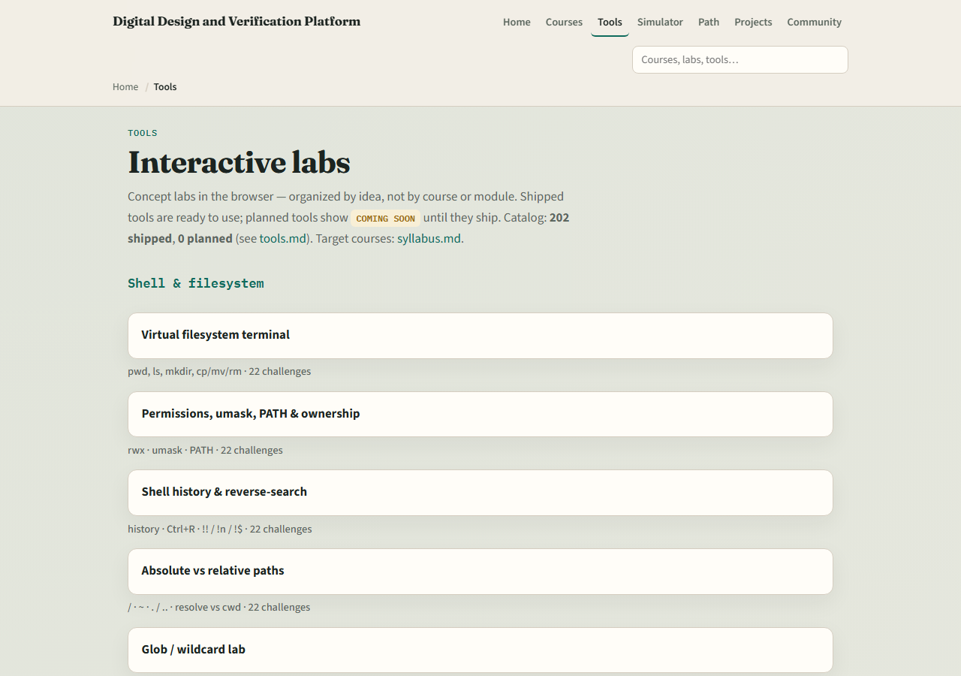
The tools you practiced
Here is the tools index again, the same shelf of concept labs you opened along the way
You do not need to re-clear every challenge
Use it as a map
learn_uvm2017 — wrap
Notes:
Here is the tools index again—the same shelf of concept labs you opened along the way. You do not need to re-clear every challenge. Use it as a map: if a skill still feels shaky, jump back to that lab, then return here when you are ready for planning, a protocol VIP, or pyuvm.

Slide 5
Next
Complete the quiz for this part
Verification planning and management deepen coverage closure, CI
learn_uvm2017 — wrap
Notes:
Verification planning and management deepen coverage closure, CI, and sign-off—do not re-teach full planning inside every VIP course. Protocol VIP work applies this anatomy to UART, SPI, I2C, and friends. Learn pyuvm covers the same methodology ideas in Python with cocotb. When your wrap checklist feels honest, continue on the syllabus ladder—or keep practicing weak modules and offline runs until factory, ConfigDB, and agents feel routine.

Slide 6
Your turn
Review the wrap checklist in the module README
Confirm you can sketch agent, env
When you are ready
learn_uvm2017 — wrap
Notes:
Review the wrap checklist in the module README. Confirm you can sketch agent, env, and scoreboard roles without looking them up, and that you know browser UVM tools are literacy only. When you are ready, take the short quiz, then open planning, a protocol VIP path, or learn pyuvm—whichever matches your next project.

