Slide 1
Run UVM on Verilator
Modules twenty-two and twenty-three moved you from host literacy to Makefile knobs
learn_uvm2017 — offline uvm verilator run
Notes:
Modules twenty-two and twenty-three moved you from host literacy to Makefile knobs. Module twenty-four is the fidelity step: compile Accellera UVM twenty seventeen with Verilator using the **in-course** and-gate hello. You leave with a command line you can repeat—UVM home, make run, read pass or fail. No dependency on ignored legacy trees for the primary path.

Slide 2
Verilator-first offline run
Browser sketches taught factory, agents, and sequences, they do not compile uvm_pkg
Offline you use the in-course Makefile: export UVM home, make run with Verilator
The flow compiles uvm_pkg plus DUT plus test into a C++ executable
First cold compile can take many minutes; later rebuilds reuse objects
learn_uvm2017 — offline uvm verilator run
Notes:
Browser sketches taught factory, agents, and sequences—they do not compile uvm_pkg. Offline you use the in-course Makefile: export UVM home, make run with Verilator. The flow compiles uvm_pkg plus DUT plus test into a C++ executable, then runs with plus UVM test name AndGateTest. First cold compile can take many minutes; later rebuilds reuse objects.

Slide 3
Offline workflow
Open examples verilator-uvm-hello beside this curriculum
Export UVM home to Accellera src
Run make dry-run if you skipped module twenty-three
Then make run
Watch Verilator compile stages finish, then the binary print UVM info and a report summary
Capture the exact command and the pass or fail line
learn_uvm2017 — offline uvm verilator run
Notes:
Open examples verilator-uvm-hello beside this curriculum. Export UVM home to Accellera src. Run make dry-run if you skipped module twenty-three. Then make run. Watch Verilator compile stages finish, then the binary print UVM info and a report summary. Capture the exact command and the pass or fail line. If it fails, record the stage—UVM home, compile, link, or run—and the first error line.

Slide 4
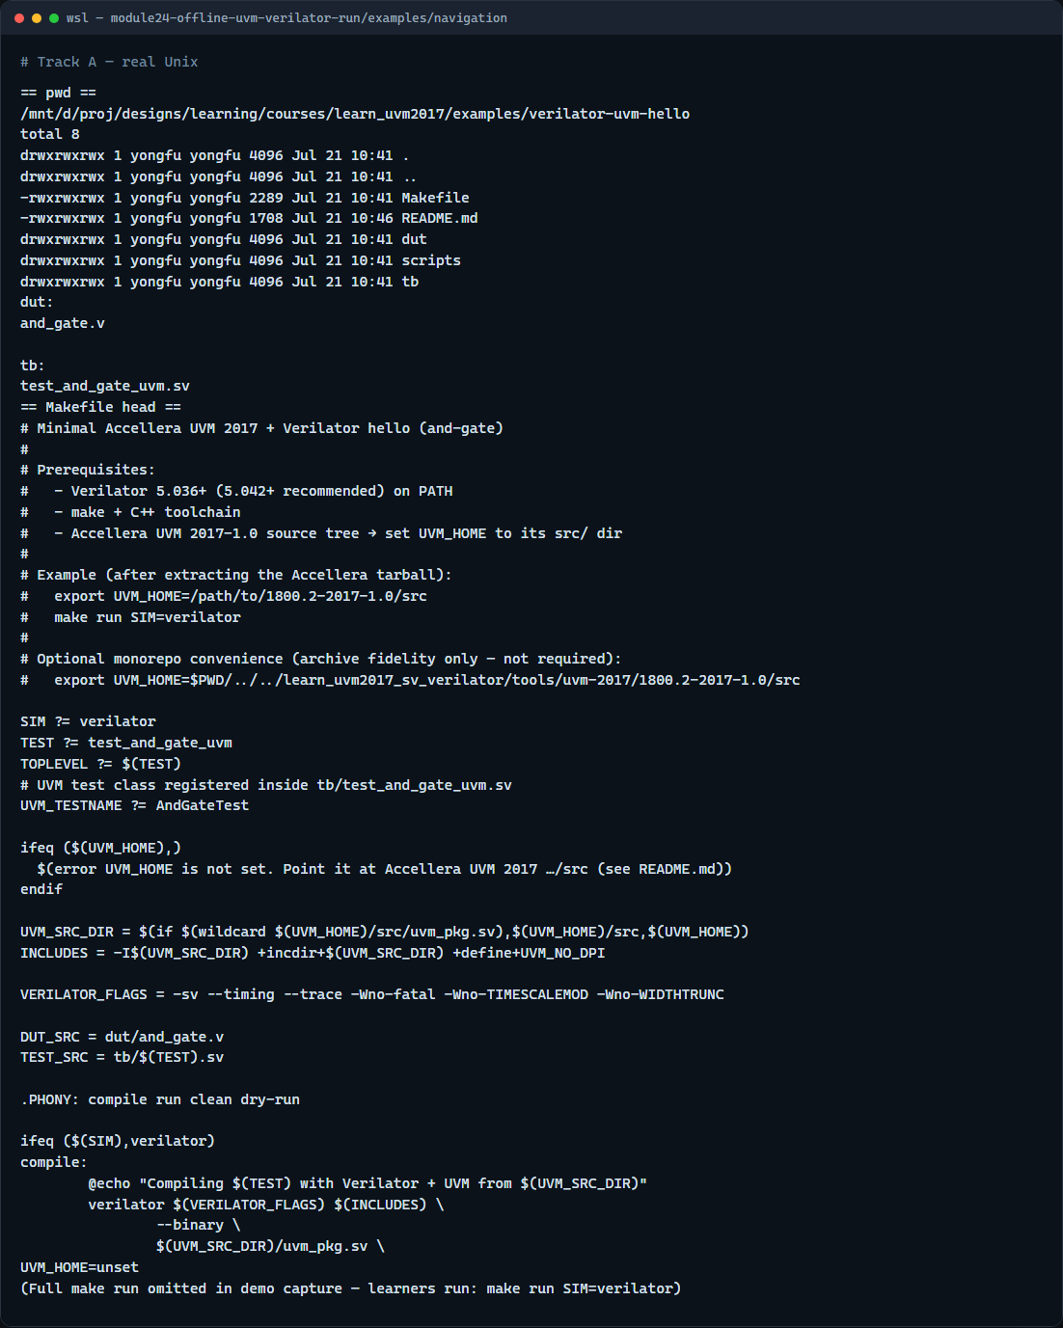
Real Verilator UVM run
Real shell — Verilator UVM make run
learn_uvm2017 — offline uvm verilator run
Notes:
In the real UVM track, enter the in-course hello, export UVM home, then compile and run.

Slide 5
Real Verilator UVM run — try these
# cd in-course Verilator + UVM hello
cd courses/learn_uvm2017/examples/verilator-uvm-hello
# export UVM_HOME — Accellera UVM 2017 src/
export UVM_HOME=/path/to/1800.2-2017-1.0/src
# make run — Verilator compile + execute +UVM_TESTNAME=AndGateTest
make run SIM=verilator
learn_uvm2017 — offline uvm verilator run

Slide 6
Pitfalls to watch
Unset UVM home fails before useful compile output
A browser UVM sketch pass is not a Verilator UVM pass
Patience on first compile, UVM templates are heavy
If Verilator is too old for UVM twenty seventeen, upgrade or note the version blocker
Keep the ignored legacy archive out of your default path
learn_uvm2017 — offline uvm verilator run
Notes:
Unset UVM home fails before useful compile output. A browser UVM sketch pass is not a Verilator UVM pass. Patience on first compile—UVM templates are heavy. If Verilator is too old for UVM twenty seventeen, upgrade or note the version blocker. Keep the ignored legacy archive out of your default path; the in-course hello is the contract for this module.

Slide 7
Your turn
Complete the checklist: dry-run green, make run finished, pass or fail recorded
Prefer the in-course and-gate hello unless your site policy points elsewhere
When you are ready, take the short quiz, then continue to the wrap module
learn_uvm2017 — offline uvm verilator run
Notes:
Complete the checklist: dry-run green, make run finished, pass or fail recorded. Prefer the in-course and-gate hello unless your site policy points elsewhere. When you are ready, take the short quiz, then continue to the wrap module.

