Slide 1
UVM path complete
You have walked the UVM twenty seventeen path
learn_uvm2017 — wrap
Notes:
You have walked the UVM twenty seventeen path—from layered testbench roles and anatomy, through phases, factory, ConfigDB, agents, TLM, sequences, and objections, to scoreboards, RAL, multi-agent coordination, VIP packages, and the Verilator fidelity arc in modules twenty-two through twenty-four. This short wrap names what you can do now and points you to the next courses on the ladder.

Slide 2
What you can do now
You can explain layered testbench roles and how UVM maps onto them
You can navigate phases, factory overrides, ConfigDB, agent anatomy
VIP handoff pieces
Run, or rehearse, a small offline UVM test on Verilator
That is the methodology literacy later VIP and planning courses expect
learn_uvm2017 — wrap
Notes:
You can explain layered testbench roles and how UVM maps onto them. You can navigate phases, factory overrides, ConfigDB, agent anatomy, and sequence-to-driver flow in your own words. You can point at scoreboard, RAL, multi-agent, virtual sequences, callbacks, reporting, protocol checkers, and VIP handoff pieces. You can explain Verilator as a UVM host, read Makefile knobs like UVM home and SIM equals Verilator, and run—or rehearse—a small offline UVM test on Verilator. That is the methodology literacy later VIP and planning courses expect.

Slide 3
Close the track gaps
If you mainly used browser labs
If you mainly used offline UVM
Either track works for self-study; both together stick best before you move on
Browser tools are literacy sketches, not a substitute for Accellera UVM on a simulator
learn_uvm2017 — wrap
Notes:
If you mainly used browser labs, prioritize Track A modules twenty-two through twenty-four—host limits, Makefile map, then make run so Accellera UVM on Verilator feels real. If you mainly used offline UVM, skim any skipped browser sketches for visual literacy on anatomy, phases, and agents. Either track works for self-study; both together stick best before you move on. Remember: browser tools are literacy sketches, not a substitute for Accellera UVM on a simulator.

Slide 4
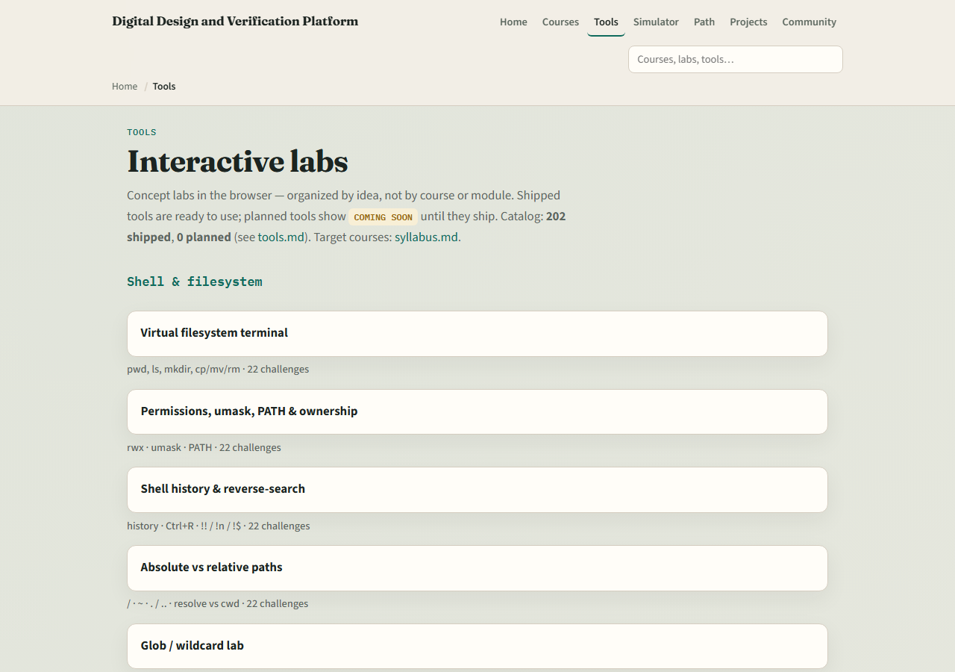
The tools you practiced
Here is the tools index again, the same shelf of concept labs you opened along the way
You do not need to re-clear every challenge
Use it as a map
learn_uvm2017 — wrap
Notes:
Here is the tools index again—the same shelf of concept labs you opened along the way. You do not need to re-clear every challenge. Use it as a map: if a skill still feels shaky, jump back to that lab, then return here when you are ready for planning, a protocol VIP, or pyuvm.

Slide 5
Next
Complete the quiz for this part
Verification planning and management deepen coverage closure, CI
learn_uvm2017 — wrap
Notes:
Verification planning and management deepen coverage closure, CI, and sign-off—do not re-teach full planning inside every VIP course. Protocol VIP work applies this anatomy to UART, SPI, I2C, and friends. Learn pyuvm covers the same methodology ideas in Python with cocotb. When your wrap checklist feels honest, continue on the syllabus ladder—or keep practicing weak modules and the Verilator UVM run until factory, ConfigDB, and agents feel routine.

Slide 6
Your turn
Review the wrap checklist in the module README
Confirm you can sketch agent, env
When you are ready
learn_uvm2017 — wrap
Notes:
Review the wrap checklist in the module README. Confirm you can sketch agent, env, and scoreboard roles without looking them up, that you know browser UVM tools are literacy only, and that you attempted or rehearsed modules twenty-two through twenty-four. When you are ready, take the short quiz, then open planning, a protocol VIP path, or learn pyuvm—whichever matches your next project.

