Slide 1
Module 0
Installation and Setup
learn_uvm2017_sv_verilator / Module 0

Slide 2
Learning objectives
• Set up development environment and verify
installation
learn_uvm2017_sv_verilator / Module 0

Slide 3
Prerequisites
• See module README
learn_uvm2017_sv_verilator / Module 0

Slide 4
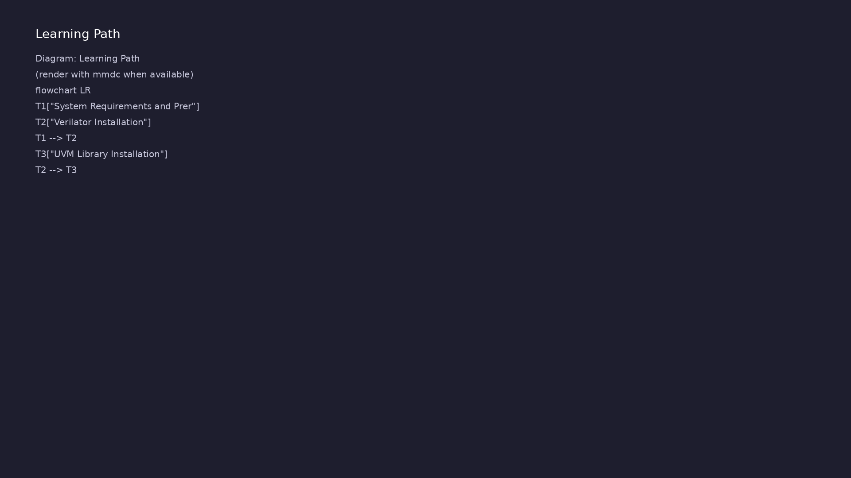
Learning path
Set up development environment and verify installation
learn_uvm2017_sv_verilator / Module 0

Slide 5
Overview
• This module covers the complete setup of your
verification environment, including all required
tool…
learn_uvm2017_sv_verilator / Module 0

Slide 6
Design architecture
learn_uvm2017_sv_verilator / Module 0

Slide 7
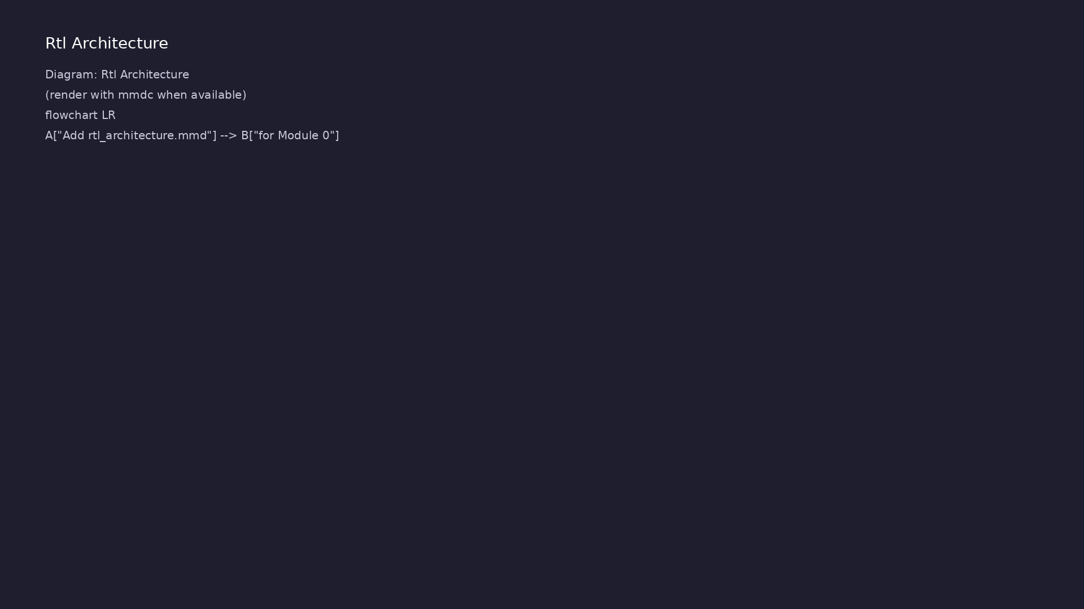
1. Course repository layout (1/3)
• Project-local install
(`--local`) keeps tools inside
the repo for reproducibility
• WSL2/Linux is the primary
target; macOS supported via
Homebrew
• Environment variables:
`VERILATOR_ROOT`, `UVM_HOME`
must resolve before running labs
• tools/verilator/: Git submodule
— SystemVerilog/Verilog
simulator (build from source)
learn_uvm2017_sv_verilator / Module 0
Notes:
From MODULE0 Design Architecture.

Slide 8
1. Course repository layout (2/3)
• tools/uvm-2017/: IEEE 1800.2-2017 UVM library
sources (UVM_HOME)
• scripts/installation.sh: One-shot installer for
Verilator + UVM + dependencies
• scripts/moduleN.sh: Per-module example orchestrator
(modules 1–8)
• moduleN/examples/: Hands-on labs referenced by
slides and EXAMPLES.md
learn_uvm2017_sv_verilator / Module 0
Notes:
From MODULE0 Design Architecture.

Slide 9
1. Course repository layout (3/3)
• media/moduleN/: Generated slides, PDF, and narrated
video per module
learn_uvm2017_sv_verilator / Module 0
Notes:
From MODULE0 Design Architecture.

Slide 10
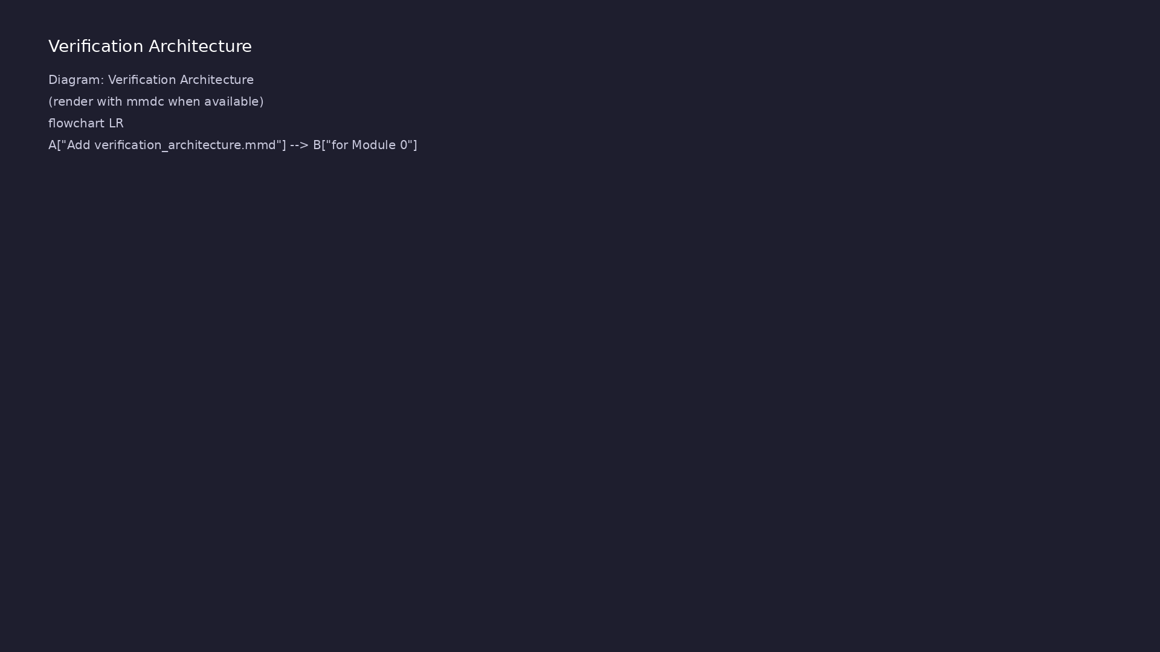
2. Build and simulation artifact flow (1/2)
• Verilator compiles design +
testbench into a single fast C++
binary
• UVM examples add
`-I$UVM_HOME/src` and
`+define+UVM_NO_DPI` for
Verilator compatibility
• Self-check flow: install →
`verilator --version` →
`./scripts/module0.sh --check` →
run Module 1 lab
• 1: Source .v/.sv — RTL and
testbench SystemVerilog
learn_uvm2017_sv_verilator / Module 0
Notes:
From MODULE0 Design Architecture.

Slide 11
2. Build and simulation artifact flow (2/2)
• 2: verilator --cc — Emits C++ model under obj_dir/
• 3: make -C obj_dir — Links Vtop (or V<module>)
executable
• 4: ./obj_dir/V* — Runs simulation; prints PASS/FAIL
or UVM report
• 5: *.vcd (optional) — Waveform when --trace enabled
learn_uvm2017_sv_verilator / Module 0
Notes:
From MODULE0 Design Architecture.

Slide 12
Installation & execution
learn_uvm2017_sv_verilator / Module 0

Slide 13
How to run this module
• From repo root: ./scripts/module0.sh --check —
validate environment
• ./scripts/module0.sh --demo — print demo commands to
run locally
• ./scripts/module0.sh --scaffold — create
~/unix_practice/ exercise files
• Open module0/EXAMPLES.md — run each numbered lab in
your terminal
• Track progress with module0/CHECKLIST.md before
moving on
learn_uvm2017_sv_verilator / Module 0
Notes:
From MODULE0 — execution and artifact layout.

Slide 14
Artifact flow (spec → sim) (1)
• 1: Source .v/.sv — RTL and testbench SystemVerilog
• 2: verilator --cc — Emits C++ model under obj_dir/
• 3: make -C obj_dir — Links Vtop (or V<module>)
executable
• 4: ./obj_dir/V* — Runs simulation; prints PASS/FAIL
or UVM report
learn_uvm2017_sv_verilator / Module 0
Notes:
From MODULE0 — execution and artifact layout.

Slide 15
Artifact flow (spec → sim) (2)
• 5: *.vcd (optional) — Waveform when --trace enabled
learn_uvm2017_sv_verilator / Module 0
Notes:
From MODULE0 — execution and artifact layout.

Slide 16
Example directory layout (1)
• tools/verilator/: Git submodule —
SystemVerilog/Verilog simulator (build from source)
• tools/uvm-2017/: IEEE 1800.2-2017 UVM library
sources (UVM_HOME)
• scripts/installation.sh: One-shot installer for
Verilator + UVM + dependencies
• scripts/moduleN.sh: Per-module example orchestrator
(modules 1–8)
• moduleN/examples/: Hands-on labs referenced by
slides and EXAMPLES.md
learn_uvm2017_sv_verilator / Module 0
Notes:
Match each path to files under module/examples/.

Slide 17
Example directory layout (2)
• media/moduleN/: Generated slides, PDF, and narrated
video per module
learn_uvm2017_sv_verilator / Module 0
Notes:
Match each path to files under module/examples/.

Slide 18
Step-by-step execution sequence
• install
• verilator --version
• ./scripts/module0.sh --check
• run Module 1 lab
learn_uvm2017_sv_verilator / Module 0
Notes:
Follow these steps in order when working through this module.

Slide 19
Verification & testing methods
learn_uvm2017_sv_verilator / Module 0

Slide 20
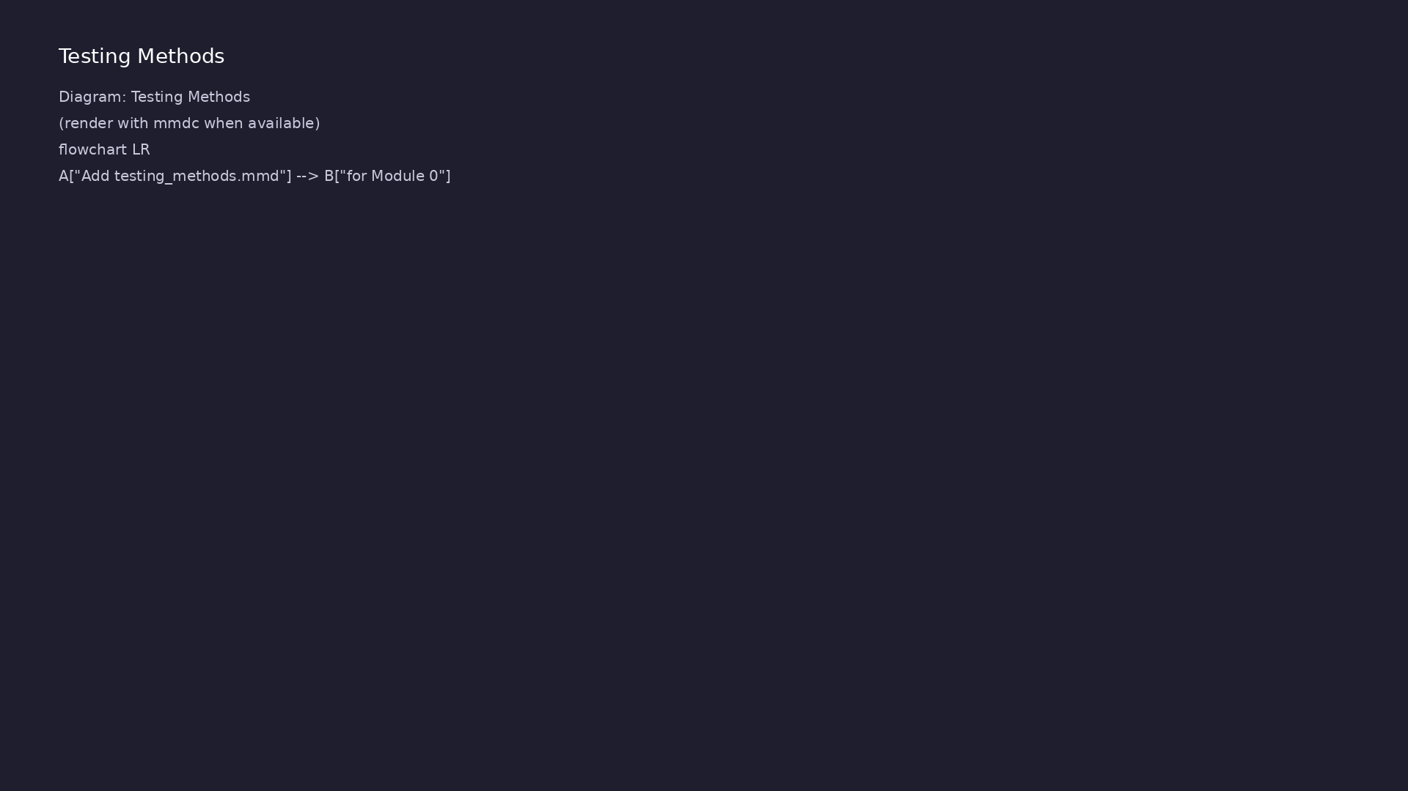
1. Environment verification strategy (1/2)
• Run `./scripts/installation.sh`
(or per-tool scripts) before any
module labs
• Verify compiler toolchain: `gcc
--version`, `make --version`,
`git --version`
• Confirm Verilator: `verilator
--version` and a minimal
`--lint-only` compile
• Confirm UVM: `echo $UVM_HOME`
points at `tools/uvm-
2017/1800.2-2017-1.0/src`
learn_uvm2017_sv_verilator / Module 0
Notes:
From MODULE0 Verification & Testing Methods.

Slide 21
1. Environment verification strategy (2/2)
• Use `./scripts/module0.sh --check` for an automated
PASS summary
learn_uvm2017_sv_verilator / Module 0
Notes:
From MODULE0 Verification & Testing Methods.

Slide 22
2. Smoke test and troubleshooting workflow (1/2)
• Smoke test: compile one trivial
Verilog file with Verilator;
expect clean exit
• UVM smoke: run `module3/examples
/class_hierarchy` after Module 0
completes
• Common failures: missing
`UVM_HOME`, wrong Verilator
version, WSL path issues
• Logs: capture terminal output;
search for `Error`, `%Error`,
`UVM_FATAL`
learn_uvm2017_sv_verilator / Module 0
Notes:
From MODULE0 Verification & Testing Methods.

Slide 23
2. Smoke test and troubleshooting workflow (2/2)
• Escalation: re-run installer with `--from-submodule`
for a clean Verilator build
learn_uvm2017_sv_verilator / Module 0
Notes:
From MODULE0 Verification & Testing Methods.

Slide 24
Syllabus topics
learn_uvm2017_sv_verilator / Module 0

Slide 25
1. System Requirements and Prerequisites (1/3)
• Operating System Support
• Linux (Ubuntu/Debian, CentOS/RHEL, Fedora)
• macOS (Intel and Apple Silicon)
• Windows (WSL2 recommended)
• Hardware Requirements
• Minimum 8GB RAM (16GB+ recommended)
learn_uvm2017_sv_verilator / Module 0
Notes:
From MODULE0 Topics Covered.

Slide 26
1. System Requirements and Prerequisites (2/3)
• 10GB free disk space
• Multi-core processor recommended
• Software Prerequisites
• C/C++ compiler (GCC 7+, Clang 10+, or MSVC)
• Make or Ninja build system
• Git
learn_uvm2017_sv_verilator / Module 0
Notes:
From MODULE0 Topics Covered.

Slide 27
1. System Requirements and Prerequisites (3/3)
• Perl (for UVM library)
learn_uvm2017_sv_verilator / Module 0
Notes:
From MODULE0 Topics Covered.

Slide 28
2. Verilator Installation (1/6)
• What is Verilator?
• Open-source Verilog/SystemVerilog simulator
• Fast compilation and simulation
• Limited SystemVerilog support (see limitations
section)
• Automated Installation (Recommended)
• Using the installation script:
learn_uvm2017_sv_verilator / Module 0
Notes:
From MODULE0 Topics Covered.

Slide 29
2. Verilator Installation (2/6)
• The script automatically:
• Checks for existing installations
• Installs system dependencies (build tools,
libraries)
• Sets up git submodule in `tools/verilator/`
• Builds and installs Verilator
• Verifies the installation
learn_uvm2017_sv_verilator / Module 0
Notes:
From MODULE0 Topics Covered.

Slide 30
2. Verilator Installation (3/6)
• Manual Installation Methods
• Linux Installation
• Ubuntu/Debian: `sudo apt-get install verilator`
• CentOS/RHEL: `sudo yum install verilator` or `sudo
dnf install verilator`
• Fedora: `sudo dnf install verilator`
• Building from source (latest features)
learn_uvm2017_sv_verilator / Module 0
Notes:
From MODULE0 Topics Covered.

Slide 31
2. Verilator Installation (4/6)
• macOS Installation
• Homebrew installation: `brew install verilator`
• MacPorts installation (alternative)
• Building from source
• Windows/WSL2 Installation
• Installing in WSL2 Ubuntu: `sudo apt-get install
verilator`
learn_uvm2017_sv_verilator / Module 0
Notes:
From MODULE0 Topics Covered.

Slide 32
2. Verilator Installation (5/6)
• Building from source in WSL2
• Verifying installation
• Uninstallation
• Verification Steps
• Check Verilator version: `verilator --version`
• Run simple Verilator test
learn_uvm2017_sv_verilator / Module 0
Notes:
From MODULE0 Topics Covered.

Slide 33
2. Verilator Installation (6/6)
• Verify compilation works
learn_uvm2017_sv_verilator / Module 0
Notes:
From MODULE0 Topics Covered.

Slide 34
3. UVM Library Installation (1/5)
• What is UVM?
• Universal Verification Methodology
• IEEE 1800.2-2017 standard
• Industry-standard verification framework
• Automated Installation (Recommended)
• Using the installation script:
learn_uvm2017_sv_verilator / Module 0
Notes:
From MODULE0 Topics Covered.

Slide 35
3. UVM Library Installation (2/5)
• The script automatically:
• Downloads Accellera UVM 2017-1.0 tarball to
`tools/uvm-2017/`
• Extracts and sets up UVM library
• Creates environment setup script
(`scripts/setup_uvm_env.sh`)
• Configures UVM library paths
• Manual Installation Methods
learn_uvm2017_sv_verilator / Module 0
Notes:
From MODULE0 Topics Covered.

Slide 36
3. UVM Library Installation (3/5)
• From Accellera Tarball:
• From System Package (if available):
• Some Linux distributions provide UVM packages
• Check your distribution's package manager
• Uninstallation
• Environment Variables
learn_uvm2017_sv_verilator / Module 0
Notes:
From MODULE0 Topics Covered.

Slide 37
3. UVM Library Installation (4/5)
• `UVM_HOME`: Path to UVM library
• `UVM_VERBOSITY`: Default verbosity level
• Include paths for compilation
• Verification Steps
• Check UVM library exists: `ls $UVM_HOME/uvm_pkg.sv`
(after sourcing `scripts/setup_uvm_env.sh`)
• Compile simple UVM test
learn_uvm2017_sv_verilator / Module 0
Notes:
From MODULE0 Topics Covered.

Slide 38
3. UVM Library Installation (5/5)
• Verify UVM classes available
learn_uvm2017_sv_verilator / Module 0
Notes:
From MODULE0 Topics Covered.

Slide 39
4. Commercial Simulator Setup (Optional) (1/2)
• Synopsys VCS
• Installation from Synopsys
• License setup
• UVM library integration
• Mentor QuestaSim/ModelSim
• Installation from Siemens
learn_uvm2017_sv_verilator / Module 0
Notes:
From MODULE0 Topics Covered.

Slide 40
4. Commercial Simulator Setup (Optional) (2/2)
• License setup
• UVM library integration
• Cadence Xcelium
• Installation from Cadence
• License setup
• UVM library integration
learn_uvm2017_sv_verilator / Module 0
Notes:
From MODULE0 Topics Covered.

Slide 41
5. Build System Configuration (1/3)
• Makefile Setup
• Basic Makefile for Verilator
• Compilation flags
• Include paths
• Test execution
• Verilator Compilation
learn_uvm2017_sv_verilator / Module 0
Notes:
From MODULE0 Topics Covered.

Slide 42
5. Build System Configuration (2/3)
• SystemVerilog flags: `-sv`, `--timing`
• Include paths: `+incdir+$UVM_HOME` (UVM_HOME already
points to the src directory)
• Optimization flags
• Coverage options
• Commercial Simulator Setup
• Compilation scripts
learn_uvm2017_sv_verilator / Module 0
Notes:
From MODULE0 Topics Covered.

Slide 43
5. Build System Configuration (3/3)
• Simulation scripts
• Waveform generation
learn_uvm2017_sv_verilator / Module 0
Notes:
From MODULE0 Topics Covered.

Slide 44
6. IDE Setup and Configuration (1/3)
• Recommended IDEs
• VS Code with SystemVerilog extension
• Verible (SystemVerilog linter/formatter)
• Sigasi Studio (commercial)
• Vim/Neovim with LSP
• VS Code Configuration
learn_uvm2017_sv_verilator / Module 0
Notes:
From MODULE0 Topics Covered.

Slide 45
6. IDE Setup and Configuration (2/3)
• SystemVerilog extension setup
• Verilator integration
• Debugging configuration
• Task runner setup for simulations
• Extension recommendations
• Editor Configuration
learn_uvm2017_sv_verilator / Module 0
Notes:
From MODULE0 Topics Covered.

Slide 46
6. IDE Setup and Configuration (3/3)
• SystemVerilog formatting (Verible)
• Linting (Verilator, Verible)
• Code formatting on save
• Syntax highlighting
learn_uvm2017_sv_verilator / Module 0
Notes:
From MODULE0 Topics Covered.

Slide 47
7. Project Structure Setup (1/4)
• Directory Structure
• Source code organization
• Test directory structure
• DUT (Design Under Test) organization
• Configuration files
• `tools/` directory for tools (Verilator as git
submodule, UVM as tarball)
learn_uvm2017_sv_verilator / Module 0
Notes:
From MODULE0 Topics Covered.

Slide 48
7. Project Structure Setup (2/4)
• Git Submodules Management
• Verilator is managed as a git submodule in
`tools/verilator/`
• UVM is downloaded as a tarball to `tools/uvm-2017/`
(not a git submodule)
• Initialize submodules:
`./scripts/init_submodules.sh` or `git submodule
update --init --recursive`
• Update submodules: `./scripts/update_submodules.sh`
or `git submodule update --remote`
• Add new submodule: `./scripts/add_submodule.sh
<repo_url> <path>`
learn_uvm2017_sv_verilator / Module 0
Notes:
From MODULE0 Topics Covered.

Slide 49
7. Project Structure Setup (3/4)
• Remove submodule: `./scripts/remove_submodule.sh
<path>`
• Makefile/Configuration
• Simple Makefile for running tests
• Verilator configuration
• Environment variable management
• Version Control
learn_uvm2017_sv_verilator / Module 0
Notes:
From MODULE0 Topics Covered.

Slide 50
7. Project Structure Setup (4/4)
• Git initialization
• .gitignore for SystemVerilog and simulation (include
build artifacts, waveforms)
• Initial commit structure
• Git submodules in `.gitmodules` file (only
Verilator, not UVM)
learn_uvm2017_sv_verilator / Module 0
Notes:
From MODULE0 Topics Covered.

Slide 51
8. First "Hello World" Verification Test (1/3)
• Prerequisites
• Ensure all tools are installed:
`./scripts/installation.sh`
• Verify tools are accessible: `verilator --version`
and `ls $UVM_HOME/uvm_pkg.sv` (after sourcing `s…
• Simple DUT Creation
• Basic Verilog module (e.g., AND gate)
• Simple testbench structure
learn_uvm2017_sv_verilator / Module 0
Notes:
From MODULE0 Topics Covered.

Slide 52
8. First "Hello World" Verification Test (2/3)
• SystemVerilog Test
• Basic SystemVerilog testbench structure
• Clock generation
• Signal driving and reading
• Running the test
• UVM Test
learn_uvm2017_sv_verilator / Module 0
Notes:
From MODULE0 Topics Covered.

Slide 53
8. First "Hello World" Verification Test (3/3)
• First UVM test class
• Basic UVM phases
• Running UVM test
• Understanding output
learn_uvm2017_sv_verilator / Module 0
Notes:
From MODULE0 Topics Covered.

Slide 54
9. Verilator Limitations and Workarounds (1/3)
• Known Limitations
• Limited SystemVerilog support
• Some UVM classes may not work
• Complex TLM connections may fail
• Full assertion support limited
• Workarounds
learn_uvm2017_sv_verilator / Module 0
Notes:
From MODULE0 Topics Covered.

Slide 55
9. Verilator Limitations and Workarounds (2/3)
• Use simplified patterns where possible
• Document commercial alternatives
• Focus on concepts over tool features
• Commercial Simulator Alternatives
• When Verilator doesn't support a feature
• How to adapt examples for commercial tools
learn_uvm2017_sv_verilator / Module 0
Notes:
From MODULE0 Topics Covered.

Slide 56
9. Verilator Limitations and Workarounds (3/3)
• Compatibility notes
learn_uvm2017_sv_verilator / Module 0
Notes:
From MODULE0 Topics Covered.

Slide 57
10. Troubleshooting Common Issues (1/4)
• Verilator Issues
• Compilation errors
• Missing dependencies
• Version compatibility
• Path issues
• SystemVerilog syntax errors
learn_uvm2017_sv_verilator / Module 0
Notes:
From MODULE0 Topics Covered.

Slide 58
10. Troubleshooting Common Issues (2/4)
• UVM Library Issues
• Import errors
• Path configuration
• Version compatibility
• Compilation errors
• Build System Issues
learn_uvm2017_sv_verilator / Module 0
Notes:
From MODULE0 Topics Covered.

Slide 59
10. Troubleshooting Common Issues (3/4)
• Makefile errors
• Include path problems
• Compilation flags
• IDE Issues
• SystemVerilog syntax highlighting
• Import resolution problems
learn_uvm2017_sv_verilator / Module 0
Notes:
From MODULE0 Topics Covered.

Slide 60
10. Troubleshooting Common Issues (4/4)
• Debugging not working
learn_uvm2017_sv_verilator / Module 0
Notes:
From MODULE0 Topics Covered.

Slide 61
11. Verification Checklist (1/3)
• C/C++ compiler installed and working
• Verilator installed and verified
• Using script: `./scripts/install_verilator.sh
--from-submodule`
• Verify: `verilator --version`
• UVM library installed and verified
• Using script: `./scripts/installation.sh` (UVM is
installed automatically)
learn_uvm2017_sv_verilator / Module 0
Notes:
From MODULE0 Topics Covered.

Slide 62
11. Verification Checklist (2/3)
• Verify: `ls $UVM_HOME/uvm_pkg.sv` (after sourcing
`scripts/setup_uvm_env.sh`)
• All tools verified together: Run
`./scripts/installation.sh` and verify with
`verilator --version`…
• IDE configured and working
• First test runs successfully
• Can create and run simple testbench
• Understand basic project structure
learn_uvm2017_sv_verilator / Module 0
Notes:
From MODULE0 Topics Covered.

Slide 63
11. Verification Checklist (3/3)
• Know how to get help when stuck
• Understand Verilator limitations
learn_uvm2017_sv_verilator / Module 0
Notes:
From MODULE0 Topics Covered.

Slide 64
Hands-on examples
learn_uvm2017_sv_verilator / Module 0

Slide 65

Module 0 self-check
$ verilator --version
learn_uvm2017_sv_verilator / Module 0
Notes:
Run from course repository root.

Slide 66
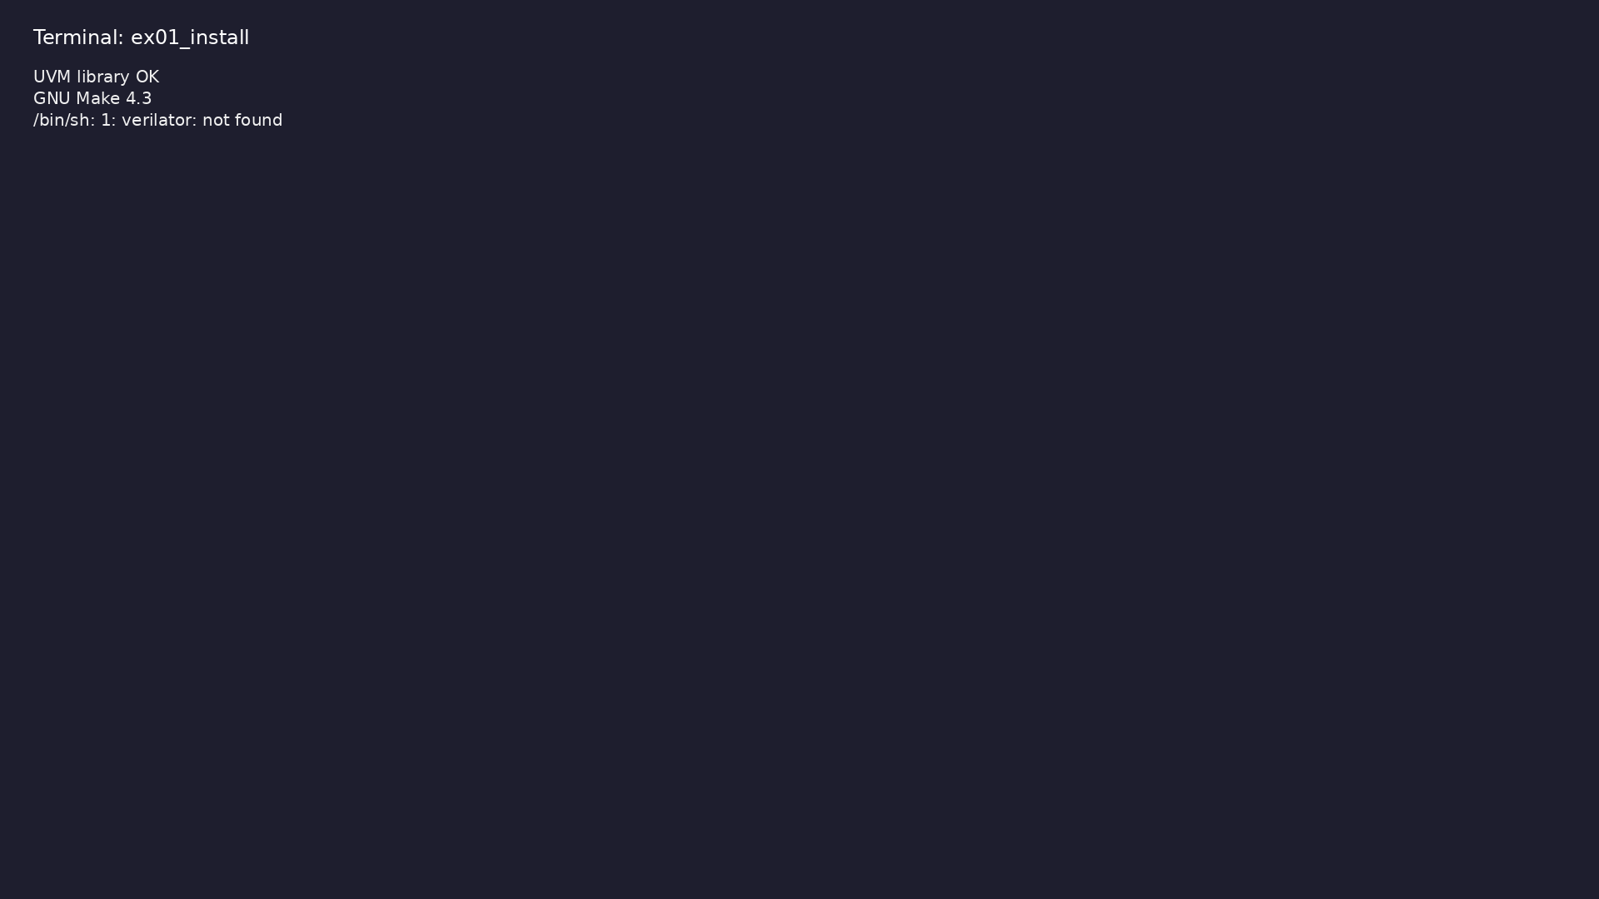
Demo: Verify toolchain
$ verilator --version && source scripts/setup_uvm_env.sh 2>/dev/null
|| true && test -f
"${UVM_HOME:-tools/uvm-2017/1800.2-2017-1.0/src}/uvm_pkg.sv" && echo
"UVM library OK" && make…
learn_uvm2017_sv_verilator / Module 0
Notes:
Hands-on: module0/examples/install/

Slide 67
Demo: Project layout
$ ls -la docs/MODULE0.md module1/README.md scripts/installation.sh
(screenshot pending: assets/screenshots/ex02_project.png)
learn_uvm2017_sv_verilator / Module 0
Notes:
Hands-on: module0/examples/project/

Slide 68
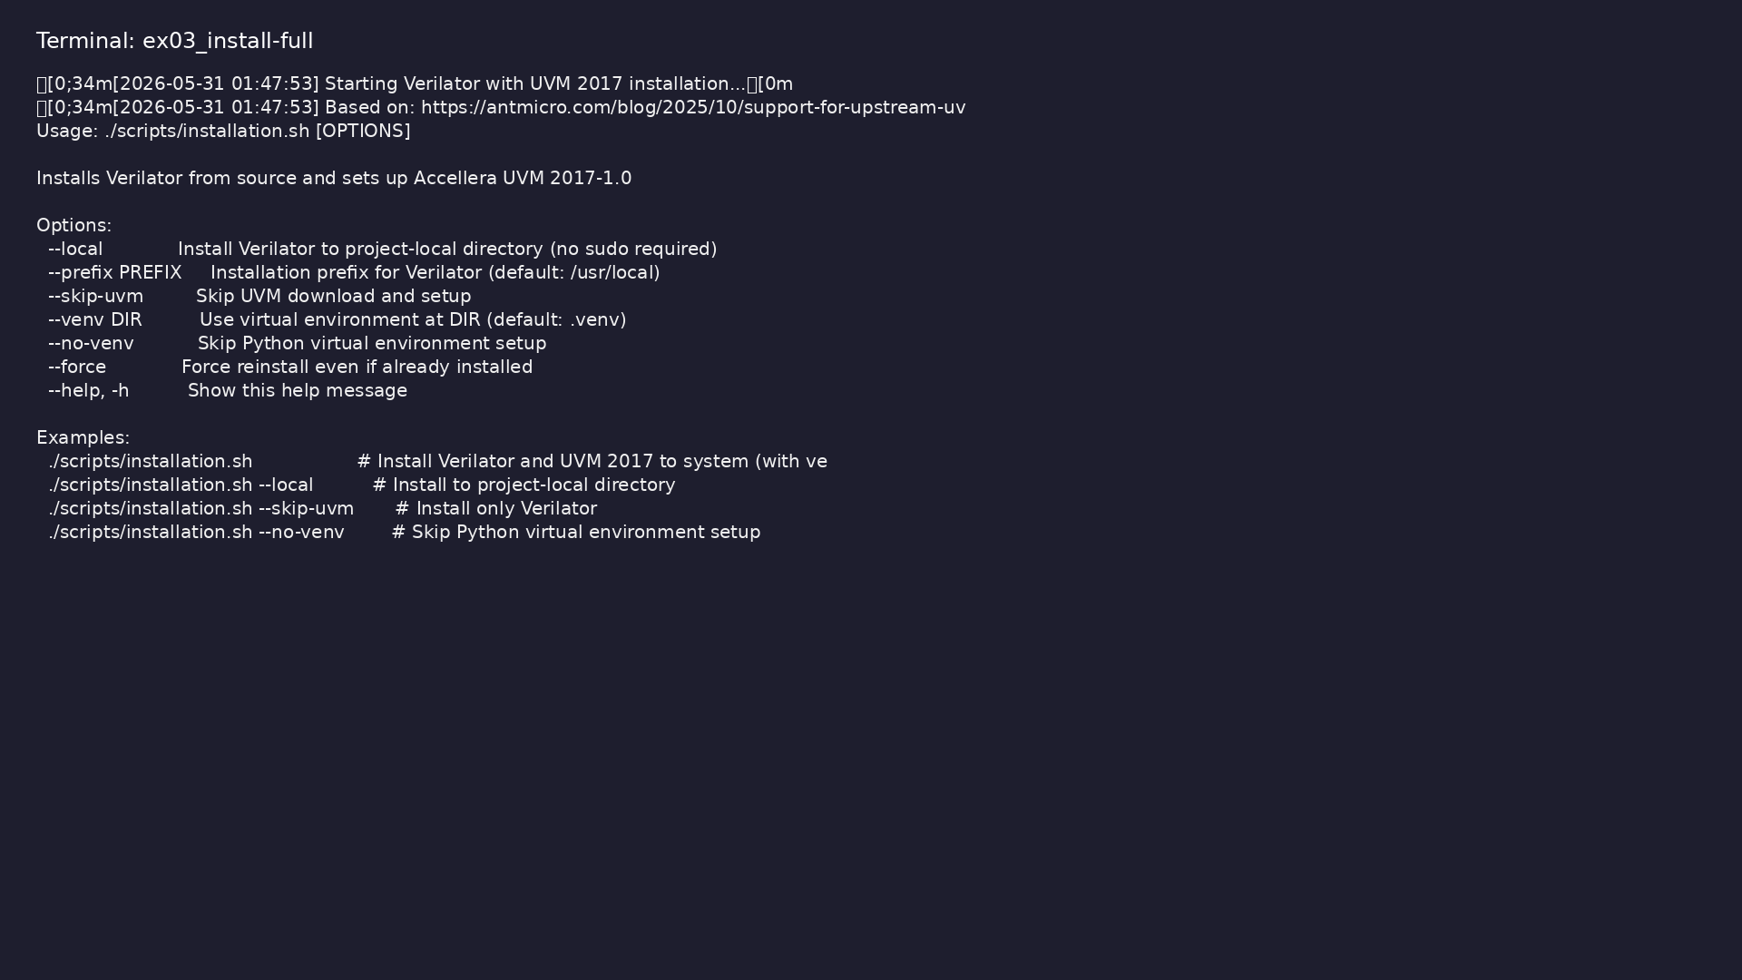
Demo: Optional full install
$ ./scripts/installation.sh --help | head -20
learn_uvm2017_sv_verilator / Module 0
Notes:
Hands-on: module0/examples/install-full/

Slide 69
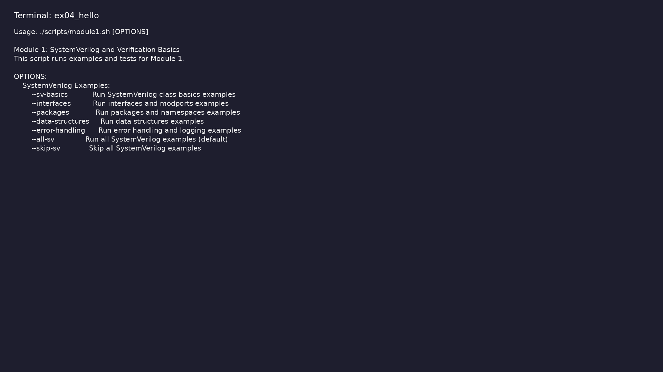
Demo: First smoke test
$ ./scripts/module1.sh --help | head -15
learn_uvm2017_sv_verilator / Module 0
Notes:
Hands-on: module0/examples/hello/

Slide 70
Practice & assessment
learn_uvm2017_sv_verilator / Module 0

Slide 71
What you should know (1/2)
• Install and configure all required tools
• Set up Verilator
• Install and verify UVM library
• Configure your IDE for verification work
• Create a basic project structure
• Run a simple verification test
learn_uvm2017_sv_verilator / Module 0
Notes:
From MODULE0 Learning Outcomes.

Slide 72
What you should know (2/2)
• Understand Verilator limitations
• Troubleshoot common installation issues
learn_uvm2017_sv_verilator / Module 0
Notes:
From MODULE0 Learning Outcomes.

Slide 73
Exercises
• Installation Verification
• Environment Setup
• First Test
• IDE Configuration
• Project Structure
learn_uvm2017_sv_verilator / Module 0

Slide 74
Assessment checklist
• Can install all required tools independently
• Can set up Verilator
• Can verify Verilator installation
• Can verify UVM library installation
• Can configure IDE for verification work
• Can create and run a simple test
learn_uvm2017_sv_verilator / Module 0

Slide 75
Summary & next steps
• Set up development environment and verify
installation
• Complete module0/CHECKLIST.md
• Review module0/EXAMPLES.md and run each lab
• Next: Next module in course
learn_uvm2017_sv_verilator / Module 0

