Slide 1
Module 1
SystemVerilog and Verification Basics
learn_uvm2017_sv_verilator / Module 1

Slide 2
Learning objectives
• Understand SystemVerilog for verification and
verification fundamentals
learn_uvm2017_sv_verilator / Module 1

Slide 3
Prerequisites
• See module README
learn_uvm2017_sv_verilator / Module 1

Slide 4

Learning path
Understand SystemVerilog for verification and verification fundamentals
learn_uvm2017_sv_verilator / Module 1

Slide 5
Overview
• This module establishes the foundation for
verification work. You'll learn essential
SystemVerilog…
learn_uvm2017_sv_verilator / Module 1

Slide 6
Design architecture
learn_uvm2017_sv_verilator / Module 1

Slide 7

1. Repository and example layout (1/3)
• Each example directory is self-
contained with README and
compile/run instructions
• DUTs are intentionally minimal
so you focus on SystemVerilog
language features
• UVM tests in `tests/uvm_tests/`
preview patterns used from
Module 3 onward
• module1/examples/sv_basics/:
Classes, inheritance,
polymorphism demos
learn_uvm2017_sv_verilator / Module 1
Notes:
From MODULE1 Design Architecture.

Slide 8
1. Repository and example layout (2/3)
• module1/examples/interfaces/: Interfaces, modports,
clocking blocks
• module1/examples/packages/: Packages and name
visibility
• module1/dut/simple_gates/: Small RTL (AND gate,
counter) for directed tests
• module1/tests/sv_tests/: Makefile-driven SV
testbenches on simple DUTs
learn_uvm2017_sv_verilator / Module 1
Notes:
From MODULE1 Design Architecture.

Slide 9
1. Repository and example layout (3/3)
• scripts/module1.sh: Orchestrates all examples and
tests
learn_uvm2017_sv_verilator / Module 1
Notes:
From MODULE1 Design Architecture.

Slide 10
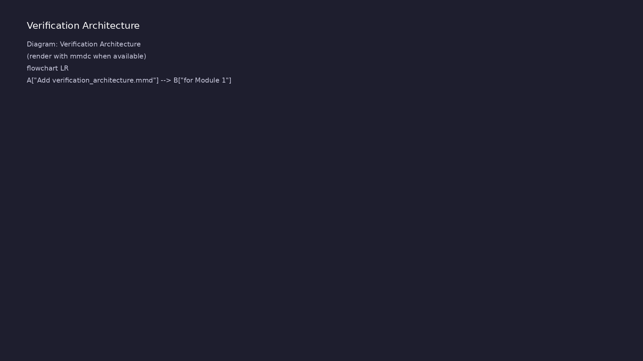
2. Verification building blocks (1/2)
• Classes — transactions and
models as reusable objects
(`uvm_object` foundation)
• Interfaces — bundle DUT signals;
connect testbench to RTL without
port lists
• Packages — share types and
parameters across testbench
files
• Data structures — queues,
associative arrays, dynamic
arrays for stimulus/history
learn_uvm2017_sv_verilator / Module 1
Notes:
From MODULE1 Design Architecture.

Slide 11
2. Verification building blocks (2/2)
• Layering: directed SV test → interface-based TB →
optional UVM wrapper
learn_uvm2017_sv_verilator / Module 1
Notes:
From MODULE1 Design Architecture.

Slide 12
RTL block diagram (reference)
Module 1: DUT hierarchy and signal flow.
learn_uvm2017_sv_verilator / Module 1

Slide 13
Execution & simulation flow
learn_uvm2017_sv_verilator / Module 1

Slide 14
How the example runs (toolchain)
• Makefile: Verilator + UVM_HOME compile RTL,
interface, and test_*.sv
• UVM phases: build → connect → run_test → report
(same pattern as Module 2)
• Sequence → driver → DUT → monitor → scoreboard (read
SCOREBOARD at end)
• Typical command: make SIM=verilator TEST=test_* (see
module1 demo slide)
• Loopback / hooks connect monitor observations to
scoreboard checks
learn_uvm2017_sv_verilator / Module 1
Notes:
From MODULE1 — execution and artifact layout.

Slide 15
Example directory layout (1)
• module1/examples/sv_basics/: Classes, inheritance,
polymorphism demos
• module1/examples/interfaces/: Interfaces, modports,
clocking blocks
• module1/examples/packages/: Packages and name
visibility
• module1/dut/simple_gates/: Small RTL (AND gate,
counter) for directed tests
• module1/tests/sv_tests/: Makefile-driven SV
testbenches on simple DUTs
learn_uvm2017_sv_verilator / Module 1
Notes:
Match each path to files under module/examples/.

Slide 16
Example directory layout (2)
• scripts/module1.sh: Orchestrates all examples and
tests
learn_uvm2017_sv_verilator / Module 1
Notes:
Match each path to files under module/examples/.

Slide 17
Directed test execution sequence
• make SIM=verilator TEST=test_and_gate
• compile
• run
• read result
learn_uvm2017_sv_verilator / Module 1
Notes:
Follow this order when tracing waveforms or debugging.

Slide 18
Verification & testing methods
learn_uvm2017_sv_verilator / Module 1

Slide 19
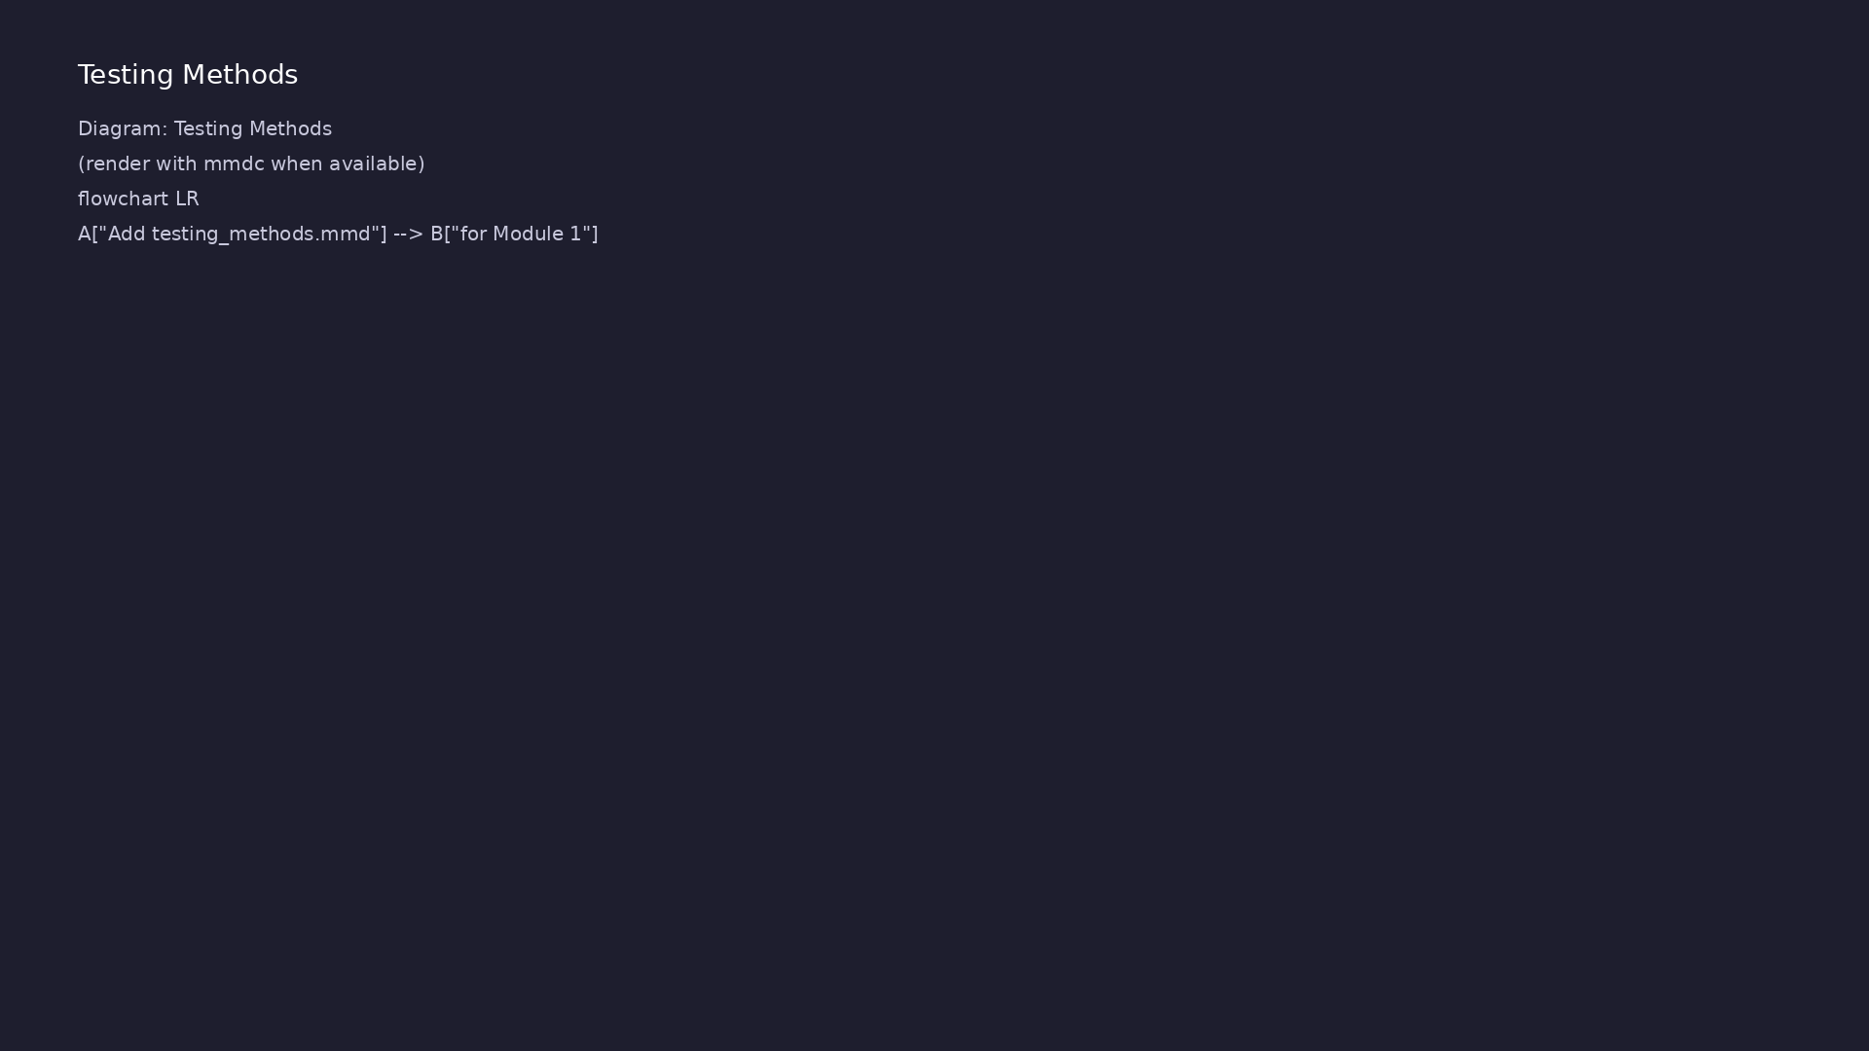
1. Directed self-check methodology
• Instantiate DUT, apply known
stimulus in `initial` block or
C++ main
• Compare outputs in-test; print
`PASS` / `FAIL` (no external
scoreboard yet)
• Use `$display` / `$error` for
visibility; graduate to
structured logging in Module 2
• Simulation flow: `make
SIM=verilator
TEST=test_and_gate` → compile →
run → read result
learn_uvm2017_sv_verilator / Module 1
Notes:
From MODULE1 Verification & Testing Methods.

Slide 20
2. Baseline test closure (1/2)
• Stimulus: fixed vectors covering
corner cases (0, 1, overflow,
reset)
• Checking: inline assertions and
explicit comparisons against
expected values
• Coverage: manual review of cases
exercised (functional coverage
in Module 5)
• Regression:
`./scripts/module1.sh --all-sv`
runs all example compilations
learn_uvm2017_sv_verilator / Module 1
Notes:
From MODULE1 Verification & Testing Methods.

Slide 21
2. Baseline test closure (2/2)
• Out of scope: constrained-random, scoreboards,
multi-agent coordination (later modules)
learn_uvm2017_sv_verilator / Module 1
Notes:
From MODULE1 Verification & Testing Methods.

Slide 22
Syllabus topics
learn_uvm2017_sv_verilator / Module 1

Slide 23
Protocol & design details
learn_uvm2017_sv_verilator / Module 1

Slide 24
Detail: Example 1.1: Transaction Classes (`module1/examples/sv_basics…
• Base `Transaction` class with static variables
(`id_counter`)
• Instance variables (`id`, `data`, `timestamp`)
• Special methods: `new()`, `copy()`, `compare()`,
`convert2string()`
• Inheritance: `ReadTransaction` and
`WriteTransaction` inherit from `Transaction`
learn_uvm2017_sv_verilator / Module 1
Notes:
From MODULE1 Topics Covered — protocol/design depth.

Slide 25
Detail: Example 1.1: Transaction Classes (`module1/examples/sv_basics…
• Method overriding: Child classes override
`convert2string()` method
• Using `super` to call parent class methods
• Purpose: Initialize object when created
• Called: Automatically via `Transaction txn = new();`
learn_uvm2017_sv_verilator / Module 1
Notes:
From MODULE1 Topics Covered — protocol/design depth.

Slide 26
Detail: Example 1.2: Interfaces and Modports (`module1/examples/inter…
• Interface Definition: `apb_if` interface with
signals and clocking block
• Modports: `master_mp` and `slave_mp` modports with
different signal directions
• Clocking Block: `cb` clocking block for synchronous
access
• Interface Usage: Module using interface with modport
learn_uvm2017_sv_verilator / Module 1
Notes:
From MODULE1 Topics Covered — protocol/design depth.

Slide 27
Detail: Example 1.2: Interfaces and Modports (`module1/examples/inter…
• Testbench Integration: Testbench connecting to
interface
• Task Usage: Clock generation task, APB transaction
tasks
• Purpose: Generate free-running clock signal
• Built-in Features: `forever` loop, delay operator
`#`, bitwise NOT `~`
learn_uvm2017_sv_verilator / Module 1
Notes:
From MODULE1 Topics Covered — protocol/design depth.

Slide 28
Detail: Example 1.3: Packages (`module1/examples/packages/package_exa…
• Package Definition: `verification_pkg` with common
types and functions
• Package Import: Using `import verification_pkg::*`
• Name Resolution: Handling name conflicts
• Package Organization: Structuring verification code
learn_uvm2017_sv_verilator / Module 1
Notes:
From MODULE1 Topics Covered — protocol/design depth.

Slide 29
Detail: Example 1.3: Packages (`module1/examples/packages/package_exa…
• Function Definitions: `is_valid_address()`,
`calculate_checksum()` functions
• Task Definitions: `wait_for_condition()` task with
timeout
• Purpose: Validates address range (returns 1 if
valid, 0 if invalid)
• Usage: `if (is_valid_address(addr)) ...`
learn_uvm2017_sv_verilator / Module 1
Notes:
From MODULE1 Topics Covered — protocol/design depth.

Slide 30
Detail: Example 1.4: Data Structures (`module1/examples/data_structur…
• Dynamic Arrays: Transaction arrays that grow
dynamically
• Queues: FIFO queues for transaction management
• Associative Arrays: Indexed by transaction ID
• Structures: Complex data structures for verification
learn_uvm2017_sv_verilator / Module 1
Notes:
From MODULE1 Topics Covered — protocol/design depth.

Slide 31
Detail: Example 1.4: Data Structures (`module1/examples/data_structur…
• Array Methods: Using built-in array methods
• Class Methods: Queue and scoreboard methods
(`push()`, `pop()`, `check()`)
• `push()`: Wraps `push_back()` for FIFO enqueue
• `pop()`: Wraps `pop_front()` for FIFO dequeue
learn_uvm2017_sv_verilator / Module 1
Notes:
From MODULE1 Topics Covered — protocol/design depth.

Slide 32
Detail: Example 1.5: Error Handling (`module1/examples/error_handling…
• UVM Reporting: Using `uvm_report_info()`,
`uvm_report_error()`, etc.
• Assertions: Immediate and concurrent assertions
• Error Handling: Try-catch blocks for exception
handling
• Logging Patterns: Structured logging for
verification
learn_uvm2017_sv_verilator / Module 1
Notes:
From MODULE1 Topics Covered — protocol/design depth.

Slide 33
Detail: Example 1.5: Error Handling (`module1/examples/error_handling…
• Retry Logic: Task with retry mechanism using
`retry_task()`
• Exception Objects: Custom exception class with
`convert2string()` method
• Constructor: Initializes exception with message and
code
• `convert2string()`: Formats exception for display
learn_uvm2017_sv_verilator / Module 1
Notes:
From MODULE1 Topics Covered — protocol/design depth.

Slide 34
Detail: Functions vs Tasks (1)
• Purpose: Compute and return a single value
• Return Type: Must declare a return type (`void`,
`int`, `string`, `bit`, etc.)
• Timing: Execute in zero simulation time (no delays
allowed)
• Usage: For calculations, data transformations,
comparisons
learn_uvm2017_sv_verilator / Module 1
Notes:
From MODULE1 Topics Covered — protocol/design depth.

Slide 35
Detail: Functions vs Tasks (2)
• Syntax: `function <return_type> <name>(<arguments>);
... endfunction`
• When to Use:
• ✅ Data validation (`is_valid_address()`)
• ✅ Calculations (`calculate_checksum()`)
learn_uvm2017_sv_verilator / Module 1
Notes:
From MODULE1 Topics Covered — protocol/design depth.

Slide 36
Detail: Built-in SystemVerilog Functions (1)
• Purpose: Print formatted text to console (like
`printf` in C)
• Format Specifiers:
• `%0d` - Decimal integer (no leading zeros)
• `%0h` or `%0x` - Hexadecimal (no leading zeros)
learn_uvm2017_sv_verilator / Module 1
Notes:
From MODULE1 Topics Covered — protocol/design depth.

Slide 37
Detail: Built-in SystemVerilog Functions (2)
• `%0b` - Binary
• `%0s` - String
• `%0t` - Time
• `%0f` - Real (floating point)
learn_uvm2017_sv_verilator / Module 1
Notes:
From MODULE1 Topics Covered — protocol/design depth.

Slide 38
Detail: Class Methods (Functions in Classes) (1)
• Purpose: Initialize object when created
• Called: Automatically when using `new()` operator
• Parameters: Can have default values
• Example: `Transaction txn = new();` creates object
and calls `new()`
learn_uvm2017_sv_verilator / Module 1
Notes:
From MODULE1 Topics Covered — protocol/design depth.

Slide 39
Detail: Class Methods (Functions in Classes) (2)
• Purpose: Create deep copy of object
• Usage: Duplicate transactions for scoreboards,
queues
• Null Check: Always check for null before accessing
object fields
• Example: `txn_copy.copy(txn1);` copies all fields
from `txn1` to `txn_copy`
learn_uvm2017_sv_verilator / Module 1
Notes:
From MODULE1 Topics Covered — protocol/design depth.

Slide 40
Detail: Tasks in Testbenches (1)
• Purpose: Organize test code into reusable units
• Timing: Can contain delays (`#10`) and event waits
(`@(posedge clk)`)
• Usage: Each test case is a separate task
• Calling: `test_basic();` executes the task
learn_uvm2017_sv_verilator / Module 1
Notes:
From MODULE1 Topics Covered — protocol/design depth.

Slide 41
Detail: Tasks in Testbenches (2)
• Purpose: Encapsulate common sequences (reset,
initialization)
• Reusability: Can be called from multiple test tasks
• Usage: `reset();` applies reset sequence before each
test
• Purpose: Pass data to tasks
learn_uvm2017_sv_verilator / Module 1
Notes:
From MODULE1 Topics Covered — protocol/design depth.

Slide 42
Detail: Array Methods (1)
• `push_back()`: Add element to end (FIFO enqueue)
• `pop_front()`: Remove element from front (FIFO
dequeue)
• `size()`: Return number of elements
• Usage: Transaction queues, scoreboards
learn_uvm2017_sv_verilator / Module 1
Notes:
From MODULE1 Topics Covered — protocol/design depth.

Slide 43
Detail: Array Methods (2)
• `exists()`: Check if key exists in associative array
• Indexing: Use any integral type as key
• Usage: Scoreboards, coverage collectors
learn_uvm2017_sv_verilator / Module 1
Notes:
From MODULE1 Topics Covered — protocol/design depth.

Slide 44
Detail: Function and Task Best Practices (1)
• Functions execute in zero time
• Perfect for data transformations, comparisons
• Must return a value (or `void`)
• Tasks can contain delays
learn_uvm2017_sv_verilator / Module 1
Notes:
From MODULE1 Topics Covered — protocol/design depth.

Slide 45
Detail: Function and Task Best Practices (2)
• Perfect for test sequences, stimulus generation
• No return value
• Always check for null before accessing object fields
• Prevents simulation crashes
learn_uvm2017_sv_verilator / Module 1
Notes:
From MODULE1 Topics Covered — protocol/design depth.

Slide 46
Detail: Real-World Testbench Examples (1)
• Uses delays (`#10`) for signal propagation
• Uses `assert` with `$error()` for verification
• Uses `$display()` for test output
• Organized as separate task for reusability
learn_uvm2017_sv_verilator / Module 1
Notes:
From MODULE1 Topics Covered — protocol/design depth.

Slide 47
Detail: Real-World Testbench Examples (2)
• Helper task (`reset()`) encapsulates common sequence
• Uses `@(posedge clk)` for clock synchronization
• Combines delays and event control
• Uses type casting (`8'(i)`) for bit width matching
learn_uvm2017_sv_verilator / Module 1
Notes:
From MODULE1 Topics Covered — protocol/design depth.

Slide 48
Detail: Performance Considerations (1)
• Functions: Execute in zero time, no simulation
overhead
• Tasks: Consume simulation time, have scheduling
overhead
• Recommendation: Use functions for calculations,
tasks only when timing is needed
• `push_back()` / `pop_front()`: O(1) for queues
learn_uvm2017_sv_verilator / Module 1
Notes:
From MODULE1 Topics Covered — protocol/design depth.

Slide 49
Detail: Performance Considerations (2)
• `size()`: O(1) for queues and arrays
• `exists()`: O(1) average for associative arrays
• `foreach`: O(n) where n is number of elements
learn_uvm2017_sv_verilator / Module 1
Notes:
From MODULE1 Topics Covered — protocol/design depth.

Slide 50
Detail: Troubleshooting Guide (1)
• Cause: Trying to use `#`, `@`, or `wait` in a
function
• Solution: Convert to task or remove timing control
• Cause: Accessing object fields without null check
• Solution: Always check `if (obj == null)` before
accessing
learn_uvm2017_sv_verilator / Module 1
Notes:
From MODULE1 Topics Covered — protocol/design depth.

Slide 51
Detail: Troubleshooting Guide (2)
• Cause: Trying to use task return value: `int x =
task_name();`
• Solution: Use output parameter: `task_name(output
int x);`
• Cause: Function declared with return type but no
return statement
• Solution: Add `return` statement or change to `void`
function
learn_uvm2017_sv_verilator / Module 1
Notes:
From MODULE1 Topics Covered — protocol/design depth.

Slide 52
Detail: Summary (1)
• Functions: Zero-time operations that return values;
use for calculations
• Tasks: Time-consuming operations; use for test
sequences
• Class Methods: Functions within classes; enable
object-oriented programming
• Built-in Functions: `$display()`, `$sformatf()`,
`$finish()`, `$error()`
learn_uvm2017_sv_verilator / Module 1
Notes:
From MODULE1 Topics Covered — protocol/design depth.

Slide 53
Detail: Summary (2)
• Array Methods: `push_back()`, `pop_front()`,
`size()`, `exists()`
• Best Practices: Null checks, method overriding, task
organization
• Common Pitfalls: Delays in functions, missing null
checks, wrong assignment types
• Performance: Functions are faster; use tasks only
when timing is needed
learn_uvm2017_sv_verilator / Module 1
Notes:
From MODULE1 Topics Covered — protocol/design depth.

Slide 54
Verification flow (reference)
Stimulus, DUT response, and check points for this module.
learn_uvm2017_sv_verilator / Module 1

Slide 55
1. SystemVerilog Classes and Inheritance for Verification (1/9)
• Object-Oriented Programming Basics
• Classes and objects
• Instance variables and methods
• Static variables and methods
• Encapsulation concepts
• Access modifiers (public, protected, local)
learn_uvm2017_sv_verilator / Module 1
Notes:
From MODULE1 Topics Covered.

Slide 56
1. SystemVerilog Classes and Inheritance for Verification (2/9)
• Inheritance in SystemVerilog
• Single inheritance
• Method overriding
• `super` keyword usage
• Virtual methods and polymorphism
• Abstract classes
learn_uvm2017_sv_verilator / Module 1
Notes:
From MODULE1 Topics Covered.

Slide 57
1. SystemVerilog Classes and Inheritance for Verification (3/9)
• Special Methods
• `new()` constructor
• `copy()` and `clone()` methods
• `compare()` and `convert2string()` methods
• `print()` and `sprint()` methods
• Class Design Patterns for Verification
learn_uvm2017_sv_verilator / Module 1
Notes:
From MODULE1 Topics Covered.

Slide 58
1. SystemVerilog Classes and Inheritance for Verification (4/9)
• Factory pattern basics
• Singleton pattern
• Builder pattern
• Strategy pattern
• Base `Transaction` class with static variables
(`id_counter`)
• Instance variables (`id`, `data`, `timestamp`)
learn_uvm2017_sv_verilator / Module 1
Notes:
From MODULE1 Topics Covered.

Slide 59
1. SystemVerilog Classes and Inheritance for Verification (5/9)
• Special methods: `new()`, `copy()`, `compare()`,
`convert2string()`
• Inheritance: `ReadTransaction` and
`WriteTransaction` inherit from `Transaction`
• Method overriding: Child classes override
`convert2string()` method
• Using `super` to call parent class methods
• Purpose: Initialize object when created
• Called: Automatically via `Transaction txn = new();`
learn_uvm2017_sv_verilator / Module 1
Notes:
From MODULE1 Topics Covered.

Slide 60
1. SystemVerilog Classes and Inheritance for Verification (6/9)
• Default Parameters: `name` parameter has default
value
• Purpose: Deep copy of transaction object
• Null Check: Always validates input before accessing
• Usage: `txn_copy.copy(txn1);` copies all fields
• Returns: `1` if equal, `0` if not equal
• Usage: `if (txn1.compare(txn2)) $display("Match!");`
learn_uvm2017_sv_verilator / Module 1
Notes:
From MODULE1 Topics Covered.

Slide 61
1. SystemVerilog Classes and Inheritance for Verification (7/9)
• Uses: `$sformatf()` built-in function for formatting
• Format Specifiers: `%0d` (decimal), `%0h`
(hexadecimal)
• Usage: `$display("%s", txn.convert2string());`
• Purpose: Encapsulated access to private fields
• Usage: `int id_val = txn.get_id();`
• Polymorphism: Derived class method called when using
base class handle
learn_uvm2017_sv_verilator / Module 1
Notes:
From MODULE1 Topics Covered.

Slide 62
1. SystemVerilog Classes and Inheritance for Verification (8/9)
• Base transaction creation and manipulation
• Derived transaction examples showing inheritance
• Copy and compare operations working correctly
• String conversion examples
• Static Variables: `id_counter` is shared across all
instances
• Instance Variables: Each transaction has its own
`id`, `data`, `timestamp`
learn_uvm2017_sv_verilator / Module 1
Notes:
From MODULE1 Topics Covered.

Slide 63
1. SystemVerilog Classes and Inheritance for Verification (9/9)
• Special Methods: Enable UVM-compatible behavior
(copy, compare, string conversion)
• Inheritance: `ReadTransaction` and
`WriteTransaction` extend base functionality
• Method Overriding: Child classes customize string
representation
• Function Syntax: `function <return_type>
<name>(<args>); ... endfunction`
• Null Safety: Always check for null before accessing
object fields
• Built-in Functions: `$sformatf()`, `$error()`,
`$display()` used throughout
learn_uvm2017_sv_verilator / Module 1
Notes:
From MODULE1 Topics Covered.

Slide 64
2. Interfaces and Modports (1/8)
• SystemVerilog Interfaces
• Interface definition
• Interface signals
• Interface methods
• Interface instantiation
• Modports
learn_uvm2017_sv_verilator / Module 1
Notes:
From MODULE1 Topics Covered.

Slide 65
2. Interfaces and Modports (2/8)
• Modport definition
• Direction specification (input, output, inout)
• Modport usage in modules
• Multiple modports per interface
• Clocking Blocks
• Clocking block definition
learn_uvm2017_sv_verilator / Module 1
Notes:
From MODULE1 Topics Covered.

Slide 66
2. Interfaces and Modports (3/8)
• Clocking block signals
• Synchronous signal access
• Clocking block in interfaces
• Verification-Specific Interfaces
• Driver interfaces
• Monitor interfaces
learn_uvm2017_sv_verilator / Module 1
Notes:
From MODULE1 Topics Covered.

Slide 67
2. Interfaces and Modports (4/8)
• Scoreboard interfaces
• Agent interfaces
• Interface Definition: `apb_if` interface with
signals and clocking block
• Modports: `master_mp` and `slave_mp` modports with
different signal directions
• Clocking Block: `cb` clocking block for synchronous
access
• Interface Usage: Module using interface with modport
learn_uvm2017_sv_verilator / Module 1
Notes:
From MODULE1 Topics Covered.

Slide 68
2. Interfaces and Modports (5/8)
• Testbench Integration: Testbench connecting to
interface
• Task Usage: Clock generation task, APB transaction
tasks
• Purpose: Generate free-running clock signal
• Built-in Features: `forever` loop, delay operator
`#`, bitwise NOT `~`
• Result: Clock with 10 time unit period (50% duty
cycle)
• Event Control: `@(posedge clk)` waits for clock edge
learn_uvm2017_sv_verilator / Module 1
Notes:
From MODULE1 Topics Covered.

Slide 69
2. Interfaces and Modports (6/8)
• Non-blocking Assignment: `<=` for sequential logic
• Wait Loop: `while (!condition) @(posedge clk)`
pattern
• Blocking Assignment: `=` for initialization
(combinational)
• Non-blocking Assignment: `<=` for sequential logic
(clocked)
• Interface Signal Access: `bus.signal_name` accesses
interface signals
• Interfaces provide structured communication between
modules
learn_uvm2017_sv_verilator / Module 1
Notes:
From MODULE1 Topics Covered.

Slide 70
2. Interfaces and Modports (7/8)
• Modports control signal direction and access
• Clocking blocks enable synchronous signal access
• Interfaces are essential for UVM testbenches
• Event Control: `@(posedge clk)` synchronizes to
clock edges
• Assignment Types: `=` (blocking) vs `<=` (non-
blocking)
• Wait Patterns: `while (!condition) @(posedge clk)`
for handshaking
learn_uvm2017_sv_verilator / Module 1
Notes:
From MODULE1 Topics Covered.

Slide 71
2. Interfaces and Modports (8/8)
• Built-in Operators: `~` (NOT), `&&` (AND), `!`
(logical NOT)
learn_uvm2017_sv_verilator / Module 1
Notes:
From MODULE1 Topics Covered.

Slide 72
3. Packages and Namespaces (1/7)
• SystemVerilog Packages
• Package definition
• Package items (classes, functions, types)
• Package import
• Package compilation order
• Namespaces
learn_uvm2017_sv_verilator / Module 1
Notes:
From MODULE1 Topics Covered.

Slide 73
3. Packages and Namespaces (2/7)
• Package namespaces
• Resolving name conflicts
• Wildcard imports
• Explicit imports
• Verification Packages
• Common verification types
learn_uvm2017_sv_verilator / Module 1
Notes:
From MODULE1 Topics Covered.

Slide 74
3. Packages and Namespaces (3/7)
• Utility functions
• Shared classes
• Configuration types
• Package Definition: `verification_pkg` with common
types and functions
• Package Import: Using `import verification_pkg::*`
• Name Resolution: Handling name conflicts
learn_uvm2017_sv_verilator / Module 1
Notes:
From MODULE1 Topics Covered.

Slide 75
3. Packages and Namespaces (4/7)
• Package Organization: Structuring verification code
• Function Definitions: `is_valid_address()`,
`calculate_checksum()` functions
• Task Definitions: `wait_for_condition()` task with
timeout
• Purpose: Validates address range (returns 1 if
valid, 0 if invalid)
• Usage: `if (is_valid_address(addr)) ...`
• Key Feature: `automatic` keyword makes function re-
entrant
learn_uvm2017_sv_verilator / Module 1
Notes:
From MODULE1 Topics Covered.

Slide 76
3. Packages and Namespaces (5/7)
• Purpose: Calculates XOR checksum of 32-bit data
• Returns: 8-bit checksum value
• Usage: `logic [7:0] checksum =
calculate_checksum(data);`
• Purpose: Wait for condition with timeout
• Key Features:
• `ref` parameter passes by reference
learn_uvm2017_sv_verilator / Module 1
Notes:
From MODULE1 Topics Covered.

Slide 77
3. Packages and Namespaces (6/7)
• Contains delays (`#1`)
• Demonstrates task with timing control
• Packages organize related code (types, functions,
tasks, constants)
• Import statements control namespace
• Functions in packages are reusable across modules
• `automatic` keyword enables re-entrant
functions/tasks
learn_uvm2017_sv_verilator / Module 1
Notes:
From MODULE1 Topics Covered.

Slide 78
3. Packages and Namespaces (7/7)
• Tasks can contain delays, functions cannot
• Packages improve code reusability
• Essential for UVM library organization
learn_uvm2017_sv_verilator / Module 1
Notes:
From MODULE1 Topics Covered.

Slide 79
4. Data Structures for Verification (1/8)
• SystemVerilog Data Types
• `bit` and `logic` types
• `int`, `longint`, `shortint`
• `real` and `realtime`
• `string` type
• `enum` types
learn_uvm2017_sv_verilator / Module 1
Notes:
From MODULE1 Topics Covered.

Slide 80
4. Data Structures for Verification (2/8)
• Arrays
• Fixed-size arrays
• Dynamic arrays
• Associative arrays
• Queues
• Array methods
learn_uvm2017_sv_verilator / Module 1
Notes:
From MODULE1 Topics Covered.

Slide 81
4. Data Structures for Verification (3/8)
• Structures and Unions
• `struct` definition
• Packed and unpacked structures
• `union` types
• Structure methods
• Verification-Specific Data Structures
learn_uvm2017_sv_verilator / Module 1
Notes:
From MODULE1 Topics Covered.

Slide 82
4. Data Structures for Verification (4/8)
• Transaction queues
• Coverage bins
• Scoreboard structures
• Configuration structures
• Dynamic Arrays: Transaction arrays that grow
dynamically
• Queues: FIFO queues for transaction management
learn_uvm2017_sv_verilator / Module 1
Notes:
From MODULE1 Topics Covered.

Slide 83
4. Data Structures for Verification (5/8)
• Associative Arrays: Indexed by transaction ID
• Structures: Complex data structures for verification
• Array Methods: Using built-in array methods
• Class Methods: Queue and scoreboard methods
(`push()`, `pop()`, `check()`)
• `push()`: Wraps `push_back()` for FIFO enqueue
• `pop()`: Wraps `pop_front()` for FIFO dequeue
learn_uvm2017_sv_verilator / Module 1
Notes:
From MODULE1 Topics Covered.

Slide 84
4. Data Structures for Verification (6/8)
• `size()`: Returns queue element count
• Usage: `queue.push(txn); txn = queue.pop();`
• `add_expected()`: Stores expected values
• `check()`: Compares expected vs actual using
`exists()` method
• Usage: `scoreboard.add_expected(1, data);
scoreboard.check(1);`
• `sample_address()`: Records address access
learn_uvm2017_sv_verilator / Module 1
Notes:
From MODULE1 Topics Covered.

Slide 85
4. Data Structures for Verification (7/8)
• `get_coverage()`: Calculates coverage percentage
• Built-in Features: `foreach` loop, `exists()`
method, type casting
• Dynamic arrays provide flexibility
• Queues are ideal for FIFO operations
• Associative arrays enable key-value lookups
• Structures organize related data
learn_uvm2017_sv_verilator / Module 1
Notes:
From MODULE1 Topics Covered.

Slide 86
4. Data Structures for Verification (8/8)
• Array methods (`push_back()`, `pop_front()`,
`size()`, `exists()`) are essential
• Wrapper methods provide clean interfaces to built-in
array operations
• `foreach` loops iterate over associative arrays
efficiently
learn_uvm2017_sv_verilator / Module 1
Notes:
From MODULE1 Topics Covered.

Slide 87
5. Error Handling and Logging (1/7)
• SystemVerilog Assertions
• Immediate assertions
• Concurrent assertions
• Assertion severity
• Assertion coverage
• UVM Reporting
learn_uvm2017_sv_verilator / Module 1
Notes:
From MODULE1 Topics Covered.

Slide 88
5. Error Handling and Logging (2/7)
• UVM messaging system
• Severity levels (FATAL, ERROR, WARNING, INFO, DEBUG)
• Verbosity levels
• Message formatting
• Exception Handling
• Try-catch blocks (SystemVerilog 2017+)
learn_uvm2017_sv_verilator / Module 1
Notes:
From MODULE1 Topics Covered.

Slide 89
5. Error Handling and Logging (3/7)
• Error propagation
• Graceful error handling
• Logging Patterns
• Structured logging
• Log file management
• Debug logging
learn_uvm2017_sv_verilator / Module 1
Notes:
From MODULE1 Topics Covered.

Slide 90
5. Error Handling and Logging (4/7)
• Production logging
• UVM Reporting: Using `uvm_report_info()`,
`uvm_report_error()`, etc.
• Assertions: Immediate and concurrent assertions
• Error Handling: Try-catch blocks for exception
handling
• Logging Patterns: Structured logging for
verification
• Retry Logic: Task with retry mechanism using
`retry_task()`
learn_uvm2017_sv_verilator / Module 1
Notes:
From MODULE1 Topics Covered.

Slide 91
5. Error Handling and Logging (5/7)
• Exception Objects: Custom exception class with
`convert2string()` method
• Constructor: Initializes exception with message and
code
• `convert2string()`: Formats exception for display
• Usage: `$display("%s", exc.convert2string());`
• Purpose: Retry operation with configurable attempts
• Built-in Functions Used:
learn_uvm2017_sv_verilator / Module 1
Notes:
From MODULE1 Topics Covered.

Slide 92
5. Error Handling and Logging (6/7)
• `$display()`: Print formatted messages
• `$urandom_range()`: Generate random numbers for
simulation
• Usage: `comp.retry_task(3);` retries up to 3 times
• Purpose: Demonstrate different message severity
levels
• Usage: Shows structured logging patterns
• UVM reporting provides standardized messaging
learn_uvm2017_sv_verilator / Module 1
Notes:
From MODULE1 Topics Covered.

Slide 93
5. Error Handling and Logging (7/7)
• Assertions catch design errors early
• Exception handling enables graceful failures
• Logging is essential for debugging
• Tasks can implement retry logic with delays
• Built-in functions like `$urandom_range()` are
useful for simulation
• Custom exception classes provide structured error
information
learn_uvm2017_sv_verilator / Module 1
Notes:
From MODULE1 Topics Covered.

Slide 94
6. SystemVerilog Functions and Tasks (1/26)
• Purpose: Compute and return a single value
• Return Type: Must declare a return type (`void`,
`int`, `string`, `bit`, etc.)
• Timing: Execute in zero simulation time (no delays
allowed)
• Usage: For calculations, data transformations,
comparisons
• Syntax: `function <return_type> <name>(<arguments>);
... endfunction`
• When to Use:
learn_uvm2017_sv_verilator / Module 1
Notes:
From MODULE1 Topics Covered.

Slide 95
6. SystemVerilog Functions and Tasks (2/26)
• ✅ Data validation (`is_valid_address()`)
• ✅ Calculations (`calculate_checksum()`)
• ✅ Comparisons (`compare()`)
• ✅ String formatting (`convert2string()`)
• ✅ Accessor methods (`get_id()`)
• ❌ Operations requiring delays
learn_uvm2017_sv_verilator / Module 1
Notes:
From MODULE1 Topics Covered.

Slide 96
6. SystemVerilog Functions and Tasks (3/26)
• ❌ Test sequences
• Purpose: Perform operations that may consume time
• Return Type: No return value (implicitly `void`)
• Timing: Can contain delays (`#`, `@`, `wait`)
• Usage: For test sequences, stimulus generation,
complex operations
• Syntax: `task <name>(<arguments>); ... endtask`
learn_uvm2017_sv_verilator / Module 1
Notes:
From MODULE1 Topics Covered.

Slide 97
6. SystemVerilog Functions and Tasks (4/26)
• When to Use:
• ✅ Test sequences (`test_basic()`, `test_reset()`)
• ✅ Reset/initialization sequences (`reset()`)
• ✅ Clock generation
• ✅ Protocol transactions (APB write/read)
• ✅ Retry logic with delays
learn_uvm2017_sv_verilator / Module 1
Notes:
From MODULE1 Topics Covered.

Slide 98
6. SystemVerilog Functions and Tasks (5/26)
• ❌ Simple calculations (use function instead)
• ❌ Data transformations (use function instead)
• Purpose: Print formatted text to console (like
`printf` in C)
• Format Specifiers:
• `%0d` - Decimal integer (no leading zeros)
• `%0h` or `%0x` - Hexadecimal (no leading zeros)
learn_uvm2017_sv_verilator / Module 1
Notes:
From MODULE1 Topics Covered.

Slide 99
6. SystemVerilog Functions and Tasks (6/26)
• `%0b` - Binary
• `%0s` - String
• `%0t` - Time
• `%0f` - Real (floating point)
• `%0e` - Scientific notation
• Variants:
learn_uvm2017_sv_verilator / Module 1
Notes:
From MODULE1 Topics Covered.

Slide 100
6. SystemVerilog Functions and Tasks (7/26)
• `$display()` - Standard output
• `$displayb()` - Binary format
• `$displayh()` - Hexadecimal format
• `$displayo()` - Octal format
• Example from code: Used extensively in all examples
for test output
• Real Example (from `test_counter.sv`):
learn_uvm2017_sv_verilator / Module 1
Notes:
From MODULE1 Topics Covered.

Slide 101
6. SystemVerilog Functions and Tasks (8/26)
• Purpose: Format string with placeholders (like
`sprintf` in C)
• Returns: Formatted string (doesn't print to console)
• Usage: Create string representations of objects
• Example from code: Used in `convert2string()`
methods to format transaction data
• Real Example (from `transaction.sv`):
• Purpose: Stop simulation and exit
learn_uvm2017_sv_verilator / Module 1
Notes:
From MODULE1 Topics Covered.

Slide 102
6. SystemVerilog Functions and Tasks (9/26)
• Usage: End testbench execution after tests complete
• Exit Codes: 0 = success, 1 = error, 2 = fatal
• Example from code: Called at end of all test
programs
• Real Example (from `test_and_gate.sv`):
• Purpose: Report errors with formatted messages
• Usage: In assertions and error handling
learn_uvm2017_sv_verilator / Module 1
Notes:
From MODULE1 Topics Covered.

Slide 103
6. SystemVerilog Functions and Tasks (10/26)
• Severity: ERROR level (stops simulation if severity
is high enough)
• Example from code: Used in test assertions when
checks fail
• Real Example (from `test_and_gate.sv`):
• Purpose: Different severity levels for reporting
• Usage: Use appropriate level for the situation
• Severity Order: FATAL > ERROR > WARNING > INFO
learn_uvm2017_sv_verilator / Module 1
Notes:
From MODULE1 Topics Covered.

Slide 104
6. SystemVerilog Functions and Tasks (11/26)
• Purpose: Get current simulation time
• Usage: Timing verification, logging with timestamps
• Purpose: Generate random numbers for test stimulus
• Usage: Random test generation, constrained random
verification
• Example from code: Used in
`error_handling_example.sv` for retry simulation
• Purpose: Safe type casting between compatible types
learn_uvm2017_sv_verilator / Module 1
Notes:
From MODULE1 Topics Covered.

Slide 105
6. SystemVerilog Functions and Tasks (12/26)
• Returns: `1` if cast succeeds, `0` if fails
• Usage: Polymorphic object handling, type checking
• Purpose: Initialize object when created
• Called: Automatically when using `new()` operator
• Parameters: Can have default values
• Example: `Transaction txn = new();` creates object
and calls `new()`
learn_uvm2017_sv_verilator / Module 1
Notes:
From MODULE1 Topics Covered.

Slide 106
6. SystemVerilog Functions and Tasks (13/26)
• Purpose: Create deep copy of object
• Usage: Duplicate transactions for scoreboards,
queues
• Null Check: Always check for null before accessing
object fields
• Example: `txn_copy.copy(txn1);` copies all fields
from `txn1` to `txn_copy`
• Purpose: Compare two objects for equality
• Returns: `1` if equal, `0` if not equal
learn_uvm2017_sv_verilator / Module 1
Notes:
From MODULE1 Topics Covered.

Slide 107
6. SystemVerilog Functions and Tasks (14/26)
• Usage: Scoreboard checking, test verification
• Example: `if (txn1.compare(txn2))
$display("Match!");`
• Purpose: Create human-readable string representation
• Returns: Formatted string with object fields
• Usage: Debugging, logging, test output
• Example: `$display("%s", txn.convert2string());`
learn_uvm2017_sv_verilator / Module 1
Notes:
From MODULE1 Topics Covered.

Slide 108
6. SystemVerilog Functions and Tasks (15/26)
• Purpose: Provide controlled access to private fields
• Usage: Encapsulation, data access
• Example: `int id_val = txn.get_id();`
• Purpose: Organize test code into reusable units
• Timing: Can contain delays (`#10`) and event waits
(`@(posedge clk)`)
• Usage: Each test case is a separate task
learn_uvm2017_sv_verilator / Module 1
Notes:
From MODULE1 Topics Covered.

Slide 109
6. SystemVerilog Functions and Tasks (16/26)
• Calling: `test_basic();` executes the task
• Purpose: Encapsulate common sequences (reset,
initialization)
• Reusability: Can be called from multiple test tasks
• Usage: `reset();` applies reset sequence before each
test
• Purpose: Pass data to tasks
• Usage: Make tasks flexible and reusable
learn_uvm2017_sv_verilator / Module 1
Notes:
From MODULE1 Topics Covered.

Slide 110
6. SystemVerilog Functions and Tasks (17/26)
• Calling: `write_transaction(16'h1000,
32'hDEADBEEF);`
• `push_back()`: Add element to end (FIFO enqueue)
• `pop_front()`: Remove element from front (FIFO
dequeue)
• `size()`: Return number of elements
• Usage: Transaction queues, scoreboards
• `exists()`: Check if key exists in associative array
learn_uvm2017_sv_verilator / Module 1
Notes:
From MODULE1 Topics Covered.

Slide 111
6. SystemVerilog Functions and Tasks (18/26)
• Indexing: Use any integral type as key
• Usage: Scoreboards, coverage collectors
• Functions execute in zero time
• Perfect for data transformations, comparisons
• Must return a value (or `void`)
• Tasks can contain delays
learn_uvm2017_sv_verilator / Module 1
Notes:
From MODULE1 Topics Covered.

Slide 112
6. SystemVerilog Functions and Tasks (19/26)
• Perfect for test sequences, stimulus generation
• No return value
• Always check for null before accessing object fields
• Prevents simulation crashes
• Derived classes can override base class methods
• Provides polymorphic behavior
learn_uvm2017_sv_verilator / Module 1
Notes:
From MODULE1 Topics Covered.

Slide 113
6. SystemVerilog Functions and Tasks (20/26)
• Each test case as separate task
• Main `initial` block orchestrates test execution
• Improves code readability and maintainability
• Uses delays (`#10`) for signal propagation
• Uses `assert` with `$error()` for verification
• Uses `$display()` for test output
learn_uvm2017_sv_verilator / Module 1
Notes:
From MODULE1 Topics Covered.

Slide 114
6. SystemVerilog Functions and Tasks (21/26)
• Organized as separate task for reusability
• Helper task (`reset()`) encapsulates common sequence
• Uses `@(posedge clk)` for clock synchronization
• Combines delays and event control
• Uses type casting (`8'(i)`) for bit width matching
• Uses nested loops for exhaustive testing
learn_uvm2017_sv_verilator / Module 1
Notes:
From MODULE1 Topics Covered.

Slide 115
6. SystemVerilog Functions and Tasks (22/26)
• Type casting with `bit'(i)`
• Expression evaluation in assertion
• Multiple format specifiers in `$error()`
• Functions: Execute in zero time, no simulation
overhead
• Tasks: Consume simulation time, have scheduling
overhead
• Recommendation: Use functions for calculations,
tasks only when timing is needed
learn_uvm2017_sv_verilator / Module 1
Notes:
From MODULE1 Topics Covered.

Slide 116
6. SystemVerilog Functions and Tasks (23/26)
• `push_back()` / `pop_front()`: O(1) for queues
• `size()`: O(1) for queues and arrays
• `exists()`: O(1) average for associative arrays
• `foreach`: O(n) where n is number of elements
• Cause: Trying to use `#`, `@`, or `wait` in a
function
• Solution: Convert to task or remove timing control
learn_uvm2017_sv_verilator / Module 1
Notes:
From MODULE1 Topics Covered.

Slide 117
6. SystemVerilog Functions and Tasks (24/26)
• Cause: Accessing object fields without null check
• Solution: Always check `if (obj == null)` before
accessing
• Cause: Trying to use task return value: `int x =
task_name();`
• Solution: Use output parameter: `task_name(output
int x);`
• Cause: Function declared with return type but no
return statement
• Solution: Add `return` statement or change to `void`
function
learn_uvm2017_sv_verilator / Module 1
Notes:
From MODULE1 Topics Covered.

Slide 118
6. SystemVerilog Functions and Tasks (25/26)
• Cause: Using wrong format in `$display()` or
`$sformatf()`
• Solution: Use `%0d` for decimal, `%0h` for hex,
`%0b` for binary, `%0s` for string
• Functions: Zero-time operations that return values;
use for calculations
• Tasks: Time-consuming operations; use for test
sequences
• Class Methods: Functions within classes; enable
object-oriented programming
• Built-in Functions: `$display()`, `$sformatf()`,
`$finish()`, `$error()`
learn_uvm2017_sv_verilator / Module 1
Notes:
From MODULE1 Topics Covered.

Slide 119
6. SystemVerilog Functions and Tasks (26/26)
• Array Methods: `push_back()`, `pop_front()`,
`size()`, `exists()`
• Best Practices: Null checks, method overriding, task
organization
• Common Pitfalls: Delays in functions, missing null
checks, wrong assignment types
• Performance: Functions are faster; use tasks only
when timing is needed
learn_uvm2017_sv_verilator / Module 1
Notes:
From MODULE1 Topics Covered.

Slide 120
Run: Example 1.1: Transaction Classes
./scripts/module1.sh --sv-basics
cd module1/examples/sv_basics
verilator -sv --cc --exe transaction.sv -o transaction_example
make -C obj_dir -f Vtransaction_example.mk
./obj_dir/Vtransaction_example
learn_uvm2017_sv_verilator / Module 1
Notes:
Execute from course root or example directory — see docs/MODULE1.md.

Slide 121
Hands-on examples
learn_uvm2017_sv_verilator / Module 1

Slide 122
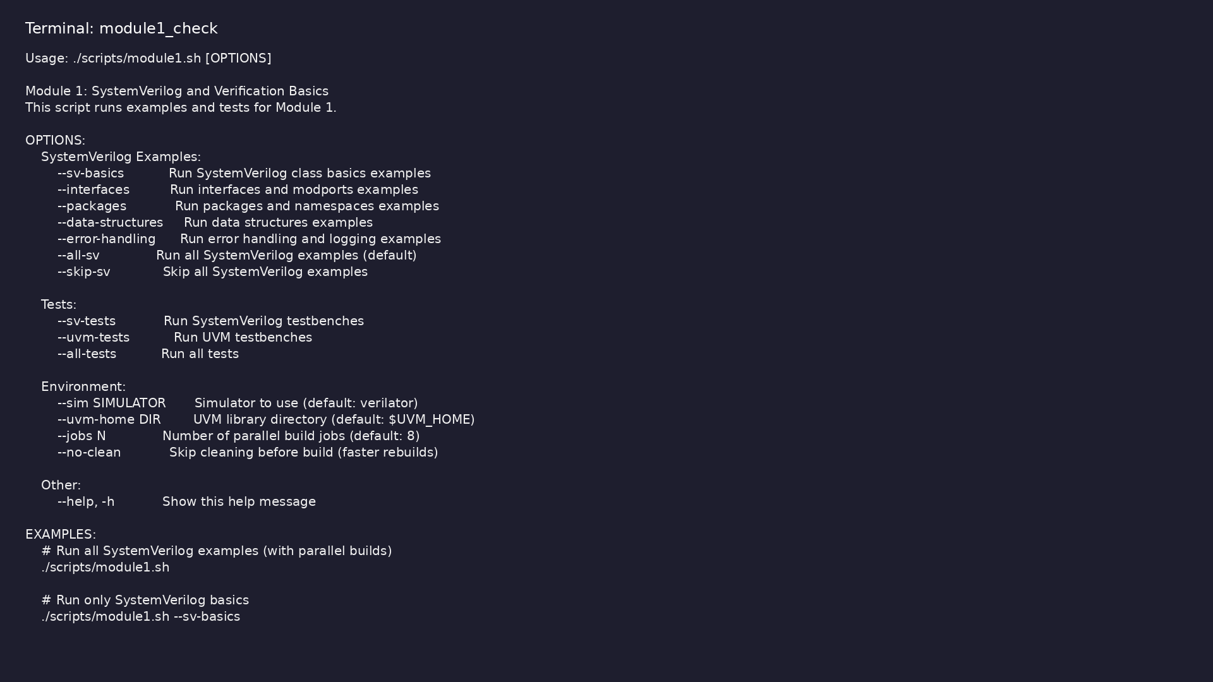
Module 1 self-check
$ ./scripts/module1.sh --help
learn_uvm2017_sv_verilator / Module 1
Notes:
Run from course repository root.

Slide 123
Exercise scaffold
./scripts/module1.sh --scaffold
learn_uvm2017_sv_verilator / Module 1

Slide 124
Example 1: Transaction Classes
• Base `Transaction` class with static variables
(`id_counter`)
• Instance variables (`id`, `data`, `timestamp`)
• Special methods: `new()`, `copy()`, `compare()`,
`convert2string()`
• Inheritance: `ReadTransaction` and
`WriteTransaction` inherit from `Transaction`
• Method overriding: Child classes override
`convert2string()` method
learn_uvm2017_sv_verilator / Module 1
Notes:
module1/examples/sv_basics/README.md

Slide 125
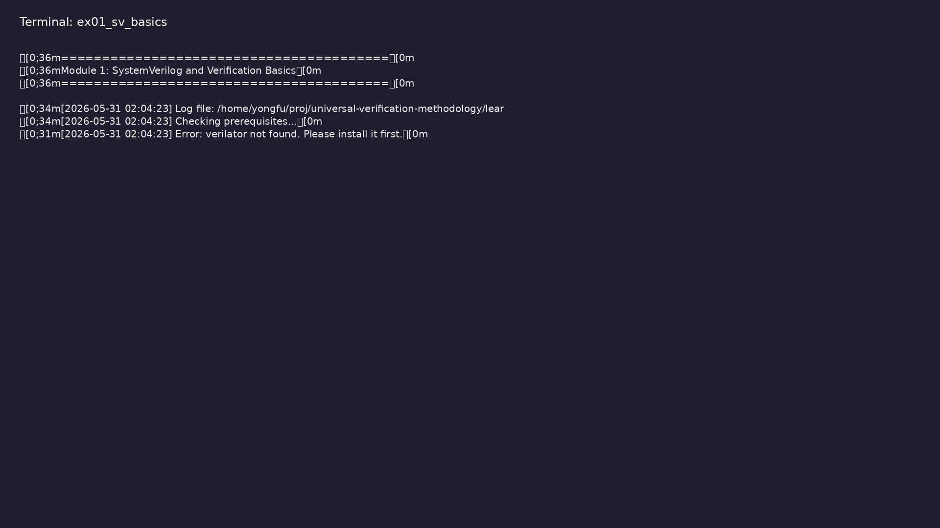
Demo: Transaction Classes
$ ./scripts/module1.sh --sv-basics && cd module1/examples/sv_basics &&
verilator -sv --cc --exe transaction.sv -o transaction_example &&
make -C obj_dir -f Vtransaction_example.mk
learn_uvm2017_sv_verilator / Module 1
Notes:
Hands-on: module1/examples/sv_basics/

Slide 126
Example 2: Interfaces and Modports
• Interface Definition: `apb_if` interface with
signals and clocking block
• Modports: `master_mp` and `slave_mp` modports with
different signal directions
• Clocking Block: `cb` clocking block for synchronous
access
• Interface Usage: Module using interface with modport
• Testbench Integration: Testbench connecting to
interface
learn_uvm2017_sv_verilator / Module 1
Notes:
module1/examples/interfaces/README.md

Slide 127
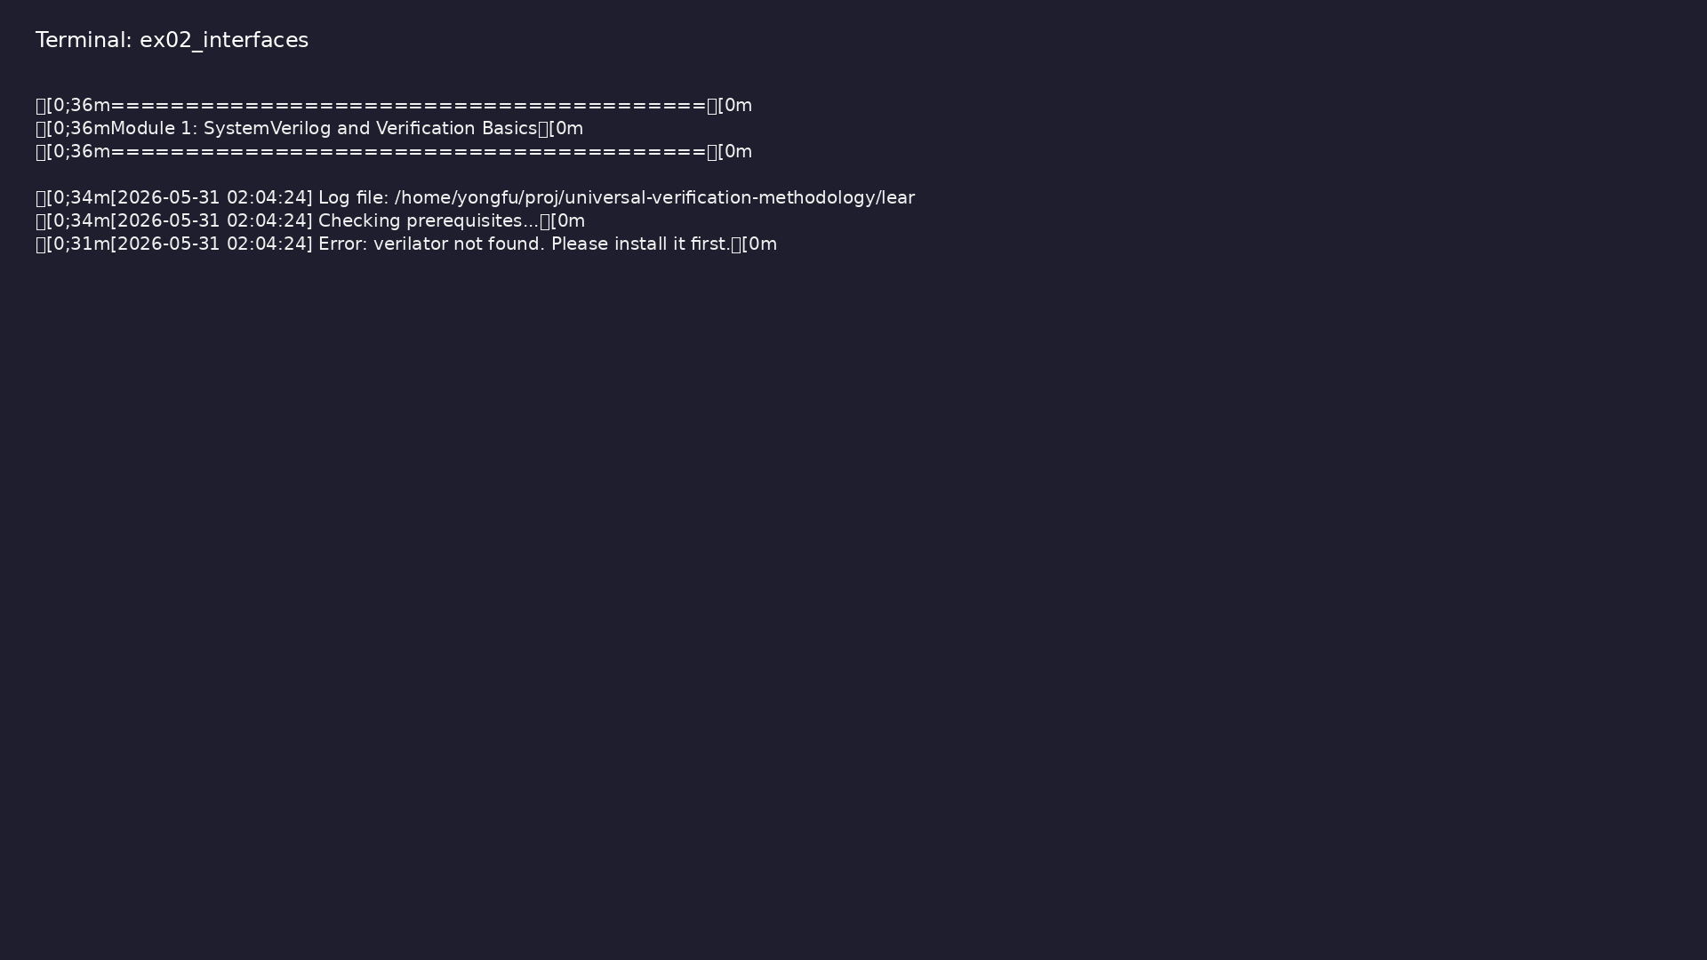
Demo: Interfaces and Modports
$ ./scripts/module1.sh --interfaces
learn_uvm2017_sv_verilator / Module 1
Notes:
Hands-on: module1/examples/interfaces/

Slide 128
Example 3: Packages
• Package Definition: `verification_pkg` with common
types and functions
• Package Import: Using `import verification_pkg::*`
• Name Resolution: Handling name conflicts
• Package Organization: Structuring verification code
• Function Definitions: `is_valid_address()`,
`calculate_checksum()` functions
learn_uvm2017_sv_verilator / Module 1
Notes:
module1/examples/packages/README.md

Slide 129
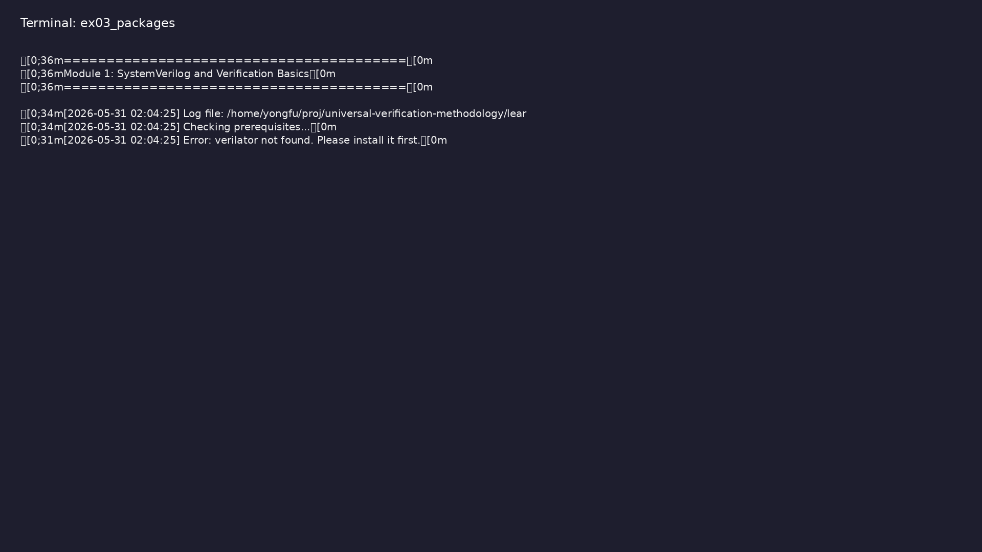
Demo: Packages
$ ./scripts/module1.sh --packages
learn_uvm2017_sv_verilator / Module 1
Notes:
Hands-on: module1/examples/packages/

Slide 130
Example 4: Data Structures
• Dynamic Arrays: Transaction arrays that grow
dynamically
• Queues: FIFO queues for transaction management
• Associative Arrays: Indexed by transaction ID
• Structures: Complex data structures for verification
• Array Methods: Using built-in array methods
learn_uvm2017_sv_verilator / Module 1
Notes:
module1/examples/data_structures/README.md

Slide 131
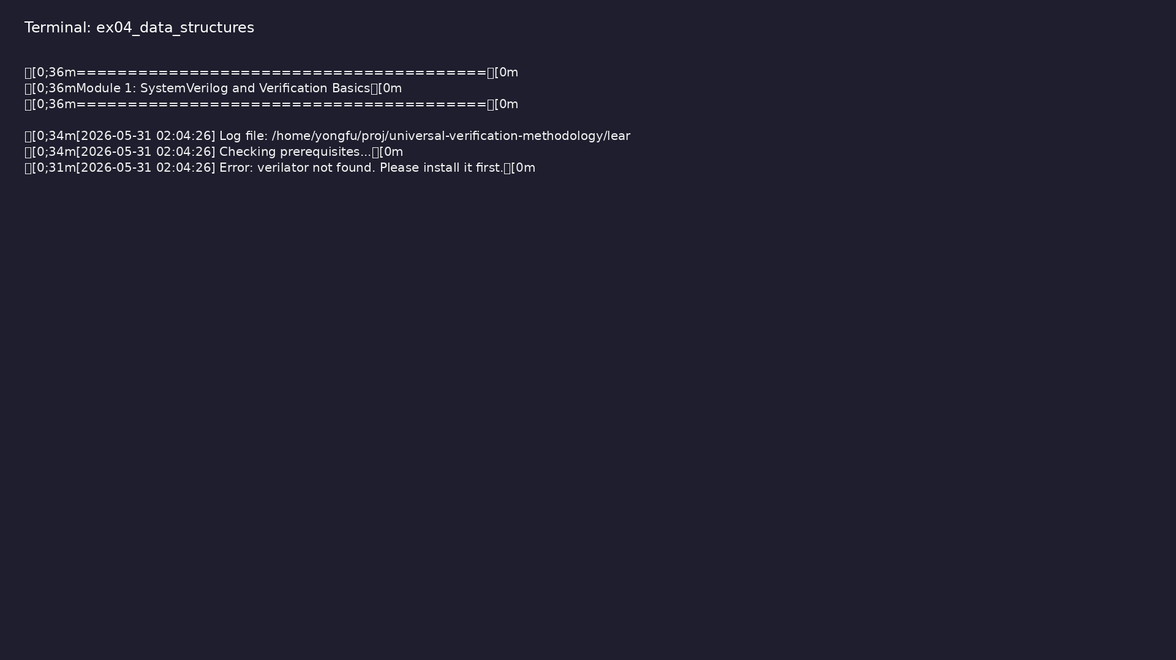
Demo: Data Structures
$ ./scripts/module1.sh --data-structures
learn_uvm2017_sv_verilator / Module 1
Notes:
Hands-on: module1/examples/data_structures/

Slide 132
Example 5: Error Handling
• UVM Reporting: Using `uvm_report_info()`,
`uvm_report_error()`, etc.
• Assertions: Immediate and concurrent assertions
• Error Handling: Try-catch blocks for exception
handling
• Logging Patterns: Structured logging for
verification
• Retry Logic: Task with retry mechanism using
`retry_task()`
learn_uvm2017_sv_verilator / Module 1
Notes:
module1/examples/error_handling/README.md

Slide 133
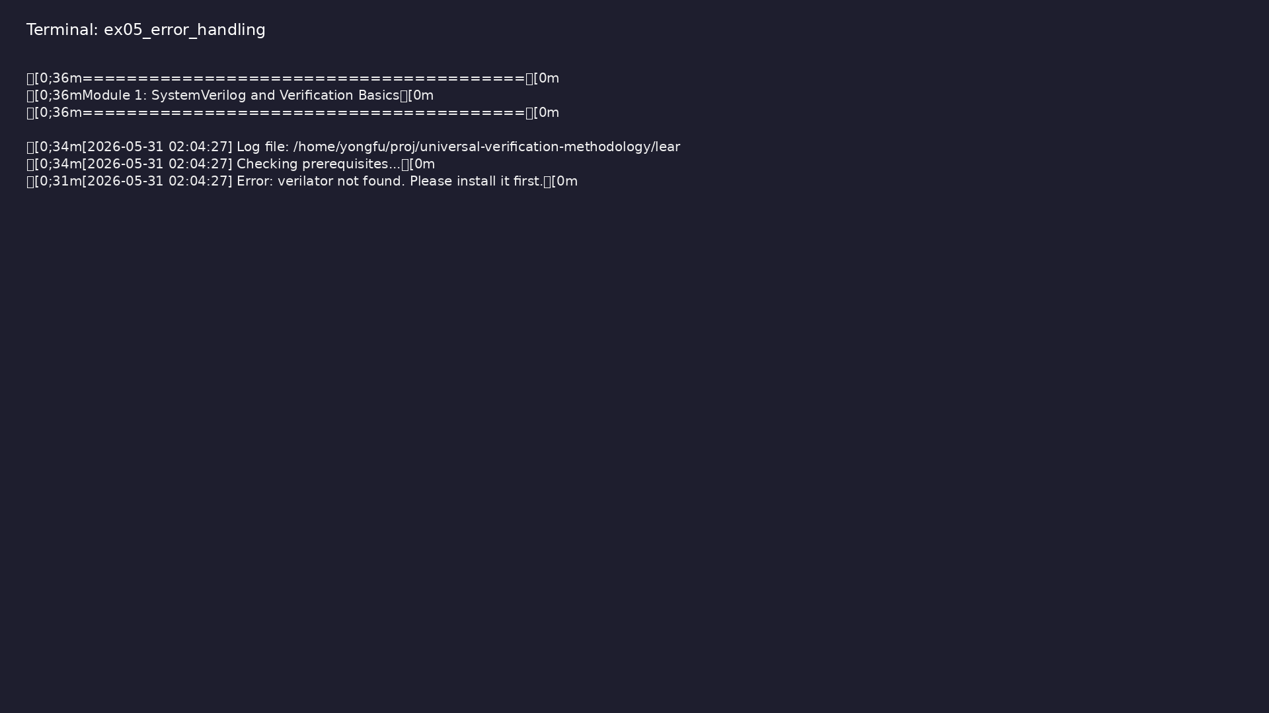
Demo: Error Handling
$ ./scripts/module1.sh --error-handling
learn_uvm2017_sv_verilator / Module 1
Notes:
Hands-on: module1/examples/error_handling/

Slide 134
Common pitfalls
learn_uvm2017_sv_verilator / Module 1

Slide 135
Transaction Class Design
• Create a base transaction class
• Implement copy, compare, and string conversion
methods
• Create derived transaction classes
• Test inheritance and polymorphism
learn_uvm2017_sv_verilator / Module 1
Notes:
From MODULE1 Common Pitfalls.

Slide 136
Interface Design
• Design an interface for a simple bus protocol
• Create modports for master and slave
• Implement a clocking block
• Connect interface to a module
learn_uvm2017_sv_verilator / Module 1
Notes:
From MODULE1 Common Pitfalls.

Slide 137
Package Organization
• Create a verification package
• Define common types and functions
• Import and use package in testbench
• Resolve name conflicts
learn_uvm2017_sv_verilator / Module 1
Notes:
From MODULE1 Common Pitfalls.

Slide 138
Data Structure Usage
• Use dynamic arrays for transaction storage
• Implement a queue-based scoreboard
• Use associative arrays for coverage tracking
• Create structures for configuration
learn_uvm2017_sv_verilator / Module 1
Notes:
From MODULE1 Common Pitfalls.

Slide 139
Error Handling
• Implement UVM reporting in testbench
• Add assertions to verify design behavior
• Handle exceptions gracefully
• Create structured logging
learn_uvm2017_sv_verilator / Module 1
Notes:
From MODULE1 Common Pitfalls.

Slide 140
Practice & assessment
learn_uvm2017_sv_verilator / Module 1

Slide 141
What you should know (1/2)
• Understand SystemVerilog OOP concepts
• Create and use SystemVerilog classes
• Design interfaces with modports
• Organize code using packages
• Use appropriate data structures for verification
• Implement error handling and logging
learn_uvm2017_sv_verilator / Module 1
Notes:
From MODULE1 Learning Outcomes.

Slide 142
What you should know (2/2)
• Write basic SystemVerilog testbenches
• Understand UVM class structure basics
learn_uvm2017_sv_verilator / Module 1
Notes:
From MODULE1 Learning Outcomes.

Slide 143
Exercises
• Transaction Class Design
• Interface Design
• Package Organization
• Data Structure Usage
• Error Handling
learn_uvm2017_sv_verilator / Module 1

Slide 144
Assessment checklist
• Can create SystemVerilog classes with inheritance
• Can design and use interfaces with modports
• Can organize code using packages
• Can use appropriate data structures
• Can implement error handling and logging
• Can write basic SystemVerilog testbenches
learn_uvm2017_sv_verilator / Module 1

Slide 145
Summary & next steps
• Understand SystemVerilog for verification and
verification fundamentals
• Complete module1/CHECKLIST.md
• Review module1/EXAMPLES.md and run each lab
• Next: Next module in course
learn_uvm2017_sv_verilator / Module 1

