Slide 1
Module 2
SystemVerilog Testbench Fundamentals
learn_uvm2017_sv_verilator / Module 2

Slide 2
Learning objectives
• Master SystemVerilog testbench construction
learn_uvm2017_sv_verilator / Module 2

Slide 3
Prerequisites
• See module README
learn_uvm2017_sv_verilator / Module 2

Slide 4

Learning path
Master SystemVerilog testbench construction
learn_uvm2017_sv_verilator / Module 2

Slide 5
Overview
• This module provides comprehensive coverage of
SystemVerilog testbench construction. You'll learn
h…
learn_uvm2017_sv_verilator / Module 2

Slide 6
Design architecture
learn_uvm2017_sv_verilator / Module 2

Slide 7

1. SystemVerilog testbench architecture (1/3)
• DUT boundary: signals cross via
module ports or SystemVerilog
interfaces
• Hierarchy: TB module → DUT
instance → optional interface
instance
• Time: `#delay`, `@posedge`, and
C++ time loop must stay
consistent
• See [SYSTEMVERILOG_VERILATOR_INT
ERACTION.md](SYSTEMVERILOG_VERIL
ATOR_INTERACTION.md) for
compile/si…
learn_uvm2017_sv_verilator / Module 2
Notes:
From MODULE2 Design Architecture.

Slide 8
1. SystemVerilog testbench architecture (2/3)
• module2/dut/: RTL blocks under test (registers,
FIFOs, state machines)
• module2/examples/*/: Focused TB patterns (clock,
reset, triggers, access)
• module2/tests/uvm_tests/: UVM wrappers on the same
DUTs (bridge to Module 3)
• Testbench module: Instantiates DUT + interfaces;
generates clk/rst
learn_uvm2017_sv_verilator / Module 2
Notes:
From MODULE2 Design Architecture.

Slide 9
1. SystemVerilog testbench architecture (3/3)
• sim_main.cpp: C++ entry: drives time, calls eval()
each cycle
learn_uvm2017_sv_verilator / Module 2
Notes:
From MODULE2 Design Architecture.

Slide 10

2. RTL block architecture (example DUTs)
• Register files — address decode,
read/write timing, reset
behavior
• FIFOs — full/empty flags,
pointer management, back-
pressure
• State machines — explicit
states, transition conditions,
output logic
• Signal flow: clk/rst →
sequential logic → status flags
→ TB monitors
learn_uvm2017_sv_verilator / Module 2
Notes:
From MODULE2 Design Architecture.

Slide 11
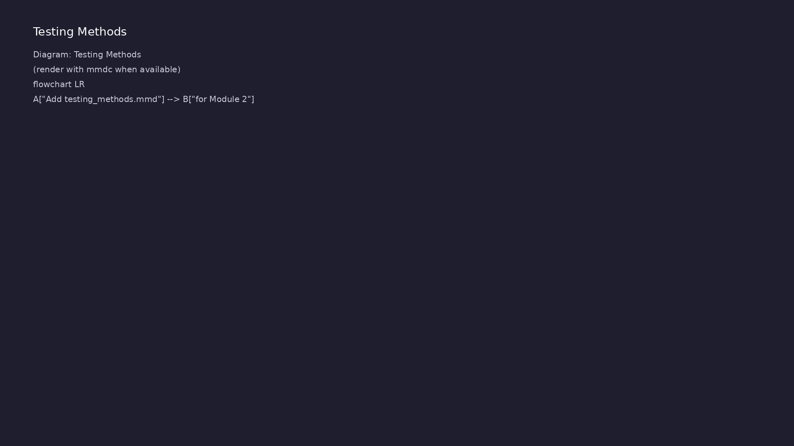
3. Verilator execution pipeline
• 1: Makefile — Invokes Verilator
with --cc --exe --timing
• 2: obj_dir/V*.cpp — Generated
cycle-accurate C++ model
• 3: sim_main.cpp — Clock
generation and $finish
coordination
• 4: ./obj_dir/V* — Executable; TB
prints PASS/FAIL
learn_uvm2017_sv_verilator / Module 2
Notes:
From MODULE2 Design Architecture.

Slide 12
RTL block diagram (reference)
Module 2: DUT hierarchy and signal flow.
learn_uvm2017_sv_verilator / Module 2

Slide 13
Verification / testbench diagram (reference)
Module 2: stimulus, observation, and checking.
learn_uvm2017_sv_verilator / Module 2

Slide 14
Execution & simulation flow
learn_uvm2017_sv_verilator / Module 2

Slide 15
How the example runs (toolchain)
• Makefile: Verilator + UVM_HOME compile RTL,
interface, and test_*.sv
• UVM phases: build → connect → run_test → report
(same pattern as Module 2)
• Sequence → driver → DUT → monitor → scoreboard (read
SCOREBOARD at end)
• Typical command: make SIM=verilator TEST=test_* (see
module2 demo slide)
• Loopback / hooks connect monitor observations to
scoreboard checks
learn_uvm2017_sv_verilator / Module 2
Notes:
From MODULE2 — execution and artifact layout.

Slide 16
Artifact flow (spec → sim)
• 1: Makefile — Invokes Verilator with --cc --exe
--timing
• 2: obj_dir/V*.cpp — Generated cycle-accurate C++
model
• 3: sim_main.cpp — Clock generation and $finish
coordination
• 4: ./obj_dir/V* — Executable; TB prints PASS/FAIL
learn_uvm2017_sv_verilator / Module 2
Notes:
From MODULE2 — execution and artifact layout.

Slide 17
Example directory layout
• module2/dut/: RTL blocks under test (registers,
FIFOs, state machines)
• module2/examples/*/: Focused TB patterns (clock,
reset, triggers, access)
• module2/tests/uvm_tests/: UVM wrappers on the same
DUTs (bridge to Module 3)
• Testbench module: Instantiates DUT + interfaces;
generates clk/rst
• sim_main.cpp: C++ entry: drives time, calls eval()
each cycle
learn_uvm2017_sv_verilator / Module 2
Notes:
Match each path to files under module/examples/.

Slide 18
Directed test execution sequence
• make
• link
• run
• grep PASS in log
learn_uvm2017_sv_verilator / Module 2
Notes:
Follow this order when tracing waveforms or debugging.

Slide 19
Verification & testing methods
learn_uvm2017_sv_verilator / Module 2

Slide 20
1. Stimulus and timing strategy
• Clock generation: parameterized
period/duty; multiple clocks for
CDC awareness
• Reset sequences: assert length,
sync deassert, mid-test reset
injection
• Triggers: `@posedge`, `wait()`,
`fork-join` for parallel
activity
• Signal access: hierarchical
references and interface modport
access
learn_uvm2017_sv_verilator / Module 2
Notes:
From MODULE2 Verification & Testing Methods.

Slide 21
2. Checking and debug workflow (1/2)
• Self-checking tests compare DUT
outputs against expected values
each cycle
• Waveforms (`--trace`) for
debugging timing and reset
issues
• Closure criteria: all directed
cases PASS; no `$error` or
timeout
• `./scripts/module2.sh --all-
examples` for module-level
regression
learn_uvm2017_sv_verilator / Module 2
Notes:
From MODULE2 Verification & Testing Methods.

Slide 22
2. Checking and debug workflow (2/2)
• UVM tests reuse same DUTs — compare directed vs
phase-based execution in Module 3
learn_uvm2017_sv_verilator / Module 2
Notes:
From MODULE2 Verification & Testing Methods.

Slide 23
Syllabus topics
learn_uvm2017_sv_verilator / Module 2

Slide 24
Protocol & design details
learn_uvm2017_sv_verilator / Module 2

Slide 25
Detail: Example 2.1: Clock Generation (`module2/examples/clock_genera…
• Simple Clock: Basic clock generation with `always`
block
• Parameterized Clock: Clock with configurable period
and duty cycle
• Multiple Clocks: Generating multiple independent
clocks
• Clock Gating: Conditional clock generation
learn_uvm2017_sv_verilator / Module 2
Notes:
From MODULE2 Topics Covered — protocol/design depth.

Slide 26
Detail: Example 2.1: Clock Generation (`module2/examples/clock_genera…
• Clock Stopping: Controlled clock stopping
• Uses `always` block for continuous execution
• Delay operator `#` controls timing
• Creates 50% duty cycle clock
learn_uvm2017_sv_verilator / Module 2
Notes:
From MODULE2 Topics Covered — protocol/design depth.

Slide 27
Detail: Example 2.2: Reset Patterns (`module2/examples/reset_patterns…
• Synchronous Reset: Reset synchronized to clock
• Asynchronous Reset: Reset independent of clock
• Reset Sequence: Controlled reset assertion and de-
assertion
• Reset Verification: Checking reset behavior
learn_uvm2017_sv_verilator / Module 2
Notes:
From MODULE2 Topics Covered — protocol/design depth.

Slide 28
Detail: Example 2.2: Reset Patterns (`module2/examples/reset_patterns…
• Purpose: Encapsulates async reset sequence
• Parameters: Configurable reset duration
• Usage: `async_reset_sequence(100);`
• Key Features: Uses delays, displays timing info
learn_uvm2017_sv_verilator / Module 2
Notes:
From MODULE2 Topics Covered — protocol/design depth.

Slide 29
Detail: Example 2.3: Signal Access (`module2/examples/signal_access/s…
• Signal Reading: Reading DUT signal values
• Signal Driving: Driving signals to DUT
• Signal Monitoring: Monitoring signal changes
• Signal Types: Handling different signal types
learn_uvm2017_sv_verilator / Module 2
Notes:
From MODULE2 Topics Covered — protocol/design depth.

Slide 30
Detail: Example 2.3: Signal Access (`module2/examples/signal_access/s…
• Purpose: Demonstrates reading signal values
• Uses: `$display()` with format specifiers (`%02h`,
`%0d`, `%b`)
• Key: Reads signals after delays for proper timing
• Purpose: Demonstrates driving signals to DUT
learn_uvm2017_sv_verilator / Module 2
Notes:
From MODULE2 Topics Covered — protocol/design depth.

Slide 31
Detail: Example 2.4: Triggers and Timing (`module2/examples/triggers/…
• Event Control: Using `@` for event-based timing
• Delay Control: Using `#` for time-based delays
• Wait Statements: Using `wait` for condition-based
waiting
• Fork-Join: Parallel execution with synchronization
learn_uvm2017_sv_verilator / Module 2
Notes:
From MODULE2 Topics Covered — protocol/design depth.

Slide 32
Detail: Example 2.4: Triggers and Timing (`module2/examples/triggers/…
• Named Events: Event-based synchronization
• Timeout Handling: Timeout patterns
• Purpose: Demonstrates event-based timing
• Uses: `@(posedge)`, `@(negedge)`, `@(signal)` for
event control
learn_uvm2017_sv_verilator / Module 2
Notes:
From MODULE2 Topics Covered — protocol/design depth.

Slide 33
Detail: Example 2.5: Common Patterns (`module2/examples/common_patter…
• Testbench Structure: Organized testbench with phases
• Driver Pattern: Stimulus generation component
• Monitor Pattern: Response monitoring component
• Scoreboard Pattern: Response checking component
learn_uvm2017_sv_verilator / Module 2
Notes:
From MODULE2 Topics Covered — protocol/design depth.

Slide 34
Detail: Example 2.5: Common Patterns (`module2/examples/common_patter…
• Reusable Components: Component reuse patterns
• Purpose: Demonstrates organized testbench phases
• Structure: Initialization → Reset → Stimulus →
Checking → Cleanup
• Key: Clear separation of test phases
learn_uvm2017_sv_verilator / Module 2
Notes:
From MODULE2 Topics Covered — protocol/design depth.

Slide 35
Detail: Testbench Task Patterns (1)
• Purpose: Encapsulate reset sequences
• Reusability: Can be called from multiple test tasks
• Parameters: Configurable duration/cycles
• Purpose: Generate clock signals
learn_uvm2017_sv_verilator / Module 2
Notes:
From MODULE2 Topics Covered — protocol/design depth.

Slide 36
Detail: Testbench Task Patterns (2)
• Pattern: Use `always` blocks for continuous
generation
• Key: Delay operator `#` controls timing
• Purpose: Organize test into phases
• Structure: Clear separation of concerns
learn_uvm2017_sv_verilator / Module 2
Notes:
From MODULE2 Topics Covered — protocol/design depth.

Slide 37
Detail: Timing Control Functions and Tasks (1)
• Purpose: Create time-based delays
• Usage: In tasks and initial blocks
• Key: Cannot be used in functions
• Purpose: Synchronize to events
learn_uvm2017_sv_verilator / Module 2
Notes:
From MODULE2 Topics Covered — protocol/design depth.

Slide 38
Detail: Timing Control Functions and Tasks (2)
• Usage: In tasks and always blocks
• Key: Event-driven synchronization
• Purpose: Condition-based waiting
• Usage: In tasks
learn_uvm2017_sv_verilator / Module 2
Notes:
From MODULE2 Topics Covered — protocol/design depth.

Slide 39
Detail: Built-in Functions for Testbenches (1)
• Purpose: Track simulation time
• Usage: Timing verification, logging
• Purpose: Get signal dimensions
• Usage: Dynamic signal handling
learn_uvm2017_sv_verilator / Module 2
Notes:
From MODULE2 Topics Covered — protocol/design depth.

Slide 40
Detail: Built-in Functions for Testbenches (2)
• Purpose: Print formatted output
• Format Specifiers: `%0d` (decimal), `%0h` (hex),
`%0b` (binary), `%0t` (time)
• Purpose: Verify conditions
• Usage: Test verification
learn_uvm2017_sv_verilator / Module 2
Notes:
From MODULE2 Topics Covered — protocol/design depth.

Slide 41
Detail: Common Testbench Patterns (1)
• Pattern: Free-running clock
• Key: Uses `forever` loop
• Pattern: Reusable reset sequence
• Key: Encapsulated in task
learn_uvm2017_sv_verilator / Module 2
Notes:
From MODULE2 Topics Covered — protocol/design depth.

Slide 42
Detail: Common Testbench Patterns (2)
• Pattern: Loop-based stimulus
• Key: Synchronized to clock
• Pattern: Assertion-based checking
• Key: Uses `assert` with `$error()`
learn_uvm2017_sv_verilator / Module 2
Notes:
From MODULE2 Topics Covered — protocol/design depth.

Slide 43
Detail: Best Practices for Testbench Tasks (1)
• Each test phase as separate task
• Helper tasks for common operations
• Clear task naming conventions
• Use parameters for configurability
learn_uvm2017_sv_verilator / Module 2
Notes:
From MODULE2 Topics Covered — protocol/design depth.

Slide 44
Detail: Best Practices for Testbench Tasks (2)
• Default parameter values
• Type-safe parameters
• Always synchronize to clock edges
• Use appropriate delays
learn_uvm2017_sv_verilator / Module 2
Notes:
From MODULE2 Topics Covered — protocol/design depth.

Slide 45
Detail: Common Pitfalls in Testbench Construction (1)
• Issue: `forever` with `~` operator can cause timing
issues
• Solution: Use explicit assignment with delays
• Issue: Fixed delays don't guarantee clock alignment
• Solution: Always use `@(posedge clk)` for
synchronization
learn_uvm2017_sv_verilator / Module 2
Notes:
From MODULE2 Topics Covered — protocol/design depth.

Slide 46
Detail: Common Pitfalls in Testbench Construction (2)
• Issue: Insufficient reset duration or propagation
time
• Solution: Use configurable duration and add
propagation delay
• Issue: Non-blocking assignments in tasks can cause
timing issues
• Solution: Use blocking assignments (`=`) in tasks
learn_uvm2017_sv_verilator / Module 2
Notes:
From MODULE2 Topics Covered — protocol/design depth.

Slide 47
Detail: Performance Considerations (1)
• Simple clocks: Use `always` blocks (efficient)
• Multiple clocks: Each clock needs separate `always`
block
• Gated clocks: Conditional logic adds minimal
overhead
• Tasks: Slower due to timing simulation overhead
learn_uvm2017_sv_verilator / Module 2
Notes:
From MODULE2 Topics Covered — protocol/design depth.

Slide 48
Detail: Performance Considerations (2)
• Functions: Faster (zero-time), but can't use delays
• Recommendation: Use functions for calculations,
tasks for sequences
• `@(posedge clk)`: Efficient, event-driven
• `#delay`: Time-based, requires scheduling
learn_uvm2017_sv_verilator / Module 2
Notes:
From MODULE2 Topics Covered — protocol/design depth.

Slide 49
Detail: Troubleshooting Guide (1)
• Symptoms: Clock signal stuck at 0 or 1
• Causes:
• `always` block not executing
• Delay value too large or zero
learn_uvm2017_sv_verilator / Module 2
Notes:
From MODULE2 Topics Covered — protocol/design depth.

Slide 50
Detail: Troubleshooting Guide (2)
• Blocking on condition that never becomes true
• Solutions:
• Check `always` block syntax
• Verify delay values are positive
learn_uvm2017_sv_verilator / Module 2
Notes:
From MODULE2 Topics Covered — protocol/design depth.

Slide 51
Verification flow (reference)
Stimulus, DUT response, and check points for this module.
learn_uvm2017_sv_verilator / Module 2

Slide 52
1. SystemVerilog Testbench Architecture (1/3)
• What is a Testbench?
• Testbench purpose and structure
• DUT (Design Under Test) connection
• Stimulus generation
• Response checking
• Testbench Components
learn_uvm2017_sv_verilator / Module 2
Notes:
From MODULE2 Topics Covered.

Slide 53
1. SystemVerilog Testbench Architecture (2/3)
• Testbench module
• DUT instantiation
• Interface instantiation
• Clock and reset generation
• Stimulus and monitoring
• Key Concepts
learn_uvm2017_sv_verilator / Module 2
Notes:
From MODULE2 Topics Covered.

Slide 54
1. SystemVerilog Testbench Architecture (3/3)
• Module hierarchy
• Signal connectivity
• Time management
• Event scheduling
learn_uvm2017_sv_verilator / Module 2
Notes:
From MODULE2 Topics Covered.

Slide 55
2. Clock Generation and Management (1/8)
• Clock Generation
• Simple clock generation
• Clock with parameters (period, duty cycle)
• Multiple clocks
• Clock gating
• Clock Patterns
learn_uvm2017_sv_verilator / Module 2
Notes:
From MODULE2 Topics Covered.

Slide 56
2. Clock Generation and Management (2/8)
• Regular clocks
• Gated clocks
• Clock division
• Clock stopping
• Clock domain crossing
• Clock Domain Management
learn_uvm2017_sv_verilator / Module 2
Notes:
From MODULE2 Topics Covered.

Slide 57
2. Clock Generation and Management (3/8)
• Multiple clock domains
• Clock domain crossing verification
• Synchronization between domains
• Metastability handling
• Simple Clock: Basic clock generation with `always`
block
• Parameterized Clock: Clock with configurable period
and duty cycle
learn_uvm2017_sv_verilator / Module 2
Notes:
From MODULE2 Topics Covered.

Slide 58
2. Clock Generation and Management (4/8)
• Multiple Clocks: Generating multiple independent
clocks
• Clock Gating: Conditional clock generation
• Clock Stopping: Controlled clock stopping
• Uses `always` block for continuous execution
• Delay operator `#` controls timing
• Creates 50% duty cycle clock
learn_uvm2017_sv_verilator / Module 2
Notes:
From MODULE2 Topics Covered.

Slide 59
2. Clock Generation and Management (5/8)
• Uses parameters for flexibility
• Same pattern, different frequency
• Conditional clock generation
• Uses `if-else` for gating control
• Uses `wait` statement for condition-based stopping
• Demonstrates controlled clock stopping
learn_uvm2017_sv_verilator / Module 2
Notes:
From MODULE2 Topics Covered.

Slide 60
2. Clock Generation and Management (6/8)
• `$display()` - Print clock information
• `$time` - Get current simulation time
• `$finish` - Terminate simulation
• Clocks are fundamental to synchronous designs
• Parameterized clocks enable flexibility
• Multiple clocks require careful synchronization
learn_uvm2017_sv_verilator / Module 2
Notes:
From MODULE2 Topics Covered.

Slide 61
2. Clock Generation and Management (7/8)
• Clock gating is common in low-power designs
• `always` blocks create continuous processes
• Delay operator `#` controls timing
• `wait` statements enable condition-based control
• Simple clock generation with configurable period
• Multiple independent clocks demonstrated
learn_uvm2017_sv_verilator / Module 2
Notes:
From MODULE2 Topics Covered.

Slide 62
2. Clock Generation and Management (8/8)
• Clock gating and stopping patterns working correctly
learn_uvm2017_sv_verilator / Module 2
Notes:
From MODULE2 Topics Covered.

Slide 63
3. Reset Patterns and Sequences (1/7)
• Reset Types
• Synchronous reset
• Asynchronous reset
• Reset assertion and de-assertion
• Reset timing
• Reset Patterns
learn_uvm2017_sv_verilator / Module 2
Notes:
From MODULE2 Topics Covered.

Slide 64
3. Reset Patterns and Sequences (2/7)
• Power-on reset
• Software reset
• Hardware reset
• Partial reset
• Reset Sequences
• Reset assertion sequence
learn_uvm2017_sv_verilator / Module 2
Notes:
From MODULE2 Topics Covered.

Slide 65
3. Reset Patterns and Sequences (3/7)
• Reset de-assertion sequence
• Reset verification
• Reset timing checks
• Synchronous Reset: Reset synchronized to clock
• Asynchronous Reset: Reset independent of clock
• Reset Sequence: Controlled reset assertion and de-
assertion
learn_uvm2017_sv_verilator / Module 2
Notes:
From MODULE2 Topics Covered.

Slide 66
3. Reset Patterns and Sequences (4/7)
• Reset Verification: Checking reset behavior
• Purpose: Encapsulates async reset sequence
• Parameters: Configurable reset duration
• Usage: `async_reset_sequence(100);`
• Key Features: Uses delays, displays timing info
• Purpose: Encapsulates sync reset sequence
learn_uvm2017_sv_verilator / Module 2
Notes:
From MODULE2 Topics Covered.

Slide 67
3. Reset Patterns and Sequences (5/7)
• Parameters: Number of reset cycles
• Usage: `sync_reset_sequence(5);`
• Key Features: Uses `repeat` and `@(posedge clk)` for
clock synchronization
• Purpose: Verifies reset properly initializes
registers
• Uses: `assert` statements with `$error()` for
verification
• Usage: `verify_reset();`
learn_uvm2017_sv_verilator / Module 2
Notes:
From MODULE2 Topics Covered.

Slide 68
3. Reset Patterns and Sequences (6/7)
• Reset is critical for proper design initialization
• Synchronous vs asynchronous reset have different
timing
• Reset sequences must follow design requirements
• Reset verification ensures proper operation
• Tasks encapsulate reset sequences for reusability
• `repeat` statement repeats clock cycles
learn_uvm2017_sv_verilator / Module 2
Notes:
From MODULE2 Topics Covered.

Slide 69
3. Reset Patterns and Sequences (7/7)
• `@(posedge clk)` synchronizes to clock edges
• `assert` statements verify reset behavior
• Synchronous and asynchronous reset patterns
demonstrated
• Reset sequences executed correctly
• Reset verification checks passing
learn_uvm2017_sv_verilator / Module 2
Notes:
From MODULE2 Topics Covered.

Slide 70
4. Signal Access and Driving (1/8)
• Signal Access
• Reading signal values
• Signal types and widths
• Signal state checking
• Signal monitoring
• Driving Signals
learn_uvm2017_sv_verilator / Module 2
Notes:
From MODULE2 Topics Covered.

Slide 71
4. Signal Access and Driving (2/8)
• Assigning values
• Continuous assignment
• Procedural assignment
• Signal driving timing
• Signal Types
• Single-bit signals
learn_uvm2017_sv_verilator / Module 2
Notes:
From MODULE2 Topics Covered.

Slide 72
4. Signal Access and Driving (3/8)
• Multi-bit signals (vectors)
• Buses and arrays
• Bidirectional signals
• Signal Reading: Reading DUT signal values
• Signal Driving: Driving signals to DUT
• Signal Monitoring: Monitoring signal changes
learn_uvm2017_sv_verilator / Module 2
Notes:
From MODULE2 Topics Covered.

Slide 73
4. Signal Access and Driving (4/8)
• Signal Types: Handling different signal types
• Purpose: Demonstrates reading signal values
• Uses: `$display()` with format specifiers (`%02h`,
`%0d`, `%b`)
• Key: Reads signals after delays for proper timing
• Purpose: Demonstrates driving signals to DUT
• Uses: Blocking assignment (`=`) for signal driving
learn_uvm2017_sv_verilator / Module 2
Notes:
From MODULE2 Topics Covered.

Slide 74
4. Signal Access and Driving (5/8)
• Verification: Uses `assert` to verify driven values
• Purpose: Automatically monitors signal changes
• Uses: `always @(signal)` for event-driven monitoring
• Key: Runs in parallel with test tasks
• Purpose: Demonstrates different signal types
• Uses: `$bits()` built-in function for signal width
learn_uvm2017_sv_verilator / Module 2
Notes:
From MODULE2 Topics Covered.

Slide 75
4. Signal Access and Driving (6/8)
• Key: Handles single-bit, multi-bit, and array
signals
• `$display()` - Print signal values with formatting
• `$time` - Get current simulation time
• `$bits()` - Get signal bit width
• `$error()` - Report errors in assertions
• Signal access is fundamental to testbench operation
learn_uvm2017_sv_verilator / Module 2
Notes:
From MODULE2 Topics Covered.

Slide 76
4. Signal Access and Driving (7/8)
• Proper timing is essential for signal driving
• Signal monitoring enables response checking
• Different signal types require different handling
• Tasks organize signal access operations
• `always @(signal)` creates event-driven monitors
• Blocking assignment (`=`) for signal driving
learn_uvm2017_sv_verilator / Module 2
Notes:
From MODULE2 Topics Covered.

Slide 77
4. Signal Access and Driving (8/8)
• Format specifiers (`%b`, `%h`, `%d`) for display
• Signal reading operations working correctly
• Signal driving verified with assertions
• Signal monitoring capturing changes
• Different signal types handled properly
learn_uvm2017_sv_verilator / Module 2
Notes:
From MODULE2 Topics Covered.

Slide 78
5. Event and Timing Control (1/9)
• SystemVerilog Events
• Event declaration
• Event triggering (`->`)
• Event waiting (`@`)
• Named events
• Timing Control
learn_uvm2017_sv_verilator / Module 2
Notes:
From MODULE2 Topics Covered.

Slide 79
5. Event and Timing Control (2/9)
• `#` delay operator
• `@` event control
• `wait` statement
• `fork-join` constructs
• Synchronization
• Task synchronization
learn_uvm2017_sv_verilator / Module 2
Notes:
From MODULE2 Topics Covered.

Slide 80
5. Event and Timing Control (3/9)
• Barrier synchronization
• Timeout handling
• Race condition avoidance
• Event Control: Using `@` for event-based timing
• Delay Control: Using `#` for time-based delays
• Wait Statements: Using `wait` for condition-based
waiting
learn_uvm2017_sv_verilator / Module 2
Notes:
From MODULE2 Topics Covered.

Slide 81
5. Event and Timing Control (4/9)
• Fork-Join: Parallel execution with synchronization
• Named Events: Event-based synchronization
• Timeout Handling: Timeout patterns
• Purpose: Demonstrates event-based timing
• Uses: `@(posedge)`, `@(negedge)`, `@(signal)` for
event control
• Key: Waits for specific events before continuing
learn_uvm2017_sv_verilator / Module 2
Notes:
From MODULE2 Topics Covered.

Slide 82
5. Event and Timing Control (5/9)
• Purpose: Demonstrates time-based delays
• Uses: `#` delay operator with fixed and
parameterized values
• Key: Tracks time using `$time` built-in function
• Purpose: Demonstrates condition-based waiting
• Uses: `wait(condition)` statement
• Key: Waits until condition becomes true
learn_uvm2017_sv_verilator / Module 2
Notes:
From MODULE2 Topics Covered.

Slide 83
5. Event and Timing Control (6/9)
• Purpose: Demonstrates parallel execution
• Uses: `fork-join` for parallel tasks
• Key: Waits for all tasks to complete
• Purpose: Continues after first task completes
• Uses: `fork-join_any` construct
• Key: Doesn't wait for all tasks
learn_uvm2017_sv_verilator / Module 2
Notes:
From MODULE2 Topics Covered.

Slide 84
5. Event and Timing Control (7/9)
• Purpose: Starts tasks without waiting
• Uses: `fork-join_none` construct
• Key: Continues immediately, tasks run in background
• Purpose: Demonstrates named event synchronization
• Uses: `event` declaration, `@(event)` wait, `->
event` trigger
• Key: Flexible synchronization mechanism
learn_uvm2017_sv_verilator / Module 2
Notes:
From MODULE2 Topics Covered.

Slide 85
5. Event and Timing Control (8/9)
• Events enable synchronization between processes
• Timing control is essential for proper testbench
operation
• Wait statements enable condition-based
synchronization
• Fork-join enables parallel execution
• `@(posedge/negedge)` waits for signal edges
• `#` delay operator creates time-based delays
learn_uvm2017_sv_verilator / Module 2
Notes:
From MODULE2 Topics Covered.

Slide 86
5. Event and Timing Control (9/9)
• `wait(condition)` waits for condition to become true
• `fork-join` creates parallel execution with
synchronization
• Named events provide flexible synchronization
learn_uvm2017_sv_verilator / Module 2
Notes:
From MODULE2 Topics Covered.

Slide 87
6. Common Verification Patterns (1/7)
• Testbench Structure
• Initialization phase
• Stimulus generation
• Response checking
• Cleanup phase
• Verification Patterns
learn_uvm2017_sv_verilator / Module 2
Notes:
From MODULE2 Topics Covered.

Slide 88
6. Common Verification Patterns (2/7)
• Directed testing
• Constrained random testing
• Coverage-driven verification
• Assertion-based verification
• Reusable Components
• Driver components
learn_uvm2017_sv_verilator / Module 2
Notes:
From MODULE2 Topics Covered.

Slide 89
6. Common Verification Patterns (3/7)
• Monitor components
• Scoreboard components
• Checker components
• Testbench Structure: Organized testbench with phases
• Driver Pattern: Stimulus generation component
• Monitor Pattern: Response monitoring component
learn_uvm2017_sv_verilator / Module 2
Notes:
From MODULE2 Topics Covered.

Slide 90
6. Common Verification Patterns (4/7)
• Scoreboard Pattern: Response checking component
• Reusable Components: Component reuse patterns
• Purpose: Demonstrates organized testbench phases
• Structure: Initialization → Reset → Stimulus →
Checking → Cleanup
• Key: Clear separation of test phases
• Purpose: Stimulus generation component
learn_uvm2017_sv_verilator / Module 2
Notes:
From MODULE2 Topics Covered.

Slide 91
6. Common Verification Patterns (5/7)
• Uses: Virtual task for polymorphism
• Key: Can be extended in derived classes
• Purpose: Response monitoring component
• Uses: Constructor function, virtual task, accessor
function
• Key: Captures and provides access to monitored data
• Purpose: Response checking component
learn_uvm2017_sv_verilator / Module 2
Notes:
From MODULE2 Topics Covered.

Slide 92
6. Common Verification Patterns (6/7)
• Uses: Queue methods (`push_back()`, `size()`),
comparison logic
• Key: Compares expected vs actual results
• Structured testbenches are easier to maintain
• Reusable components improve productivity
• Common patterns enable code reuse
• Patterns prepare for UVM methodology
learn_uvm2017_sv_verilator / Module 2
Notes:
From MODULE2 Topics Covered.

Slide 93
6. Common Verification Patterns (7/7)
• Tasks organize test phases (init, reset, stimulus,
check)
• Virtual tasks enable polymorphism
• Class methods encapsulate component behavior
• Queue operations manage transaction lists
learn_uvm2017_sv_verilator / Module 2
Notes:
From MODULE2 Topics Covered.

Slide 94
7. Test Structure and Organization (1/3)
• Test Function Structure
• Test module organization
• Test phases
• Test organization
• Test parameters
• Multiple Tests
learn_uvm2017_sv_verilator / Module 2
Notes:
From MODULE2 Topics Covered.

Slide 95
7. Test Structure and Organization (2/3)
• Test discovery
• Test selection
• Test parameters
• Test fixtures
• Test Organization
• Test file structure
learn_uvm2017_sv_verilator / Module 2
Notes:
From MODULE2 Topics Covered.

Slide 96
7. Test Structure and Organization (3/3)
• Test naming conventions
• Test documentation
• Test maintenance
learn_uvm2017_sv_verilator / Module 2
Notes:
From MODULE2 Topics Covered.

Slide 97
7. Functions and Tasks for Testbench Construction (1/23)
• Purpose: Encapsulate reset sequences
• Reusability: Can be called from multiple test tasks
• Parameters: Configurable duration/cycles
• Purpose: Generate clock signals
• Pattern: Use `always` blocks for continuous
generation
• Key: Delay operator `#` controls timing
learn_uvm2017_sv_verilator / Module 2
Notes:
From MODULE2 Topics Covered.

Slide 98
7. Functions and Tasks for Testbench Construction (2/23)
• Purpose: Organize test into phases
• Structure: Clear separation of concerns
• Maintainability: Easy to modify individual phases
• Purpose: Encapsulate signal operations
• Output Parameters: Use `output` for return values
• Timing: Synchronize with clock edges
learn_uvm2017_sv_verilator / Module 2
Notes:
From MODULE2 Topics Covered.

Slide 99
7. Functions and Tasks for Testbench Construction (3/23)
• Purpose: Create time-based delays
• Usage: In tasks and initial blocks
• Key: Cannot be used in functions
• Purpose: Synchronize to events
• Usage: In tasks and always blocks
• Key: Event-driven synchronization
learn_uvm2017_sv_verilator / Module 2
Notes:
From MODULE2 Topics Covered.

Slide 100
7. Functions and Tasks for Testbench Construction (4/23)
• Purpose: Condition-based waiting
• Usage: In tasks
• Key: Waits until condition becomes true
• Purpose: Parallel execution
• Usage: In tasks
• Key: Different join types for different
synchronization needs
learn_uvm2017_sv_verilator / Module 2
Notes:
From MODULE2 Topics Covered.

Slide 101
7. Functions and Tasks for Testbench Construction (5/23)
• Purpose: Track simulation time
• Usage: Timing verification, logging
• Purpose: Get signal dimensions
• Usage: Dynamic signal handling
• Purpose: Print formatted output
• Format Specifiers: `%0d` (decimal), `%0h` (hex),
`%0b` (binary), `%0t` (time)
learn_uvm2017_sv_verilator / Module 2
Notes:
From MODULE2 Topics Covered.

Slide 102
7. Functions and Tasks for Testbench Construction (6/23)
• Purpose: Verify conditions
• Usage: Test verification
• Severity: ERROR, FATAL, WARNING
• Pattern: Free-running clock
• Key: Uses `forever` loop
• Pattern: Reusable reset sequence
learn_uvm2017_sv_verilator / Module 2
Notes:
From MODULE2 Topics Covered.

Slide 103
7. Functions and Tasks for Testbench Construction (7/23)
• Key: Encapsulated in task
• Pattern: Loop-based stimulus
• Key: Synchronized to clock
• Pattern: Assertion-based checking
• Key: Uses `assert` with `$error()`
• Pattern: Event-driven monitoring
learn_uvm2017_sv_verilator / Module 2
Notes:
From MODULE2 Topics Covered.

Slide 104
7. Functions and Tasks for Testbench Construction (8/23)
• Key: Uses `always @(posedge clk)`
• Each test phase as separate task
• Helper tasks for common operations
• Clear task naming conventions
• Use parameters for configurability
• Default parameter values
learn_uvm2017_sv_verilator / Module 2
Notes:
From MODULE2 Topics Covered.

Slide 105
7. Functions and Tasks for Testbench Construction (9/23)
• Type-safe parameters
• Always synchronize to clock edges
• Use appropriate delays
• Avoid race conditions
• Use assertions for verification
• Provide informative error messages
learn_uvm2017_sv_verilator / Module 2
Notes:
From MODULE2 Topics Covered.

Slide 106
7. Functions and Tasks for Testbench Construction (10/23)
• Handle edge cases
• Encapsulate common sequences
• Use virtual tasks for polymorphism
• Create reusable components
• Issue: `forever` with `~` operator can cause timing
issues
• Solution: Use explicit assignment with delays
learn_uvm2017_sv_verilator / Module 2
Notes:
From MODULE2 Topics Covered.

Slide 107
7. Functions and Tasks for Testbench Construction (11/23)
• Issue: Fixed delays don't guarantee clock alignment
• Solution: Always use `@(posedge clk)` for
synchronization
• Issue: Insufficient reset duration or propagation
time
• Solution: Use configurable duration and add
propagation delay
• Issue: Non-blocking assignments in tasks can cause
timing issues
• Solution: Use blocking assignments (`=`) in tasks
learn_uvm2017_sv_verilator / Module 2
Notes:
From MODULE2 Topics Covered.

Slide 108
7. Functions and Tasks for Testbench Construction (12/23)
• Issue: No way to verify tasks completed successfully
• Solution: Add completion messages or flags
• Issue: Wait statement can hang if condition never
becomes true
• Solution: Use fork-join with timeout
• Simple clocks: Use `always` blocks (efficient)
• Multiple clocks: Each clock needs separate `always`
block
learn_uvm2017_sv_verilator / Module 2
Notes:
From MODULE2 Topics Covered.

Slide 109
7. Functions and Tasks for Testbench Construction (13/23)
• Gated clocks: Conditional logic adds minimal
overhead
• Tasks: Slower due to timing simulation overhead
• Functions: Faster (zero-time), but can't use delays
• Recommendation: Use functions for calculations,
tasks for sequences
• `@(posedge clk)`: Efficient, event-driven
• `#delay`: Time-based, requires scheduling
learn_uvm2017_sv_verilator / Module 2
Notes:
From MODULE2 Topics Covered.

Slide 110
7. Functions and Tasks for Testbench Construction (14/23)
• `wait(condition)`: Polls condition, can be slower
• `fork-join`: Creates parallel processes (overhead)
• Use sparingly: Only when parallel execution is
needed
• Alternative: Sequential execution is faster
• Symptoms: Clock signal stuck at 0 or 1
• Causes:
learn_uvm2017_sv_verilator / Module 2
Notes:
From MODULE2 Topics Covered.

Slide 111
7. Functions and Tasks for Testbench Construction (15/23)
• `always` block not executing
• Delay value too large or zero
• Blocking on condition that never becomes true
• Solutions:
• Check `always` block syntax
• Verify delay values are positive
learn_uvm2017_sv_verilator / Module 2
Notes:
From MODULE2 Topics Covered.

Slide 112
7. Functions and Tasks for Testbench Construction (16/23)
• Use `$display` to debug clock generation
• Symptoms: Registers not resetting to expected values
• Causes:
• Insufficient reset duration
• Reset de-asserted too early
• Missing propagation delay
learn_uvm2017_sv_verilator / Module 2
Notes:
From MODULE2 Topics Covered.

Slide 113
7. Functions and Tasks for Testbench Construction (17/23)
• Solutions:
• Increase reset duration
• Add delay after reset de-assert
• Verify reset polarity (active-high vs active-low)
• Symptoms: Signal value doesn't change as expected
• Causes:
learn_uvm2017_sv_verilator / Module 2
Notes:
From MODULE2 Topics Covered.

Slide 114
7. Functions and Tasks for Testbench Construction (18/23)
• Not synchronized to clock
• Using wrong assignment type
• Signal not being driven
• Solutions:
• Use `@(posedge clk)` before reading
• Use blocking assignment (`=`) in tasks
learn_uvm2017_sv_verilator / Module 2
Notes:
From MODULE2 Topics Covered.

Slide 115
7. Functions and Tasks for Testbench Construction (19/23)
• Verify signal is being driven
• Symptoms: Inconsistent behavior, timing-dependent
failures
• Causes:
• Multiple processes accessing same signal
• Clock and data changing simultaneously
• Missing synchronization
learn_uvm2017_sv_verilator / Module 2
Notes:
From MODULE2 Topics Covered.

Slide 116
7. Functions and Tasks for Testbench Construction (20/23)
• Solutions:
• Use proper clock synchronization
• Avoid shared variable access
• Use non-blocking assignment in sequential logic
• Symptoms: Code continues before tasks complete
• Causes:
learn_uvm2017_sv_verilator / Module 2
Notes:
From MODULE2 Topics Covered.

Slide 117
7. Functions and Tasks for Testbench Construction (21/23)
• Using `join_none` instead of `join`
• Tasks completing before join
• Solutions:
• Use `join` to wait for all tasks
• Use `join_any` to wait for first task
• Add completion flags if needed
learn_uvm2017_sv_verilator / Module 2
Notes:
From MODULE2 Topics Covered.

Slide 118
7. Functions and Tasks for Testbench Construction (22/23)
• Symptoms: Simulation hangs, never completes
• Causes:
• Condition never becomes true
• Signal never assigned
• Logic error in condition
• Solutions:
learn_uvm2017_sv_verilator / Module 2
Notes:
From MODULE2 Topics Covered.

Slide 119
7. Functions and Tasks for Testbench Construction (23/23)
• Add timeout mechanism
• Verify condition logic
• Check signal assignments
• Use `$display` to debug
learn_uvm2017_sv_verilator / Module 2
Notes:
From MODULE2 Topics Covered.

Slide 120
Hands-on examples
learn_uvm2017_sv_verilator / Module 2

Slide 121
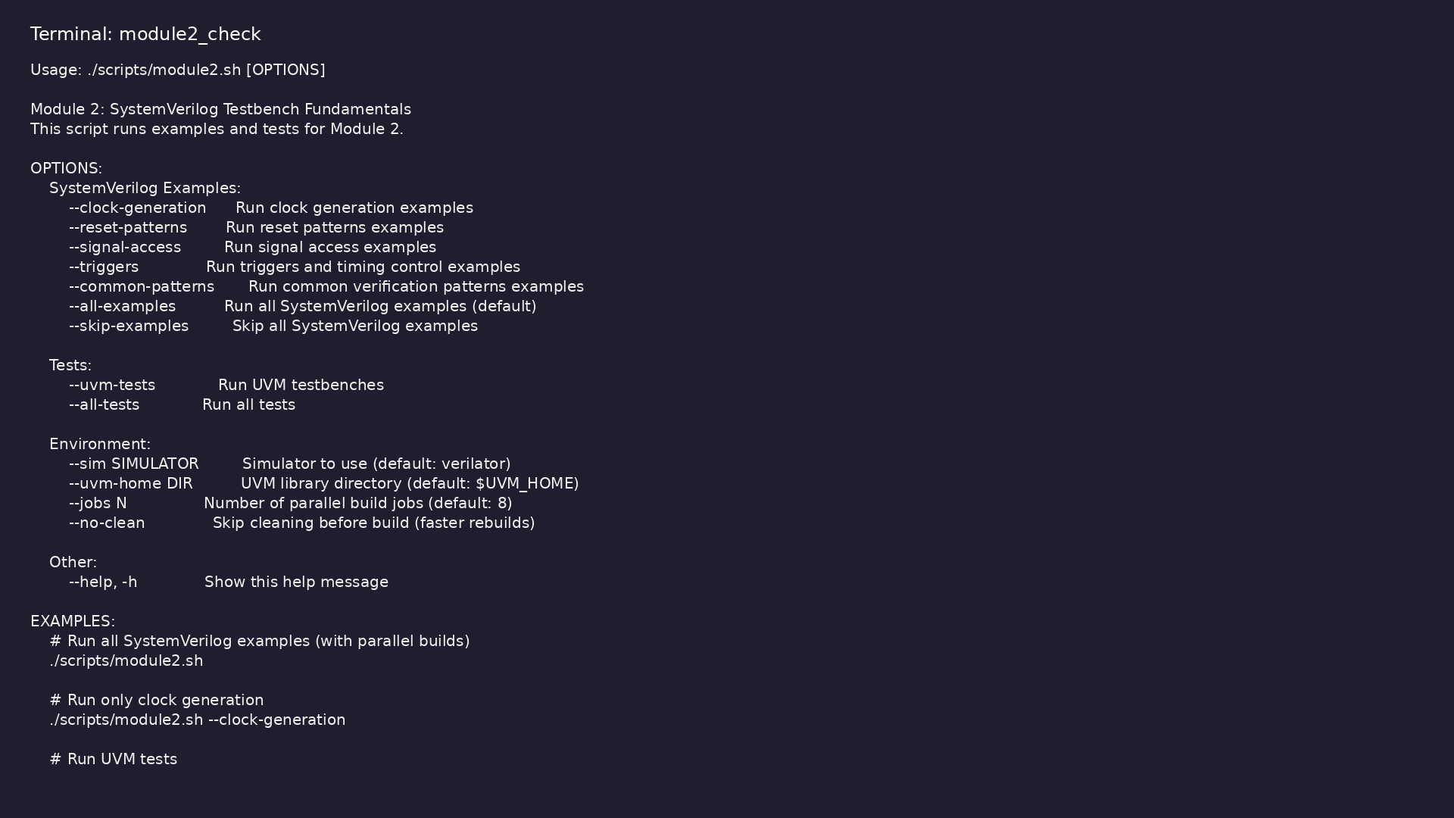
Module 2 self-check
$ ./scripts/module2.sh --help
learn_uvm2017_sv_verilator / Module 2
Notes:
Run from course repository root.

Slide 122
Exercise scaffold
./scripts/module2.sh --scaffold
learn_uvm2017_sv_verilator / Module 2

Slide 123
Example 1: Clock Generation
• Simple Clock: Basic clock generation with `always`
block
• Parameterized Clock: Clock with configurable period
and duty cycle
• Multiple Clocks: Generating multiple independent
clocks
• Clock Gating: Conditional clock generation
• Clock Stopping: Controlled clock stopping
learn_uvm2017_sv_verilator / Module 2
Notes:
module2/examples/clock_generation/README.md

Slide 124
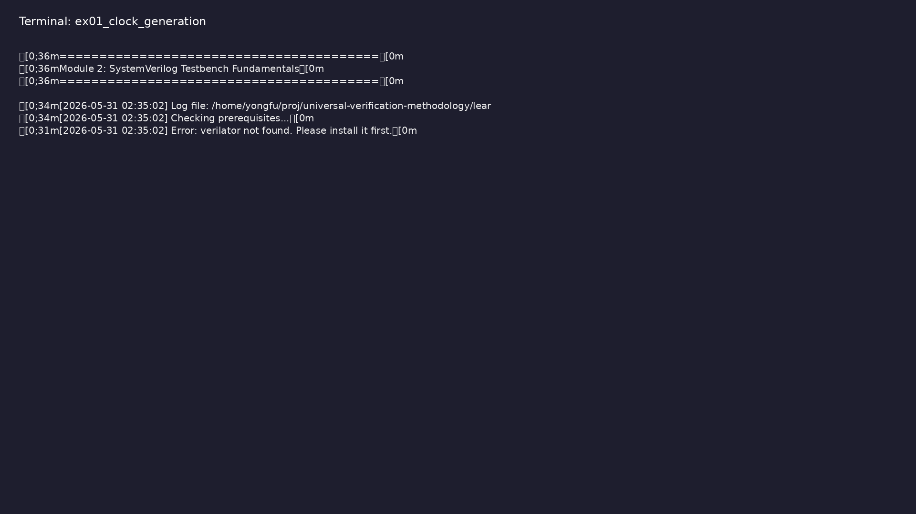
Demo: Clock Generation
$ ./scripts/module2.sh --clock-generation
learn_uvm2017_sv_verilator / Module 2
Notes:
Hands-on: module2/examples/clock_generation/

Slide 125
Example 2: Reset Patterns
• Synchronous Reset: Reset synchronized to clock
• Asynchronous Reset: Reset independent of clock
• Reset Sequence: Controlled reset assertion and de-
assertion
• Reset Verification: Checking reset behavior
learn_uvm2017_sv_verilator / Module 2
Notes:
module2/examples/reset_patterns/README.md

Slide 126

Demo: Reset Patterns
$ ./scripts/module2.sh --reset-patterns
learn_uvm2017_sv_verilator / Module 2
Notes:
Hands-on: module2/examples/reset_patterns/

Slide 127
Example 3: Signal Access
• Signal Reading: Reading DUT signal values
• Signal Driving: Driving signals to DUT
• Signal Monitoring: Monitoring signal changes
• Signal Types: Handling different signal types
learn_uvm2017_sv_verilator / Module 2
Notes:
module2/examples/signal_access/README.md

Slide 128
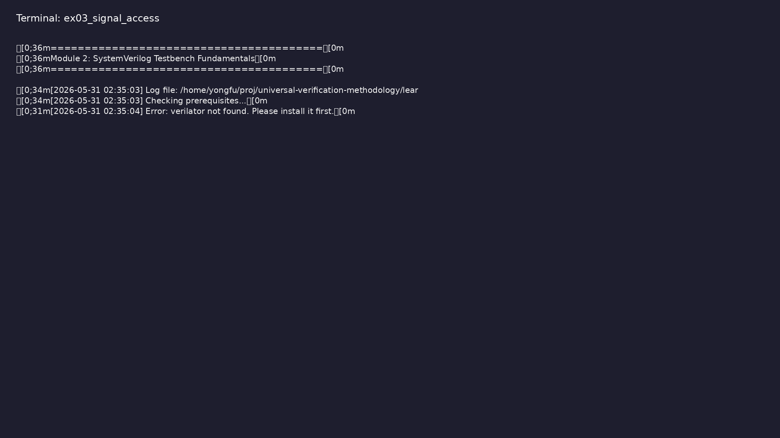
Demo: Signal Access
$ ./scripts/module2.sh --signal-access
learn_uvm2017_sv_verilator / Module 2
Notes:
Hands-on: module2/examples/signal_access/

Slide 129
Example 4: Triggers and Timing
• Event Control: Using `@` for event-based timing
• Delay Control: Using `#` for time-based delays
• Wait Statements: Using `wait` for condition-based
waiting
• Fork-Join: Parallel execution with synchronization
• Named Events: Event-based synchronization
learn_uvm2017_sv_verilator / Module 2
Notes:
module2/examples/triggers/README.md

Slide 130
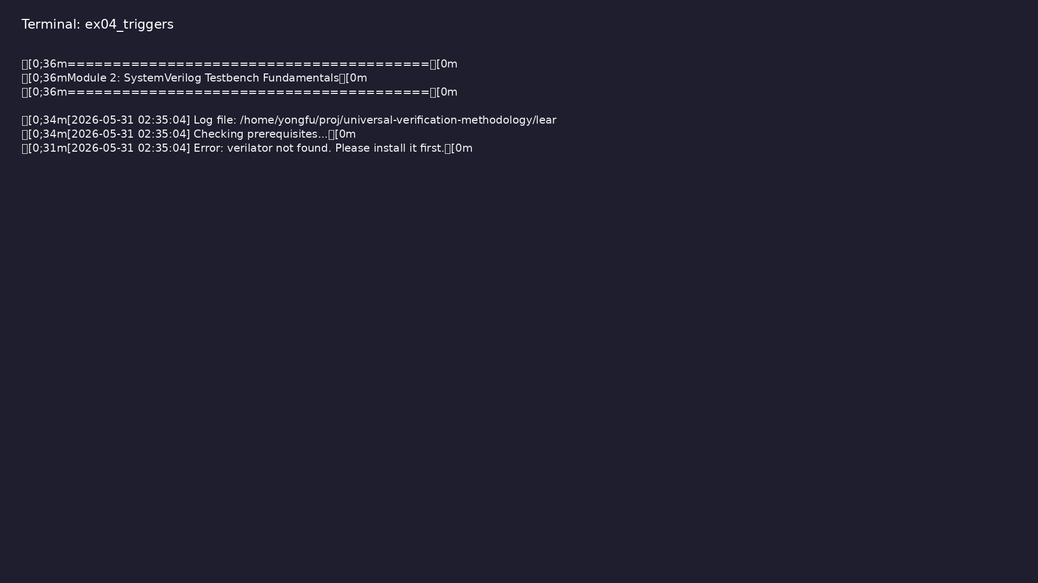
Demo: Triggers and Timing
$ ./scripts/module2.sh --triggers
learn_uvm2017_sv_verilator / Module 2
Notes:
Hands-on: module2/examples/triggers/

Slide 131
Example 5: Common Patterns
• Testbench Structure: Organized testbench with phases
• Driver Pattern: Stimulus generation component
• Monitor Pattern: Response monitoring component
• Scoreboard Pattern: Response checking component
• Reusable Components: Component reuse patterns
learn_uvm2017_sv_verilator / Module 2
Notes:
module2/examples/common_patterns/README.md

Slide 132
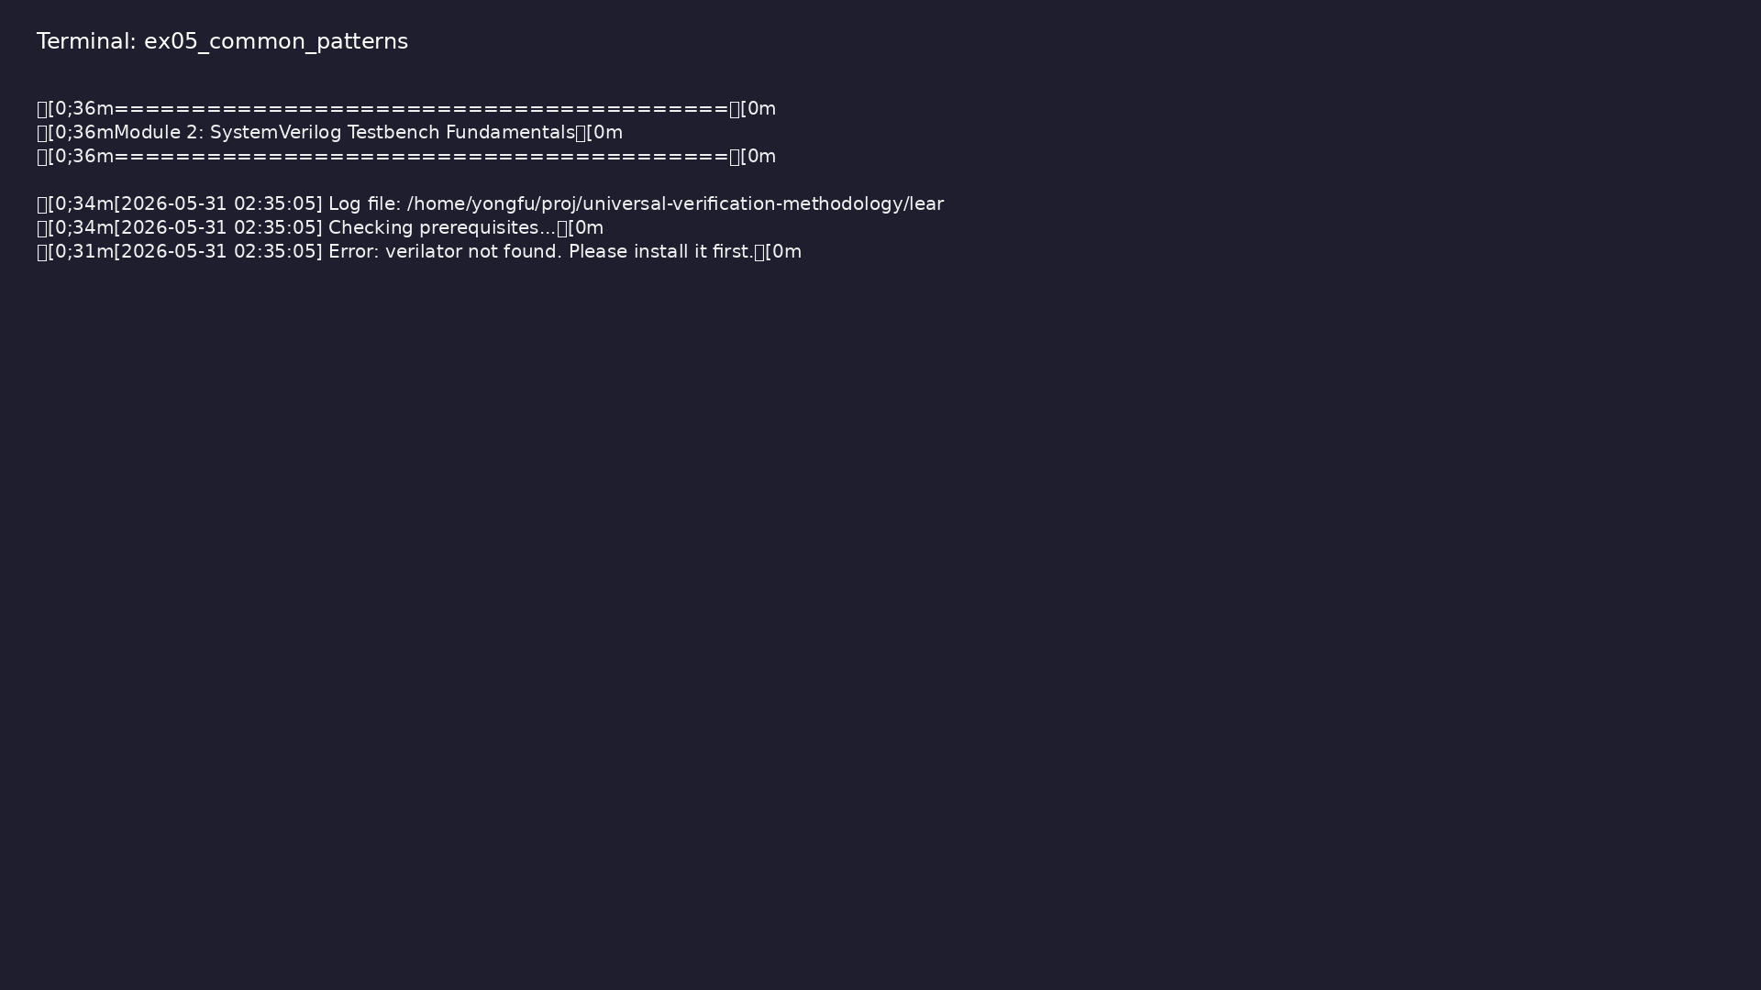
Demo: Common Patterns
$ ./scripts/module2.sh --common-patterns
learn_uvm2017_sv_verilator / Module 2
Notes:
Hands-on: module2/examples/common_patterns/

Slide 133
Common pitfalls
learn_uvm2017_sv_verilator / Module 2

Slide 134
Clock Generation
• Create a parameterized clock generator
• Generate multiple clocks with different frequencies
• Implement clock gating
• Test clock domain crossing
learn_uvm2017_sv_verilator / Module 2
Notes:
From MODULE2 Common Pitfalls.

Slide 135
Reset Implementation
• Implement synchronous and asynchronous reset
• Create reset sequences
• Verify reset behavior
• Test reset timing
learn_uvm2017_sv_verilator / Module 2
Notes:
From MODULE2 Common Pitfalls.

Slide 136
Signal Access
• Read and drive DUT signals
• Monitor signal changes
• Handle different signal types
• Implement signal checking
learn_uvm2017_sv_verilator / Module 2
Notes:
From MODULE2 Common Pitfalls.

Slide 137
Timing Control
• Use events for synchronization
• Implement delays and waits
• Use fork-join for parallel execution
• Handle timeouts
learn_uvm2017_sv_verilator / Module 2
Notes:
From MODULE2 Common Pitfalls.

Slide 138
Testbench Patterns
• Implement driver pattern
• Implement monitor pattern
• Implement scoreboard pattern
• Create reusable testbench components
learn_uvm2017_sv_verilator / Module 2
Notes:
From MODULE2 Common Pitfalls.

Slide 139
Practice & assessment
learn_uvm2017_sv_verilator / Module 2

Slide 140
What you should know (1/2)
• Understand SystemVerilog testbench architecture
• Generate clocks and manage clock domains
• Implement reset patterns and sequences
• Access and drive signals correctly
• Use events and timing control effectively
• Apply common verification patterns
learn_uvm2017_sv_verilator / Module 2
Notes:
From MODULE2 Learning Outcomes.

Slide 141
What you should know (2/2)
• Structure testbenches for maintainability
• Prepare for UVM methodology
• Write effective testbench tasks and functions
• Use timing control constructs properly
learn_uvm2017_sv_verilator / Module 2
Notes:
From MODULE2 Learning Outcomes.

Slide 142
Exercises
• Clock Generation
• Reset Implementation
• Signal Access
• Timing Control
• Testbench Patterns
learn_uvm2017_sv_verilator / Module 2

Slide 143
Assessment checklist
• Can generate clocks and manage clock domains
• Can implement reset patterns
• Can access and drive signals correctly
• Can use events and timing control
• Can apply common verification patterns
• Can structure testbenches effectively
learn_uvm2017_sv_verilator / Module 2

Slide 144
Summary & next steps
• Master SystemVerilog testbench construction
• Complete module2/CHECKLIST.md
• Review module2/EXAMPLES.md and run each lab
• Next: Next module in course
learn_uvm2017_sv_verilator / Module 2

