Slide 1
Module 3
UVM Basics
learn_uvm2017_sv_verilator / Module 3

Slide 2
Learning objectives
• Master UVM class hierarchy and phases
learn_uvm2017_sv_verilator / Module 3

Slide 3
Prerequisites
• See module README
learn_uvm2017_sv_verilator / Module 3

Slide 4

Learning path
Master UVM class hierarchy and phases
learn_uvm2017_sv_verilator / Module 3

Slide 5
Overview
• This module introduces the Universal Verification
Methodology (UVM) using SystemVerilog. You'll lea…
learn_uvm2017_sv_verilator / Module 3

Slide 6
Design architecture
learn_uvm2017_sv_verilator / Module 3

Slide 7

1. UVM class hierarchy (1/3)
• Object hierarchy: `uvm_object` →
`uvm_sequence_item` → your
transaction
• Component hierarchy:
`uvm_component` →
driver/monitor/agent/env/test
• Factory macros
(`uvm_component_utils`) register
types for `type_id::create()`
• Component tree: Test → Env →
Agent → {Driver, Monitor,
Sequencer}
learn_uvm2017_sv_verilator / Module 3
Notes:
From MODULE3 Design Architecture.

Slide 8
1. UVM class hierarchy (2/3)
• uvm_test: Top-level; calls run_test(), owns
environment
• uvm_env: Contains agents, scoreboard, coverage (as
needed)
• uvm_agent: Groups driver, monitor, sequencer on one
interface
• uvm_driver: Converts sequence items to pin wiggles
learn_uvm2017_sv_verilator / Module 3
Notes:
From MODULE3 Design Architecture.

Slide 9
1. UVM class hierarchy (3/3)
• uvm_monitor: Observes bus/DUT; emits transactions
• uvm_sequence_item: Transaction payload (data,
address, etc.)
learn_uvm2017_sv_verilator / Module 3
Notes:
From MODULE3 Design Architecture.

Slide 10

2. UVM phase graph and execution order (1/2)
• Build-time (top-down):
`build_phase` → `connect_phase`
→ `end_of_elaboration_phase`
• Run-time (bottom-up):
`run_phase` with objections
controlling sim time
• Report: `report_phase`
summarizes
UVM_INFO/WARNING/ERROR counts
• `super.build_phase(phase)`
required in every override to
preserve hierarchy
learn_uvm2017_sv_verilator / Module 3
Notes:
From MODULE3 Design Architecture.

Slide 11
2. UVM phase graph and execution order (2/2)
• Simulation flow: elaboration → `run_test()` → phases
→ `$finish`
learn_uvm2017_sv_verilator / Module 3
Notes:
From MODULE3 Design Architecture.

Slide 12

3. Module 3 repository map
• 1: module3/examples/class_hierar
chy/ — Minimal full UVM
hierarchy demo
• 2: module3/examples/phases/ —
Phase callback visibility
• 3: module3/dut/simple_blocks/add
er.v — Small RTL for integrated
UVM test
• 4: module3/tests/uvm_tests/test_
adder_uvm.sv — End-to-end UVM
testbench
learn_uvm2017_sv_verilator / Module 3
Notes:
From MODULE3 Design Architecture.

Slide 13
RTL block diagram (reference)
Module 3: DUT hierarchy and signal flow.
learn_uvm2017_sv_verilator / Module 3

Slide 14
Verification / testbench diagram (reference)
Module 3: stimulus, observation, and checking.
learn_uvm2017_sv_verilator / Module 3

Slide 15
Execution & simulation flow
learn_uvm2017_sv_verilator / Module 3

Slide 16
How the example runs (toolchain)
• Makefile: Verilator + UVM_HOME compile RTL,
interface, and test_*.sv
• UVM phases: build → connect → run_test → report
(same pattern as Module 2)
• Sequence → driver → DUT → monitor → scoreboard (read
SCOREBOARD at end)
• Typical command: make SIM=verilator TEST=test_* (see
module3 demo slide)
• Loopback / hooks connect monitor observations to
scoreboard checks
learn_uvm2017_sv_verilator / Module 3
Notes:
From MODULE3 — execution and artifact layout.

Slide 17
Artifact flow (spec → sim)
• 1: module3/examples/class_hierarchy/ — Minimal full
UVM hierarchy demo
• 2: module3/examples/phases/ — Phase callback
visibility
• 3: module3/dut/simple_blocks/adder.v — Small RTL for
integrated UVM test
• 4: module3/tests/uvm_tests/test_adder_uvm.sv — End-
to-end UVM testbench
learn_uvm2017_sv_verilator / Module 3
Notes:
From MODULE3 — execution and artifact layout.

Slide 18
Example directory layout (1)
• uvm_test: Top-level; calls run_test(), owns
environment
• uvm_env: Contains agents, scoreboard, coverage (as
needed)
• uvm_agent: Groups driver, monitor, sequencer on one
interface
• uvm_driver: Converts sequence items to pin wiggles
• uvm_monitor: Observes bus/DUT; emits transactions
learn_uvm2017_sv_verilator / Module 3
Notes:
Match each path to files under module/examples/.

Slide 19
Example directory layout (2)
• uvm_sequence_item: Transaction payload (data,
address, etc.)
learn_uvm2017_sv_verilator / Module 3
Notes:
Match each path to files under module/examples/.

Slide 20
Directed test execution sequence (1)
• ./scripts/module3.sh --class-hierarchy
• UVM report
• PASS
• elaboration
• run_test()
learn_uvm2017_sv_verilator / Module 3
Notes:
Follow this order when tracing waveforms or debugging.

Slide 21
Directed test execution sequence (2)
• phases
• $finish
learn_uvm2017_sv_verilator / Module 3
Notes:
Follow this order when tracing waveforms or debugging.

Slide 22
Verification & testing methods
learn_uvm2017_sv_verilator / Module 3

Slide 23
1. UVM infrastructure patterns
• Factory — create components with
`type_id::create()`; enable
overrides later
• ConfigDB — pass virtual
interfaces and config objects
down the hierarchy
• Reporting —
`uvm_info`/`uvm_error` with
verbosity and ID filtering
• Objections — `raise_objection`/`
drop_objection` in `run_phase`
hold simulation alive
learn_uvm2017_sv_verilator / Module 3
Notes:
From MODULE3 Verification & Testing Methods.

Slide 24
2. Verilator + UVM execution strategy (1/2)
• Compile with `-I$UVM_HOME/src
+define+UVM_NO_DPI` (no DPI for
Verilator)
• C++ `main` calls `uvm_main` or
wrapper that invokes
`run_test("MyTest")`
• Start with standalone examples
(no DUT) to learn hierarchy and
phases
• Progress to `test_adder_uvm` —
connect virtual interface to RTL
adder
learn_uvm2017_sv_verilator / Module 3
Notes:
From MODULE3 Verification & Testing Methods.

Slide 25
2. Verilator + UVM execution strategy (2/2)
• Closure: zero `UVM_ERROR`/`UVM_FATAL`; expected INFO
lines in log
learn_uvm2017_sv_verilator / Module 3
Notes:
From MODULE3 Verification & Testing Methods.

Slide 26
Syllabus topics
learn_uvm2017_sv_verilator / Module 3

Slide 27
Protocol & design details
learn_uvm2017_sv_verilator / Module 3

Slide 28
Detail: Example 3.1: Class Hierarchy (`module3/examples/class_hierarc…
• Transaction Class (`MyTransaction`): Extends
`uvm_sequence_item` (uvm_object hierarchy)
• Driver Class (`MyDriver`): Extends `uvm_driver`
(uvm_component hierarchy)
• Monitor Class (`MyMonitor`): Extends `uvm_monitor`
(uvm_component hierarchy)
• Agent Class (`MyAgent`): Extends `uvm_agent`,
demonstrates component composition
learn_uvm2017_sv_verilator / Module 3
Notes:
From MODULE3 Topics Covered — protocol/design depth.

Slide 29
Detail: Example 3.1: Class Hierarchy (`module3/examples/class_hierarc…
• Environment Class (`MyEnv`): Extends `uvm_env`, top-
level verification environment
• Test Class (`ClassHierarchyTest`): Extends
`uvm_test`, orchestrates test execution
• Purpose: Automatically register class with UVM
factory
• Usage: Must be inside class definition
learn_uvm2017_sv_verilator / Module 3
Notes:
From MODULE3 Topics Covered — protocol/design depth.

Slide 30
Detail: Example 3.2: Phases (`module3/examples/phases/phases.sv`) (1)
• Build-Time Phases: Top-down execution (parent before
child)
• Run-Time Phases: Bottom-up execution (child before
parent)
• Cleanup Phases: Bottom-up execution (child before
parent)
• Phase Execution Order: Demonstrates all UVM phases
learn_uvm2017_sv_verilator / Module 3
Notes:
From MODULE3 Topics Covered — protocol/design depth.

Slide 31
Detail: Example 3.2: Phases (`module3/examples/phases/phases.sv`) (2)
• Purpose: Component construction and setup
• Execution: Top-down (parent before child)
• Key: Use `super.build_phase(phase)` to maintain
hierarchy
• Purpose: Test execution phases
learn_uvm2017_sv_verilator / Module 3
Notes:
From MODULE3 Topics Covered — protocol/design depth.

Slide 32
Detail: Example 3.3: Reporting (`module3/examples/reporting/reporting…
• Severity Levels: INFO, WARNING, ERROR, FATAL
• Verbosity Levels: UVM_LOW, UVM_MEDIUM, UVM_HIGH,
UVM_FULL, UVM_DEBUG
• Message Formatting: Formatted messages with data
values
• Hierarchical Reporting: Component context in
messages
learn_uvm2017_sv_verilator / Module 3
Notes:
From MODULE3 Topics Covered — protocol/design depth.

Slide 33
Detail: Example 3.3: Reporting (`module3/examples/reporting/reporting…
• Purpose: Print formatted messages with severity
• Parameters:
• `TAG`: Message category/tag
• `Message`: Text to display
learn_uvm2017_sv_verilator / Module 3
Notes:
From MODULE3 Topics Covered — protocol/design depth.

Slide 34
Detail: Example 3.4: ConfigDB (`module3/examples/configdb/configdb.sv…
• Setting Configuration: Global and component-specific
• Getting Configuration: Hierarchical lookup
• Configuration Objects: Complex configuration data
• Scalar Values: Simple configuration values
learn_uvm2017_sv_verilator / Module 3
Notes:
From MODULE3 Topics Covered — protocol/design depth.

Slide 35
Detail: Example 3.4: ConfigDB (`module3/examples/configdb/configdb.sv…
• Purpose: Store configuration in database
• Syntax: `uvm_config_db#(type)::set(contxt, path,
field, value)`
• Parameters:
• `contxt`: Context (usually `this` in test)
learn_uvm2017_sv_verilator / Module 3
Notes:
From MODULE3 Topics Covered — protocol/design depth.

Slide 36
Detail: Example 3.5: Factory (`module3/examples/factory/factory.sv`)…
• Factory Registration: Automatic registration via
`uvm_object_utils`
• Factory Creation: Using `type_id::create()`
• Type Override: Substituting base class with extended
class
• Instance Override: Overriding specific instances
learn_uvm2017_sv_verilator / Module 3
Notes:
From MODULE3 Topics Covered — protocol/design depth.

Slide 37
Detail: Example 3.5: Factory (`module3/examples/factory/factory.sv`)…
• Purpose: Automatically register class with factory
• Usage: Must be inside class definition
• Key: Enables factory-based creation and overrides
• Purpose: Create objects/components via factory
learn_uvm2017_sv_verilator / Module 3
Notes:
From MODULE3 Topics Covered — protocol/design depth.

Slide 38
Detail: Example 3.6: Objections (`module3/examples/objections/objecti…
• Raising Objections: Keep simulation running
• Dropping Objections: Allow phase completion
• Multiple Objections: Per-component objection
tracking
• Coordinated Completion: Phase completes when all
objections dropped
learn_uvm2017_sv_verilator / Module 3
Notes:
From MODULE3 Topics Covered — protocol/design depth.

Slide 39
Detail: Example 3.6: Objections (`module3/examples/objections/objecti…
• Purpose: Keep phase running until objection is
dropped
• Usage: Call at start of `run_phase()` or other run-
time phases
• Parameters:
• `this`: Component raising objection
learn_uvm2017_sv_verilator / Module 3
Notes:
From MODULE3 Topics Covered — protocol/design depth.

Slide 40
Detail: UVM Factory Macros and Methods (1)
• Purpose: Register class with UVM factory
• Location: Inside class definition
• Enables: Factory creation and overrides
• Syntax: `ClassName::type_id::create(name, parent)`
learn_uvm2017_sv_verilator / Module 3
Notes:
From MODULE3 Topics Covered — protocol/design depth.

Slide 41
Detail: UVM Factory Macros and Methods (2)
• Returns: Handle to created object/component
• Key: Factory applies overrides automatically
learn_uvm2017_sv_verilator / Module 3
Notes:
From MODULE3 Topics Covered — protocol/design depth.

Slide 42
Detail: UVM Reporting Macros (1)
• `UVM_LOW` - Always displayed (default)
• `UVM_MEDIUM` - Medium detail (most common)
• `UVM_HIGH` - High detail
• `UVM_FULL` - Full detail
learn_uvm2017_sv_verilator / Module 3
Notes:
From MODULE3 Topics Covered — protocol/design depth.

Slide 43
Detail: UVM Reporting Macros (2)
• `UVM_DEBUG` - Debug-level detail
learn_uvm2017_sv_verilator / Module 3
Notes:
From MODULE3 Topics Covered — protocol/design depth.

Slide 44
Detail: ConfigDB Methods (1)
• Set configuration in test's `build_phase()` before
creating components
• Get configuration in component's `build_phase()`
• Always check return value of `get()`
• Provide default values if configuration not found
learn_uvm2017_sv_verilator / Module 3
Notes:
From MODULE3 Topics Covered — protocol/design depth.

Slide 45
Detail: ConfigDB Methods (2)
• Use hierarchical paths for component-specific
configuration
learn_uvm2017_sv_verilator / Module 3
Notes:
From MODULE3 Topics Covered — protocol/design depth.

Slide 46
Detail: Objection Methods
• Must raise objection if doing work in run-time phase
• Must drop objection when work completes
• Phase completes when all objections are dropped
• Each `raise_objection()` must have matching
`drop_objection()`
learn_uvm2017_sv_verilator / Module 3
Notes:
From MODULE3 Topics Covered — protocol/design depth.

Slide 47
Detail: Component Utility Methods
• Purpose: Component identification
• Usage: Logging, debugging, hierarchical paths
learn_uvm2017_sv_verilator / Module 3
Notes:
From MODULE3 Topics Covered — protocol/design depth.

Slide 48
Detail: Sequence Methods (1)
• Purpose: Generate and send transactions to driver
• Usage: Sequences generate test vectors
• Flow: Sequence → Sequencer → Driver → DUT
• Purpose: Post-processing after randomization
learn_uvm2017_sv_verilator / Module 3
Notes:
From MODULE3 Topics Covered — protocol/design depth.

Slide 49
Detail: Sequence Methods (2)
• Usage: Calculate expected results, validate data
learn_uvm2017_sv_verilator / Module 3
Notes:
From MODULE3 Topics Covered — protocol/design depth.

Slide 50
Detail: TLM Port Methods (Driver) (1)
• Purpose: Driver-sequencer communication
• Methods:
• `get_next_item(txn)`: Get next transaction
(blocking)
• `item_done()`: Signal transaction processing
complete
learn_uvm2017_sv_verilator / Module 3
Notes:
From MODULE3 Topics Covered — protocol/design depth.

Slide 51
Detail: TLM Port Methods (Driver) (2)
• Flow: Sequencer provides → Driver receives → DUT
learn_uvm2017_sv_verilator / Module 3
Notes:
From MODULE3 Topics Covered — protocol/design depth.

Slide 52
Detail: Analysis Port Methods (Monitor/Scoreboard) (1)
• Purpose: Broadcast transactions to subscribers
• Usage: Monitor sends transactions to scoreboard,
coverage, etc.
• Purpose: Receive transactions from monitor
• Usage: Scoreboard checks DUT behavior
learn_uvm2017_sv_verilator / Module 3
Notes:
From MODULE3 Topics Covered — protocol/design depth.

Slide 53
Detail: Analysis Port Methods (Monitor/Scoreboard) (2)
• Purpose: Connect analysis port to analysis export
• Usage: Establish monitor → scoreboard communication
learn_uvm2017_sv_verilator / Module 3
Notes:
From MODULE3 Topics Covered — protocol/design depth.

Slide 54
Detail: Virtual Interface Methods
• Purpose: Get virtual interface handle
• Usage: Driver/monitor access DUT signals via virtual
interface
• Setting: `uvm_config_db#(virtual
interface_type)::set(null, "*", "vif", vif_inst)`
learn_uvm2017_sv_verilator / Module 3
Notes:
From MODULE3 Topics Covered — protocol/design depth.

Slide 55
Detail: Top-Level UVM Functions
• Purpose: Start UVM test execution
• Parameters: Test class name (string)
• Behavior: Creates test instance, executes all phases
• Override: `+UVM_TESTNAME=TestName` command line
option
learn_uvm2017_sv_verilator / Module 3
Notes:
From MODULE3 Topics Covered — protocol/design depth.

Slide 56
Verification flow (reference)
Stimulus, DUT response, and check points for this module.
learn_uvm2017_sv_verilator / Module 3

Slide 57
1. Introduction to UVM (1/8)
• Universal Verification Methodology
• UVM standard (IEEE 1800.2-2017)
• UVM class library
• Methodology benefits
• Industry adoption
• UVM Benefits
learn_uvm2017_sv_verilator / Module 3
Notes:
From MODULE3 Topics Covered.

Slide 58
1. Introduction to UVM (2/8)
• Reusability
• Standardization
• Scalability
• Maintainability
• Transaction Class (`MyTransaction`): Extends
`uvm_sequence_item` (uvm_object hierarchy)
• Driver Class (`MyDriver`): Extends `uvm_driver`
(uvm_component hierarchy)
learn_uvm2017_sv_verilator / Module 3
Notes:
From MODULE3 Topics Covered.

Slide 59
1. Introduction to UVM (3/8)
• Monitor Class (`MyMonitor`): Extends `uvm_monitor`
(uvm_component hierarchy)
• Agent Class (`MyAgent`): Extends `uvm_agent`,
demonstrates component composition
• Environment Class (`MyEnv`): Extends `uvm_env`, top-
level verification environment
• Test Class (`ClassHierarchyTest`): Extends
`uvm_test`, orchestrates test execution
• Purpose: Automatically register class with UVM
factory
• Usage: Must be inside class definition
learn_uvm2017_sv_verilator / Module 3
Notes:
From MODULE3 Topics Covered.

Slide 60
1. Introduction to UVM (4/8)
• Key: Enables factory-based object creation
• Purpose: Initialize UVM objects and components
• Parameters:
• `name`: Component/object name
• `parent`: Parent component (for hierarchy)
• Key: Must call `super.new()` to initialize base
class
learn_uvm2017_sv_verilator / Module 3
Notes:
From MODULE3 Topics Covered.

Slide 61
1. Introduction to UVM (5/8)
• Purpose: Implement UVM phase behavior
• Key: Must call `super.build_phase(phase)` etc. to
maintain hierarchy
• Objections: Use in `run_phase()` to control
simulation
• Purpose: Create objects/components using factory
• Syntax: `ClassName::type_id::create(name, parent)`
• Key: Factory enables overrides and centralized
creation
learn_uvm2017_sv_verilator / Module 3
Notes:
From MODULE3 Topics Covered.

Slide 62
1. Introduction to UVM (6/8)
• Purpose: Connect component ports in
`connect_phase()`
• Usage: Connect driver to sequencer, monitor to
scoreboard, etc.
• Purpose: Provide human-readable string
representation
• Usage: Debugging, logging, reporting
• `uvm_object` - Base class for all UVM objects
(transactions, sequences)
• `uvm_component` - Base class for all UVM components
(drivers, monitors, agents)
learn_uvm2017_sv_verilator / Module 3
Notes:
From MODULE3 Topics Covered.

Slide 63
1. Introduction to UVM (7/8)
• Component hierarchy: Test → Environment → Agent →
Driver/Monitor
• Component creation using factory pattern
• Factory macros (`uvm_object_utils`,
`uvm_component_utils`) enable registration
• Phase functions/tasks implement component behavior
• Factory creation (`type_id::create()`) enables
overrides
• Component hierarchy construction
learn_uvm2017_sv_verilator / Module 3
Notes:
From MODULE3 Topics Covered.

Slide 64
1. Introduction to UVM (8/8)
• Phase execution demonstration
• Component creation and connection
• UVM report summary
learn_uvm2017_sv_verilator / Module 3
Notes:
From MODULE3 Topics Covered.

Slide 65
2. UVM Class Hierarchy (1/3)
• Object vs Component
• `uvm_object` - Base for transactions, sequences
• `uvm_component` - Base for testbench components
• Lifetime differences
• Hierarchy differences
• Component Classes
learn_uvm2017_sv_verilator / Module 3
Notes:
From MODULE3 Topics Covered.

Slide 66
2. UVM Class Hierarchy (2/3)
• `uvm_test` - Top-level test class
• `uvm_env` - Verification environment
• `uvm_agent` - Agent containing driver, monitor,
sequencer
• `uvm_driver` - Drives transactions to DUT
• `uvm_monitor` - Observes DUT behavior
• `uvm_sequencer` - Manages sequence execution
learn_uvm2017_sv_verilator / Module 3
Notes:
From MODULE3 Topics Covered.

Slide 67
2. UVM Class Hierarchy (3/3)
• Object Classes
• `uvm_sequence_item` - Base transaction class
• `uvm_sequence` - Sequence of transactions
• Class relationships and inheritance
learn_uvm2017_sv_verilator / Module 3
Notes:
From MODULE3 Topics Covered.

Slide 68
3. UVM Phases (1/8)
• Build-Time Phases (Top-down)
• `build_phase()` - Component construction
• `connect_phase()` - Component connections
• `end_of_elaboration_phase()` - Final setup
• `start_of_simulation_phase()` - Simulation start
• Run-Time Phases (Bottom-up)
learn_uvm2017_sv_verilator / Module 3
Notes:
From MODULE3 Topics Covered.

Slide 69
3. UVM Phases (2/8)
• `pre_reset_phase()`, `reset_phase()`,
`post_reset_phase()`
• `pre_configure_phase()`, `configure_phase()`,
`post_configure_phase()`
• `pre_main_phase()`, `main_phase()`,
`post_main_phase()`
• `pre_shutdown_phase()`, `shutdown_phase()`,
`post_shutdown_phase()`
• Cleanup Phases (Bottom-up)
• `extract_phase()` - Extract results
learn_uvm2017_sv_verilator / Module 3
Notes:
From MODULE3 Topics Covered.

Slide 70
3. UVM Phases (3/8)
• `check_phase()` - Final checks
• `report_phase()` - Generate reports
• `final_phase()` - Final cleanup
• Build-Time Phases: Top-down execution (parent before
child)
• Run-Time Phases: Bottom-up execution (child before
parent)
• Cleanup Phases: Bottom-up execution (child before
parent)
learn_uvm2017_sv_verilator / Module 3
Notes:
From MODULE3 Topics Covered.

Slide 71
3. UVM Phases (4/8)
• Phase Execution Order: Demonstrates all UVM phases
• Purpose: Component construction and setup
• Execution: Top-down (parent before child)
• Key: Use `super.build_phase(phase)` to maintain
hierarchy
• Purpose: Test execution phases
• Execution: Bottom-up (child before parent)
learn_uvm2017_sv_verilator / Module 3
Notes:
From MODULE3 Topics Covered.

Slide 72
3. UVM Phases (5/8)
• Key: Use objections in `main_phase()` to control
simulation
• Purpose: Result extraction and reporting
• Execution: Bottom-up (child before parent)
• Key: Use for final verification and reporting
• Purpose: Get component identification
• Usage: Logging, debugging, hierarchical paths
learn_uvm2017_sv_verilator / Module 3
Notes:
From MODULE3 Topics Covered.

Slide 73
3. UVM Phases (6/8)
• Build-time phases execute top-down (parent before
child)
• Run-time phases execute bottom-up (child before
parent)
• Cleanup phases execute bottom-up (child before
parent)
• Phases enable structured testbench execution
• Build-time phases are functions (no delays allowed)
• Run-time phases are tasks (can have delays)
learn_uvm2017_sv_verilator / Module 3
Notes:
From MODULE3 Topics Covered.

Slide 74
3. UVM Phases (7/8)
• Cleanup phases are functions (no delays allowed)
• Must call `super.phase_name(phase)` to maintain
hierarchy
• Use `get_name()` and `get_full_name()` for component
identification
• All build-time phases executed in order
• All run-time phases executed in order
• All cleanup phases executed in order
learn_uvm2017_sv_verilator / Module 3
Notes:
From MODULE3 Topics Covered.

Slide 75
3. UVM Phases (8/8)
• Phase execution logging
learn_uvm2017_sv_verilator / Module 3
Notes:
From MODULE3 Topics Covered.

Slide 76
4. UVM Reporting (1/8)
• UVM Messaging System
• Severity levels: FATAL, ERROR, WARNING, INFO, DEBUG
• Verbosity levels: UVM_LOW, UVM_MEDIUM, UVM_HIGH,
UVM_FULL, UVM_DEBUG
• Message formatting
• Hierarchical reporting
• Severity Levels: INFO, WARNING, ERROR, FATAL
learn_uvm2017_sv_verilator / Module 3
Notes:
From MODULE3 Topics Covered.

Slide 77
4. UVM Reporting (2/8)
• Verbosity Levels: UVM_LOW, UVM_MEDIUM, UVM_HIGH,
UVM_FULL, UVM_DEBUG
• Message Formatting: Formatted messages with data
values
• Hierarchical Reporting: Component context in
messages
• Purpose: Print formatted messages with severity
• Parameters:
• `TAG`: Message category/tag
learn_uvm2017_sv_verilator / Module 3
Notes:
From MODULE3 Topics Covered.

Slide 78
4. UVM Reporting (3/8)
• `Message`: Text to display
• `Verbosity`: For `uvm_info` only (UVM_LOW,
UVM_MEDIUM, etc.)
• Usage: Standard UVM messaging
• Purpose: Include data values in messages
• Uses: `$sformatf()` for string formatting
• Key: Combine UVM macros with SystemVerilog
formatting
learn_uvm2017_sv_verilator / Module 3
Notes:
From MODULE3 Topics Covered.

Slide 79
4. UVM Reporting (4/8)
• Purpose: Control message visibility
• Usage: Set in `build_phase()` or test
• Levels: UVM_LOW < UVM_MEDIUM < UVM_HIGH < UVM_FULL <
UVM_DEBUG
• Purpose: Include component hierarchy in messages
• Uses: `get_full_name()` for hierarchical path
• INFO: Informational messages (non-critical)
learn_uvm2017_sv_verilator / Module 3
Notes:
From MODULE3 Topics Covered.

Slide 80
4. UVM Reporting (5/8)
• WARNING: Potential issues (non-fatal)
• ERROR: Actual errors (may stop simulation)
• FATAL: Fatal errors (stops simulation immediately)
• UVM_LOW: Always displayed (default)
• UVM_MEDIUM: Medium detail (default for most
messages)
• UVM_HIGH: High detail
learn_uvm2017_sv_verilator / Module 3
Notes:
From MODULE3 Topics Covered.

Slide 81
4. UVM Reporting (6/8)
• UVM_FULL: Full detail
• UVM_DEBUG: Debug-level detail
• Severity indicates message importance
• Verbosity controls message visibility
• Messages include component hierarchy context
• Reporting enables debugging and monitoring
learn_uvm2017_sv_verilator / Module 3
Notes:
From MODULE3 Topics Covered.

Slide 82
4. UVM Reporting (7/8)
• `uvm_info` is most common (with verbosity control)
• `uvm_warning` for non-critical issues
• `uvm_error` for errors (may stop simulation)
• `uvm_fatal` for fatal errors (stops simulation)
• Use `$sformatf()` for formatted messages with data
• Different severity levels demonstrated
learn_uvm2017_sv_verilator / Module 3
Notes:
From MODULE3 Topics Covered.

Slide 83
4. UVM Reporting (8/8)
• Verbosity control demonstrated
• Formatted messages with data
• Hierarchical message context
learn_uvm2017_sv_verilator / Module 3
Notes:
From MODULE3 Topics Covered.

Slide 84
5. ConfigDB (1/7)
• Configuration Database Basics
• Setting configuration
• Getting configuration
• Configuration hierarchy
• Configuration objects
• Setting Configuration: Global and component-specific
learn_uvm2017_sv_verilator / Module 3
Notes:
From MODULE3 Topics Covered.

Slide 85
5. ConfigDB (2/7)
• Getting Configuration: Hierarchical lookup
• Configuration Objects: Complex configuration data
• Scalar Values: Simple configuration values
• Purpose: Store configuration in database
• Syntax: `uvm_config_db#(type)::set(contxt, path,
field, value)`
• Parameters:
learn_uvm2017_sv_verilator / Module 3
Notes:
From MODULE3 Topics Covered.

Slide 86
5. ConfigDB (3/7)
• `contxt`: Context (usually `this` in test)
• `path`: Component path (`"*"` for global,
`"comp_name"` for specific)
• `field`: Configuration field name (string)
• `value`: Value to store
• Usage: Set in test's `build_phase()` before creating
components
• Purpose: Retrieve configuration from database
learn_uvm2017_sv_verilator / Module 3
Notes:
From MODULE3 Topics Covered.

Slide 87
5. ConfigDB (4/7)
• Syntax: `uvm_config_db#(type)::get(contxt, path,
field, var)`
• Returns: `1` if found, `0` if not found
• Usage: Get in component's `build_phase()`
• Key: Always check return value, provide defaults if
not found
• Purpose: String representation of configuration
• Usage: Debugging, logging
learn_uvm2017_sv_verilator / Module 3
Notes:
From MODULE3 Topics Covered.

Slide 88
5. ConfigDB (5/7)
• ConfigDB enables flexible test configuration
• Configuration can be set globally or per-component
• Components look up configuration in `build_phase()`
• Hierarchical paths enable component-specific config
• Set before create: Configuration must be set before
components are created
• Get in build_phase: Components get configuration in
their `build_phase()`
learn_uvm2017_sv_verilator / Module 3
Notes:
From MODULE3 Topics Covered.

Slide 89
5. ConfigDB (6/7)
• Check return value: Always check if `get()`
succeeded
• Provide defaults: Use default values if
configuration not found
• Type safety: ConfigDB is type-safe (uses template
parameter)
• Configuration setting and getting
• Hierarchical configuration lookup
• Component-specific configuration
learn_uvm2017_sv_verilator / Module 3
Notes:
From MODULE3 Topics Covered.

Slide 90
5. ConfigDB (7/7)
• Configuration object usage
learn_uvm2017_sv_verilator / Module 3
Notes:
From MODULE3 Topics Covered.

Slide 91
6. Factory Pattern (1/6)
• Factory Pattern Basics
• Factory registration
• Factory creation
• Type override
• Instance override
• Factory Registration: Automatic registration via
`uvm_object_utils`
learn_uvm2017_sv_verilator / Module 3
Notes:
From MODULE3 Topics Covered.

Slide 92
6. Factory Pattern (2/6)
• Factory Creation: Using `type_id::create()`
• Type Override: Substituting base class with extended
class
• Instance Override: Overriding specific instances
• Purpose: Automatically register class with factory
• Usage: Must be inside class definition
• Key: Enables factory-based creation and overrides
learn_uvm2017_sv_verilator / Module 3
Notes:
From MODULE3 Topics Covered.

Slide 93
6. Factory Pattern (3/6)
• Purpose: Create objects/components via factory
• Syntax: `ClassName::type_id::create(name, parent)`
• Key: Factory applies overrides automatically
• Purpose: Replace all instances of base class with
extended class
• Usage: Set in test's `build_phase()` before creating
components
• Effect: All `BaseDriver::type_id::create()` calls
create `ExtendedDriver`
learn_uvm2017_sv_verilator / Module 3
Notes:
From MODULE3 Topics Covered.

Slide 94
6. Factory Pattern (4/6)
• Purpose: Replace specific instance with extended
class
• Usage: Set in test's `build_phase()` before creating
components
• Effect: Only specified instance is overridden
• Purpose: Get type wrapper for override operations
• Usage: Used in override methods
• Factory enables centralized object creation
learn_uvm2017_sv_verilator / Module 3
Notes:
From MODULE3 Topics Covered.

Slide 95
6. Factory Pattern (5/6)
• Type override affects all instances
• Instance override affects specific instances
• Overrides enable test customization
• Factory macros (`uvm_object_utils`,
`uvm_component_utils`) register classes
• Factory creation (`type_id::create()`) applies
overrides automatically
• Set overrides before create: Overrides must be set
before creating components
learn_uvm2017_sv_verilator / Module 3
Notes:
From MODULE3 Topics Covered.

Slide 96
6. Factory Pattern (6/6)
• Type override: Affects all instances of the base
class
• Instance override: Affects only the specified
instance
• Factory creation demonstrated
• Type override demonstrated
• Instance override demonstrated
• Override effects verified
learn_uvm2017_sv_verilator / Module 3
Notes:
From MODULE3 Topics Covered.

Slide 97
7. Objections (1/6)
• Objection Mechanism
• Raising objections
• Dropping objections
• Phase completion
• Simulation control
• Raising Objections: Keep simulation running
learn_uvm2017_sv_verilator / Module 3
Notes:
From MODULE3 Topics Covered.

Slide 98
7. Objections (2/6)
• Dropping Objections: Allow phase completion
• Multiple Objections: Per-component objection
tracking
• Coordinated Completion: Phase completes when all
objections dropped
• Purpose: Keep phase running until objection is
dropped
• Usage: Call at start of `run_phase()` or other run-
time phases
• Parameters:
learn_uvm2017_sv_verilator / Module 3
Notes:
From MODULE3 Topics Covered.

Slide 99
7. Objections (3/6)
• `this`: Component raising objection
• `description`: Optional description for named
objections
• Key: Must raise objection if doing work in run-time
phase
• Purpose: Signal that work is complete
• Usage: Call when work in phase is finished
• Key: Must drop objection when work completes
learn_uvm2017_sv_verilator / Module 3
Notes:
From MODULE3 Topics Covered.

Slide 100
7. Objections (4/6)
• Pattern: Raise at start, drop when complete
• Key: Ensures phase doesn't end prematurely
• Purpose: Track multiple independent tasks
• Usage: Use named objections for different tasks
• Key: Each named objection is tracked separately
• Raise objection to keep phase running
learn_uvm2017_sv_verilator / Module 3
Notes:
From MODULE3 Topics Covered.

Slide 101
7. Objections (5/6)
• Drop objection when work completes
• Phase completes when all objections dropped
• Multiple objections per component supported
• Raise at start: Call `raise_objection()` at
beginning of work
• Drop when done: Call `drop_objection()` when work
completes
• Phase completion: Phase ends when all objections are
dropped
learn_uvm2017_sv_verilator / Module 3
Notes:
From MODULE3 Topics Covered.

Slide 102
7. Objections (6/6)
• Named objections: Use for tracking multiple tasks
• Must match: Each `raise_objection()` must have
matching `drop_objection()`
• Objection raising and dropping
• Phase completion control
• Multiple objection handling
• Coordinated phase completion
learn_uvm2017_sv_verilator / Module 3
Notes:
From MODULE3 Topics Covered.

Slide 103
8. UVM Functions and Methods Reference (1/8)
• Purpose: Register class with UVM factory
• Location: Inside class definition
• Enables: Factory creation and overrides
• Syntax: `ClassName::type_id::create(name, parent)`
• Returns: Handle to created object/component
• Key: Factory applies overrides automatically
learn_uvm2017_sv_verilator / Module 3
Notes:
From MODULE3 Topics Covered.

Slide 104
8. UVM Functions and Methods Reference (2/8)
• `UVM_LOW` - Always displayed (default)
• `UVM_MEDIUM` - Medium detail (most common)
• `UVM_HIGH` - High detail
• `UVM_FULL` - Full detail
• `UVM_DEBUG` - Debug-level detail
• Set configuration in test's `build_phase()` before
creating components
learn_uvm2017_sv_verilator / Module 3
Notes:
From MODULE3 Topics Covered.

Slide 105
8. UVM Functions and Methods Reference (3/8)
• Get configuration in component's `build_phase()`
• Always check return value of `get()`
• Provide default values if configuration not found
• Use hierarchical paths for component-specific
configuration
• Must raise objection if doing work in run-time phase
• Must drop objection when work completes
learn_uvm2017_sv_verilator / Module 3
Notes:
From MODULE3 Topics Covered.

Slide 106
8. UVM Functions and Methods Reference (4/8)
• Phase completes when all objections are dropped
• Each `raise_objection()` must have matching
`drop_objection()`
• Purpose: Component identification
• Usage: Logging, debugging, hierarchical paths
• Purpose: Generate and send transactions to driver
• Usage: Sequences generate test vectors
learn_uvm2017_sv_verilator / Module 3
Notes:
From MODULE3 Topics Covered.

Slide 107
8. UVM Functions and Methods Reference (5/8)
• Flow: Sequence → Sequencer → Driver → DUT
• Purpose: Post-processing after randomization
• Usage: Calculate expected results, validate data
• Purpose: Driver-sequencer communication
• Methods:
• `get_next_item(txn)`: Get next transaction
(blocking)
learn_uvm2017_sv_verilator / Module 3
Notes:
From MODULE3 Topics Covered.

Slide 108
8. UVM Functions and Methods Reference (6/8)
• `item_done()`: Signal transaction processing
complete
• Flow: Sequencer provides → Driver receives → DUT
• Purpose: Broadcast transactions to subscribers
• Usage: Monitor sends transactions to scoreboard,
coverage, etc.
• Purpose: Receive transactions from monitor
• Usage: Scoreboard checks DUT behavior
learn_uvm2017_sv_verilator / Module 3
Notes:
From MODULE3 Topics Covered.

Slide 109
8. UVM Functions and Methods Reference (7/8)
• Purpose: Connect analysis port to analysis export
• Usage: Establish monitor → scoreboard communication
• Purpose: Get virtual interface handle
• Usage: Driver/monitor access DUT signals via virtual
interface
• Setting: `uvm_config_db#(virtual
interface_type)::set(null, "*", "vif", vif_inst)`
• Purpose: Start UVM test execution
learn_uvm2017_sv_verilator / Module 3
Notes:
From MODULE3 Topics Covered.

Slide 110
8. UVM Functions and Methods Reference (8/8)
• Parameters: Test class name (string)
• Behavior: Creates test instance, executes all phases
• Override: `+UVM_TESTNAME=TestName` command line
option
learn_uvm2017_sv_verilator / Module 3
Notes:
From MODULE3 Topics Covered.

Slide 111
Run: Example 3.1: Class Hierarchy
./scripts/module3.sh --class-hierarchy
cd module3/examples/class_hierarchy
verilator -sv --cc --exe --timing --trace \
-I$UVM_HOME/src +incdir+$UVM_HOME/src +define+UVM_NO_DPI \
--binary $UVM_HOME/src/uvm_pkg.sv class_hierarchy.sv class_hierarchy.cpp
\
--top-module class_hierarchy
make -C obj_dir -f Vclass_hierarchy.mk
./obj_dir/Vclass_hierarchy
learn_uvm2017_sv_verilator / Module 3
Notes:
Execute from course root or example directory — see docs/MODULE3.md.

Slide 112
Run: Example 3.2: Phases
./scripts/module3.sh --phases
learn_uvm2017_sv_verilator / Module 3
Notes:
Execute from course root or example directory — see docs/MODULE3.md.

Slide 113
Run: Example 3.3: Reporting
./scripts/module3.sh --reporting
learn_uvm2017_sv_verilator / Module 3
Notes:
Execute from course root or example directory — see docs/MODULE3.md.

Slide 114
Run: Example 3.4: ConfigDB
./scripts/module3.sh --configdb
learn_uvm2017_sv_verilator / Module 3
Notes:
Execute from course root or example directory — see docs/MODULE3.md.

Slide 115
Run: Example 3.5: Factory
./scripts/module3.sh --factory
learn_uvm2017_sv_verilator / Module 3
Notes:
Execute from course root or example directory — see docs/MODULE3.md.

Slide 116
Run: Example 3.6: Objections
./scripts/module3.sh --objections
learn_uvm2017_sv_verilator / Module 3
Notes:
Execute from course root or example directory — see docs/MODULE3.md.

Slide 117
Hands-on examples
learn_uvm2017_sv_verilator / Module 3

Slide 118
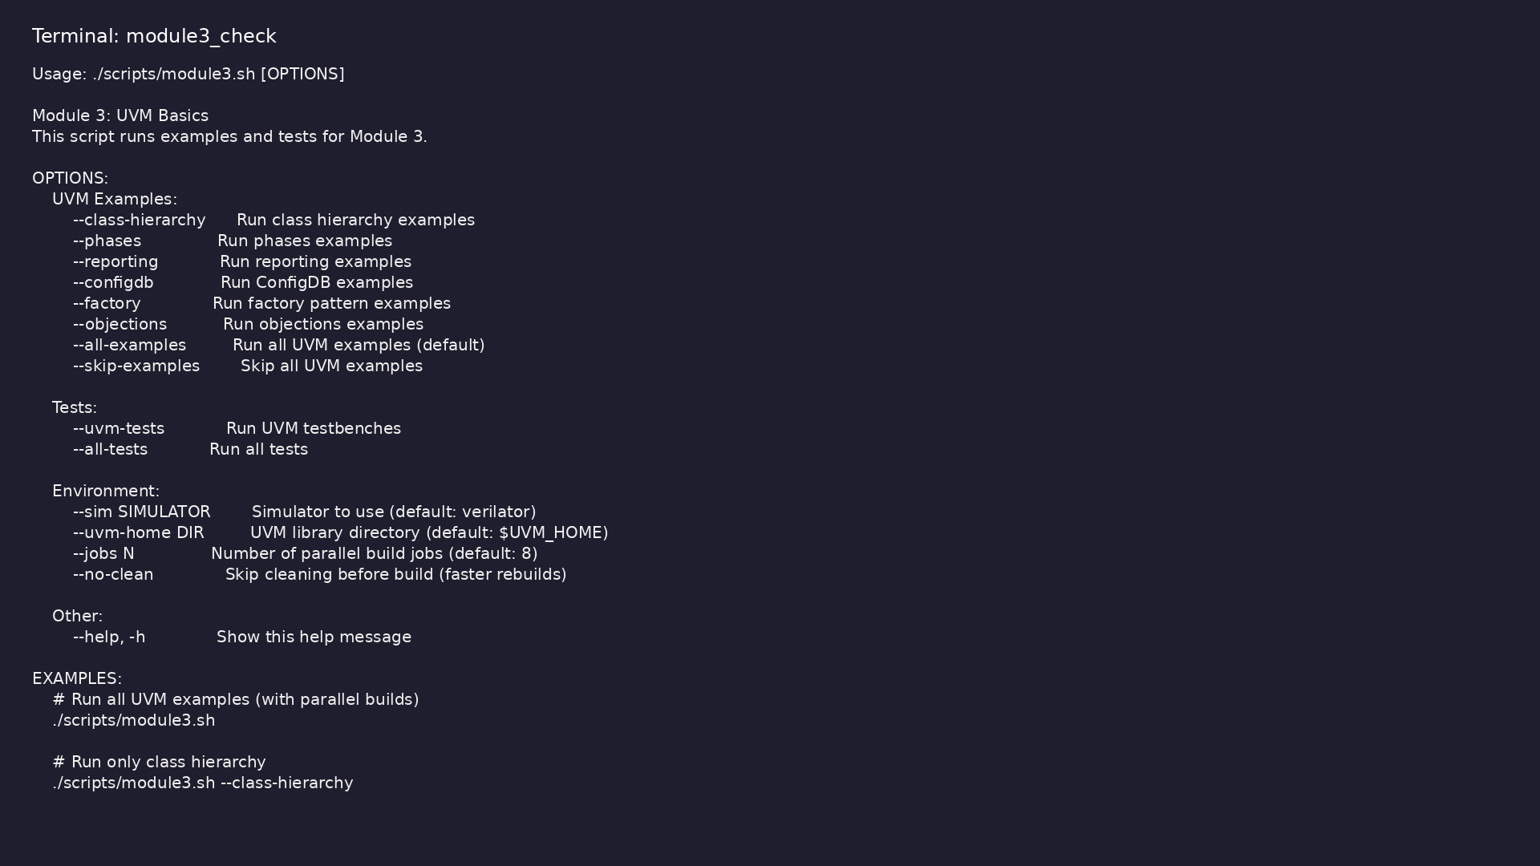
Module 3 self-check
$ ./scripts/module3.sh --help
learn_uvm2017_sv_verilator / Module 3
Notes:
Run from course repository root.

Slide 119
Exercise scaffold
./scripts/module3.sh --scaffold
learn_uvm2017_sv_verilator / Module 3

Slide 120
Example 1: Class Hierarchy
• Transaction Class (`MyTransaction`): Extends
`uvm_sequence_item` (uvm_object hierarchy)
• Driver Class (`MyDriver`): Extends `uvm_driver`
(uvm_component hierarchy)
• Monitor Class (`MyMonitor`): Extends `uvm_monitor`
(uvm_component hierarchy)
• Agent Class (`MyAgent`): Extends `uvm_agent`,
demonstrates component composition
• Environment Class (`MyEnv`): Extends `uvm_env`, top-
level verification environment
learn_uvm2017_sv_verilator / Module 3
Notes:
module3/examples/class_hierarchy/README.md

Slide 121
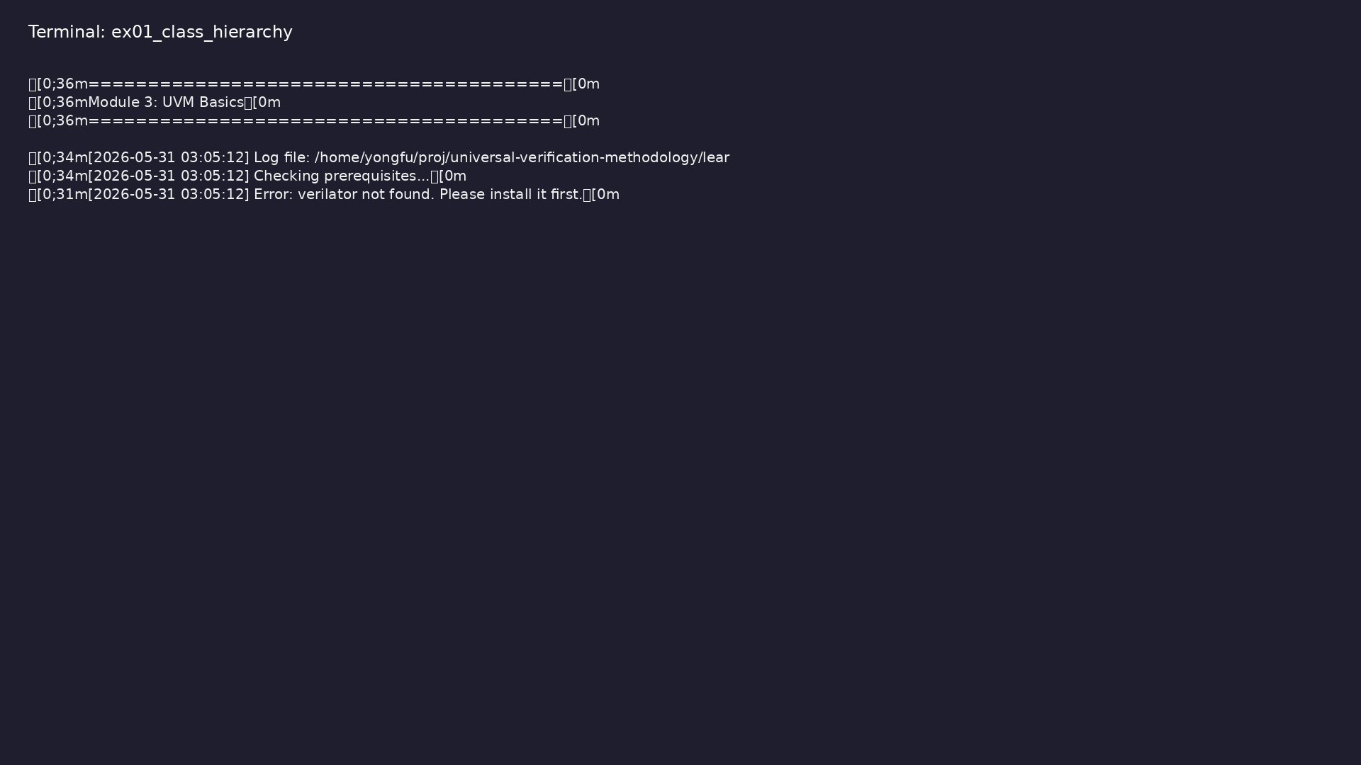
Demo: Class Hierarchy
$ ./scripts/module3.sh --class-hierarchy
learn_uvm2017_sv_verilator / Module 3
Notes:
Hands-on: module3/examples/class_hierarchy/

Slide 122
Example 2: Phases
• Build-Time Phases: Top-down execution (parent before
child)
• Run-Time Phases: Bottom-up execution (child before
parent)
• Cleanup Phases: Bottom-up execution (child before
parent)
• Phase Execution Order: Demonstrates all UVM phases
learn_uvm2017_sv_verilator / Module 3
Notes:
module3/examples/phases/README.md

Slide 123
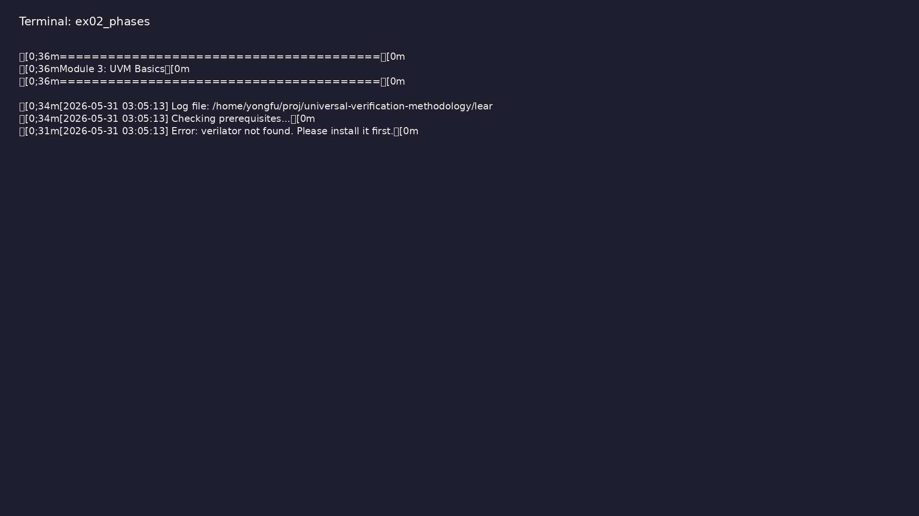
Demo: Phases
$ ./scripts/module3.sh --phases
learn_uvm2017_sv_verilator / Module 3
Notes:
Hands-on: module3/examples/phases/

Slide 124
Example 3: Reporting
• Severity Levels: INFO, WARNING, ERROR, FATAL
• Verbosity Levels: UVM_LOW, UVM_MEDIUM, UVM_HIGH,
UVM_FULL, UVM_DEBUG
• Message Formatting: Formatted messages with data
values
• Hierarchical Reporting: Component context in
messages
learn_uvm2017_sv_verilator / Module 3
Notes:
module3/examples/reporting/README.md

Slide 125
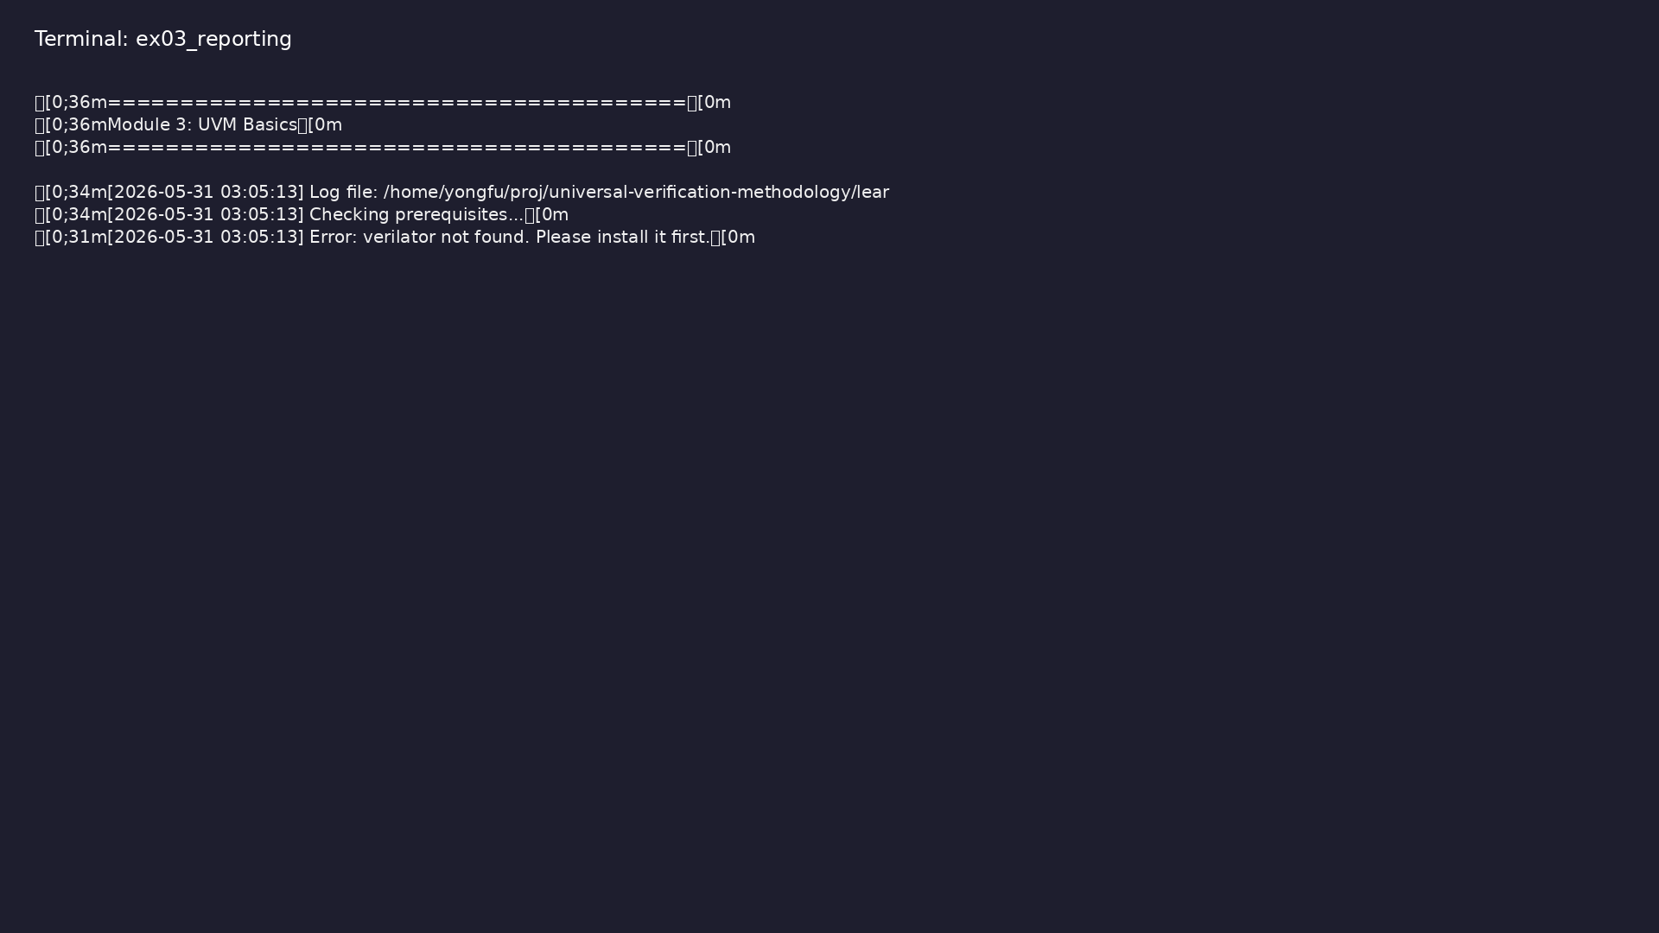
Demo: Reporting
$ ./scripts/module3.sh --reporting
learn_uvm2017_sv_verilator / Module 3
Notes:
Hands-on: module3/examples/reporting/

Slide 126
Example 4: ConfigDB
• Setting Configuration: Global and component-specific
• Getting Configuration: Hierarchical lookup
• Configuration Objects: Complex configuration data
• Scalar Values: Simple configuration values
learn_uvm2017_sv_verilator / Module 3
Notes:
module3/examples/configdb/README.md

Slide 127
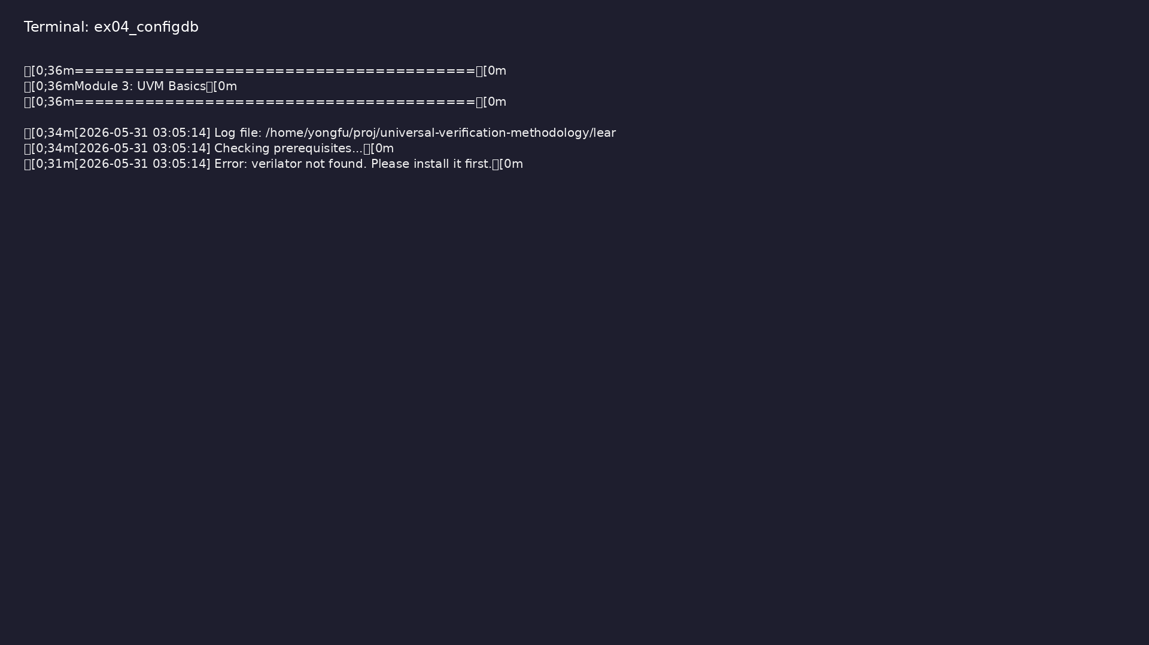
Demo: ConfigDB
$ ./scripts/module3.sh --configdb
learn_uvm2017_sv_verilator / Module 3
Notes:
Hands-on: module3/examples/configdb/

Slide 128
Example 5: Factory
• Factory Registration: Automatic registration via
`uvm_object_utils`
• Factory Creation: Using `type_id::create()`
• Type Override: Substituting base class with extended
class
• Instance Override: Overriding specific instances
learn_uvm2017_sv_verilator / Module 3
Notes:
module3/examples/factory/README.md

Slide 129

Demo: Factory
$ ./scripts/module3.sh --factory
learn_uvm2017_sv_verilator / Module 3
Notes:
Hands-on: module3/examples/factory/

Slide 130
Example 6: Objections
• Raising Objections: Keep simulation running
• Dropping Objections: Allow phase completion
• Multiple Objections: Per-component objection
tracking
• Coordinated Completion: Phase completes when all
objections dropped
learn_uvm2017_sv_verilator / Module 3
Notes:
module3/examples/objections/README.md

Slide 131

Demo: Objections
$ ./scripts/module3.sh --objections
learn_uvm2017_sv_verilator / Module 3
Notes:
Hands-on: module3/examples/objections/

Slide 132
Common pitfalls
learn_uvm2017_sv_verilator / Module 3

Slide 133
Class Hierarchy
• Create transaction classes extending
uvm_sequence_item
• Create component classes extending uvm_component
• Build component hierarchy
• Test component creation
learn_uvm2017_sv_verilator / Module 3
Notes:
From MODULE3 Common Pitfalls.

Slide 134
Phases
• Implement all build-time phases
• Implement run-time phases
• Implement cleanup phases
• Verify phase execution order
learn_uvm2017_sv_verilator / Module 3
Notes:
From MODULE3 Common Pitfalls.

Slide 135
Reporting
• Use different severity levels
• Control verbosity
• Format messages with data
• Test hierarchical reporting
learn_uvm2017_sv_verilator / Module 3
Notes:
From MODULE3 Common Pitfalls.

Slide 136
ConfigDB
• Set global configuration
• Set component-specific configuration
• Get configuration in components
• Use configuration objects
learn_uvm2017_sv_verilator / Module 3
Notes:
From MODULE3 Common Pitfalls.

Slide 137
Factory
• Register classes with factory
• Create objects using factory
• Implement type overrides
• Implement instance overrides
learn_uvm2017_sv_verilator / Module 3
Notes:
From MODULE3 Common Pitfalls.

Slide 138
Objections
• Raise objections in run_phase
• Drop objections when work completes
• Test multiple objections
• Verify phase completion
learn_uvm2017_sv_verilator / Module 3
Notes:
From MODULE3 Common Pitfalls.

Slide 139
Practice & assessment
learn_uvm2017_sv_verilator / Module 3

Slide 140
What you should know (1/2)
• Understand UVM class hierarchy (uvm_object vs
uvm_component)
• Master UVM phases (build-time, run-time, cleanup)
• Use UVM reporting effectively (severity, verbosity,
formatting)
• Configure components using ConfigDB
• Understand factory pattern (registration, creation,
overrides)
• Control simulation with objections
learn_uvm2017_sv_verilator / Module 3
Notes:
From MODULE3 Learning Outcomes.

Slide 141
What you should know (2/2)
• Structure UVM testbenches properly
learn_uvm2017_sv_verilator / Module 3
Notes:
From MODULE3 Learning Outcomes.

Slide 142
Exercises
• Class Hierarchy
• Phases
• Reporting
• ConfigDB
• Factory
learn_uvm2017_sv_verilator / Module 3

Slide 143
Exercises
• Objections
learn_uvm2017_sv_verilator / Module 3

Slide 144
Assessment checklist
• Understands UVM class hierarchy
• Masters UVM phases
• Uses UVM reporting effectively
• Configures components using ConfigDB
• Understands factory pattern
• Controls simulation with objections
learn_uvm2017_sv_verilator / Module 3

Slide 145
Summary & next steps
• Master UVM class hierarchy and phases
• Complete module3/CHECKLIST.md
• Review module3/EXAMPLES.md and run each lab
• Next: Next module in course
learn_uvm2017_sv_verilator / Module 3

