Slide 1
Module 4
UVM Components
learn_uvm2017_sv_verilator / Module 4

Slide 2
Learning objectives
• Build complete UVM agents with driver, monitor, and
sequencer
learn_uvm2017_sv_verilator / Module 4

Slide 3
Prerequisites
• See module README
learn_uvm2017_sv_verilator / Module 4

Slide 4
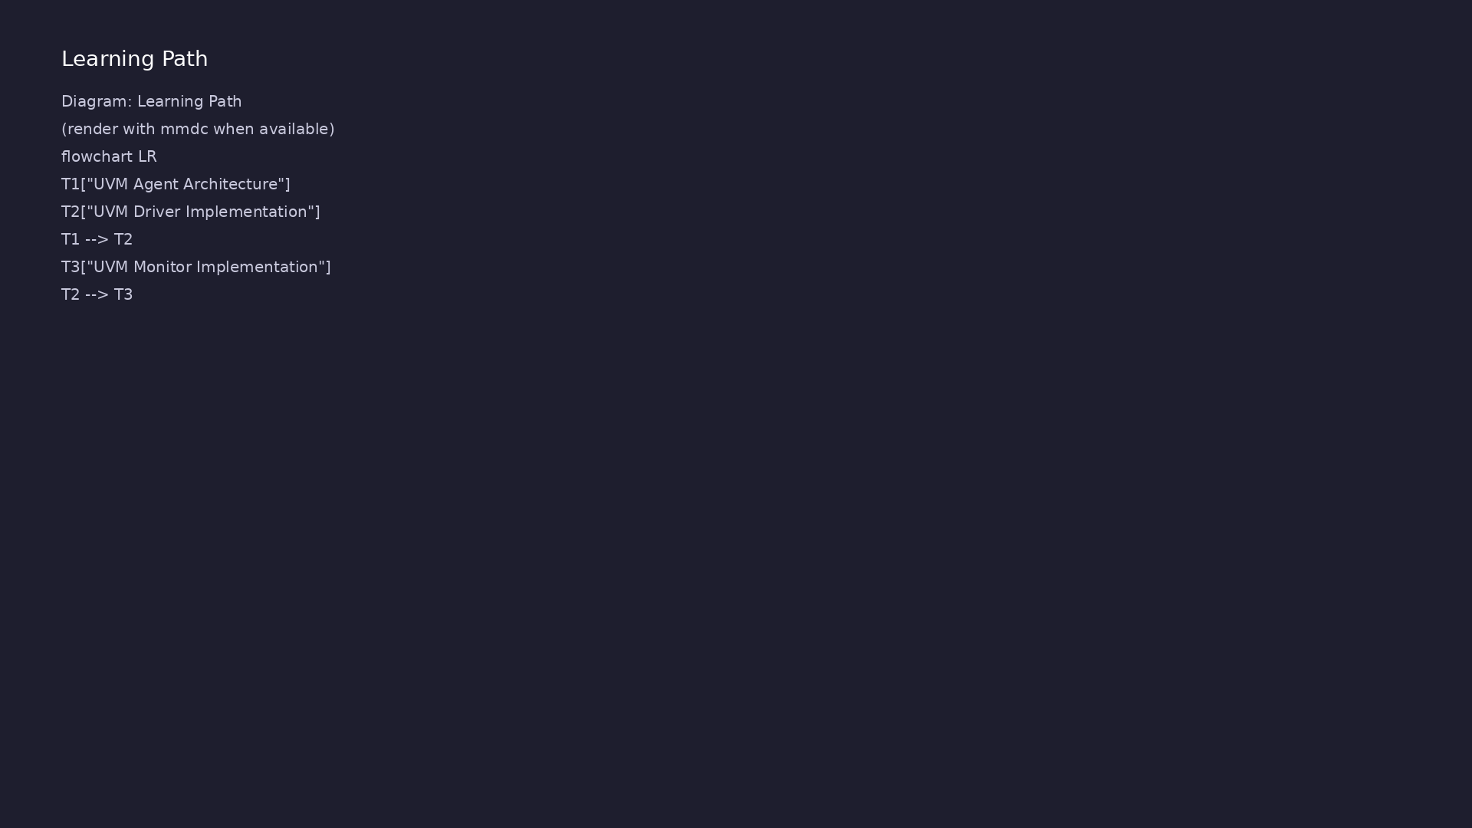
Learning path
Build complete UVM agents with driver, monitor, and sequencer
learn_uvm2017_sv_verilator / Module 4

Slide 5
Overview
• This module covers the core UVM components used to
build verification environments. You'll learn ho…
learn_uvm2017_sv_verilator / Module 4

Slide 6
Design architecture
learn_uvm2017_sv_verilator / Module 4

Slide 7

1. UVM agent internal architecture (1/3)
• Active agent: sequencer + driver
+ monitor (generates and
observes stimulus)
• Passive agent: monitor only
(observation/checking on
monitored bus)
• Agent `is_active` config selects
build-time component set
• Sequencer-driver TLM: `driver.se
q_item_port.connect(sequencer.se
q_item_export)`
learn_uvm2017_sv_verilator / Module 4
Notes:
From MODULE4 Design Architecture.

Slide 8
1. UVM agent internal architecture (2/3)
• uvm_sequencer: Arbitrates sequences; exports
seq_item_export
• uvm_driver: seq_item_port pulls items; drives
virtual interface
• uvm_monitor: Passive observation; broadcasts via
analysis port
• uvm_agent: Configures active/passive; builds child
components
learn_uvm2017_sv_verilator / Module 4
Notes:
From MODULE4 Design Architecture.

Slide 9
1. UVM agent internal architecture (3/3)
• uvm_sequence: Produces randomized/constrained
transactions
learn_uvm2017_sv_verilator / Module 4
Notes:
From MODULE4 Design Architecture.

Slide 10
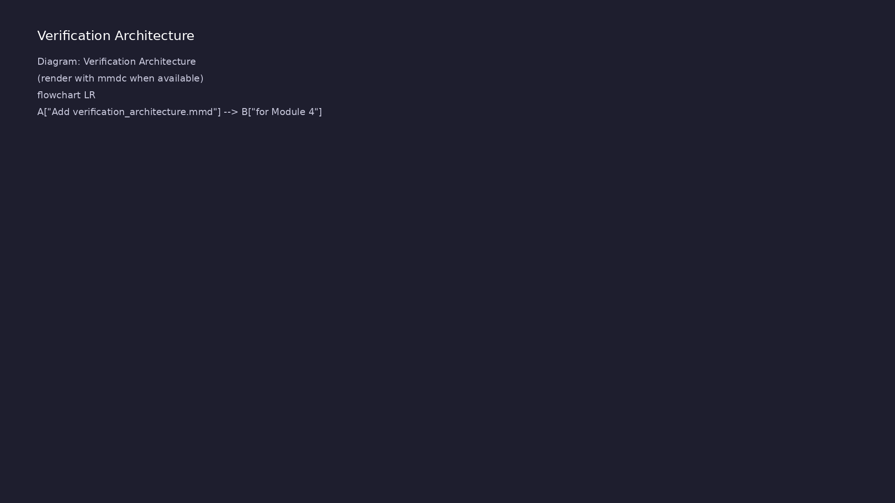
2. Transaction-level data path (1/3)
• TLM ports: `uvm_analysis_port` /
`uvm_analysis_export` for
monitor → scoreboard
• Transactions implement
`do_copy`, `do_compare`,
`convert2string` for debug and
checking
• Execution sequence: build agent
→ connect TLM → start sequence
in `run_phase`
• 1: Sequence — randomize()
transaction fields
learn_uvm2017_sv_verilator / Module 4
Notes:
From MODULE4 Design Architecture.

Slide 11
2. Transaction-level data path (2/3)
• 2: Sequencer — Sends item to driver via TLM port
• 3: Driver — Drives interface signals from item
• 4: DUT — Responds on bus/interface
• 5: Monitor — Captures pin activity → transaction
learn_uvm2017_sv_verilator / Module 4
Notes:
From MODULE4 Design Architecture.

Slide 12
2. Transaction-level data path (3/3)
• 6: Scoreboard — Compares expected vs observed
(Module 4 examples)
learn_uvm2017_sv_verilator / Module 4
Notes:
From MODULE4 Design Architecture.

Slide 13
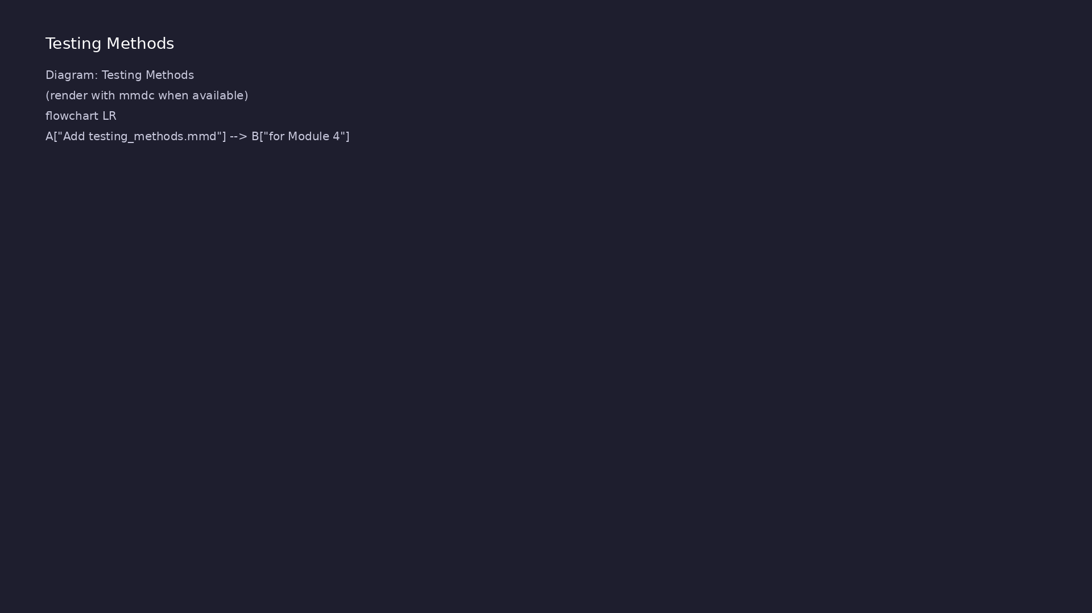
3. Module 4 example progression (1/2)
• `examples/transactions/` → data
modeling fundamentals
• `examples/drivers/`,
`monitors/`, `sequencers/` →
individual components
• `examples/tlm/`, `scoreboards/`
→ communication and checking
• `examples/agents/` → integrated
active agent
learn_uvm2017_sv_verilator / Module 4
Notes:
From MODULE4 Design Architecture.

Slide 14
3. Module 4 example progression (2/2)
• `tests/uvm_tests/test_complete_agent_uvm.sv` — full
agent on interface DUT
learn_uvm2017_sv_verilator / Module 4
Notes:
From MODULE4 Design Architecture.

Slide 15
RTL block diagram (reference)
Module 4: DUT hierarchy and signal flow.
learn_uvm2017_sv_verilator / Module 4

Slide 16
Verification / testbench diagram (reference)
Module 4: stimulus, observation, and checking.
learn_uvm2017_sv_verilator / Module 4

Slide 17
Execution & simulation flow
learn_uvm2017_sv_verilator / Module 4

Slide 18
How the example runs (toolchain)
• Makefile: Verilator + UVM_HOME compile RTL,
interface, and test_*.sv
• UVM phases: build → connect → run_test → report
(same pattern as Module 2)
• Sequence → driver → DUT → monitor → scoreboard (read
SCOREBOARD at end)
• Typical command: make SIM=verilator TEST=test_* (see
module4 demo slide)
• Loopback / hooks connect monitor observations to
scoreboard checks
learn_uvm2017_sv_verilator / Module 4
Notes:
From MODULE4 — execution and artifact layout.

Slide 19
Artifact flow (spec → sim) (1)
• 1: Sequence — randomize() transaction fields
• 2: Sequencer — Sends item to driver via TLM port
• 3: Driver — Drives interface signals from item
• 4: DUT — Responds on bus/interface
learn_uvm2017_sv_verilator / Module 4
Notes:
From MODULE4 — execution and artifact layout.

Slide 20
Artifact flow (spec → sim) (2)
• 5: Monitor — Captures pin activity → transaction
• 6: Scoreboard — Compares expected vs observed
(Module 4 examples)
learn_uvm2017_sv_verilator / Module 4
Notes:
From MODULE4 — execution and artifact layout.

Slide 21
Example directory layout
• uvm_sequencer: Arbitrates sequences; exports
seq_item_export
• uvm_driver: seq_item_port pulls items; drives
virtual interface
• uvm_monitor: Passive observation; broadcasts via
analysis port
• uvm_agent: Configures active/passive; builds child
components
• uvm_sequence: Produces randomized/constrained
transactions
learn_uvm2017_sv_verilator / Module 4
Notes:
Match each path to files under module/examples/.

Slide 22
Directed test execution sequence
• build agent
• connect TLM
• start sequence in run_phase
learn_uvm2017_sv_verilator / Module 4
Notes:
Follow this order when tracing waveforms or debugging.

Slide 23
Verification & testing methods
learn_uvm2017_sv_verilator / Module 4

Slide 24
1. Component-level verification strategy
• Verify each component in
isolation before agent
integration
• Driver: loopback or simple slave
model confirms pin wiggles match
items
• Monitor: drive known patterns;
confirm reconstructed
transactions
• Sequencer: run single sequence;
count items completed vs
requested
learn_uvm2017_sv_verilator / Module 4
Notes:
From MODULE4 Verification & Testing Methods.

Slide 25
2. Agent integration and closure (1/2)
• Connect monitor analysis port to
scoreboard export in
`connect_phase`
• Use `uvm_config_db` to pass
virtual interface to driver and
monitor
• Regression:
`./scripts/module4.sh --all-
examples` then `--uvm-tests`
• Pass criteria: scoreboard match
count equals transaction count;
no UVM_ERROR
learn_uvm2017_sv_verilator / Module 4
Notes:
From MODULE4 Verification & Testing Methods.

Slide 26
2. Agent integration and closure (2/2)
• Waveform optional — rely on transaction logs and
scoreboard summary first
learn_uvm2017_sv_verilator / Module 4
Notes:
From MODULE4 Verification & Testing Methods.

Slide 27
Syllabus topics
learn_uvm2017_sv_verilator / Module 4

Slide 28
Protocol & design details
learn_uvm2017_sv_verilator / Module 4

Slide 29
Detail: Example 4.1: Transactions (`module4/examples/transactions/tra…
• BaseTransaction: Basic transaction with `data` and
`address` fields
• ExtendedTransaction: Extended transaction with
`control` and `status` fields
• ConstrainedTransaction: Transaction with
randomization constraints
• Transaction Operations: Copy, comparison, and string
conversion
learn_uvm2017_sv_verilator / Module 4
Notes:
From MODULE4 Topics Covered — protocol/design depth.

Slide 30
Detail: Example 4.1: Transactions (`module4/examples/transactions/tra…
• Purpose: Provide human-readable string
representation
• Usage: Debugging, logging, reporting
• Key: Override from `uvm_object` base class
• Purpose: Create independent copy of transaction
learn_uvm2017_sv_verilator / Module 4
Notes:
From MODULE4 Topics Covered — protocol/design depth.

Slide 31
Detail: Example 4.2: Drivers (`module4/examples/drivers/drivers.sv`)…
• SimpleDriver: Basic driver implementation with
transaction reception
• ProtocolDriver: Protocol-aware driver with
handshaking
• Driver-Sequencer Communication: Using
`seq_item_port` for transaction flow
• Signal Driving: Converting transactions to DUT
signals
learn_uvm2017_sv_verilator / Module 4
Notes:
From MODULE4 Topics Covered — protocol/design depth.

Slide 32
Detail: Example 4.2: Drivers (`module4/examples/drivers/drivers.sv`)…
• Purpose: Get transaction from sequencer (blocking)
• Usage: Called in driver's `run_phase()` forever loop
• Key: Blocks until sequencer provides transaction
• Purpose: Signal that transaction processing is
complete
learn_uvm2017_sv_verilator / Module 4
Notes:
From MODULE4 Topics Covered — protocol/design depth.

Slide 33
Detail: Example 4.3: Monitors (`module4/examples/monitors/monitors.sv…
• SimpleMonitor: Basic monitor implementation with
signal sampling
• ProtocolMonitor: Protocol-aware monitor with
handshake monitoring
• Transaction Creation: Creating transactions from
sampled signals
• Analysis Port: Forwarding transactions via analysis
port
learn_uvm2017_sv_verilator / Module 4
Notes:
From MODULE4 Topics Covered — protocol/design depth.

Slide 34
Detail: Example 4.3: Monitors (`module4/examples/monitors/monitors.sv…
• Purpose: Broadcast transaction to all subscribers
• Usage: Called after creating transaction from
sampled signals
• Key: Non-blocking, broadcasts to all connected
subscribers
• Purpose: Create analysis port in constructor
learn_uvm2017_sv_verilator / Module 4
Notes:
From MODULE4 Topics Covered — protocol/design depth.

Slide 35
Detail: Example 4.4: Sequencers (`module4/examples/sequencers/sequenc…
• SimpleSequence: Basic sequence implementation
• ExtendedSequence: Extended sequence with
configurable item count
• Sequence Execution: Starting sequences on sequencers
• Sequence Item Generation: Creating and sending
sequence items
learn_uvm2017_sv_verilator / Module 4
Notes:
From MODULE4 Topics Covered — protocol/design depth.

Slide 36
Detail: Example 4.4: Sequencers (`module4/examples/sequencers/sequenc…
• Purpose: Generate and send sequence items
• Usage: Main sequence logic
• Key: Called when sequence is started
• Purpose: Request sequence item from sequencer
learn_uvm2017_sv_verilator / Module 4
Notes:
From MODULE4 Topics Covered — protocol/design depth.

Slide 37
Detail: Example 4.5: TLM (`module4/examples/tlm/tlm.sv`) (1)
• TlmProducer: Uses `uvm_blocking_put_port` to produce
transactions
• TlmConsumer: Uses `uvm_blocking_get_export` to
consume transactions
• AnalysisProducer: Uses `uvm_analysis_port` to
broadcast transactions
• AnalysisSubscriber: Uses `uvm_subscriber` to receive
transactions
learn_uvm2017_sv_verilator / Module 4
Notes:
From MODULE4 Topics Covered — protocol/design depth.

Slide 38
Detail: Example 4.5: TLM (`module4/examples/tlm/tlm.sv`) (2)
• Purpose: Send transaction to consumer (blocking)
• Usage: Producer sends transactions
• Key: Blocks until consumer receives
• Purpose: Receive transaction from producer
(blocking)
learn_uvm2017_sv_verilator / Module 4
Notes:
From MODULE4 Topics Covered — protocol/design depth.

Slide 39
Detail: Example 4.6: Scoreboards (`module4/examples/scoreboards/score…
• SimpleScoreboard: Basic scoreboard with transaction
comparison
• Transaction Storage: Storing expected and actual
transactions
• Comparison Logic: Comparing transactions for
verification
• Result Reporting: Reporting pass/fail counts
learn_uvm2017_sv_verilator / Module 4
Notes:
From MODULE4 Topics Covered — protocol/design depth.

Slide 40
Detail: Example 4.6: Scoreboards (`module4/examples/scoreboards/score…
• Purpose: Receive transactions from monitor
• Usage: Called automatically when monitor writes to
analysis port
• Key: Compares actual vs expected results
• Purpose: Store expected transaction for later
comparison
learn_uvm2017_sv_verilator / Module 4
Notes:
From MODULE4 Topics Covered — protocol/design depth.

Slide 41
Detail: Example 4.7: Complete Agents (`module4/examples/agents/agents…
• CompleteAgent: Contains driver, monitor, and
sequencer
• Agent Configuration: Configurable as active or
passive
• Component Integration: Integrating all agent
components
• Agent Testing: Testing complete agent functionality
learn_uvm2017_sv_verilator / Module 4
Notes:
From MODULE4 Topics Covered — protocol/design depth.

Slide 42
Detail: Example 4.7: Complete Agents (`module4/examples/agents/agents…
• Purpose: Create agent components based on
configuration
• Key: Active agent has driver+sequencer, passive has
monitor only
• Monitor: Always created (both active and passive
modes)
• Driver/Sequencer: Only created in active mode
learn_uvm2017_sv_verilator / Module 4
Notes:
From MODULE4 Topics Covered — protocol/design depth.

Slide 43
Verification flow (reference)
Stimulus, DUT response, and check points for this module.
learn_uvm2017_sv_verilator / Module 4

Slide 44
1. UVM Agent Architecture (1/9)
• Agent Overview and Structure
• Agent purpose and responsibilities
• Agent components (driver, monitor, sequencer)
• Agent configuration
• Active vs passive agents
• Agent Components
learn_uvm2017_sv_verilator / Module 4
Notes:
From MODULE4 Topics Covered.

Slide 45
1. UVM Agent Architecture (2/9)
• Driver for stimulus generation
• Monitor for observation
• Sequencer for sequence management
• Agent integration
• BaseTransaction: Basic transaction with `data` and
`address` fields
• ExtendedTransaction: Extended transaction with
`control` and `status` fields
learn_uvm2017_sv_verilator / Module 4
Notes:
From MODULE4 Topics Covered.

Slide 46
1. UVM Agent Architecture (3/9)
• ConstrainedTransaction: Transaction with
randomization constraints
• Transaction Operations: Copy, comparison, and string
conversion
• Purpose: Provide human-readable string
representation
• Usage: Debugging, logging, reporting
• Key: Override from `uvm_object` base class
• Purpose: Create independent copy of transaction
learn_uvm2017_sv_verilator / Module 4
Notes:
From MODULE4 Topics Covered.

Slide 47
1. UVM Agent Architecture (4/9)
• Usage: `txn2.copy(txn1)` - creates deep copy
• Key: Must call `super.do_copy(rhs)` first, then copy
all fields
• Purpose: Compare two transactions for equality
• Usage: `if (txn1.compare(txn2))` - returns 1 if
equal
• Key: Returns 1 if all fields match, 0 otherwise
• Purpose: Generate random values satisfying
constraints
learn_uvm2017_sv_verilator / Module 4
Notes:
From MODULE4 Topics Covered.

Slide 48
1. UVM Agent Architecture (5/9)
• Usage: `txn.randomize()` - returns 1 if successful
• Key: Constraints ensure protocol compliance
• Purpose: Post-process after randomization
• Usage: Calculate derived fields, validate
constraints
• Key: Called automatically after `randomize()`
succeeds
• Example: Calculate expected results, checksums,
derived values
learn_uvm2017_sv_verilator / Module 4
Notes:
From MODULE4 Topics Covered.

Slide 49
1. UVM Agent Architecture (6/9)
• Purpose: Type-safe conversion from `uvm_object` to
specific type
• Usage: Required in `do_copy()` and `do_compare()`
• Key: Always check return value, handle type mismatch
• Purpose: Extend base transaction with additional
fields
• Key: Must call `super` methods to handle base class
fields
• Transaction class design extending
`uvm_sequence_item`
learn_uvm2017_sv_verilator / Module 4
Notes:
From MODULE4 Topics Covered.

Slide 50
1. UVM Agent Architecture (7/9)
• Transaction fields and data members
• Transaction copy and comparison operations
• Extended transactions with inheritance
• Constrained random transactions
• `convert2string()` for debugging and logging
• `do_copy()` for deep copying transactions
learn_uvm2017_sv_verilator / Module 4
Notes:
From MODULE4 Topics Covered.

Slide 51
1. UVM Agent Architecture (8/9)
• `do_compare()` for transaction comparison
• `randomize()` for constrained random generation
• Constraints ensure protocol compliance
• Transaction creation and initialization
• Transaction copy operations
• Transaction comparison operations
learn_uvm2017_sv_verilator / Module 4
Notes:
From MODULE4 Topics Covered.

Slide 52
1. UVM Agent Architecture (9/9)
• Extended transaction inheritance
• Constrained random transaction generation
learn_uvm2017_sv_verilator / Module 4
Notes:
From MODULE4 Topics Covered.

Slide 53
2. UVM Driver Implementation (1/8)
• Driver Purpose and Responsibilities
• Stimulus generation
• Protocol implementation
• Signal driving
• Transaction-to-signal conversion
• Driver Implementation
learn_uvm2017_sv_verilator / Module 4
Notes:
From MODULE4 Topics Covered.

Slide 54
2. UVM Driver Implementation (2/8)
• Driver class structure
• Sequencer communication
• Transaction reception
• Signal driving patterns
• SimpleDriver: Basic driver implementation with
transaction reception
• ProtocolDriver: Protocol-aware driver with
handshaking
learn_uvm2017_sv_verilator / Module 4
Notes:
From MODULE4 Topics Covered.

Slide 55
2. UVM Driver Implementation (3/8)
• Driver-Sequencer Communication: Using
`seq_item_port` for transaction flow
• Signal Driving: Converting transactions to DUT
signals
• Purpose: Get transaction from sequencer (blocking)
• Usage: Called in driver's `run_phase()` forever loop
• Key: Blocks until sequencer provides transaction
• Purpose: Signal that transaction processing is
complete
learn_uvm2017_sv_verilator / Module 4
Notes:
From MODULE4 Topics Covered.

Slide 56
2. UVM Driver Implementation (4/8)
• Usage: Called after driving transaction to DUT
• Key: Allows sequencer to provide next transaction
• Purpose: Convert transaction to DUT signals
• Usage: Called after `get_next_item()`
• Key: Implements protocol-specific driving logic
• Purpose: Implement protocol-specific handshaking
learn_uvm2017_sv_verilator / Module 4
Notes:
From MODULE4 Topics Covered.

Slide 57
2. UVM Driver Implementation (5/8)
• Key: Handles request/grant, timing, protocol
compliance
• Purpose: Connect driver to sequencer
• Usage: In agent's `connect_phase()`
• Key: Establishes TLM communication channel
• Driver class structure extending `uvm_driver`
• Transaction reception from sequencer via
`seq_item_port`
learn_uvm2017_sv_verilator / Module 4
Notes:
From MODULE4 Topics Covered.

Slide 58
2. UVM Driver Implementation (6/8)
• Signal driving to DUT
• Driver-sequencer communication
• Protocol-specific driving patterns
• `get_next_item()` - Get transaction from sequencer
(blocking)
• `item_done()` - Signal transaction completion
• `drive_transaction()` - Convert transaction to
signals
learn_uvm2017_sv_verilator / Module 4
Notes:
From MODULE4 Topics Covered.

Slide 59
2. UVM Driver Implementation (7/8)
• TLM connection -
`seq_item_port.connect(sequencer.seq_item_export)`
• Forever loop - Driver continuously processes
transactions
• Driver creation and initialization
• Transaction reception from sequencer
• Signal driving to DUT
• Protocol-specific driving patterns
learn_uvm2017_sv_verilator / Module 4
Notes:
From MODULE4 Topics Covered.

Slide 60
2. UVM Driver Implementation (8/8)
• Driver-sequencer communication
learn_uvm2017_sv_verilator / Module 4
Notes:
From MODULE4 Topics Covered.

Slide 61
3. UVM Monitor Implementation (1/7)
• Monitor Purpose and Responsibilities
• DUT observation
• Signal sampling
• Transaction creation
• Analysis port usage
• Monitor Implementation
learn_uvm2017_sv_verilator / Module 4
Notes:
From MODULE4 Topics Covered.

Slide 62
3. UVM Monitor Implementation (2/7)
• Monitor class structure
• Signal sampling
• Transaction creation
• Analysis port forwarding
• SimpleMonitor: Basic monitor implementation with
signal sampling
• ProtocolMonitor: Protocol-aware monitor with
handshake monitoring
learn_uvm2017_sv_verilator / Module 4
Notes:
From MODULE4 Topics Covered.

Slide 63
3. UVM Monitor Implementation (3/7)
• Transaction Creation: Creating transactions from
sampled signals
• Analysis Port: Forwarding transactions via analysis
port
• Purpose: Broadcast transaction to all subscribers
• Usage: Called after creating transaction from
sampled signals
• Key: Non-blocking, broadcasts to all connected
subscribers
• Purpose: Create analysis port in constructor
learn_uvm2017_sv_verilator / Module 4
Notes:
From MODULE4 Topics Covered.

Slide 64
3. UVM Monitor Implementation (4/7)
• Key: Analysis ports created in constructor, not
build_phase
• Purpose: Sample DUT signals and create transactions
• Key: Monitor is passive (doesn't drive DUT)
• Purpose: Connect monitor to subscribers (scoreboard,
coverage, etc.)
• Key: One monitor can connect to multiple subscribers
• Purpose: Receive transactions from analysis port
learn_uvm2017_sv_verilator / Module 4
Notes:
From MODULE4 Topics Covered.

Slide 65
3. UVM Monitor Implementation (5/7)
• Usage: Scoreboard, coverage collector, logger
• Key: Automatically called when monitor writes to
analysis port
• Monitor class structure extending `uvm_monitor`
• Signal sampling from DUT
• Transaction creation from sampled signals
• Analysis port usage
learn_uvm2017_sv_verilator / Module 4
Notes:
From MODULE4 Topics Covered.

Slide 66
3. UVM Monitor Implementation (6/7)
• Protocol-specific monitoring
• `ap.write(txn)` - Broadcast transaction to
subscribers
• Analysis port creation - In constructor, not
build_phase
• Signal sampling - Wait for protocol events, sample
signals
• Transaction creation - Create from sampled signals
• Subscriber pattern - Components receive via
`write()` method
learn_uvm2017_sv_verilator / Module 4
Notes:
From MODULE4 Topics Covered.

Slide 67
3. UVM Monitor Implementation (7/7)
• Monitor creation and initialization
• Signal sampling from DUT
• Transaction creation from signals
• Analysis port forwarding
• Protocol-specific monitoring
learn_uvm2017_sv_verilator / Module 4
Notes:
From MODULE4 Topics Covered.

Slide 68
4. UVM Sequencer and Sequences (1/8)
• Sequencer Implementation
• Sequencer purpose
• Sequence item management
• Sequence execution
• Sequencer-driver communication
• Sequence Implementation
learn_uvm2017_sv_verilator / Module 4
Notes:
From MODULE4 Topics Covered.

Slide 69
4. UVM Sequencer and Sequences (2/8)
• Sequence items (`uvm_sequence_item`)
• Sequences (`uvm_sequence`)
• Sequence execution
• Sequence libraries
• SimpleSequence: Basic sequence implementation
• ExtendedSequence: Extended sequence with
configurable item count
learn_uvm2017_sv_verilator / Module 4
Notes:
From MODULE4 Topics Covered.

Slide 70
4. UVM Sequencer and Sequences (3/8)
• Sequence Execution: Starting sequences on sequencers
• Sequence Item Generation: Creating and sending
sequence items
• Purpose: Generate and send sequence items
• Usage: Main sequence logic
• Key: Called when sequence is started
• Purpose: Request sequence item from sequencer
learn_uvm2017_sv_verilator / Module 4
Notes:
From MODULE4 Topics Covered.

Slide 71
4. UVM Sequencer and Sequences (4/8)
• Usage: Called before setting item fields
• Key: Blocking call, waits for sequencer availability
• Purpose: Send sequence item to driver
• Usage: Called after setting item fields
• Key: Item flows: Sequence → Sequencer → Driver
• Purpose: Start sequence execution on sequencer
learn_uvm2017_sv_verilator / Module 4
Notes:
From MODULE4 Topics Covered.

Slide 72
4. UVM Sequencer and Sequences (5/8)
• Usage: In test's `run_phase()`
• Key: Sequence executes `body()` task
• Purpose: Generate random test vectors
• Key: Constraints ensure valid values
• Purpose: Configurable sequence with parameters
• Key: Can be configured via ConfigDB or constructor
learn_uvm2017_sv_verilator / Module 4
Notes:
From MODULE4 Topics Covered.

Slide 73
4. UVM Sequencer and Sequences (6/8)
• Sequencer implementation
• Sequence items (`uvm_sequence_item`)
• Sequences (`uvm_sequence`)
• Sequence execution
• Sequence libraries
• `body()` - Main sequence logic (generates items)
learn_uvm2017_sv_verilator / Module 4
Notes:
From MODULE4 Topics Covered.

Slide 74
4. UVM Sequencer and Sequences (7/8)
• `start_item(item)` - Request item from sequencer
• `finish_item(item)` - Send item to driver
• `seq.start(sequencer)` - Start sequence execution
• Item flow: Sequence → Sequencer → Driver
• Sequencer creation and initialization
• Sequence item generation
learn_uvm2017_sv_verilator / Module 4
Notes:
From MODULE4 Topics Covered.

Slide 75
4. UVM Sequencer and Sequences (8/8)
• Sequence execution
• Sequencer-driver communication
• Sequence libraries
learn_uvm2017_sv_verilator / Module 4
Notes:
From MODULE4 Topics Covered.

Slide 76
5. TLM (Transaction-Level Modeling) (1/8)
• TLM Interfaces
• Put/get interfaces
• Peek interfaces
• Transport interfaces
• Analysis interfaces
• TLM Components
learn_uvm2017_sv_verilator / Module 4
Notes:
From MODULE4 Topics Covered.

Slide 77
5. TLM (Transaction-Level Modeling) (2/8)
• TLM ports and exports
• TLM FIFOs
• Analysis ports and exports
• TLM connections
• TlmProducer: Uses `uvm_blocking_put_port` to produce
transactions
• TlmConsumer: Uses `uvm_blocking_get_export` to
consume transactions
learn_uvm2017_sv_verilator / Module 4
Notes:
From MODULE4 Topics Covered.

Slide 78
5. TLM (Transaction-Level Modeling) (3/8)
• AnalysisProducer: Uses `uvm_analysis_port` to
broadcast transactions
• AnalysisSubscriber: Uses `uvm_subscriber` to receive
transactions
• Purpose: Send transaction to consumer (blocking)
• Usage: Producer sends transactions
• Key: Blocks until consumer receives
• Purpose: Receive transaction from producer
(blocking)
learn_uvm2017_sv_verilator / Module 4
Notes:
From MODULE4 Topics Covered.

Slide 79
5. TLM (Transaction-Level Modeling) (4/8)
• Usage: Consumer receives transactions
• Key: Blocks until producer sends
• Purpose: Buffer between producer and consumer
• Usage: Decouples producer and consumer timing
• Key: FIFO stores transactions temporarily
• Purpose: Broadcast transaction to multiple
subscribers
learn_uvm2017_sv_verilator / Module 4
Notes:
From MODULE4 Topics Covered.

Slide 80
5. TLM (Transaction-Level Modeling) (5/8)
• Usage: One-to-many communication
• Key: Non-blocking, broadcasts to all subscribers
• Purpose: Receive transactions from analysis port
• Usage: Scoreboard, coverage, logger
• Key: Automatically called when producer writes
• TLM interfaces (put, get, peek, transport)
learn_uvm2017_sv_verilator / Module 4
Notes:
From MODULE4 Topics Covered.

Slide 81
5. TLM (Transaction-Level Modeling) (6/8)
• TLM ports and exports
• TLM FIFOs
• Analysis ports and exports
• TLM connections
• `put_port.put(txn)` - Send transaction (blocking)
• `get_export.get(txn)` - Receive transaction
(blocking)
learn_uvm2017_sv_verilator / Module 4
Notes:
From MODULE4 Topics Covered.

Slide 82
5. TLM (Transaction-Level Modeling) (7/8)
• `ap.write(txn)` - Broadcast transaction (non-
blocking)
• `write(t)` - Receive in subscriber (automatic)
• TLM FIFO - Decouples producer and consumer
• Analysis port - One-to-many communication
• TLM port/export creation
• TLM connection establishment
learn_uvm2017_sv_verilator / Module 4
Notes:
From MODULE4 Topics Covered.

Slide 83
5. TLM (Transaction-Level Modeling) (8/8)
• Transaction flow via TLM
• Analysis port broadcasting
• TLM FIFO usage
learn_uvm2017_sv_verilator / Module 4
Notes:
From MODULE4 Topics Covered.

Slide 84
6. Scoreboards (1/8)
• Scoreboard Purpose
• Result checking
• Transaction comparison
• Pass/fail tracking
• Verification closure
• Scoreboard Implementation
learn_uvm2017_sv_verilator / Module 4
Notes:
From MODULE4 Topics Covered.

Slide 85
6. Scoreboards (2/8)
• Scoreboard structure
• Transaction storage
• Comparison logic
• Result reporting
• SimpleScoreboard: Basic scoreboard with transaction
comparison
• Transaction Storage: Storing expected and actual
transactions
learn_uvm2017_sv_verilator / Module 4
Notes:
From MODULE4 Topics Covered.

Slide 86
6. Scoreboards (3/8)
• Comparison Logic: Comparing transactions for
verification
• Result Reporting: Reporting pass/fail counts
• Purpose: Receive transactions from monitor
• Usage: Called automatically when monitor writes to
analysis port
• Key: Compares actual vs expected results
• Purpose: Store expected transaction for later
comparison
learn_uvm2017_sv_verilator / Module 4
Notes:
From MODULE4 Topics Covered.

Slide 87
6. Scoreboards (4/8)
• Usage: Called before actual transaction arrives
• Key: Queue stores expected transactions in order
• Purpose: Manage expected transaction queue
• Key: FIFO queue ensures order matching
• Purpose: Compare actual vs expected results
• Key: Reports pass/fail, tracks counts
learn_uvm2017_sv_verilator / Module 4
Notes:
From MODULE4 Topics Covered.

Slide 88
6. Scoreboards (5/8)
• Purpose: Report final test results
• Usage: Called in cleanup phase
• Key: Provides test pass/fail summary
• Purpose: Connect monitor to scoreboard
• Key: Monitor writes → Scoreboard receives
• Scoreboard purpose and structure
learn_uvm2017_sv_verilator / Module 4
Notes:
From MODULE4 Topics Covered.

Slide 89
6. Scoreboards (6/8)
• Transaction comparison
• Result checking
• Pass/fail tracking
• `write(txn)` - Receive transaction from monitor
• `add_expected(txn)` - Store expected transaction
• Queue operations - `push_back()`, `pop_front()`,
`size()`
learn_uvm2017_sv_verilator / Module 4
Notes:
From MODULE4 Topics Covered.

Slide 90
6. Scoreboards (7/8)
• Comparison logic - Compare actual vs expected
• Report phase - Final test results
• Analysis export - `uvm_analysis_imp` receives
transactions
• Scoreboard creation and initialization
• Transaction storage
• Transaction comparison
learn_uvm2017_sv_verilator / Module 4
Notes:
From MODULE4 Topics Covered.

Slide 91
6. Scoreboards (8/8)
• Pass/fail tracking
• Result reporting
learn_uvm2017_sv_verilator / Module 4
Notes:
From MODULE4 Topics Covered.

Slide 92
7. Complete Agent Example (1/6)
• Building Complete Agents
• Agent structure
• Component integration
• Agent configuration
• Active vs passive agents
• CompleteAgent: Contains driver, monitor, and
sequencer
learn_uvm2017_sv_verilator / Module 4
Notes:
From MODULE4 Topics Covered.

Slide 93
7. Complete Agent Example (2/6)
• Agent Configuration: Configurable as active or
passive
• Component Integration: Integrating all agent
components
• Agent Testing: Testing complete agent functionality
• Purpose: Create agent components based on
configuration
• Key: Active agent has driver+sequencer, passive has
monitor only
• Monitor: Always created (both active and passive
modes)
learn_uvm2017_sv_verilator / Module 4
Notes:
From MODULE4 Topics Covered.

Slide 94
7. Complete Agent Example (3/6)
• Driver/Sequencer: Only created in active mode
• Purpose: Connect agent components
• Key: Driver-sequencer connection only for active
agents
• Note: Monitor analysis port connected in
environment's connect_phase
• Purpose: Configure agent as active or passive
• Usage: Set before creating agent
learn_uvm2017_sv_verilator / Module 4
Notes:
From MODULE4 Topics Covered.

Slide 95
7. Complete Agent Example (4/6)
• Key: Active = driver+sequencer+monitor, Passive =
monitor only
• Timing: Must be set in test's build_phase before
agent creation
• Purpose: Use agent based on mode
• Key: Check `is_active` before using driver/sequencer
• Agent structure
• Component integration
learn_uvm2017_sv_verilator / Module 4
Notes:
From MODULE4 Topics Covered.

Slide 96
7. Complete Agent Example (5/6)
• Agent configuration
• Active vs passive agents
• Active agent - Driver + Sequencer + Monitor
• Passive agent - Monitor only
• Configuration - Via ConfigDB before creation
• Component creation - Based on active/passive mode
learn_uvm2017_sv_verilator / Module 4
Notes:
From MODULE4 Topics Covered.

Slide 97
7. Complete Agent Example (6/6)
• Connection - Driver-sequencer only for active agents
• Complete agent creation
• Component integration
• Agent configuration
• Active/passive agent modes
• Agent functionality
learn_uvm2017_sv_verilator / Module 4
Notes:
From MODULE4 Topics Covered.

Slide 98
Run: Example 4.1: Transactions
./scripts/module4.sh --transactions
cd module4/examples/transactions
verilator -sv --cc --exe --timing --trace \
-I$UVM_HOME/src +incdir+$UVM_HOME/src +define+UVM_NO_DPI \
--binary $UVM_HOME/src/uvm_pkg.sv transactions.sv transactions.cpp \
--top-module transactions
make -C obj_dir -f Vtransactions.mk
./obj_dir/Vtransactions
learn_uvm2017_sv_verilator / Module 4
Notes:
Execute from course root or example directory — see docs/MODULE4.md.

Slide 99
Run: Example 4.2: Drivers
./scripts/module4.sh --drivers
learn_uvm2017_sv_verilator / Module 4
Notes:
Execute from course root or example directory — see docs/MODULE4.md.

Slide 100
Run: Example 4.3: Monitors
./scripts/module4.sh --monitors
learn_uvm2017_sv_verilator / Module 4
Notes:
Execute from course root or example directory — see docs/MODULE4.md.

Slide 101
Run: Example 4.4: Sequencers
./scripts/module4.sh --sequencers
learn_uvm2017_sv_verilator / Module 4
Notes:
Execute from course root or example directory — see docs/MODULE4.md.

Slide 102
Run: Example 4.5: TLM
./scripts/module4.sh --tlm
learn_uvm2017_sv_verilator / Module 4
Notes:
Execute from course root or example directory — see docs/MODULE4.md.

Slide 103
Run: Example 4.6: Scoreboards
./scripts/module4.sh --scoreboards
learn_uvm2017_sv_verilator / Module 4
Notes:
Execute from course root or example directory — see docs/MODULE4.md.

Slide 104
Run: Example 4.7: Complete Agents
./scripts/module4.sh --agents
learn_uvm2017_sv_verilator / Module 4
Notes:
Execute from course root or example directory — see docs/MODULE4.md.

Slide 105
Hands-on examples
learn_uvm2017_sv_verilator / Module 4

Slide 106
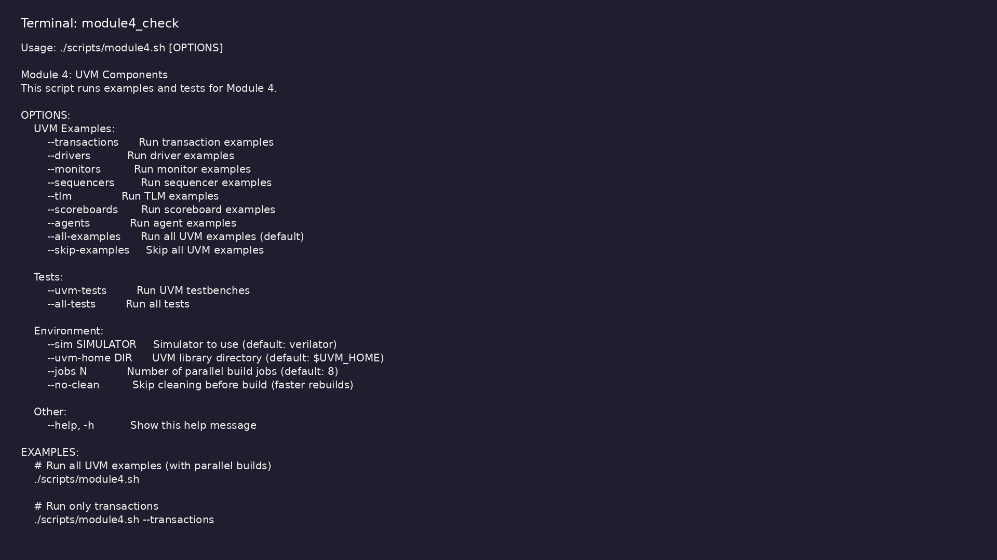
Module 4 self-check
$ ./scripts/module4.sh --help
learn_uvm2017_sv_verilator / Module 4
Notes:
Run from course repository root.

Slide 107
Exercise scaffold
./scripts/module4.sh --scaffold
learn_uvm2017_sv_verilator / Module 4

Slide 108
Example 1: Transactions
• BaseTransaction: Basic transaction with `data` and
`address` fields
• ExtendedTransaction: Extended transaction with
`control` and `status` fields
• ConstrainedTransaction: Transaction with
randomization constraints
• Transaction Operations: Copy, comparison, and string
conversion
learn_uvm2017_sv_verilator / Module 4
Notes:
module4/examples/transactions/README.md

Slide 109
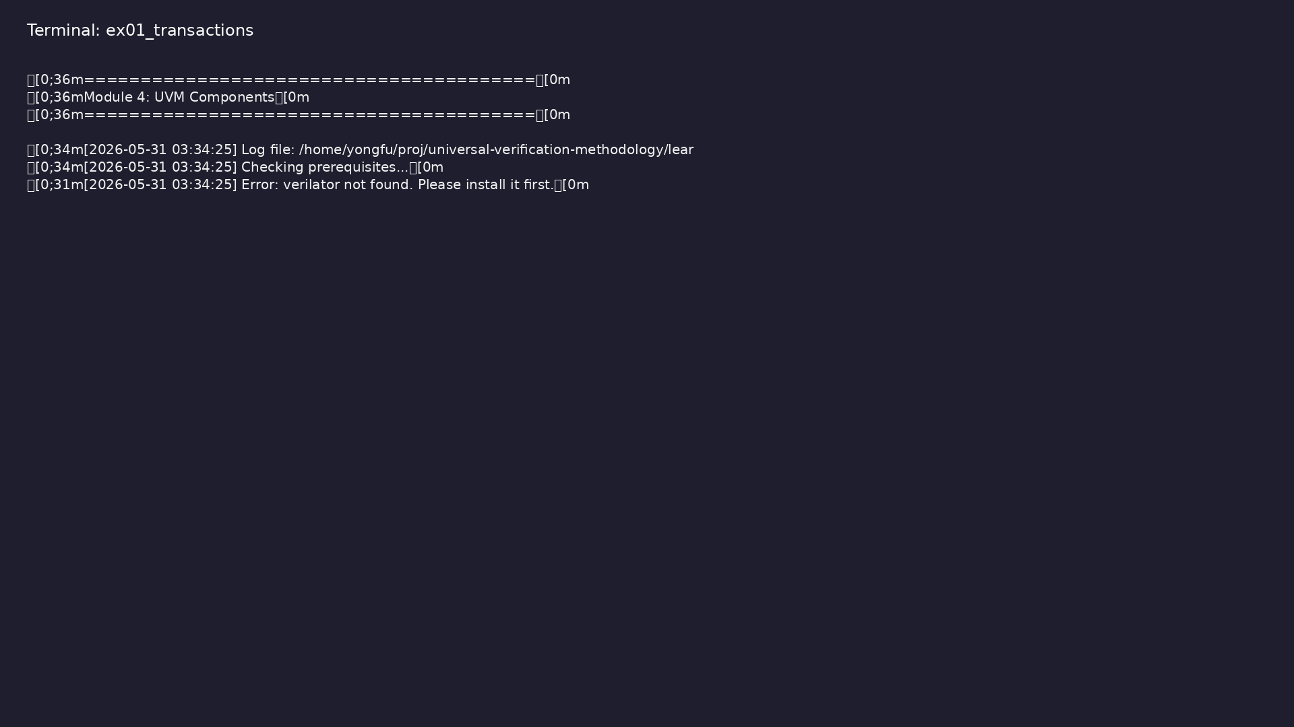
Demo: Transactions
$ ./scripts/module4.sh --transactions
learn_uvm2017_sv_verilator / Module 4
Notes:
Hands-on: module4/examples/transactions/

Slide 110
Example 2: Drivers
• SimpleDriver: Basic driver implementation with
transaction reception
• ProtocolDriver: Protocol-aware driver with
handshaking
• Driver-Sequencer Communication: Using
`seq_item_port` for transaction flow
• Signal Driving: Converting transactions to DUT
signals
learn_uvm2017_sv_verilator / Module 4
Notes:
module4/examples/drivers/README.md

Slide 111
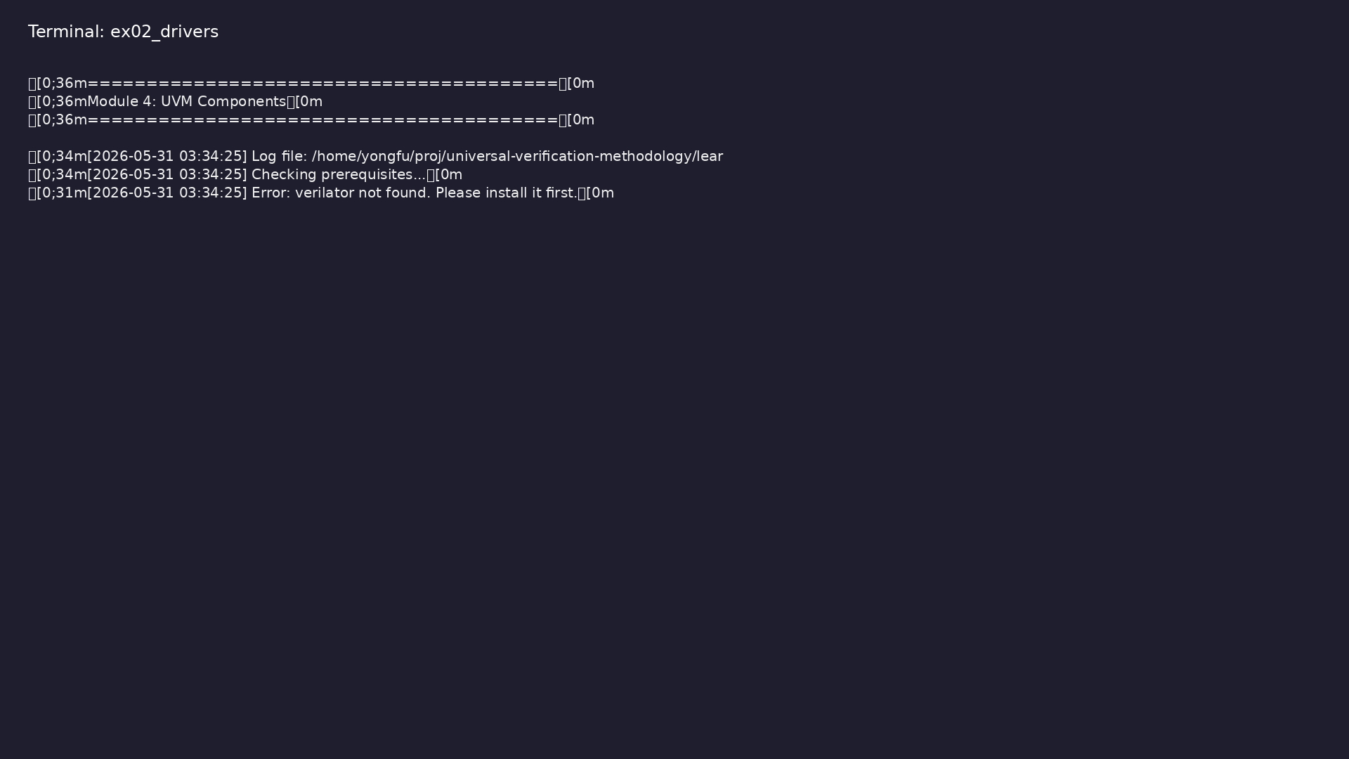
Demo: Drivers
$ ./scripts/module4.sh --drivers
learn_uvm2017_sv_verilator / Module 4
Notes:
Hands-on: module4/examples/drivers/

Slide 112
Example 3: Monitors
• SimpleMonitor: Basic monitor implementation with
signal sampling
• ProtocolMonitor: Protocol-aware monitor with
handshake monitoring
• Transaction Creation: Creating transactions from
sampled signals
• Analysis Port: Forwarding transactions via analysis
port
learn_uvm2017_sv_verilator / Module 4
Notes:
module4/examples/monitors/README.md

Slide 113
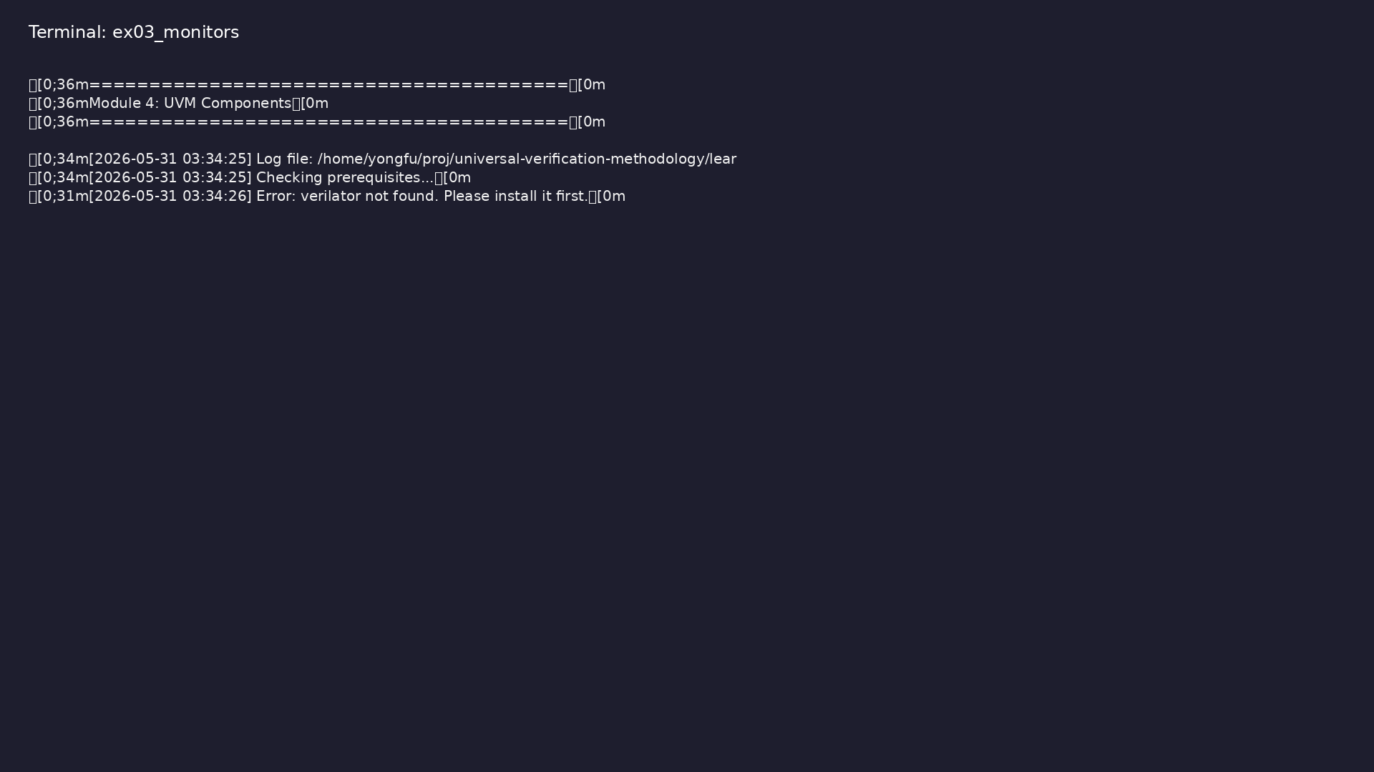
Demo: Monitors
$ ./scripts/module4.sh --monitors
learn_uvm2017_sv_verilator / Module 4
Notes:
Hands-on: module4/examples/monitors/

Slide 114
Example 4: Sequencers
• SimpleSequence: Basic sequence implementation
• ExtendedSequence: Extended sequence with
configurable item count
• Sequence Execution: Starting sequences on sequencers
• Sequence Item Generation: Creating and sending
sequence items
learn_uvm2017_sv_verilator / Module 4
Notes:
module4/examples/sequencers/README.md

Slide 115
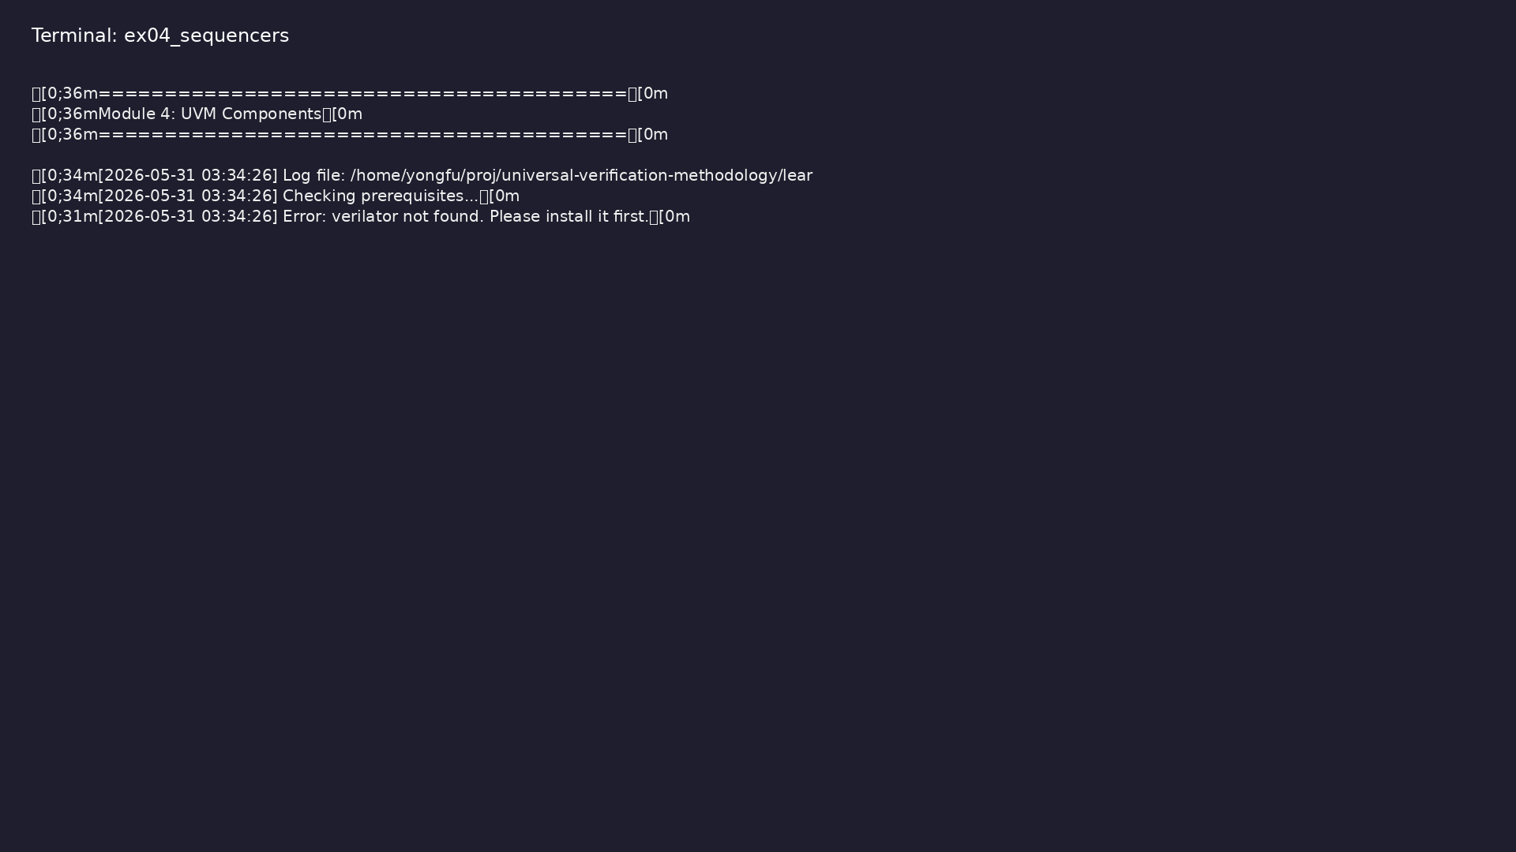
Demo: Sequencers
$ ./scripts/module4.sh --sequencers
learn_uvm2017_sv_verilator / Module 4
Notes:
Hands-on: module4/examples/sequencers/

Slide 116
Example 5: TLM
• TlmProducer: Uses `uvm_blocking_put_port` to produce
transactions
• TlmConsumer: Uses `uvm_blocking_get_export` to
consume transactions
• AnalysisProducer: Uses `uvm_analysis_port` to
broadcast transactions
• AnalysisSubscriber: Uses `uvm_subscriber` to receive
transactions
learn_uvm2017_sv_verilator / Module 4
Notes:
module4/examples/tlm/README.md

Slide 117
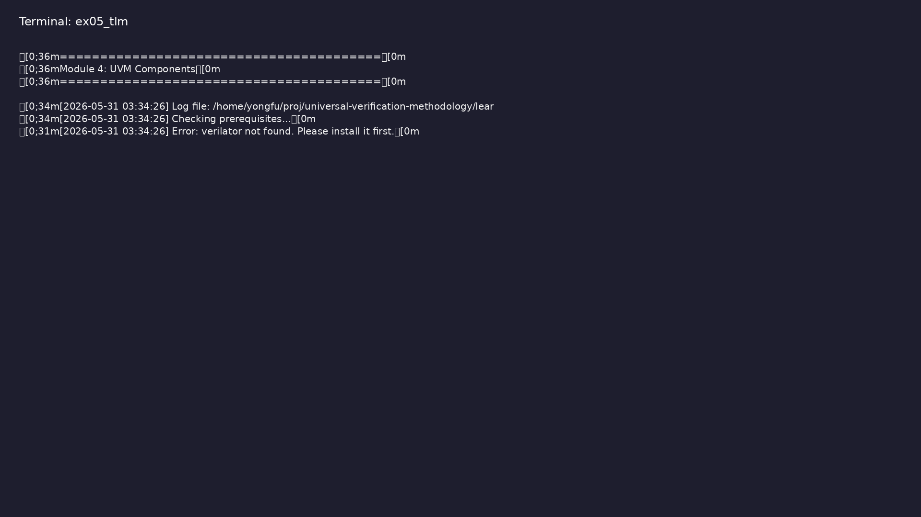
Demo: TLM
$ ./scripts/module4.sh --tlm
learn_uvm2017_sv_verilator / Module 4
Notes:
Hands-on: module4/examples/tlm/

Slide 118
Example 6: Scoreboards
• SimpleScoreboard: Basic scoreboard with transaction
comparison
• Transaction Storage: Storing expected and actual
transactions
• Comparison Logic: Comparing transactions for
verification
• Result Reporting: Reporting pass/fail counts
learn_uvm2017_sv_verilator / Module 4
Notes:
module4/examples/scoreboards/README.md

Slide 119

Demo: Scoreboards
$ ./scripts/module4.sh --scoreboards
learn_uvm2017_sv_verilator / Module 4
Notes:
Hands-on: module4/examples/scoreboards/

Slide 120
Example 7: Complete Agents
• CompleteAgent: Contains driver, monitor, and
sequencer
• Agent Configuration: Configurable as active or
passive
• Component Integration: Integrating all agent
components
• Agent Testing: Testing complete agent functionality
learn_uvm2017_sv_verilator / Module 4
Notes:
module4/examples/agents/README.md

Slide 121
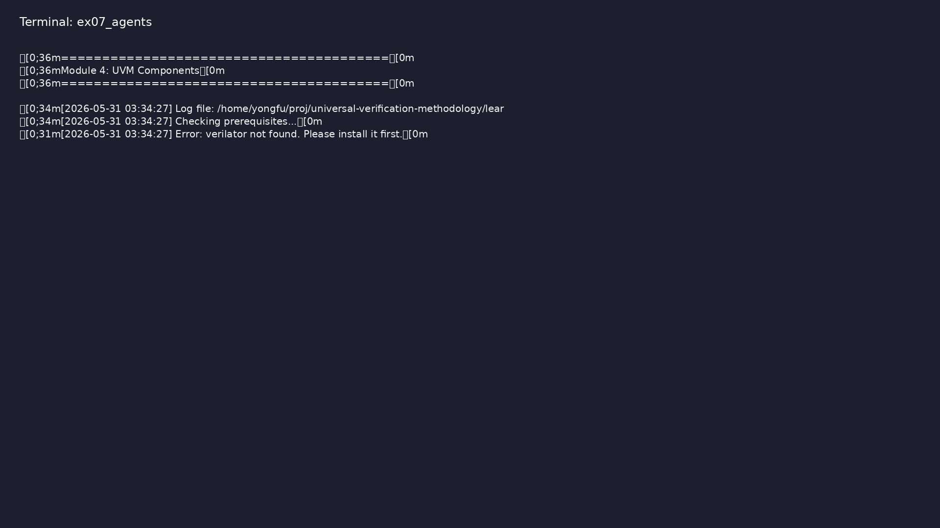
Demo: Complete Agents
$ ./scripts/module4.sh --agents
learn_uvm2017_sv_verilator / Module 4
Notes:
Hands-on: module4/examples/agents/

Slide 122
Practice & assessment
learn_uvm2017_sv_verilator / Module 4

Slide 123
What you should know (1/2)
• Design and implement transaction classes
• Create drivers for DUT stimulus generation
• Implement monitors for DUT observation
• Build sequencers and sequences for test generation
• Use TLM for component communication
• Create scoreboards for result checking
learn_uvm2017_sv_verilator / Module 4
Notes:
From MODULE4 Learning Outcomes.

Slide 124
What you should know (2/2)
• Build complete agents with all components integrated
• Apply UVM component patterns in testbenches
learn_uvm2017_sv_verilator / Module 4
Notes:
From MODULE4 Learning Outcomes.

Slide 125
Exercises
• Transaction Modeling
• Driver Implementation
• Monitor Implementation
• Sequencer and Sequences
• TLM Communication
learn_uvm2017_sv_verilator / Module 4

Slide 126
Exercises
• Scoreboards
• Complete Agents
learn_uvm2017_sv_verilator / Module 4

Slide 127
Assessment checklist
• Can design and implement transaction classes
• Can create drivers for DUT stimulus
• Can implement monitors for DUT observation
• Can build sequencers and sequences
• Can use TLM for component communication
• Can create scoreboards for result checking
learn_uvm2017_sv_verilator / Module 4

Slide 128
Summary & next steps
• Build complete UVM agents with driver, monitor, and
sequencer
• Complete module4/CHECKLIST.md
• Review module4/EXAMPLES.md and run each lab
• Next: Next module in course
learn_uvm2017_sv_verilator / Module 4

