Slide 1
Module 5
Advanced UVM Concepts
learn_uvm2017_sv_verilator / Module 5

Slide 2
Learning objectives
• Master advanced UVM features and patterns
learn_uvm2017_sv_verilator / Module 5

Slide 3
Prerequisites
• See module README
learn_uvm2017_sv_verilator / Module 5

Slide 4

Learning path
Master advanced UVM features and patterns
learn_uvm2017_sv_verilator / Module 5

Slide 5
Overview
• This module covers advanced UVM concepts including
virtual sequences, coverage models, advanced con…
learn_uvm2017_sv_verilator / Module 5

Slide 6
Design architecture
learn_uvm2017_sv_verilator / Module 5

Slide 7

1. Advanced UVM coordination architecture (1/3)
• Virtual sequences run on virtual
sequencer; delegate to agent
sequencers
• Register model maps address
space — frontdoor (bus) and
backdoor (hdl paths)
• Callbacks intercept pre/post
drive, report, or phase hooks
• Hierarchy: Test → Env →
{Agent(s), Reg model, Coverage
collector}
learn_uvm2017_sv_verilator / Module 5
Notes:
From MODULE5 Design Architecture.

Slide 8
1. Advanced UVM coordination architecture (2/3)
• uvm_virtual_sequencer: Coordinates multiple sub-
sequencers (multi-agent)
• uvm_reg_block / uvm_reg: Register abstraction layer
(RAL)
• uvm_subscriber / callbacks: Hook component behavior
without subclassing
• Coverage model: covergroup in classes or standalone
cover components
learn_uvm2017_sv_verilator / Module 5
Notes:
From MODULE5 Design Architecture.

Slide 9
1. Advanced UVM coordination architecture (3/3)
• Config objects: Structured uvm_object passed via
ConfigDB
learn_uvm2017_sv_verilator / Module 5
Notes:
From MODULE5 Design Architecture.

Slide 10

2. Cross-cutting concern flow (1/2)
• 1: Config object — Built in
test; set via uvm_config_db
• 2: Virtual sequence — Starts
traffic on multiple interfaces
• 3: Functional coverage — Samples
during monitor/scoreboard
activity
• 4: Register sequences — RAL
write/read with predicted values
learn_uvm2017_sv_verilator / Module 5
Notes:
From MODULE5 Design Architecture.

Slide 11
2. Cross-cutting concern flow (2/2)
• 5: Callback — Alters or logs transaction before
drive
learn_uvm2017_sv_verilator / Module 5
Notes:
From MODULE5 Design Architecture.

Slide 12

3. Module 5 DUT context
• `dut/advanced/multi_channel.v` —
multi-channel design for virtual
sequence demos
• Examples map 1:1 to advanced
topics (virtual seq, coverage,
reg model, callbacks)
• Integrated test
`test_advanced_uvm.sv` combines
multiple advanced features
learn_uvm2017_sv_verilator / Module 5
Notes:
From MODULE5 Design Architecture.

Slide 13
RTL block diagram (reference)
Module 5: DUT hierarchy and signal flow.
learn_uvm2017_sv_verilator / Module 5

Slide 14
Verification / testbench diagram (reference)
Module 5: stimulus, observation, and checking.
learn_uvm2017_sv_verilator / Module 5

Slide 15
Execution & simulation flow
learn_uvm2017_sv_verilator / Module 5

Slide 16
How the example runs (toolchain)
• Makefile: Verilator + UVM_HOME compile RTL,
interface, and test_*.sv
• UVM phases: build → connect → run_test → report
(same pattern as Module 2)
• Sequence → driver → DUT → monitor → scoreboard (read
SCOREBOARD at end)
• Typical command: make SIM=verilator TEST=test_* (see
module5 demo slide)
• Loopback / hooks connect monitor observations to
scoreboard checks
learn_uvm2017_sv_verilator / Module 5
Notes:
From MODULE5 — execution and artifact layout.

Slide 17
Artifact flow (spec → sim) (1)
• 1: Config object — Built in test; set via
uvm_config_db
• 2: Virtual sequence — Starts traffic on multiple
interfaces
• 3: Functional coverage — Samples during
monitor/scoreboard activity
• 4: Register sequences — RAL write/read with
predicted values
learn_uvm2017_sv_verilator / Module 5
Notes:
From MODULE5 — execution and artifact layout.

Slide 18
Artifact flow (spec → sim) (2)
• 5: Callback — Alters or logs transaction before
drive
learn_uvm2017_sv_verilator / Module 5
Notes:
From MODULE5 — execution and artifact layout.

Slide 19
Example directory layout
• uvm_virtual_sequencer: Coordinates multiple sub-
sequencers (multi-agent)
• uvm_reg_block / uvm_reg: Register abstraction layer
(RAL)
• uvm_subscriber / callbacks: Hook component behavior
without subclassing
• Coverage model: covergroup in classes or standalone
cover components
• Config objects: Structured uvm_object passed via
ConfigDB
learn_uvm2017_sv_verilator / Module 5
Notes:
Match each path to files under module/examples/.

Slide 20
Directed test execution sequence
• config
• build
• connect
• virtual seq
• report + coverage
learn_uvm2017_sv_verilator / Module 5
Notes:
Follow this order when tracing waveforms or debugging.

Slide 21
Verification & testing methods
learn_uvm2017_sv_verilator / Module 5

Slide 22
1. System-level stimulus strategy
• Virtual sequences coordinate
reset, config, traffic, and
shutdown across agents
• Constrained-random transactions
with covergroups measuring
interesting bins
• Register tests: reset values,
bit-field access, alias rules,
prediction vs actual
• Callbacks for error injection
and debug without modifying
driver source
learn_uvm2017_sv_verilator / Module 5
Notes:
From MODULE5 Verification & Testing Methods.

Slide 23
2. Coverage-driven closure (1/2)
• Define coverpoints on
transaction fields and cross
coverage between channels
• Use `uvm_config_db` to
enable/disable coverage and set
verbosity per test
• Closure metrics: functional
coverage goals + zero scoreboard
mismatches
• `./scripts/module5.sh
--coverage` demonstrates
sampling and report
learn_uvm2017_sv_verilator / Module 5
Notes:
From MODULE5 Verification & Testing Methods.

Slide 24
2. Coverage-driven closure (2/2)
• Out of scope on Verilator: some advanced RAL
backdoor paths may be limited
learn_uvm2017_sv_verilator / Module 5
Notes:
From MODULE5 Verification & Testing Methods.

Slide 25
Syllabus topics
learn_uvm2017_sv_verilator / Module 5

Slide 26
Protocol & design details
learn_uvm2017_sv_verilator / Module 5

Slide 27
Detail: Example 5.1: Virtual Sequences (`module5/examples/virtual_seq…
• VirtualSequencer: Contains references to multiple
sequencers (`master_seqr`, `slave_seqr`)
• VirtualSequence: Coordinates sequences on multiple
sequencers
• ChannelSequence: Regular sequence for a single
channel
• Parallel Execution: Using `fork-join` for concurrent
sequences
learn_uvm2017_sv_verilator / Module 5
Notes:
From MODULE5 Topics Covered — protocol/design depth.

Slide 28
Detail: Example 5.1: Virtual Sequences (`module5/examples/virtual_seq…
• Sequential Execution: Sequential sequence
coordination
• Purpose: Hold references to multiple sequencers
• Key: References are set in `connect_phase()` from
environment
• Note: Virtual sequencer doesn't create sequencers,
only references them
learn_uvm2017_sv_verilator / Module 5
Notes:
From MODULE5 Topics Covered — protocol/design depth.

Slide 29
Detail: Example 5.2: Coverage (`module5/examples/coverage/coverage.sv…
• CoverageModel: Extends `uvm_subscriber` for coverage
collection
• Coverage Sampling: Via `write()` method from
analysis port
• Coverage Types: Data, address range, command, and
cross coverage
• Coverage Analysis: Coverage statistics and reporting
learn_uvm2017_sv_verilator / Module 5
Notes:
From MODULE5 Topics Covered — protocol/design depth.

Slide 30
Detail: Example 5.2: Coverage (`module5/examples/coverage/coverage.sv…
• Purpose: Sample coverage data from transactions
• Usage: Called automatically when monitor writes to
analysis port
• Key: Uses associative arrays to track unique values
• Purpose: Track unique values and counts
learn_uvm2017_sv_verilator / Module 5
Notes:
From MODULE5 Topics Covered — protocol/design depth.

Slide 31
Detail: Example 5.3: Advanced Configuration (`module5/examples/config…
• AgentConfig: Complex configuration object with
multiple fields
• EnvConfig: Environment-level configuration
containing agent configs
• Configuration Hierarchy: Multi-level configuration
structure
• Configuration Usage: Setting and getting complex
configuration
learn_uvm2017_sv_verilator / Module 5
Notes:
From MODULE5 Topics Covered — protocol/design depth.

Slide 32
Detail: Example 5.3: Advanced Configuration (`module5/examples/config…
• Purpose: Enable configuration copying
• Usage: Allows configuration inheritance and copying
• Key: Must copy all configuration fields
• Purpose: Multi-level configuration hierarchy
learn_uvm2017_sv_verilator / Module 5
Notes:
From MODULE5 Topics Covered — protocol/design depth.

Slide 33
Detail: Example 5.4: Callbacks (`module5/examples/callbacks/callbacks…
• DriverCallbackBase: Base callback class for driver
• DriverCallback: Driver callback implementation
• MonitorCallbackBase: Base callback class for monitor
• MonitorCallback: Monitor callback implementation
learn_uvm2017_sv_verilator / Module 5
Notes:
From MODULE5 Topics Covered — protocol/design depth.

Slide 34
Detail: Example 5.4: Callbacks (`module5/examples/callbacks/callbacks…
• Callback Registration: Registering callbacks with
components
• Purpose: Define callback interface
• Key: Virtual functions to be overridden in derived
classes
• Purpose: Implement callback behavior
learn_uvm2017_sv_verilator / Module 5
Notes:
From MODULE5 Topics Covered — protocol/design depth.

Slide 35
Detail: Example 5.5: Register Model (`module5/examples/register_model…
• RegisterField: Represents a register field with
offset, width, and value
• Register: Represents a register with address and
fields
• RegisterBlock: Represents a register block with
multiple registers
• Register Operations: Read/write operations on
registers
learn_uvm2017_sv_verilator / Module 5
Notes:
From MODULE5 Topics Covered — protocol/design depth.

Slide 36
Detail: Example 5.5: Register Model (`module5/examples/register_model…
• Purpose: Represent individual register fields
• Key: Fields have offset, width, and value
• Purpose: Add field to register
• Usage: Build register structure
learn_uvm2017_sv_verilator / Module 5
Notes:
From MODULE5 Topics Covered — protocol/design depth.

Slide 37
Detail: Virtual Sequence Methods (1)
• Sequencer References: Hold references to multiple
sequencers
• Connect Phase: Set references from environment
• No Transaction Type: Virtual sequencer doesn't
extend `uvm_sequencer #(type)`
• Body Task: Coordinates sequences on multiple
sequencers
learn_uvm2017_sv_verilator / Module 5
Notes:
From MODULE5 Topics Covered — protocol/design depth.

Slide 38
Detail: Virtual Sequence Methods (2)
• Sequencer References: Set before starting sequence
• Parallel Execution: `fork-join` for concurrent
sequences
• Sequential Execution: Sequential `start()` calls
learn_uvm2017_sv_verilator / Module 5
Notes:
From MODULE5 Topics Covered — protocol/design depth.

Slide 39
Detail: Coverage Methods (1)
• `write(t)` - Receive transaction for sampling
• Associative Arrays - Track unique values
• `exists(key)` - Check if key exists
• `num()` - Count unique keys
learn_uvm2017_sv_verilator / Module 5
Notes:
From MODULE5 Topics Covered — protocol/design depth.

Slide 40
Detail: Coverage Methods (2)
• `foreach` - Iterate over keys
learn_uvm2017_sv_verilator / Module 5
Notes:
From MODULE5 Topics Covered — protocol/design depth.

Slide 41
Detail: Advanced Configuration Methods
• `do_copy(rhs)` - Copy configuration fields
• `convert2string()` - String representation
• Nested Configs - Config objects containing other
configs
learn_uvm2017_sv_verilator / Module 5
Notes:
From MODULE5 Topics Covered — protocol/design depth.

Slide 42
Detail: Callback Methods
• `uvm_register_cb(Component, Callback)` - Register
callback type
• `uvm_do_callbacks(Component, Callback,
method(args))` - Execute callbacks
• `uvm_callbacks#(Component, Callback)::add(component,
callback)` - Add callback
• `uvm_callbacks#(Component,
Callback)::delete(component, callback)` - Remove
callback
learn_uvm2017_sv_verilator / Module 5
Notes:
From MODULE5 Topics Covered — protocol/design depth.

Slide 43
Detail: Register Model Methods (1)
• `convert2string()` - String representation
• `add_field(field)` - Add field to register
• `write(data)` - Write value to register
• `read()` - Read value from register
learn_uvm2017_sv_verilator / Module 5
Notes:
From MODULE5 Topics Covered — protocol/design depth.

Slide 44
Detail: Register Model Methods (2)
• `add_register(reg)` - Add register to block
• `get_register(name)` - Look up register by name
• `write_register(name, data)` - Write register by
name
• `read_register(name)` - Read register by name
learn_uvm2017_sv_verilator / Module 5
Notes:
From MODULE5 Topics Covered — protocol/design depth.

Slide 45
Verification flow (reference)
Stimulus, DUT response, and check points for this module.
learn_uvm2017_sv_verilator / Module 5

Slide 46
1. Virtual Sequences and Sequencers (1/9)
• Virtual Sequence Purpose
• Coordinating multiple sequencers
• Cross-agent stimulus generation
• System-level sequence coordination
• Sequence libraries
• Virtual Sequencer Implementation
learn_uvm2017_sv_verilator / Module 5
Notes:
From MODULE5 Topics Covered.

Slide 47
1. Virtual Sequences and Sequencers (2/9)
• Virtual sequencer structure
• Sequencer references
• Connection in connect_phase
• Virtual sequencer usage
• VirtualSequencer: Contains references to multiple
sequencers (`master_seqr`, `slave_seqr`)
• VirtualSequence: Coordinates sequences on multiple
sequencers
learn_uvm2017_sv_verilator / Module 5
Notes:
From MODULE5 Topics Covered.

Slide 48
1. Virtual Sequences and Sequencers (3/9)
• ChannelSequence: Regular sequence for a single
channel
• Parallel Execution: Using `fork-join` for concurrent
sequences
• Sequential Execution: Sequential sequence
coordination
• Purpose: Hold references to multiple sequencers
• Key: References are set in `connect_phase()` from
environment
• Note: Virtual sequencer doesn't create sequencers,
only references them
learn_uvm2017_sv_verilator / Module 5
Notes:
From MODULE5 Topics Covered.

Slide 49
1. Virtual Sequences and Sequencers (4/9)
• Purpose: Coordinate sequences on multiple sequencers
• Key: Virtual sequence doesn't extend `uvm_sequence
#(transaction_type)`
• Parallel: Use `fork-join` for concurrent execution
• Sequential: Call `start()` sequentially for ordered
execution
• Purpose: Connect virtual sequencer/sequence to
actual sequencers
• Usage: In test's `connect_phase()`
learn_uvm2017_sv_verilator / Module 5
Notes:
From MODULE5 Topics Covered.

Slide 50
1. Virtual Sequences and Sequencers (5/9)
• Key: Must be set before starting virtual sequence
• Purpose: Start virtual sequence execution
• Key: Virtual sequence can start on virtual sequencer
or null
• Purpose: Execute sequences concurrently
• Key: Both sequences run in parallel, `join` waits
for both
• Timing: Total time = max(seq1_time, seq2_time)
learn_uvm2017_sv_verilator / Module 5
Notes:
From MODULE5 Topics Covered.

Slide 51
1. Virtual Sequences and Sequencers (6/9)
• Use case: Independent operations, concurrent testing
• fork-join: Wait for all sequences (most common)
• fork-join_any: Wait for first to complete
• fork-join_none: Fire and forget
• Purpose: Execute sequences in order
• Key: Second sequence starts after first completes
learn_uvm2017_sv_verilator / Module 5
Notes:
From MODULE5 Topics Covered.

Slide 52
1. Virtual Sequences and Sequencers (7/9)
• Timing: Total time = seq1_time + seq2_time
• Use case: Ordered operations, dependencies
• Purpose: Check sequencer availability
• Key: Always check for null before using sequencer
references
• Virtual sequencer contains references to multiple
sequencers
• Virtual sequence coordinates sequences on different
sequencers
learn_uvm2017_sv_verilator / Module 5
Notes:
From MODULE5 Topics Covered.

Slide 53
1. Virtual Sequences and Sequencers (8/9)
• Parallel sequence execution using fork-join enables
concurrent testing
• Sequential sequence execution enables ordered
coordination
• Virtual sequencer - Holds references, doesn't create
sequencers
• Virtual sequence - Coordinates sequences on multiple
sequencers
• Sequencer references - Set in `connect_phase()` from
environment
• Parallel execution - `fork-join` for concurrent
sequences
learn_uvm2017_sv_verilator / Module 5
Notes:
From MODULE5 Topics Covered.

Slide 54
1. Virtual Sequences and Sequencers (9/9)
• Sequential execution - Sequential `start()` calls
for ordered execution
• Virtual sequencer creation and connection
• Virtual sequence coordination
• Parallel sequence execution
• Sequential sequence execution
learn_uvm2017_sv_verilator / Module 5
Notes:
From MODULE5 Topics Covered.

Slide 55
2. Coverage Models (1/8)
• Functional Coverage
• Coverage model structure
• Coverage sampling
• Coverage analysis
• Coverage reporting
• Coverage Types
learn_uvm2017_sv_verilator / Module 5
Notes:
From MODULE5 Topics Covered.

Slide 56
2. Coverage Models (2/8)
• Data coverage
• Address range coverage
• Command coverage
• Cross coverage
• CoverageModel: Extends `uvm_subscriber` for coverage
collection
• Coverage Sampling: Via `write()` method from
analysis port
learn_uvm2017_sv_verilator / Module 5
Notes:
From MODULE5 Topics Covered.

Slide 57
2. Coverage Models (3/8)
• Coverage Types: Data, address range, command, and
cross coverage
• Coverage Analysis: Coverage statistics and reporting
• Purpose: Sample coverage data from transactions
• Usage: Called automatically when monitor writes to
analysis port
• Key: Uses associative arrays to track unique values
• Purpose: Track unique values and counts
learn_uvm2017_sv_verilator / Module 5
Notes:
From MODULE5 Topics Covered.

Slide 58
2. Coverage Models (4/8)
• Key: Associative arrays enable efficient coverage
tracking
• Purpose: Report coverage statistics
• Usage: Called in cleanup phase
• Key: Uses `num()` to count unique keys
• Purpose: Connect producer to coverage model
• Key: Coverage automatically receives via `write()`
method
learn_uvm2017_sv_verilator / Module 5
Notes:
From MODULE5 Topics Covered.

Slide 59
2. Coverage Models (5/8)
• Purpose: Track combinations of multiple fields
• Key: 2D associative arrays for cross coverage
• Usage: Track (data, command) pairs, (address, data)
pairs, etc.
• Purpose: Initialize coverage data structures
• Key: Fixed arrays initialized in constructor
• Coverage model class extending `uvm_subscriber`
enables automatic sampling
learn_uvm2017_sv_verilator / Module 5
Notes:
From MODULE5 Topics Covered.

Slide 60
2. Coverage Models (6/8)
• Coverage sampling via `write()` method receives
transactions
• Coverpoints and bins track unique values and ranges
• Cross coverage between multiple fields tracks
combinations
• `write(t)` - Receive transaction for coverage
sampling
• Associative arrays - Track unique values efficiently
• `exists(key)` - Check if key exists in associative
array
learn_uvm2017_sv_verilator / Module 5
Notes:
From MODULE5 Topics Covered.

Slide 61
2. Coverage Models (7/8)
• `num()` - Count number of unique keys
• `foreach` - Iterate over associative array keys
• 2D associative arrays - Track cross coverage pairs
• Coverage sampling demonstrated
• Data coverage tracking
• Address range coverage
learn_uvm2017_sv_verilator / Module 5
Notes:
From MODULE5 Topics Covered.

Slide 62
2. Coverage Models (8/8)
• Command coverage tracking
• Cross coverage analysis
learn_uvm2017_sv_verilator / Module 5
Notes:
From MODULE5 Topics Covered.

Slide 63
3. Advanced Configuration (1/7)
• Complex Configuration Objects
• Configuration object design
• Configuration fields
• Configuration methods
• Configuration copying
• Configuration Hierarchy
learn_uvm2017_sv_verilator / Module 5
Notes:
From MODULE5 Topics Covered.

Slide 64
3. Advanced Configuration (2/7)
• Environment-level configuration
• Agent-level configuration
• Component-specific configuration
• Configuration inheritance
• AgentConfig: Complex configuration object with
multiple fields
• EnvConfig: Environment-level configuration
containing agent configs
learn_uvm2017_sv_verilator / Module 5
Notes:
From MODULE5 Topics Covered.

Slide 65
3. Advanced Configuration (3/7)
• Configuration Hierarchy: Multi-level configuration
structure
• Configuration Usage: Setting and getting complex
configuration
• Purpose: Enable configuration copying
• Usage: Allows configuration inheritance and copying
• Key: Must copy all configuration fields
• Purpose: Multi-level configuration hierarchy
learn_uvm2017_sv_verilator / Module 5
Notes:
From MODULE5 Topics Covered.

Slide 66
3. Advanced Configuration (4/7)
• Key: Configuration objects can contain other
configuration objects
• Purpose: Set configuration for specific components
• Key: Use component path in `set()` call
• Purpose: Retrieve configuration in component
• Key: Always check return value, provide defaults
• Purpose: Debug configuration values
learn_uvm2017_sv_verilator / Module 5
Notes:
From MODULE5 Topics Covered.

Slide 67
3. Advanced Configuration (5/7)
• Usage: Logging, debugging
• Complex configuration objects enable rich
configuration data
• Configuration hierarchy supports multi-level
configuration
• Resource database usage provides flexible
configuration access
• Configuration inheritance enables configuration
reuse
• `do_copy()` - Enable configuration copying
learn_uvm2017_sv_verilator / Module 5
Notes:
From MODULE5 Topics Covered.

Slide 68
3. Advanced Configuration (6/7)
• Nested configs - Configuration objects containing
other configs
• Component-specific paths - Set config for specific
components
• Config hierarchy - Multi-level configuration
structure
• `convert2string()` - Debug configuration values
• Complex configuration object creation
• Configuration hierarchy demonstrated
learn_uvm2017_sv_verilator / Module 5
Notes:
From MODULE5 Topics Covered.

Slide 69
3. Advanced Configuration (7/7)
• Configuration setting and getting
• Configuration object usage
learn_uvm2017_sv_verilator / Module 5
Notes:
From MODULE5 Topics Covered.

Slide 70
4. Callbacks (1/8)
• Callback Mechanism
• Callback base classes
• Callback registration
• Pre/post callbacks
• Callback execution
• Callback Usage Patterns
learn_uvm2017_sv_verilator / Module 5
Notes:
From MODULE5 Topics Covered.

Slide 71
4. Callbacks (2/8)
• Driver callbacks
• Monitor callbacks
• Transaction modification
• Side-effect actions
• DriverCallbackBase: Base callback class for driver
• DriverCallback: Driver callback implementation
learn_uvm2017_sv_verilator / Module 5
Notes:
From MODULE5 Topics Covered.

Slide 72
4. Callbacks (3/8)
• MonitorCallbackBase: Base callback class for monitor
• MonitorCallback: Monitor callback implementation
• Callback Registration: Registering callbacks with
components
• Purpose: Define callback interface
• Key: Virtual functions to be overridden in derived
classes
• Purpose: Implement callback behavior
learn_uvm2017_sv_verilator / Module 5
Notes:
From MODULE5 Topics Covered.

Slide 73
4. Callbacks (4/8)
• Key: `uvm_register_cb` macro registers callback type
• Purpose: Register callback type with component type
• Usage: Must be in callback class definition
• Key: Enables type-safe callback registration
• Purpose: Execute all registered callbacks
• Usage: Call at appropriate points in component code
learn_uvm2017_sv_verilator / Module 5
Notes:
From MODULE5 Topics Covered.

Slide 74
4. Callbacks (5/8)
• Key: Executes all callbacks registered for this
component instance
• Purpose: Connect callback to component instance
• Usage: In test's `connect_phase()`
• Key: Callback must be registered before it can be
executed
• Purpose: Manage callbacks
• Key: Static methods operate on callback registry
learn_uvm2017_sv_verilator / Module 5
Notes:
From MODULE5 Topics Covered.

Slide 75
4. Callbacks (6/8)
• Purpose: Multiple callbacks for same component
• Key: All registered callbacks execute in
registration order
• Purpose: Control callback execution order
• Key: Pre-callbacks → operation → post-callbacks
• Callback mechanism enables non-intrusive extension
• Pre/post callbacks provide hooks for customization
learn_uvm2017_sv_verilator / Module 5
Notes:
From MODULE5 Topics Covered.

Slide 76
4. Callbacks (7/8)
• Callback registration connects callbacks to
components
• Callback usage patterns enable flexible test
customization
• `uvm_register_cb` - Register callback type
• `uvm_do_callbacks` - Execute all registered
callbacks
• Callback base class - Define callback interface
• Callback registration - Connect callback to
component
learn_uvm2017_sv_verilator / Module 5
Notes:
From MODULE5 Topics Covered.

Slide 77
4. Callbacks (8/8)
• Pre/post callbacks - Hooks before/after operations
• Callback registration demonstrated
• Pre-drive callbacks executed
• Post-drive callbacks executed
• Monitor callbacks executed
learn_uvm2017_sv_verilator / Module 5
Notes:
From MODULE5 Topics Covered.

Slide 78
5. Register Model (1/9)
• Register Model Basics
• Register model structure
• Register blocks, registers, fields
• Register read/write operations
• Register predictor
• Register Model Components
learn_uvm2017_sv_verilator / Module 5
Notes:
From MODULE5 Topics Covered.

Slide 79
5. Register Model (2/9)
• RegisterField: Individual register fields
• Register: Complete registers
• RegisterBlock: Register address spaces
• Register operations
• RegisterField: Represents a register field with
offset, width, and value
• Register: Represents a register with address and
fields
learn_uvm2017_sv_verilator / Module 5
Notes:
From MODULE5 Topics Covered.

Slide 80
5. Register Model (3/9)
• RegisterBlock: Represents a register block with
multiple registers
• Register Operations: Read/write operations on
registers
• Purpose: Represent individual register fields
• Key: Fields have offset, width, and value
• Purpose: Add field to register
• Usage: Build register structure
learn_uvm2017_sv_verilator / Module 5
Notes:
From MODULE5 Topics Covered.

Slide 81
5. Register Model (4/9)
• Key: Fields stored in queue
• Purpose: Write value to register
• Key: Updates register value and all field values
• Field extraction: Uses bit shifting and masking
• Purpose: Read register value
• Returns: Register value
learn_uvm2017_sv_verilator / Module 5
Notes:
From MODULE5 Topics Covered.

Slide 82
5. Register Model (5/9)
• Purpose: Add register to block
• Key: Automatically assigns address based on position
• Purpose: Look up register by name
• Key: Returns null if register not found
• Purpose: High-level register access
• Usage: Access registers by name
learn_uvm2017_sv_verilator / Module 5
Notes:
From MODULE5 Topics Covered.

Slide 83
5. Register Model (6/9)
• Key: Handles null checks
• Purpose: Extract field values from register value
• Key: Bit shifting and masking for field extraction
• Example: Field at offset 4, width 3: `(data >> 4) &
7`
• Purpose: Compose register value from field values
• Key: Shift and OR field values into register
learn_uvm2017_sv_verilator / Module 5
Notes:
From MODULE5 Topics Covered.

Slide 84
5. Register Model (7/9)
• Purpose: Automatically assign register addresses
• Key: Address = base_address + (index * 4) for 32-bit
registers
• Register model structure provides abstraction for
register access
• Register blocks, registers, fields organize register
hierarchy
• Register read/write operations enable register
verification
• Simplified register model demonstrates concepts
(full implementation requires uvm_reg)
learn_uvm2017_sv_verilator / Module 5
Notes:
From MODULE5 Topics Covered.

Slide 85
5. Register Model (8/9)
• `add_field()` - Add field to register
• `write(data)` - Write value to register
• `read()` - Read value from register
• `add_register()` - Add register to block
• `get_register(name)` - Look up register by name
• `write_register()` - High-level write by name
learn_uvm2017_sv_verilator / Module 5
Notes:
From MODULE5 Topics Covered.

Slide 86
5. Register Model (9/9)
• `read_register()` - High-level read by name
• Field extraction - Bit shifting and masking for
field values
• Register model structure demonstrated
• Register field operations
• Register read/write operations
• Register block management
learn_uvm2017_sv_verilator / Module 5
Notes:
From MODULE5 Topics Covered.

Slide 87
6. Advanced UVM Methods Reference (1/5)
• Sequencer References: Hold references to multiple
sequencers
• Connect Phase: Set references from environment
• No Transaction Type: Virtual sequencer doesn't
extend `uvm_sequencer #(type)`
• Body Task: Coordinates sequences on multiple
sequencers
• Sequencer References: Set before starting sequence
• Parallel Execution: `fork-join` for concurrent
sequences
learn_uvm2017_sv_verilator / Module 5
Notes:
From MODULE5 Topics Covered.

Slide 88
6. Advanced UVM Methods Reference (2/5)
• Sequential Execution: Sequential `start()` calls
• `write(t)` - Receive transaction for sampling
• Associative Arrays - Track unique values
• `exists(key)` - Check if key exists
• `num()` - Count unique keys
• `foreach` - Iterate over keys
learn_uvm2017_sv_verilator / Module 5
Notes:
From MODULE5 Topics Covered.

Slide 89
6. Advanced UVM Methods Reference (3/5)
• `do_copy(rhs)` - Copy configuration fields
• `convert2string()` - String representation
• Nested Configs - Config objects containing other
configs
• `uvm_register_cb(Component, Callback)` - Register
callback type
• `uvm_do_callbacks(Component, Callback,
method(args))` - Execute callbacks
• `uvm_callbacks#(Component, Callback)::add(component,
callback)` - Add callback
learn_uvm2017_sv_verilator / Module 5
Notes:
From MODULE5 Topics Covered.

Slide 90
6. Advanced UVM Methods Reference (4/5)
• `uvm_callbacks#(Component,
Callback)::delete(component, callback)` - Remove
callback
• `convert2string()` - String representation
• `add_field(field)` - Add field to register
• `write(data)` - Write value to register
• `read()` - Read value from register
• `add_register(reg)` - Add register to block
learn_uvm2017_sv_verilator / Module 5
Notes:
From MODULE5 Topics Covered.

Slide 91
6. Advanced UVM Methods Reference (5/5)
• `get_register(name)` - Look up register by name
• `write_register(name, data)` - Write register by
name
• `read_register(name)` - Read register by name
learn_uvm2017_sv_verilator / Module 5
Notes:
From MODULE5 Topics Covered.

Slide 92
Run: Example 5.1: Virtual Sequences
./scripts/module5.sh --virtual-sequences
cd module5/examples/virtual_sequences
verilator -sv --cc --exe --timing --trace \
-I$UVM_HOME/src +incdir+$UVM_HOME/src +define+UVM_NO_DPI \
--binary $UVM_HOME/src/uvm_pkg.sv virtual_sequences.sv
virtual_sequences.cpp \
--top-module virtual_sequences
make -C obj_dir -f Vvirtual_sequences.mk
./obj_dir/Vvirtual_sequences
learn_uvm2017_sv_verilator / Module 5
Notes:
Execute from course root or example directory — see docs/MODULE5.md.

Slide 93
Run: Example 5.2: Coverage
./scripts/module5.sh --coverage
learn_uvm2017_sv_verilator / Module 5
Notes:
Execute from course root or example directory — see docs/MODULE5.md.

Slide 94
Run: Example 5.3: Advanced Configuration
./scripts/module5.sh --configuration
learn_uvm2017_sv_verilator / Module 5
Notes:
Execute from course root or example directory — see docs/MODULE5.md.

Slide 95
Run: Example 5.4: Callbacks
./scripts/module5.sh --callbacks
learn_uvm2017_sv_verilator / Module 5
Notes:
Execute from course root or example directory — see docs/MODULE5.md.

Slide 96
Run: Example 5.5: Register Model
./scripts/module5.sh --register-model
learn_uvm2017_sv_verilator / Module 5
Notes:
Execute from course root or example directory — see docs/MODULE5.md.

Slide 97
Hands-on examples
learn_uvm2017_sv_verilator / Module 5

Slide 98
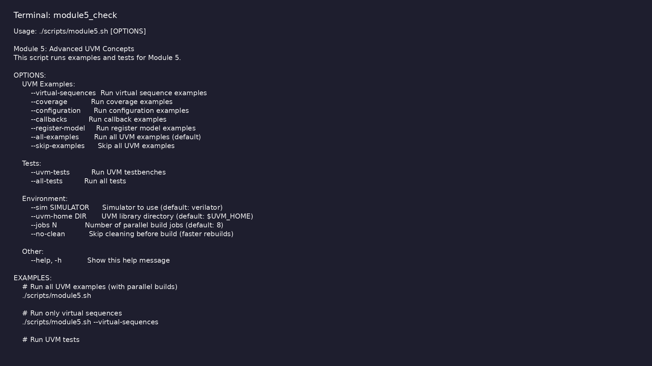
Module 5 self-check
$ ./scripts/module5.sh --help
learn_uvm2017_sv_verilator / Module 5
Notes:
Run from course repository root.

Slide 99
Exercise scaffold
./scripts/module5.sh --scaffold
learn_uvm2017_sv_verilator / Module 5

Slide 100
Example 1: Virtual Sequences
• VirtualSequencer: Contains references to multiple
sequencers (`master_seqr`, `slave_seqr`)
• VirtualSequence: Coordinates sequences on multiple
sequencers
• ChannelSequence: Regular sequence for a single
channel
• Parallel Execution: Using `fork-join` for concurrent
sequences
• Sequential Execution: Sequential sequence
coordination
learn_uvm2017_sv_verilator / Module 5
Notes:
module5/examples/virtual_sequences/README.md

Slide 101
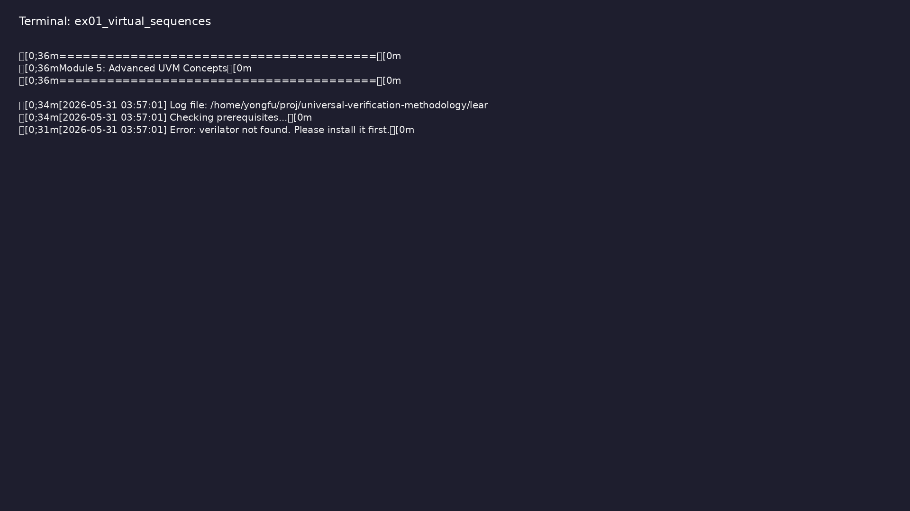
Demo: Virtual Sequences
$ ./scripts/module5.sh --virtual-sequences
learn_uvm2017_sv_verilator / Module 5
Notes:
Hands-on: module5/examples/virtual_sequences/

Slide 102
Example 2: Coverage
• CoverageModel: Extends `uvm_subscriber` for coverage
collection
• Coverage Sampling: Via `write()` method from
analysis port
• Coverage Types: Data, address range, command, and
cross coverage
• Coverage Analysis: Coverage statistics and reporting
learn_uvm2017_sv_verilator / Module 5
Notes:
module5/examples/coverage/README.md

Slide 103
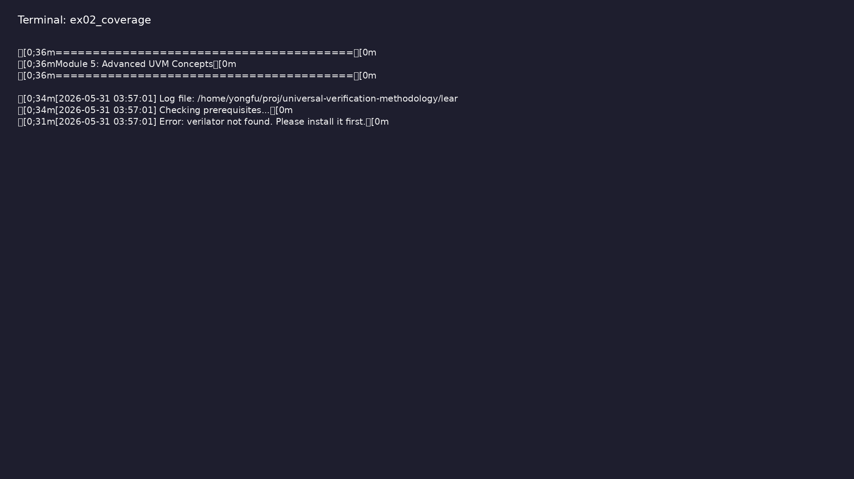
Demo: Coverage
$ ./scripts/module5.sh --coverage
learn_uvm2017_sv_verilator / Module 5
Notes:
Hands-on: module5/examples/coverage/

Slide 104
Example 3: Advanced Configuration
• AgentConfig: Complex configuration object with
multiple fields
• EnvConfig: Environment-level configuration
containing agent configs
• Configuration Hierarchy: Multi-level configuration
structure
• Configuration Usage: Setting and getting complex
configuration
learn_uvm2017_sv_verilator / Module 5
Notes:
module5/examples/configuration/README.md

Slide 105
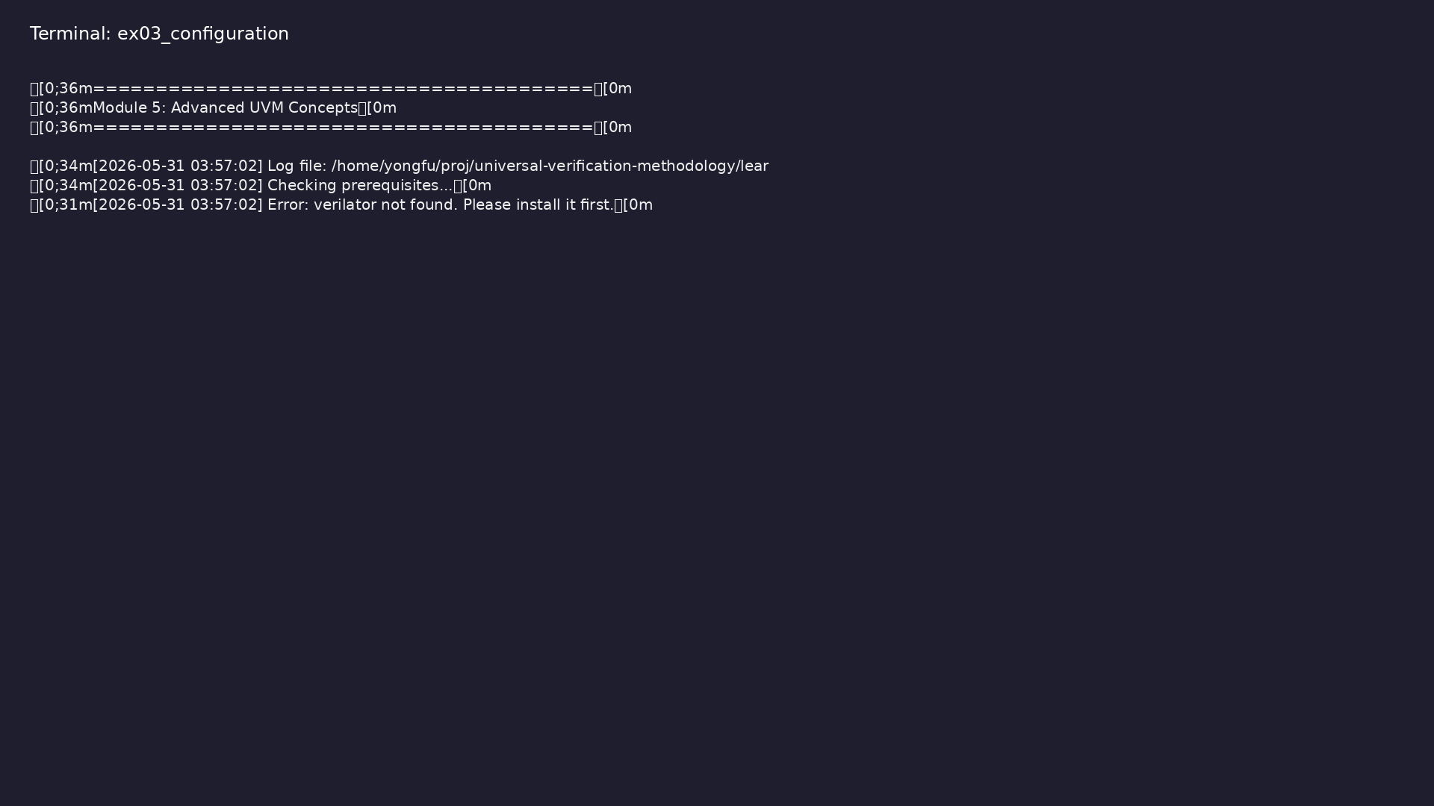
Demo: Advanced Configuration
$ ./scripts/module5.sh --configuration
learn_uvm2017_sv_verilator / Module 5
Notes:
Hands-on: module5/examples/configuration/

Slide 106
Example 4: Callbacks
• DriverCallbackBase: Base callback class for driver
• DriverCallback: Driver callback implementation
• MonitorCallbackBase: Base callback class for monitor
• MonitorCallback: Monitor callback implementation
• Callback Registration: Registering callbacks with
components
learn_uvm2017_sv_verilator / Module 5
Notes:
module5/examples/callbacks/README.md

Slide 107

Demo: Callbacks
$ ./scripts/module5.sh --callbacks
learn_uvm2017_sv_verilator / Module 5
Notes:
Hands-on: module5/examples/callbacks/

Slide 108
Example 5: Register Model
• RegisterField: Represents a register field with
offset, width, and value
• Register: Represents a register with address and
fields
• RegisterBlock: Represents a register block with
multiple registers
• Register Operations: Read/write operations on
registers
learn_uvm2017_sv_verilator / Module 5
Notes:
module5/examples/register_model/README.md

Slide 109

Demo: Register Model
$ ./scripts/module5.sh --register-model
learn_uvm2017_sv_verilator / Module 5
Notes:
Hands-on: module5/examples/register_model/

Slide 110
Practice & assessment
learn_uvm2017_sv_verilator / Module 5

Slide 111
What you should know
• Implement virtual sequences to coordinate multiple
sequencers
• Create coverage models for functional verification
• Use advanced configuration with complex objects
• Implement callbacks for component extension
• Use register models for register verification
• Apply advanced UVM patterns in testbenches
learn_uvm2017_sv_verilator / Module 5
Notes:
From MODULE5 Learning Outcomes.

Slide 112
Exercises
• Virtual Sequences
• Coverage Models
• Advanced Configuration
• Callbacks
• Register Model
learn_uvm2017_sv_verilator / Module 5

Slide 113
Assessment checklist
• Can implement virtual sequences
• Can create coverage models
• Can use advanced configuration
• Can implement callbacks
• Can use register models
• Understands advanced UVM patterns
learn_uvm2017_sv_verilator / Module 5

Slide 114
Summary & next steps
• Master advanced UVM features and patterns
• Complete module5/CHECKLIST.md
• Review module5/EXAMPLES.md and run each lab
• Next: Next module in course
learn_uvm2017_sv_verilator / Module 5

