Slide 1
Module 6
Complex Testbenches
learn_uvm2017_sv_verilator / Module 6

Slide 2
Learning objectives
• Build production-quality multi-agent testbenches
learn_uvm2017_sv_verilator / Module 6

Slide 3
Prerequisites
• See module README
learn_uvm2017_sv_verilator / Module 6

Slide 4

Learning path
Build production-quality multi-agent testbenches
learn_uvm2017_sv_verilator / Module 6

Slide 5
Overview
• This module covers building complex, production-
quality testbenches with multiple agents, protocol…
learn_uvm2017_sv_verilator / Module 6

Slide 6
Design architecture
learn_uvm2017_sv_verilator / Module 6

Slide 7

1. Multi-agent testbench architecture (1/3)
• Horizontal reuse: one agent type
per interface; duplicate for
multi-port DUTs
• Vertical reuse: env composes
agents + checkers + scoreboard
• `module6/dut/protocols/axi4_lite
_slave.v` — realistic protocol
DUT
• Environment config object
controls agent count,
active/passive, address maps
learn_uvm2017_sv_verilator / Module 6
Notes:
From MODULE6 Design Architecture.

Slide 8
1. Multi-agent testbench architecture (2/3)
• uvm_env (top): Instantiates multiple agents,
scoreboards, predictors
• Master agent: Initiates protocol transactions (e.g.,
AXI master)
• Slave agent: Responds to bus requests; memory model
• Protocol checker: Passive monitor enforcing protocol
rules
learn_uvm2017_sv_verilator / Module 6
Notes:
From MODULE6 Design Architecture.

Slide 9
1. Multi-agent testbench architecture (3/3)
• Multi-channel scoreboard: Per-channel expected vs
actual queues
learn_uvm2017_sv_verilator / Module 6
Notes:
From MODULE6 Design Architecture.

Slide 10

2. Protocol verification architecture (1/2)
• 1: Interface SVA / checker —
Legal handshake and timing rules
• 2: Monitor — Transaction
reconstruction from pins
• 3: Predictor / reference model —
Expected response from stimulus
• 4: Scoreboard — Compare monitor
vs predictor streams
learn_uvm2017_sv_verilator / Module 6
Notes:
From MODULE6 Design Architecture.

Slide 11
2. Protocol verification architecture (2/2)
• 5: Report — Protocol violations as UVM_ERROR
learn_uvm2017_sv_verilator / Module 6
Notes:
From MODULE6 Design Architecture.

Slide 12
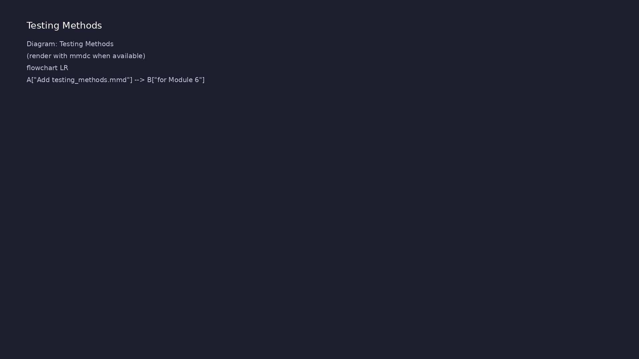
3. Module 6 example map (1/2)
• `examples/architecture/` — env
composition patterns
• `examples/multi_agent/` — two
(or more) agents in one env
• `examples/protocol/` +
`protocol_checkers/` — bus rules
and checking
• `examples/scoreboards/` — multi-
stream compare
learn_uvm2017_sv_verilator / Module 6
Notes:
From MODULE6 Design Architecture.

Slide 13
3. Module 6 example map (2/2)
• `test_complex_testbench_uvm.sv` — production-style
integration
learn_uvm2017_sv_verilator / Module 6
Notes:
From MODULE6 Design Architecture.

Slide 14
RTL block diagram (reference)
Module 6: DUT hierarchy and signal flow.
learn_uvm2017_sv_verilator / Module 6

Slide 15
Verification / testbench diagram (reference)
Module 6: stimulus, observation, and checking.
learn_uvm2017_sv_verilator / Module 6

Slide 16
Execution & simulation flow
learn_uvm2017_sv_verilator / Module 6

Slide 17
How the example runs (toolchain)
• Makefile: Verilator + UVM_HOME compile RTL,
interface, and test_*.sv
• UVM phases: build → connect → run_test → report
(same pattern as Module 2)
• Sequence → driver → DUT → monitor → scoreboard (read
SCOREBOARD at end)
• Typical command: make SIM=verilator TEST=test_* (see
module6 demo slide)
• Loopback / hooks connect monitor observations to
scoreboard checks
learn_uvm2017_sv_verilator / Module 6
Notes:
From MODULE6 — execution and artifact layout.

Slide 18
Artifact flow (spec → sim) (1)
• 1: Interface SVA / checker — Legal handshake and
timing rules
• 2: Monitor — Transaction reconstruction from pins
• 3: Predictor / reference model — Expected response
from stimulus
• 4: Scoreboard — Compare monitor vs predictor streams
learn_uvm2017_sv_verilator / Module 6
Notes:
From MODULE6 — execution and artifact layout.

Slide 19
Artifact flow (spec → sim) (2)
• 5: Report — Protocol violations as UVM_ERROR
learn_uvm2017_sv_verilator / Module 6
Notes:
From MODULE6 — execution and artifact layout.

Slide 20
Example directory layout
• uvm_env (top): Instantiates multiple agents,
scoreboards, predictors
• Master agent: Initiates protocol transactions (e.g.,
AXI master)
• Slave agent: Responds to bus requests; memory model
• Protocol checker: Passive monitor enforcing protocol
rules
• Multi-channel scoreboard: Per-channel expected vs
actual queues
learn_uvm2017_sv_verilator / Module 6
Notes:
Match each path to files under module/examples/.

Slide 21
Directed test execution sequence
• reset
• config agents
• concurrent sequences
• drain scoreboards
learn_uvm2017_sv_verilator / Module 6
Notes:
Follow this order when tracing waveforms or debugging.

Slide 22
Verification & testing methods
learn_uvm2017_sv_verilator / Module 6

Slide 23
1. Multi-agent coordination strategy
• Assign each agent a virtual
interface and address/data range
via ConfigDB
• Run parallel sequences with
objections on env or test (not
per short sequence)
• Protocol checker runs passively
— does not drive, only flags
violations
• Use predictable directed traffic
before enabling constrained-
random stress
learn_uvm2017_sv_verilator / Module 6
Notes:
From MODULE6 Verification & Testing Methods.

Slide 24
2. System-level closure workflow (1/2)
• Scoreboard empty at end — no
pending expected transactions
• Protocol checker reports zero
violations
• Regression:
`./scripts/module6.sh --all-
examples --uvm-tests`
• Debug order: signal wave →
monitor log → scoreboard
mismatch → checker message
learn_uvm2017_sv_verilator / Module 6
Notes:
From MODULE6 Verification & Testing Methods.

Slide 25
2. System-level closure workflow (2/2)
• Performance: `--jobs N` for parallel example builds
during development
learn_uvm2017_sv_verilator / Module 6
Notes:
From MODULE6 Verification & Testing Methods.

Slide 26
Syllabus topics
learn_uvm2017_sv_verilator / Module 6

Slide 27
Protocol & design details
learn_uvm2017_sv_verilator / Module 6

Slide 28
Detail: Example 6.1: Testbench Architecture (`module6/examples/archit…
• Transaction Class (`ArchTxn`): Base transaction with
address, data, and write/read control
• Sequencer (`ArchSequencer`): UVM sequencer for
transaction flow control
• Driver (`ArchDriver`): UVM driver that receives and
drives transactions
• Monitor (`ArchMonitor`): UVM monitor that observes
DUT behavior
learn_uvm2017_sv_verilator / Module 6
Notes:
From MODULE6 Topics Covered — protocol/design depth.

Slide 29
Detail: Example 6.1: Testbench Architecture (`module6/examples/archit…
• Agent (`ArchAgent`): UVM agent containing sequencer,
driver, and monitor
• Environment (`ArchEnv`): UVM environment containing
agent instances
• Sequence (`ArchSmokeSeq`): UVM sequence generating
random transactions
• Test (`ArchitectureTest`): Top-level UVM test
orchestrating verification
learn_uvm2017_sv_verilator / Module 6
Notes:
From MODULE6 Topics Covered — protocol/design depth.

Slide 30
Detail: Example 6.2: Multi-Agent Environment (`module6/examples/multi…
• Transaction (`MA_Txn`): Transaction with agent ID
and data fields
• Agent (`MA_Agent`): Parameterized agent with
configurable agent ID
• Virtual Sequence (`MA_VirtualSeq`): Coordinates
sequences across multiple sequencers
• Environment (`MA_Env`): Contains two agent instances
(a0 and a1)
learn_uvm2017_sv_verilator / Module 6
Notes:
From MODULE6 Topics Covered — protocol/design depth.

Slide 31
Detail: Example 6.2: Multi-Agent Environment (`module6/examples/multi…
• Test (`MultiAgentTest`): Orchestrates multi-agent
verification
• Method Signature: `static function bit
get(uvm_component cntxt, string inst_name, string
field_name…
• Template Parameter: `T` = type of value (int,
string, object, etc.)
• Purpose: Retrieve configuration values from ConfigDB
learn_uvm2017_sv_verilator / Module 6
Notes:
From MODULE6 Topics Covered — protocol/design depth.

Slide 32
Detail: Example 6.3: Protocol Verification (`module6/examples/protoco…
• Interface (`axi_lite_if`): AXI4-Lite interface with
all required signals
• Transaction (`AxiTxn`): AXI transaction with
read/write, address, and data
• Driver (`AxiDriver`): Protocol-aware driver
implementing AXI4-Lite handshake protocol
• Monitor (`AxiMonitor`): Protocol monitor for
observing AXI transactions
learn_uvm2017_sv_verilator / Module 6
Notes:
From MODULE6 Topics Covered — protocol/design depth.

Slide 33
Detail: Example 6.3: Protocol Verification (`module6/examples/protoco…
• Environment (`ProtocolEnv`): Protocol verification
environment
• Test (`ProtocolTest`): Protocol verification test
with AXI4-Lite slave DUT
• Purpose: Get virtual interface for protocol access
• Key: Must be set before driver can access signals
learn_uvm2017_sv_verilator / Module 6
Notes:
From MODULE6 Topics Covered — protocol/design depth.

Slide 34
Detail: Example 6.4: Protocol Checkers (`module6/examples/protocol_ch…
• Interface (`chk_if`): Simple handshake interface
with valid/ready signals
• Checker Component (`CheckerComp`): UVM component
that monitors protocol rules
• Protocol Rules: Valid must stay asserted until ready
(bounded wait)
• Test (`ProtocolCheckersTest`): Test that exercises
protocol checker
learn_uvm2017_sv_verilator / Module 6
Notes:
From MODULE6 Topics Covered — protocol/design depth.

Slide 35
Detail: Example 6.4: Protocol Checkers (`module6/examples/protocol_ch…
• Purpose: Monitor protocol compliance
• Key: Bounded wait prevents infinite waits
• Purpose: Check that protocol doesn't wait
indefinitely
• Key: Count cycles, report if exceeded
learn_uvm2017_sv_verilator / Module 6
Notes:
From MODULE6 Topics Covered — protocol/design depth.

Slide 36
Detail: Example 6.5: Multi-Channel Scoreboards (`module6/examples/sco…
• Transaction (`SB_Txn`): Scoreboard transaction with
stream ID, sequence number, and data
• Stream Producer (`StreamProducer`): Component that
generates transactions for a stream
• Multi-Channel Scoreboard (`MultiChannelScoreboard`):
Scoreboard that matches transactions from mult…
• Test (`ScoreboardsTest`): Test with two stream
producers and a scoreboard
learn_uvm2017_sv_verilator / Module 6
Notes:
From MODULE6 Topics Covered — protocol/design depth.

Slide 37
Detail: Example 6.5: Multi-Channel Scoreboards (`module6/examples/sco…
• Purpose: Match transactions from multiple streams
• Key: Use associative arrays indexed by sequence
number
• Purpose: Manage transaction queues per stream
• Key: Associative arrays enable efficient lookup
learn_uvm2017_sv_verilator / Module 6
Notes:
From MODULE6 Topics Covered — protocol/design depth.

Slide 38
Detail: Component Creation and Hierarchy (1)
• Purpose: Create components using UVM factory
• Usage: In `build_phase()` of parent component
• Key: Always provide name and parent
• Purpose: Connect TLM ports/exports
learn_uvm2017_sv_verilator / Module 6
Notes:
From MODULE6 Topics Covered — protocol/design depth.

Slide 39
Detail: Component Creation and Hierarchy (2)
• Usage: In `connect_phase()` after build
• Key: Connect driver to sequencer
• Purpose: Execute sequence on sequencer
• Usage: In test's `run_phase()`
learn_uvm2017_sv_verilator / Module 6
Notes:
From MODULE6 Topics Covered — protocol/design depth.

Slide 40
Detail: Agent Configuration (1)
• Purpose: Configure agent parameters
• Usage: Before creating agent
• Key: Set config, then create component
• Purpose: Retrieve agent configuration
learn_uvm2017_sv_verilator / Module 6
Notes:
From MODULE6 Topics Covered — protocol/design depth.

Slide 41
Detail: Agent Configuration (2)
• Usage: In agent's `build_phase()`
• Key: Check return value, provide defaults
learn_uvm2017_sv_verilator / Module 6
Notes:
From MODULE6 Topics Covered — protocol/design depth.

Slide 42
Detail: Virtual Sequence Methods (1)
• Purpose: Execute transaction directly on sequencer
• Usage: Alternative to `start_item()`/`finish_item()`
• Key: Useful in virtual sequences for direct
execution
• Note: Transaction must be created and randomized
first
learn_uvm2017_sv_verilator / Module 6
Notes:
From MODULE6 Topics Covered — protocol/design depth.

Slide 43
Detail: Virtual Sequence Methods (2)
• Purpose: Coordinate multiple sequencers
• Key: Set sequencer references before starting
learn_uvm2017_sv_verilator / Module 6
Notes:
From MODULE6 Topics Covered — protocol/design depth.

Slide 44
Detail: Virtual Interface Access (1)
• Purpose: Get virtual interface for protocol access
• Usage: In driver/monitor `build_phase()`
• Key: Must be set before component can access signals
• Purpose: Set interface for all components
learn_uvm2017_sv_verilator / Module 6
Notes:
From MODULE6 Topics Covered — protocol/design depth.

Slide 45
Detail: Virtual Interface Access (2)
• Usage: In module before `run_test()`
• Key: Use wildcard `"*"` to match all components
learn_uvm2017_sv_verilator / Module 6
Notes:
From MODULE6 Topics Covered — protocol/design depth.

Slide 46
Detail: Protocol Handshake Patterns (1)
• Purpose: Implement VALID/READY handshake
• Key: Assert VALID, wait for READY, deassert VALID
• Purpose: AXI write transaction
• Key: Drive address and data, wait for both ready
learn_uvm2017_sv_verilator / Module 6
Notes:
From MODULE6 Topics Covered — protocol/design depth.

Slide 47
Detail: Protocol Handshake Patterns (2)
• Purpose: AXI read transaction
• Key: Drive address, wait for ready, capture data
learn_uvm2017_sv_verilator / Module 6
Notes:
From MODULE6 Topics Covered — protocol/design depth.

Slide 48
Detail: Bounded Wait Checking (1)
• Purpose: Check protocol doesn't wait indefinitely
• Key: Count cycles, report if exceeded bound
• Purpose: Ignore protocol during reset
• Key: Use `continue` to skip reset cycles
learn_uvm2017_sv_verilator / Module 6
Notes:
From MODULE6 Topics Covered — protocol/design depth.

Slide 49
Detail: Bounded Wait Checking (2)
• Purpose: Continuously monitor protocol
• Key: Forever loop with clock synchronization
learn_uvm2017_sv_verilator / Module 6
Notes:
From MODULE6 Topics Covered — protocol/design depth.

Slide 50
Detail: Associative Array Operations (1)
• Purpose: Store transactions by sequence number
• Key: Use sequence number as index
• Purpose: Check if transaction exists
• Key: Use `exists()` method
learn_uvm2017_sv_verilator / Module 6
Notes:
From MODULE6 Topics Covered — protocol/design depth.

Slide 51
Detail: Associative Array Operations (2)
• Purpose: Remove matched transactions
• Key: Use `delete()` method
learn_uvm2017_sv_verilator / Module 6
Notes:
From MODULE6 Topics Covered — protocol/design depth.

Slide 52
Detail: Transaction Matching (1)
• Purpose: Match transactions across streams
• Key: Check both streams, compare, clean up
• Purpose: Connect multiple streams to one scoreboard
• Key: One scoreboard can receive from multiple
sources
learn_uvm2017_sv_verilator / Module 6
Notes:
From MODULE6 Topics Covered — protocol/design depth.

Slide 53
Detail: Transaction Matching (2)
• Problem: `uvm_fatal("NO_VIF", ...)` error
• Solution: Set interface in module before
`run_test()`
• Code: `uvm_config_db#(virtual if)::set(null, "*",
"vif", vif);`
• Problem: Agent uses default values
learn_uvm2017_sv_verilator / Module 6
Notes:
From MODULE6 Topics Covered — protocol/design depth.

Slide 54
Verification flow (reference)
Stimulus, DUT response, and check points for this module.
learn_uvm2017_sv_verilator / Module 6

Slide 55
1. Testbench Architecture (1/13)
• Hierarchical Component Organization
• Component hierarchy design
• Separation of concerns
• Component relationships
• Environment structure
• Component Integration
learn_uvm2017_sv_verilator / Module 6
Notes:
From MODULE6 Topics Covered.

Slide 56
1. Testbench Architecture (2/13)
• Agent construction
• Environment assembly
• Component connections
• Phase-based execution
• Best Practices
• Clean component hierarchy
learn_uvm2017_sv_verilator / Module 6
Notes:
From MODULE6 Topics Covered.

Slide 57
1. Testbench Architecture (3/13)
• Reusable components
• Configuration management
• Maintainable testbench structure
• Transaction Class (`ArchTxn`): Base transaction with
address, data, and write/read control
• Sequencer (`ArchSequencer`): UVM sequencer for
transaction flow control
• Driver (`ArchDriver`): UVM driver that receives and
drives transactions
learn_uvm2017_sv_verilator / Module 6
Notes:
From MODULE6 Topics Covered.

Slide 58
1. Testbench Architecture (4/13)
• Monitor (`ArchMonitor`): UVM monitor that observes
DUT behavior
• Agent (`ArchAgent`): UVM agent containing sequencer,
driver, and monitor
• Environment (`ArchEnv`): UVM environment containing
agent instances
• Sequence (`ArchSmokeSeq`): UVM sequence generating
random transactions
• Test (`ArchitectureTest`): Top-level UVM test
orchestrating verification
• Method Signature: `function bit randomize();`
learn_uvm2017_sv_verilator / Module 6
Notes:
From MODULE6 Topics Covered.

Slide 59
1. Testbench Architecture (5/13)
• Return Type: `bit` (1 = success, 0 = failure)
• Purpose: Generate random test vectors with
constraints
• Usage: Call after creating transaction, before
sending to sequencer
• Key: `void'()` suppresses Verilator warning about
ignored return value
• Constraints: Use `with { constraint_expression; }`
for conditional randomization
• Example: `void'(t.randomize() with { addr[31:16] ==
16'h0000; });` constrains upper address bits
learn_uvm2017_sv_verilator / Module 6
Notes:
From MODULE6 Topics Covered.

Slide 60
1. Testbench Architecture (6/13)
• Method Signature: `task body();` (no parameters, no
return)
• Purpose: Generate and send multiple transactions to
sequencer
• Execution Flow:
• Key: `repeat` loop generates multiple transactions
sequentially
• Blocking Behavior: `start_item()` and
`finish_item()` both block
• Transaction Lifetime: Transaction created in loop,
sent to sequencer, then driver processes it
learn_uvm2017_sv_verilator / Module 6
Notes:
From MODULE6 Topics Covered.

Slide 61
1. Testbench Architecture (7/13)
• Method Signature: `function void
build_phase(uvm_phase phase);`
• Phase Type: Build-time phase (function, executes
top-down)
• Purpose: Create all child components of the agent
• Execution Order:
• Key: All components created in agent's
`build_phase()`, before `connect_phase()`
• Factory Benefits: Enables type/instance overrides
via factory
learn_uvm2017_sv_verilator / Module 6
Notes:
From MODULE6 Topics Covered.

Slide 62
1. Testbench Architecture (8/13)
• Hierarchical Naming: Full path =
"test.env.agent.seqr" (automatic)
• Method Signature: `function void
connect_phase(uvm_phase phase);`
• Phase Type: Connect-time phase (function, executes
bottom-up)
• Purpose: Connect TLM ports/exports between
components
• Execution Order:
• Key: TLM connections made in `connect_phase()`,
after all components created
learn_uvm2017_sv_verilator / Module 6
Notes:
From MODULE6 Topics Covered.

Slide 63
1. Testbench Architecture (9/13)
• TLM Pattern: Port (initiator) connects to Export
(target)
• Transaction Flow: Sequence → Sequencer (export) →
Driver (port) → DUT
• Connection Timing: Must happen after `build_phase()`
(components must exist)
• Method Signature: `task run_phase(uvm_phase phase);`
• Phase Type: Run-time phase (task, executes
concurrently)
• Purpose: Execute test stimulus (sequences, driving,
monitoring)
learn_uvm2017_sv_verilator / Module 6
Notes:
From MODULE6 Topics Covered.

Slide 64
1. Testbench Architecture (10/13)
• Execution Flow:
• Key: Objection mechanism controls phase completion
• Sequence Execution: `seq.start(sequencer)` blocks
until `body()` completes
• Transaction Flow: Test → Sequence → Sequencer →
Driver → DUT
• Timing: All run_phase tasks execute concurrently
(forked)
• Hierarchical component organization enables
maintainable testbenches
learn_uvm2017_sv_verilator / Module 6
Notes:
From MODULE6 Topics Covered.

Slide 65
1. Testbench Architecture (11/13)
• Separation of concerns (driver, monitor, sequencer)
improves reusability
• Component factory and configuration provide
flexibility
• Phase-based execution model ensures proper
initialization and execution
• Transaction-based communication decouples components
• Component hierarchy: Test → Env → Agent →
Sequencer/Driver/Monitor
• Factory creation: `type_id::create()` for all
components
learn_uvm2017_sv_verilator / Module 6
Notes:
From MODULE6 Topics Covered.

Slide 66
1. Testbench Architecture (12/13)
• Phase execution: Build → Connect → Run → Report
• Sequence execution: `seq.start(sequencer)` in
run_phase
• UVM component hierarchy construction
• Transaction generation and driving
• Component phase execution
• UVM report summary with component counts
learn_uvm2017_sv_verilator / Module 6
Notes:
From MODULE6 Topics Covered.

Slide 67
1. Testbench Architecture (13/13)
• Component Hierarchy: Agent →
Sequencer/Driver/Monitor structure
• Factory Pattern: Using `type_id::create()` for
component creation
• Phase Execution: Build, connect, run, check, report
phases
• Transaction Flow: Sequence → Sequencer → Driver →
DUT
learn_uvm2017_sv_verilator / Module 6
Notes:
From MODULE6 Topics Covered.

Slide 68
2. Multi-Agent Environments (1/12)
• Multiple Agent Coordination
• Multiple agent instantiation
• Agent configuration
• Agent communication
• Cross-agent stimulus
• Virtual Sequences
learn_uvm2017_sv_verilator / Module 6
Notes:
From MODULE6 Topics Covered.

Slide 69
2. Multi-Agent Environments (2/12)
• Virtual sequence definition
• Multi-sequencer coordination
• Parallel sequence execution
• Sequence synchronization
• Agent Reuse
• Parameterized agents
learn_uvm2017_sv_verilator / Module 6
Notes:
From MODULE6 Topics Covered.

Slide 70
2. Multi-Agent Environments (3/12)
• Agent configuration database
• Reusable agent patterns
• Agent instantiation patterns
• Transaction (`MA_Txn`): Transaction with agent ID
and data fields
• Agent (`MA_Agent`): Parameterized agent with
configurable agent ID
• Virtual Sequence (`MA_VirtualSeq`): Coordinates
sequences across multiple sequencers
learn_uvm2017_sv_verilator / Module 6
Notes:
From MODULE6 Topics Covered.

Slide 71
2. Multi-Agent Environments (4/12)
• Environment (`MA_Env`): Contains two agent instances
(a0 and a1)
• Test (`MultiAgentTest`): Orchestrates multi-agent
verification
• Method Signature: `static function bit
get(uvm_component cntxt, string inst_name, string
field_name…
• Template Parameter: `T` = type of value (int,
string, object, etc.)
• Purpose: Retrieve configuration values from ConfigDB
• Search Behavior: Searches up component hierarchy
from `cntxt`
learn_uvm2017_sv_verilator / Module 6
Notes:
From MODULE6 Topics Covered.

Slide 72
2. Multi-Agent Environments (5/12)
• Usage: Call in `build_phase()` before using the
value
• Key: Always check return value, provide defaults
• Hierarchy Search: Searches current component →
parent → ... → top
• Method Signature: `static function void
set(uvm_component cntxt, string inst_name, string
field_nam…
• Template Parameter: `T` = type of value
• Purpose: Store configuration values in ConfigDB
learn_uvm2017_sv_verilator / Module 6
Notes:
From MODULE6 Topics Covered.

Slide 73
2. Multi-Agent Environments (6/12)
• Timing: MUST be called BEFORE creating the component
• Hierarchical Path: Full path = "env.a0.agent_id"
(automatic)
• Key: Set config → Create component → Component
retrieves config in its `build_phase()`
• Pattern: Environment sets config, agents retrieve
config
• Method Signature: `task
execute_item(uvm_sequence_item item);`
• Purpose: Execute transaction directly on sequencer
(combines start_item + finish_item)
learn_uvm2017_sv_verilator / Module 6
Notes:
From MODULE6 Topics Covered.

Slide 74
2. Multi-Agent Environments (7/12)
• Behavior:
• Sends transaction to sequencer
• Waits for driver to complete
• Blocks until transaction fully processed
• Usage: Alternative to `start_item()` +
`finish_item()` pair
• Key: Useful in virtual sequences for direct
execution on multiple sequencers
learn_uvm2017_sv_verilator / Module 6
Notes:
From MODULE6 Topics Covered.

Slide 75
2. Multi-Agent Environments (8/12)
• Parallel Execution: Fork-join enables concurrent
execution on multiple sequencers
• Transaction Flow: Virtual sequence → Multiple
sequencers → Multiple drivers → DUT
• Method Signature: `task start(uvm_sequencer_base
sequencer);`
• Purpose: Start virtual sequence execution
• Virtual Sequence Pattern:
• Key: Sequencer references MUST be set before calling
`start()`
learn_uvm2017_sv_verilator / Module 6
Notes:
From MODULE6 Topics Covered.

Slide 76
2. Multi-Agent Environments (9/12)
• Difference: Regular sequences use
`start(sequencer)`, virtual sequences use assigned
references
• Execution: Virtual sequence body() uses assigned
sequencers for parallel execution
• Purpose: Execute transactions on multiple agents
concurrently
• Key: Fork-join enables parallel execution
• Multiple agents enable complex verification
scenarios
• Virtual sequences coordinate stimulus across agents
learn_uvm2017_sv_verilator / Module 6
Notes:
From MODULE6 Topics Covered.

Slide 77
2. Multi-Agent Environments (10/12)
• Agent configuration via config database provides
flexibility
• Parallel sequence execution using fork-join enables
concurrent testing
• Agent reuse patterns improve productivity
• Agent configuration - Via ConfigDB before creation
• Virtual sequence - Coordinates multiple sequencers
• `execute_item()` - Direct transaction execution
learn_uvm2017_sv_verilator / Module 6
Notes:
From MODULE6 Topics Covered.

Slide 78
2. Multi-Agent Environments (11/12)
• Parallel execution - Fork-join for concurrent agents
• Agent reuse - Same agent class, different instances
• Two agents running in parallel
• Virtual sequence coordinating both agents
• Agent-specific transaction generation
• Cross-agent stimulus coordination
learn_uvm2017_sv_verilator / Module 6
Notes:
From MODULE6 Topics Covered.

Slide 79
2. Multi-Agent Environments (12/12)
• Virtual Sequences: Sequences that coordinate
multiple sequencers
• Agent Configuration: Using `uvm_config_db` to
configure agent parameters
• Parallel Execution: Fork-join for concurrent
sequence execution
• Agent Reuse: Same agent class used for multiple
instances
learn_uvm2017_sv_verilator / Module 6
Notes:
From MODULE6 Topics Covered.

Slide 80
3. Protocol Verification (1/9)
• Protocol Modeling
• Interface definition
• Protocol transaction modeling
• Protocol signal mapping
• Protocol timing
• Protocol Sequences
learn_uvm2017_sv_verilator / Module 6
Notes:
From MODULE6 Topics Covered.

Slide 81
3. Protocol Verification (2/9)
• Protocol-aware sequences
• Protocol transaction generation
• Protocol sequence patterns
• Protocol coverage
• Protocol Drivers and Monitors
• Protocol driver implementation
learn_uvm2017_sv_verilator / Module 6
Notes:
From MODULE6 Topics Covered.

Slide 82
3. Protocol Verification (3/9)
• Protocol monitor implementation
• Handshake protocol handling
• Protocol signal sampling
• Interface (`axi_lite_if`): AXI4-Lite interface with
all required signals
• Transaction (`AxiTxn`): AXI transaction with
read/write, address, and data
• Driver (`AxiDriver`): Protocol-aware driver
implementing AXI4-Lite handshake protocol
learn_uvm2017_sv_verilator / Module 6
Notes:
From MODULE6 Topics Covered.

Slide 83
3. Protocol Verification (4/9)
• Monitor (`AxiMonitor`): Protocol monitor for
observing AXI transactions
• Environment (`ProtocolEnv`): Protocol verification
environment
• Test (`ProtocolTest`): Protocol verification test
with AXI4-Lite slave DUT
• Purpose: Get virtual interface for protocol access
• Key: Must be set before driver can access signals
• Purpose: Implement AXI write protocol
learn_uvm2017_sv_verilator / Module 6
Notes:
From MODULE6 Topics Covered.

Slide 84
3. Protocol Verification (5/9)
• Key: Handshake pattern - assert VALID, wait for
READY
• Purpose: Implement AXI read protocol
• Key: Capture read data from interface
• Purpose: Generic handshake implementation
• Key: Assert VALID, wait for READY, deassert VALID
• Purpose: Synchronize with protocol clock
learn_uvm2017_sv_verilator / Module 6
Notes:
From MODULE6 Topics Covered.

Slide 85
3. Protocol Verification (6/9)
• Key: All protocol operations clock-synchronized
• Purpose: Set interface for all components
• Key: Set before `run_test()`
• Protocol-shaped driver/monitor scaffolding enables
protocol verification
• Handshake protocol implementation (VALID/READY) is
fundamental
• Interface-based communication provides structured
protocol access
learn_uvm2017_sv_verilator / Module 6
Notes:
From MODULE6 Topics Covered.

Slide 86
3. Protocol Verification (7/9)
• Protocol transaction modeling captures protocol
semantics
• Clock-synchronized protocol operations ensure
correct timing
• Virtual interface - Access protocol signals
• Handshake pattern - VALID/READY protocol
• Clock synchronization - `@(posedge clk)` for all
operations
• Write protocol - Address + Data + Response channels
learn_uvm2017_sv_verilator / Module 6
Notes:
From MODULE6 Topics Covered.

Slide 87
3. Protocol Verification (8/9)
• Read protocol - Address + Data channels
• `do-while` loop - Wait for handshake completion
• AXI4-Lite write and read transactions
• Handshake protocol demonstration
• Protocol driver and monitor operation
• DUT interaction with protocol interface
learn_uvm2017_sv_verilator / Module 6
Notes:
From MODULE6 Topics Covered.

Slide 88
3. Protocol Verification (9/9)
• Protocol Interfaces: Structured interface definition
for protocol signals
• Handshake Protocol: VALID/READY handshake for flow
control
• Protocol Drivers: Clock-synchronized protocol signal
driving
• Protocol Monitors: Protocol signal observation and
transaction reconstruction
learn_uvm2017_sv_verilator / Module 6
Notes:
From MODULE6 Topics Covered.

Slide 89
4. Protocol Checkers (1/8)
• Protocol Rule Checking
• Protocol rule definition
• Assertion-like checking
• Bounded wait checking
• Protocol compliance verification
• Error Detection
learn_uvm2017_sv_verilator / Module 6
Notes:
From MODULE6 Topics Covered.

Slide 90
4. Protocol Checkers (2/8)
• Protocol violation detection
• Error reporting
• Protocol timing checks
• Protocol state checking
• Checker Implementation
• UVM checker components
learn_uvm2017_sv_verilator / Module 6
Notes:
From MODULE6 Topics Covered.

Slide 91
4. Protocol Checkers (3/8)
• Interface monitoring
• Rule enforcement
• Compliance reporting
• Interface (`chk_if`): Simple handshake interface
with valid/ready signals
• Checker Component (`CheckerComp`): UVM component
that monitors protocol rules
• Protocol Rules: Valid must stay asserted until ready
(bounded wait)
learn_uvm2017_sv_verilator / Module 6
Notes:
From MODULE6 Topics Covered.

Slide 92
4. Protocol Checkers (4/8)
• Test (`ProtocolCheckersTest`): Test that exercises
protocol checker
• Purpose: Monitor protocol compliance
• Key: Bounded wait prevents infinite waits
• Purpose: Check that protocol doesn't wait
indefinitely
• Key: Count cycles, report if exceeded
• Purpose: Ignore protocol during reset
learn_uvm2017_sv_verilator / Module 6
Notes:
From MODULE6 Topics Covered.

Slide 93
4. Protocol Checkers (5/8)
• Key: Use `continue` to skip reset cycles
• Purpose: Detect protocol states
• Key: Check signal combinations
• Purpose: Report protocol violations
• Key: Use appropriate severity level
• Protocol rule checking ensures protocol compliance
learn_uvm2017_sv_verilator / Module 6
Notes:
From MODULE6 Topics Covered.

Slide 94
4. Protocol Checkers (6/8)
• Assertion-like patterns in UVM provide structured
checking
• Bounded wait checking prevents protocol violations
• Protocol compliance verification catches design
errors
• Error detection and reporting enable debugging
• Bounded wait - Check timeout conditions
• Reset handling - Skip checking during reset
learn_uvm2017_sv_verilator / Module 6
Notes:
From MODULE6 Topics Covered.

Slide 95
4. Protocol Checkers (7/8)
• State monitoring - Check protocol signal
combinations
• Error reporting - Report violations with `uvm_error`
• Forever loop - Continuous monitoring
• Protocol handshake monitoring
• Rule violation detection (if any)
• Bounded wait checking
learn_uvm2017_sv_verilator / Module 6
Notes:
From MODULE6 Topics Covered.

Slide 96
4. Protocol Checkers (8/8)
• Protocol compliance reporting
• Protocol Checkers: UVM components that monitor
protocol rules
• Bounded Wait: Checking that protocol signals don't
wait indefinitely
• Rule Enforcement: Detecting and reporting protocol
violations
• Compliance Verification: Ensuring design follows
protocol specification
learn_uvm2017_sv_verilator / Module 6
Notes:
From MODULE6 Topics Covered.

Slide 97
5. Multi-Channel Scoreboards (1/21)
• Multi-Channel Scoreboarding
• Multiple stream handling
• Transaction matching
• Result aggregation
• Scoreboard architecture
• Transaction Matching
learn_uvm2017_sv_verilator / Module 6
Notes:
From MODULE6 Topics Covered.

Slide 98
5. Multi-Channel Scoreboards (2/21)
• Matching algorithms
• Transaction comparison
• Match criteria
• Unmatched transaction handling
• Result Aggregation
• Pass/fail counting
learn_uvm2017_sv_verilator / Module 6
Notes:
From MODULE6 Topics Covered.

Slide 99
5. Multi-Channel Scoreboards (3/21)
• Result reporting
• Statistics collection
• Coverage tracking
• Transaction (`SB_Txn`): Scoreboard transaction with
stream ID, sequence number, and data
• Stream Producer (`StreamProducer`): Component that
generates transactions for a stream
• Multi-Channel Scoreboard (`MultiChannelScoreboard`):
Scoreboard that matches transactions from mult…
learn_uvm2017_sv_verilator / Module 6
Notes:
From MODULE6 Topics Covered.

Slide 100
5. Multi-Channel Scoreboards (4/21)
• Test (`ScoreboardsTest`): Test with two stream
producers and a scoreboard
• Purpose: Match transactions from multiple streams
• Key: Use associative arrays indexed by sequence
number
• Purpose: Manage transaction queues per stream
• Key: Associative arrays enable efficient lookup
• Purpose: Match transactions by sequence number
learn_uvm2017_sv_verilator / Module 6
Notes:
From MODULE6 Topics Covered.

Slide 101
5. Multi-Channel Scoreboards (5/21)
• Key: Compare data, track pass/fail, clean up
• Purpose: Generate transactions for a stream
• Key: Assign sequence numbers for matching
• Purpose: Connect multiple streams to scoreboard
• Key: One scoreboard can receive from multiple
sources
• Purpose: Report final results
learn_uvm2017_sv_verilator / Module 6
Notes:
From MODULE6 Topics Covered.

Slide 102
5. Multi-Channel Scoreboards (6/21)
• Key: Aggregate pass/fail counts
• Multi-channel scoreboarding enables complex
verification scenarios
• Transaction matching across streams verifies data
integrity
• Result aggregation provides overall test status
• Scoreboard architecture supports multiple
verification paths
• Stream-based verification enables parallel checking
learn_uvm2017_sv_verilator / Module 6
Notes:
From MODULE6 Topics Covered.

Slide 103
5. Multi-Channel Scoreboards (7/21)
• Associative arrays - Store transactions by sequence
number
• `exists(key)` - Check if both streams have
transaction
• `delete(key)` - Remove matched transactions
• Transaction matching - Match by sequence number,
compare data
• Multiple streams - One scoreboard, multiple
producers
• Result aggregation - Track pass/fail across all
matches
learn_uvm2017_sv_verilator / Module 6
Notes:
From MODULE6 Topics Covered.

Slide 104
5. Multi-Channel Scoreboards (8/21)
• Two stream producers generating transactions
• Scoreboard matching transactions from both streams
• Pass/fail reporting
• Transaction matching results
• Multi-Channel Scoreboards: Scoreboards that handle
multiple transaction streams
• Transaction Matching: Matching transactions based on
sequence numbers or other criteria
learn_uvm2017_sv_verilator / Module 6
Notes:
From MODULE6 Topics Covered.

Slide 105
5. Multi-Channel Scoreboards (9/21)
• Result Aggregation: Collecting and reporting overall
test results
• Stream-Based Verification: Verifying data integrity
across multiple paths
• Purpose: Create components using UVM factory
• Usage: In `build_phase()` of parent component
• Key: Always provide name and parent
• Purpose: Connect TLM ports/exports
learn_uvm2017_sv_verilator / Module 6
Notes:
From MODULE6 Topics Covered.

Slide 106
5. Multi-Channel Scoreboards (10/21)
• Usage: In `connect_phase()` after build
• Key: Connect driver to sequencer
• Purpose: Execute sequence on sequencer
• Usage: In test's `run_phase()`
• Key: Create sequence, then start on sequencer
• Purpose: Configure agent parameters
learn_uvm2017_sv_verilator / Module 6
Notes:
From MODULE6 Topics Covered.

Slide 107
5. Multi-Channel Scoreboards (11/21)
• Usage: Before creating agent
• Key: Set config, then create component
• Purpose: Retrieve agent configuration
• Usage: In agent's `build_phase()`
• Key: Check return value, provide defaults
• Purpose: Execute transaction directly on sequencer
learn_uvm2017_sv_verilator / Module 6
Notes:
From MODULE6 Topics Covered.

Slide 108
5. Multi-Channel Scoreboards (12/21)
• Usage: Alternative to `start_item()`/`finish_item()`
• Key: Useful in virtual sequences for direct
execution
• Note: Transaction must be created and randomized
first
• Purpose: Coordinate multiple sequencers
• Key: Set sequencer references before starting
• Purpose: Get virtual interface for protocol access
learn_uvm2017_sv_verilator / Module 6
Notes:
From MODULE6 Topics Covered.

Slide 109
5. Multi-Channel Scoreboards (13/21)
• Usage: In driver/monitor `build_phase()`
• Key: Must be set before component can access signals
• Purpose: Set interface for all components
• Usage: In module before `run_test()`
• Key: Use wildcard `"*"` to match all components
• Purpose: Implement VALID/READY handshake
learn_uvm2017_sv_verilator / Module 6
Notes:
From MODULE6 Topics Covered.

Slide 110
5. Multi-Channel Scoreboards (14/21)
• Key: Assert VALID, wait for READY, deassert VALID
• Purpose: AXI write transaction
• Key: Drive address and data, wait for both ready
• Purpose: AXI read transaction
• Key: Drive address, wait for ready, capture data
• Purpose: Check protocol doesn't wait indefinitely
learn_uvm2017_sv_verilator / Module 6
Notes:
From MODULE6 Topics Covered.

Slide 111
5. Multi-Channel Scoreboards (15/21)
• Key: Count cycles, report if exceeded bound
• Purpose: Ignore protocol during reset
• Key: Use `continue` to skip reset cycles
• Purpose: Continuously monitor protocol
• Key: Forever loop with clock synchronization
• Purpose: Store transactions by sequence number
learn_uvm2017_sv_verilator / Module 6
Notes:
From MODULE6 Topics Covered.

Slide 112
5. Multi-Channel Scoreboards (16/21)
• Key: Use sequence number as index
• Purpose: Check if transaction exists
• Key: Use `exists()` method
• Purpose: Remove matched transactions
• Key: Use `delete()` method
• Purpose: Match transactions across streams
learn_uvm2017_sv_verilator / Module 6
Notes:
From MODULE6 Topics Covered.

Slide 113
5. Multi-Channel Scoreboards (17/21)
• Key: Check both streams, compare, clean up
• Purpose: Connect multiple streams to one scoreboard
• Key: One scoreboard can receive from multiple
sources
• Problem: `uvm_fatal("NO_VIF", ...)` error
• Solution: Set interface in module before
`run_test()`
• Code: `uvm_config_db#(virtual if)::set(null, "*",
"vif", vif);`
learn_uvm2017_sv_verilator / Module 6
Notes:
From MODULE6 Topics Covered.

Slide 114
5. Multi-Channel Scoreboards (18/21)
• Problem: Agent uses default values
• Solution: Check return value, provide defaults
• Code: `if (!uvm_config_db#(int)::get(...)) agent_id
= 0;`
• Problem: Null pointer exception
• Solution: Set sequencer references before starting
• Code: `vseq.seqr0 = env.a0.seqr; vseq.start(null);`
learn_uvm2017_sv_verilator / Module 6
Notes:
From MODULE6 Topics Covered.

Slide 115
5. Multi-Channel Scoreboards (19/21)
• Problem: Simulation hangs waiting for READY
• Solution: Use bounded wait in protocol checker
• Code: `while (condition && cycles < max_cycles)`
• Problem: Unmatched transactions accumulate
• Solution: Delete matched transactions
• Code: `q0.delete(t.seq); q1.delete(t.seq);`
learn_uvm2017_sv_verilator / Module 6
Notes:
From MODULE6 Topics Covered.

Slide 116
5. Multi-Channel Scoreboards (20/21)
• Check: Virtual interface retrieved in
`build_phase()`
• Check: Interface set before `run_test()`
• Check: Clock running in module
• Check: Sequencer references set before `start()`
• Check: Objection raised in test's `run_phase()`
• Check: Sequence created before starting
learn_uvm2017_sv_verilator / Module 6
Notes:
From MODULE6 Topics Covered.

Slide 117
5. Multi-Channel Scoreboards (21/21)
• Check: Sequence numbers assigned correctly
• Check: Both streams connected to scoreboard
• Check: `write()` method called for both streams
• Check: Reset handling (skip during reset)
• Check: Bounded wait threshold appropriate
• Check: Protocol state detection correct
learn_uvm2017_sv_verilator / Module 6
Notes:
From MODULE6 Topics Covered.

Slide 118
Run: Example 6.1: Testbench Architecture
./scripts/module6.sh --architecture
cd module6/examples/architecture
verilator -sv --cc --exe --timing --trace architecture.sv
architecture.cpp \
-I"$UVM_HOME" +incdir+"$UVM_HOME" +define+UVM_NO_DPI \
"$UVM_HOME/uvm_pkg.sv" --top-module architecture
make -C obj_dir -f Varchitecture.mk
./obj_dir/Varchitecture
learn_uvm2017_sv_verilator / Module 6
Notes:
Execute from course root or example directory — see docs/MODULE6.md.

Slide 119
Run: Example 6.2: Multi-Agent Environment
./scripts/module6.sh --multi-agent
cd module6/examples/multi_agent
verilator -sv --cc --exe --timing --trace multi_agent.sv multi_agent.cpp
\
-I"$UVM_HOME" +incdir+"$UVM_HOME" +define+UVM_NO_DPI \
"$UVM_HOME/uvm_pkg.sv" --top-module multi_agent
make -C obj_dir -f Vmulti_agent.mk
./obj_dir/Vmulti_agent
learn_uvm2017_sv_verilator / Module 6
Notes:
Execute from course root or example directory — see docs/MODULE6.md.

Slide 120
Run: Example 6.3: Protocol Verification
./scripts/module6.sh --protocol
cd module6/examples/protocol
verilator -sv --cc --exe --timing --trace protocol.sv protocol.cpp \
-I"$UVM_HOME" +incdir+"$UVM_HOME" +define+UVM_NO_DPI \
"$UVM_HOME/uvm_pkg.sv" ../dut/protocols/axi4_lite_slave.v --top-module
protocol
make -C obj_dir -f Vprotocol.mk
./obj_dir/Vprotocol
learn_uvm2017_sv_verilator / Module 6
Notes:
Execute from course root or example directory — see docs/MODULE6.md.

Slide 121
Run: Example 6.4: Protocol Checkers
./scripts/module6.sh --protocol-checkers
cd module6/examples/protocol_checkers
verilator -sv --cc --exe --timing --trace protocol_checkers.sv
protocol_checkers.cpp \
-I"$UVM_HOME" +incdir+"$UVM_HOME" +define+UVM_NO_DPI \
"$UVM_HOME/uvm_pkg.sv" --top-module protocol_checkers
make -C obj_dir -f Vprotocol_checkers.mk
./obj_dir/Vprotocol_checkers
learn_uvm2017_sv_verilator / Module 6
Notes:
Execute from course root or example directory — see docs/MODULE6.md.

Slide 122
Run: Example 6.5: Multi-Channel Scoreboards
./scripts/module6.sh --scoreboards
cd module6/examples/scoreboards
verilator -sv --cc --exe --timing --trace scoreboards.sv scoreboards.cpp
\
-I"$UVM_HOME" +incdir+"$UVM_HOME" +define+UVM_NO_DPI \
"$UVM_HOME/uvm_pkg.sv" --top-module scoreboards
make -C obj_dir -f Vscoreboards.mk
./obj_dir/Vscoreboards
learn_uvm2017_sv_verilator / Module 6
Notes:
Execute from course root or example directory — see docs/MODULE6.md.

Slide 123
Hands-on examples
learn_uvm2017_sv_verilator / Module 6

Slide 124
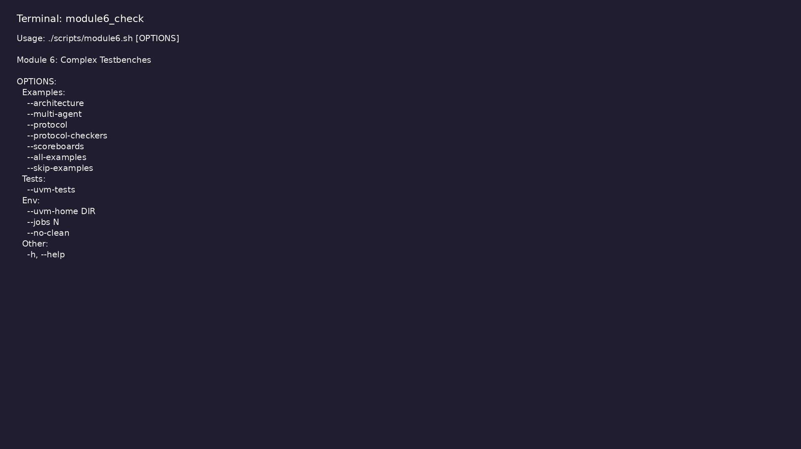
Module 6 self-check
$ ./scripts/module6.sh --help
learn_uvm2017_sv_verilator / Module 6
Notes:
Run from course repository root.

Slide 125
Exercise scaffold
./scripts/module6.sh --scaffold
learn_uvm2017_sv_verilator / Module 6

Slide 126
Example 1: Testbench Architecture
• Transaction Class (`ArchTxn`): Base transaction with
address, data, and write/read control
• Sequencer (`ArchSequencer`): UVM sequencer for
transaction flow control
• Driver (`ArchDriver`): UVM driver that receives and
drives transactions
• Monitor (`ArchMonitor`): UVM monitor that observes
DUT behavior
• Agent (`ArchAgent`): UVM agent containing sequencer,
driver, and monitor
learn_uvm2017_sv_verilator / Module 6
Notes:
module6/examples/architecture/README.md

Slide 127
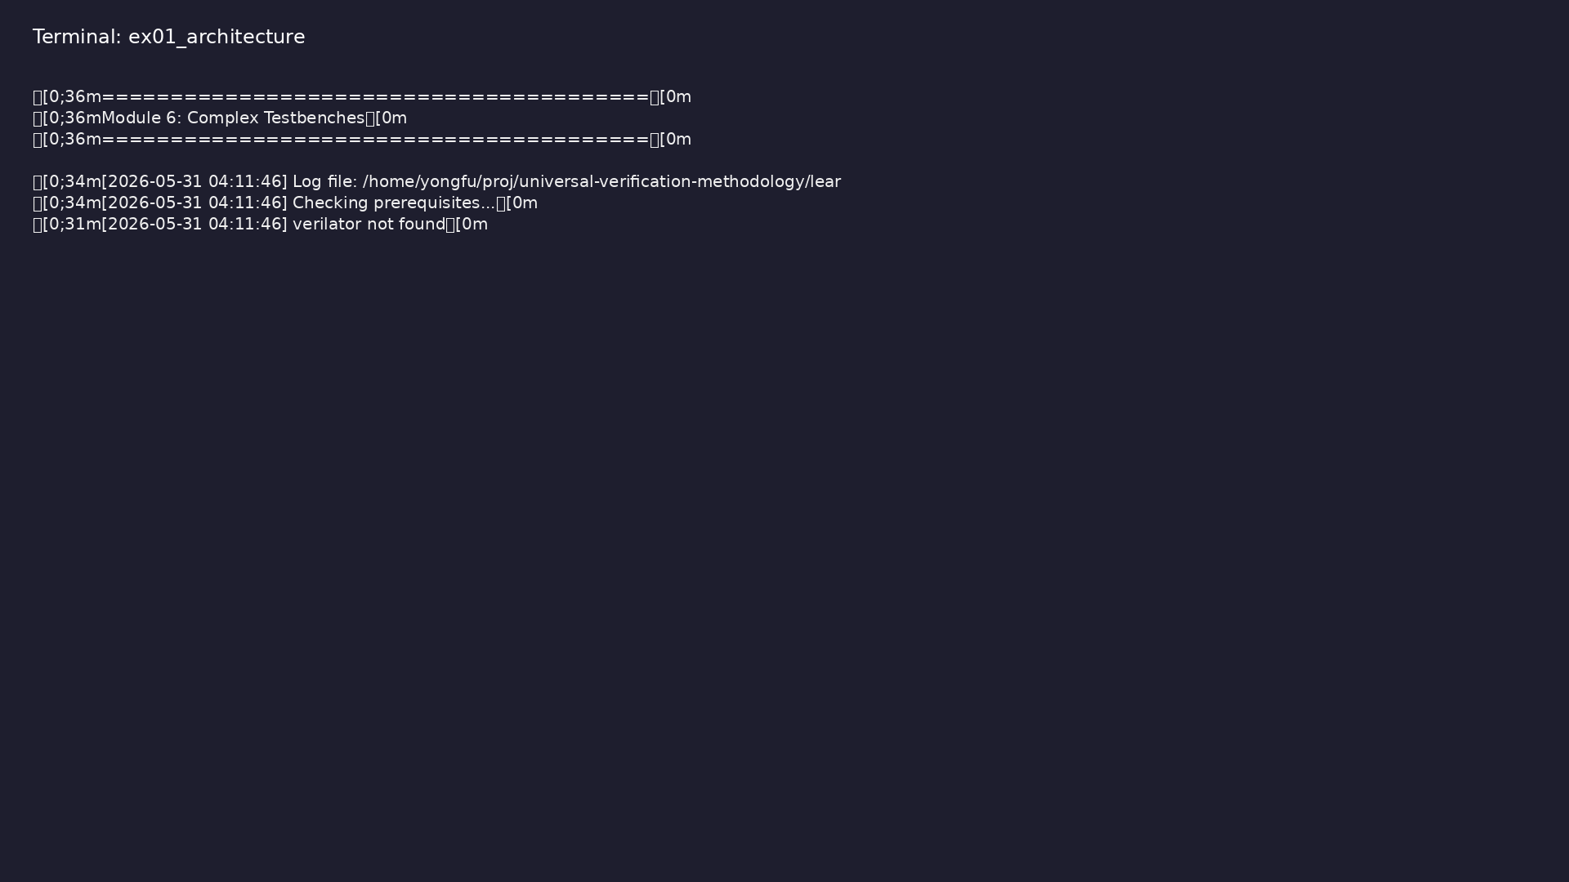
Demo: Testbench Architecture
$ ./scripts/module6.sh --architecture
learn_uvm2017_sv_verilator / Module 6
Notes:
Hands-on: module6/examples/architecture/

Slide 128
Example 2: Multi-Agent Environment
• Transaction (`MA_Txn`): Transaction with agent ID
and data fields
• Agent (`MA_Agent`): Parameterized agent with
configurable agent ID
• Virtual Sequence (`MA_VirtualSeq`): Coordinates
sequences across multiple sequencers
• Environment (`MA_Env`): Contains two agent instances
(a0 and a1)
• Test (`MultiAgentTest`): Orchestrates multi-agent
verification
learn_uvm2017_sv_verilator / Module 6
Notes:
module6/examples/multi_agent/README.md

Slide 129
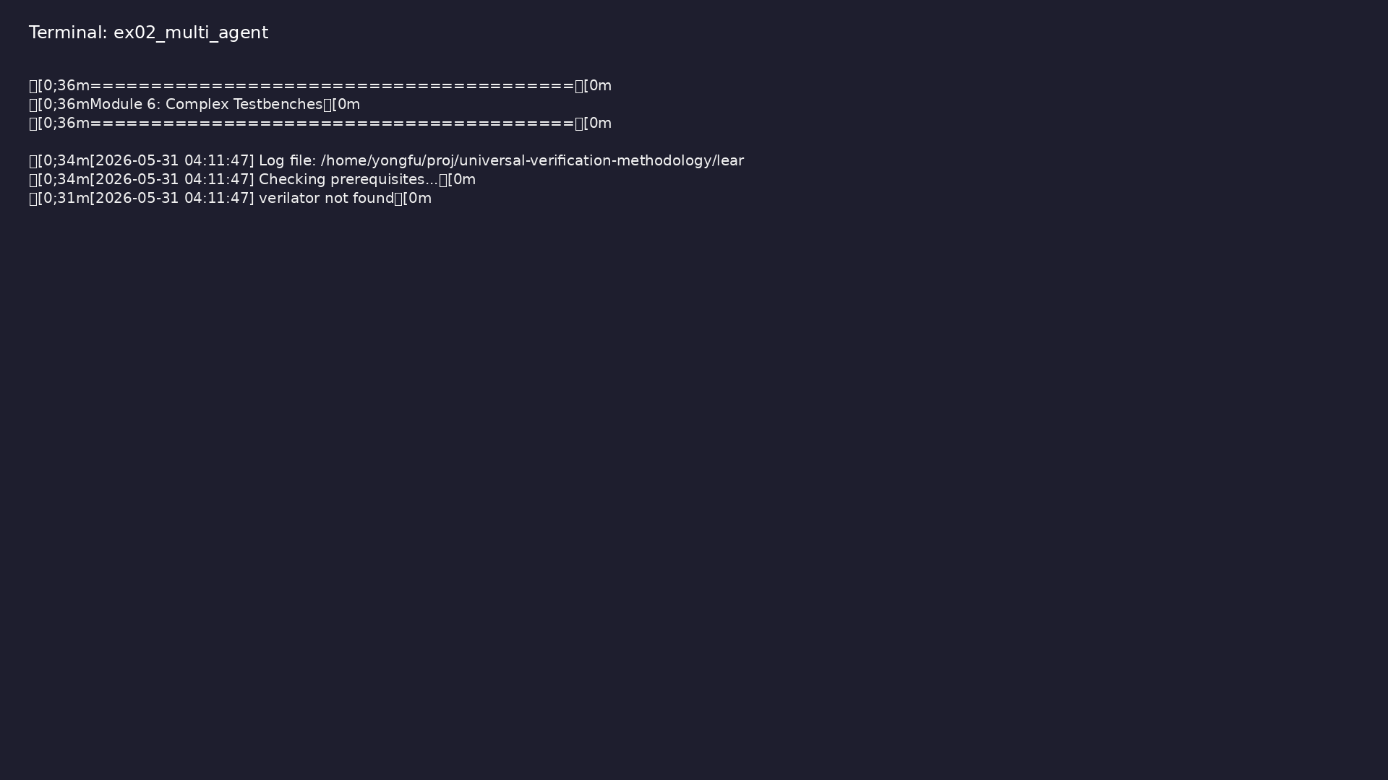
Demo: Multi-Agent Environment
$ ./scripts/module6.sh --multi-agent
learn_uvm2017_sv_verilator / Module 6
Notes:
Hands-on: module6/examples/multi_agent/

Slide 130
Example 3: Protocol Verification
• Interface (`axi_lite_if`): AXI4-Lite interface with
all required signals
• Transaction (`AxiTxn`): AXI transaction with
read/write, address, and data
• Driver (`AxiDriver`): Protocol-aware driver
implementing AXI4-Lite handshake protocol
• Monitor (`AxiMonitor`): Protocol monitor for
observing AXI transactions
• Environment (`ProtocolEnv`): Protocol verification
environment
learn_uvm2017_sv_verilator / Module 6
Notes:
module6/examples/protocol/README.md

Slide 131

Demo: Protocol Verification
$ ./scripts/module6.sh --protocol
learn_uvm2017_sv_verilator / Module 6
Notes:
Hands-on: module6/examples/protocol/

Slide 132
Example 4: Protocol Checkers
• Interface (`chk_if`): Simple handshake interface
with valid/ready signals
• Checker Component (`CheckerComp`): UVM component
that monitors protocol rules
• Protocol Rules: Valid must stay asserted until ready
(bounded wait)
• Test (`ProtocolCheckersTest`): Test that exercises
protocol checker
learn_uvm2017_sv_verilator / Module 6
Notes:
module6/examples/protocol_checkers/README.md

Slide 133
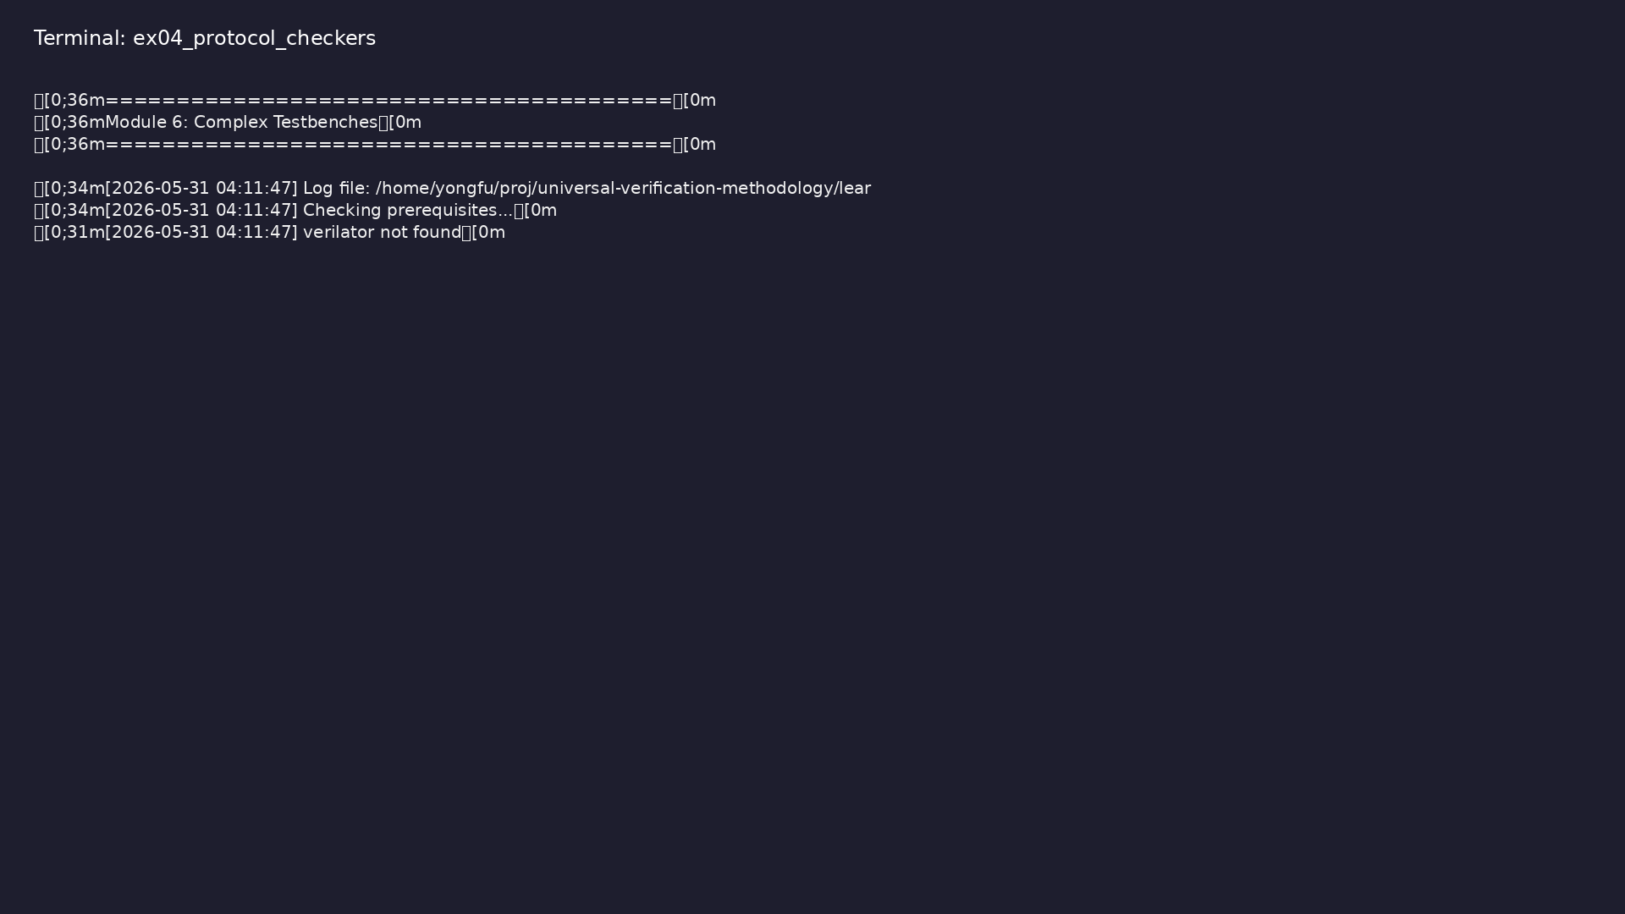
Demo: Protocol Checkers
$ ./scripts/module6.sh --protocol-checkers && cd
module6/examples/protocol_checkers && verilator -sv --cc --exe
--timing --trace protocol_checkers.sv protocol_checkers.cpp \ &&
-I"$…
learn_uvm2017_sv_verilator / Module 6
Notes:
Hands-on: module6/examples/protocol_checkers/

Slide 134
Example 5: Multi-Channel Scoreboards
• Transaction (`SB_Txn`): Scoreboard transaction with
stream ID, sequence number, and data
• Stream Producer (`StreamProducer`): Component that
generates transactions for a stream
• Multi-Channel Scoreboard (`MultiChannelScoreboard`):
Scoreboard that matches transactions from mult…
• Test (`ScoreboardsTest`): Test with two stream
producers and a scoreboard
learn_uvm2017_sv_verilator / Module 6
Notes:
module6/examples/scoreboards/README.md

Slide 135

Demo: Multi-Channel Scoreboards
$ ./scripts/module6.sh --scoreboards
learn_uvm2017_sv_verilator / Module 6
Notes:
Hands-on: module6/examples/scoreboards/

Slide 136
Common pitfalls
learn_uvm2017_sv_verilator / Module 6

Slide 137
Virtual Interface Not Set
• Problem: `uvm_fatal("NO_VIF", ...)` error
• Solution: Set interface in module before
`run_test()`
• Code: `uvm_config_db#(virtual if)::set(null, "*",
"vif", vif);`
learn_uvm2017_sv_verilator / Module 6
Notes:
From MODULE6 Common Pitfalls.

Slide 138
Agent Configuration Not Retrieved
• Problem: Agent uses default values
• Solution: Check return value, provide defaults
• Code: `if (!uvm_config_db#(int)::get(...)) agent_id
= 0;`
learn_uvm2017_sv_verilator / Module 6
Notes:
From MODULE6 Common Pitfalls.

Slide 139
Virtual Sequence References Not Set
• Problem: Null pointer exception
• Solution: Set sequencer references before starting
• Code: `vseq.seqr0 = env.a0.seqr; vseq.start(null);`
learn_uvm2017_sv_verilator / Module 6
Notes:
From MODULE6 Common Pitfalls.

Slide 140
Protocol Handshake Deadlock
• Problem: Simulation hangs waiting for READY
• Solution: Use bounded wait in protocol checker
• Code: `while (condition && cycles < max_cycles)`
learn_uvm2017_sv_verilator / Module 6
Notes:
From MODULE6 Common Pitfalls.

Slide 141
Scoreboard Memory Leak
• Problem: Unmatched transactions accumulate
• Solution: Delete matched transactions
• Code: `q0.delete(t.seq); q1.delete(t.seq);`
• Check: Virtual interface retrieved in
`build_phase()`
learn_uvm2017_sv_verilator / Module 6
Notes:
From MODULE6 Common Pitfalls.

Slide 142
Testbench Architecture
• Design a hierarchical testbench with multiple agents
• Implement component separation of concerns
• Create reusable agent and environment patterns
• Structure testbench for maintainability
learn_uvm2017_sv_verilator / Module 6
Notes:
From MODULE6 Common Pitfalls.

Slide 143
Practice & assessment
learn_uvm2017_sv_verilator / Module 6

Slide 144
What you should know (1/2)
• Design complex testbench architectures with
hierarchical component organization
• Coordinate multiple agents using virtual sequences
• Verify protocols using protocol-shaped drivers and
monitors
• Implement protocol checkers for compliance
verification
• Build multi-channel scoreboards for transaction
matching
• Apply production-quality testbench patterns
learn_uvm2017_sv_verilator / Module 6
Notes:
From MODULE6 Learning Outcomes.

Slide 145
What you should know (2/2)
• Create reusable verification components
• Structure testbenches for maintainability and
scalability
learn_uvm2017_sv_verilator / Module 6
Notes:
From MODULE6 Learning Outcomes.

Slide 146
Exercises
• Testbench Architecture
• Multi-Agent Coordination
• Protocol Verification
• Protocol Checkers
• Multi-Channel Scoreboards
learn_uvm2017_sv_verilator / Module 6

Slide 147
Assessment checklist
• Can design complex testbench architectures
• Can coordinate multiple agents
• Can verify protocols
• Can implement protocol checkers
• Can build multi-channel scoreboards
• Can apply production-quality testbench patterns
learn_uvm2017_sv_verilator / Module 6

Slide 148
Summary & next steps
• Build production-quality multi-agent testbenches
• Complete module6/CHECKLIST.md
• Review module6/EXAMPLES.md and run each lab
• Next: Next module in course
learn_uvm2017_sv_verilator / Module 6

