Slide 1
Module 7
Real-World Applications
learn_uvm2017_sv_verilator / Module 7

Slide 2
Learning objectives
• Apply UVM to real-world verification scenarios
learn_uvm2017_sv_verilator / Module 7

Slide 3
Prerequisites
• See module README
learn_uvm2017_sv_verilator / Module 7

Slide 4

Learning path
Apply UVM to real-world verification scenarios
learn_uvm2017_sv_verilator / Module 7

Slide 5
Overview
• This module applies UVM to real-world verification
scenarios including DMA verification, protocol v…
learn_uvm2017_sv_verilator / Module 7

Slide 6
Design architecture
learn_uvm2017_sv_verilator / Module 7

Slide 7

1. Real-world verification architecture (1/3)
• DMA path: CPU/config →
descriptor ring → bus master →
memory/peripheral
• Protocol path: serial frame →
byte stream → transaction →
scoreboard
• VIP encapsulates protocol
knowledge for reuse across
projects and modules
• `module7/dut/dma/simple_dma.v`
and `dut/protocols/uart.v`
anchor the labs
learn_uvm2017_sv_verilator / Module 7
Notes:
From MODULE7 Design Architecture.

Slide 8
1. Real-world verification architecture (2/3)
• DMA agent: Programs descriptors; monitors transfer
completion
• Protocol agents (UART/SPI/I2C): Bus-specific
driver/monitor/sequencer sets
• VIP package: Reusable agent + sequences + config for
a protocol
• Scoreboard / predictor: End-to-end data integrity
across DMA + peripheral
learn_uvm2017_sv_verilator / Module 7
Notes:
From MODULE7 Design Architecture.

Slide 9
1. Real-world verification architecture (3/3)
• Reference model: Software model of DMA or protocol
behavior
learn_uvm2017_sv_verilator / Module 7
Notes:
From MODULE7 Design Architecture.

Slide 10

2. VIP and reuse architecture (1/2)
• 1: VIP interface — Standardized
signal bundle + modport
• 2: VIP agent — Configurable
active/passive agent
• 3: VIP sequences — Library of
legal and stress sequences
• 4: Integration env —
Instantiates DUT + VIP +
scoreboard
learn_uvm2017_sv_verilator / Module 7
Notes:
From MODULE7 Design Architecture.

Slide 11
2. VIP and reuse architecture (2/2)
• 5: Test suite — Directed + random tests using VIP
API
learn_uvm2017_sv_verilator / Module 7
Notes:
From MODULE7 Design Architecture.

Slide 12

3. Module 7 application map (1/2)
• `examples/dma/` — descriptor
programming, transfer status,
interrupts
• `examples/protocols/` — UART,
SPI, I2C patterns (timing and
framing)
• `examples/vip/` — packaging
reusable verification IP
• `examples/best_practices/` —
naming, config, debug,
regression discipline
learn_uvm2017_sv_verilator / Module 7
Notes:
From MODULE7 Design Architecture.

Slide 13
3. Module 7 application map (2/2)
• `test_real_world_uvm.sv` — integrated scenario
combining subsystems
learn_uvm2017_sv_verilator / Module 7
Notes:
From MODULE7 Design Architecture.

Slide 14
RTL block diagram (reference)
Module 7: DUT hierarchy and signal flow.
learn_uvm2017_sv_verilator / Module 7

Slide 15
Verification / testbench diagram (reference)
Module 7: stimulus, observation, and checking.
learn_uvm2017_sv_verilator / Module 7

Slide 16
Execution & simulation flow
learn_uvm2017_sv_verilator / Module 7

Slide 17
How the example runs (toolchain)
• Makefile: Verilator + UVM_HOME compile RTL,
interface, and test_*.sv
• UVM phases: build → connect → run_test → report
(same pattern as Module 2)
• Sequence → driver → DUT → monitor → scoreboard (read
SCOREBOARD at end)
• Typical command: make SIM=verilator TEST=test_* (see
module7 demo slide)
• Loopback / hooks connect monitor observations to
scoreboard checks
learn_uvm2017_sv_verilator / Module 7
Notes:
From MODULE7 — execution and artifact layout.

Slide 18
Artifact flow (spec → sim) (1)
• 1: VIP interface — Standardized signal bundle +
modport
• 2: VIP agent — Configurable active/passive agent
• 3: VIP sequences — Library of legal and stress
sequences
• 4: Integration env — Instantiates DUT + VIP +
scoreboard
learn_uvm2017_sv_verilator / Module 7
Notes:
From MODULE7 — execution and artifact layout.

Slide 19
Artifact flow (spec → sim) (2)
• 5: Test suite — Directed + random tests using VIP
API
learn_uvm2017_sv_verilator / Module 7
Notes:
From MODULE7 — execution and artifact layout.

Slide 20
Example directory layout
• DMA agent: Programs descriptors; monitors transfer
completion
• Protocol agents (UART/SPI/I2C): Bus-specific
driver/monitor/sequencer sets
• VIP package: Reusable agent + sequences + config for
a protocol
• Scoreboard / predictor: End-to-end data integrity
across DMA + peripheral
• Reference model: Software model of DMA or protocol
behavior
learn_uvm2017_sv_verilator / Module 7
Notes:
Match each path to files under module/examples/.

Slide 21
Directed test execution sequence
• VIP config
• env build
• sequence library
• coverage + report
learn_uvm2017_sv_verilator / Module 7
Notes:
Follow this order when tracing waveforms or debugging.

Slide 22
Verification & testing methods
learn_uvm2017_sv_verilator / Module 7

Slide 23
1. Application-specific verification strategy
• DMA: descriptor alignment,
boundary lengths, error flags,
concurrent channels
• Serial protocols: baud/bit
timing, framing, parity, back-
to-back packets
• VIP usage: configure via object;
run standard sequences before
custom stress
• Directed tests prove basic
paths; random tests explore
corner combinations
learn_uvm2017_sv_verilator / Module 7
Notes:
From MODULE7 Verification & Testing Methods.

Slide 24
2. Production best practices (1/2)
• Centralize plusargs via CLP
(Module 8) for seed, verbosity,
test name
• Separate test intent (test
class) from reusable env (VIP +
env)
• Log protocol transactions at
UVM_MEDIUM; errors at UVM_LOW
• Regression:
`./scripts/module7.sh --all-
examples --uvm-tests`
learn_uvm2017_sv_verilator / Module 7
Notes:
From MODULE7 Verification & Testing Methods.

Slide 25
2. Production best practices (2/2)
• Closure: functional coverage bins hit + scoreboard
clean + VIP protocol clean
learn_uvm2017_sv_verilator / Module 7
Notes:
From MODULE7 Verification & Testing Methods.

Slide 26
Syllabus topics
learn_uvm2017_sv_verilator / Module 7

Slide 27
Protocol & design details
learn_uvm2017_sv_verilator / Module 7

Slide 28
Detail: Example 7.1: DMA Verification (`module7/examples/dma/dma.sv`)…
• Interface (`dma_if`): DMA interface with start,
done, addresses, length, and channel signals
• Transaction (`DmaTxn`): DMA transaction with source
address, destination address, length, and chann…
• Sequence (`DmaSeq`): DMA sequence generating random
DMA transfers
• Driver (`DmaDriver`): DMA driver implementing DMA
protocol
learn_uvm2017_sv_verilator / Module 7
Notes:
From MODULE7 Topics Covered — protocol/design depth.

Slide 29
Detail: Example 7.1: DMA Verification (`module7/examples/dma/dma.sv`)…
• Environment (`DmaEnv`): DMA verification environment
• Test (`DmaTest`): DMA verification test with simple
DMA DUT
• Method Signature: `function bit randomize();`
• Purpose: Generate random DMA transfer parameters
learn_uvm2017_sv_verilator / Module 7
Notes:
From MODULE7 Topics Covered — protocol/design depth.

Slide 30
Detail: Example 7.2: UART Verification (`module7/examples/protocols/u…
• Interface (`uart_if`): UART interface with TX/RX
signals and control
• Transaction (`UartTxn`): UART transaction with data
field
• Sequence (`UartSeq`): UART sequence generating
random UART transfers
• Driver (`UartDriver`): UART driver implementing UART
protocol
learn_uvm2017_sv_verilator / Module 7
Notes:
From MODULE7 Topics Covered — protocol/design depth.

Slide 31
Detail: Example 7.2: UART Verification (`module7/examples/protocols/u…
• Environment (`UartEnv`): UART verification
environment
• Test (`UartTest`): UART verification test with UART
DUT
• Method Signature:
• `task get_next_item(ref T item);` - Get transaction
from sequencer
learn_uvm2017_sv_verilator / Module 7
Notes:
From MODULE7 Topics Covered — protocol/design depth.

Slide 32
Detail: Example 7.3: SPI Verification (`module7/examples/protocols/sp…
• Test (`SpiExampleTest`): SPI verification test
scaffold
• UVM Pattern: Demonstrates UVM structure for SPI
verification
• SPI protocol verification patterns provide reusable
structure
• UVM scaffold for protocol verification enables rapid
development
learn_uvm2017_sv_verilator / Module 7
Notes:
From MODULE7 Topics Covered — protocol/design depth.

Slide 33
Detail: Example 7.3: SPI Verification (`module7/examples/protocols/sp…
• Protocol-specific testbench structure supports
future DUT integration
learn_uvm2017_sv_verilator / Module 7
Notes:
From MODULE7 Topics Covered — protocol/design depth.

Slide 34
Detail: Example 7.4: I2C Verification (`module7/examples/protocols/i2…
• Test (`I2cExampleTest`): I2C verification test
scaffold
• UVM Pattern: Demonstrates UVM structure for I2C
verification
• I2C protocol verification patterns provide reusable
structure
• UVM scaffold for protocol verification enables rapid
development
learn_uvm2017_sv_verilator / Module 7
Notes:
From MODULE7 Topics Covered — protocol/design depth.

Slide 35
Detail: Example 7.4: I2C Verification (`module7/examples/protocols/i2…
• Protocol-specific testbench structure supports
future DUT integration
learn_uvm2017_sv_verilator / Module 7
Notes:
From MODULE7 Topics Covered — protocol/design depth.

Slide 36
Detail: Example 7.5: VIP Development (`module7/examples/vip/vip.sv`)…
• Transaction (`VipTxn`): VIP transaction with payload
• Sequence (`VipSeq`): VIP sequence generating
transactions
• Driver (`VipDriver`): VIP driver
• Agent (`VipAgent`): VIP agent containing sequencer
and driver
learn_uvm2017_sv_verilator / Module 7
Notes:
From MODULE7 Topics Covered — protocol/design depth.

Slide 37
Detail: Example 7.5: VIP Development (`module7/examples/vip/vip.sv`)…
• Test (`VipTest`): VIP test demonstrating VIP usage
• Purpose: Package VIP components (sequencer + driver)
in agent
• Pattern: Agent encapsulates all VIP components
• Key: Standard UVM agent structure for reusability
learn_uvm2017_sv_verilator / Module 7
Notes:
From MODULE7 Topics Covered — protocol/design depth.

Slide 38
Detail: Example 7.6: Best Practices (`module7/examples/best_practices…
• Test (`BestPracticesTest`): Test demonstrating best
practices
• Phase Organization: Proper phase usage and logging
• Topology Printing: Component hierarchy visualization
• Logging Patterns: Structured logging for
maintainability
learn_uvm2017_sv_verilator / Module 7
Notes:
From MODULE7 Topics Covered — protocol/design depth.

Slide 39
Detail: Example 7.6: Best Practices (`module7/examples/best_practices…
• Purpose: Log execution flow through phases
• Pattern: Log at start of each phase
• Key: Consistent logging improves debugging
• Method Signature:
learn_uvm2017_sv_verilator / Module 7
Notes:
From MODULE7 Topics Covered — protocol/design depth.

Slide 40
Detail: DMA Transaction Randomization (1)
• Method Signature: `function bit randomize();`
• Return Type: `bit` (1 = success, 0 = failure)
• Purpose: Generate random DMA transfer parameters
• Usage: `void'(t.randomize() with { len inside
{[1:20]}; });`
learn_uvm2017_sv_verilator / Module 7
Notes:
From MODULE7 Topics Covered — protocol/design depth.

Slide 41
Detail: DMA Transaction Randomization (2)
• Parameters: None (randomizes all `rand` fields in
object)
• Constraints: Use `with { constraint_expression; }`
to limit values
• Example: `len inside {[1:20]}` constrains transfer
length to 1-20 bytes
• Key: `void'()` suppresses Verilator warning about
ignored return value
learn_uvm2017_sv_verilator / Module 7
Notes:
From MODULE7 Topics Covered — protocol/design depth.

Slide 42
Detail: DMA Protocol Implementation
• Pattern: Start pulse → Wait for done → Completion
• Key: `do-while` loop waits for `dma_done` pulse
learn_uvm2017_sv_verilator / Module 7
Notes:
From MODULE7 Topics Covered — protocol/design depth.

Slide 43
Detail: UART Protocol Implementation (1)
• Pattern: Data → Start → Wait for busy deassert →
Completion
• Key: Wait for `tx_busy` to deassert
• Event Control: `@(posedge clk)` - wait for positive
clock edge
• Non-blocking Assignment: `<=` - schedule assignment
for next time step
learn_uvm2017_sv_verilator / Module 7
Notes:
From MODULE7 Topics Covered — protocol/design depth.

Slide 44
Detail: UART Protocol Implementation (2)
• Do-While Loop: `do @(posedge clk); while
(condition);` - wait for condition
• Purpose: Enable loopback testing
• Use Case: Minimal smoke testing without external
device
learn_uvm2017_sv_verilator / Module 7
Notes:
From MODULE7 Topics Covered — protocol/design depth.

Slide 45
Detail: VIP Agent Packaging
• Purpose: Package VIP components for reusability
• Pattern: Agent encapsulates sequencer + driver
• Key: Standard UVM agent structure
learn_uvm2017_sv_verilator / Module 7
Notes:
From MODULE7 Topics Covered — protocol/design depth.

Slide 46
Detail: VIP Logging (1)
• Macro: `uvm_info(id, message, verbosity)`
• Function: `$sformatf(format, args)` → string
• Purpose: Log transaction with formatted message
• Format Specifiers:
learn_uvm2017_sv_verilator / Module 7
Notes:
From MODULE7 Topics Covered — protocol/design depth.

Slide 47
Detail: VIP Logging (2)
• `%02h` - 2-digit hexadecimal, zero-padded
• `%08h` - 8-digit hexadecimal, zero-padded
• `%0d` - Decimal, no padding
• `%s` - String
learn_uvm2017_sv_verilator / Module 7
Notes:
From MODULE7 Topics Covered — protocol/design depth.

Slide 48
Detail: Phase-Based Logging
• Purpose: Log execution flow through phases
• Pattern: Log at start of each phase
• Key: Consistent logging improves debugging
learn_uvm2017_sv_verilator / Module 7
Notes:
From MODULE7 Topics Covered — protocol/design depth.

Slide 49
Detail: Topology Printing (1)
• Method Signature:
• `static function uvm_root get();` → returns
singleton root
• `function void print_topology();` → prints hierarchy
• Purpose: Visualize component hierarchy
learn_uvm2017_sv_verilator / Module 7
Notes:
From MODULE7 Topics Covered — protocol/design depth.

Slide 50
Detail: Topology Printing (2)
• Timing: Call in `end_of_elaboration_phase()` (after
all connections)
• Output: Prints complete component tree with
hierarchical paths
• Usage:
learn_uvm2017_sv_verilator / Module 7
Notes:
From MODULE7 Topics Covered — protocol/design depth.

Slide 51
Detail: end_of_elaboration_phase (1)
• Phase Type: Build-time phase (function, executes
bottom-up)
• Purpose: Final elaboration tasks after all
connections
• Timing: After `connect_phase()`, before
`start_of_simulation_phase()`
• Common Uses:
learn_uvm2017_sv_verilator / Module 7
Notes:
From MODULE7 Topics Covered — protocol/design depth.

Slide 52
Detail: end_of_elaboration_phase (2)
• Print topology
• Validate configuration
• Final checks
• Setup verification
learn_uvm2017_sv_verilator / Module 7
Notes:
From MODULE7 Topics Covered — protocol/design depth.

Slide 53
Verification flow (reference)
Stimulus, DUT response, and check points for this module.
learn_uvm2017_sv_verilator / Module 7

Slide 54
1. DMA Verification (1/9)
• DMA Controller Verification
• DMA transaction modeling
• DMA protocol implementation
• DMA sequence generation
• DMA result checking
• DMA Patterns
learn_uvm2017_sv_verilator / Module 7
Notes:
From MODULE7 Topics Covered.

Slide 55
1. DMA Verification (2/9)
• DMA transfer patterns
• Multi-channel DMA
• DMA completion handling
• DMA error handling
• Interface (`dma_if`): DMA interface with start,
done, addresses, length, and channel signals
• Transaction (`DmaTxn`): DMA transaction with source
address, destination address, length, and chann…
learn_uvm2017_sv_verilator / Module 7
Notes:
From MODULE7 Topics Covered.

Slide 56
1. DMA Verification (3/9)
• Sequence (`DmaSeq`): DMA sequence generating random
DMA transfers
• Driver (`DmaDriver`): DMA driver implementing DMA
protocol
• Environment (`DmaEnv`): DMA verification environment
• Test (`DmaTest`): DMA verification test with simple
DMA DUT
• Method Signature: `function bit randomize();`
• Purpose: Generate random DMA transfer parameters
learn_uvm2017_sv_verilator / Module 7
Notes:
From MODULE7 Topics Covered.

Slide 57
1. DMA Verification (4/9)
• Constraints: Use `with { constraint; }` to limit
values
• Key: `len inside {[1:20]}` constrains transfer
length
• Method Signature:
• `task get_next_item(ref T item);` - Get transaction
from sequencer
• `task item_done();` - Signal transaction completion
• Purpose: Implement DMA protocol with start/done
handshake
learn_uvm2017_sv_verilator / Module 7
Notes:
From MODULE7 Topics Covered.

Slide 58
1. DMA Verification (5/9)
• Protocol Flow:
• Key: `do-while` loop waits for `dma_done` pulse
(blocking wait)
• Timing: Start signal is one clock cycle pulse
• Blocking Behavior: `get_next_item()` blocks until
sequencer provides transaction, `item_done()` unb…
• Completion Detection: Wait for `dma_done` signal
assertion (may take multiple clock cycles)
• Method Signature: `task body();` (no parameters, no
return)
learn_uvm2017_sv_verilator / Module 7
Notes:
From MODULE7 Topics Covered.

Slide 59
1. DMA Verification (6/9)
• Purpose: Generate and send multiple DMA transfers to
sequencer
• Execution Flow:
• Key: `repeat` loop creates multiple transactions
sequentially
• Blocking Behavior:
• `start_item()` blocks until sequencer grants access
• `finish_item()` blocks until driver completes
transaction (may take many cycles)
learn_uvm2017_sv_verilator / Module 7
Notes:
From MODULE7 Topics Covered.

Slide 60
1. DMA Verification (7/9)
• Transaction Lifetime:
• Created in loop
• Sent to sequencer via `start_item()`
• Driver processes it (drives signals, waits for DMA
done)
• Driver signals completion via `item_done()`
• `finish_item()` returns, loop continues
learn_uvm2017_sv_verilator / Module 7
Notes:
From MODULE7 Topics Covered.

Slide 61
1. DMA Verification (8/9)
• Constraint: `len inside {[1:20]}` ensures reasonable
transfer lengths
• DMA transaction modeling captures transfer semantics
• DMA protocol implementation handles start/done
handshake
• DMA sequence generation creates realistic transfer
scenarios
• DMA result checking verifies transfer completion
• DMA Protocol: Start pulse → Wait for done →
Completion
learn_uvm2017_sv_verilator / Module 7
Notes:
From MODULE7 Topics Covered.

Slide 62
1. DMA Verification (9/9)
• Transaction Flow: Sequence → Sequencer → Driver →
DUT
• Completion Detection: Wait for `dma_done` signal
assertion
• DMA transaction generation
• DMA protocol execution
• DMA transfer completion
• UVM report summary
learn_uvm2017_sv_verilator / Module 7
Notes:
From MODULE7 Topics Covered.

Slide 63
2. Protocol Verification (1/9)
• UART Verification
• UART protocol modeling
• Serial communication verification
• Loopback testing
• UART-specific patterns
• SPI Verification
learn_uvm2017_sv_verilator / Module 7
Notes:
From MODULE7 Topics Covered.

Slide 64
2. Protocol Verification (2/9)
• SPI protocol verification patterns
• UVM scaffold for SPI
• Protocol-specific testbench structure
• I2C Verification
• I2C protocol verification patterns
• UVM scaffold for I2C
learn_uvm2017_sv_verilator / Module 7
Notes:
From MODULE7 Topics Covered.

Slide 65
2. Protocol Verification (3/9)
• Protocol-specific testbench structure
• Interface (`uart_if`): UART interface with TX/RX
signals and control
• Transaction (`UartTxn`): UART transaction with data
field
• Sequence (`UartSeq`): UART sequence generating
random UART transfers
• Driver (`UartDriver`): UART driver implementing UART
protocol
• Environment (`UartEnv`): UART verification
environment
learn_uvm2017_sv_verilator / Module 7
Notes:
From MODULE7 Topics Covered.

Slide 66
2. Protocol Verification (4/9)
• Test (`UartTest`): UART verification test with UART
DUT
• Method Signature:
• `task get_next_item(ref T item);` - Get transaction
from sequencer
• `task item_done();` - Signal transaction completion
• Purpose: Implement UART TX protocol
• Protocol Flow:
learn_uvm2017_sv_verilator / Module 7
Notes:
From MODULE7 Topics Covered.

Slide 67
2. Protocol Verification (5/9)
• Key: Wait for `tx_busy` to deassert (transmission
complete)
• Timing: Start signal is one clock cycle pulse
• Blocking Behavior: `get_next_item()` blocks until
sequencer provides transaction, `item_done()` unb…
• Completion Detection: Wait for `tx_busy` signal
deassertion (may take many clock cycles for serial…
• UART Characteristics: Serial transmission takes time
(one bit per baud period)
• Purpose: Enable loopback testing
learn_uvm2017_sv_verilator / Module 7
Notes:
From MODULE7 Topics Covered.

Slide 68
2. Protocol Verification (6/9)
• Pattern: `assign rx = tx` creates loopback path
• Use Case: Minimal smoke testing without external
device
• UART protocol modeling captures serial communication
• Serial communication verification tests TX/RX paths
• Loopback testing enables minimal smoke testing
• Protocol-specific patterns provide reusable
verification components
learn_uvm2017_sv_verilator / Module 7
Notes:
From MODULE7 Topics Covered.

Slide 69
2. Protocol Verification (7/9)
• UART Protocol: Data → Start → Wait for busy →
Completion
• Loopback Pattern: TX output connected to RX input
• Busy Signal: Wait for `tx_busy` deassertion
• UART transaction generation
• UART protocol execution
• UART TX/RX operation
learn_uvm2017_sv_verilator / Module 7
Notes:
From MODULE7 Topics Covered.

Slide 70
2. Protocol Verification (8/9)
• Loopback verification
• Test (`SpiExampleTest`): SPI verification test
scaffold
• UVM Pattern: Demonstrates UVM structure for SPI
verification
• SPI protocol verification patterns provide reusable
structure
• UVM scaffold for protocol verification enables rapid
development
• Protocol-specific testbench structure supports
future DUT integration
learn_uvm2017_sv_verilator / Module 7
Notes:
From MODULE7 Topics Covered.

Slide 71
2. Protocol Verification (9/9)
• Test (`I2cExampleTest`): I2C verification test
scaffold
• UVM Pattern: Demonstrates UVM structure for I2C
verification
• I2C protocol verification patterns provide reusable
structure
• UVM scaffold for protocol verification enables rapid
development
• Protocol-specific testbench structure supports
future DUT integration
learn_uvm2017_sv_verilator / Module 7
Notes:
From MODULE7 Topics Covered.

Slide 72
3. VIP Development (1/6)
• VIP Architecture
• VIP component organization
• VIP packaging patterns
• VIP reuse strategies
• VIP configuration
• VIP Components
learn_uvm2017_sv_verilator / Module 7
Notes:
From MODULE7 Topics Covered.

Slide 73
3. VIP Development (2/6)
• Transaction classes
• Sequence classes
• Driver and monitor
• Agent packaging
• Transaction (`VipTxn`): VIP transaction with payload
• Sequence (`VipSeq`): VIP sequence generating
transactions
learn_uvm2017_sv_verilator / Module 7
Notes:
From MODULE7 Topics Covered.

Slide 74
3. VIP Development (3/6)
• Driver (`VipDriver`): VIP driver
• Agent (`VipAgent`): VIP agent containing sequencer
and driver
• Test (`VipTest`): VIP test demonstrating VIP usage
• Purpose: Package VIP components (sequencer + driver)
in agent
• Pattern: Agent encapsulates all VIP components
• Key: Standard UVM agent structure for reusability
learn_uvm2017_sv_verilator / Module 7
Notes:
From MODULE7 Topics Covered.

Slide 75
3. VIP Development (4/6)
• Purpose: VIP driver with structured logging
• Logging: Use `uvm_info` with formatted messages
• Key: `$sformatf()` for formatted string generation
• Purpose: Demonstrate VIP usage in test
• Pattern: Create VIP agent, use its sequencer
• Key: VIP agent is reusable component
learn_uvm2017_sv_verilator / Module 7
Notes:
From MODULE7 Topics Covered.

Slide 76
3. VIP Development (5/6)
• VIP architecture enables reusable verification
components
• VIP component organization provides clear structure
• VIP packaging patterns support easy integration
• VIP reuse strategies improve productivity
• VIP Packaging: Transaction + Sequence + Driver +
Agent
• Reusability: VIP agent can be instantiated in any
test
learn_uvm2017_sv_verilator / Module 7
Notes:
From MODULE7 Topics Covered.

Slide 77
3. VIP Development (6/6)
• Structured Logging: Use `uvm_info` with formatted
messages
• VIP transaction generation
• VIP agent operation
• VIP packaging demonstration
• VIP reuse pattern
learn_uvm2017_sv_verilator / Module 7
Notes:
From MODULE7 Topics Covered.

Slide 78
4. Best Practices (1/10)
• Code Organization
• Component organization
• File structure
• Module organization
• Package organization
• Naming Conventions
learn_uvm2017_sv_verilator / Module 7
Notes:
From MODULE7 Topics Covered.

Slide 79
4. Best Practices (2/10)
• Component naming
• Variable naming
• File naming
• Test naming
• Logging and Debugging
• Structured logging
learn_uvm2017_sv_verilator / Module 7
Notes:
From MODULE7 Topics Covered.

Slide 80
4. Best Practices (3/10)
• Phase-based logging
• Topology visualization
• Debug techniques
• Test (`BestPracticesTest`): Test demonstrating best
practices
• Phase Organization: Proper phase usage and logging
• Topology Printing: Component hierarchy visualization
learn_uvm2017_sv_verilator / Module 7
Notes:
From MODULE7 Topics Covered.

Slide 81
4. Best Practices (4/10)
• Logging Patterns: Structured logging for
maintainability
• Purpose: Log execution flow through phases
• Pattern: Log at start of each phase
• Key: Consistent logging improves debugging
• Method Signature:
• `static function uvm_root get();` → returns
singleton root instance
learn_uvm2017_sv_verilator / Module 7
Notes:
From MODULE7 Topics Covered.

Slide 82
4. Best Practices (5/10)
• `function void print_topology();` → prints hierarchy
• Purpose: Visualize component hierarchy for debugging
• Timing: Call in `end_of_elaboration_phase()` (after
all connections)
• Output: Prints complete component tree with
hierarchical paths
• Output Format:
• Key: Helps debug component structure and connections
learn_uvm2017_sv_verilator / Module 7
Notes:
From MODULE7 Topics Covered.

Slide 83
4. Best Practices (6/10)
• When to Use:
• After all components created
• After all connections made
• When debugging component hierarchy issues
• To verify testbench structure
• Benefits:
learn_uvm2017_sv_verilator / Module 7
Notes:
From MODULE7 Topics Covered.

Slide 84
4. Best Practices (7/10)
• Visual representation of testbench structure
• Helps identify missing components
• Verifies hierarchical naming
• Aids in debugging connection issues
• Method Signature: `function void
end_of_elaboration_phase(uvm_phase phase);`
• Phase Type: Build-time phase (function, executes
bottom-up)
learn_uvm2017_sv_verilator / Module 7
Notes:
From MODULE7 Topics Covered.

Slide 85
4. Best Practices (8/10)
• Purpose: Final elaboration tasks after all
connections
• Common Uses: Print topology, validate configuration,
final checks
• Timing: After `connect_phase()`, before
`start_of_simulation_phase()`
• Code organization improves maintainability
• Naming conventions enhance readability
• Phase-based logging provides clear execution flow
learn_uvm2017_sv_verilator / Module 7
Notes:
From MODULE7 Topics Covered.

Slide 86
4. Best Practices (9/10)
• Topology visualization aids debugging
• Phase Logging: Log at start of each phase
• Topology Printing: Use `print_topology()` in
`end_of_elaboration_phase()`
• Structured Logging: Use consistent message IDs and
formats
• end_of_elaboration_phase: Use for final checks and
topology printing
• Phase-based logging
learn_uvm2017_sv_verilator / Module 7
Notes:
From MODULE7 Topics Covered.

Slide 87
4. Best Practices (10/10)
• Component topology printing
• Best practices demonstration
• Structured logging output
learn_uvm2017_sv_verilator / Module 7
Notes:
From MODULE7 Topics Covered.

Slide 88
5. System-Level Verification (1/24)
• Multi-DUT Verification
• Multiple DUT instantiation
• Multi-DUT coordination
• System integration
• System-level testing
• Real-World Patterns
learn_uvm2017_sv_verilator / Module 7
Notes:
From MODULE7 Topics Covered.

Slide 89
5. System-Level Verification (2/24)
• Practical verification scenarios
• Production-quality testbenches
• Maintainable verification environments
• Scalable verification solutions
• Method Signature: `function bit randomize();`
• Return Type: `bit` (1 = success, 0 = failure)
learn_uvm2017_sv_verilator / Module 7
Notes:
From MODULE7 Topics Covered.

Slide 90
5. System-Level Verification (3/24)
• Purpose: Generate random DMA transfer parameters
• Usage: `void'(t.randomize() with { len inside
{[1:20]}; });`
• Parameters: None (randomizes all `rand` fields in
object)
• Constraints: Use `with { constraint_expression; }`
to limit values
• Example: `len inside {[1:20]}` constrains transfer
length to 1-20 bytes
• Key: `void'()` suppresses Verilator warning about
ignored return value
learn_uvm2017_sv_verilator / Module 7
Notes:
From MODULE7 Topics Covered.

Slide 91
5. System-Level Verification (4/24)
• Constraint Syntax:
• `len inside {[1:20]}` - Range constraint
• `len inside {1, 2, 4, 8, 16}` - Set constraint
• `len > 0 && len < 100` - Boolean constraint
• Randomization Order:
• Pattern: Start pulse → Wait for done → Completion
learn_uvm2017_sv_verilator / Module 7
Notes:
From MODULE7 Topics Covered.

Slide 92
5. System-Level Verification (5/24)
• Key: `do-while` loop waits for `dma_done` pulse
• Pattern: Data → Start → Wait for busy deassert →
Completion
• Key: Wait for `tx_busy` to deassert
• Event Control: `@(posedge clk)` - wait for positive
clock edge
• Non-blocking Assignment: `<=` - schedule assignment
for next time step
• Do-While Loop: `do @(posedge clk); while
(condition);` - wait for condition
learn_uvm2017_sv_verilator / Module 7
Notes:
From MODULE7 Topics Covered.

Slide 93
5. System-Level Verification (6/24)
• Purpose: Enable loopback testing
• Use Case: Minimal smoke testing without external
device
• Purpose: Package VIP components for reusability
• Pattern: Agent encapsulates sequencer + driver
• Key: Standard UVM agent structure
• Macro: `uvm_info(id, message, verbosity)`
learn_uvm2017_sv_verilator / Module 7
Notes:
From MODULE7 Topics Covered.

Slide 94
5. System-Level Verification (7/24)
• Function: `$sformatf(format, args)` → string
• Purpose: Log transaction with formatted message
• Format Specifiers:
• `%02h` - 2-digit hexadecimal, zero-padded
• `%08h` - 8-digit hexadecimal, zero-padded
• `%0d` - Decimal, no padding
learn_uvm2017_sv_verilator / Module 7
Notes:
From MODULE7 Topics Covered.

Slide 95
5. System-Level Verification (8/24)
• `%s` - String
• Verbosity Levels: UVM_NONE, UVM_LOW, UVM_MEDIUM,
UVM_HIGH, UVM_FULL
• Message IDs: Use consistent IDs for filtering and
debugging
• Purpose: Log execution flow through phases
• Pattern: Log at start of each phase
• Key: Consistent logging improves debugging
learn_uvm2017_sv_verilator / Module 7
Notes:
From MODULE7 Topics Covered.

Slide 96
5. System-Level Verification (9/24)
• Method Signature:
• `static function uvm_root get();` → returns
singleton root
• `function void print_topology();` → prints hierarchy
• Purpose: Visualize component hierarchy
• Timing: Call in `end_of_elaboration_phase()` (after
all connections)
• Output: Prints complete component tree with
hierarchical paths
learn_uvm2017_sv_verilator / Module 7
Notes:
From MODULE7 Topics Covered.

Slide 97
5. System-Level Verification (10/24)
• Usage:
• Phase Type: Build-time phase (function, executes
bottom-up)
• Purpose: Final elaboration tasks after all
connections
• Timing: After `connect_phase()`, before
`start_of_simulation_phase()`
• Common Uses:
• Print topology
learn_uvm2017_sv_verilator / Module 7
Notes:
From MODULE7 Topics Covered.

Slide 98
5. System-Level Verification (11/24)
• Validate configuration
• Final checks
• Setup verification
• Pattern: `forever #period clk = ~clk;`
• Purpose: Generate continuous clock signal
• Period: `#period` determines clock period (half
period per edge)
learn_uvm2017_sv_verilator / Module 7
Notes:
From MODULE7 Topics Covered.

Slide 99
5. System-Level Verification (12/24)
• Key: `forever` loop runs indefinitely
• Pattern: `repeat(n) @(posedge clk);`
• Purpose: Wait for n clock cycles
• Usage: Reset sequences, initialization delays
• Key: `repeat` loop with event control
• Pattern: Set ConfigDB before `run_test()`
learn_uvm2017_sv_verilator / Module 7
Notes:
From MODULE7 Topics Covered.

Slide 100
5. System-Level Verification (13/24)
• Purpose: Configure components before test starts
• Key: Use `null` context and `"*"` wildcard for
global configuration
• Operator: `@(event)` - event control
• Purpose: Wait for event to occur
• Behavior: Blocks until event occurs
• Usage: Clock synchronization, signal change
detection
learn_uvm2017_sv_verilator / Module 7
Notes:
From MODULE7 Topics Covered.

Slide 101
5. System-Level Verification (14/24)
• Operator: `#time` - delay operator
• Purpose: Wait for specified time
• Behavior: Blocks for specified time units
• Usage: Clock generation, timing delays
• Operator: `<=` - non-blocking assignment
• Purpose: Schedule assignment for next simulation
time step
learn_uvm2017_sv_verilator / Module 7
Notes:
From MODULE7 Topics Covered.

Slide 102
5. System-Level Verification (15/24)
• Behavior: All non-blocking assignments in current
time step execute together
• Usage: Clock-synchronized signal assignments
• Statement: `repeat(n) statement;`
• Purpose: Execute statement n times
• Behavior: Loops n times
• Usage: Reset sequences, initialization delays
learn_uvm2017_sv_verilator / Module 7
Notes:
From MODULE7 Topics Covered.

Slide 103
5. System-Level Verification (16/24)
• Statement: `forever statement;`
• Purpose: Execute statement indefinitely
• Behavior: Infinite loop
• Usage: Clock generation, continuous monitoring
• Function: `$sformatf(format, args...)` → string
• Purpose: Format string with variables
learn_uvm2017_sv_verilator / Module 7
Notes:
From MODULE7 Topics Covered.

Slide 104
5. System-Level Verification (17/24)
• Return: Formatted string
• Usage: Logging, debugging, reporting
• Problem: Simulation hangs waiting for `dma_done`
• Solution: Check DUT implementation, add timeout
• Code:
• Prevention: Add bounded wait with timeout checking
learn_uvm2017_sv_verilator / Module 7
Notes:
From MODULE7 Topics Covered.

Slide 105
5. System-Level Verification (18/24)
• Problem: Simulation hangs waiting for `tx_busy`
deassert
• Solution: Check DUT implementation, verify clock
• Code:
• Prevention: Add bounded wait with timeout checking
• Problem: `print_topology()` shows nothing
• Solution: Call in `end_of_elaboration_phase()`, not
earlier
learn_uvm2017_sv_verilator / Module 7
Notes:
From MODULE7 Topics Covered.

Slide 106
5. System-Level Verification (19/24)
• Code: Must be after `connect_phase()` completes
• Check: Verify all components created in
`build_phase()`
• Problem: VIP agent hardcoded for specific use
• Solution: Use ConfigDB for configuration, avoid
hardcoded values
• Code:
• Problem: Too many log messages
learn_uvm2017_sv_verilator / Module 7
Notes:
From MODULE7 Topics Covered.

Slide 107
5. System-Level Verification (20/24)
• Solution: Use appropriate verbosity levels
• Code: `UVM_MEDIUM` for normal, `UVM_HIGH` for
detailed
• Control: Set verbosity via
`+UVM_VERBOSITY=UVM_MEDIUM`
• Problem: Simulation hangs, no progress
• Solution: Verify clock generation in module
• Code:
learn_uvm2017_sv_verilator / Module 7
Notes:
From MODULE7 Topics Covered.

Slide 108
5. System-Level Verification (21/24)
• Check: Clock must be in `initial` block, not
`always` block
• Problem: `uvm_fatal("NO_VIF", ...)` error
• Solution: Set interface before `run_test()`
• Code:
• Timing: ConfigDB set → run_test() → component
build_phase() retrieves
• Problem: DUT stuck in reset
learn_uvm2017_sv_verilator / Module 7
Notes:
From MODULE7 Topics Covered.

Slide 109
5. System-Level Verification (22/24)
• Solution: Verify reset sequence completes
• Code:
• Check: DUT `dma_done` signal implementation
• Check: Clock running correctly
• Check: Reset sequence completed
• Check: Address/length values valid
learn_uvm2017_sv_verilator / Module 7
Notes:
From MODULE7 Topics Covered.

Slide 110
5. System-Level Verification (23/24)
• Check: DUT `tx_busy` signal implementation
• Check: Clock running correctly
• Check: Loopback connection (if used)
• Check: Data values valid
• Check: Called in `end_of_elaboration_phase()`
• Check: All components created in `build_phase()`
learn_uvm2017_sv_verilator / Module 7
Notes:
From MODULE7 Topics Covered.

Slide 111
5. System-Level Verification (24/24)
• Check: All connections made in `connect_phase()`
• Check: Virtual interface set via ConfigDB
• Check: Agent configuration retrieved correctly
• Check: Sequencer/driver connections made
learn_uvm2017_sv_verilator / Module 7
Notes:
From MODULE7 Topics Covered.

Slide 112
Run: Example 7.1: DMA Verification
./scripts/module7.sh --dma
cd module7/examples/dma
verilator -sv --cc --exe --timing --trace dma.sv dma.cpp \
-I"$UVM_HOME" +incdir+"$UVM_HOME" +define+UVM_NO_DPI \
"$UVM_HOME/uvm_pkg.sv" ../dut/dma/simple_dma.v --top-module dma
make -C obj_dir -f Vdma.mk
./obj_dir/Vdma
learn_uvm2017_sv_verilator / Module 7
Notes:
Execute from course root or example directory — see docs/MODULE7.md.

Slide 113
Run: Example 7.2: UART Verification
./scripts/module7.sh --protocols
cd module7/examples/protocols
verilator -sv --cc --exe --timing --trace uart_example.sv
uart_example.cpp \
-I"$UVM_HOME" +incdir+"$UVM_HOME" +define+UVM_NO_DPI \
"$UVM_HOME/uvm_pkg.sv" ../dut/protocols/uart.v --top-module uart_example
make -C obj_dir -f Vuart_example.mk
./obj_dir/Vuart_example
learn_uvm2017_sv_verilator / Module 7
Notes:
Execute from course root or example directory — see docs/MODULE7.md.

Slide 114
Run: Example 7.5: VIP Development
./scripts/module7.sh --vip
cd module7/examples/vip
verilator -sv --cc --exe --timing --trace vip.sv vip.cpp \
-I"$UVM_HOME" +incdir+"$UVM_HOME" +define+UVM_NO_DPI \
"$UVM_HOME/uvm_pkg.sv" --top-module vip
make -C obj_dir -f Vvip.mk
./obj_dir/Vvip
learn_uvm2017_sv_verilator / Module 7
Notes:
Execute from course root or example directory — see docs/MODULE7.md.

Slide 115
Run: Example 7.6: Best Practices
./scripts/module7.sh --best-practices
cd module7/examples/best_practices
verilator -sv --cc --exe --timing --trace best_practices.sv
best_practices.cpp \
-I"$UVM_HOME" +incdir+"$UVM_HOME" +define+UVM_NO_DPI \
"$UVM_HOME/uvm_pkg.sv" --top-module best_practices
make -C obj_dir -f Vbest_practices.mk
./obj_dir/Vbest_practices
learn_uvm2017_sv_verilator / Module 7
Notes:
Execute from course root or example directory — see docs/MODULE7.md.

Slide 116
Hands-on examples
learn_uvm2017_sv_verilator / Module 7

Slide 117

Module 7 self-check
$ ./scripts/module7.sh --help
learn_uvm2017_sv_verilator / Module 7
Notes:
Run from course repository root.

Slide 118
Example 1: DMA Verification
• Interface (`dma_if`): DMA interface with start,
done, addresses, length, and channel signals
• Transaction (`DmaTxn`): DMA transaction with source
address, destination address, length, and chann…
• Sequence (`DmaSeq`): DMA sequence generating random
DMA transfers
• Driver (`DmaDriver`): DMA driver implementing DMA
protocol
• Environment (`DmaEnv`): DMA verification environment
learn_uvm2017_sv_verilator / Module 7
Notes:
module7/examples/dma/README.md

Slide 119
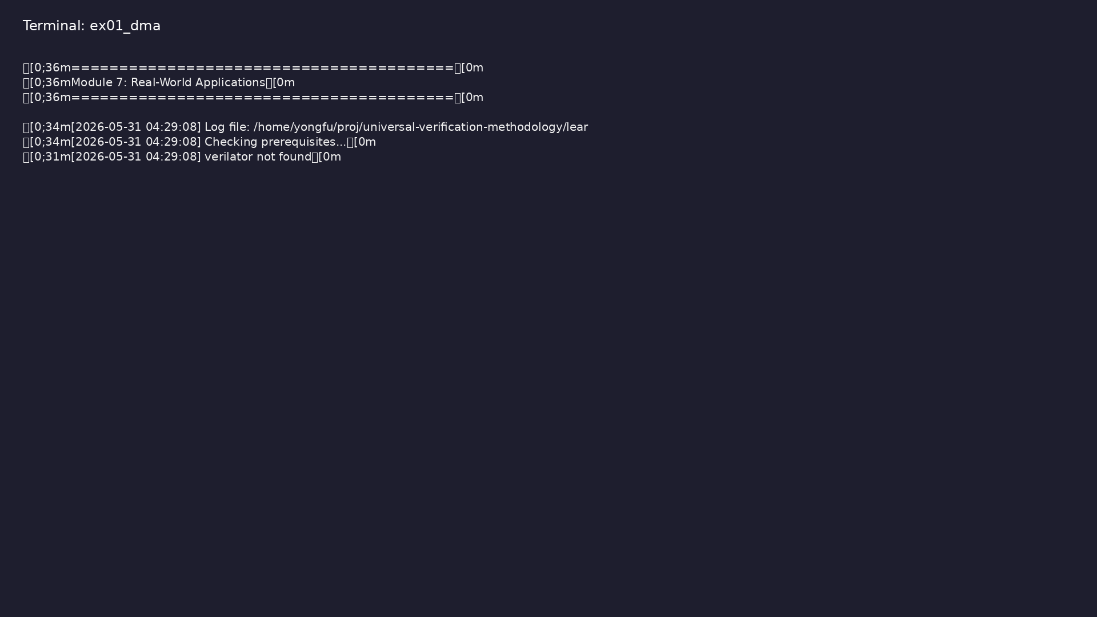
Demo: DMA Verification
$ ./scripts/module7.sh --dma
learn_uvm2017_sv_verilator / Module 7
Notes:
Hands-on: module7/examples/dma/

Slide 120
Example 2: UART Verification
• Interface (`uart_if`): UART interface with TX/RX
signals and control
• Transaction (`UartTxn`): UART transaction with data
field
• Sequence (`UartSeq`): UART sequence generating
random UART transfers
• Driver (`UartDriver`): UART driver implementing UART
protocol
• Environment (`UartEnv`): UART verification
environment
learn_uvm2017_sv_verilator / Module 7
Notes:
module7/examples/protocols/README.md

Slide 121
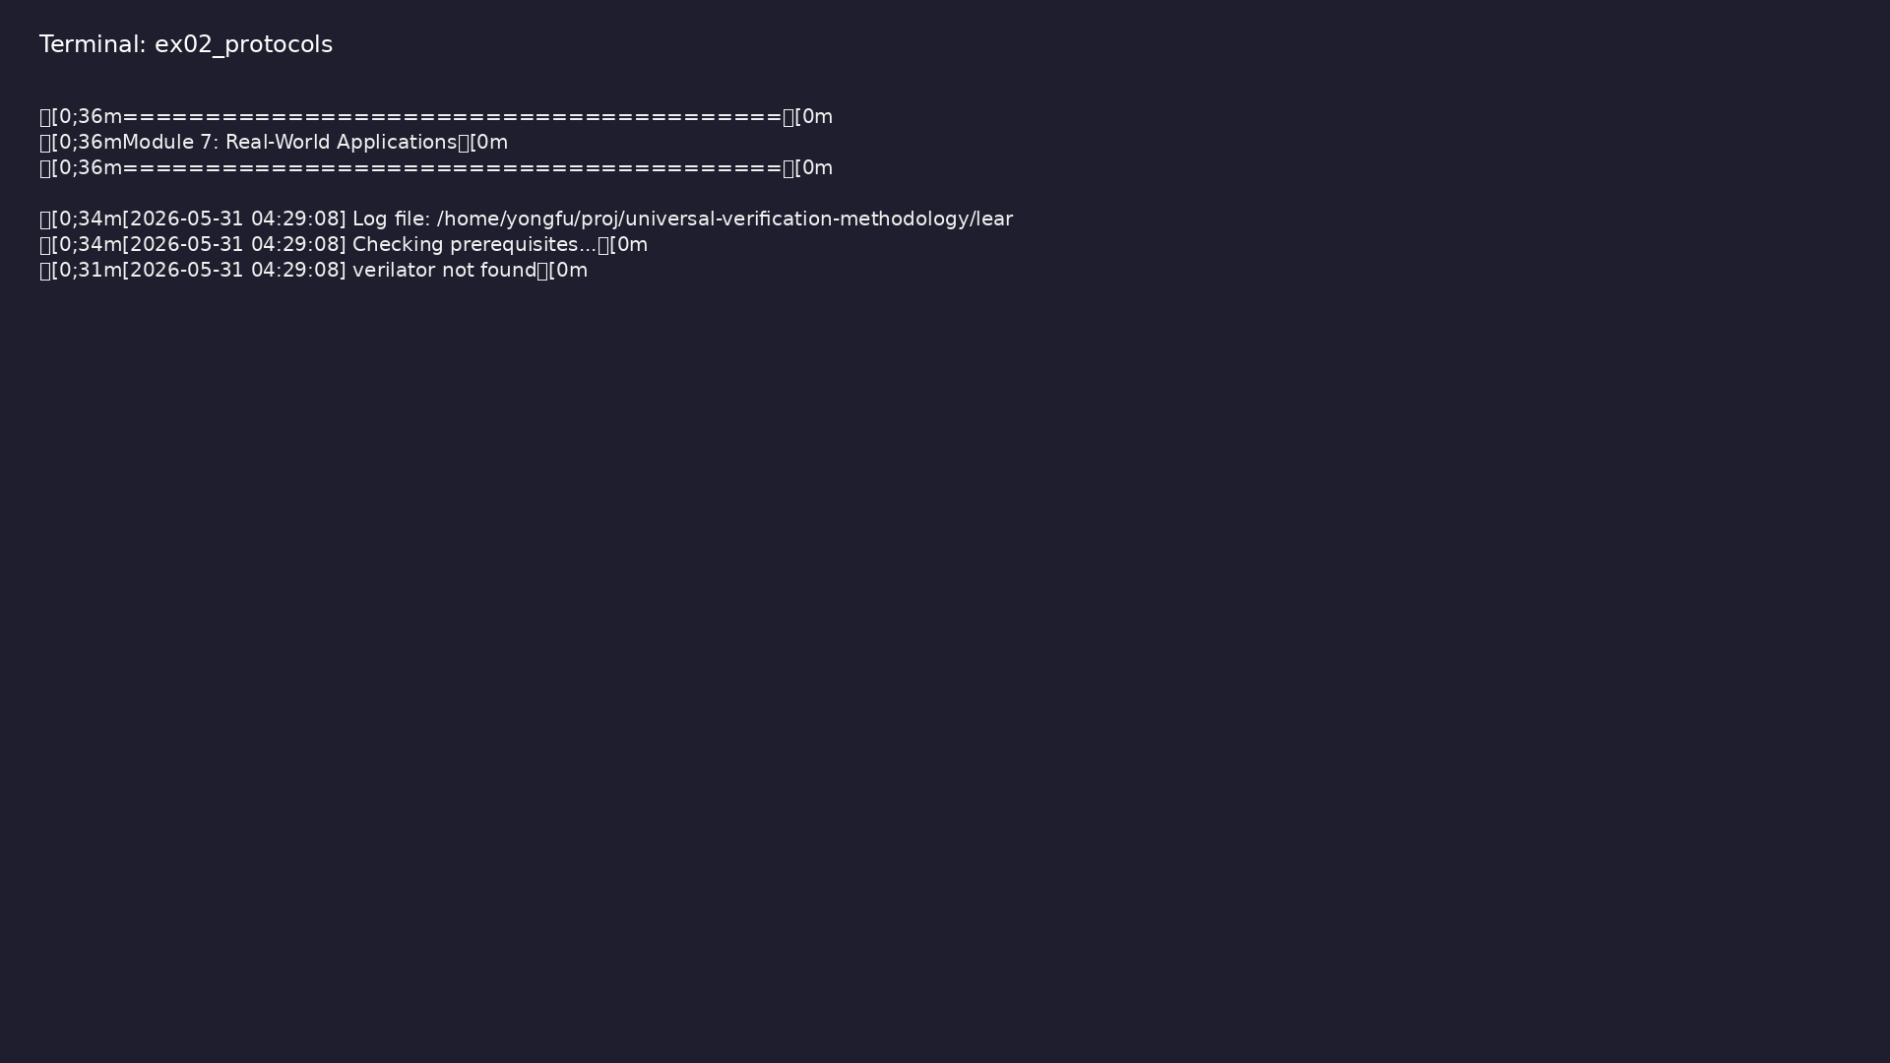
Demo: UART Verification
$ ./scripts/module7.sh --protocols
learn_uvm2017_sv_verilator / Module 7
Notes:
Hands-on: module7/examples/protocols/

Slide 122
Example 3: SPI Verification
• Test (`SpiExampleTest`): SPI verification test
scaffold
• UVM Pattern: Demonstrates UVM structure for SPI
verification
learn_uvm2017_sv_verilator / Module 7
Notes:
module7/examples/protocols/README.md

Slide 123

Demo: SPI Verification
$ ./scripts/module7.sh --protocols
learn_uvm2017_sv_verilator / Module 7
Notes:
Hands-on: module7/examples/protocols/

Slide 124
Example 4: I2C Verification
• Test (`I2cExampleTest`): I2C verification test
scaffold
• UVM Pattern: Demonstrates UVM structure for I2C
verification
learn_uvm2017_sv_verilator / Module 7
Notes:
module7/examples/protocols/README.md

Slide 125

Demo: I2C Verification
$ ./scripts/module7.sh --protocols
learn_uvm2017_sv_verilator / Module 7
Notes:
Hands-on: module7/examples/protocols/

Slide 126
Example 5: VIP Development
• Transaction (`VipTxn`): VIP transaction with payload
• Sequence (`VipSeq`): VIP sequence generating
transactions
• Driver (`VipDriver`): VIP driver
• Agent (`VipAgent`): VIP agent containing sequencer
and driver
• Test (`VipTest`): VIP test demonstrating VIP usage
learn_uvm2017_sv_verilator / Module 7
Notes:
module7/examples/vip/README.md

Slide 127
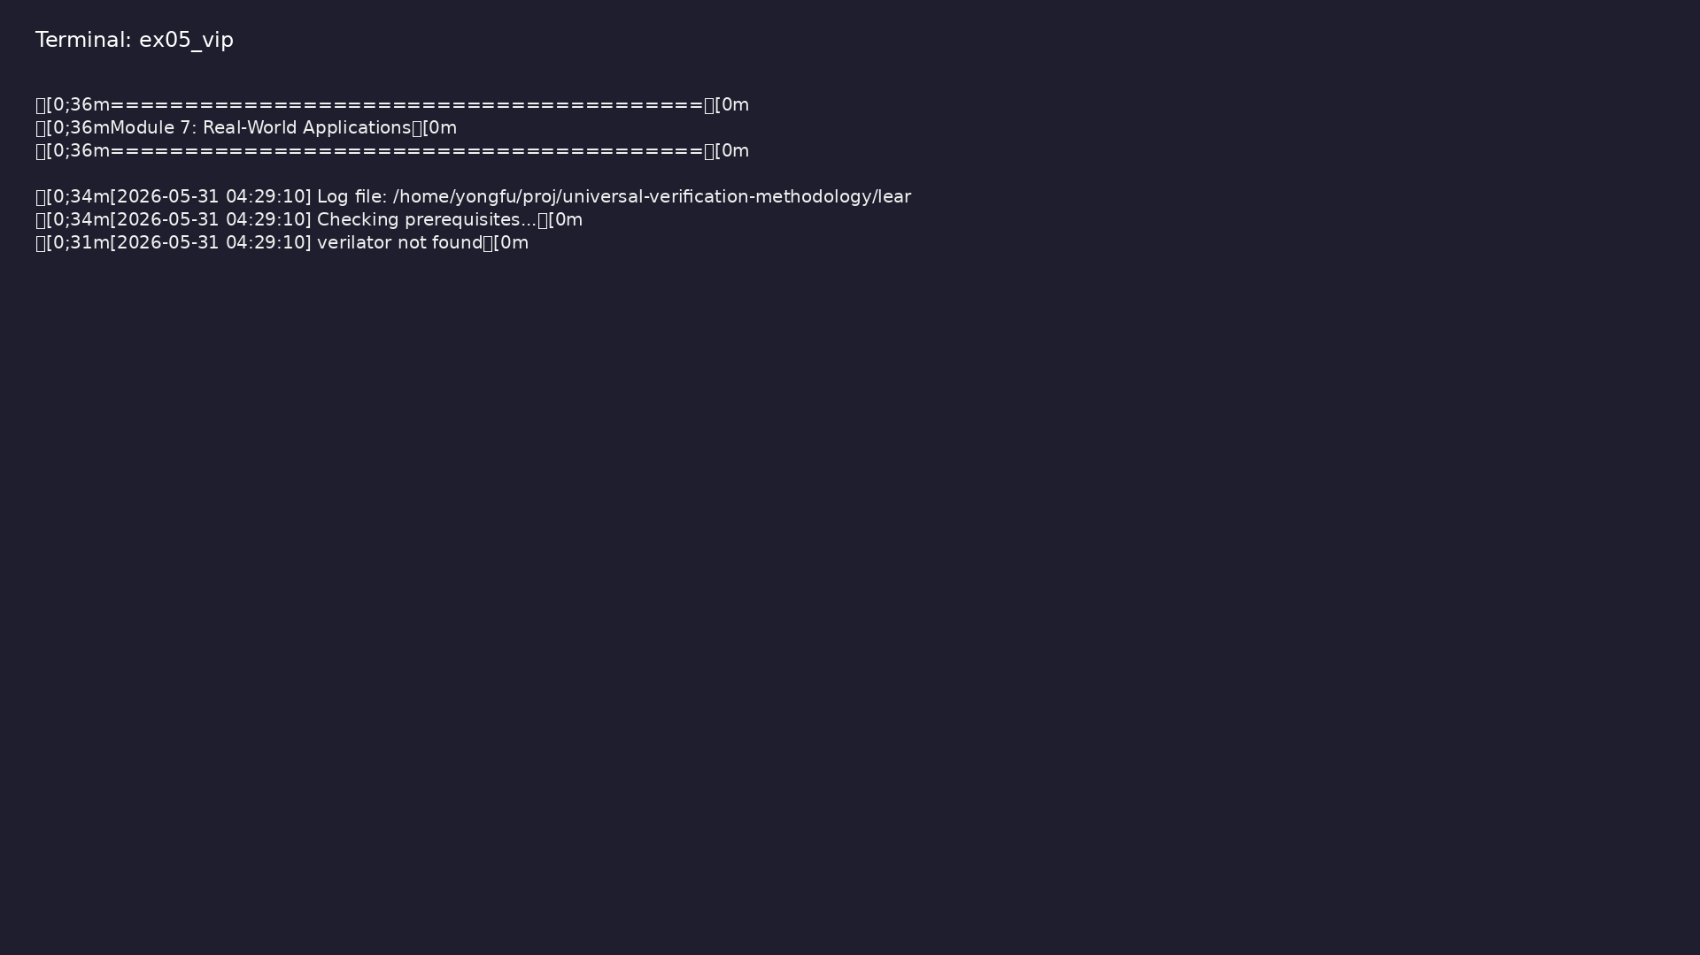
Demo: VIP Development
$ ./scripts/module7.sh --vip && cd module7/examples/vip && verilator
-sv --cc --exe --timing --trace vip.sv vip.cpp \ && -I"$UVM_HOME"
+incdir+"$UVM_HOME" +define+UVM_NO_DPI \
learn_uvm2017_sv_verilator / Module 7
Notes:
Hands-on: module7/examples/vip/

Slide 128
Example 6: Best Practices
• Test (`BestPracticesTest`): Test demonstrating best
practices
• Phase Organization: Proper phase usage and logging
• Topology Printing: Component hierarchy visualization
• Logging Patterns: Structured logging for
maintainability
learn_uvm2017_sv_verilator / Module 7
Notes:
module7/examples/best_practices/README.md

Slide 129
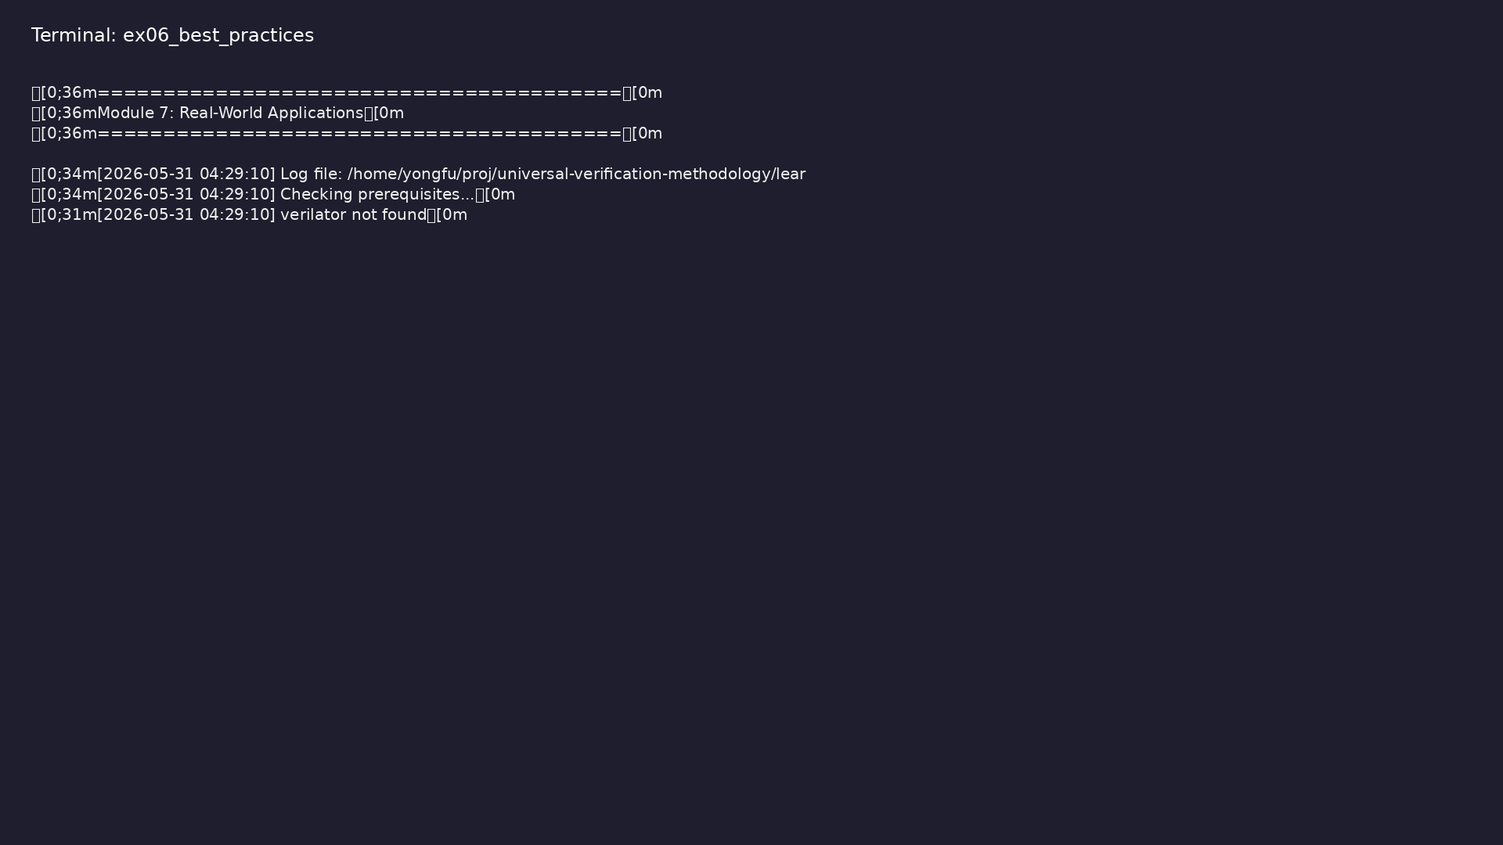
Demo: Best Practices
$ ./scripts/module7.sh --best-practices
learn_uvm2017_sv_verilator / Module 7
Notes:
Hands-on: module7/examples/best_practices/

Slide 130
Common pitfalls
learn_uvm2017_sv_verilator / Module 7

Slide 131
DMA Done Not Detected
• Problem: Simulation hangs waiting for `dma_done`
• Solution: Check DUT implementation, add timeout
• Code:
• Prevention: Add bounded wait with timeout checking
learn_uvm2017_sv_verilator / Module 7
Notes:
From MODULE7 Common Pitfalls.

Slide 132
UART Busy Never Deasserts
• Problem: Simulation hangs waiting for `tx_busy`
deassert
• Solution: Check DUT implementation, verify clock
• Code:
• Prevention: Add bounded wait with timeout checking
learn_uvm2017_sv_verilator / Module 7
Notes:
From MODULE7 Common Pitfalls.

Slide 133
Topology Not Printed
• Problem: `print_topology()` shows nothing
• Solution: Call in `end_of_elaboration_phase()`, not
earlier
• Code: Must be after `connect_phase()` completes
• Check: Verify all components created in
`build_phase()`
learn_uvm2017_sv_verilator / Module 7
Notes:
From MODULE7 Common Pitfalls.

Slide 134
VIP Agent Not Reusable
• Problem: VIP agent hardcoded for specific use
• Solution: Use ConfigDB for configuration, avoid
hardcoded values
• Code:
learn_uvm2017_sv_verilator / Module 7
Notes:
From MODULE7 Common Pitfalls.

Slide 135
Phase Logging Too Verbose
• Problem: Too many log messages
• Solution: Use appropriate verbosity levels
• Code: `UVM_MEDIUM` for normal, `UVM_HIGH` for
detailed
• Control: Set verbosity via
`+UVM_VERBOSITY=UVM_MEDIUM`
learn_uvm2017_sv_verilator / Module 7
Notes:
From MODULE7 Common Pitfalls.

Slide 136
Clock Not Running
• Problem: Simulation hangs, no progress
• Solution: Verify clock generation in module
• Code:
• Check: Clock must be in `initial` block, not
`always` block
learn_uvm2017_sv_verilator / Module 7
Notes:
From MODULE7 Common Pitfalls.

Slide 137
Practice & assessment
learn_uvm2017_sv_verilator / Module 7

Slide 138
What you should know (1/2)
• Verify complex designs (DMA, protocols) using UVM
patterns
• Develop reusable VIP with proper architecture
• Apply best practices for code organization and
maintainability
• Perform system-level verification with multiple DUTs
• Create production-quality testbenches
• Understand protocol verification patterns
learn_uvm2017_sv_verilator / Module 7
Notes:
From MODULE7 Learning Outcomes.

Slide 139
What you should know (2/2)
• Package verification components for reuse
• Use topology printing for debugging
• Implement phase-based logging
• Apply real-world verification patterns
learn_uvm2017_sv_verilator / Module 7
Notes:
From MODULE7 Learning Outcomes.

Slide 140
Exercises
• DMA Verification
• Protocol Verification
• VIP Development
• Best Practices
• System-Level Verification
learn_uvm2017_sv_verilator / Module 7

Slide 141
Assessment checklist
• Can verify complex designs (DMA, protocols)
• Can develop reusable VIP
• Can apply best practices
• Can perform system-level verification
• Can create production-quality testbenches
• Understands protocol verification patterns
learn_uvm2017_sv_verilator / Module 7

Slide 142
Summary & next steps
• Apply UVM to real-world verification scenarios
• Complete module7/CHECKLIST.md
• Review module7/EXAMPLES.md and run each lab
• Next: Next module in course
learn_uvm2017_sv_verilator / Module 7

