Slide 1
Module 0
Installation and Setup
learn_uvm_pyuvm / Module 0

Slide 2
Learning objectives
• Set up development environment and verify
installation
learn_uvm_pyuvm / Module 0

Slide 3
Prerequisites
• See module README
learn_uvm_pyuvm / Module 0

Slide 4

Learning path
Set up development environment and verify installation
learn_uvm_pyuvm / Module 0

Slide 5
Overview
• This module covers the complete setup of your
verification environment, including all required
tool…
learn_uvm_pyuvm / Module 0

Slide 6
How to learn this module
learn_uvm_pyuvm / Module 0

Slide 7
Suggested learning path
• Clone the repo and read `docs/MODULE0.md` for
toolchain expectations (GCC/Clang, Python 3.10+,
Git,…
• Confirm you have build essentials for Verilator
(`sudo apt install build-essential` on Debian/Ubunt…
• Decide install modes: Verilator
(`submodule`/`system`/`source`), cocotb/pyuvm (`pip`
or `submodule`…
• Plan for a project-local venv at `.venv`; activate
it (`source .venv/bin/activate`) before any Pyth…
• No RTL or simulation in this module — success means
every tool probe passes before Module 1
learn_uvm_pyuvm / Module 0
Notes:
From docs/MODULE0.md — read guides before running demos.

Slide 8
Design architecture
learn_uvm_pyuvm / Module 0

Slide 9

1. Toolchain and repository layout
• Course root: `docs/`,
`moduleN/`,
`scripts/moduleN.sh`,
`media/moduleN/` for slides and
video
• Python 3.10+ virtual environment
(`.venv`) holds cocotb, pyuvm,
and course dependencies
• Verilator compiles RTL when
modules include `dut/`; cocotb
bridges Python testbenches to
the simula…
• Orchestrator
`scripts/module0.sh` installs
and verifies Verilator, cocotb,
and pyuvm in order
learn_uvm_pyuvm / Module 0
Notes:
From MODULE0 Design Architecture.

Slide 10

2. Verification stack architecture
• Bottom layer: OS, compiler
(GCC/Clang), Make/Ninja, Git
• Simulator layer: Verilator
(default) produces fast cycle-
accurate models from
SystemVerilog/Verilog
• Testbench layer: cocotb
(coroutine-driven) and pyuvm
(UVM 1.2 in Python) share the
same venv
• Artifacts: logs under module
runs, optional VCD/FST waveforms
from Make targets in later
modules
learn_uvm_pyuvm / Module 0
Notes:
From MODULE0 Design Architecture.

Slide 11
3. Execution pipeline
• Install: `module0.sh` → dependency scripts → venv
population → version probes (no compile/sim/check…
• Build: not applicable — no DUT or Makefile targets
in Module 0
• Sim: not applicable — cocotb/Verilator coupling is
validated only via import and `--version` probes
• Check: `--verify-only` aggregates pass/fail; all
three tools must report OK before Module 1 labs
learn_uvm_pyuvm / Module 0
Notes:
From MODULE0 Design Architecture.

Slide 12
4. What is not in this module
• No DUT or UVM hierarchy — focus is reproducible
environment setup
• Later modules attach Python tests to RTL under
`moduleN/dut/`
• Self-check only validates tools; functional
verification starts in Module 1
• Waveforms, scoreboards, and regression Makefiles
appear from Module 1 onward
learn_uvm_pyuvm / Module 0
Notes:
From MODULE0 Design Architecture.

Slide 13
Install orchestrator (excerpt)
#!/bin/bash
# Module 0: Installation and Setup Orchestrator
# This script orchestrates the installation of all tools required for
Module 0
# Usage: ./module0.sh [OPTIONS]
set -euo pipefail
# Colors for output
RED='\033[0;31m'
GREEN='\033[0;32m'
YELLOW='\033[1;33m'
BLUE='\033[0;34m'
CYAN='\033[0;36m'
NC='\033[0m' # No Color
# ...
learn_uvm_pyuvm / Module 0
Notes:
Entry point for Verilator, cocotb, and pyuvm install order.

Slide 14
Key files to study
learn_uvm_pyuvm / Module 0

Slide 15
Open these in the repo
• `scripts/module0.sh` — orchestrator for Verilator,
cocotb, and pyuvm install plus verification prob…
• `scripts/install_verilator.sh` — builds or links
Verilator per `--verilator-mode`
• `scripts/install_cocotb.sh` — installs cocotb into
`.venv` or submodule tree
• `scripts/install_pyuvm.sh` — installs pyuvm and pins
course Python dependencies
• `docs/MODULE0.md` — assessment checklist mapping
environment readiness to course progress
• `requirements.txt` / `pyproject.toml` — dependency
versions consumed by pip install paths
learn_uvm_pyuvm / Module 0
Notes:
Trace while running module0/EXAMPLES.md labs.

Slide 16
Verification & testing methods
learn_uvm_pyuvm / Module 0

Slide 17
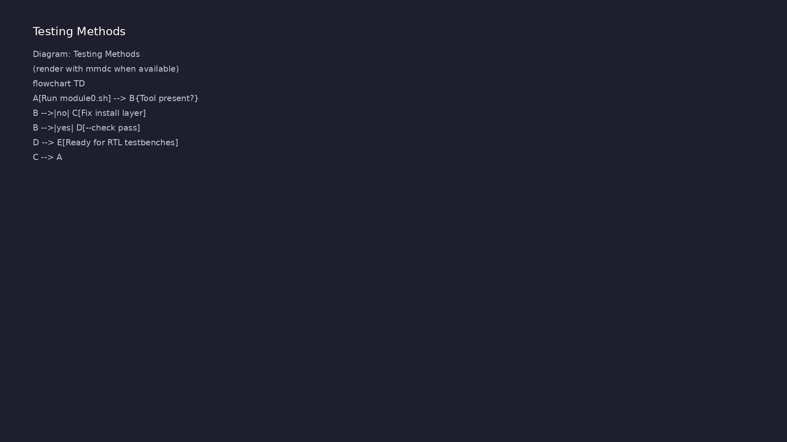
1. Installation verification strategy
• Run `./scripts/module0.sh` for
full install or per-tool flags
(`--verilator-mode`, `--cocotb-
mode`,…
• `./scripts/module0.sh --verify-
only` confirms `verilator`,
`cocotb-config`, and importable
`pyuvm`
• Version probes (`verilator
--version`, `python -c 'import
cocotb'`) catch PATH and venv
mistakes ea…
learn_uvm_pyuvm / Module 0
Notes:
From MODULE0 Verification & Testing Methods.

Slide 18
2. Smoke and regression mindset
• Treat install as the first regression: every tool
must pass before Module 1 labs
• Re-run `--verify-only` after OS updates or submodule
pulls
• Document failures in install logs; fix one layer at
a time (compiler → Verilator → Python packages)
learn_uvm_pyuvm / Module 0
Notes:
From MODULE0 Verification & Testing Methods.

Slide 19
3. Step-by-step lab execution
• 1. From repo root: `./scripts/module0.sh` (or
selective `--skip-*` flags if tools already
installed)
• 2. Activate venv: `source .venv/bin/activate`
• 3. Verify: `./scripts/module0.sh --verify-only` —
expect green checks for Verilator, cocotb, pyuvm
• 4. Optional manual probes: `verilator --version`,
`cocotb-config --version`, `python3 -c 'import py…
• 5. Record pass in MODULE0 assessment checklist;
proceed to Module 1 only when all probes succeed
learn_uvm_pyuvm / Module 0
Notes:
From MODULE0 Verification & Testing Methods.

Slide 20
4. Closure for Module 0
• Pass criteria: all install scripts succeed and
`--verify-only` reports required tools present
• Optional: run a minimal cocotb compile in Module 1
only after Module 0 passes
• Assessment checklist in `docs/MODULE0.md` maps
environment readiness to course progress
learn_uvm_pyuvm / Module 0
Notes:
From MODULE0 Verification & Testing Methods.

Slide 21
Syllabus topics
learn_uvm_pyuvm / Module 0

Slide 22
1. System Requirements and Prerequisites (1/3)
• Operating System Support
• Linux (Ubuntu/Debian, CentOS/RHEL, Fedora)
• macOS (Intel and Apple Silicon)
• Windows (WSL2 recommended)
• Hardware Requirements
• Minimum 4GB RAM (8GB+ recommended)
learn_uvm_pyuvm / Module 0
Notes:
From MODULE0 Topics Covered.

Slide 23
1. System Requirements and Prerequisites (2/3)
• 10GB free disk space
• Multi-core processor recommended
• Software Prerequisites
• Python 3.8+ (3.10+ recommended)
• Git
• C/C++ compiler (GCC, Clang, or MSVC)
learn_uvm_pyuvm / Module 0
Notes:
From MODULE0 Topics Covered.

Slide 24
1. System Requirements and Prerequisites (3/3)
• Make or Ninja build system
learn_uvm_pyuvm / Module 0
Notes:
From MODULE0 Topics Covered.

Slide 25
2. Python Environment Setup (1/3)
• Python Installation
• Installing Python 3.10+ on Linux
• Installing Python 3.10+ on macOS
• Installing Python 3.10+ on Windows/WSL2
• Verifying Python installation
• Virtual Environment Management
learn_uvm_pyuvm / Module 0
Notes:
From MODULE0 Topics Covered.

Slide 26
2. Python Environment Setup (2/3)
• Using `venv` (Python built-in)
• Using `conda` (Anaconda/Miniconda)
• Using `uv` or `rye` (modern Python package managers)
• Best practices for virtual environments
• Package Management
• pip basics
learn_uvm_pyuvm / Module 0
Notes:
From MODULE0 Topics Covered.

Slide 27
2. Python Environment Setup (3/3)
• requirements.txt management
• Dependency resolution
learn_uvm_pyuvm / Module 0
Notes:
From MODULE0 Topics Covered.

Slide 28
3. Verilator Installation (1/6)
• What is Verilator?
• Open-source Verilog/SystemVerilog simulator
• Fast compilation and simulation
• Integration with cocotb
• Automated Installation (Recommended)
• Using the installation script:
learn_uvm_pyuvm / Module 0
Notes:
From MODULE0 Topics Covered.

Slide 29
3. Verilator Installation (2/6)
• The script automatically:
• Checks for existing installations
• Installs system dependencies (build tools,
libraries)
• Sets up git submodule in `tools/verilator/`
• Builds and installs Verilator
• Verifies the installation
learn_uvm_pyuvm / Module 0
Notes:
From MODULE0 Topics Covered.

Slide 30
3. Verilator Installation (3/6)
• Manual Installation Methods
• Linux Installation
• Ubuntu/Debian: `sudo apt-get install verilator`
• CentOS/RHEL: `sudo yum install verilator` or `sudo
dnf install verilator`
• Fedora: `sudo dnf install verilator`
• Building from source (latest features)
learn_uvm_pyuvm / Module 0
Notes:
From MODULE0 Topics Covered.

Slide 31
3. Verilator Installation (4/6)
• macOS Installation
• Homebrew installation: `brew install verilator`
• MacPorts installation (alternative)
• Building from source
• Windows/WSL2 Installation
• Installing in WSL2 Ubuntu: `sudo apt-get install
verilator`
learn_uvm_pyuvm / Module 0
Notes:
From MODULE0 Topics Covered.

Slide 32
3. Verilator Installation (5/6)
• Building from source in WSL2
• Verifying installation
• Uninstallation
• Verification Steps
• Check Verilator version: `verilator --version`
• Run simple Verilator test
learn_uvm_pyuvm / Module 0
Notes:
From MODULE0 Topics Covered.

Slide 33
3. Verilator Installation (6/6)
• Verify compilation works
learn_uvm_pyuvm / Module 0
Notes:
From MODULE0 Topics Covered.

Slide 34
4. cocotb Installation and Verification (1/5)
• What is cocotb?
• Coroutine-based testbench framework
• Python testbenches for hardware
• Simulator abstraction layer
• Automated Installation (Recommended)
• Using the installation script:
learn_uvm_pyuvm / Module 0
Notes:
From MODULE0 Topics Covered.

Slide 35
4. cocotb Installation and Verification (2/5)
• The script automatically:
• Creates/uses virtual environment (default: `.venv`)
• Sets up git submodule in `tools/cocotb/` (if using
submodule mode)
• Installs dependencies
• Installs cocotb (via pip or from source)
• Verifies the installation
learn_uvm_pyuvm / Module 0
Notes:
From MODULE0 Topics Covered.

Slide 36
4. cocotb Installation and Verification (3/5)
• Manual Installation Methods
• pip installation (recommended):
• Development installation from source
• Version pinning for stability: `pip install
cocotb==2.0.0`
• Uninstallation
• Simulator Configuration
learn_uvm_pyuvm / Module 0
Notes:
From MODULE0 Topics Covered.

Slide 37
4. cocotb Installation and Verification (4/5)
• Verilator configuration
• Icarus Verilog configuration (alternative)
• ModelSim/QuestaSim configuration (if available)
• GHDL configuration (VHDL support)
• Environment Variables
• `COCOTB_REDUCED_LOG_FMT`
learn_uvm_pyuvm / Module 0
Notes:
From MODULE0 Topics Covered.

Slide 38
4. cocotb Installation and Verification (5/5)
• `MODULE` and `TESTCASE`
• `SIM` variable for simulator selection
• Verification Steps
• Import cocotb successfully: `python3 -c "import
cocotb; print(cocotb.__version__)"`
• Run simple cocotb test
• Verify simulator integration
learn_uvm_pyuvm / Module 0
Notes:
From MODULE0 Topics Covered.

Slide 39
5. pyuvm Installation and Verification (1/5)
• What is pyuvm?
• Python implementation of UVM 1.2
• Works with cocotb
• Full UVM methodology support
• Automated Installation (Recommended)
• Using the installation script:
learn_uvm_pyuvm / Module 0
Notes:
From MODULE0 Topics Covered.

Slide 40
5. pyuvm Installation and Verification (2/5)
• The script automatically:
• Creates/uses virtual environment (default: `.venv`)
• Sets up git submodule in `tools/pyuvm/` (if using
submodule mode)
• Installs dependencies
• Installs pyuvm (via pip or from source)
• Verifies the installation
learn_uvm_pyuvm / Module 0
Notes:
From MODULE0 Topics Covered.

Slide 41
5. pyuvm Installation and Verification (3/5)
• Manual Installation Methods
• pip installation:
• Installation from source (development)
• Version selection and compatibility: `pip install
pyuvm==2.9.0`
• Uninstallation
• Dependencies
learn_uvm_pyuvm / Module 0
Notes:
From MODULE0 Topics Covered.

Slide 42
5. pyuvm Installation and Verification (4/5)
• Understanding pyuvm dependencies
• Resolving dependency conflicts
• Updating pyuvm
• Verification Steps
• Import pyuvm successfully: `python3 -c "import
pyuvm; print(pyuvm.__version__)"`
• Check pyuvm version
learn_uvm_pyuvm / Module 0
Notes:
From MODULE0 Topics Covered.

Slide 43
5. pyuvm Installation and Verification (5/5)
• Run simple pyuvm test
• Verify UVM classes available
learn_uvm_pyuvm / Module 0
Notes:
From MODULE0 Topics Covered.

Slide 44
6. IDE Setup and Configuration (1/4)
• Recommended IDEs
• VS Code with Python extension
• PyCharm (Community or Professional)
• Vim/Neovim with LSP
• Emacs with Python support
• VS Code Configuration
learn_uvm_pyuvm / Module 0
Notes:
From MODULE0 Topics Covered.

Slide 45
6. IDE Setup and Configuration (2/4)
• Python extension setup
• Pylance/Pyright configuration
• Debugging configuration
• Task runner setup for simulations
• Extension recommendations
• PyCharm Configuration
learn_uvm_pyuvm / Module 0
Notes:
From MODULE0 Topics Covered.

Slide 46
6. IDE Setup and Configuration (3/4)
• Python interpreter setup
• Virtual environment configuration
• Run configurations for tests
• Debugging setup
• Editor Configuration
• Python formatting (Black, Ruff)
learn_uvm_pyuvm / Module 0
Notes:
From MODULE0 Topics Covered.

Slide 47
6. IDE Setup and Configuration (4/4)
• Linting (pylint, flake8, ruff)
• Type checking (mypy, pyright)
• Code formatting on save
learn_uvm_pyuvm / Module 0
Notes:
From MODULE0 Topics Covered.

Slide 48
7. Project Structure Setup (1/4)
• Directory Structure
• Source code organization
• Test directory structure
• DUT (Design Under Test) organization
• Configuration files
• `tools/` directory for git submodules (Verilator,
cocotb, pyuvm)
learn_uvm_pyuvm / Module 0
Notes:
From MODULE0 Topics Covered.

Slide 49
7. Project Structure Setup (2/4)
• Git Submodules Management
• Tools are managed as git submodules in the `tools/`
directory
• Initialize submodules:
`./scripts/init_submodules.sh` or `git submodule
update --init --recursive`
• Update submodules: `./scripts/update_submodules.sh`
or `git submodule update --remote`
• Add new submodule: `./scripts/add_submodule.sh
<repo_url> <path>`
• Remove submodule: `./scripts/remove_submodule.sh
<path>`
learn_uvm_pyuvm / Module 0
Notes:
From MODULE0 Topics Covered.

Slide 50
7. Project Structure Setup (3/4)
• Makefile/Configuration
• Simple Makefile for running tests
• pytest configuration
• cocotb Makefile setup
• Environment variable management
• Version Control
learn_uvm_pyuvm / Module 0
Notes:
From MODULE0 Topics Covered.

Slide 51
7. Project Structure Setup (4/4)
• Git initialization
• .gitignore for Python and simulation (include
`.venv/`, `__pycache__/`, build artifacts)
• Initial commit structure
• Git submodules in `.gitmodules` file
learn_uvm_pyuvm / Module 0
Notes:
From MODULE0 Topics Covered.

Slide 52
8. First "Hello World" Verification Test (1/3)
• Prerequisites
• Ensure all tools are installed:
`./scripts/module0.sh --verify-only`
• Activate virtual environment: `source
.venv/bin/activate` (if using venv)
• Verify tools are accessible
• Simple DUT Creation
• Basic Verilog module (e.g., AND gate)
learn_uvm_pyuvm / Module 0
Notes:
From MODULE0 Topics Covered.

Slide 53
8. First "Hello World" Verification Test (2/3)
• Simple testbench structure
• cocotb Test
• Basic cocotb test structure
• Clock generation
• Signal driving and reading
• Running the test (requires Verilator and cocotb to
be installed)
learn_uvm_pyuvm / Module 0
Notes:
From MODULE0 Topics Covered.

Slide 54
8. First "Hello World" Verification Test (3/3)
• pyuvm Test
• First UVM test class
• Basic UVM phases
• Running pyuvm test (requires cocotb and pyuvm to be
installed)
• Understanding output
learn_uvm_pyuvm / Module 0
Notes:
From MODULE0 Topics Covered.

Slide 55
9. Troubleshooting Common Issues (1/4)
• Python Issues
• Python version conflicts
• Virtual environment activation problems
• Package installation failures
• Verilator Issues
• Compilation errors
learn_uvm_pyuvm / Module 0
Notes:
From MODULE0 Topics Covered.

Slide 56
9. Troubleshooting Common Issues (2/4)
• Missing dependencies
• Version compatibility
• Path issues
• cocotb Issues
• Simulator not found
• Import errors
learn_uvm_pyuvm / Module 0
Notes:
From MODULE0 Topics Covered.

Slide 57
9. Troubleshooting Common Issues (3/4)
• Environment variable problems
• Module loading issues
• pyuvm Issues
• Import errors
• Version compatibility
• Dependency conflicts
learn_uvm_pyuvm / Module 0
Notes:
From MODULE0 Topics Covered.

Slide 58
9. Troubleshooting Common Issues (4/4)
• IDE Issues
• Python interpreter not found
• Import resolution problems
• Debugging not working
learn_uvm_pyuvm / Module 0
Notes:
From MODULE0 Topics Covered.

Slide 59
10. Verification Checklist (1/3)
• Python 3.10+ installed and working
• Virtual environment created and activated (or use
`./scripts/module0.sh` which creates it automatic…
• Verilator installed and verified
• Using script: `./scripts/install_verilator.sh
--from-submodule`
• Verify: `verilator --version`
• cocotb installed and verified
learn_uvm_pyuvm / Module 0
Notes:
From MODULE0 Topics Covered.

Slide 60
10. Verification Checklist (2/3)
• Using script: `./scripts/install_cocotb.sh --pip
--venv .venv`
• Verify: `python3 -c "import cocotb;
print(cocotb.__version__)"`
• pyuvm installed and verified
• Using script: `./scripts/install_pyuvm.sh --pip
--venv .venv`
• Verify: `python3 -c "import pyuvm;
print(pyuvm.__version__)"`
• All tools verified together: `./scripts/module0.sh
--verify-only`
learn_uvm_pyuvm / Module 0
Notes:
From MODULE0 Topics Covered.

Slide 61
10. Verification Checklist (3/3)
• IDE configured and working
• First test runs successfully
• Can create and run simple testbench
• Understand basic project structure
• Know how to get help when stuck
learn_uvm_pyuvm / Module 0
Notes:
From MODULE0 Topics Covered.

Slide 62
Command reference highlights
learn_uvm_pyuvm / Module 0

Slide 63
Full toolchain install
• `./scripts/module0.sh` — install Verilator, cocotb,
and pyuvm with default modes into `.venv`
• `./scripts/module0.sh --verilator-mode system
--cocotb-mode pip --pyuvm-mode pip` — explicit mode
s…
• `./scripts/module0.sh --skip-verilator` — refresh
Python packages only when Verilator already prese…
learn_uvm_pyuvm / Module 0
Notes:
Full detail in docs/MODULE0.md command reference.

Slide 64
Verify without reinstalling
• `./scripts/module0.sh --verify-only` — probe
`verilator`, `cocotb-config`, and `import pyuvm`
witho…
• `verilator --version` — confirms simulator on PATH
after submodule or system install
• `python3 -c "import cocotb, pyuvm; print('OK')"` —
quick venv sanity check outside the orchestrator
learn_uvm_pyuvm / Module 0
Notes:
Full detail in docs/MODULE0.md command reference.

Slide 65
Manual probes (debug)
• `which verilator && cocotb-config --version` —
separate PATH issues from Python import failures
• `source .venv/bin/activate` — required before manual
Python probes if `--no-venv` was not used
• Re-run `--verify-only` after OS updates, submodule
pulls, or venv recreation
learn_uvm_pyuvm / Module 0
Notes:
Full detail in docs/MODULE0.md command reference.

Slide 66
Hands-on examples
learn_uvm_pyuvm / Module 0

Slide 67
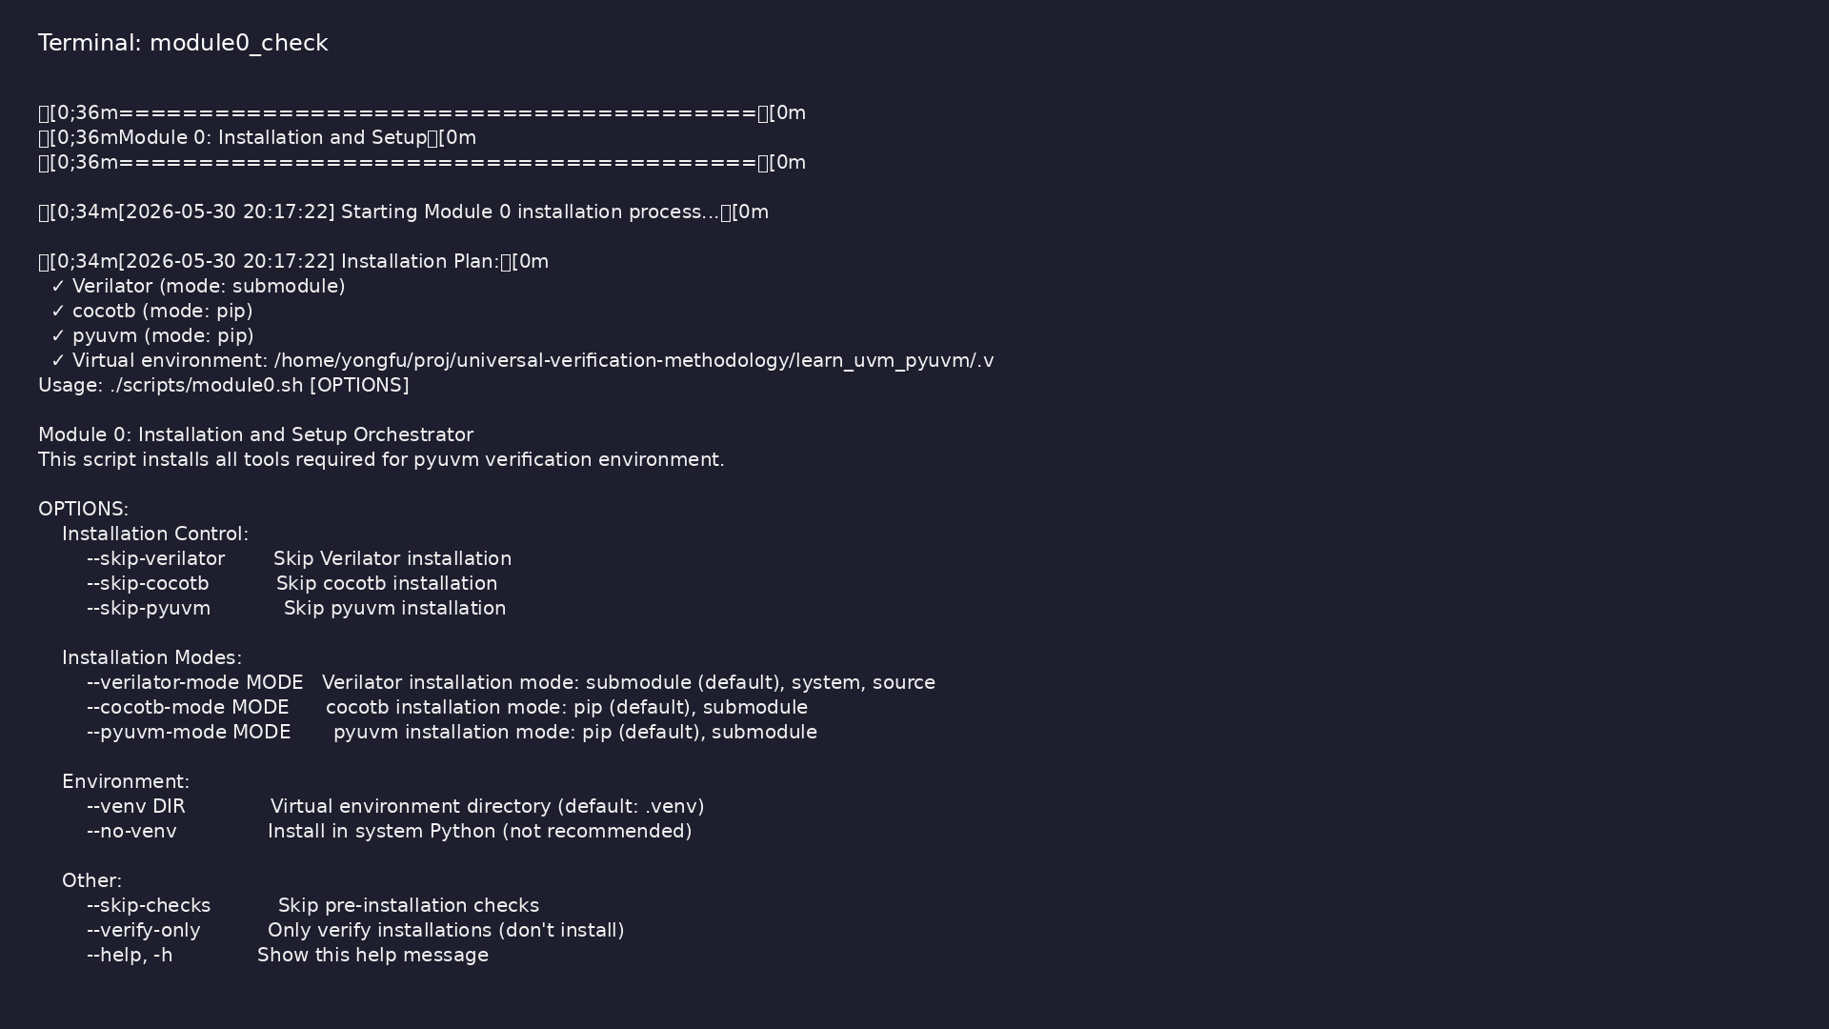
Module 0 orchestrator
$ ./scripts/module0.sh --help
learn_uvm_pyuvm / Module 0
Notes:
Run from course repository root.

Slide 68
Exercise scaffold
./scripts/module0.sh --scaffold
learn_uvm_pyuvm / Module 0

Slide 69
Practice & assessment
learn_uvm_pyuvm / Module 0

Slide 70
What you should know (1/2)
• Install and configure all required tools
• Set up a Python virtual environment
• Install and verify Verilator
• Install and verify cocotb
• Install and verify pyuvm
• Configure your IDE for verification work
learn_uvm_pyuvm / Module 0
Notes:
From MODULE0 Learning Outcomes.

Slide 71
What you should know (2/2)
• Create a basic project structure
• Run a simple verification test
• Troubleshoot common installation issues
learn_uvm_pyuvm / Module 0
Notes:
From MODULE0 Learning Outcomes.

Slide 72
Exercises
• Installation Verification
• Environment Setup
• First Test
• IDE Configuration
• Project Structure
learn_uvm_pyuvm / Module 0

Slide 73
Assessment checklist
• Can install all required tools independently
• Can set up Python virtual environment
• Can verify Verilator installation
• Can verify cocotb installation
• Can verify pyuvm installation
• Can configure IDE for verification work
learn_uvm_pyuvm / Module 0

Slide 74
Summary & next steps
• Set up development environment and verify
installation
• Verify tools: verilator, cocotb, pyuvm (see
MODULE0.md)
• Review module0/EXAMPLES.md and run each lab
• Next: Next module in course
learn_uvm_pyuvm / Module 0

