Slide 1
Module 1
Python and Verification Basics
learn_uvm_pyuvm / Module 1

Slide 2
Learning objectives
• Understand Python for verification and verification
fundamentals
learn_uvm_pyuvm / Module 1

Slide 3
Prerequisites
• See module README
learn_uvm_pyuvm / Module 1

Slide 4

Learning path
Understand Python for verification and verification fundamentals
learn_uvm_pyuvm / Module 1

Slide 5
Overview
• This module establishes the foundation for
verification work. You'll learn essential Python
concept…
learn_uvm_pyuvm / Module 1

Slide 6
How to learn this module
learn_uvm_pyuvm / Module 1

Slide 7
Suggested learning path
• Complete Module 0 (`./scripts/module0.sh --verify-
only`) so Verilator, cocotb, and pyuvm are availa…
• Skim `docs/MODULE1.md` and run pure Python examples
first — no simulator required for OOP/async fou…
• Review `module1/dut/simple_gates/` RTL (AND gate,
counter) before opening cocotb tests
• Understand the testbench mental model: DUT ←
driver/stimulus ← test ← checker ← monitor
• Keep venv active; cocotb Makefiles expect
`SIM=verilator` and `COCOTB_REDIRECT_OUTPUT=1`
defaults f…
learn_uvm_pyuvm / Module 1
Notes:
From docs/MODULE1.md — read guides before running demos.

Slide 8
Design architecture
learn_uvm_pyuvm / Module 1

Slide 9

1. RTL block architecture
• DUTs in
`module1/dut/simple_gates/` —
`and_gate.v` (combinational) and
`counter.v` (enable, active-…
• Synchronous blocks: clock,
active-low reset, multi-bit data
paths on the counter
• Flat hierarchy — no buses; ideal
for first cocotb signal access
and pyuvm hook-up
learn_uvm_pyuvm / Module 1
Notes:
From MODULE1 Design Architecture.

Slide 10
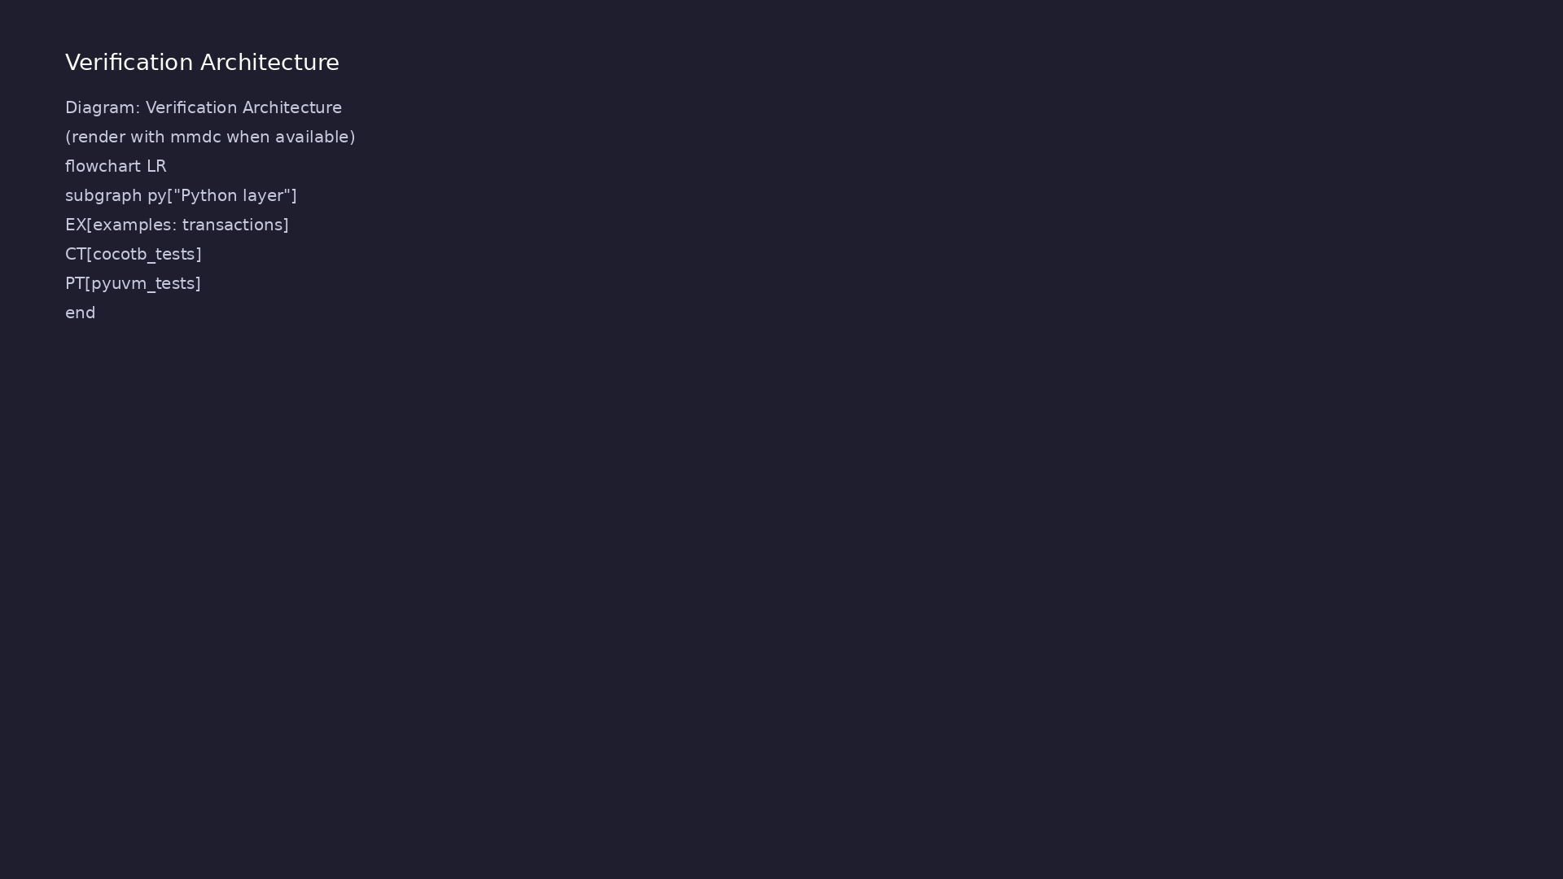
2. Python verification layer architecture
• `module1/examples/` — pure
Python (transactions,
decorators, async, data
structures, logging)
• `module1/tests/cocotb_tests/` —
coroutine testbenches driving
RTL via cocotb handles
• `module1/tests/pyuvm_tests/` —
minimal UVM-style hierarchy
introduction
• Transaction classes in `examples
/python_basics/transaction.py`
model stimulus items reused in
TB th…
learn_uvm_pyuvm / Module 1
Notes:
From MODULE1 Design Architecture.

Slide 11
3. Execution pipeline
• Build: Verilator compiles
`module1/dut/simple_gates/*.v` via cocotb Makefile
(`VERILOG_SOURCES`, to…
• Sim: cocotb loads Python test module; coroutines
advance time on `RisingEdge(clk)` and combinationa…
• Check: assertions in test functions plus cocotb
`TestSuccess`/`TestFailure`; pyuvm tests report UVM…
• Orchestrator path: `module1.sh --cocotb-tests` wraps
`make` with venv and simulator checks
learn_uvm_pyuvm / Module 1
Notes:
From MODULE1 Design Architecture.

Slide 12
4. Testbench mental model
• DUT (RTL) ← driver/stimulus ← test ←
checker/scoreboard ← monitor → observations
• Simulation time advances on clock edges; Python
coroutines (`async`/`await`) align with cocotb
• Assertions and logging close the loop between
expected and actual behavior
• Python examples teach patterns (transactions, async)
reused when pyuvm sequences appear in Module 3
learn_uvm_pyuvm / Module 1
Notes:
From MODULE1 Design Architecture.

Slide 13
DUT — AND gate ports
module and_gate (
input wire a,
input wire b,
output reg y
);
always @(*) begin
y = a & b;
end
endmodule
learn_uvm_pyuvm / Module 1
Notes:
Flat combinational block; cocotb accesses dut.a, dut.b, dut.y.

Slide 14
cocotb — drive inputs and assert
@cocotb.test()
async def test_and_gate_basic(dut):
"""
Basic AND gate test.
Tests all input combinations.
"""
# Initialize inputs
dut.a.value = 0
dut.b.value = 0
# Wait for initial values to settle
await Timer(10, units="ns")
# Test case 1: 0 & 0 = 0
dut.a.value = 0
# ...
learn_uvm_pyuvm / Module 1

Slide 15
Key files to study
learn_uvm_pyuvm / Module 1

Slide 16
Open these in the repo
• `module1/dut/simple_gates/and_gate.v` — 2-input AND;
first combinational DUT for cocotb handles
• `module1/dut/simple_gates/counter.v` — clocked
counter with enable/reset for sequential labs
• `module1/examples/python_basics/transaction.py` —
transaction class with `__eq__`/`__hash__` patter…
• `module1/tests/cocotb_tests/test_and_gate.py` —
directed cocotb vectors and edge triggers
• `module1/tests/pyuvm_tests/test_and_gate_uvm.py` —
minimal pyuvm hierarchy on the AND gate
• `scripts/module1.sh` — routes Python examples and
`--cocotb-tests` / `--pyuvm-tests` regressions
learn_uvm_pyuvm / Module 1
Notes:
Trace while running module1/EXAMPLES.md labs.

Slide 17
Verification & testing methods
learn_uvm_pyuvm / Module 1

Slide 18
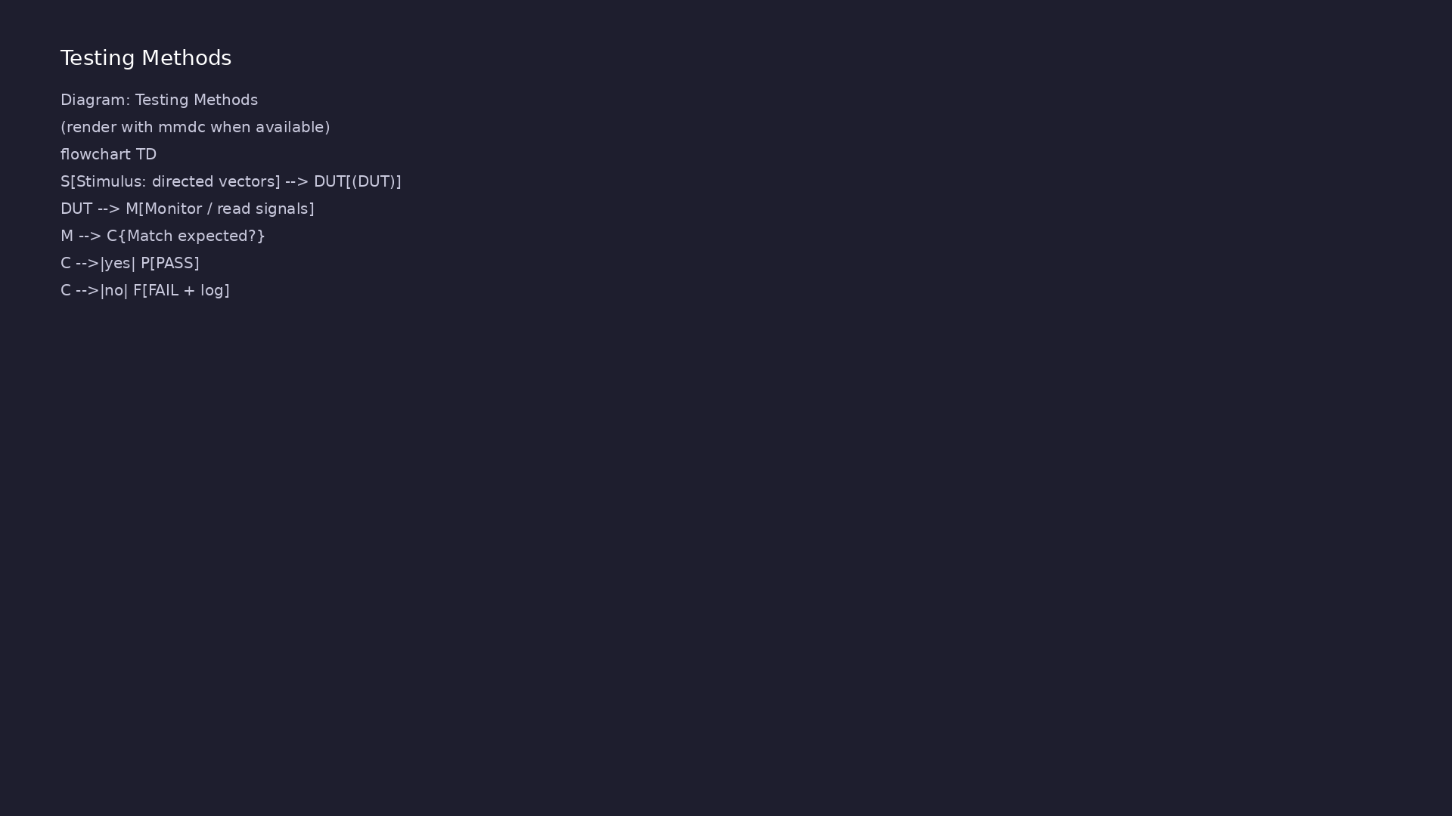
1. cocotb testing methods
• Tests in `test_and_gate.py`,
`test_counter.py`: reset,
directed vectors, edge cases
• Run: `cd
module1/tests/cocotb_tests &&
make SIM=verilator
TEST=test_and_gate`
• Triggers: `RisingEdge(clk)`,
`ReadOnly`/`Write` phases for
signal stability
learn_uvm_pyuvm / Module 1
Notes:
From MODULE1 Verification & Testing Methods.

Slide 19
2. pyuvm and Python unit-style checks
• `./scripts/module1.sh --pyuvm-tests` — compile/run
introductory pyuvm tests against simple DUTs
• Examples run without simulator (`python3
module1/examples/...`) to teach OOP patterns first
• Error-handling example shows structured logging for
debuggable regressions
learn_uvm_pyuvm / Module 1
Notes:
From MODULE1 Verification & Testing Methods.

Slide 20
3. Step-by-step lab execution
• 1. Run Python track: `./scripts/module1.sh` (or
individual `--python-basics`, `--async-await`, …)
• 2. cocotb AND gate: `cd module1/tests/cocotb_tests
&& make SIM=verilator TEST=test_and_gate`
• 3. cocotb counter: `make SIM=verilator
TEST=test_counter` — observe reset and enable
sequencing
• 4. pyuvm entry: `./scripts/module1.sh --pyuvm-tests`
— confirm UVM-style test completes without fat…
• 5. Full regression: `./scripts/module1.sh --all-
tests` before MODULE1 assessment sign-off
learn_uvm_pyuvm / Module 1
Notes:
From MODULE1 Verification & Testing Methods.

Slide 21
4. Closure and self-check
• `./scripts/module1.sh --all-tests` runs required
examples and simulator-backed tests
• Combine directed cocotb tests with transaction
equality (`__eq__`, `__hash__`) from Python examples
• Assessment: OOP for verification, basic TB
structure, cocotb + pyuvm entry points
learn_uvm_pyuvm / Module 1
Notes:
From MODULE1 Verification & Testing Methods.

Slide 22
Makefile — build and run flow
# Makefile for Module 1 cocotb tests
# Usage: make SIM=verilator test_and_gate
# Default simulator
SIM ?= verilator
# Python files
PYTHON_FILES = test_and_gate.py test_counter.py
# Verilog files
VERILOG_FILES = ../../dut/simple_gates/and_gate.v
../../dut/simple_gates/counter.v
# Test to run
TEST ?= test_and_gate
# Cocotb variables
# ...
learn_uvm_pyuvm / Module 1
Notes:
SIM=verilator, TEST= selects cocotb module; cocotb-config drives compile.

Slide 23
Syllabus topics
learn_uvm_pyuvm / Module 1

Slide 24
1. Python Classes and Inheritance for Verification (1/6)
• Object-Oriented Programming Basics
• Classes and objects
• Instance variables and methods
• Class variables and methods
• Encapsulation concepts
• Inheritance in Python
learn_uvm_pyuvm / Module 1
Notes:
From MODULE1 Topics Covered.

Slide 25
1. Python Classes and Inheritance for Verification (2/6)
• Single inheritance
• Multiple inheritance (MRO)
• Method overriding
• `super()` function usage
• Special Methods (Dunder Methods)
• `__init__()` for initialization
learn_uvm_pyuvm / Module 1
Notes:
From MODULE1 Topics Covered.

Slide 26
1. Python Classes and Inheritance for Verification (3/6)
• `__str__()` and `__repr__()` for string
representation
• `__eq__()` for equality comparison
• `__hash__()` for hashable objects
• Class Design Patterns for Verification
• Factory pattern basics
• Singleton pattern
learn_uvm_pyuvm / Module 1
Notes:
From MODULE1 Topics Covered.

Slide 27
1. Python Classes and Inheritance for Verification (4/6)
• Builder pattern
• Strategy pattern
• Base `Transaction` class with class variables
(`_id_counter`)
• Instance variables (`id`, `data`, `timestamp`)
• Special methods: `__init__()`, `__str__()`,
`__repr__()`, `__eq__()`, `__hash__()`
• Inheritance: `ReadTransaction` and
`WriteTransaction` inherit from `Transaction`
learn_uvm_pyuvm / Module 1
Notes:
From MODULE1 Topics Covered.

Slide 28
1. Python Classes and Inheritance for Verification (5/6)
• Method overriding: Child classes override
`__str__()` method
• Using `super()` to call parent class methods
• Transaction(id=1, data=4660, timestamp=0)
• ReadTransaction(id=2, address=0x1000, data=0xDEAD)
• WriteTransaction(id=3, address=0x2000, data=0xBEEF)
• Class Variables: `_id_counter` is shared across all
instances
learn_uvm_pyuvm / Module 1
Notes:
From MODULE1 Topics Covered.

Slide 29
1. Python Classes and Inheritance for Verification (6/6)
• Instance Variables: Each transaction has its own
`id`, `data`, `timestamp`
• Special Methods: Enable Pythonic behavior (string
representation, equality, hashing)
• Inheritance: `ReadTransaction` and
`WriteTransaction` extend base functionality
• Method Overriding: Child classes customize string
representation
learn_uvm_pyuvm / Module 1
Notes:
From MODULE1 Topics Covered.

Slide 30
2. Decorators and Context Managers (1/5)
• Python Decorators
• Function decorators
• Class decorators
• Decorator syntax and usage
• Common decorators (`@property`, `@staticmethod`,
`@classmethod`)
• Context Managers
learn_uvm_pyuvm / Module 1
Notes:
From MODULE1 Topics Covered.

Slide 31
2. Decorators and Context Managers (2/5)
• `with` statement
• `__enter__()` and `__exit__()` methods
• Context manager protocol
• `contextlib` utilities
• Verification-Specific Decorators
• cocotb decorators (`@cocotb.test()`,
`@cocotb.coroutine`)
learn_uvm_pyuvm / Module 1
Notes:
From MODULE1 Topics Covered.

Slide 32
2. Decorators and Context Managers (3/5)
• Custom decorators for verification
• Timing decorators
• Function Decorators: `@timing_decorator` and
`@log_calls_decorator` wrap functions
• Decorator Stacking: Multiple decorators can be
applied to the same function
• Context Manager Class: `VerificationContext`
implements `__enter__()` and `__exit__()`
• Function-based Context Manager: `simulation_phase()`
using `@contextmanager`
learn_uvm_pyuvm / Module 1
Notes:
From MODULE1 Topics Covered.

Slide 33
2. Decorators and Context Managers (4/5)
• Nested Context Managers: Using multiple context
managers together
• Logging Integration: Decorators and context managers
use Python's logging module
• Decorators: Functions that modify other functions
without changing their code
• `functools.wraps`: Preserves function metadata when
decorating
• Context Managers: Ensure proper resource cleanup
using `with` statements
• Exception Handling: Context managers can handle
exceptions in `__exit__()`
learn_uvm_pyuvm / Module 1
Notes:
From MODULE1 Topics Covered.

Slide 34
2. Decorators and Context Managers (5/5)
• Logging: Integration with Python's logging module
for verification workflows
learn_uvm_pyuvm / Module 1
Notes:
From MODULE1 Topics Covered.

Slide 35
3. Async/Await for Simulation (1/6)
• Asynchronous Programming Concepts
• Coroutines vs functions
• Event loop basics
• Concurrency vs parallelism
• Python `async` and `await`
• Defining async functions
learn_uvm_pyuvm / Module 1
Notes:
From MODULE1 Topics Covered.

Slide 36
3. Async/Await for Simulation (2/6)
• Awaiting coroutines
• Async context managers
• Async iterators
• cocotb Coroutines
• cocotb coroutine concept
• `await` for simulation time
learn_uvm_pyuvm / Module 1
Notes:
From MODULE1 Topics Covered.

Slide 37
3. Async/Await for Simulation (3/6)
• Trigger objects
• Coroutine scheduling
• Common Patterns
• Parallel coroutines
• Sequential execution
• Timeout handling
learn_uvm_pyuvm / Module 1
Notes:
From MODULE1 Topics Covered.

Slide 38
3. Async/Await for Simulation (4/6)
• Exception handling in async code
• Async Functions: Defining coroutines with `async
def`
• Awaiting Operations: Using `await` to wait for async
operations
• Clock Generation: Simulating clock signals with
async functions
• Parallel Execution: Running multiple coroutines
concurrently with `asyncio.gather()`
• Sequential Execution: Running coroutines one after
another
learn_uvm_pyuvm / Module 1
Notes:
From MODULE1 Topics Covered.

Slide 39
3. Async/Await for Simulation (5/6)
• Timeout Handling: Using `asyncio.wait_for()` with
timeout
• Exception Handling: Catching exceptions in async
code
• Queues: Using `asyncio.Queue` for communication
between coroutines
• Coroutines: Functions defined with `async def` that
can be paused and resumed
• Event Loop: `asyncio.run()` creates and manages the
event loop
• Concurrency: Multiple coroutines can run
concurrently (not in parallel)
learn_uvm_pyuvm / Module 1
Notes:
From MODULE1 Topics Covered.

Slide 40
3. Async/Await for Simulation (6/6)
• `asyncio.gather()`: Runs multiple coroutines
concurrently and waits for all
• `asyncio.wait_for()`: Adds timeout to coroutine
execution
• Async Queues: `asyncio.Queue` for safe communication
between coroutines
• Simulation Time: In cocotb, `await Timer()` advances
simulation time
learn_uvm_pyuvm / Module 1
Notes:
From MODULE1 Topics Covered.

Slide 41
4. Verification Fundamentals (1/3)
• What is Verification?
• Design vs verification
• Verification goals
• Verification metrics
• Verification lifecycle
• Testbench Architecture
learn_uvm_pyuvm / Module 1
Notes:
From MODULE1 Topics Covered.

Slide 42
4. Verification Fundamentals (2/3)
• Testbench components
• Stimulus generation
• Response checking
• Coverage collection
• Verification Levels
• Unit level verification
learn_uvm_pyuvm / Module 1
Notes:
From MODULE1 Topics Covered.

Slide 43
4. Verification Fundamentals (3/3)
• Block level verification
• System level verification
• SoC level verification
learn_uvm_pyuvm / Module 1
Notes:
From MODULE1 Topics Covered.

Slide 44
5. Testbench Architecture Basics (1/3)
• Testbench Structure
• Design Under Test (DUT)
• Testbench components
• Interface definition
• Clock and reset generation
• Stimulus Generation
learn_uvm_pyuvm / Module 1
Notes:
From MODULE1 Topics Covered.

Slide 45
5. Testbench Architecture Basics (2/3)
• Deterministic stimulus
• Random stimulus
• Constrained random
• Directed tests
• Response Checking
• Self-checking testbenches
learn_uvm_pyuvm / Module 1
Notes:
From MODULE1 Topics Covered.

Slide 46
5. Testbench Architecture Basics (3/3)
• Reference models
• Scoreboards
• Assertions
learn_uvm_pyuvm / Module 1
Notes:
From MODULE1 Topics Covered.

Slide 47
6. Simulation Flow (1/3)
• Simulation Phases
• Initialization
• Reset phase
• Test execution
• Cleanup phase
• Time Management
learn_uvm_pyuvm / Module 1
Notes:
From MODULE1 Topics Covered.

Slide 48
6. Simulation Flow (2/3)
• Simulation time vs real time
• Time units (ns, ps, etc.)
• Clock cycles
• Timing relationships
• Event-Driven Simulation
• Event scheduling
learn_uvm_pyuvm / Module 1
Notes:
From MODULE1 Topics Covered.

Slide 49
6. Simulation Flow (3/3)
• Delta cycles
• Signal updates
• Trigger conditions
learn_uvm_pyuvm / Module 1
Notes:
From MODULE1 Topics Covered.

Slide 50
7. Assertions Introduction (1/3)
• What are Assertions?
• Immediate assertions
• Concurrent assertions
• Assertion types
• Basic Assertions
• Simple property checks
learn_uvm_pyuvm / Module 1
Notes:
From MODULE1 Topics Covered.

Slide 51
7. Assertions Introduction (2/3)
• Signal value assertions
• Timing assertions
• Assertion Best Practices
• When to use assertions
• Assertion placement
• Assertion messages
learn_uvm_pyuvm / Module 1
Notes:
From MODULE1 Topics Covered.

Slide 52
7. Assertions Introduction (3/3)
• Assertion coverage
learn_uvm_pyuvm / Module 1
Notes:
From MODULE1 Topics Covered.

Slide 53
8. Python Testing Frameworks (Overview) (1/3)
• pytest Basics
• Test discovery
• Fixtures
• Parametrization
• Markers
• Unit Testing Concepts
learn_uvm_pyuvm / Module 1
Notes:
From MODULE1 Topics Covered.

Slide 54
8. Python Testing Frameworks (Overview) (2/3)
• Test organization
• Test isolation
• Mocking and stubbing
• Test coverage
• Integration with Verification
• Using pytest with cocotb
learn_uvm_pyuvm / Module 1
Notes:
From MODULE1 Topics Covered.

Slide 55
8. Python Testing Frameworks (Overview) (3/3)
• Test organization patterns
• Reporting and logging
learn_uvm_pyuvm / Module 1
Notes:
From MODULE1 Topics Covered.

Slide 56
9. Data Structures for Verification (1/5)
• Lists and Dictionaries
• Common operations
• List comprehensions
• Dictionary comprehensions
• Nested structures
• Collections Module
learn_uvm_pyuvm / Module 1
Notes:
From MODULE1 Topics Covered.

Slide 57
9. Data Structures for Verification (2/5)
• `deque` for queues
• `defaultdict` for default values
• `Counter` for counting
• `namedtuple` for structured data
• Verification-Specific Structures
• Transaction queues
learn_uvm_pyuvm / Module 1
Notes:
From MODULE1 Topics Covered.

Slide 58
9. Data Structures for Verification (3/5)
• Scoreboard data structures
• Coverage data structures
• `deque`: Double-ended queue for FIFO/LIFO operations
in `TransactionQueue`
• `defaultdict`: Dictionary with default values for
scoreboard
• `Counter`: Counting occurrences for statistics
• `namedtuple`: Structured data for transactions
learn_uvm_pyuvm / Module 1
Notes:
From MODULE1 Topics Covered.

Slide 59
9. Data Structures for Verification (4/5)
• List Comprehensions: Creating lists from iterables
• Dictionary Comprehensions: Creating dictionaries
from iterables
• Scoreboard Pattern: Comparing expected vs actual
results
• Coverage Collection: Tracking coverage bins and hit
counts
• `deque`: Efficient FIFO/LIFO operations, thread-safe
for async code
• `defaultdict`: Automatically creates default values
for missing keys
learn_uvm_pyuvm / Module 1
Notes:
From MODULE1 Topics Covered.

Slide 60
9. Data Structures for Verification (5/5)
• `Counter`: Specialized dictionary for counting
occurrences
• `namedtuple`: Lightweight alternative to classes for
simple data structures
• Comprehensions: Pythonic way to create lists/dicts
from iterables
• Scoreboard: Common verification pattern for checking
results
• Coverage: Tracking which values/conditions have been
tested
learn_uvm_pyuvm / Module 1
Notes:
From MODULE1 Topics Covered.

Slide 61
10. Error Handling and Logging (1/5)
• Exception Handling
• Try/except blocks
• Exception types
• Custom exceptions
• Exception chaining
• Logging in Python
learn_uvm_pyuvm / Module 1
Notes:
From MODULE1 Topics Covered.

Slide 62
10. Error Handling and Logging (2/5)
• `logging` module basics
• Log levels
• Log formatting
• Log handlers
• Verification Logging
• UVM reporting (preview)
learn_uvm_pyuvm / Module 1
Notes:
From MODULE1 Topics Covered.

Slide 63
10. Error Handling and Logging (3/5)
• Testbench logging patterns
• Debug logging
• Log analysis
• Custom Exceptions: `VerificationError`,
`MismatchError`, `TimeoutError`
• Exception Handling: Try/except blocks with specific
exception types
• Exception Chaining: Using `raise ... from ...` to
chain exceptions
learn_uvm_pyuvm / Module 1
Notes:
From MODULE1 Topics Covered.

Slide 64
10. Error Handling and Logging (4/5)
• Retry Logic: Implementing retry mechanisms with
error handling
• Logging Levels: DEBUG, INFO, WARNING, ERROR,
CRITICAL
• Log Handlers: File and console handlers
• Log Formatting: Custom log message formats
• Verification Statistics: Tracking pass/fail/error
counts
• Custom Exceptions: Create domain-specific exceptions
for better error handling
learn_uvm_pyuvm / Module 1
Notes:
From MODULE1 Topics Covered.

Slide 65
10. Error Handling and Logging (5/5)
• Exception Chaining: Preserve original exception
context with `raise ... from ...`
• Retry Logic: Implement robust error recovery
mechanisms
• Logging Levels: Use appropriate levels (DEBUG < INFO
< WARNING < ERROR < CRITICAL)
• Log Handlers: Multiple handlers (file, console) for
different outputs
• Log Formatting: Customize log message format with
timestamps, levels, etc.
• Verification Statistics: Track test results and
errors for reporting
learn_uvm_pyuvm / Module 1
Notes:
From MODULE1 Topics Covered.

Slide 66
Command reference highlights
learn_uvm_pyuvm / Module 1

Slide 67
Python examples (no simulator)
• `./scripts/module1.sh` — runs all five Python
example tracks (default)
• `./scripts/module1.sh --decorators --async-await` —
selective example subsets
• `python3
module1/examples/python_basics/transaction.py` —
standalone OOP/transaction drill
learn_uvm_pyuvm / Module 1
Notes:
Full detail in docs/MODULE1.md command reference.

Slide 68
cocotb RTL tests
• `./scripts/module1.sh --cocotb-tests` — build and
run cocotb regressions via orchestrator
• `cd module1/tests/cocotb_tests && make SIM=verilator
TEST=test_and_gate` — single-test Makefile flow
• `make SIM=verilator TEST=test_counter` — sequential
counter regression with reset/enable checks
learn_uvm_pyuvm / Module 1
Notes:
Full detail in docs/MODULE1.md command reference.

Slide 69
pyuvm entry tests
• `./scripts/module1.sh --pyuvm-tests` — compile RTL
and run introductory pyuvm test against AND gate
• `cd module1/tests/pyuvm_tests && make SIM=verilator`
— direct Make entry when debugging pyuvm wiring
• `./scripts/module1.sh --all-tests` — Python examples
plus cocotb and pyuvm test suites
learn_uvm_pyuvm / Module 1
Notes:
Full detail in docs/MODULE1.md command reference.

Slide 70
Hands-on examples
learn_uvm_pyuvm / Module 1

Slide 71
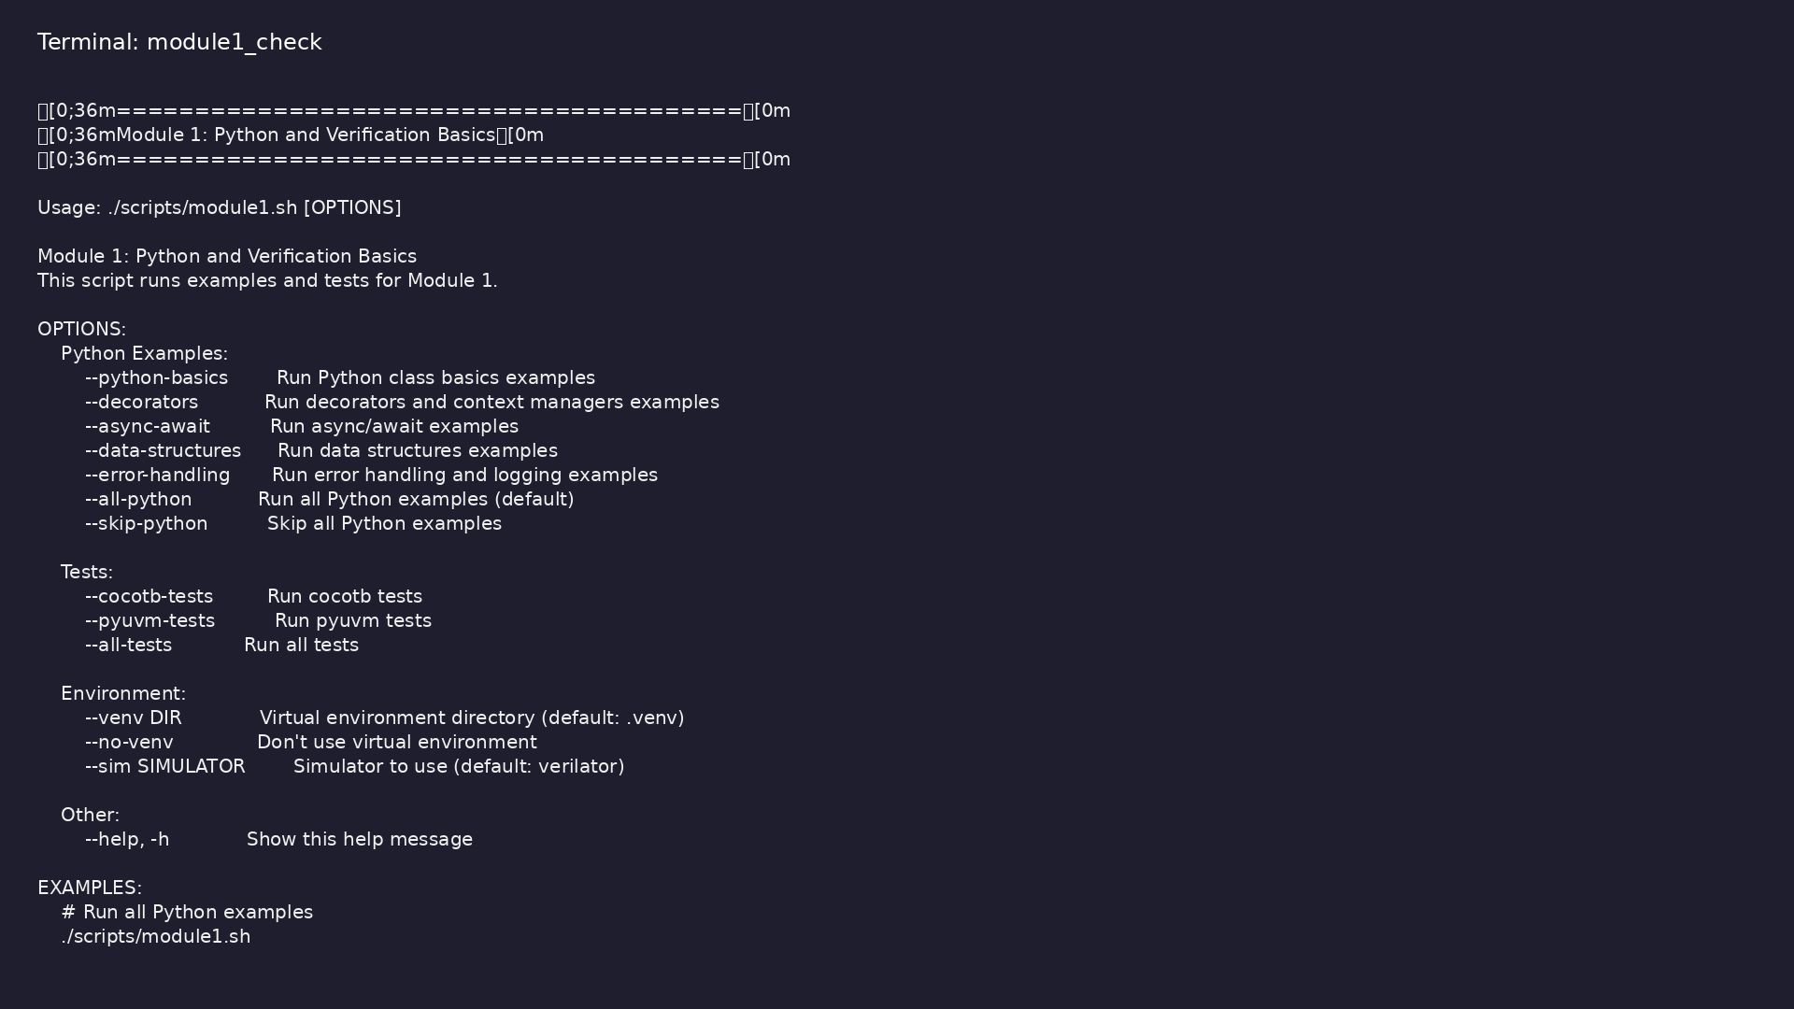
Module 1 orchestrator
$ ./scripts/module1.sh --help
learn_uvm_pyuvm / Module 1
Notes:
Run from course repository root.

Slide 72
Exercise scaffold
./scripts/module1.sh --scaffold
learn_uvm_pyuvm / Module 1

Slide 73
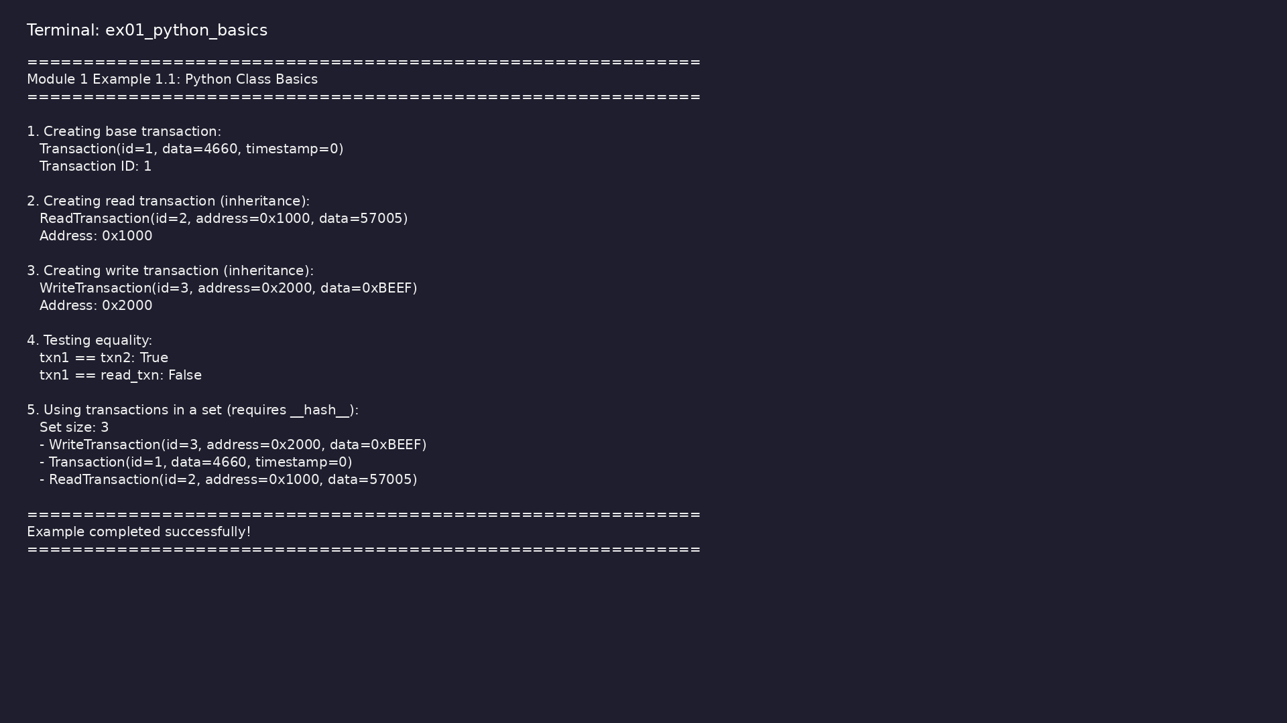
Demo: Transaction Classes
$ .venv/bin/python module1/examples/python_basics/transaction.py
learn_uvm_pyuvm / Module 1
Notes:
Hands-on: module1/examples/python_basics/

Slide 74
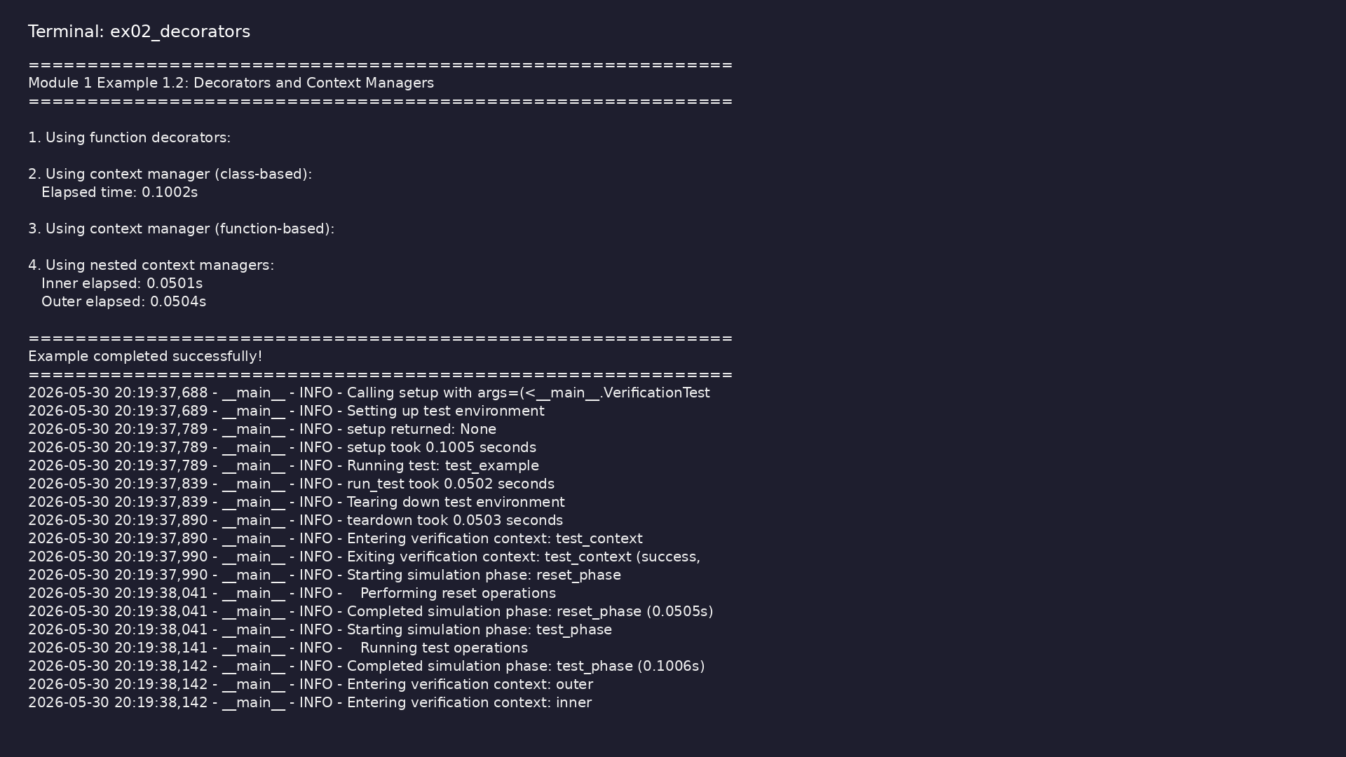
Demo: Decorators and Context Managers
$ .venv/bin/python module1/examples/decorators/decorators_example.py
learn_uvm_pyuvm / Module 1
Notes:
Hands-on: module1/examples/decorators/

Slide 75
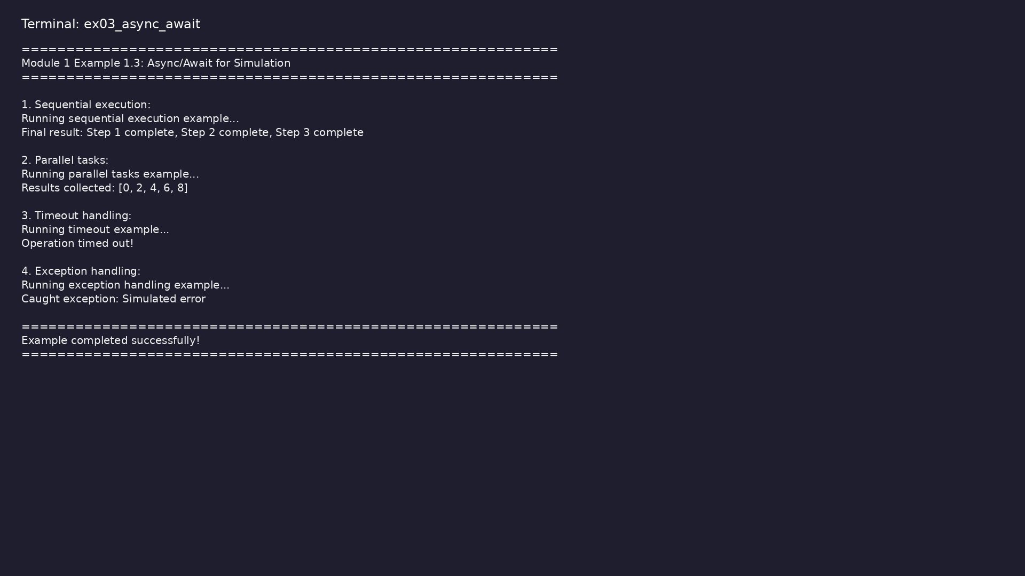
Demo: Async/Await Patterns
$ .venv/bin/python module1/examples/async_await/async_example.py
learn_uvm_pyuvm / Module 1
Notes:
Hands-on: module1/examples/async_await/

Slide 76
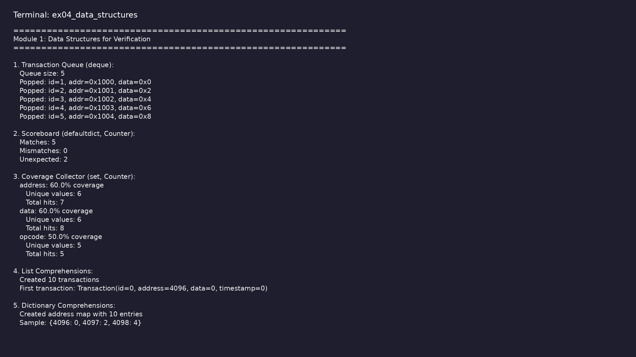
Demo: Data Structures
$ .venv/bin/python
module1/examples/data_structures/data_structures_example.py
learn_uvm_pyuvm / Module 1
Notes:
Hands-on: module1/examples/data_structures/

Slide 77
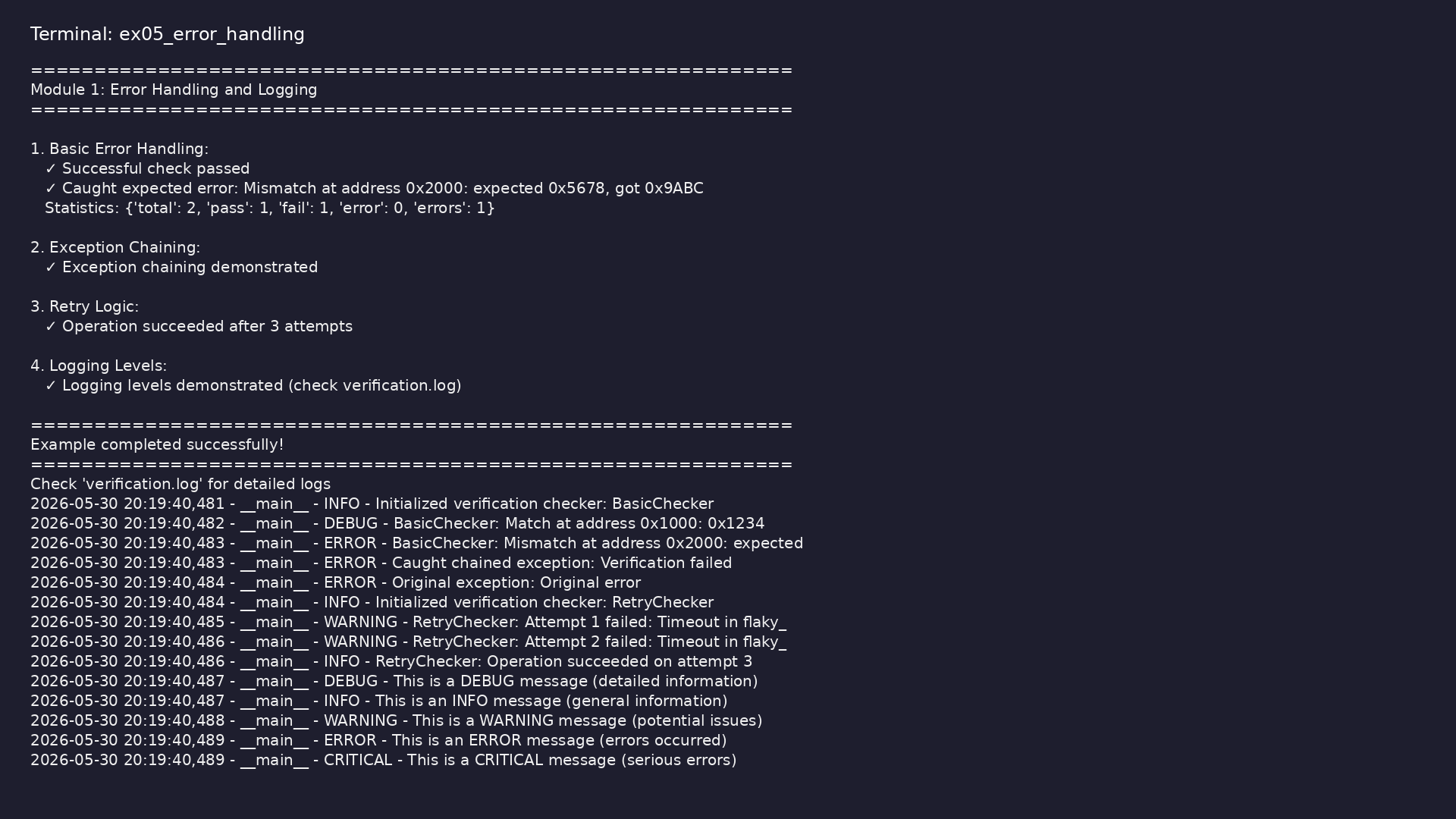
Demo: Error Handling and Logging
$ .venv/bin/python
module1/examples/error_handling/error_handling_example.py
learn_uvm_pyuvm / Module 1
Notes:
Hands-on: module1/examples/error_handling/

Slide 78
Practice & assessment
learn_uvm_pyuvm / Module 1

Slide 79
What you should know (1/9)
• Write Python classes with inheritance
• Use decorators and context managers effectively
• Understand and use async/await for simulation
• Explain verification fundamentals
• Understand testbench architecture
• Comprehend simulation flow
learn_uvm_pyuvm / Module 1
Notes:
From MODULE1 Learning Outcomes.

Slide 80
What you should know (2/9)
• Write basic assertions
• Use Python testing frameworks
• Handle errors and implement logging
• Class definition
• Instance variables
• Methods
learn_uvm_pyuvm / Module 1
Notes:
From MODULE1 Learning Outcomes.

Slide 81
What you should know (3/9)
• Inheritance
• Function decorators
• Async function definition
• Await usage
• Testbench structure
• Clock generation
learn_uvm_pyuvm / Module 1
Notes:
From MODULE1 Learning Outcomes.

Slide 82
What you should know (4/9)
• Signal driving
• Basic checking
• Test Structure: Using `@cocotb.test()` decorator
• Signal Access: Reading and writing DUT signals
(`dut.a`, `dut.b`, `dut.y`)
• Timing Control: Using `await Timer()` for simulation
time
• Assertions: Python assertions for checking results
learn_uvm_pyuvm / Module 1
Notes:
From MODULE1 Learning Outcomes.

Slide 83
What you should know (5/9)
• Test Cases: Multiple test functions for different
scenarios
• Truth Table Testing: Systematic testing of all input
combinations
• `@cocotb.test()`: Decorator marks function as a test
• DUT Access: `dut.signal_name.value` to read/write
signals
• `Timer()`: Advances simulation time
• Assertions: Python `assert` statements for checking
learn_uvm_pyuvm / Module 1
Notes:
From MODULE1 Learning Outcomes.

Slide 84
What you should know (6/9)
• Test Organization: Multiple test functions in one
file
• Clock Generation: Creating clock signal with
`generate_clock()` coroutine
• Reset Sequence: Implementing reset with proper
timing
• Sequential Logic Testing: Testing clocked
(sequential) circuits
• Enable Control: Testing enable/disable functionality
• Edge Detection: Using `RisingEdge()` trigger
learn_uvm_pyuvm / Module 1
Notes:
From MODULE1 Learning Outcomes.

Slide 85
What you should know (7/9)
• Multiple Test Scenarios: Reset, increment, enable,
overflow tests
• Clock Generation: Background coroutine for clock
signal
• `cocotb.start_soon()`: Start background coroutines
• `RisingEdge()`: Wait for clock edge
• Reset Timing: Proper reset sequence with timing
• Sequential Testing: Testing state machines and
counters
learn_uvm_pyuvm / Module 1
Notes:
From MODULE1 Learning Outcomes.

Slide 86
What you should know (8/9)
• UVM Test Structure: `@uvm_test()` decorator
• UVM Phases: `build_phase()`, `run_phase()`,
`check_phase()`
• UVM Components: `uvm_test`, `uvm_env`, `uvm_agent`,
`uvm_driver`, `uvm_monitor`
• UVM Sequences: `uvm_sequence` and
`uvm_sequence_item`
• UVM Reporting: Using `self.logger` for messages
• Objections: Using `raise_objection()` and
`drop_objection()` for test control
learn_uvm_pyuvm / Module 1
Notes:
From MODULE1 Learning Outcomes.

Slide 87
What you should know (9/9)
• UVM Phases: Build, connect, run, check phases
• Component Hierarchy: Test → Environment → Agent →
Driver/Monitor
• Sequences: Generate and send transactions
• Objections: Control test execution duration
• Factory Pattern: UVM uses factory for component
creation
learn_uvm_pyuvm / Module 1
Notes:
From MODULE1 Learning Outcomes.

Slide 88
Exercises
• Class Design
• Async Patterns
• Testbench Structure
• Assertions
• Logging
learn_uvm_pyuvm / Module 1

Slide 89
Assessment checklist
• Can write Python classes with inheritance
• Understands decorators and context managers
• Can use async/await effectively
• Understands verification fundamentals
• Can explain testbench architecture
• Understands simulation flow
learn_uvm_pyuvm / Module 1

Slide 90
Summary & next steps
• Understand Python for verification and verification
fundamentals
• Complete module1/CHECKLIST.md
• Review module1/EXAMPLES.md and run each lab
• Next: Next module in course
learn_uvm_pyuvm / Module 1

