Slide 1
Module 2
cocotb Fundamentals
learn_uvm_pyuvm / Module 2

Slide 2
Learning objectives
• Master cocotb for hardware verification
learn_uvm_pyuvm / Module 2

Slide 3
Prerequisites
• See module README
learn_uvm_pyuvm / Module 2

Slide 4
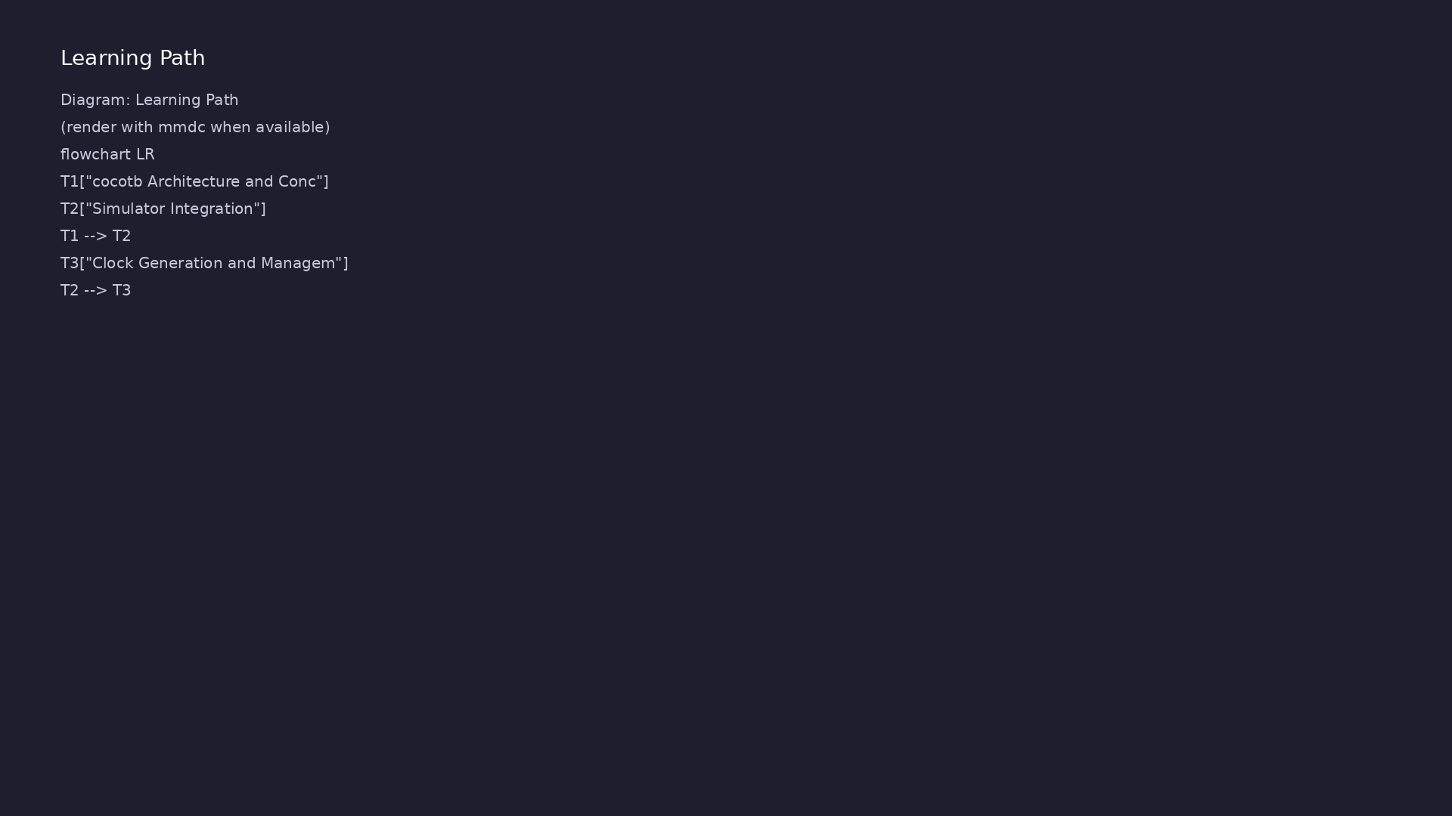
Learning path
Master cocotb for hardware verification
learn_uvm_pyuvm / Module 2

Slide 5
Overview
• This module provides comprehensive coverage of
cocotb, the coroutine-based testbench framework
that…
learn_uvm_pyuvm / Module 2

Slide 6
How to learn this module
learn_uvm_pyuvm / Module 2

Slide 7
Suggested learning path
• Finish Module 1 cocotb labs so clock/reset coroutine
patterns are familiar
• Read `module2/dut/registers/simple_register.v` and
`shift_register.v` port lists before writing sti…
• Work through `module2/examples/triggers/` —
`RisingEdge`, `FallingEdge`, and `Timer` are core to
al…
• Study `module2/examples/clock_generation/` and
`reset_patterns/` — shared fixtures decouple timing…
• No pyuvm yet; tests are flat `@cocotb.test`
functions selected by Makefile `TEST=`
learn_uvm_pyuvm / Module 2
Notes:
From docs/MODULE2.md — read guides before running demos.

Slide 8
Design architecture
learn_uvm_pyuvm / Module 2

Slide 9
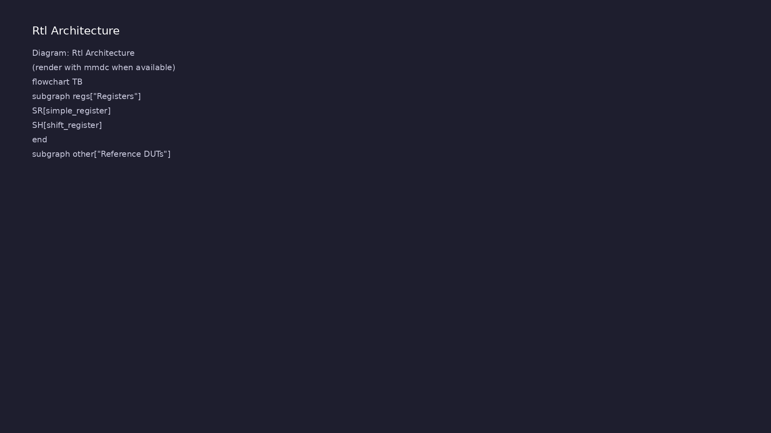
1. RTL portfolio architecture
• `simple_register.v` — 8-bit
register, enable, synchronous
reset (primary lab DUT)
• `shift_register.v` — serial
in/out, parallel tap; exercises
multi-cycle behavior
• `simple_fifo.v` — 16×8 FIFO with
full/empty flags (reference for
extension)
• `simple_fsm.v` —
IDLE/START/WORK/DONE four-state
controller (optional study)
learn_uvm_pyuvm / Module 2
Notes:
From MODULE2 Design Architecture.

Slide 10
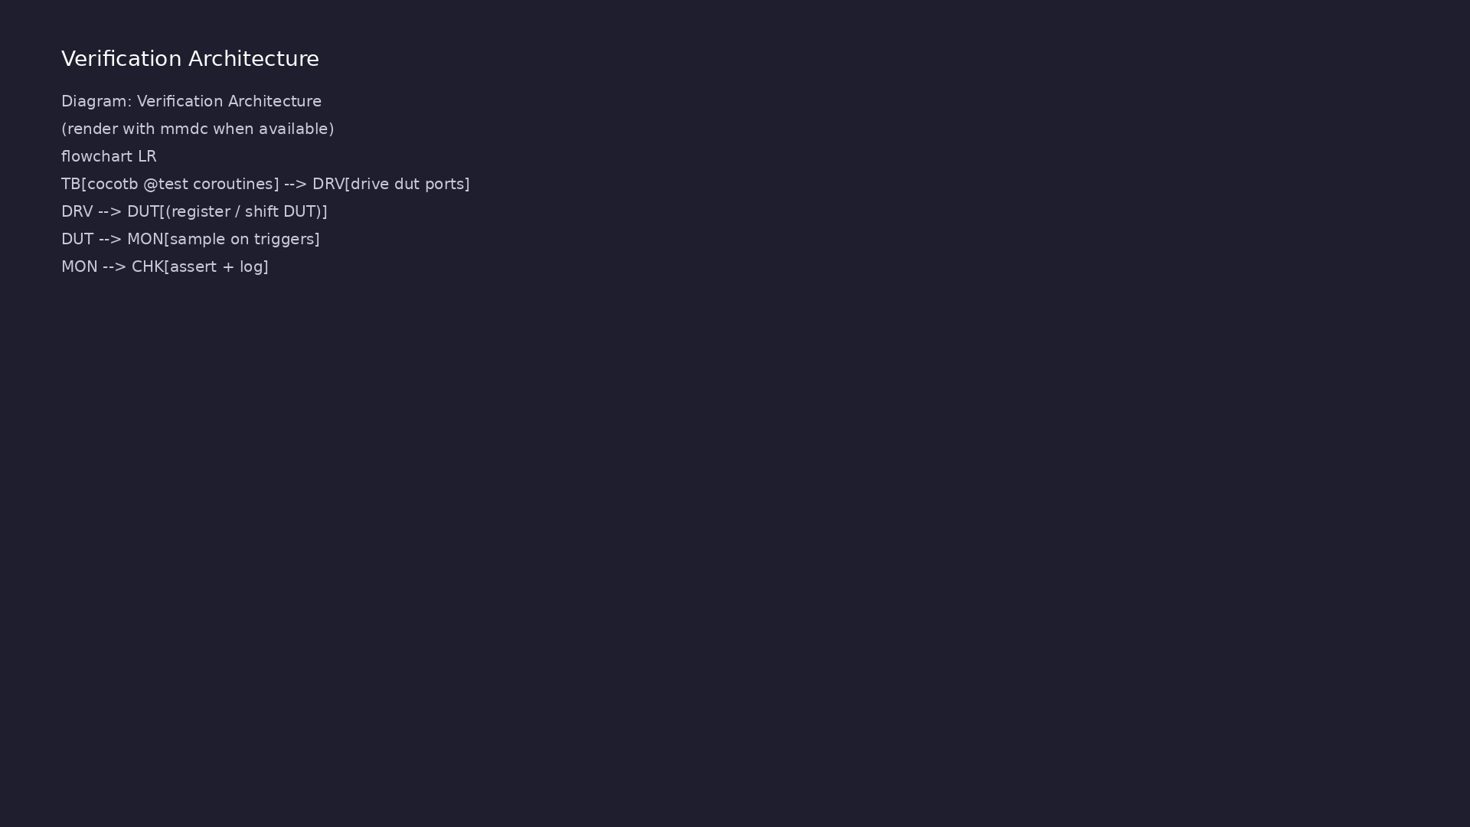
2. cocotb testbench architecture
• Test module → coroutines
(`@cocotb.test`) → DUT signals
via `dut.signal` handles
• Clock generators in examples
decouple timing from test logic
• No UVM hierarchy; flat Python
functions and shared fixtures
via Makefile `TEST=` selection
• Concurrent coroutines use
triggers to model parallel
clock, reset, and stimulus
threads
learn_uvm_pyuvm / Module 2
Notes:
From MODULE2 Design Architecture.

Slide 11
3. Execution pipeline
• Build: Verilator compiles selected DUT under
`module2/dut/registers/` per Makefile top module
• Sim: cocotb schedules coroutines on triggers; reset
coroutines establish known state before stimulus
• Check: Python assertions on `dut.q.value` / shift
outputs; cocotb regression aggregates `results.xm…
• Examples path: `module2.sh --triggers` runs tutorial
makes without full DUT regression
learn_uvm_pyuvm / Module 2
Notes:
From MODULE2 Design Architecture.

Slide 12
4. Example vs test separation
• `module2/examples/` — signal access, clocks,
triggers, reset patterns (runnable tutorials)
• `module2/tests/cocotb_tests/` — regression tests
bound to specific DUTs
• Orchestrator `scripts/module2.sh` routes flags to
examples or cocotb makes
• Reference FIFO/FSM RTL supports self-study; graded
labs focus on register and shift register
learn_uvm_pyuvm / Module 2
Notes:
From MODULE2 Design Architecture.

Slide 13
DUT — simple register
/**
* Module 2: Simple Register
*
* A basic register with clock, reset, and enable.
*
* Ports:
* clk: Clock signal
* rst_n: Active-low reset
* enable: Register enable
* d: Data input
* q: Data output
*/
module simple_register (
input wire clk,
input wire rst_n,
# ...
learn_uvm_pyuvm / Module 2

Slide 14
cocotb — reset then write
"""
Module 2 Test: Simple Register
Comprehensive testbench for simple_register module.
"""
import cocotb
from cocotb.clock import Clock
from cocotb.triggers import Timer, RisingEdge, FallingEdge
from cocotb.binary import BinaryValue
async def reset_dut(dut, duration_ns=50, propagation_delay_ns=10):
"""
Reset the DUT.
Args:
# ...
learn_uvm_pyuvm / Module 2

Slide 15
Key files to study
learn_uvm_pyuvm / Module 2

Slide 16
Open these in the repo
• `module2/dut/registers/simple_register.v` — 8-bit
register with enable and synchronous reset (prima…
• `module2/dut/registers/shift_register.v` — serial
in/out with parallel tap; multi-cycle behavior
• `module2/examples/triggers/triggers_example.py` —
cocotb trigger primitives and concurrency
• `module2/tests/cocotb_tests/test_simple_register.py`
— directed write/read and boundary values
• `module2/tests/cocotb_tests/test_shift_register.py`
— serial shift timing regression
• `scripts/module2.sh` — routes example makes and
`--cocotb-tests` regressions
learn_uvm_pyuvm / Module 2
Notes:
Trace while running module2/EXAMPLES.md labs.

Slide 17
Verification & testing methods
learn_uvm_pyuvm / Module 2

Slide 18
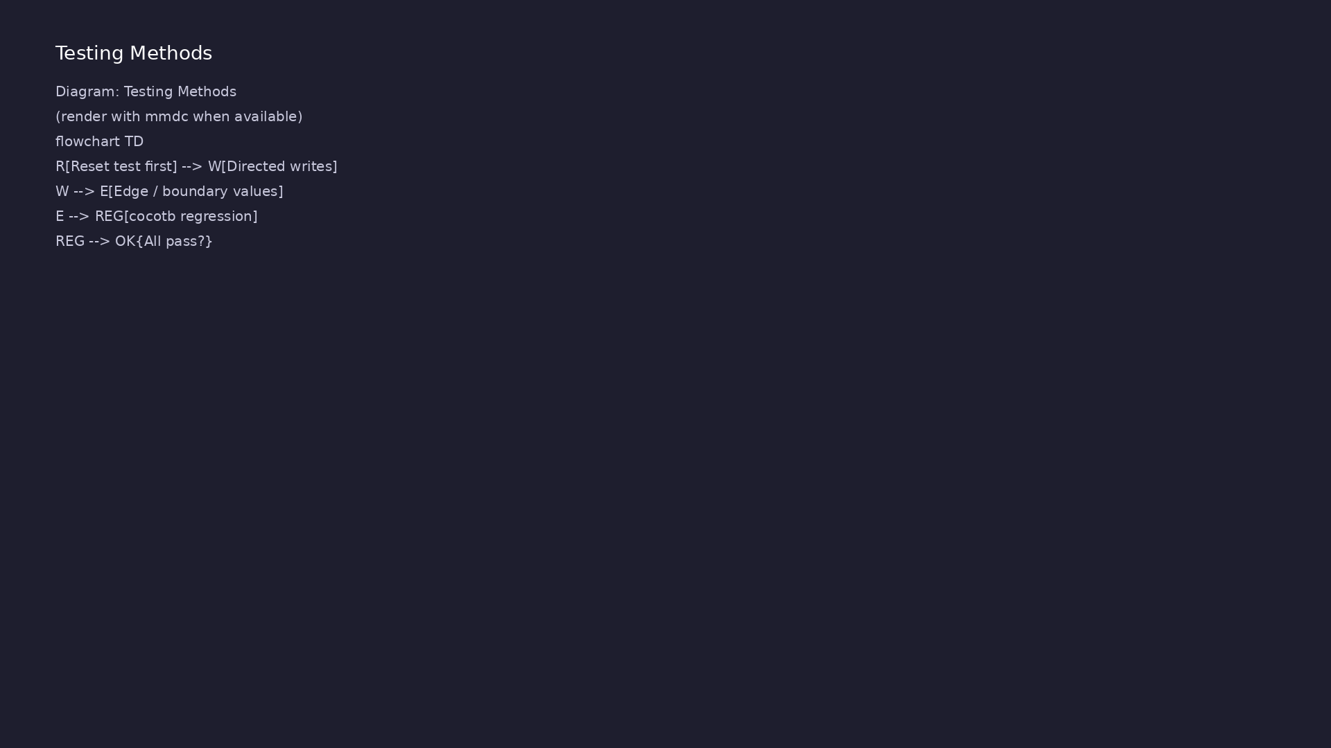
1. Stimulus and observation
• Directed writes/reads on
register ports; shift tests
exercise serial timing
• `RisingEdge`/`FallingEdge`/`Time
r` triggers structure concurrent
activity
• Reset tests run first in
regression order to establish
known state
learn_uvm_pyuvm / Module 2
Notes:
From MODULE2 Verification & Testing Methods.

Slide 19
2. Regression and Makefile flow
• `make SIM=verilator TEST=test_simple_register`
selects cocotb test module
• Regression runner executes multiple tests; pass/fail
per `cocotb.regression`
• Boundary tests (`test_register_all_values`) cover
0x00, 0x7F, 0x80, 0xFF
learn_uvm_pyuvm / Module 2
Notes:
From MODULE2 Verification & Testing Methods.

Slide 20
3. Step-by-step lab execution
• 1. Tutorials: `./scripts/module2.sh --signal-access
--triggers --reset-patterns`
• 2. Register lab: `cd module2/tests/cocotb_tests &&
make SIM=verilator TEST=test_simple_register`
• 3. Shift register lab: `make SIM=verilator
TEST=test_shift_register` — verify serial-to-
parallel ti…
• 4. Full DUT regression: `./scripts/module2.sh
--cocotb-tests`
• 5. Debug failures with waves/logging before MODULE2
assessment
learn_uvm_pyuvm / Module 2
Notes:
From MODULE2 Verification & Testing Methods.

Slide 21
4. Debug and closure
• Logging via `cocotb.log`; VCD from simulator flags
for waveform debug
• `./scripts/module2.sh --cocotb-tests` validates key
cocotb tests and example makes
• Assessment: clocks, triggers, reset sequences,
structured cocotb tests
learn_uvm_pyuvm / Module 2
Notes:
From MODULE2 Verification & Testing Methods.

Slide 22
Regression Makefile
# Makefile for Module 2 cocotb tests
# Usage: make SIM=verilator test_simple_register
# Default simulator
SIM ?= verilator
# Python files
PYTHON_FILES = test_simple_register.py test_shift_register.py
# Verilog files
VERILOG_FILES = ../../dut/registers/simple_register.v
../../dut/registers/shift_register.v
# Test to run
TEST ?= test_simple_register
# Cocotb variables
# ...
learn_uvm_pyuvm / Module 2

Slide 23
Syllabus topics
learn_uvm_pyuvm / Module 2

Slide 24
1. cocotb Architecture and Concepts (1/3)
• What is cocotb?
• Coroutine-based testbench framework
• Python testbenches for Verilog/VHDL
• Simulator abstraction
• History and motivation
• cocotb Architecture
learn_uvm_pyuvm / Module 2
Notes:
From MODULE2 Topics Covered.

Slide 25
1. cocotb Architecture and Concepts (2/3)
• Python testbench layer
• Simulator interface layer
• DUT interaction
• Event scheduling
• Key Concepts
• Coroutines for simulation
learn_uvm_pyuvm / Module 2
Notes:
From MODULE2 Topics Covered.

Slide 26
1. cocotb Architecture and Concepts (3/3)
• Triggers for synchronization
• Handles for signal access
• Simulation time management
learn_uvm_pyuvm / Module 2
Notes:
From MODULE2 Topics Covered.

Slide 27
2. Simulator Integration (1/3)
• Supported Simulators
• Verilator (recommended)
• Icarus Verilog
• ModelSim/QuestaSim
• GHDL (VHDL)
• VCS, Xcelium (commercial)
learn_uvm_pyuvm / Module 2
Notes:
From MODULE2 Topics Covered.

Slide 28
2. Simulator Integration (2/3)
• Simulator Selection
• Environment variables
• Makefile configuration
• Simulator-specific features
• Compilation Process
• Verilog compilation
learn_uvm_pyuvm / Module 2
Notes:
From MODULE2 Topics Covered.

Slide 29
2. Simulator Integration (3/3)
• cocotb library compilation
• Linking process
• Makefile structure
learn_uvm_pyuvm / Module 2
Notes:
From MODULE2 Topics Covered.

Slide 30
3. Clock Generation and Management (1/3)
• Clock Generation
• `Clock` class usage
• Clock parameters (period, units)
• Starting clocks
• Multiple clocks
• Clock Patterns
learn_uvm_pyuvm / Module 2
Notes:
From MODULE2 Topics Covered.

Slide 31
3. Clock Generation and Management (2/3)
• Regular clocks
• Gated clocks
• Clock division
• Clock stopping
• Clock Domain Management
• Multiple clock domains
learn_uvm_pyuvm / Module 2
Notes:
From MODULE2 Topics Covered.

Slide 32
3. Clock Generation and Management (3/3)
• Clock domain crossing
• Synchronization between domains
learn_uvm_pyuvm / Module 2
Notes:
From MODULE2 Topics Covered.

Slide 33
4. Signal Access and Driving (1/4)
• Signal Handles
• Accessing DUT signals
• `dut.signal_name` syntax
• Signal value types
• Signal properties
• Reading Signal Values
learn_uvm_pyuvm / Module 2
Notes:
From MODULE2 Topics Covered.

Slide 34
4. Signal Access and Driving (2/4)
• `.value` property
• Integer conversion
• Binary representation
• Signal state checking
• Driving Signals
• Assigning values
learn_uvm_pyuvm / Module 2
Notes:
From MODULE2 Topics Covered.

Slide 35
4. Signal Access and Driving (3/4)
• Integer assignment
• Binary string assignment
• High-impedance (Z) and unknown (X)
• Signal Types
• Single-bit signals
• Multi-bit signals (vectors)
learn_uvm_pyuvm / Module 2
Notes:
From MODULE2 Topics Covered.

Slide 36
4. Signal Access and Driving (4/4)
• Buses and arrays
• Bidirectional signals
learn_uvm_pyuvm / Module 2
Notes:
From MODULE2 Topics Covered.

Slide 37
5. Triggers and Coroutines (1/4)
• Trigger Types
• `RisingEdge(signal)`
• `FallingEdge(signal)`
• `Edge(signal)` (any edge)
• `Timer(time, units)`
• `ReadOnly()` (end of time step)
learn_uvm_pyuvm / Module 2
Notes:
From MODULE2 Topics Covered.

Slide 38
5. Triggers and Coroutines (2/4)
• `ReadWrite()` (during time step)
• `Combine(*triggers)` (multiple triggers)
• `First(*triggers)` (first to occur)
• Coroutine Execution
• Defining coroutines
• Starting coroutines
learn_uvm_pyuvm / Module 2
Notes:
From MODULE2 Topics Covered.

Slide 39
5. Triggers and Coroutines (3/4)
• `cocotb.start_soon()` vs `await`
• Parallel execution
• Coroutine Synchronization
• Waiting for triggers
• Coordinating multiple coroutines
• Timeout handling
learn_uvm_pyuvm / Module 2
Notes:
From MODULE2 Topics Covered.

Slide 40
5. Triggers and Coroutines (4/4)
• Exception propagation
learn_uvm_pyuvm / Module 2
Notes:
From MODULE2 Topics Covered.

Slide 41
6. Test Structure and Organization (1/3)
• Test Function Structure
• `@cocotb.test()` decorator
• Test function signature
• DUT parameter
• Test organization
• Test Phases
learn_uvm_pyuvm / Module 2
Notes:
From MODULE2 Topics Covered.

Slide 42
6. Test Structure and Organization (2/3)
• Setup phase
• Test execution
• Cleanup phase
• Error handling
• Multiple Tests
• Test discovery
learn_uvm_pyuvm / Module 2
Notes:
From MODULE2 Topics Covered.

Slide 43
6. Test Structure and Organization (3/3)
• Test selection
• Test parameters
• Test fixtures
learn_uvm_pyuvm / Module 2
Notes:
From MODULE2 Topics Covered.

Slide 44
7. Reset and Initialization (1/2)
• Reset Strategies
• Synchronous reset
• Asynchronous reset
• Reset sequences
• Reset verification
• Initialization Patterns
learn_uvm_pyuvm / Module 2
Notes:
From MODULE2 Topics Covered.

Slide 45
7. Reset and Initialization (2/2)
• Signal initialization
• State initialization
• Configuration setup
• Initial conditions
learn_uvm_pyuvm / Module 2
Notes:
From MODULE2 Topics Covered.

Slide 46
8. Common Verification Patterns (1/3)
• Stimulus Generation
• Sequential patterns
• Random patterns
• Constrained random
• File-based stimulus
• Response Checking
learn_uvm_pyuvm / Module 2
Notes:
From MODULE2 Topics Covered.

Slide 47
8. Common Verification Patterns (2/3)
• Immediate checking
• Deferred checking
• Reference model comparison
• Scoreboard patterns
• Transaction-Level Modeling
• Transaction classes
learn_uvm_pyuvm / Module 2
Notes:
From MODULE2 Topics Covered.

Slide 48
8. Common Verification Patterns (3/3)
• Transaction generation
• Transaction execution
• Transaction checking
learn_uvm_pyuvm / Module 2
Notes:
From MODULE2 Topics Covered.

Slide 49
9. Debugging with cocotb (1/4)
• Logging and Reporting
• cocotb logging
• Log levels
• Log formatting
• Debug messages
• Waveform Generation
learn_uvm_pyuvm / Module 2
Notes:
From MODULE2 Topics Covered.

Slide 50
9. Debugging with cocotb (2/4)
• VCD file generation
• FST file generation
• Waveform viewing
• Signal tracing
• Interactive Debugging
• Python debugger (pdb)
learn_uvm_pyuvm / Module 2
Notes:
From MODULE2 Topics Covered.

Slide 51
9. Debugging with cocotb (3/4)
• Breakpoints
• Variable inspection
• Step-through debugging
• Common Issues
• Signal access errors
• Timing issues
learn_uvm_pyuvm / Module 2
Notes:
From MODULE2 Topics Covered.

Slide 52
9. Debugging with cocotb (4/4)
• Simulation hangs
• Value conversion problems
learn_uvm_pyuvm / Module 2
Notes:
From MODULE2 Topics Covered.

Slide 53
10. Advanced cocotb Features (1/3)
• Memory Access
• Memory modeling
• Memory initialization
• Memory access patterns
• Bus Functional Models (BFM)
• BFM concepts
learn_uvm_pyuvm / Module 2
Notes:
From MODULE2 Topics Covered.

Slide 54
10. Advanced cocotb Features (2/3)
• BFM implementation
• Reusable BFMs
• Performance Optimization
• Coroutine efficiency
• Trigger optimization
• Simulation speed
learn_uvm_pyuvm / Module 2
Notes:
From MODULE2 Topics Covered.

Slide 55
10. Advanced cocotb Features (3/3)
• Memory usage
learn_uvm_pyuvm / Module 2
Notes:
From MODULE2 Topics Covered.

Slide 56
11. Integration with pytest (1/2)
• pytest Integration
• Using pytest with cocotb
• Test discovery
• Fixtures
• Parametrization
• Test Organization
learn_uvm_pyuvm / Module 2
Notes:
From MODULE2 Topics Covered.

Slide 57
11. Integration with pytest (2/2)
• Test directory structure
• Test naming conventions
• Test grouping
• Test execution
learn_uvm_pyuvm / Module 2
Notes:
From MODULE2 Topics Covered.

Slide 58
Command reference highlights
learn_uvm_pyuvm / Module 2

Slide 59
cocotb examples (tutorial makes)
• `./scripts/module2.sh --triggers` — run trigger
tutorial under `module2/examples/triggers/`
• `./scripts/module2.sh --clock-generation --reset-
patterns` — timing and reset fixture drills
• `./scripts/module2.sh` — all five example tracks
(signal access through common patterns)
learn_uvm_pyuvm / Module 2
Notes:
Full detail in docs/MODULE2.md command reference.

Slide 60
DUT regression tests
• `./scripts/module2.sh --cocotb-tests` — register and
shift-register makes via orchestrator
• `cd module2/tests/cocotb_tests && make SIM=verilator
TEST=test_simple_register`
• `make SIM=verilator TEST=test_shift_register` —
serial timing and parallel output checks
learn_uvm_pyuvm / Module 2
Notes:
Full detail in docs/MODULE2.md command reference.

Slide 61
Debug and waves
• `make SIM=verilator TEST=test_simple_register
WAVES=1` — enable VCD/FST when Makefile supports it
• Use `cocotb.log` verbosity and simulator stdout from
`results.xml` for pass/fail triage
• Re-run single `TEST=` target after RTL or stimulus
edits — faster than full example sweep
learn_uvm_pyuvm / Module 2
Notes:
Full detail in docs/MODULE2.md command reference.

Slide 62
Hands-on examples
learn_uvm_pyuvm / Module 2

Slide 63
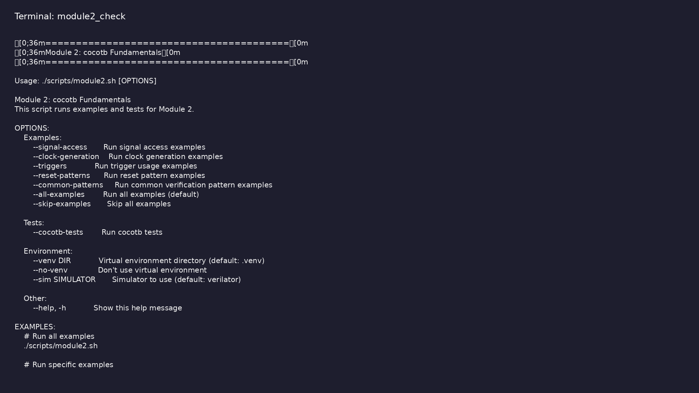
Module 2 orchestrator
$ ./scripts/module2.sh --help
learn_uvm_pyuvm / Module 2
Notes:
Run from course repository root.

Slide 64
Exercise scaffold
./scripts/module2.sh --scaffold
learn_uvm_pyuvm / Module 2

Slide 65
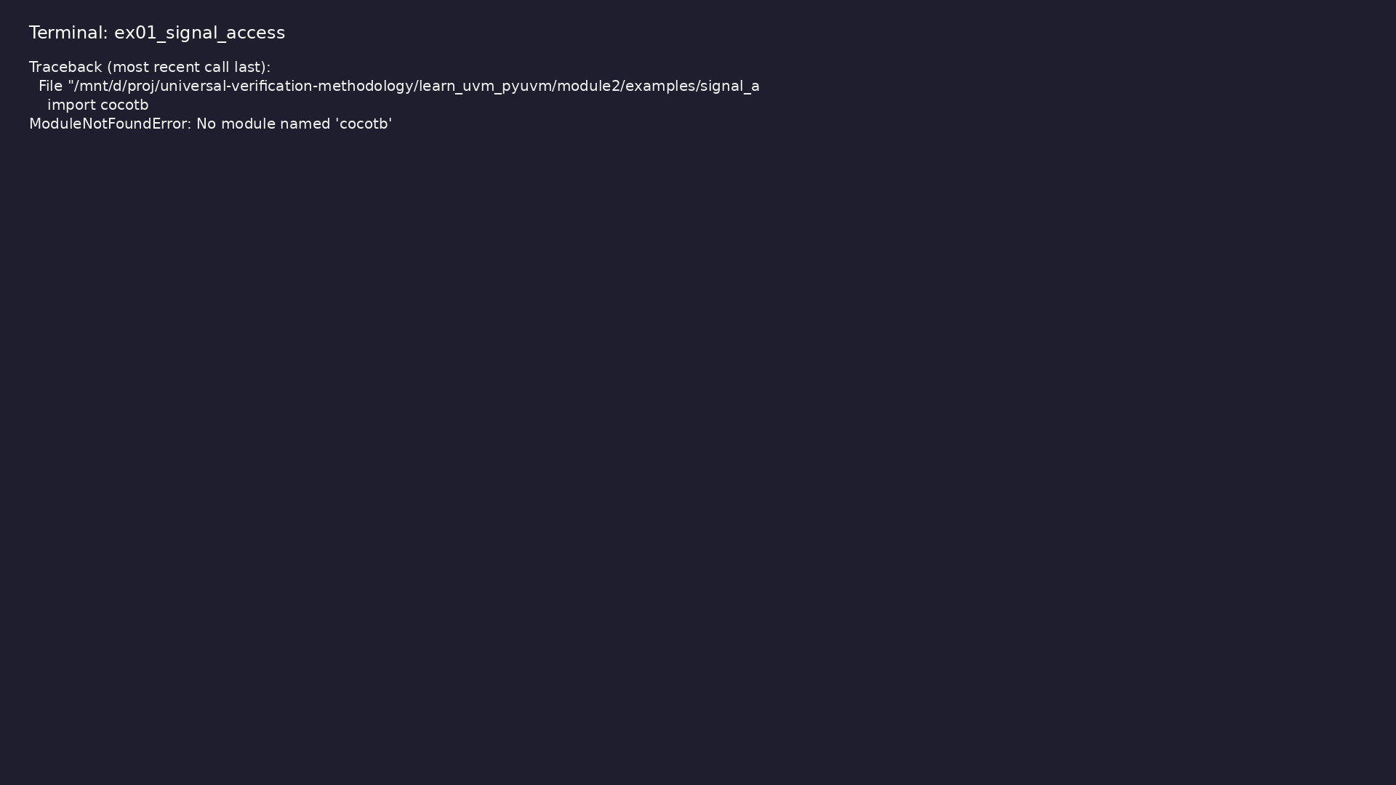
Demo: Signal Access
$ .venv/bin/python
module2/examples/signal_access/signal_access_example.py
learn_uvm_pyuvm / Module 2
Notes:
Hands-on: module2/examples/signal_access/

Slide 66
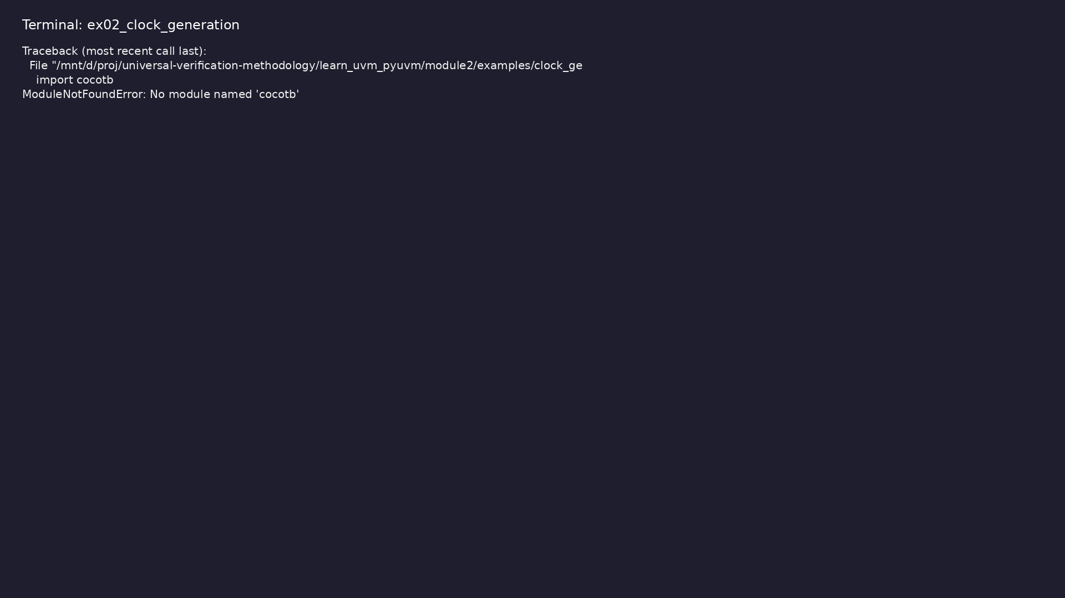
Demo: Clock Generation
$ .venv/bin/python
module2/examples/clock_generation/clock_generation_example.py
learn_uvm_pyuvm / Module 2
Notes:
Hands-on: module2/examples/clock_generation/

Slide 67
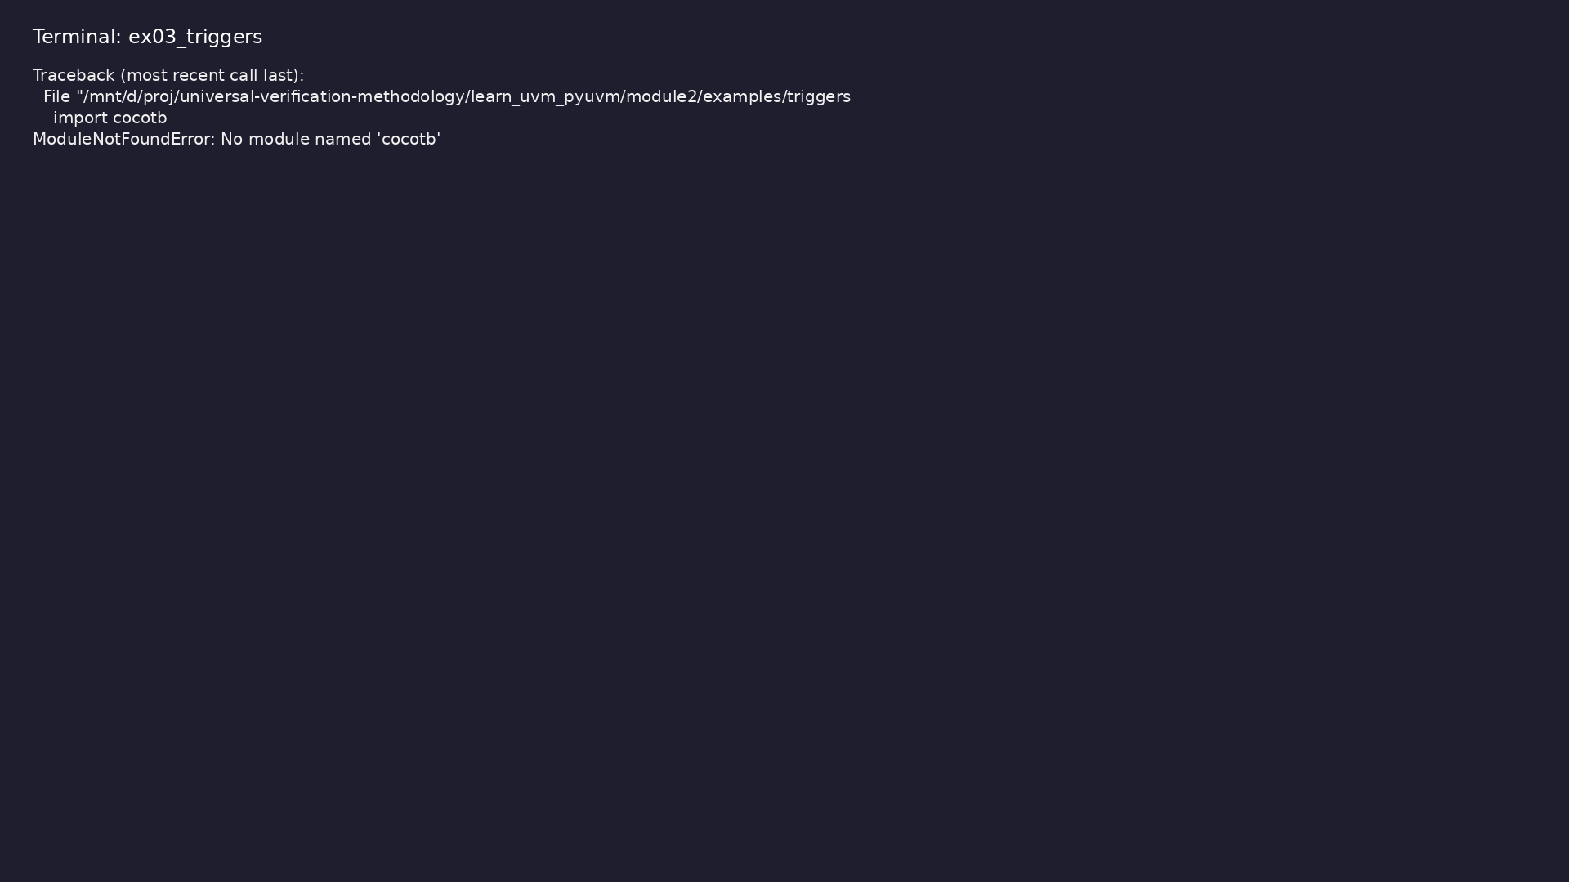
Demo: Triggers
$ .venv/bin/python module2/examples/triggers/triggers_example.py
learn_uvm_pyuvm / Module 2
Notes:
Hands-on: module2/examples/triggers/

Slide 68
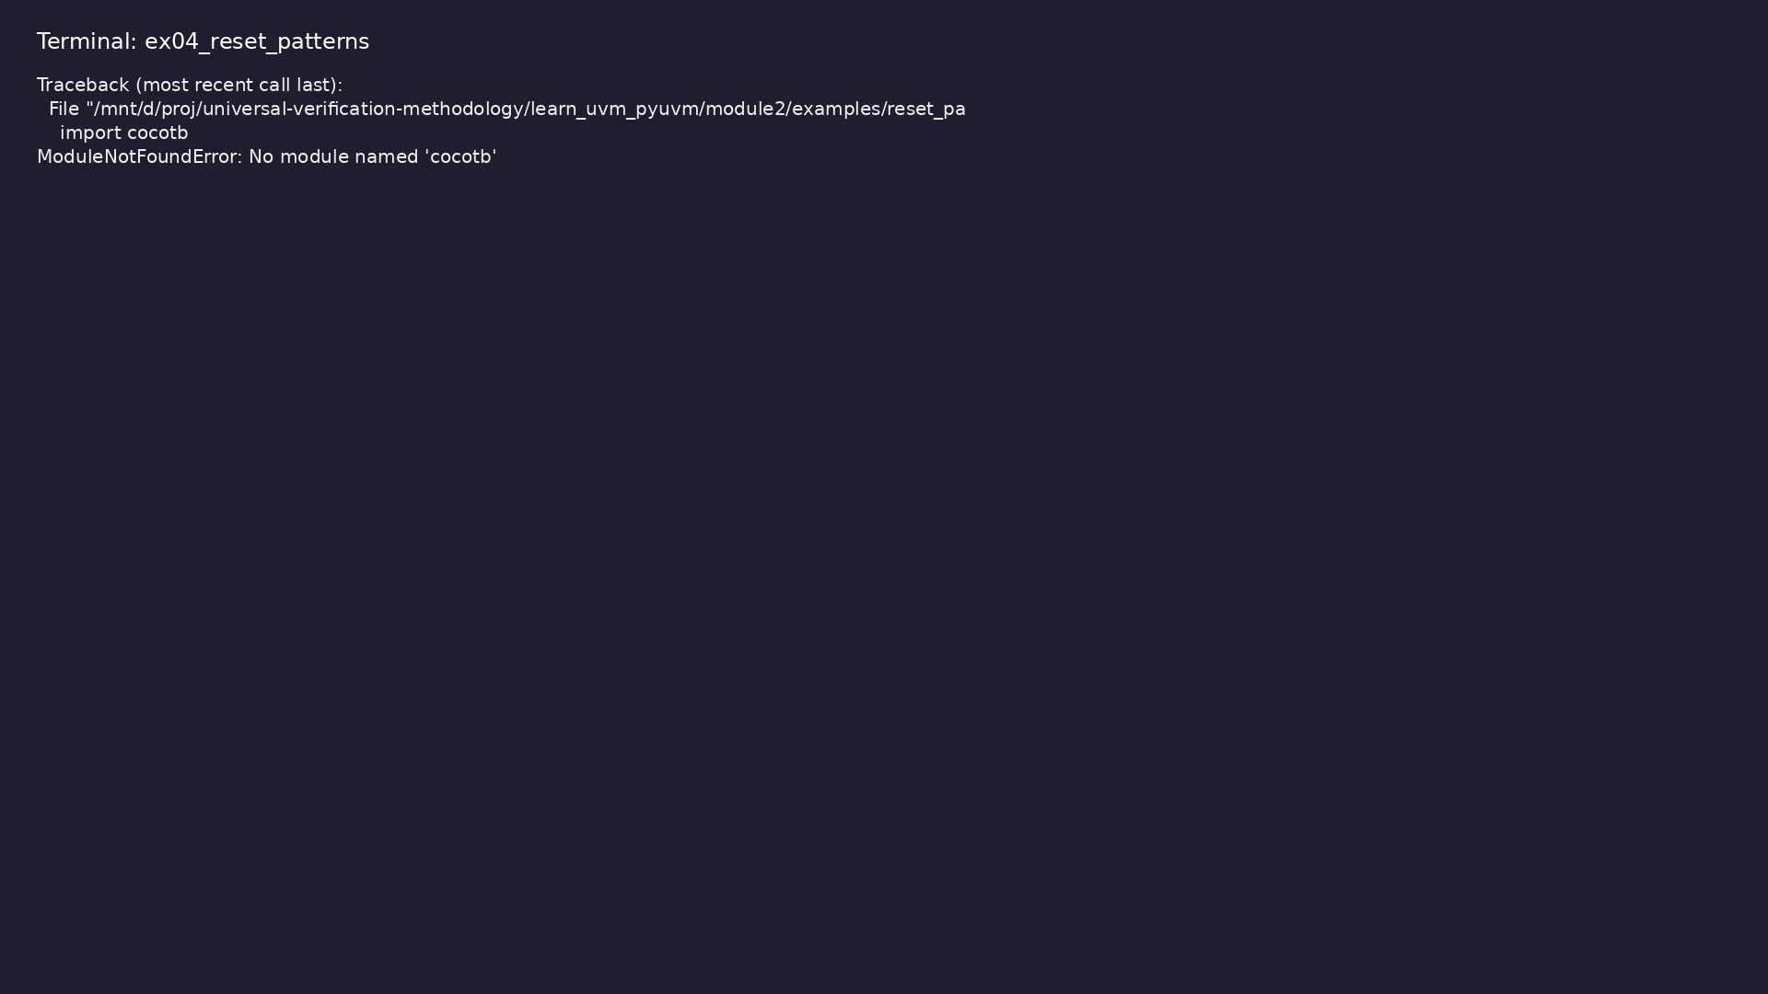
Demo: Reset Patterns
$ .venv/bin/python
module2/examples/reset_patterns/reset_patterns_example.py
learn_uvm_pyuvm / Module 2
Notes:
Hands-on: module2/examples/reset_patterns/

Slide 69

Demo: Common Verification Patterns
$ .venv/bin/python
module2/examples/common_patterns/common_patterns_example.py
learn_uvm_pyuvm / Module 2
Notes:
Hands-on: module2/examples/common_patterns/

Slide 70
Practice & assessment
learn_uvm_pyuvm / Module 2

Slide 71
What you should know (1/3)
• Understand cocotb architecture
• Integrate with simulators
• Generate and manage clocks
• Access and drive signals
• Use triggers effectively
• Structure tests properly
learn_uvm_pyuvm / Module 2
Notes:
From MODULE2 Learning Outcomes.

Slide 72
What you should know (2/3)
• Implement reset sequences
• Use common verification patterns
• Debug cocotb testbenches
• Optimize testbench performance
• Signal handles
• Value reading
learn_uvm_pyuvm / Module 2
Notes:
From MODULE2 Learning Outcomes.

Slide 73
What you should know (3/3)
• Signal types
learn_uvm_pyuvm / Module 2
Notes:
From MODULE2 Learning Outcomes.

Slide 74
Exercises
• Clock Management
• Signal Operations
• Trigger Patterns
• Test Structure
• Debugging
learn_uvm_pyuvm / Module 2

Slide 75
Assessment checklist
• Understands cocotb architecture
• Can integrate with simulators
• Can generate and manage clocks
• Can access and drive signals
• Can use triggers effectively
• Can structure tests properly
learn_uvm_pyuvm / Module 2

Slide 76
Summary & next steps
• Master cocotb for hardware verification
• Complete module2/CHECKLIST.md
• Review module2/EXAMPLES.md and run each lab
• Next: Next module in course
learn_uvm_pyuvm / Module 2

