Slide 1
Module 3
UVM Basics
learn_uvm_pyuvm / Module 3

Slide 2
Learning objectives
• Master UVM class hierarchy and phases
learn_uvm_pyuvm / Module 3

Slide 3
Prerequisites
• See module README
learn_uvm_pyuvm / Module 3

Slide 4
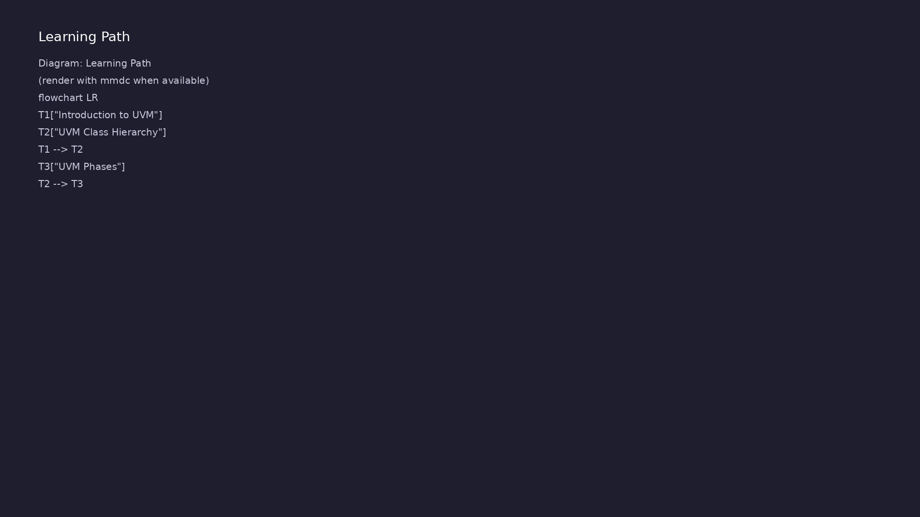
Learning path
Master UVM class hierarchy and phases
learn_uvm_pyuvm / Module 3

Slide 5
Overview
• This module introduces the Universal Verification
Methodology (UVM) and its implementation in pyuvm…
learn_uvm_pyuvm / Module 3

Slide 6
How to learn this module
learn_uvm_pyuvm / Module 3

Slide 7
Suggested learning path
• Solid cocotb skills from Module 2 — you will reuse
trigger timing inside pyuvm drivers later
• Read `module3/dut/simple_blocks/adder.v` —
combinational operands `a`, `b`, output `sum`
• Step through `module3/examples/phases/` and
`class_hierarchy/` before integrated
`test_simple_uvm.p…
• Understand UVM phase order: build → connect → run
(with objections) → report
• ConfigDB and factory examples are isolated; run them
before merging concepts in the pyuvm test
learn_uvm_pyuvm / Module 3
Notes:
From docs/MODULE3.md — read guides before running demos.

Slide 8
Design architecture
learn_uvm_pyuvm / Module 3

Slide 9

1. RTL and interfaces
• Primary DUT: `module3/dut/simple
_blocks/adder.v` — combinational
operands and sum
• Clock/reset scaffolding for
pyuvm tests that mirror industry
TB hooks
• Flat block; no protocol channels
— focus stays on UVM structure,
not bus complexity
learn_uvm_pyuvm / Module 3
Notes:
From MODULE3 Design Architecture.

Slide 10
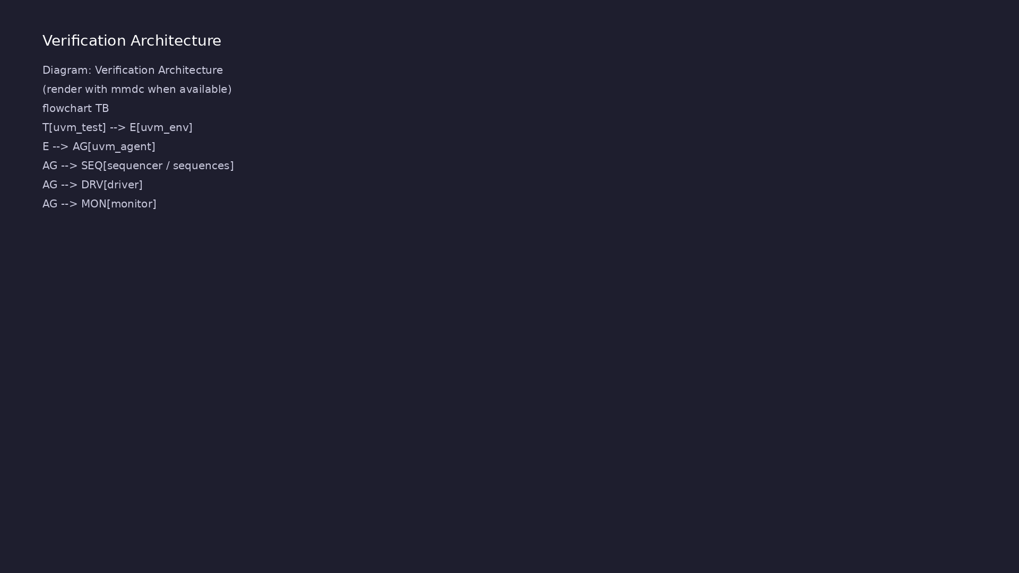
2. UVM testbench architecture
• Hierarchy: `uvm_test` →
`uvm_env` → `uvm_agent` (driver,
monitor, sequencer) → DUT
• `uvm_sequence_item` /
`uvm_sequence` carry
transactions; driver converts
items to pin wiggles
• ConfigDB publishes virtual
interfaces and parameters before
`build_phase`
• Factory + objections control
creation and phase lifetime
learn_uvm_pyuvm / Module 3
Notes:
From MODULE3 Design Architecture.

Slide 11
3. Execution pipeline
• Build: Verilator compiles adder RTL; pyuvm
`build_phase` constructs test/env/agent/component
tree
• Connect: TLM ports linked in `connect_phase`;
ConfigDB delivers virtual interface handles to
driver…
• Sim/run: sequences start on sequencer; driver
applies operands; objections hold run phase until
seq…
• Check/report: monitor samples `sum`; UVM report
phase summarizes errors; expect UVM TEST PASSED
learn_uvm_pyuvm / Module 3
Notes:
From MODULE3 Design Architecture.

Slide 12
4. Module layout
• `module3/examples/` — isolated API demos (phases,
reporting, configdb, factory, objections)
• `module3/tests/pyuvm_tests/` — integrated `make
SIM=verilator TEST=test_simple_uvm` flows
• Each example directory has its own Makefile for
incremental learning
• Assessment maps each example topic to integrated
test behaviors
learn_uvm_pyuvm / Module 3
Notes:
From MODULE3 Design Architecture.

Slide 13
DUT — 8-bit adder
module adder (
input wire clk,
input wire rst_n,
input wire [7:0] a,
input wire [7:0] b,
output reg [7:0] sum,
output reg carry
);
always @(posedge clk or negedge rst_n) begin
if (!rst_n) begin
sum <= 8'h00;
carry <= 1'b0;
end else begin
{carry, sum} <= a + b;
end
# ...
learn_uvm_pyuvm / Module 3

Slide 14
UVM transaction item
class AdderTransaction(uvm_sequence_item):
"""Transaction for adder test."""
def __init__(self, name="AdderTransaction"):
super().__init__(name)
self.a = 0
self.b = 0
self.expected_sum = 0
self.expected_carry = 0
def __str__(self):
return (f"a=0x{self.a:02X}, b=0x{self.b:02X}, "
f"expected_sum=0x{self.expected_sum:02X}, "
f"expected_carry={self.expected_carry}")
# ...
learn_uvm_pyuvm / Module 3

Slide 15
Key files to study
learn_uvm_pyuvm / Module 3

Slide 16
Open these in the repo
• `module3/dut/simple_blocks/adder.v` — primary
combinational DUT for UVM structure labs
• `module3/examples/phases/phases_example.py` — phase
callbacks and simulation lifetime
• `module3/examples/configdb/configdb_example.py` —
virtual interface and parameter publishing
• `module3/examples/factory/factory_example.py` — type
overrides without hierarchy edits
• `module3/tests/pyuvm_tests/test_simple_uvm.py` —
integrated test → env → agent → adder DUT
• `scripts/module3.sh` — per-topic flags (`--phases`,
`--factory`, …) plus `--pyuvm-tests`
learn_uvm_pyuvm / Module 3
Notes:
Trace while running module3/EXAMPLES.md labs.

Slide 17
Verification & testing methods
learn_uvm_pyuvm / Module 3

Slide 18
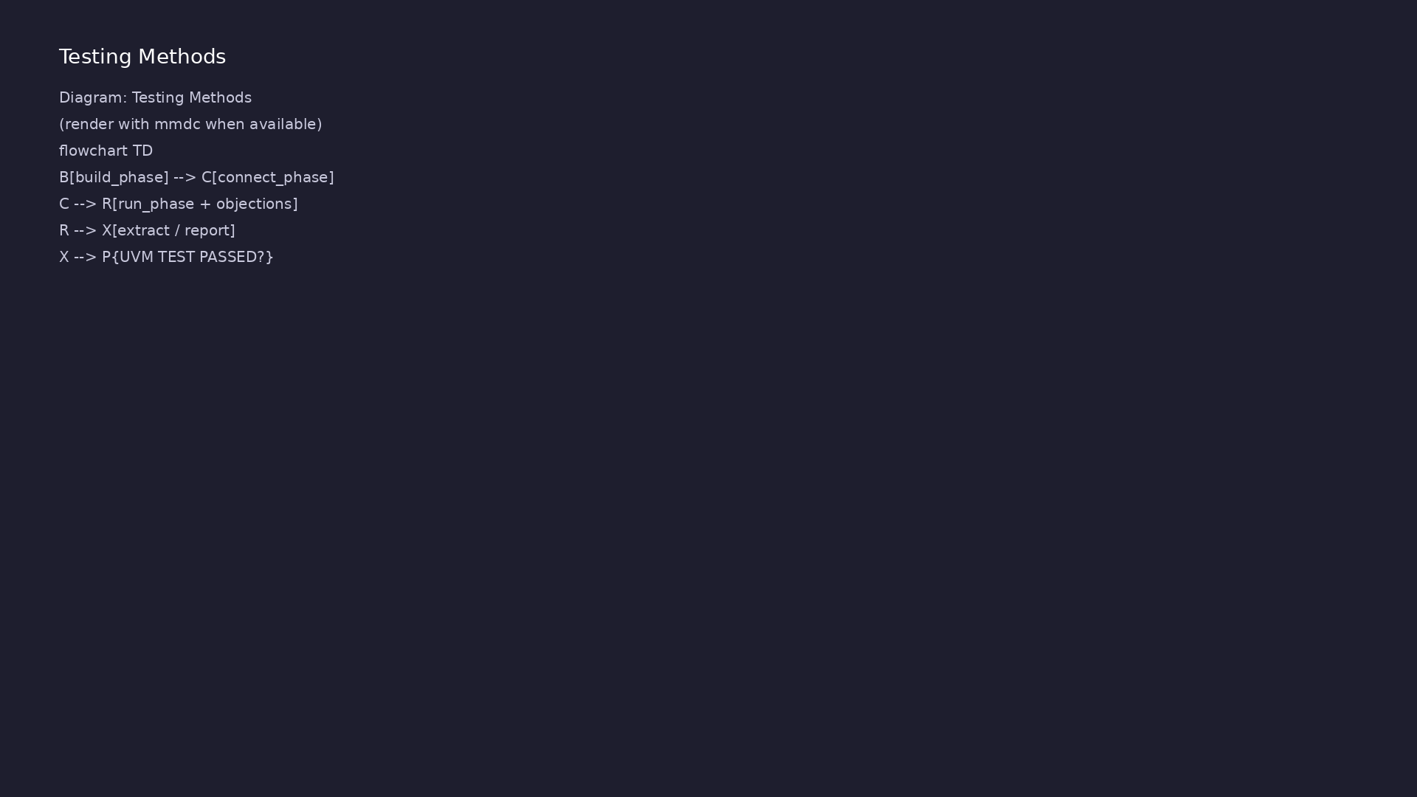
1. Phase-based test execution
• build → connect →
end_of_elaboration →
start_of_simulation → run →
extract → report
• Objections in run phase prevent
premature finish until sequences
complete
• Reporting verbosity filters
debug vs error messages
learn_uvm_pyuvm / Module 3
Notes:
From MODULE3 Verification & Testing Methods.

Slide 19
2. Stimulus and checking
• Directed sequences on adder operands; monitor
samples outputs for scoreboard hooks
• Factory overrides swap test/agent types without
editing hierarchy code
• ConfigDB sets agent active/passive and interface
handles
learn_uvm_pyuvm / Module 3
Notes:
From MODULE3 Verification & Testing Methods.

Slide 20
3. Step-by-step lab execution
• 1. API drills: `./scripts/module3.sh --class-
hierarchy --phases --configdb`
• 2. Factory/objections: `./scripts/module3.sh
--factory --objections`
• 3. Integrated test: `./scripts/module3.sh --pyuvm-
tests` (or `make TEST=test_simple_uvm`)
• 4. Confirm simulation log shows phase progression
and no UVM_ERROR/FATAL
• 5. Optional: factory override exercise from
examples, re-run integrated test to observe swapped
typ…
learn_uvm_pyuvm / Module 3
Notes:
From MODULE3 Verification & Testing Methods.

Slide 21
4. Closure
• `./scripts/module3.sh --pyuvm-tests` and per-topic
flags (`--phases`, `--factory`, …)
• Pass when simulation report shows UVM TEST PASSED
and no fatal errors
• Assessment: class hierarchy, phases, configdb,
factory, objections
learn_uvm_pyuvm / Module 3
Notes:
From MODULE3 Verification & Testing Methods.

Slide 22
Syllabus topics
learn_uvm_pyuvm / Module 3

Slide 23
1. Introduction to UVM (1/3)
• What is UVM?
• Universal Verification Methodology
• Industry standard for verification
• Methodology vs library
• History and evolution
• Why UVM?
learn_uvm_pyuvm / Module 3
Notes:
From MODULE3 Topics Covered.

Slide 24
1. Introduction to UVM (2/3)
• Reusability
• Standardization
• Scalability
• Maintainability
• UVM in Python (pyuvm)
• Python implementation of UVM 1.2
learn_uvm_pyuvm / Module 3
Notes:
From MODULE3 Topics Covered.

Slide 25
1. Introduction to UVM (3/3)
• Advantages over SystemVerilog UVM
• Compatibility and features
learn_uvm_pyuvm / Module 3
Notes:
From MODULE3 Topics Covered.

Slide 26
2. UVM Class Hierarchy (1/4)
• Base Classes
• `uvm_object` - Base for all UVM objects
• `uvm_component` - Base for all UVM components
• Differences and use cases
• Component Classes
• `uvm_test` - Top-level test class
learn_uvm_pyuvm / Module 3
Notes:
From MODULE3 Topics Covered.

Slide 27
2. UVM Class Hierarchy (2/4)
• `uvm_env` - Environment container
• `uvm_agent` - Agent (driver, monitor, sequencer)
• `uvm_driver` - Drives transactions to DUT
• `uvm_monitor` - Monitors DUT signals
• `uvm_sequencer` - Manages sequences
• `uvm_scoreboard` - Checks results
learn_uvm_pyuvm / Module 3
Notes:
From MODULE3 Topics Covered.

Slide 28
2. UVM Class Hierarchy (3/4)
• Object Classes
• `uvm_sequence_item` - Transaction objects
• `uvm_sequence` - Sequence of transactions
• `uvm_config_object` - Configuration objects
• Class Relationships
• Inheritance hierarchy
learn_uvm_pyuvm / Module 3
Notes:
From MODULE3 Topics Covered.

Slide 29
2. UVM Class Hierarchy (4/4)
• Composition patterns
• Factory pattern
learn_uvm_pyuvm / Module 3
Notes:
From MODULE3 Topics Covered.

Slide 30
3. UVM Phases (1/6)
• Phase Overview
• Why phases exist
• Phase execution order
• Phase synchronization
• Phase types
• Build Phases
learn_uvm_pyuvm / Module 3
Notes:
From MODULE3 Topics Covered.

Slide 31
3. UVM Phases (2/6)
• `build_phase()` - Component construction
• `connect_phase()` - Component connections
• `end_of_elaboration_phase()` - Final setup
• Run Phases
• `run_phase()` - Main test execution
• `pre_reset_phase()` - Before reset
learn_uvm_pyuvm / Module 3
Notes:
From MODULE3 Topics Covered.

Slide 32
3. UVM Phases (3/6)
• `reset_phase()` - Reset sequence
• `post_reset_phase()` - After reset
• `pre_configure_phase()` - Before configuration
• `configure_phase()` - Configuration
• `post_configure_phase()` - After configuration
• `pre_main_phase()` - Before main test
learn_uvm_pyuvm / Module 3
Notes:
From MODULE3 Topics Covered.

Slide 33
3. UVM Phases (4/6)
• `main_phase()` - Main test execution
• `post_main_phase()` - After main test
• `pre_shutdown_phase()` - Before shutdown
• `shutdown_phase()` - Shutdown sequence
• `post_shutdown_phase()` - After shutdown
• Cleanup Phases
learn_uvm_pyuvm / Module 3
Notes:
From MODULE3 Topics Covered.

Slide 34
3. UVM Phases (5/6)
• `extract_phase()` - Extract results
• `check_phase()` - Final checks
• `report_phase()` - Generate reports
• `final_phase()` - Final cleanup
• Phase Implementation
• Synchronous phases (build, connect)
learn_uvm_pyuvm / Module 3
Notes:
From MODULE3 Topics Covered.

Slide 35
3. UVM Phases (6/6)
• Asynchronous phases (run phases)
• Phase methods
• Phase ordering
learn_uvm_pyuvm / Module 3
Notes:
From MODULE3 Topics Covered.

Slide 36
4. UVM Reporting System (1/5)
• Reporting Overview
• UVM messaging system
• Severity levels
• Verbosity levels
• Message formatting
• Severity Levels
learn_uvm_pyuvm / Module 3
Notes:
From MODULE3 Topics Covered.

Slide 37
4. UVM Reporting System (2/5)
• `UVM_FATAL` - Fatal errors
• `UVM_ERROR` - Errors
• `UVM_WARNING` - Warnings
• `UVM_INFO` - Informational
• `UVM_DEBUG` - Debug messages
• Verbosity Levels
learn_uvm_pyuvm / Module 3
Notes:
From MODULE3 Topics Covered.

Slide 38
4. UVM Reporting System (3/5)
• `UVM_NONE` - No messages
• `UVM_LOW` - Low verbosity
• `UVM_MEDIUM` - Medium verbosity
• `UVM_HIGH` - High verbosity
• `UVM_FULL` - Full verbosity
• `UVM_DEBUG` - Debug verbosity
learn_uvm_pyuvm / Module 3
Notes:
From MODULE3 Topics Covered.

Slide 39
4. UVM Reporting System (4/5)
• Using Reporting
• `self.logger.info()`
• `self.logger.warning()`
• `self.logger.error()`
• `self.logger.fatal()`
• Message formatting
learn_uvm_pyuvm / Module 3
Notes:
From MODULE3 Topics Covered.

Slide 40
4. UVM Reporting System (5/5)
• Verbosity control
learn_uvm_pyuvm / Module 3
Notes:
From MODULE3 Topics Covered.

Slide 41
5. UVM Configuration Database (ConfigDB) (1/4)
• ConfigDB Overview
• What is ConfigDB?
• Why use ConfigDB?
• Configuration hierarchy
• Setting Configuration
• `ConfigDB().set()`
learn_uvm_pyuvm / Module 3
Notes:
From MODULE3 Topics Covered.

Slide 42
5. UVM Configuration Database (ConfigDB) (2/4)
• Configuration paths
• Configuration objects
• Scalar configuration
• Getting Configuration
• `ConfigDB().get()`
• Configuration lookup
learn_uvm_pyuvm / Module 3
Notes:
From MODULE3 Topics Covered.

Slide 43
5. UVM Configuration Database (ConfigDB) (3/4)
• Default values
• Configuration checking
• Configuration Patterns
• Agent configuration
• Environment configuration
• Test configuration
learn_uvm_pyuvm / Module 3
Notes:
From MODULE3 Topics Covered.

Slide 44
5. UVM Configuration Database (ConfigDB) (4/4)
• Hierarchical configuration
learn_uvm_pyuvm / Module 3
Notes:
From MODULE3 Topics Covered.

Slide 45
6. Factory Pattern (1/2)
• Factory Overview
• What is the factory?
• Why use factory?
• Factory benefits
• Factory Usage
• Type registration
learn_uvm_pyuvm / Module 3
Notes:
From MODULE3 Topics Covered.

Slide 46
6. Factory Pattern (2/2)
• Object creation
• Override mechanism
• Factory patterns
learn_uvm_pyuvm / Module 3
Notes:
From MODULE3 Topics Covered.

Slide 47
7. First UVM Test Class (1/3)
• Test Structure
• Test class definition
• Inheriting from `uvm_test`
• Required methods
• Test organization
• Environment Creation
learn_uvm_pyuvm / Module 3
Notes:
From MODULE3 Topics Covered.

Slide 48
7. First UVM Test Class (2/3)
• Creating environment
• Environment hierarchy
• Component instantiation
• Test Execution
• `run_phase()` implementation
• Objection mechanism
learn_uvm_pyuvm / Module 3
Notes:
From MODULE3 Topics Covered.

Slide 49
7. First UVM Test Class (3/3)
• Test flow
• Completion
learn_uvm_pyuvm / Module 3
Notes:
From MODULE3 Topics Covered.

Slide 50
8. Environment Structure (1/3)
• Environment Basics
• What is environment?
• Environment purpose
• Environment structure
• Environment Components
• Agent instantiation
learn_uvm_pyuvm / Module 3
Notes:
From MODULE3 Topics Covered.

Slide 51
8. Environment Structure (2/3)
• Scoreboard instantiation
• Coverage instantiation
• Other components
• Environment Connections
• Component connections
• Analysis port connections
learn_uvm_pyuvm / Module 3
Notes:
From MODULE3 Topics Covered.

Slide 52
8. Environment Structure (3/3)
• TLM connections
learn_uvm_pyuvm / Module 3
Notes:
From MODULE3 Topics Covered.

Slide 53
9. Objection Mechanism (1/3)
• Objections Overview
• What are objections?
• Why objections?
• Objection lifecycle
• Using Objections
• `raise_objection()`
learn_uvm_pyuvm / Module 3
Notes:
From MODULE3 Topics Covered.

Slide 54
9. Objection Mechanism (2/3)
• `drop_objection()`
• Objection timing
• Multiple objections
• Objection Patterns
• Test objections
• Sequence objections
learn_uvm_pyuvm / Module 3
Notes:
From MODULE3 Topics Covered.

Slide 55
9. Objection Mechanism (3/3)
• Component objections
• Best practices
learn_uvm_pyuvm / Module 3
Notes:
From MODULE3 Topics Covered.

Slide 56
10. UVM Test Execution (1/3)
• Test Flow
• Test startup
• Phase execution
• Test completion
• Cleanup
• Running Tests
learn_uvm_pyuvm / Module 3
Notes:
From MODULE3 Topics Covered.

Slide 57
10. UVM Test Execution (2/3)
• `uvm_root().run_test()`
• Test selection
• Test parameters
• Test execution
• Test Organization
• Multiple tests
learn_uvm_pyuvm / Module 3
Notes:
From MODULE3 Topics Covered.

Slide 58
10. UVM Test Execution (3/3)
• Test inheritance
• Test libraries
• Test selection
learn_uvm_pyuvm / Module 3
Notes:
From MODULE3 Topics Covered.

Slide 59
Command reference highlights
learn_uvm_pyuvm / Module 3

Slide 60
Isolated UVM API examples
• `./scripts/module3.sh --phases --reporting` — phase
and verbosity drills
• `./scripts/module3.sh --configdb --factory
--objections` — ConfigDB, factory, objection tracks
• `./scripts/module3.sh --class-hierarchy` — component
tree and TLM port basics
learn_uvm_pyuvm / Module 3
Notes:
Full detail in docs/MODULE3.md command reference.

Slide 61
Integrated pyuvm simulation
• `./scripts/module3.sh --pyuvm-tests` — default
integrated regression against adder DUT
• `cd module3/tests/pyuvm_tests && make SIM=verilator
TEST=test_simple_uvm` — direct Make debug path
• `./scripts/module3.sh --skip-examples --pyuvm-tests`
— jump to integrated test when API drills are…
learn_uvm_pyuvm / Module 3
Notes:
Full detail in docs/MODULE3.md command reference.

Slide 62
Verbosity and overrides
• Set `PYUVM_VERBOSITY` or plusargs (when supported)
to filter UVM report noise during debug
• Factory overrides in examples swap test/agent types
— mirror pattern in integrated test
• Re-run single example Make target under
`module3/examples/<topic>/` for fast iteration
learn_uvm_pyuvm / Module 3
Notes:
Full detail in docs/MODULE3.md command reference.

Slide 63
Hands-on examples
learn_uvm_pyuvm / Module 3

Slide 64
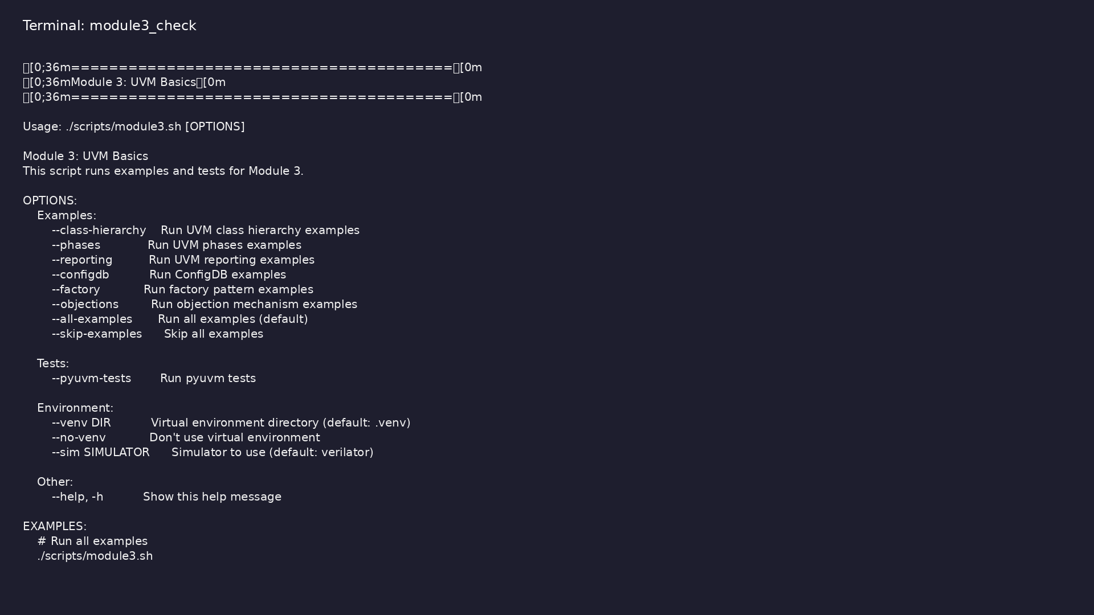
Module 3 orchestrator
$ ./scripts/module3.sh --help
learn_uvm_pyuvm / Module 3
Notes:
Run from course repository root.

Slide 65
Exercise scaffold
./scripts/module3.sh --scaffold
learn_uvm_pyuvm / Module 3

Slide 66
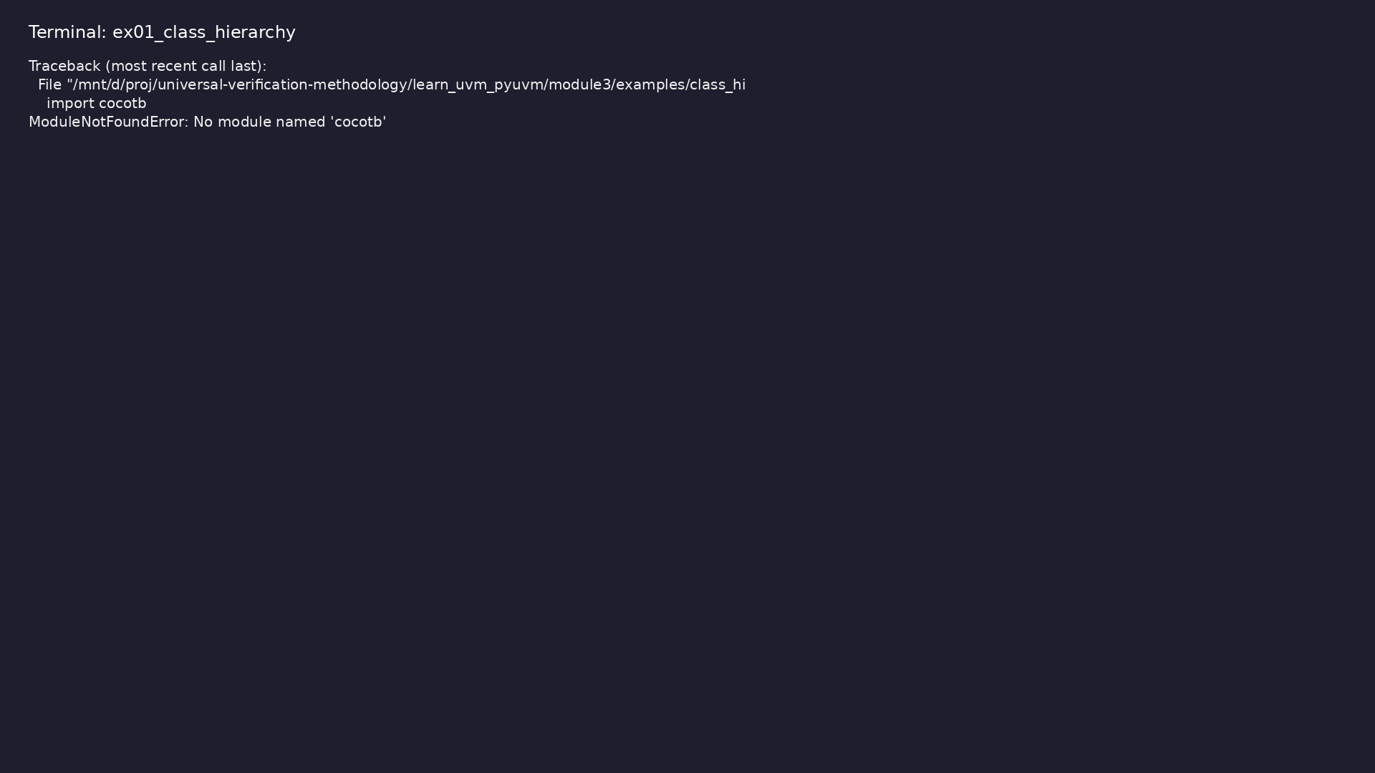
Demo: Class Hierarchy
$ .venv/bin/python
module3/examples/class_hierarchy/class_hierarchy_example.py
learn_uvm_pyuvm / Module 3
Notes:
Hands-on: module3/examples/class_hierarchy/

Slide 67
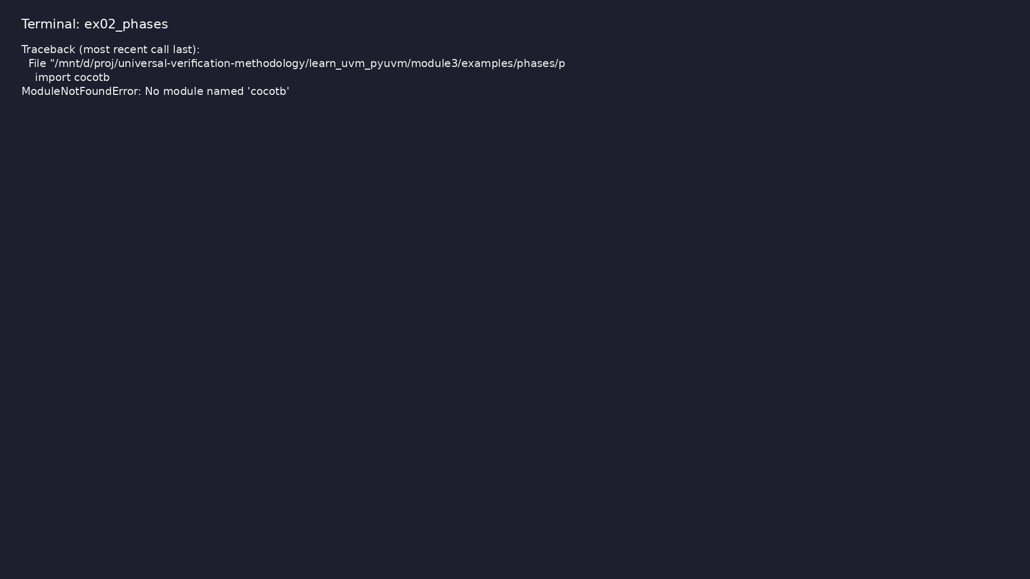
Demo: UVM Phases
$ .venv/bin/python module3/examples/phases/phases_example.py
learn_uvm_pyuvm / Module 3
Notes:
Hands-on: module3/examples/phases/

Slide 68
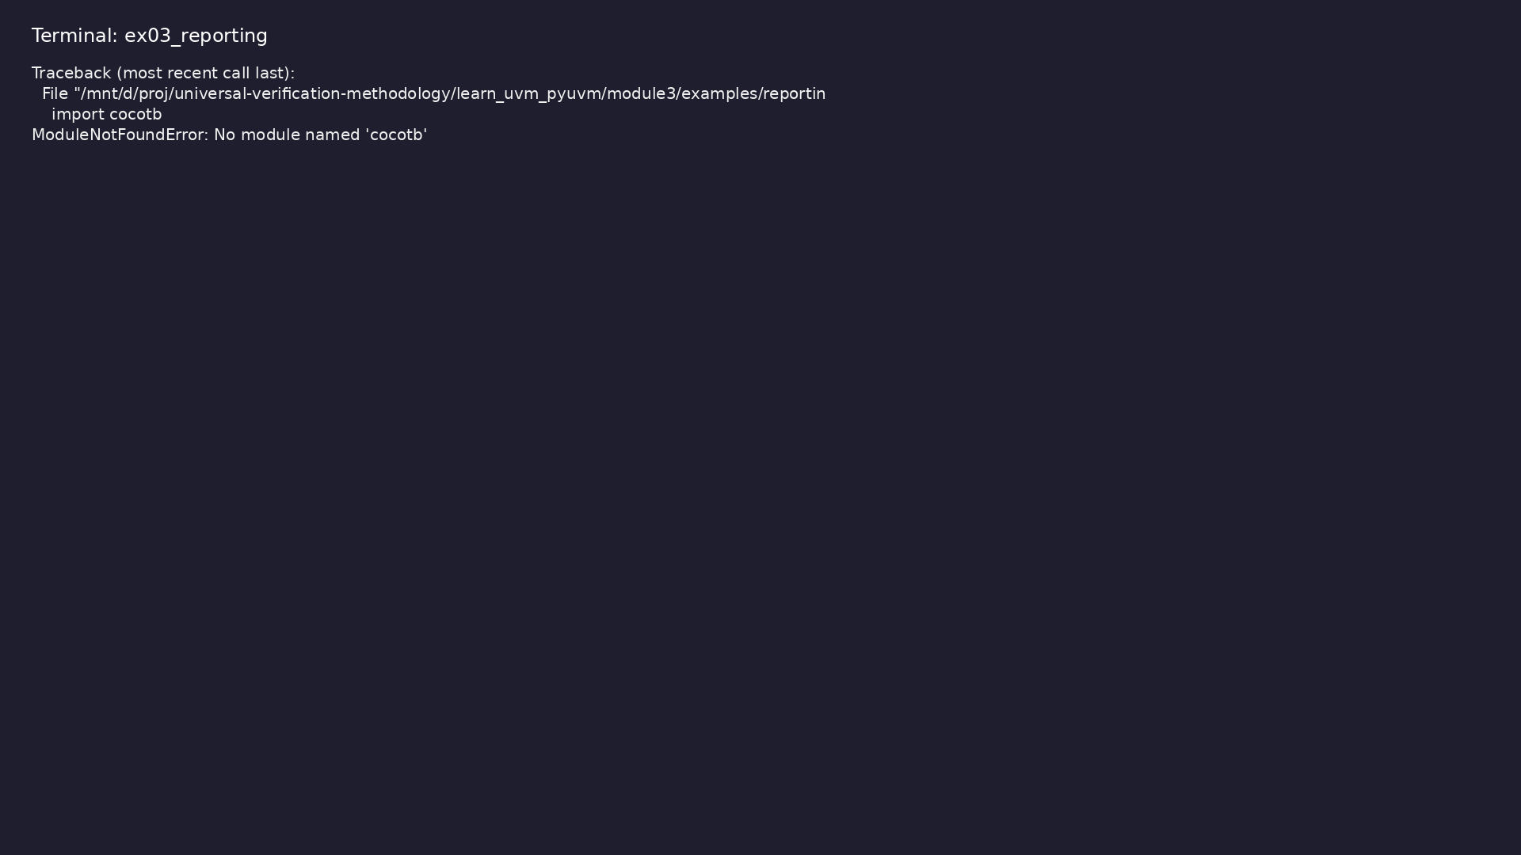
Demo: UVM Reporting
$ .venv/bin/python module3/examples/reporting/reporting_example.py
learn_uvm_pyuvm / Module 3
Notes:
Hands-on: module3/examples/reporting/

Slide 69
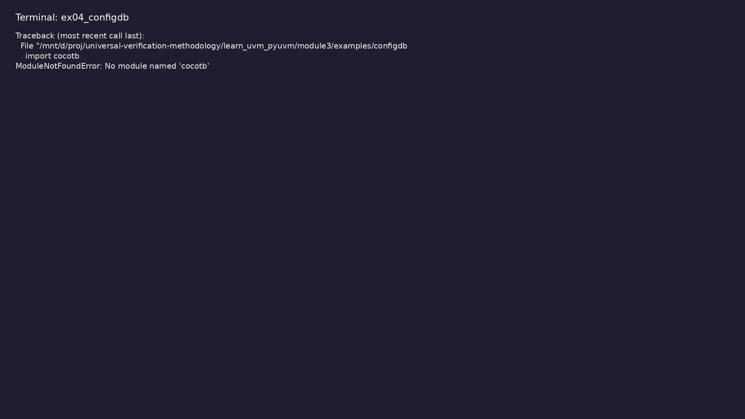
Demo: ConfigDB
$ .venv/bin/python module3/examples/configdb/configdb_example.py
learn_uvm_pyuvm / Module 3
Notes:
Hands-on: module3/examples/configdb/

Slide 70

Demo: Factory Pattern
$ .venv/bin/python module3/examples/factory/factory_example.py
learn_uvm_pyuvm / Module 3
Notes:
Hands-on: module3/examples/factory/

Slide 71

Demo: Objection Mechanism
$ .venv/bin/python module3/examples/objections/objections_example.py
learn_uvm_pyuvm / Module 3
Notes:
Hands-on: module3/examples/objections/

Slide 72
Practice & assessment
learn_uvm_pyuvm / Module 3

Slide 73
What you should know (1/3)
• Understand UVM methodology
• Explain UVM class hierarchy
• Understand and use UVM phases
• Use UVM reporting effectively
• Use ConfigDB for configuration
• Understand factory pattern
learn_uvm_pyuvm / Module 3
Notes:
From MODULE3 Learning Outcomes.

Slide 74
What you should know (2/3)
• Create UVM test classes
• Structure UVM environments
• Use objection mechanism
• Execute UVM tests
• Test class definition
• Basic phases
learn_uvm_pyuvm / Module 3
Notes:
From MODULE3 Learning Outcomes.

Slide 75
What you should know (3/3)
• Objection mechanism
learn_uvm_pyuvm / Module 3
Notes:
From MODULE3 Learning Outcomes.

Slide 76
Exercises
• Test Class Creation
• Environment Structure
• Reporting
• Configuration
• Phase Understanding
learn_uvm_pyuvm / Module 3

Slide 77
Assessment checklist
• Understands UVM methodology
• Can explain class hierarchy
• Understands all UVM phases
• Can use UVM reporting
• Can use ConfigDB
• Understands factory pattern
learn_uvm_pyuvm / Module 3

Slide 78
Summary & next steps
• Master UVM class hierarchy and phases
• Complete module3/CHECKLIST.md
• Review module3/EXAMPLES.md and run each lab
• Next: Next module in course
learn_uvm_pyuvm / Module 3

