Slide 1
Module 4
UVM Components
learn_uvm_pyuvm / Module 4

Slide 2
Learning objectives
• Build complete UVM agents with driver, monitor, and
sequencer
learn_uvm_pyuvm / Module 4

Slide 3
Prerequisites
• See module README
learn_uvm_pyuvm / Module 4

Slide 4
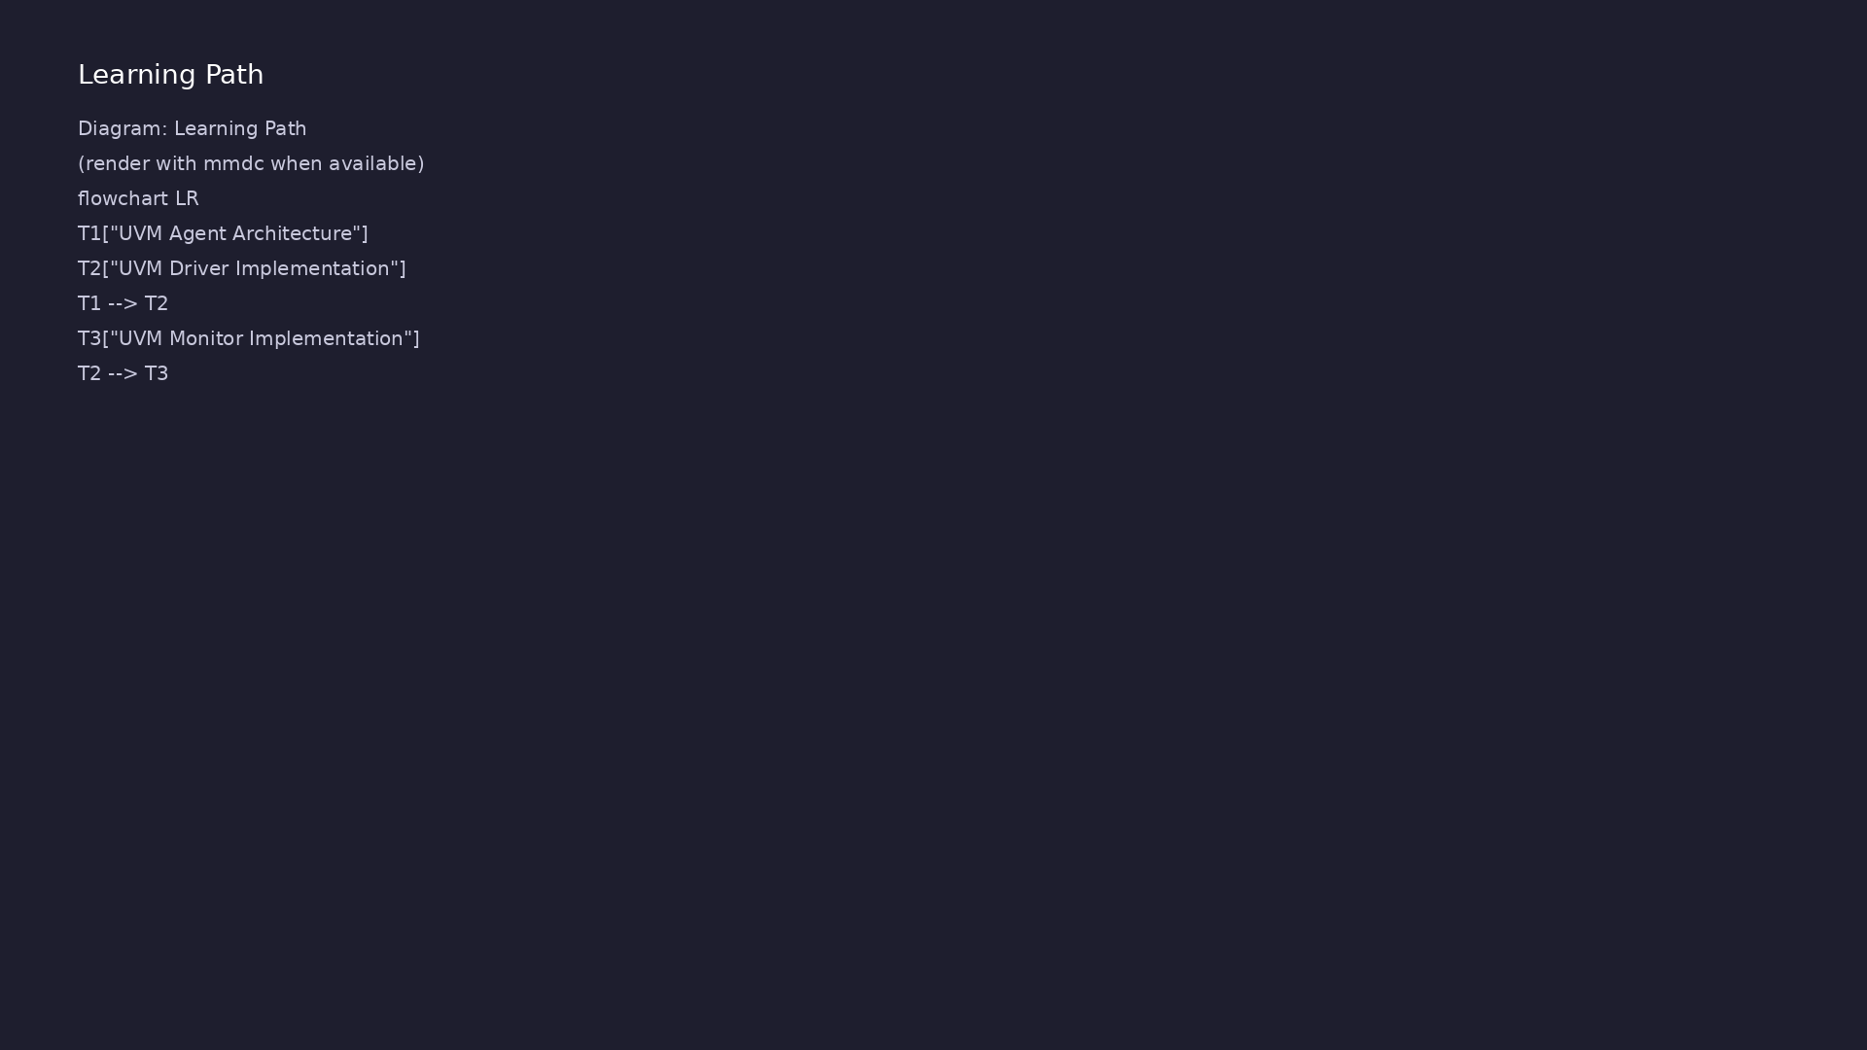
Learning path
Build complete UVM agents with driver, monitor, and sequencer
learn_uvm_pyuvm / Module 4

Slide 5
Overview
• This module covers the core UVM components used to
build verification environments. You'll learn ho…
learn_uvm_pyuvm / Module 4

Slide 6
How to learn this module
learn_uvm_pyuvm / Module 4

Slide 7
Suggested learning path
• Module 3 UVM hierarchy and phases must be
comfortable — agents bundle components you studied
separa…
• Study `module4/dut/interfaces/simple_interface.v`
valid/ready handshake before driver labs
• Run examples in order: transactions → driver →
monitor → sequencer → scoreboard → TLM → agents
• Read `InterfaceTransaction` field definitions and
`copy`/`compare` before scoreboard integration
• Integrated capstone is `test_complete_agent.py` — do
not skip per-component examples
learn_uvm_pyuvm / Module 4
Notes:
From docs/MODULE4.md — read guides before running demos.

Slide 8
Design architecture
learn_uvm_pyuvm / Module 4

Slide 9
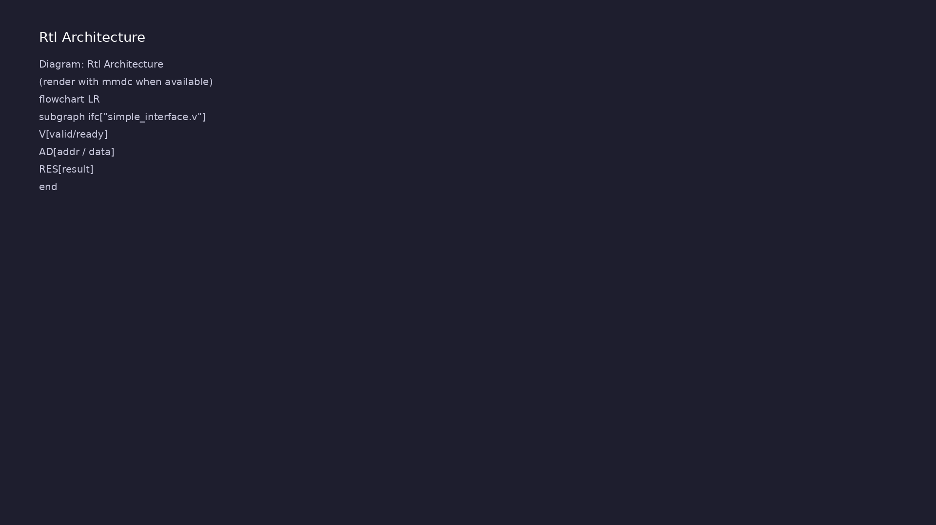
1. DUT and interface protocol
• `module4/dut/interfaces/simple_i
nterface.v` — valid/ready
handshake, address/data/result
buses
• Clocked, resettable interface
models streaming transactions
• Agent maps one transaction type
to one interface beat
learn_uvm_pyuvm / Module 4
Notes:
From MODULE4 Design Architecture.

Slide 10
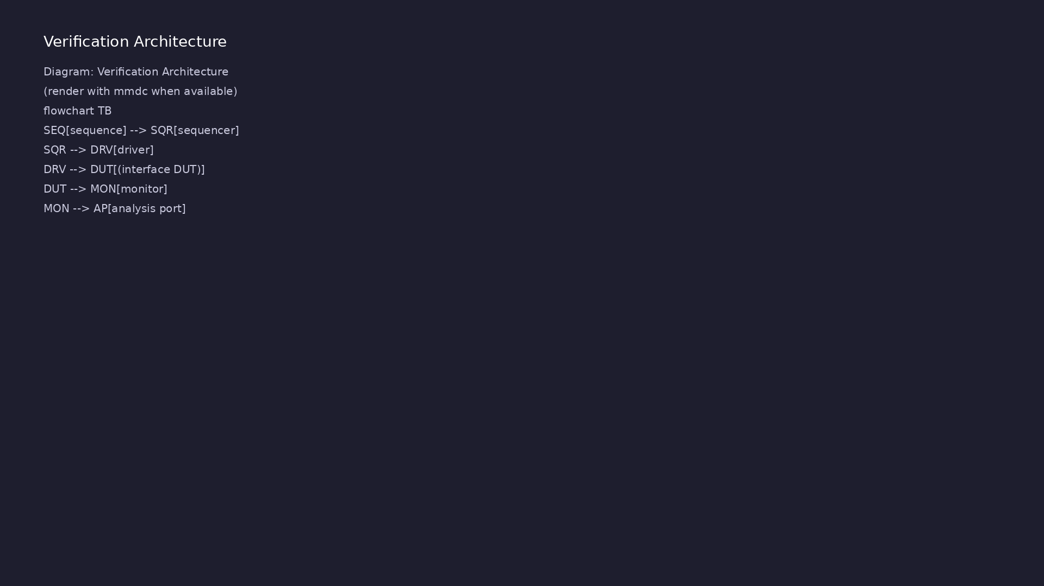
2. Agent-centric UVM architecture
• Agent bundles driver, monitor,
sequencer; env holds agent +
scoreboard
• TLM analysis ports connect
monitor → scoreboard (and
optional coverage)
• `InterfaceTransaction` defines
fields, `copy`/`compare`, and
constraints
• Complete path: sequence →
sequencer → driver → DUT →
monitor → scoreboard
learn_uvm_pyuvm / Module 4
Notes:
From MODULE4 Design Architecture.

Slide 11
3. Execution pipeline
• Build: Verilator compiles `simple_interface.v`; env
builds agent (driver, monitor, sequencer) and s…
• Connect: monitor `ap` → scoreboard `exp`/`act`
analysis imports; sequencer ↔ driver TLM ports
• Sim: sequence items drive valid/ready beats; monitor
reconstructs transactions on completed handsha…
• Check: scoreboard `compare` on monitored vs
predicted streams; UVM report summarizes mismatches
learn_uvm_pyuvm / Module 4
Notes:
From MODULE4 Design Architecture.

Slide 12
4. Component responsibilities
• Driver: pull items from sequencer, drive pins per
protocol
• Monitor: passive observation, broadcast transactions
on analysis port
• Sequencer: arbitration and sequence execution
• Scoreboard: expected vs actual from monitor streams
learn_uvm_pyuvm / Module 4
Notes:
From MODULE4 Design Architecture.

Slide 13
Interface — valid/ready handshake
/**
* Module 4: Simple Interface
*
* A simple interface for UVM component testing.
*
* Ports:
* clk: Clock signal
* rst_n: Active-low reset
* valid: Valid signal
* ready: Ready signal
* data: Data bus
* address: Address bus
*/
module simple_interface (
input wire clk,
# ...
learn_uvm_pyuvm / Module 4

Slide 14
Agent-centric env wiring
"""
Module 4 Test: Complete Agent Test
Complete UVM testbench with driver, monitor, sequencer, and scoreboard.
"""
import cocotb
from cocotb.clock import Clock
from cocotb.triggers import Timer, RisingEdge
from pyuvm import *
# Explicitly import uvm_seq_item_pull_port - it may not be exported by
from pyuvm import *
# Try multiple possible import paths
_uvm_seq_item_pull_port = None
try:
# First try: check if it's in the namespace after from pyuvm import
*
_uvm_seq_item_pull_port = globals()['uvm_seq_item_pull_port']
except KeyError:
learn_uvm_pyuvm / Module 4

Slide 15
Key files to study
learn_uvm_pyuvm / Module 4

Slide 16
Open these in the repo
• `module4/dut/interfaces/simple_interface.v` —
valid/ready streaming interface with
addr/data/result
• `module4/examples/transactions/transaction_example.p
y` — sequence item fields and compare/copy
• `module4/examples/drivers/driver_example.py` —
sequencer pull loop and pin wiggling
• `module4/examples/monitors/monitor_example.py` —
passive sampling and analysis port broadcast
• `module4/tests/pyuvm_tests/test_complete_agent.py` —
end-to-end agent, env, scoreboard integration
• `scripts/module4.sh` — `--drivers` … `--agents`
example flags and `--pyuvm-tests`
learn_uvm_pyuvm / Module 4
Notes:
Trace while running module4/EXAMPLES.md labs.

Slide 17
Verification & testing methods
learn_uvm_pyuvm / Module 4

Slide 18
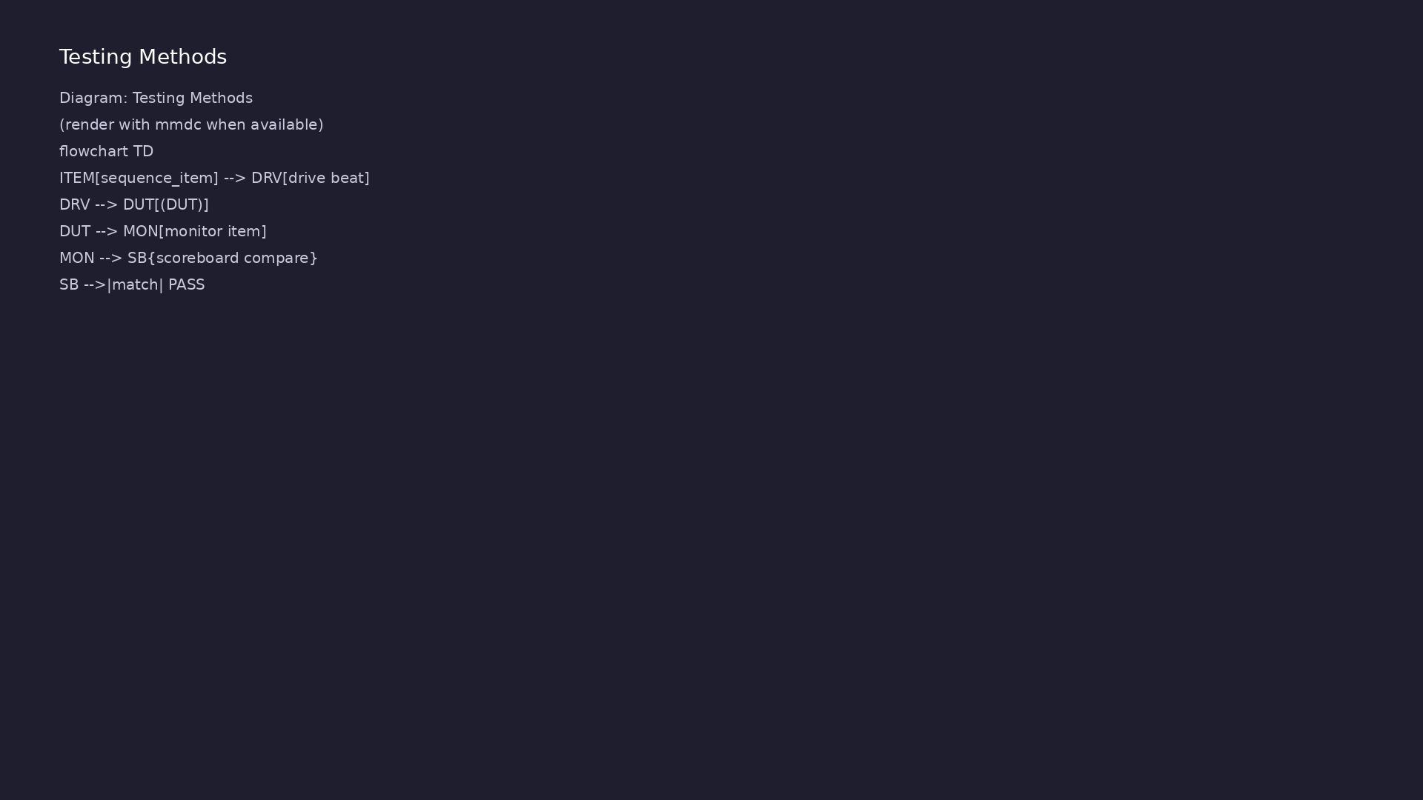
1. Integration testing method
• `test_complete_agent.py` — end-
to-end agent, env, and test
class
• Run: `./scripts/module4.sh
--pyuvm-tests` or `make
TEST=test_complete_agent`
• Per-component examples
(`driver_example.py`, …) isolate
behavior before integration
learn_uvm_pyuvm / Module 4
Notes:
From MODULE4 Verification & Testing Methods.

Slide 19
2. Checking strategy
• Scoreboard compares monitored results to predicted
model or golden vectors
• Analysis port fan-out allows multiple checkers
without changing monitor
• Sequences provide repeatable stimulus;
random/constrained extensions in exercises
learn_uvm_pyuvm / Module 4
Notes:
From MODULE4 Verification & Testing Methods.

Slide 20
3. Step-by-step lab execution
• 1. Transactions: `./scripts/module4.sh
--transactions`
• 2. Driver/monitor/sequencer: `./scripts/module4.sh
--drivers --monitors --sequencers`
• 3. Scoreboard/TLM: `./scripts/module4.sh
--scoreboards --tlm`
• 4. Agent assembly: `./scripts/module4.sh --agents`
• 5. Capstone: `./scripts/module4.sh --pyuvm-tests` —
confirm scoreboard clean and UVM TEST PASSED
learn_uvm_pyuvm / Module 4
Notes:
From MODULE4 Verification & Testing Methods.

Slide 21
4. Closure
• Self-check via `./scripts/module4.sh --pyuvm-tests`;
demo screenshots per EXAMPLES.md section
• Assessment: drivers, monitors, sequencers, agents,
scoreboards, TLM connections
• You should trace one transaction from sequence item
through to scoreboard compare
learn_uvm_pyuvm / Module 4
Notes:
From MODULE4 Verification & Testing Methods.

Slide 22
Syllabus topics
learn_uvm_pyuvm / Module 4

Slide 23
1. UVM Agent Architecture (1/3)
• Agent Overview
• What is an agent?
• Agent components
• Agent purpose
• Agent types
• Active vs Passive Agents
learn_uvm_pyuvm / Module 4
Notes:
From MODULE4 Topics Covered.

Slide 24
1. UVM Agent Architecture (2/3)
• Active agents (driver + sequencer + monitor)
• Passive agents (monitor only)
• When to use each
• Agent configuration
• Agent Structure
• Driver component
learn_uvm_pyuvm / Module 4
Notes:
From MODULE4 Topics Covered.

Slide 25
1. UVM Agent Architecture (3/3)
• Monitor component
• Sequencer component
• Agent container
learn_uvm_pyuvm / Module 4
Notes:
From MODULE4 Topics Covered.

Slide 26
2. UVM Driver Implementation (1/4)
• Driver Overview
• Driver purpose
• Driver responsibilities
• Driver interface
• Driver lifecycle
• Driver Implementation
learn_uvm_pyuvm / Module 4
Notes:
From MODULE4 Topics Covered.

Slide 27
2. UVM Driver Implementation (2/4)
• Inheriting from `uvm_driver`
• `run_phase()` implementation
• Transaction reception
• Signal driving
• Driver-Sequencer Communication
• `seq_item_port` interface
learn_uvm_pyuvm / Module 4
Notes:
From MODULE4 Topics Covered.

Slide 28
2. UVM Driver Implementation (3/4)
• `get_next_item()`
• `item_done()`
• Transaction flow
• Signal-Level Driving
• DUT signal access
• Signal value assignment
learn_uvm_pyuvm / Module 4
Notes:
From MODULE4 Topics Covered.

Slide 29
2. UVM Driver Implementation (4/4)
• Timing control
• Protocol implementation
learn_uvm_pyuvm / Module 4
Notes:
From MODULE4 Topics Covered.

Slide 30
3. UVM Monitor Implementation (1/4)
• Monitor Overview
• Monitor purpose
• Monitor responsibilities
• Monitor types
• Monitor lifecycle
• Monitor Implementation
learn_uvm_pyuvm / Module 4
Notes:
From MODULE4 Topics Covered.

Slide 31
3. UVM Monitor Implementation (2/4)
• Inheriting from `uvm_monitor`
• `run_phase()` implementation
• Signal sampling
• Transaction creation
• Analysis Ports
• Analysis port purpose
learn_uvm_pyuvm / Module 4
Notes:
From MODULE4 Topics Covered.

Slide 32
3. UVM Monitor Implementation (3/4)
• Creating analysis ports
• Writing to analysis ports
• Analysis port connections
• Transaction Creation
• Sampling signals
• Creating transaction objects
learn_uvm_pyuvm / Module 4
Notes:
From MODULE4 Topics Covered.

Slide 33
3. UVM Monitor Implementation (4/4)
• Populating transaction fields
• Broadcasting transactions
learn_uvm_pyuvm / Module 4
Notes:
From MODULE4 Topics Covered.

Slide 34
4. UVM Sequencer and Sequences (1/5)
• Sequencer Overview
• Sequencer purpose
• Sequencer responsibilities
• Sequencer types
• Sequencer lifecycle
• Sequencer Implementation
learn_uvm_pyuvm / Module 4
Notes:
From MODULE4 Topics Covered.

Slide 35
4. UVM Sequencer and Sequences (2/5)
• Inheriting from `uvm_sequencer`
• Default sequencer usage
• Custom sequencer features
• Sequencer configuration
• Sequence Items
• `uvm_sequence_item` base class
learn_uvm_pyuvm / Module 4
Notes:
From MODULE4 Topics Covered.

Slide 36
4. UVM Sequencer and Sequences (3/5)
• Transaction definition
• Transaction fields
• Transaction methods
• Sequence Basics
• `uvm_sequence` base class
• `body()` method
learn_uvm_pyuvm / Module 4
Notes:
From MODULE4 Topics Covered.

Slide 37
4. UVM Sequencer and Sequences (4/5)
• Sequence execution
• Sequence lifecycle
• Sequence Operations
• `start_item()`
• `finish_item()`
• `wait_for_grant()`
learn_uvm_pyuvm / Module 4
Notes:
From MODULE4 Topics Covered.

Slide 38
4. UVM Sequencer and Sequences (5/5)
• Transaction creation
learn_uvm_pyuvm / Module 4
Notes:
From MODULE4 Topics Covered.

Slide 39
5. TLM (Transaction-Level Modeling) - Complete Coverage (1/11)
• TLM Overview
• What is TLM?
• TLM benefits
• TLM abstraction levels
• TLM communication patterns
• TLM Interface Types
learn_uvm_pyuvm / Module 4
Notes:
From MODULE4 Topics Covered.

Slide 40
5. TLM (Transaction-Level Modeling) - Complete Coverage (2/11)
• `put` interface - Unidirectional blocking put
• `get` interface - Unidirectional blocking get
• `peek` interface - Unidirectional non-blocking peek
• `transport` interface - Bidirectional blocking
transport
• Interface characteristics and use cases
• TLM Port Types
learn_uvm_pyuvm / Module 4
Notes:
From MODULE4 Topics Covered.

Slide 41
5. TLM (Transaction-Level Modeling) - Complete Coverage (3/11)
• `uvm_put_port` - Put port
• `uvm_get_port` - Get port
• `uvm_peek_port` - Peek port
• `uvm_transport_port` - Transport port
• Port vs export vs implementation
• TLM Export Types
learn_uvm_pyuvm / Module 4
Notes:
From MODULE4 Topics Covered.

Slide 42
5. TLM (Transaction-Level Modeling) - Complete Coverage (4/11)
• `uvm_put_export` - Put export
• `uvm_get_export` - Get export
• `uvm_peek_export` - Peek export
• `uvm_transport_export` - Transport export
• Export usage patterns
• TLM Implementation Types
learn_uvm_pyuvm / Module 4
Notes:
From MODULE4 Topics Covered.

Slide 43
5. TLM (Transaction-Level Modeling) - Complete Coverage (5/11)
• `uvm_put_imp` - Put implementation
• `uvm_get_imp` - Get implementation
• `uvm_peek_imp` - Peek implementation
• `uvm_transport_imp` - Transport implementation
• Implementation requirements
• Analysis Ports and Exports (Special TLM Type)
learn_uvm_pyuvm / Module 4
Notes:
From MODULE4 Topics Covered.

Slide 44
5. TLM (Transaction-Level Modeling) - Complete Coverage (6/11)
• Analysis port concept
• Publisher-subscriber pattern
• Broadcast communication
• One-to-many connections
• `uvm_analysis_port` - Analysis port
• `uvm_analysis_export` - Analysis export
learn_uvm_pyuvm / Module 4
Notes:
From MODULE4 Topics Covered.

Slide 45
5. TLM (Transaction-Level Modeling) - Complete Coverage (7/11)
• `uvm_analysis_imp` - Analysis implementation
• Connection patterns
• TLM FIFOs
• `uvm_tlm_fifo` - TLM FIFO
• FIFO purpose and usage
• FIFO capacity and blocking behavior
learn_uvm_pyuvm / Module 4
Notes:
From MODULE4 Topics Covered.

Slide 46
5. TLM (Transaction-Level Modeling) - Complete Coverage (8/11)
• FIFO connection patterns
• When to use FIFOs
• TLM Connection Patterns
• Direct connections (port to export)
• FIFO connections (port to FIFO to export)
• Multi-port connections
learn_uvm_pyuvm / Module 4
Notes:
From MODULE4 Topics Covered.

Slide 47
5. TLM (Transaction-Level Modeling) - Complete Coverage (9/11)
• Hierarchical connections
• Connection best practices
• TLM Usage Patterns
• Producer-consumer pattern
• Request-response pattern
• Broadcast pattern
learn_uvm_pyuvm / Module 4
Notes:
From MODULE4 Topics Covered.

Slide 48
5. TLM (Transaction-Level Modeling) - Complete Coverage (10/11)
• Pipeline pattern
• TLM vs analysis ports
• TLM Implementation Examples
• Using put/get interfaces
• Using transport interface
• Using TLM FIFOs
learn_uvm_pyuvm / Module 4
Notes:
From MODULE4 Topics Covered.

Slide 49
5. TLM (Transaction-Level Modeling) - Complete Coverage (11/11)
• Combining TLM types
• TLM debugging
learn_uvm_pyuvm / Module 4
Notes:
From MODULE4 Topics Covered.

Slide 50
6. Scoreboard Implementation (1/4)
• Scoreboard Overview
• Scoreboard purpose
• Scoreboard types
• Scoreboard responsibilities
• Scoreboard lifecycle
• Scoreboard Implementation
learn_uvm_pyuvm / Module 4
Notes:
From MODULE4 Topics Covered.

Slide 51
6. Scoreboard Implementation (2/4)
• Inheriting from `uvm_component`
• Analysis port connections
• Transaction storage
• Comparison logic
• Scoreboard Patterns
• Reference model comparison
learn_uvm_pyuvm / Module 4
Notes:
From MODULE4 Topics Covered.

Slide 52
6. Scoreboard Implementation (3/4)
• Expected vs actual
• Transaction matching
• Error reporting
• Advanced Scoreboards
• Multi-channel scoreboards
• Time-based matching
learn_uvm_pyuvm / Module 4
Notes:
From MODULE4 Topics Covered.

Slide 53
6. Scoreboard Implementation (4/4)
• Complex comparison logic
• Performance optimization
learn_uvm_pyuvm / Module 4
Notes:
From MODULE4 Topics Covered.

Slide 54
7. Transaction-Level Modeling (1/3)
• Transaction Concepts
• What are transactions?
• Transaction abstraction
• Transaction fields
• Transaction methods
• Transaction Design
learn_uvm_pyuvm / Module 4
Notes:
From MODULE4 Topics Covered.

Slide 55
7. Transaction-Level Modeling (2/3)
• Transaction class structure
• Field definition
• Constraint definition
• Method implementation
• Transaction Operations
• Transaction creation
learn_uvm_pyuvm / Module 4
Notes:
From MODULE4 Topics Covered.

Slide 56
7. Transaction-Level Modeling (3/3)
• Transaction copying
• Transaction comparison
• Transaction conversion
learn_uvm_pyuvm / Module 4
Notes:
From MODULE4 Topics Covered.

Slide 57
8. Complete Agent Example (1/3)
• Agent Structure
• Agent class definition
• Component instantiation
• Component connections
• Agent configuration
• Agent Build Phase
learn_uvm_pyuvm / Module 4
Notes:
From MODULE4 Topics Covered.

Slide 58
8. Complete Agent Example (2/3)
• Component creation
• Configuration application
• Active/passive selection
• Agent Connect Phase
• Driver-sequencer connection
• Monitor analysis port
learn_uvm_pyuvm / Module 4
Notes:
From MODULE4 Topics Covered.

Slide 59
8. Complete Agent Example (3/3)
• External connections
learn_uvm_pyuvm / Module 4
Notes:
From MODULE4 Topics Covered.

Slide 60
9. Sequence Libraries (1/2)
• Sequence Organization
• Base sequences
• Derived sequences
• Sequence libraries
• Sequence reuse
• Common Sequences
learn_uvm_pyuvm / Module 4
Notes:
From MODULE4 Topics Covered.

Slide 61
9. Sequence Libraries (2/2)
• Simple sequences
• Random sequences
• Constrained sequences
• Layered sequences
learn_uvm_pyuvm / Module 4
Notes:
From MODULE4 Topics Covered.

Slide 62
10. Agent Integration (1/2)
• Environment Integration
• Adding agents to environment
• Agent configuration
• Agent connections
• Agent coordination
• Test Integration
learn_uvm_pyuvm / Module 4
Notes:
From MODULE4 Topics Covered.

Slide 63
10. Agent Integration (2/2)
• Agent instantiation
• Sequence execution
• Test coordination
• Result checking
learn_uvm_pyuvm / Module 4
Notes:
From MODULE4 Topics Covered.

Slide 64
Command reference highlights
learn_uvm_pyuvm / Module 4

Slide 65
Per-component examples
• `./scripts/module4.sh --transactions --drivers
--monitors` — stimulus and observation building
bloc…
• `./scripts/module4.sh --sequencers --scoreboards
--tlm` — sequence flow and analysis connections
• `./scripts/module4.sh --agents` — complete agent
wiring before capstone test
learn_uvm_pyuvm / Module 4
Notes:
Full detail in docs/MODULE4.md command reference.

Slide 66
Integration test
• `./scripts/module4.sh --pyuvm-tests` — run
`test_complete_agent` via orchestrator
• `cd module4/tests/pyuvm_tests && make SIM=verilator
TEST=test_complete_agent`
• `./scripts/module4.sh --skip-examples --pyuvm-tests`
— capstone only when components are understood
learn_uvm_pyuvm / Module 4
Notes:
Full detail in docs/MODULE4.md command reference.

Slide 67
Debug paths
• Run individual example Make under
`module4/examples/<component>/` to isolate failures
• Increase UVM verbosity to trace sequence → driver →
monitor transaction paths
• Verilator waveforms on interface valid/ready when
handshake debug is needed
learn_uvm_pyuvm / Module 4
Notes:
Full detail in docs/MODULE4.md command reference.

Slide 68
Hands-on examples
learn_uvm_pyuvm / Module 4

Slide 69
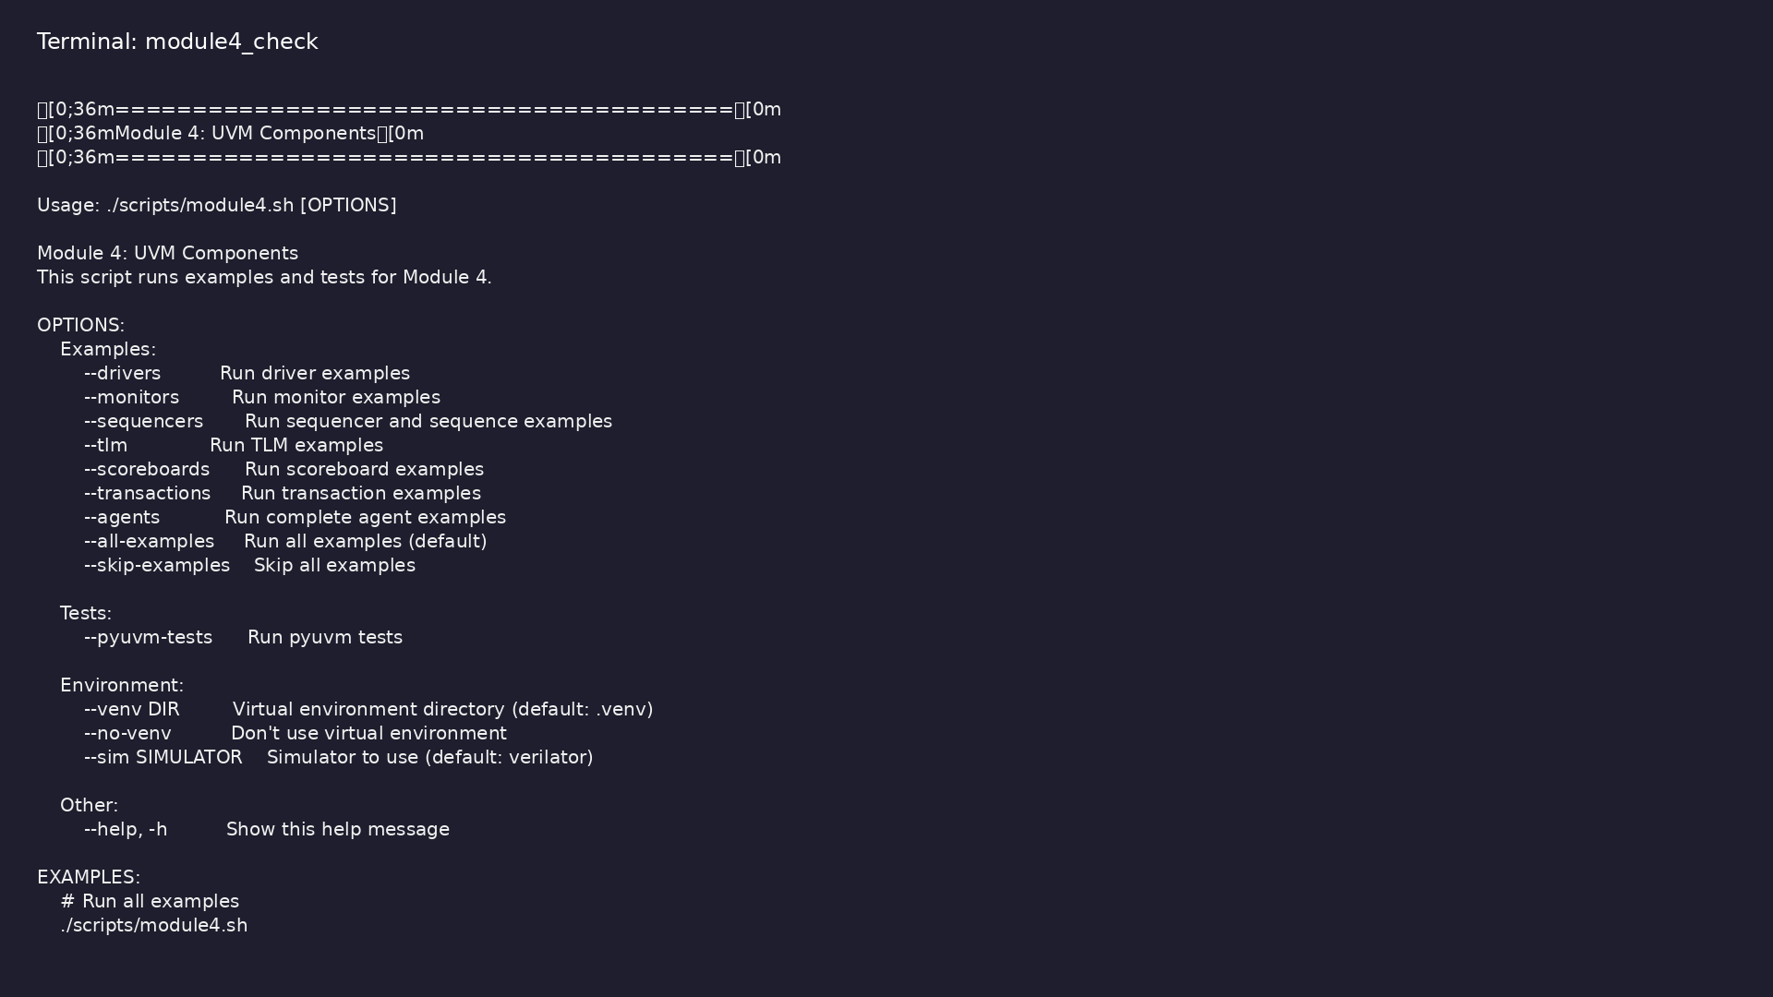
Module 4 orchestrator
$ ./scripts/module4.sh --help
learn_uvm_pyuvm / Module 4
Notes:
Run from course repository root.

Slide 70
Exercise scaffold
./scripts/module4.sh --scaffold
learn_uvm_pyuvm / Module 4

Slide 71
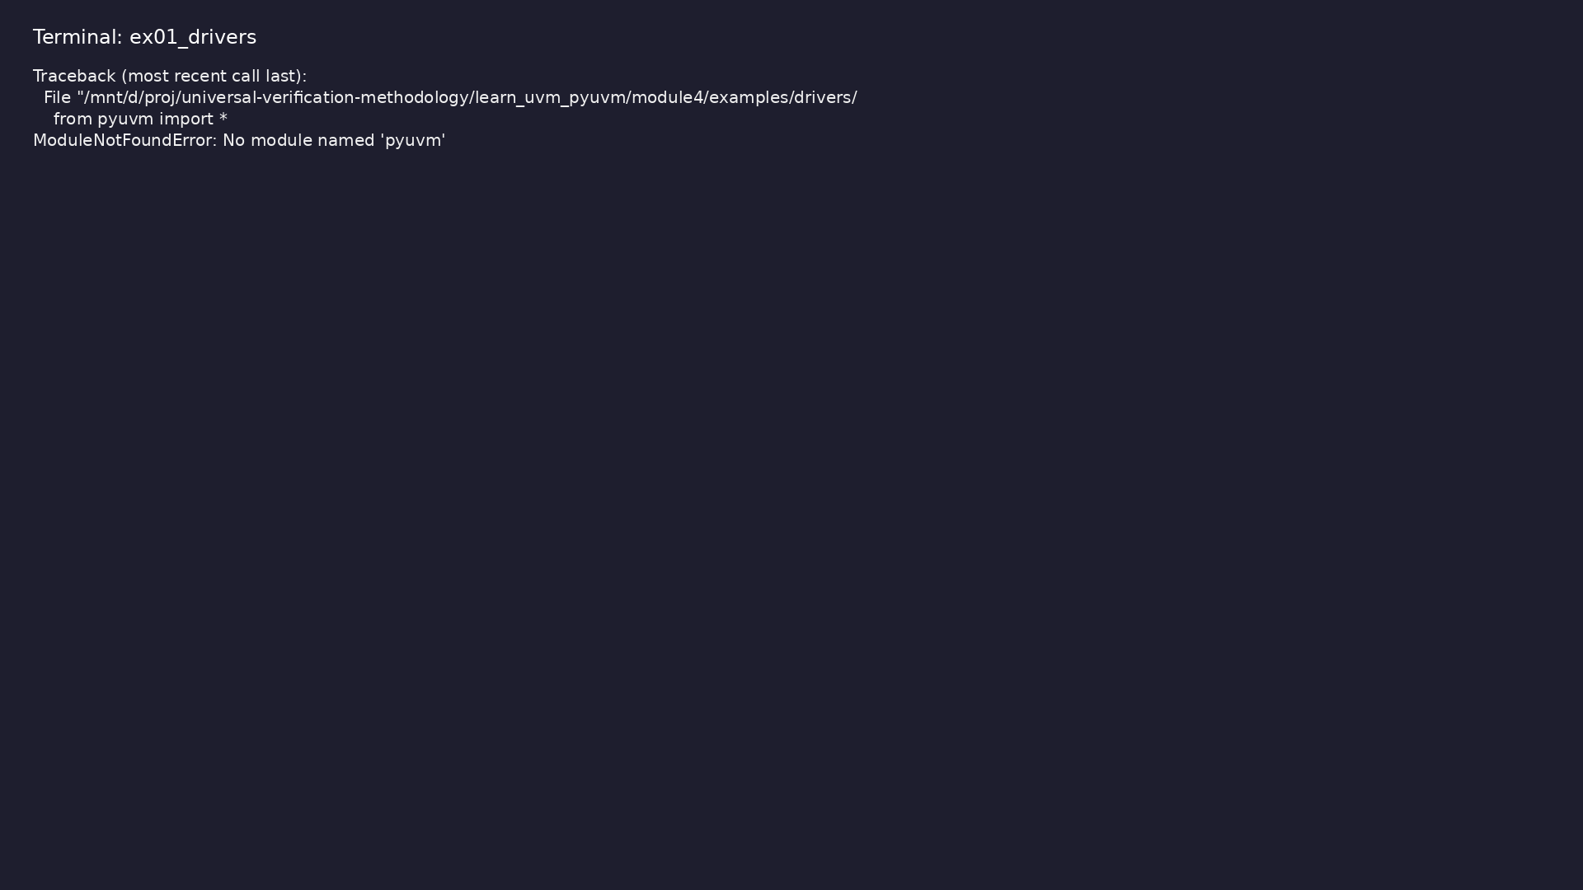
Demo: Driver Implementation
$ .venv/bin/python module4/examples/drivers/driver_example.py
learn_uvm_pyuvm / Module 4
Notes:
Hands-on: module4/examples/drivers/

Slide 72

Demo: Monitor Implementation
$ .venv/bin/python module4/examples/monitors/monitor_example.py
learn_uvm_pyuvm / Module 4
Notes:
Hands-on: module4/examples/monitors/

Slide 73
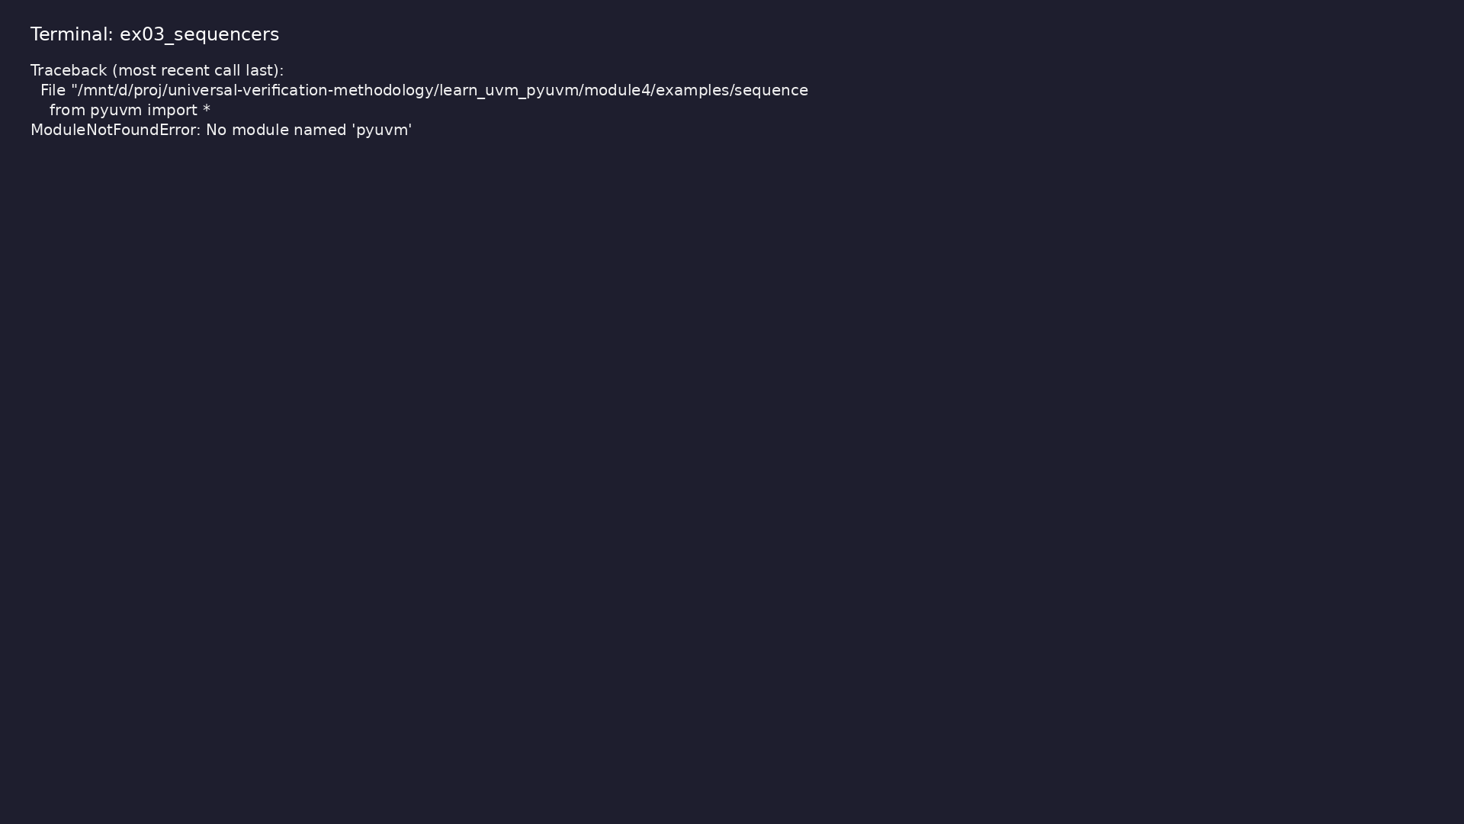
Demo: Sequencer and Sequences
$ .venv/bin/python module4/examples/sequencers/sequencer_example.py
learn_uvm_pyuvm / Module 4
Notes:
Hands-on: module4/examples/sequencers/

Slide 74

Demo: Complete Agent
$ .venv/bin/python module4/examples/agents/agent_example.py
learn_uvm_pyuvm / Module 4
Notes:
Hands-on: module4/examples/agents/

Slide 75

Demo: Scoreboard Implementation
$ .venv/bin/python module4/examples/scoreboards/scoreboard_example.py
learn_uvm_pyuvm / Module 4
Notes:
Hands-on: module4/examples/scoreboards/

Slide 76
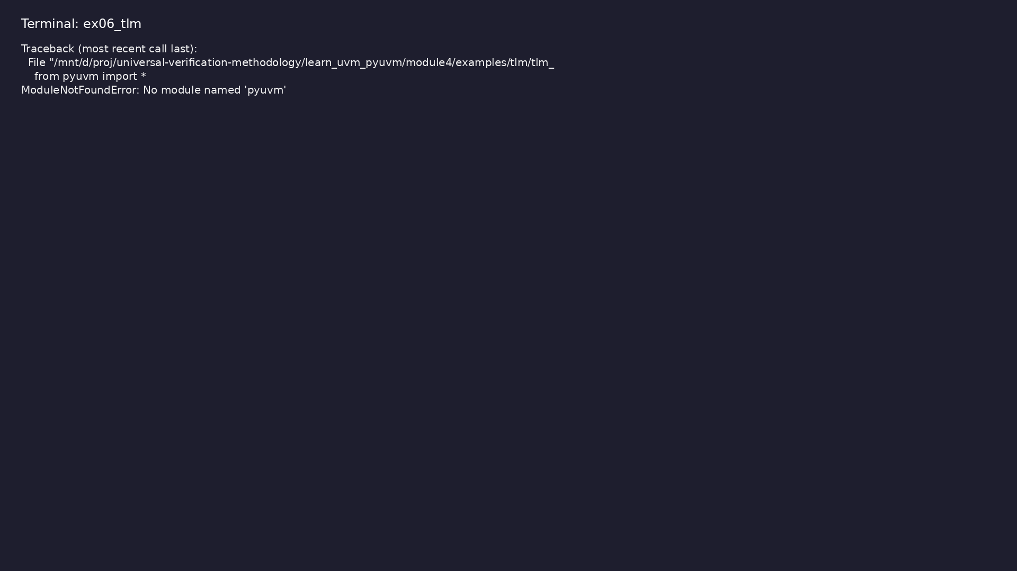
Demo: TLM Communication
$ .venv/bin/python module4/examples/tlm/tlm_example.py
learn_uvm_pyuvm / Module 4
Notes:
Hands-on: module4/examples/tlm/

Slide 77

Demo: Transaction Modeling
$ .venv/bin/python
module4/examples/transactions/transaction_example.py
learn_uvm_pyuvm / Module 4
Notes:
Hands-on: module4/examples/transactions/

Slide 78
Practice & assessment
learn_uvm_pyuvm / Module 4

Slide 79
What you should know (1/3)
• Understand agent architecture
• Implement UVM drivers
• Implement UVM monitors
• Implement sequencers and sequences
• Use analysis ports effectively
• Implement scoreboards
learn_uvm_pyuvm / Module 4
Notes:
From MODULE4 Learning Outcomes.

Slide 80
What you should know (2/3)
• Design transaction models
• Build complete agents
• Integrate agents into environments
• Execute sequences in tests
• Driver class
• Transaction reception
learn_uvm_pyuvm / Module 4
Notes:
From MODULE4 Learning Outcomes.

Slide 81
What you should know (3/3)
• Signal driving
learn_uvm_pyuvm / Module 4
Notes:
From MODULE4 Learning Outcomes.

Slide 82
Exercises
• Driver Implementation
• Monitor Implementation
• Sequence Creation
• Agent Building
• Scoreboard Implementation
learn_uvm_pyuvm / Module 4

Slide 83
Assessment checklist
• Understands agent architecture
• Can implement drivers
• Can implement monitors
• Can implement sequencers
• Can create sequences
• Can use analysis ports
learn_uvm_pyuvm / Module 4

Slide 84
Summary & next steps
• Build complete UVM agents with driver, monitor, and
sequencer
• Complete module4/CHECKLIST.md
• Review module4/EXAMPLES.md and run each lab
• Next: Next module in course
learn_uvm_pyuvm / Module 4

