Slide 1
Module 5
Advanced UVM Concepts
learn_uvm_pyuvm / Module 5

Slide 2
Learning objectives
• Master sequences, coverage, configuration, and
virtual sequences
learn_uvm_pyuvm / Module 5

Slide 3
Prerequisites
• See module README
learn_uvm_pyuvm / Module 5

Slide 4

Learning path
Master sequences, coverage, configuration, and virtual sequences
learn_uvm_pyuvm / Module 5

Slide 5
Overview
• This module covers advanced UVM concepts including
virtual sequences, coverage models, complex conf…
learn_uvm_pyuvm / Module 5

Slide 6
How to learn this module
learn_uvm_pyuvm / Module 5

Slide 7
Suggested learning path
• Module 4 agent/scoreboard integration is
prerequisite — multi-channel env extends the same
TLM patt…
• Review `module5/dut/advanced/multi_channel.v` —
multiple logical channels needing coordinated stimu…
• Study virtual sequencer concept before
`virtual_sequences/` examples — one coordinator,
many agents
• Skim RAL terminology: register map, fields, adapter,
predictor — used in `register_model/`
• Coverage and callbacks modify observation and driver
behavior without deep subclass trees
learn_uvm_pyuvm / Module 5
Notes:
From docs/MODULE5.md — read guides before running demos.

Slide 8
Design architecture
learn_uvm_pyuvm / Module 5

Slide 9

1. Advanced DUT architecture
• `module5/dut/advanced/multi_chan
nel.v` — multiple logical
channels for coordination labs
• Designed for virtual sequences
and multi-stream scoreboarding
• Register abstraction layer
examples align with memory-
mapped control/status
learn_uvm_pyuvm / Module 5
Notes:
From MODULE5 Design Architecture.

Slide 10
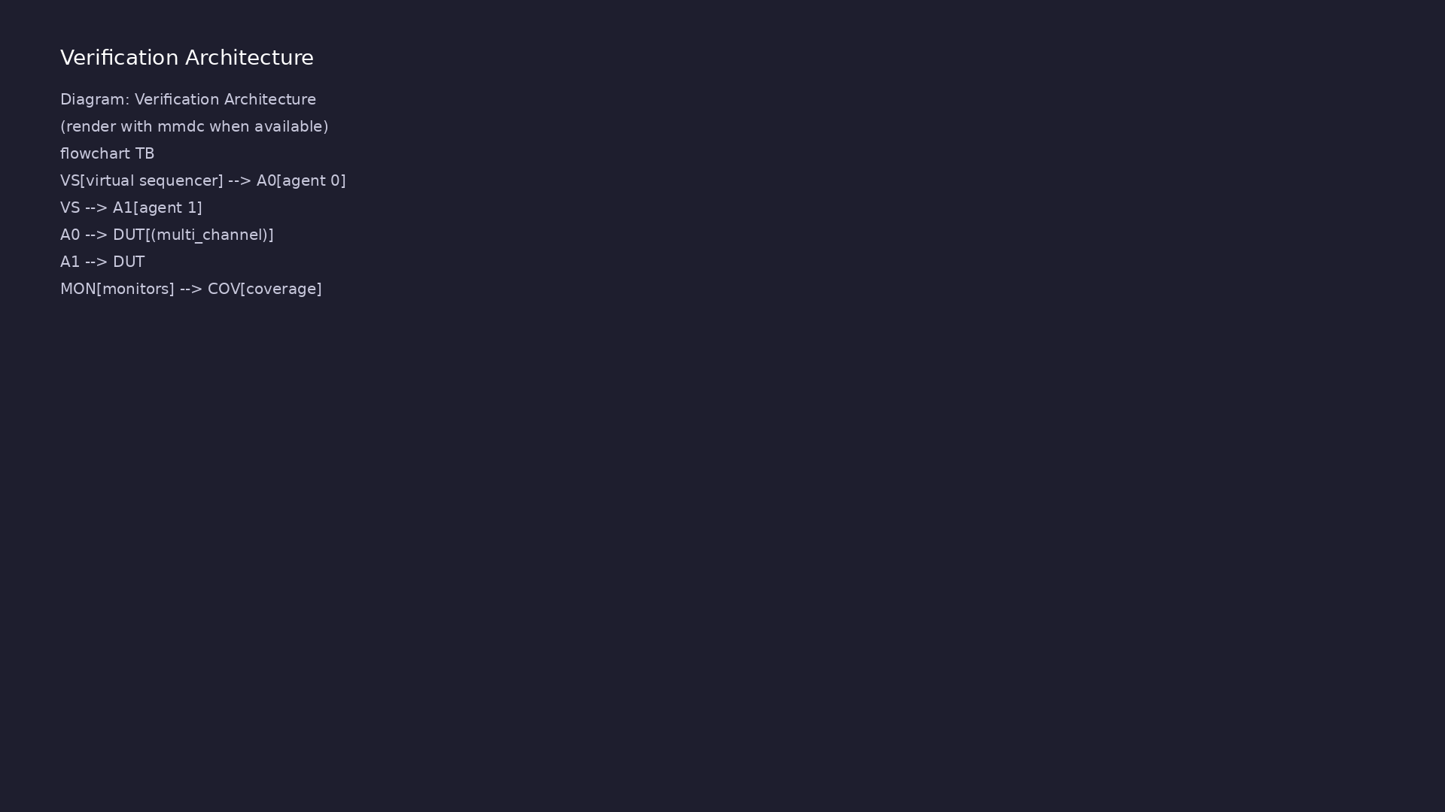
2. Advanced UVM environment architecture
• Virtual sequencers coordinate
multiple agents on different
channels
• Coverage collectors sample
transaction fields and cross
coverage
• Callbacks extend driver/monitor
without subclass explosion
• Configuration objects centralize
knobs (active/passive, timeouts,
enable flags)
learn_uvm_pyuvm / Module 5
Notes:
From MODULE5 Design Architecture.

Slide 11
3. Execution pipeline
• Build: multi-channel RTL plus env with multiple
agents, virtual sequencer, coverage, register model
• Connect: per-channel monitor analysis →
scoreboard/coverage; RAL adapter linked to bus
sequencer
• Sim: virtual sequence launches child sequences in
order; callbacks may alter driver/monitor behavio…
• Check: scoreboard per channel + coverage goals +
register mirror consistency vs DUT state
learn_uvm_pyuvm / Module 5
Notes:
From MODULE5 Design Architecture.

Slide 12
4. Register model layer
• RAL-style maps: registers, fields, access policies
(RW, RO, WO)
• Adapter links bus transactions to register
reads/writes in tests
• Predictor/update paths keep mirror model consistent
with DUT
• Register sequences replace raw bus wiggling for
software-visible setup
learn_uvm_pyuvm / Module 5
Notes:
From MODULE5 Design Architecture.

Slide 13
DUT — multi-channel block
/**
* Module 5: Multi-Channel Interface
*
* A multi-channel interface for advanced UVM testing.
*
* Ports:
* clk: Clock signal
* rst_n: Active-low reset
* master_valid: Master channel valid
* master_ready: Master channel ready
* master_data: Master channel data
* slave_valid: Slave channel valid
* slave_ready: Slave channel ready
* slave_data: Slave channel data
*/
# ...
learn_uvm_pyuvm / Module 5

Slide 14
Virtual sequencer pattern
"""
Module 5 Example 5.1: Virtual Sequences
Demonstrates virtual sequencer and virtual sequence coordination.
"""
from pyuvm import *
import cocotb
from cocotb.triggers import Timer
# Try to import uvm_seq_item_pull_port explicitly if not available from
pyuvm import *
try:
# Check if already available
_ = uvm_seq_item_pull_port
except NameError:
# Try importing from TLM modules
try:
# ...
learn_uvm_pyuvm / Module 5

Slide 15
Key files to study
learn_uvm_pyuvm / Module 5

Slide 16
Open these in the repo
• `module5/dut/advanced/multi_channel.v` — multi-
stream DUT for virtual sequence coordination
• `module5/examples/virtual_sequences/virtual_sequence
_example.py` — child sequences on multiple sequ…
• `module5/examples/coverage/coverage_example.py` —
functional coverage sampling hooks
• `module5/examples/register_model/register_model_exam
ple.py` — RAL map, adapter, mirror updates
• `module5/tests/pyuvm_tests/test_advanced_uvm.py` —
integrated advanced env regression
• `scripts/module5.sh` — `--virtual-sequences`,
`--coverage`, `--register-model`, …
learn_uvm_pyuvm / Module 5
Notes:
Trace while running module5/EXAMPLES.md labs.

Slide 17
Verification & testing methods
learn_uvm_pyuvm / Module 5

Slide 18
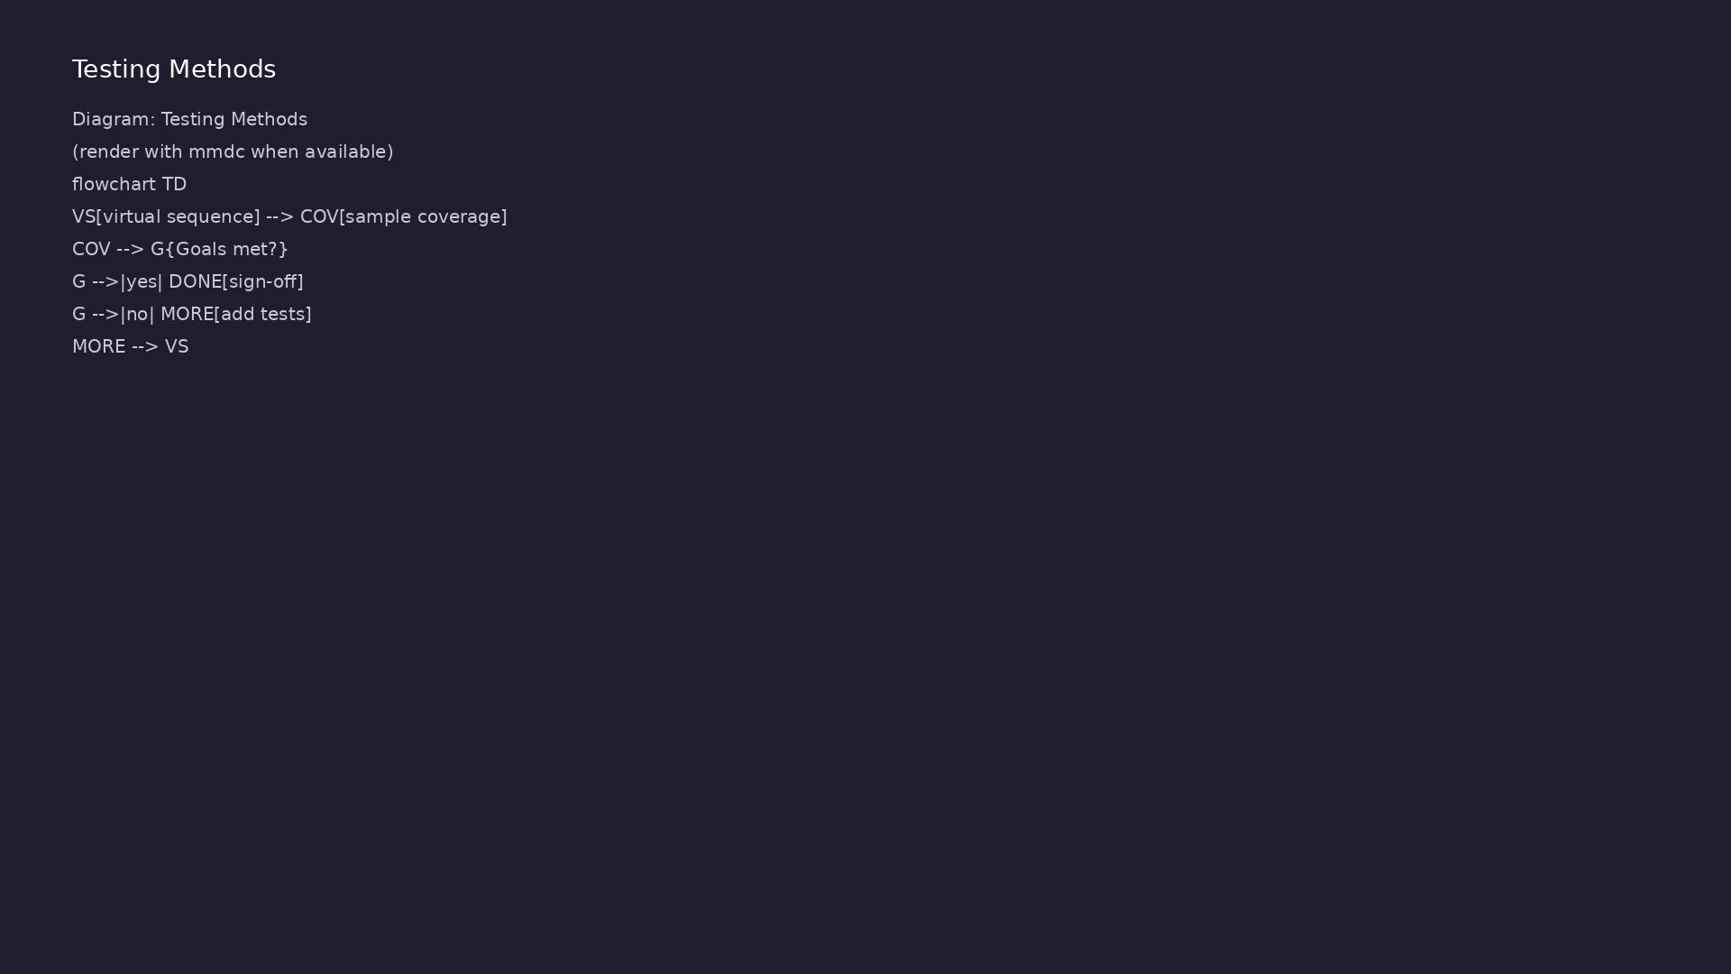
1. Coverage-driven verification
• Functional coverage on
transaction types, channel IDs,
and corner field values
• Coverage goals gate regression
sign-off in advanced flows
• Examples under
`module5/examples/coverage/`
show sampling hooks
learn_uvm_pyuvm / Module 5
Notes:
From MODULE5 Verification & Testing Methods.

Slide 19
2. Virtual sequences and configuration tests
• Virtual sequences start child sequences on multiple
sequencers in order
• Config tests prove ConfigDB + config object
overrides change behavior
• Callback tests inject errors or delays to validate
robustness
learn_uvm_pyuvm / Module 5
Notes:
From MODULE5 Verification & Testing Methods.

Slide 20
3. Step-by-step lab execution
• 1. Virtual sequences: `./scripts/module5.sh
--virtual-sequences`
• 2. Coverage/callbacks: `./scripts/module5.sh
--coverage --callbacks`
• 3. Configuration: `./scripts/module5.sh
--configuration`
• 4. Register model: `./scripts/module5.sh --register-
model`
• 5. Integrated: `./scripts/module5.sh --pyuvm-tests`
— all advanced mechanisms in one regression
learn_uvm_pyuvm / Module 5
Notes:
From MODULE5 Verification & Testing Methods.

Slide 21
4. Closure
• `./scripts/module5.sh --pyuvm-tests`; register model
and callback demos in EXAMPLES.md
• Assessment: virtual sequences, coverage, callbacks,
configuration, register model
• Demonstrate register read/write through RAL adapter
rather than ad-hoc pin toggling
learn_uvm_pyuvm / Module 5
Notes:
From MODULE5 Verification & Testing Methods.

Slide 22
Syllabus topics
learn_uvm_pyuvm / Module 5

Slide 23
1. Advanced Sequences (1/4)
• Virtual Sequences
• What are virtual sequences?
• Virtual sequence purpose
• Multiple sequencer coordination
• Virtual sequence implementation
• Sequence Libraries
learn_uvm_pyuvm / Module 5
Notes:
From MODULE5 Topics Covered.

Slide 24
1. Advanced Sequences (2/4)
• Base sequence classes
• Derived sequences
• Sequence reuse patterns
• Sequence organization
• Sequence Arbitration
• Sequencer arbitration
learn_uvm_pyuvm / Module 5
Notes:
From MODULE5 Topics Covered.

Slide 25
1. Advanced Sequences (3/4)
• Priority mechanisms
• Lock and grab
• Sequence coordination
• Layered Sequences
• High-level sequences
• Low-level sequences
learn_uvm_pyuvm / Module 5
Notes:
From MODULE5 Topics Covered.

Slide 26
1. Advanced Sequences (4/4)
• Sequence composition
• Protocol layering
learn_uvm_pyuvm / Module 5
Notes:
From MODULE5 Topics Covered.

Slide 27
2. UVM Coverage Models (1/4)
• Coverage Overview
• What is coverage?
• Coverage types
• Coverage goals
• Coverage metrics
• Functional Coverage
learn_uvm_pyuvm / Module 5
Notes:
From MODULE5 Topics Covered.

Slide 28
2. UVM Coverage Models (2/4)
• Coverage models
• Coverage groups
• Coverpoints
• Coverage bins
• Coverage Implementation
• Coverage class structure
learn_uvm_pyuvm / Module 5
Notes:
From MODULE5 Topics Covered.

Slide 29
2. UVM Coverage Models (3/4)
• Coverage sampling
• Coverage analysis
• Coverage reporting
• Coverage Patterns
• Transaction coverage
• Protocol coverage
learn_uvm_pyuvm / Module 5
Notes:
From MODULE5 Topics Covered.

Slide 30
2. UVM Coverage Models (4/4)
• State coverage
• Cross coverage
learn_uvm_pyuvm / Module 5
Notes:
From MODULE5 Topics Covered.

Slide 31
3. Complex Configuration Objects (1/4)
• Configuration Objects
• Configuration class design
• Configuration fields
• Configuration methods
• Configuration validation
• Configuration Hierarchy
learn_uvm_pyuvm / Module 5
Notes:
From MODULE5 Topics Covered.

Slide 32
3. Complex Configuration Objects (2/4)
• Hierarchical configuration
• Configuration inheritance
• Configuration override
• Configuration patterns
• Resource Database
• Resource database usage
learn_uvm_pyuvm / Module 5
Notes:
From MODULE5 Topics Covered.

Slide 33
3. Complex Configuration Objects (3/4)
• Resource types
• Resource lookup
• Resource management
• Configuration Callbacks
• Configuration callbacks
• Pre/post callbacks
learn_uvm_pyuvm / Module 5
Notes:
From MODULE5 Topics Covered.

Slide 34
3. Complex Configuration Objects (4/4)
• Callback registration
• Callback execution
learn_uvm_pyuvm / Module 5
Notes:
From MODULE5 Topics Covered.

Slide 35
4. UVM Callbacks (1/4)
• Callback Overview
• What are callbacks?
• Callback purpose
• Callback types
• Callback benefits
• Callback Implementation
learn_uvm_pyuvm / Module 5
Notes:
From MODULE5 Topics Covered.

Slide 36
4. UVM Callbacks (2/4)
• Callback class definition
• Callback registration
• Callback execution
• Callback patterns
• Pre/Post Callbacks
• Pre-callbacks
learn_uvm_pyuvm / Module 5
Notes:
From MODULE5 Topics Covered.

Slide 37
4. UVM Callbacks (3/4)
• Post-callbacks
• Callback ordering
• Callback control
• Callback Use Cases
• Driver callbacks
• Monitor callbacks
learn_uvm_pyuvm / Module 5
Notes:
From MODULE5 Topics Covered.

Slide 38
4. UVM Callbacks (4/4)
• Scoreboard callbacks
• Test callbacks
learn_uvm_pyuvm / Module 5
Notes:
From MODULE5 Topics Covered.

Slide 39
5. UVM Register Model (Advanced) (1/5)
• Register Model Overview
• Register model purpose
• Register model structure
• Register model benefits
• Register model components
• Register Model Components
learn_uvm_pyuvm / Module 5
Notes:
From MODULE5 Topics Covered.

Slide 40
5. UVM Register Model (Advanced) (2/5)
• `uvm_reg_block` - Register blocks
• `uvm_reg` - Registers
• `uvm_reg_field` - Register fields
• `uvm_reg_map` - Address maps
• Register Operations
• Register read
learn_uvm_pyuvm / Module 5
Notes:
From MODULE5 Topics Covered.

Slide 41
5. UVM Register Model (Advanced) (3/5)
• Register write
• Register peek/poke
• Register update
• Register Sequences
• Register access sequences
• Register test sequences
learn_uvm_pyuvm / Module 5
Notes:
From MODULE5 Topics Covered.

Slide 42
5. UVM Register Model (Advanced) (4/5)
• Register model integration
• Register predictor
• Backdoor Access
• Backdoor read/write
• Backdoor vs frontdoor
• Backdoor use cases
learn_uvm_pyuvm / Module 5
Notes:
From MODULE5 Topics Covered.

Slide 43
5. UVM Register Model (Advanced) (5/5)
• Backdoor implementation
learn_uvm_pyuvm / Module 5
Notes:
From MODULE5 Topics Covered.

Slide 44
6. Virtual Sequences and Virtual Sequencers (1/3)
• Virtual Sequencer
• Virtual sequencer purpose
• Virtual sequencer structure
• Multiple sequencer references
• Virtual sequencer implementation
• Virtual Sequence Coordination
learn_uvm_pyuvm / Module 5
Notes:
From MODULE5 Topics Covered.

Slide 45
6. Virtual Sequences and Virtual Sequencers (2/3)
• Coordinating multiple sequencers
• Parallel sequence execution
• Sequence synchronization
• Sequence coordination patterns
• Virtual Sequence Patterns
• Master-slave coordination
learn_uvm_pyuvm / Module 5
Notes:
From MODULE5 Topics Covered.

Slide 46
6. Virtual Sequences and Virtual Sequencers (3/3)
• Multi-channel coordination
• Protocol coordination
• Test coordination
learn_uvm_pyuvm / Module 5
Notes:
From MODULE5 Topics Covered.

Slide 47
7. Coverage Analysis and Closure (1/3)
• Coverage Analysis
• Coverage collection
• Coverage reporting
• Coverage gaps
• Coverage analysis tools
• Coverage Closure
learn_uvm_pyuvm / Module 5
Notes:
From MODULE5 Topics Covered.

Slide 48
7. Coverage Analysis and Closure (2/3)
• Coverage goals
• Coverage strategies
• Coverage improvement
• Coverage metrics
• Coverage Patterns
• Functional coverage
learn_uvm_pyuvm / Module 5
Notes:
From MODULE5 Topics Covered.

Slide 49
7. Coverage Analysis and Closure (3/3)
• Code coverage
• Assertion coverage
• Coverage correlation
learn_uvm_pyuvm / Module 5
Notes:
From MODULE5 Topics Covered.

Slide 50
8. Advanced Configuration Patterns (1/2)
• Configuration Strategies
• Top-down configuration
• Bottom-up configuration
• Mixed configuration
• Configuration best practices
• Dynamic Configuration
learn_uvm_pyuvm / Module 5
Notes:
From MODULE5 Topics Covered.

Slide 51
8. Advanced Configuration Patterns (2/2)
• Runtime configuration
• Configuration updates
• Configuration validation
• Configuration debugging
learn_uvm_pyuvm / Module 5
Notes:
From MODULE5 Topics Covered.

Slide 52
9. Performance Optimization (1/2)
• Testbench Performance
• Performance bottlenecks
• Optimization strategies
• Memory optimization
• Simulation speed
• Sequence Optimization
learn_uvm_pyuvm / Module 5
Notes:
From MODULE5 Topics Covered.

Slide 53
9. Performance Optimization (2/2)
• Efficient sequence design
• Sequence reuse
• Sequence caching
• Sequence performance
learn_uvm_pyuvm / Module 5
Notes:
From MODULE5 Topics Covered.

Slide 54
10. Advanced Debugging Techniques (1/2)
• UVM Debugging
• UVM debugging tools
• Phase debugging
• Component debugging
• Transaction debugging
• Coverage Debugging
learn_uvm_pyuvm / Module 5
Notes:
From MODULE5 Topics Covered.

Slide 55
10. Advanced Debugging Techniques (2/2)
• Coverage gaps
• Coverage analysis
• Coverage improvement
• Coverage tools
learn_uvm_pyuvm / Module 5
Notes:
From MODULE5 Topics Covered.

Slide 56
Command reference highlights
learn_uvm_pyuvm / Module 5

Slide 57
Advanced UVM topics
• `./scripts/module5.sh --virtual-sequences
--configuration` — coordination and config objects
• `./scripts/module5.sh --coverage --callbacks` —
coverage sampling and callback injection
• `./scripts/module5.sh --register-model` — RAL map
and bus adapter drill
learn_uvm_pyuvm / Module 5
Notes:
Full detail in docs/MODULE5.md command reference.

Slide 58
Integrated regression
• `./scripts/module5.sh --pyuvm-tests` —
`test_advanced_uvm` against multi-channel DUT
• `cd module5/tests/pyuvm_tests && make SIM=verilator
TEST=test_advanced_uvm`
• `./scripts/module5.sh` — all example tracks then
tests when doing full module sweep
learn_uvm_pyuvm / Module 5
Notes:
Full detail in docs/MODULE5.md command reference.

Slide 59
Coverage and config debug
• Inspect coverage reports/sample counts from example
logs when goals are not met
• Config object + ConfigDB overrides in
`--configuration` — re-run to verify behavior change
• Callback tests inject delays/errors — use verbosity
to see callback invocation order
learn_uvm_pyuvm / Module 5
Notes:
Full detail in docs/MODULE5.md command reference.

Slide 60
Hands-on examples
learn_uvm_pyuvm / Module 5

Slide 61
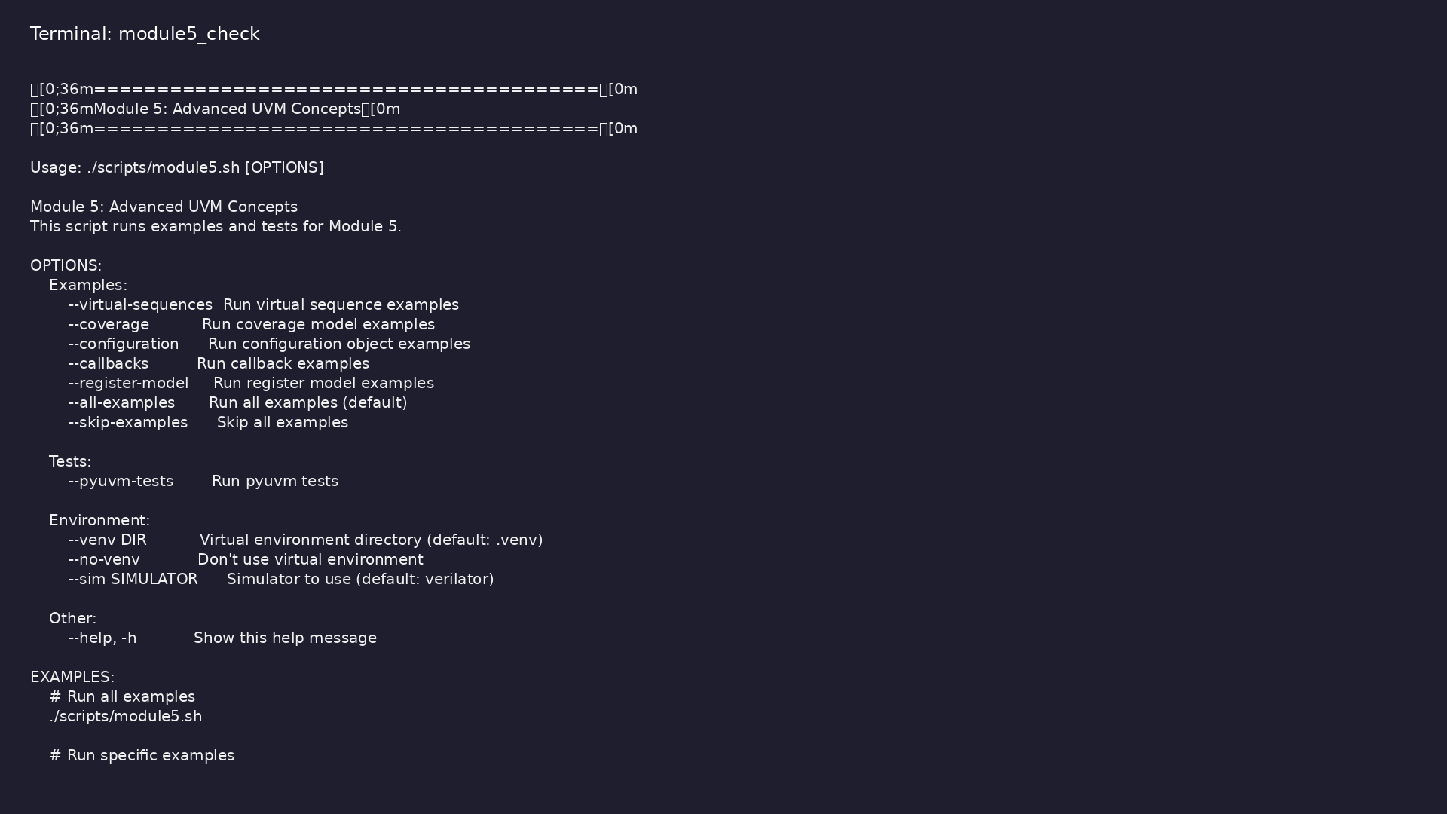
Module 5 orchestrator
$ ./scripts/module5.sh --help
learn_uvm_pyuvm / Module 5
Notes:
Run from course repository root.

Slide 62
Exercise scaffold
./scripts/module5.sh --scaffold
learn_uvm_pyuvm / Module 5

Slide 63
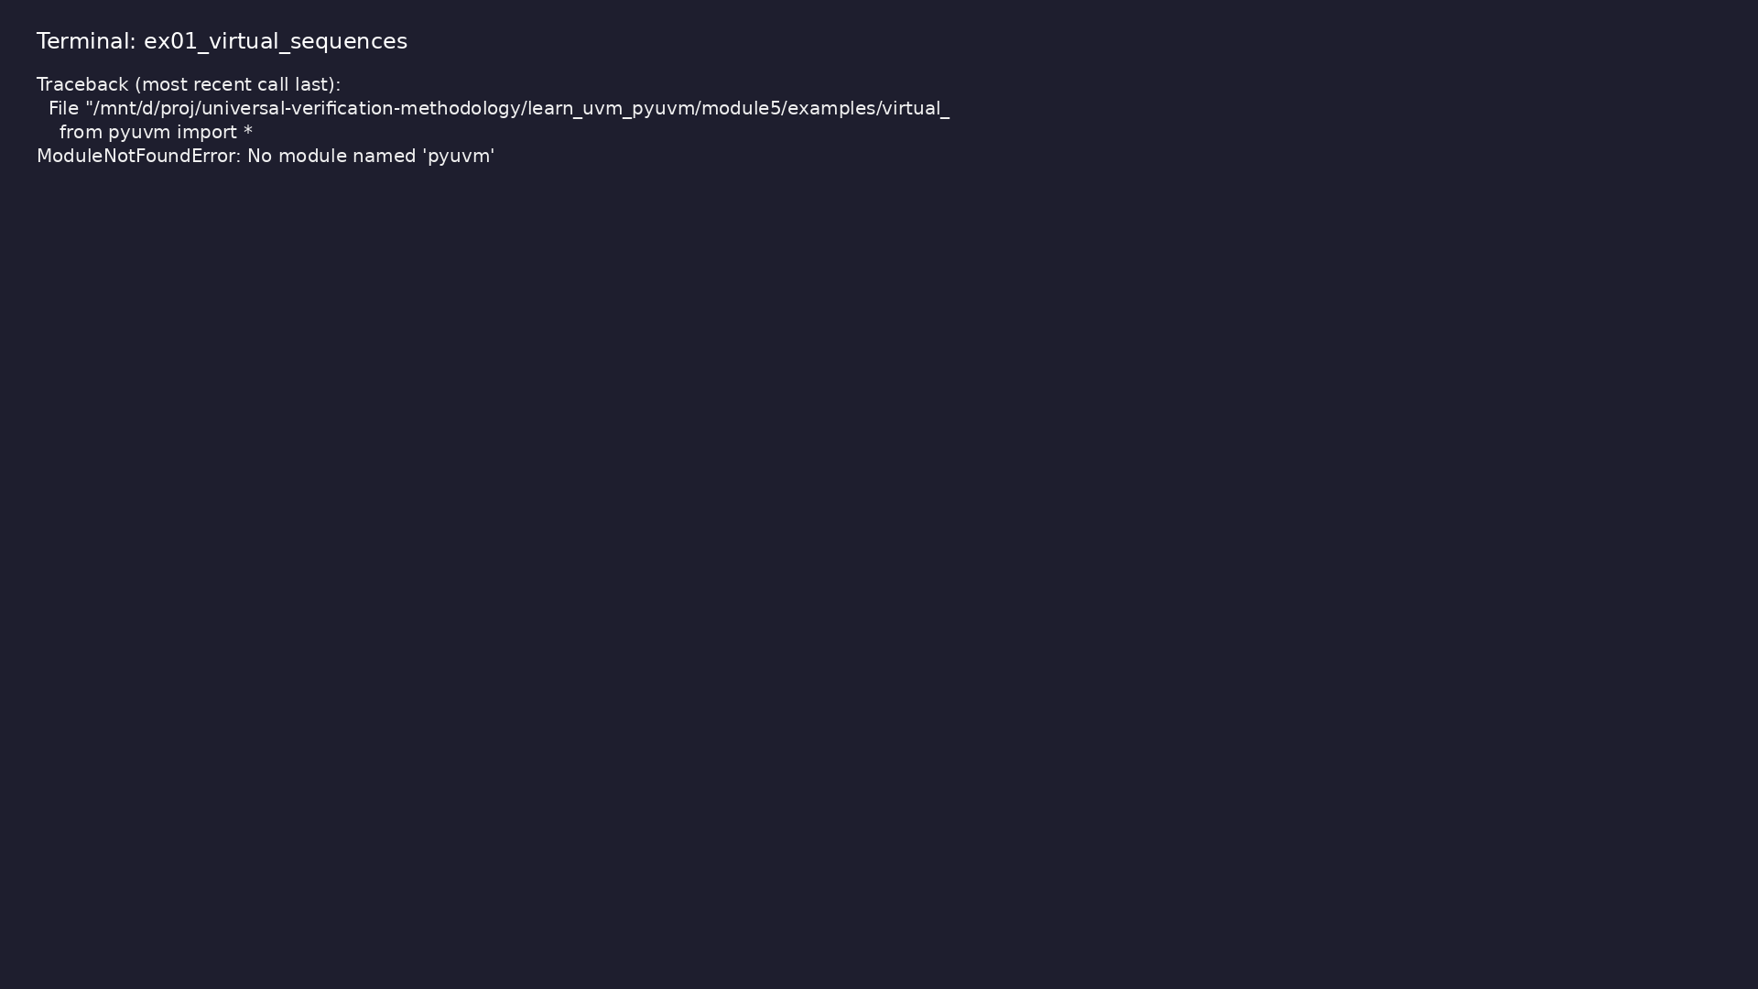
Demo: Virtual Sequences
$ .venv/bin/python
module5/examples/virtual_sequences/virtual_sequence_example.py
learn_uvm_pyuvm / Module 5
Notes:
Hands-on: module5/examples/virtual_sequences/

Slide 64
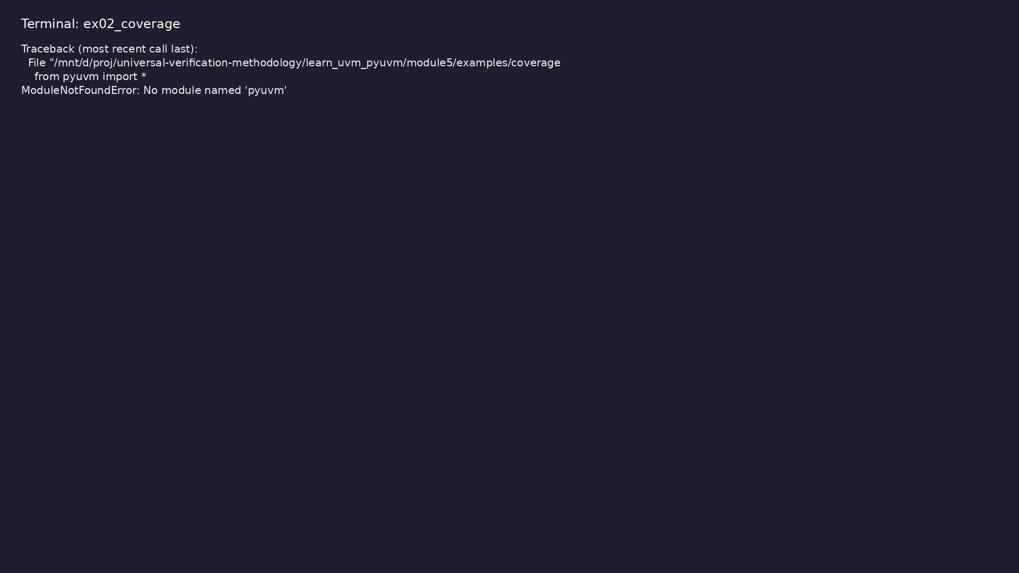
Demo: Coverage Models
$ .venv/bin/python module5/examples/coverage/coverage_example.py
learn_uvm_pyuvm / Module 5
Notes:
Hands-on: module5/examples/coverage/

Slide 65
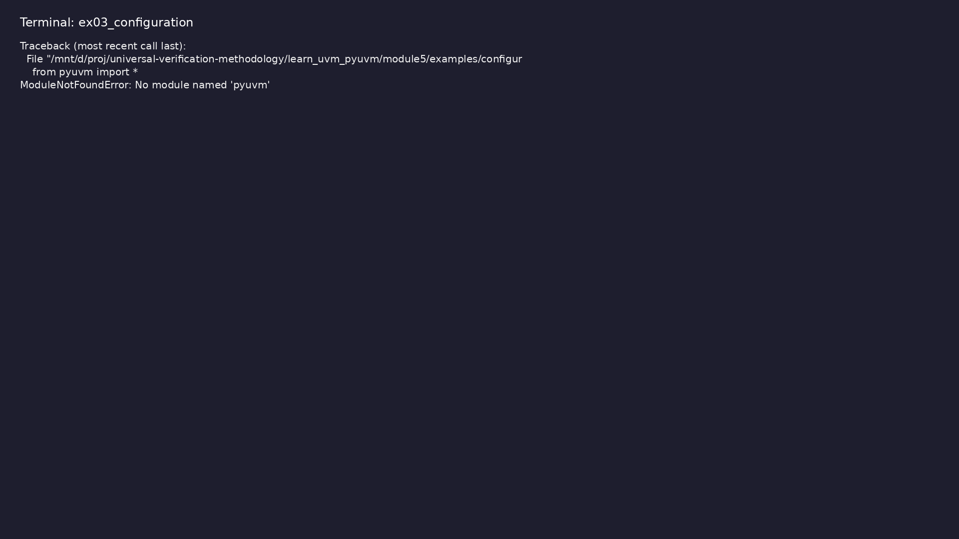
Demo: Configuration Objects
$ .venv/bin/python
module5/examples/configuration/configuration_example.py
learn_uvm_pyuvm / Module 5
Notes:
Hands-on: module5/examples/configuration/

Slide 66

Demo: UVM Callbacks
$ .venv/bin/python module5/examples/callbacks/callback_example.py
learn_uvm_pyuvm / Module 5
Notes:
Hands-on: module5/examples/callbacks/

Slide 67

Demo: Register Model
$ .venv/bin/python
module5/examples/register_model/register_model_example.py
learn_uvm_pyuvm / Module 5
Notes:
Hands-on: module5/examples/register_model/

Slide 68
Practice & assessment
learn_uvm_pyuvm / Module 5

Slide 69
What you should know (1/3)
• Create and use virtual sequences
• Implement coverage models
• Design complex configuration objects
• Use UVM callbacks effectively
• Use advanced register model features
• Coordinate multiple sequencers
learn_uvm_pyuvm / Module 5
Notes:
From MODULE5 Learning Outcomes.

Slide 70
What you should know (2/3)
• Analyze and close coverage
• Optimize testbench performance
• Debug advanced testbenches
• Apply advanced patterns
• Virtual sequencer
• Virtual sequence
learn_uvm_pyuvm / Module 5
Notes:
From MODULE5 Learning Outcomes.

Slide 71
What you should know (3/3)
• Multiple sequencer coordination
learn_uvm_pyuvm / Module 5
Notes:
From MODULE5 Learning Outcomes.

Slide 72
Exercises
• Virtual Sequences
• Coverage Implementation
• Configuration Design
• Callback Implementation
• Register Model
learn_uvm_pyuvm / Module 5

Slide 73
Assessment checklist
• Can create virtual sequences
• Can implement coverage models
• Can design configuration objects
• Can use callbacks effectively
• Can use advanced register model
• Can coordinate multiple sequencers
learn_uvm_pyuvm / Module 5

Slide 74
Summary & next steps
• Master sequences, coverage, configuration, and
virtual sequences
• Complete module5/CHECKLIST.md
• Review module5/EXAMPLES.md and run each lab
• Next: Next module in course
learn_uvm_pyuvm / Module 5

