Slide 1
Module 7
Real-World Applications
learn_uvm_pyuvm / Module 7

Slide 2
Learning objectives
• Apply UVM to real-world verification scenarios
learn_uvm_pyuvm / Module 7

Slide 3
Prerequisites
• See module README
learn_uvm_pyuvm / Module 7

Slide 4

Learning path
Apply UVM to real-world verification scenarios
learn_uvm_pyuvm / Module 7

Slide 5
Overview
• This module applies all learned concepts to real-
world verification scenarios. You'll work on compl…
learn_uvm_pyuvm / Module 7

Slide 6
How to learn this module
learn_uvm_pyuvm / Module 7

Slide 7
Suggested learning path
• Module 6 multi-agent protocol env is baseline —
Module 7 applies it to DMA and UART IP blocks
• Review `module7/dut/dma/simple_dma.v` register map
and descriptor flow before DMA examples
• Study `module7/dut/protocols/uart.v` framing (start
bit, data, stop) for serial agent labs
• VIP example packages reusable agents — focus on
directory layout and naming for reuse
• Best-practices example summarizes production-style
TB structure before integrated tests
learn_uvm_pyuvm / Module 7
Notes:
From docs/MODULE7.md — read guides before running demos.

Slide 8
Design architecture
learn_uvm_pyuvm / Module 7

Slide 9

1. Real-world DUT blocks
• `module7/dut/dma/simple_dma.v` —
DMA controller with channel
descriptors
• `module7/dut/protocols/uart.v` —
serial framing for protocol
agent labs
• Blocks represent IP-style
interfaces students will see in
SoC verification
learn_uvm_pyuvm / Module 7
Notes:
From MODULE7 Design Architecture.

Slide 10

2. Verification IP (VIP) architecture
• Reusable agents package protocol
knowledge (transactions,
sequences, checkers)
• Env composes DMA + UART (or
other) agents with shared config
and scoreboard fabric
• Best-practices example shows
directory layout, naming, and
review-friendly TB structure
• VIP boundaries separate protocol
expertise from scenario tests
learn_uvm_pyuvm / Module 7
Notes:
From MODULE7 Design Architecture.

Slide 11
3. Execution pipeline
• Build: Verilator compiles DMA and/or UART RTL; env
builds VIP agents and shared infrastructure
• Connect: register bus agent + DMA status monitors +
UART analysis paths into system scoreboard
• Sim: software-visible register writes program DMA;
UART sequences inject serial traffic concurrently
• Check: DMA transfer completion flags, memory
content, UART frame integrity — unified regression
rep…
learn_uvm_pyuvm / Module 7
Notes:
From MODULE7 Design Architecture.

Slide 12
4. Integration view
• Software-visible registers drive DMA; UART provides
async serial path
• Scoreboard and coverage span multiple IPs in one
regression
• Exercises push toward production-style reuse and
documentation
• Module 8 utilities (CLP, recorders) plug into this
env style in capstone work
learn_uvm_pyuvm / Module 7
Notes:
From MODULE7 Design Architecture.

Slide 13
DUT — simple DMA controller
/**
* Module 7: Simple DMA Controller
*
* A simple DMA controller for verification.
*
* Ports:
* clk: Clock signal
* rst_n: Active-low reset
* dma_start: Start DMA transfer
* dma_done: DMA transfer complete
* dma_src_addr: Source address
* dma_dst_addr: Destination address
* dma_length: Transfer length
* dma_channel: DMA channel select
*/
# ...
learn_uvm_pyuvm / Module 7

Slide 14
VIP-style agent reuse
"""
Module 7 Example: VIP (Verification IP) Development
Demonstrates creating reusable verification IP.
"""
from pyuvm import *
# Explicitly import TLM classes that may not be in __all__
# Try direct imports from known TLM module paths
try:
from pyuvm.s15_uvm_tlm_1 import uvm_seq_item_pull_port,
uvm_analysis_imp
except (ImportError, AttributeError):
try:
from pyuvm.s15_uvm_tlm import uvm_seq_item_pull_port,
uvm_analysis_imp
except (ImportError, AttributeError):
try:
learn_uvm_pyuvm / Module 7

Slide 15
Key files to study
learn_uvm_pyuvm / Module 7

Slide 16
Open these in the repo
• `module7/dut/dma/simple_dma.v` — DMA controller with
channel descriptors and status
• `module7/dut/protocols/uart.v` — UART TX/RX serial
interface for protocol agent labs
• `module7/examples/dma/dma_example.py` — descriptor
programming and transfer completion
• `module7/examples/protocols/uart_example.py` —
baud/framing stimulus and loopback checks
• `module7/examples/vip/vip_example.py` — packaged
verification IP agent pattern
• `scripts/module7.sh` — `--dma`, `--protocols`,
`--vip`, `--best-practices`, `--pyuvm-tests`
learn_uvm_pyuvm / Module 7
Notes:
Trace while running module7/EXAMPLES.md labs.

Slide 17
Verification & testing methods
learn_uvm_pyuvm / Module 7

Slide 18
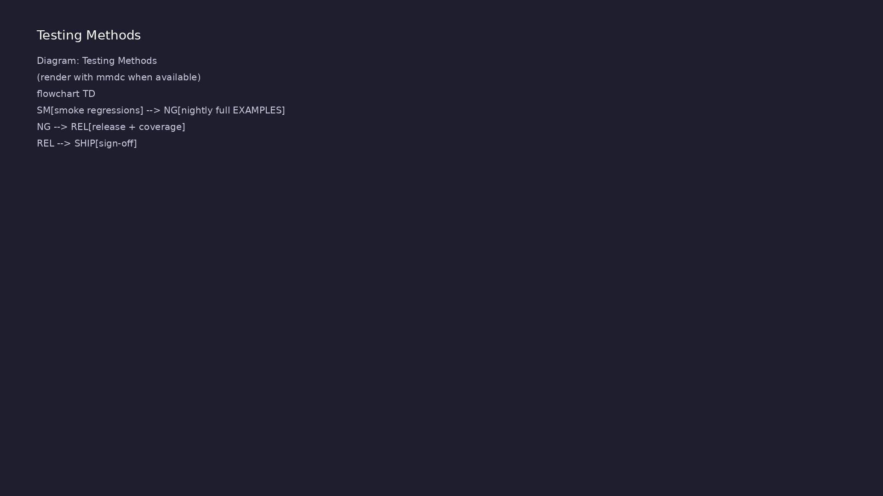
1. Application-level test methods
• DMA tests: descriptor
programming, transfer
completion, interrupt/status
flags
• UART tests: baud framing, TX/RX
loops, error injection in
exercises
• VIP tests encapsulate protocol
rules so tests focus on
scenarios not bit toggling
learn_uvm_pyuvm / Module 7
Notes:
From MODULE7 Verification & Testing Methods.

Slide 19
2. Regression and sign-off practices
• `./scripts/module7.sh` runs DMA, protocol, VIP, and
best-practices demos
• Layered regressions: smoke (short), nightly (full
EXAMPLES), release (with coverage goals)
• Waveforms and transaction logs for post-mortem on
failures
learn_uvm_pyuvm / Module 7
Notes:
From MODULE7 Verification & Testing Methods.

Slide 20
3. Step-by-step lab execution
• 1. DMA block: `./scripts/module7.sh --dma` — program
descriptor, confirm completion
• 2. UART protocol: `./scripts/module7.sh --protocols`
— framing and loopback
• 3. VIP packaging: `./scripts/module7.sh --vip` —
study reusable agent layout
• 4. Best practices: `./scripts/module7.sh --best-
practices` — review TB structure checklist
• 5. Integrated: `./scripts/module7.sh --pyuvm-tests`
— multi-IP regression pass
learn_uvm_pyuvm / Module 7
Notes:
From MODULE7 Verification & Testing Methods.

Slide 21
4. Closure
• `./scripts/module7.sh --pyuvm-tests`; assessment
covers VIP reuse, protocols, and integration
• Prepares for Module 8 utilities used in production
regressions (CLP, recorders)
• Articulate which checks live in VIP vs scenario test
vs scoreboard
learn_uvm_pyuvm / Module 7
Notes:
From MODULE7 Verification & Testing Methods.

Slide 22
Syllabus topics
learn_uvm_pyuvm / Module 7

Slide 23
1. DMA Verification (1/4)
• DMA Controller Overview
• DMA concepts
• DMA controller architecture
• DMA transfer types
• DMA verification challenges
• DMA Testbench Architecture
learn_uvm_pyuvm / Module 7
Notes:
From MODULE7 Topics Covered.

Slide 24
1. DMA Verification (2/4)
• Register interface agent
• Memory interface agent
• DMA monitor
• Scoreboard design
• Coverage model
• DMA Verification Scenarios
learn_uvm_pyuvm / Module 7
Notes:
From MODULE7 Topics Covered.

Slide 25
1. DMA Verification (3/4)
• Simple transfers
• Scatter-gather transfers
• Multiple channel transfers
• Error scenarios
• Performance verification
• DMA Test Implementation
learn_uvm_pyuvm / Module 7
Notes:
From MODULE7 Topics Covered.

Slide 26
1. DMA Verification (4/4)
• Test scenarios
• Sequence design
• Coverage closure
• Regression testing
learn_uvm_pyuvm / Module 7
Notes:
From MODULE7 Topics Covered.

Slide 27
2. Protocol Verification (Industry Standards) (1/4)
• UART Verification
• UART protocol
• UART agent design
• UART testbench
• UART verification
• SPI Verification
learn_uvm_pyuvm / Module 7
Notes:
From MODULE7 Topics Covered.

Slide 28
2. Protocol Verification (Industry Standards) (2/4)
• SPI protocol
• SPI agent design
• Master-slave coordination
• SPI testbench
• I2C Verification
• I2C protocol
learn_uvm_pyuvm / Module 7
Notes:
From MODULE7 Topics Covered.

Slide 29
2. Protocol Verification (Industry Standards) (3/4)
• I2C agent design
• Multi-master scenarios
• I2C testbench
• AXI Verification
• AXI protocol details
• AXI agent implementation
learn_uvm_pyuvm / Module 7
Notes:
From MODULE7 Topics Covered.

Slide 30
2. Protocol Verification (Industry Standards) (4/4)
• AXI testbench
• AXI compliance
learn_uvm_pyuvm / Module 7
Notes:
From MODULE7 Topics Covered.

Slide 31
3. Best Practices and Patterns (1/4)
• Code Organization
• Project structure
• File organization
• Naming conventions
• Documentation standards
• Reusability Patterns
learn_uvm_pyuvm / Module 7
Notes:
From MODULE7 Topics Covered.

Slide 32
3. Best Practices and Patterns (2/4)
• Component reuse
• Sequence reuse
• Environment reuse
• VIP (Verification IP) creation
• Documentation
• Code documentation
learn_uvm_pyuvm / Module 7
Notes:
From MODULE7 Topics Covered.

Slide 33
3. Best Practices and Patterns (3/4)
• Test documentation
• User guides
• API documentation
• Maintenance
• Code maintenance
• Test maintenance
learn_uvm_pyuvm / Module 7
Notes:
From MODULE7 Topics Covered.

Slide 34
3. Best Practices and Patterns (4/4)
• Version management
• Change management
learn_uvm_pyuvm / Module 7
Notes:
From MODULE7 Topics Covered.

Slide 35
4. Advanced Topics (1/4)
• Performance Optimization
• Testbench optimization
• Simulation speed
• Memory optimization
• CPU utilization
• Coverage Closure
learn_uvm_pyuvm / Module 7
Notes:
From MODULE7 Topics Covered.

Slide 36
4. Advanced Topics (2/4)
• Coverage strategies
• Coverage analysis
• Coverage improvement
• Coverage metrics
• Regression Testing
• Regression strategies
learn_uvm_pyuvm / Module 7
Notes:
From MODULE7 Topics Covered.

Slide 37
4. Advanced Topics (3/4)
• Test selection
• Test execution
• Result analysis
• Continuous Integration
• CI/CD setup
• Automated testing
learn_uvm_pyuvm / Module 7
Notes:
From MODULE7 Topics Covered.

Slide 38
4. Advanced Topics (4/4)
• Result reporting
• Notification systems
learn_uvm_pyuvm / Module 7
Notes:
From MODULE7 Topics Covered.

Slide 39
5. Verification IP (VIP) Development (1/3)
• VIP Overview
• What is VIP?
• VIP components
• VIP structure
• VIP benefits
• VIP Development
learn_uvm_pyuvm / Module 7
Notes:
From MODULE7 Topics Covered.

Slide 40
5. Verification IP (VIP) Development (2/3)
• VIP design
• VIP implementation
• VIP testing
• VIP documentation
• VIP Integration
• VIP integration
learn_uvm_pyuvm / Module 7
Notes:
From MODULE7 Topics Covered.

Slide 41
5. Verification IP (VIP) Development (3/3)
• VIP configuration
• VIP usage
• VIP maintenance
learn_uvm_pyuvm / Module 7
Notes:
From MODULE7 Topics Covered.

Slide 42
6. System-Level Verification (1/2)
• System Verification
• System architecture
• System testbench
• System scenarios
• System verification
• SoC Verification
learn_uvm_pyuvm / Module 7
Notes:
From MODULE7 Topics Covered.

Slide 43
6. System-Level Verification (2/2)
• SoC architecture
• SoC testbench
• SoC scenarios
• SoC verification
learn_uvm_pyuvm / Module 7
Notes:
From MODULE7 Topics Covered.

Slide 44
7. Advanced Debugging (1/2)
• Complex Debugging
• Multi-component debugging
• Transaction flow debugging
• Timing debugging
• Configuration debugging
• Debugging Tools
learn_uvm_pyuvm / Module 7
Notes:
From MODULE7 Topics Covered.

Slide 45
7. Advanced Debugging (2/2)
• Waveform tools
• Log analysis tools
• Coverage tools
• Performance tools
learn_uvm_pyuvm / Module 7
Notes:
From MODULE7 Topics Covered.

Slide 46
8. Test Planning and Strategy (1/2)
• Test Planning
• Test strategy
• Test scenarios
• Test coverage
• Test execution plan
• Verification Strategy
learn_uvm_pyuvm / Module 7
Notes:
From MODULE7 Topics Covered.

Slide 47
8. Test Planning and Strategy (2/2)
• Verification approach
• Verification metrics
• Verification closure
• Sign-off criteria
learn_uvm_pyuvm / Module 7
Notes:
From MODULE7 Topics Covered.

Slide 48
9. Industry Patterns (1/2)
• Common Patterns
• Industry patterns
• Pattern libraries
• Pattern reuse
• Pattern best practices
• Design Patterns
learn_uvm_pyuvm / Module 7
Notes:
From MODULE7 Topics Covered.

Slide 49
9. Industry Patterns (2/2)
• Verification patterns
• Architecture patterns
• Implementation patterns
• Testing patterns
learn_uvm_pyuvm / Module 7
Notes:
From MODULE7 Topics Covered.

Slide 50
10. Project: Build Your Own VIP (1/3)
• Project Requirements
• Choose protocol
• Design VIP
• Implement VIP
• Test VIP
• Document VIP
learn_uvm_pyuvm / Module 7
Notes:
From MODULE7 Topics Covered.

Slide 51
10. Project: Build Your Own VIP (2/3)
• VIP Components
• Complete agent
• Protocol checker
• Coverage model
• Scoreboard
• Register model (if applicable)
learn_uvm_pyuvm / Module 7
Notes:
From MODULE7 Topics Covered.

Slide 52
10. Project: Build Your Own VIP (3/3)
• Documentation
• Test suite
learn_uvm_pyuvm / Module 7
Notes:
From MODULE7 Topics Covered.

Slide 53
Command reference highlights
learn_uvm_pyuvm / Module 7

Slide 54
IP block examples
• `./scripts/module7.sh --dma` — DMA descriptor and
completion drills
• `./scripts/module7.sh --protocols` — UART (and
related protocol) agent examples
• `./scripts/module7.sh --vip --best-practices` —
reusable VIP layout and review-friendly structure
learn_uvm_pyuvm / Module 7
Notes:
Full detail in docs/MODULE7.md command reference.

Slide 55
Integrated tests
• `./scripts/module7.sh --pyuvm-tests` — integrated
pyuvm regressions under `module7/tests/`
• `cd module7/tests/pyuvm_tests && make SIM=verilator`
— direct Make when debugging env wiring
• `./scripts/module7.sh` — full example sweep plus
tests for module sign-off
learn_uvm_pyuvm / Module 7
Notes:
Full detail in docs/MODULE7.md command reference.

Slide 56
Layered regression mindset
• Smoke: `./scripts/module7.sh --dma` only — fast
sanity after tool changes
• Nightly: all example flags — catches cross-IP
integration regressions
• Use transaction logs and waves for UART timing vs
DMA memory content failures
learn_uvm_pyuvm / Module 7
Notes:
Full detail in docs/MODULE7.md command reference.

Slide 57
Hands-on examples
learn_uvm_pyuvm / Module 7

Slide 58
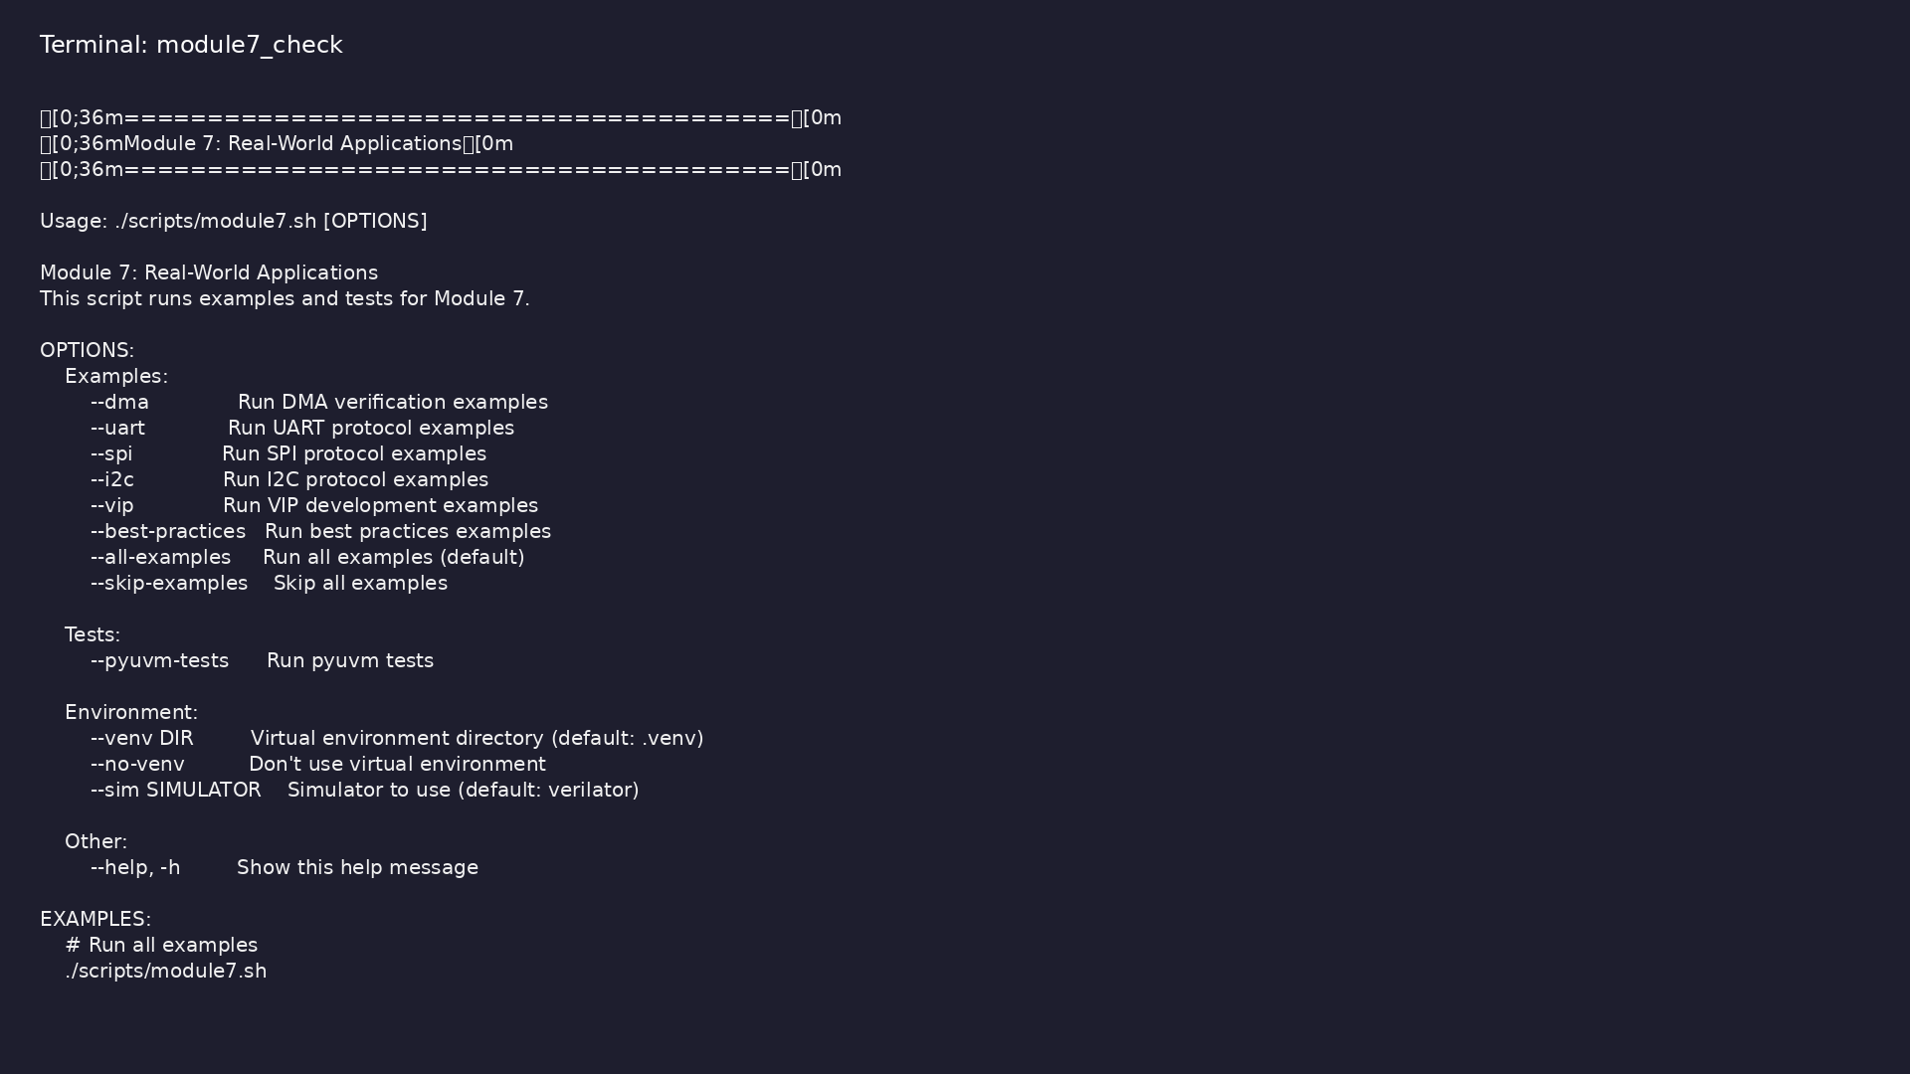
Module 7 orchestrator
$ ./scripts/module7.sh --help
learn_uvm_pyuvm / Module 7
Notes:
Run from course repository root.

Slide 59
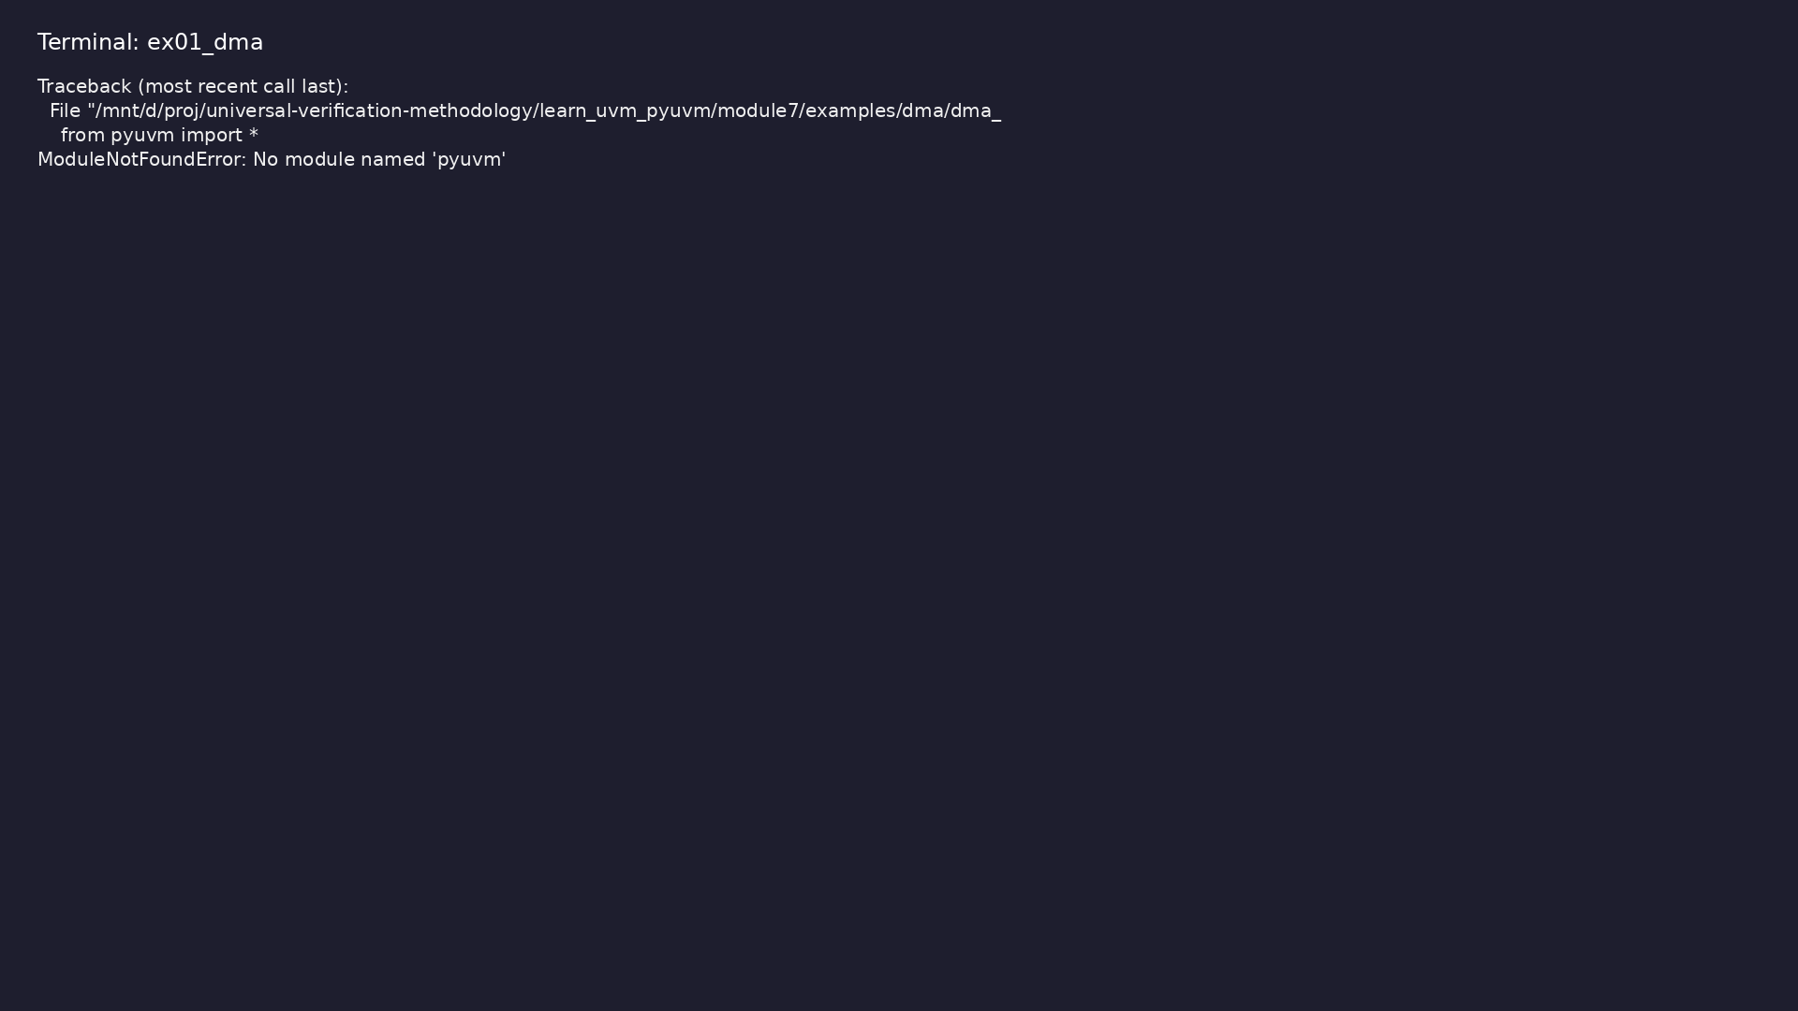
Demo: DMA Verification
$ .venv/bin/python module7/examples/dma/dma_example.py
learn_uvm_pyuvm / Module 7
Notes:
Hands-on: module7/examples/dma/

Slide 60
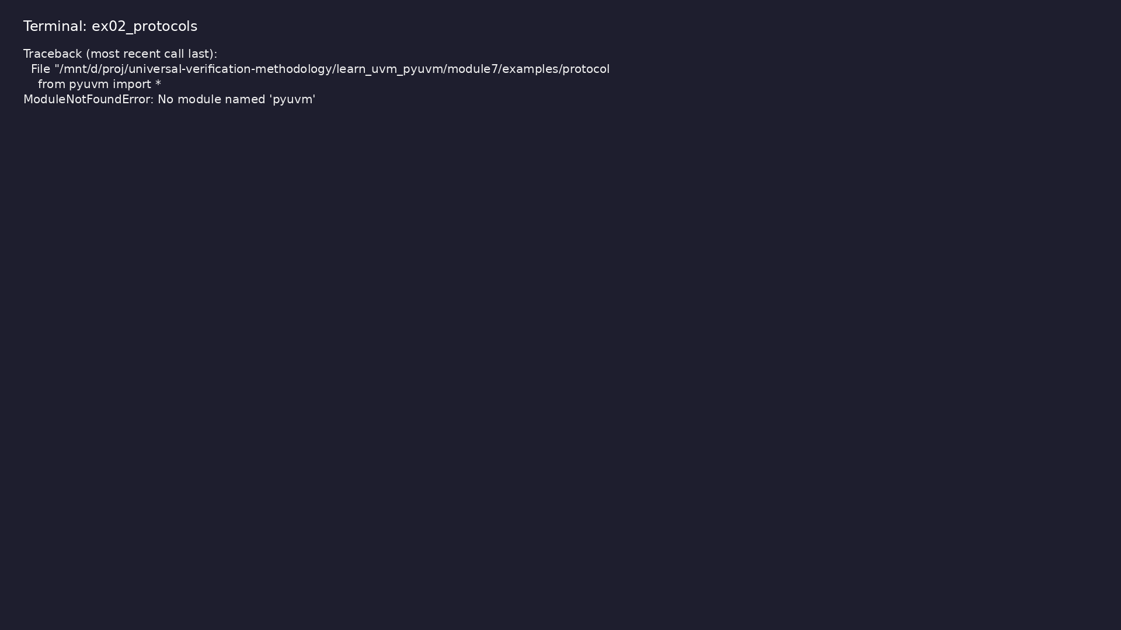
Demo: UART Protocol
$ .venv/bin/python module7/examples/protocols/uart_example.py
learn_uvm_pyuvm / Module 7
Notes:
Hands-on: module7/examples/protocols/

Slide 61

Demo: SPI Protocol
$ .venv/bin/python module7/examples/protocols/spi_example.py
learn_uvm_pyuvm / Module 7
Notes:
Hands-on: module7/examples/protocols/

Slide 62

Demo: I2C Protocol
$ .venv/bin/python module7/examples/protocols/i2c_example.py
learn_uvm_pyuvm / Module 7
Notes:
Hands-on: module7/examples/protocols/

Slide 63
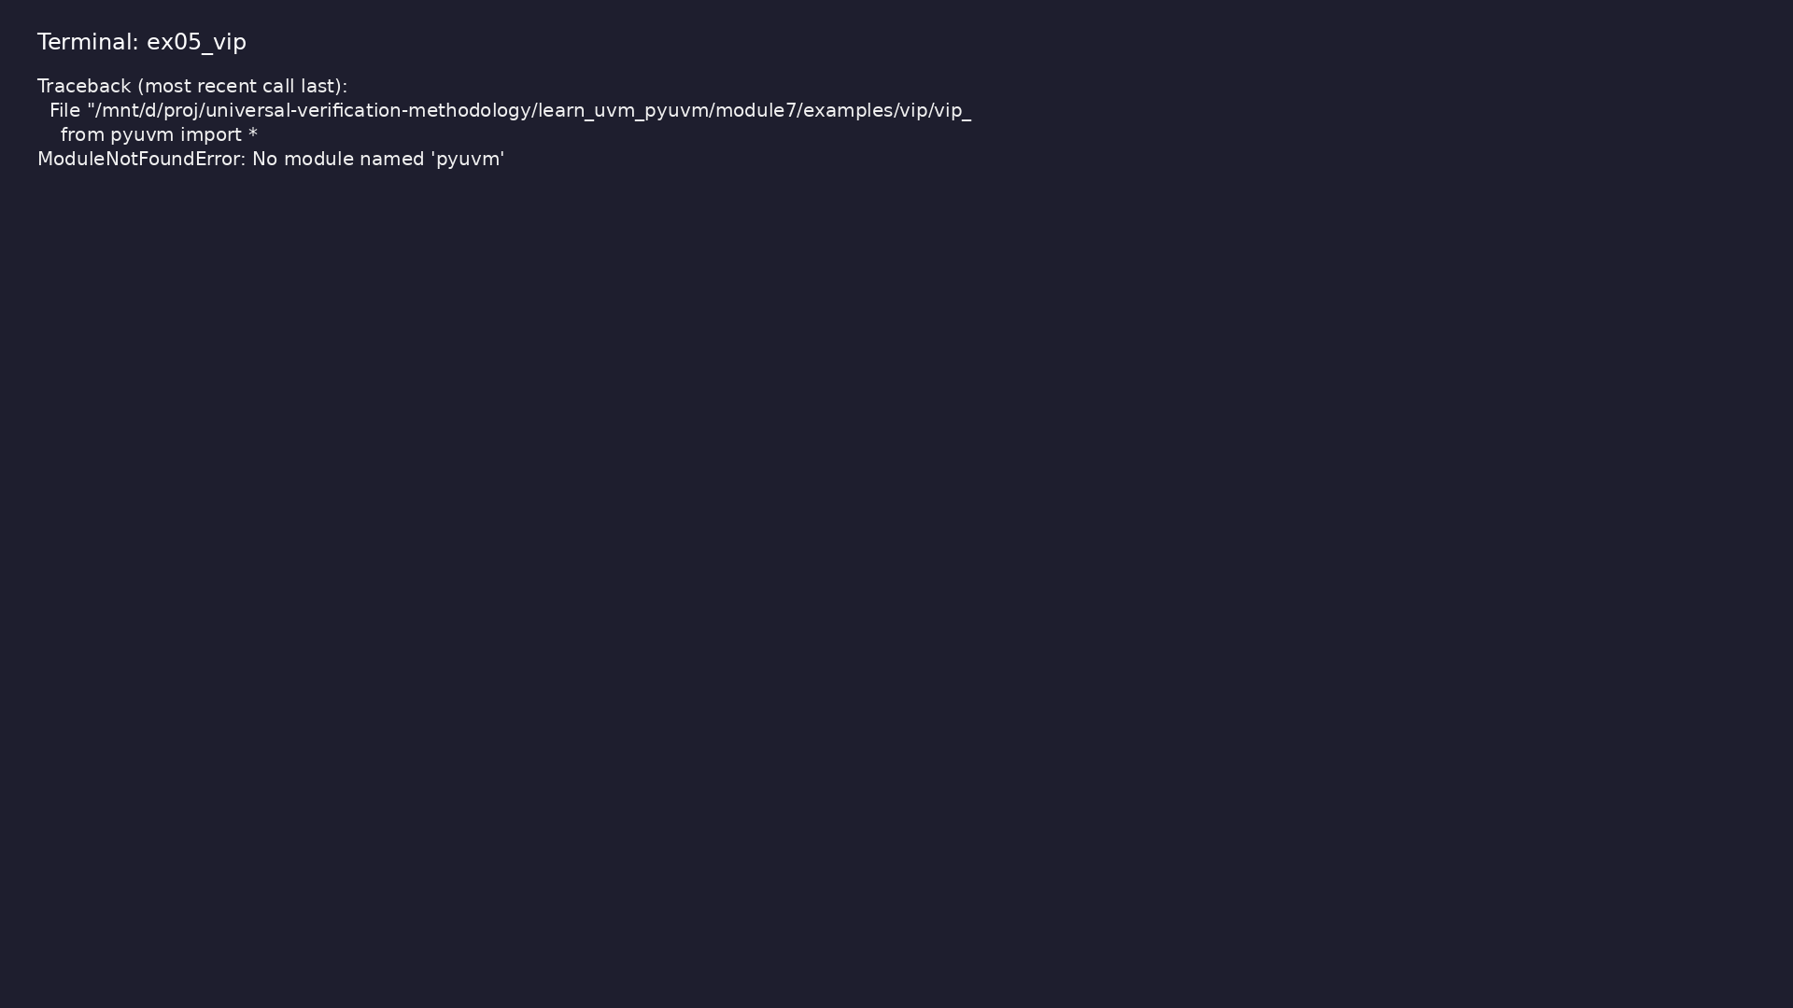
Demo: VIP Development
$ .venv/bin/python module7/examples/vip/vip_example.py
learn_uvm_pyuvm / Module 7
Notes:
Hands-on: module7/examples/vip/

Slide 64
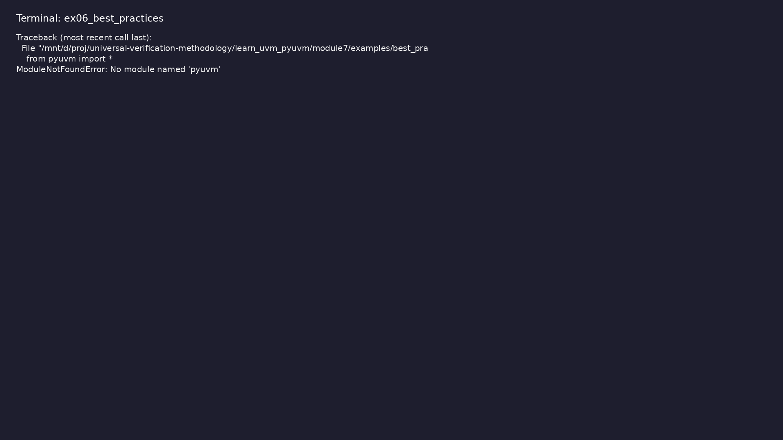
Demo: Best Practices
$ .venv/bin/python
module7/examples/best_practices/best_practices_example.py
learn_uvm_pyuvm / Module 7
Notes:
Hands-on: module7/examples/best_practices/

Slide 65
Practice & assessment
learn_uvm_pyuvm / Module 7

Slide 66
What you should know (1/3)
• Verify complex designs (DMA, protocols)
• Apply industry best practices
• Create reusable verification IP
• Optimize testbench performance
• Achieve coverage closure
• Plan and execute verification projects
learn_uvm_pyuvm / Module 7
Notes:
From MODULE7 Learning Outcomes.

Slide 67
What you should know (2/3)
• Debug complex issues
• Maintain production testbenches
• Apply industry patterns
• Create complete verification solutions
• Register model
• Multiple DMA channels
learn_uvm_pyuvm / Module 7
Notes:
From MODULE7 Learning Outcomes.

Slide 68
What you should know (3/3)
• Scatter-gather support
• Performance monitoring
• Coverage model
• Scoreboard
learn_uvm_pyuvm / Module 7
Notes:
From MODULE7 Learning Outcomes.

Slide 69
Exercises
• DMA Verification
• Protocol VIP
• Best Practices
• Coverage Closure
• Final Project
learn_uvm_pyuvm / Module 7

Slide 70
Assessment checklist
• Can verify complex designs
• Understands best practices
• Can create reusable VIP
• Can optimize performance
• Can achieve coverage closure
• Can plan verification projects
learn_uvm_pyuvm / Module 7

Slide 71
Summary & next steps
• Apply UVM to real-world verification scenarios
• Complete module7/CHECKLIST.md
• Review module7/EXAMPLES.md and run each lab
• Next: Next module in course
learn_uvm_pyuvm / Module 7

