Slide 1
Module 8
UVM Miscellaneous Utilities
learn_uvm_pyuvm / Module 8

Slide 2
Learning objectives
• Master UVM utility classes and helper functions
learn_uvm_pyuvm / Module 8

Slide 3
Prerequisites
• See module README
learn_uvm_pyuvm / Module 8

Slide 4

Learning path
Master UVM utility classes and helper functions
learn_uvm_pyuvm / Module 8

Slide 5
Overview
• This module covers the miscellaneous utilities
provided by UVM that support verification
environmen…
learn_uvm_pyuvm / Module 8

Slide 6
How to learn this module
learn_uvm_pyuvm / Module 8

Slide 7
Suggested learning path
• Modules 4–7 env patterns should be fresh — utilities
attach to analysis ports and phase hooks you a…
• No new large DUT focus;
`module8/dut/dma/simple_dma.v` reuses DMA block as a
lightweight integratio…
• Run CLP example first — plusargs configure tests
without recompilation
• Study comparators and recorders on analysis ports
before pools/queues efficiency labs
• Capstone: `integration/` wires multiple utilities;
`test_utilities.py` proves them under simulation
learn_uvm_pyuvm / Module 8
Notes:
From docs/MODULE8.md — read guides before running demos.

Slide 8
Design architecture
learn_uvm_pyuvm / Module 8

Slide 9

1. Utility layer in the testbench
• No new large DUT focus —
utilities plug into existing
envs from prior modules
• CLP (`uvm_cmdline_processor`)
configures tests without
recompilation
• Comparators, recorders, pools,
queues support analysis and
debug infrastructure
• String/math/random helpers
reduce boilerplate in checks and
stimulus
learn_uvm_pyuvm / Module 8
Notes:
From MODULE8 Design Architecture.

Slide 10
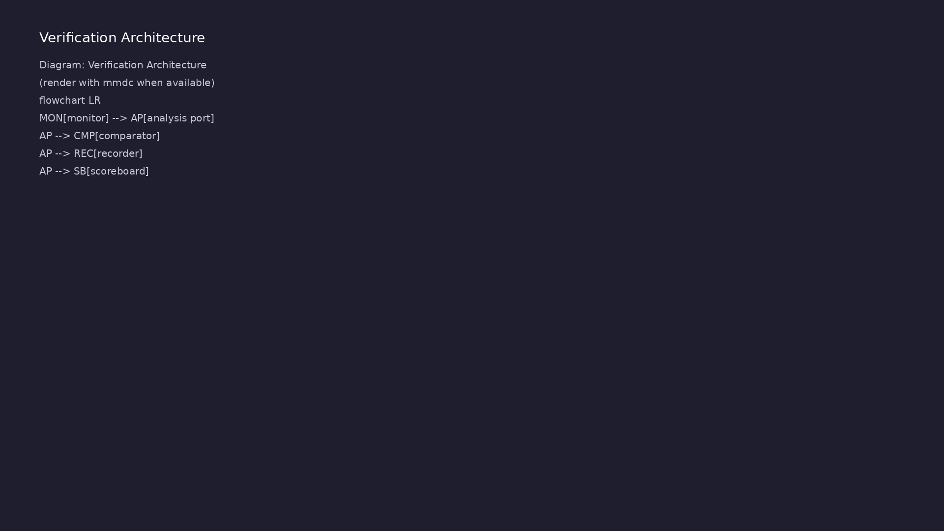
2. How utilities attach
• Comparators sit on analysis
ports beside scoreboards
• Recorders log transactions to
files for offline review
• Pools/queues manage recycled
objects and ordered work lists
• CLP reads plusargs before
build/run to select tests and
verbosity
learn_uvm_pyuvm / Module 8
Notes:
From MODULE8 Design Architecture.

Slide 11
3. Execution pipeline
• Build: standard Verilator compile; utilities
instantiate during env build like other components
• Connect: comparators/recorders tap monitor analysis
ports alongside scoreboard
• Sim: CLP-selected sequences run; recorders flush on
phase boundaries; pools recycle transaction obj…
• Check: comparators flag ordering/equality
violations; logs + UVM report provide offline audit
trail
learn_uvm_pyuvm / Module 8
Notes:
From MODULE8 Design Architecture.

Slide 12
4. Integration architecture
• `module8/examples/integration/` wires multiple
utilities in one mini-env
• Tests under `module8/tests/pyuvm_tests/` prove
utilities under simulation
• Pattern: configure via CLP → run sequence → compare
→ record → report
• Reuse utilities in Module 6/7 style envs for
capstone projects
learn_uvm_pyuvm / Module 8
Notes:
From MODULE8 Design Architecture.

Slide 13
Comparator on analysis port
"""
Module 8 Example 8.2: UVM Comparators
Demonstrates using comparators for transaction comparison in
scoreboards.
"""
from pyuvm import *
# Explicitly import uvm_analysis_imp - it may not be exported by from
pyuvm import *
# Try multiple possible import paths
_uvm_analysis_imp = None
try:
# First try: check if it's in the namespace after from pyuvm import
*
_uvm_analysis_imp = globals()['uvm_analysis_imp']
except KeyError:
# Second try: import from pyuvm module directly
import pyuvm
learn_uvm_pyuvm / Module 8

Slide 14
Key files to study
learn_uvm_pyuvm / Module 8

Slide 15
Open these in the repo
• `module8/examples/clp/clp_example.py` —
`uvm_cmdline_processor` plusarg parsing
• `module8/examples/comparators/comparator_example.py`
— equal/less/greater compare policies
• `module8/examples/recorders/recorder_example.py` —
transaction logging to files
• `module8/examples/pools/pool_example.py` and
`queues/queue_example.py` — object reuse and ordered
w…
• `module8/examples/integration/integration_example.py
` — multi-utility mini-env
• `module8/tests/pyuvm_tests/test_utilities.py` —
simulated proof of utility integration
learn_uvm_pyuvm / Module 8
Notes:
Trace while running module8/EXAMPLES.md labs.

Slide 16
Verification & testing methods
learn_uvm_pyuvm / Module 8

Slide 17
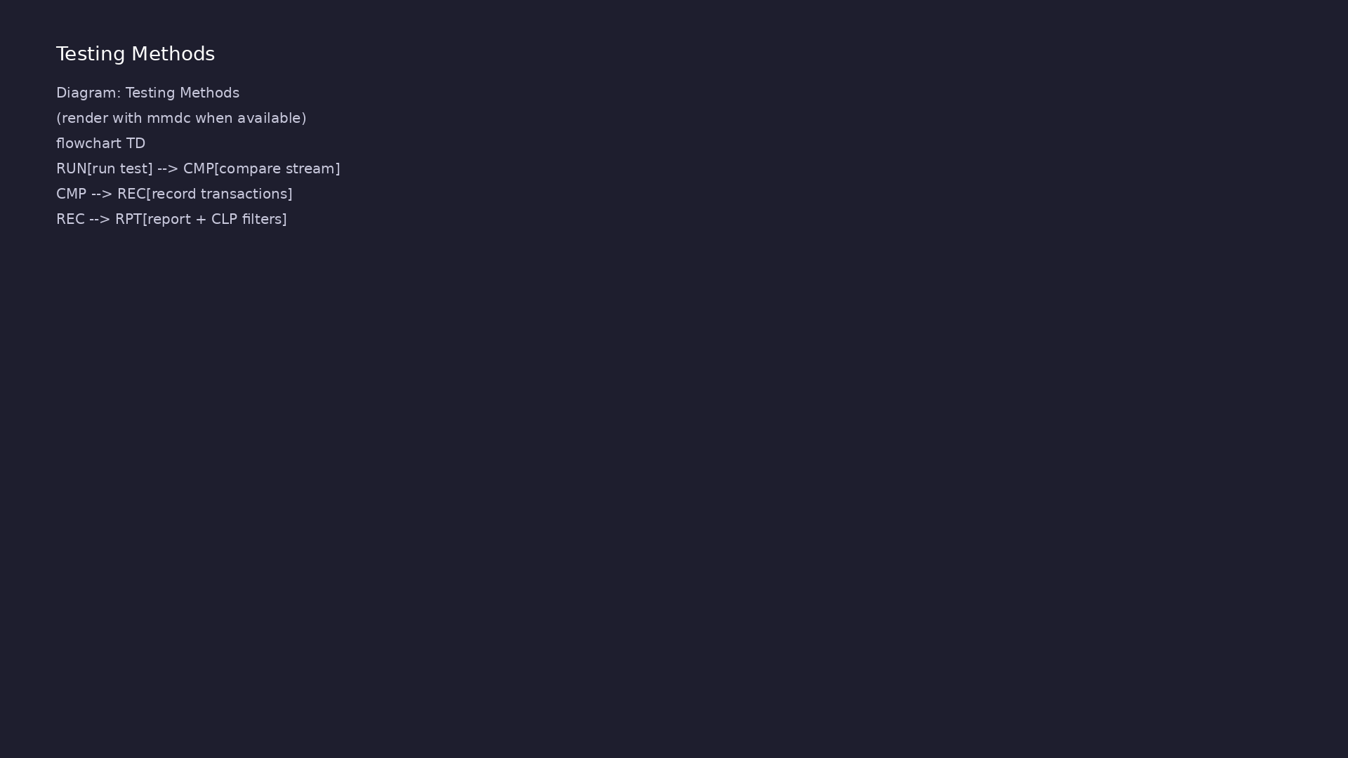
1. Utility-focused test methods
• Comparator tests:
equal/less/greater policies on
transaction streams
• Recorder tests: verify log
format and flush on phase
boundaries
• CLP tests: plusargs override
seed, verbosity, and test name
learn_uvm_pyuvm / Module 8
Notes:
From MODULE8 Verification & Testing Methods.

Slide 18
2. Efficiency and reuse
• Object pools cut allocation churn in high-
transaction regressions
• Queues order deferred checks or secondary stimulus
• Random/string/math utils keep constraints readable
in sequences
learn_uvm_pyuvm / Module 8
Notes:
From MODULE8 Verification & Testing Methods.

Slide 19
3. Step-by-step lab execution
• 1. CLP: `./scripts/module8.sh --clp` — exercise
plusarg overrides
• 2. Compare/record: `./scripts/module8.sh
--comparators --recorders`
• 3. Pools/queues: `./scripts/module8.sh --pools
--queues`
• 4. Helpers: `./scripts/module8.sh --string-utils
--math-utils --random-utils`
• 5. Capstone: `./scripts/module8.sh --integration
--pyuvm-tests` — full utility integration pass
learn_uvm_pyuvm / Module 8
Notes:
From MODULE8 Verification & Testing Methods.

Slide 20
4. Closure
• `./scripts/module8.sh --pyuvm-tests` across all
utility examples
• Assessment: CLP, comparators, recorders, pools,
queues, integration
• Capstone: combine utilities with Module 6/7 style
envs in your own project
learn_uvm_pyuvm / Module 8
Notes:
From MODULE8 Verification & Testing Methods.

Slide 21
CLP plusarg configuration
"""
Module 8 Example 8.1: Command Line Processor (CLP)
Demonstrates using UVM Command Line Processor for test configuration.
"""
from pyuvm import *
import sys
import cocotb
from cocotb.triggers import Timer
class CLPTransaction(uvm_sequence_item):
"""Transaction for CLP example."""
def __init__(self, name="CLPTransaction"):
super().__init__(name)
# ...
learn_uvm_pyuvm / Module 8

Slide 22
Syllabus topics
learn_uvm_pyuvm / Module 8

Slide 23
1. UVM Command Line Processor (CLP) (1/4)
• Command Line Processor Overview
• What is CLP?
• Why use CLP?
• CLP benefits
• CLP vs manual argument parsing
• CLP Usage
learn_uvm_pyuvm / Module 8
Notes:
From MODULE8 Topics Covered.

Slide 24
1. UVM Command Line Processor (CLP) (2/4)
• Getting command-line arguments
• Argument types (string, int, bit, time)
• Default values
• Argument validation
• CLP Methods
• `get_arg_value()` - Get argument value
learn_uvm_pyuvm / Module 8
Notes:
From MODULE8 Topics Covered.

Slide 25
1. UVM Command Line Processor (CLP) (3/4)
• `get_arg_values()` - Get multiple values
• `get_arg_count()` - Get argument count
• `has_arg()` - Check if argument exists
• CLP Patterns
• Test configuration via command line
• Debug control via command line
learn_uvm_pyuvm / Module 8
Notes:
From MODULE8 Topics Covered.

Slide 26
1. UVM Command Line Processor (CLP) (4/4)
• Simulation control via command line
• Best practices
learn_uvm_pyuvm / Module 8
Notes:
From MODULE8 Topics Covered.

Slide 27
2. UVM Comparators (1/5)
• Comparator Overview
• What are comparators?
• Comparator purpose
• When to use comparators
• Comparator types
• Built-in Comparators
learn_uvm_pyuvm / Module 8
Notes:
From MODULE8 Topics Covered.

Slide 28
2. UVM Comparators (2/5)
• `uvm_in_order_comparator` - In-order comparison
• `uvm_algorithmic_comparator` - Algorithmic
comparison
• Comparator characteristics
• Comparator selection
• In-Order Comparator
• Sequential comparison
learn_uvm_pyuvm / Module 8
Notes:
From MODULE8 Topics Covered.

Slide 29
2. UVM Comparators (3/5)
• Transaction matching
• Comparison logic
• Error reporting
• Algorithmic Comparator
• Custom comparison algorithms
• Flexible matching
learn_uvm_pyuvm / Module 8
Notes:
From MODULE8 Topics Covered.

Slide 30
2. UVM Comparators (4/5)
• Comparison functions
• Use cases
• Comparator Implementation
• Creating comparators
• Connecting comparators
• Configuring comparators
learn_uvm_pyuvm / Module 8
Notes:
From MODULE8 Topics Covered.

Slide 31
2. UVM Comparators (5/5)
• Using comparators in scoreboards
learn_uvm_pyuvm / Module 8
Notes:
From MODULE8 Topics Covered.

Slide 32
3. UVM Recorders (1/5)
• Recorder Overview
• What are recorders?
• Recorder purpose
• Transaction recording
• Recording benefits
• Recorder Types
learn_uvm_pyuvm / Module 8
Notes:
From MODULE8 Topics Covered.

Slide 33
3. UVM Recorders (2/5)
• `uvm_text_recorder` - Text recording
• `uvm_tr_database` - Transaction database
• Recording formats
• Recording selection
• Recorder Usage
• Enabling recording
learn_uvm_pyuvm / Module 8
Notes:
From MODULE8 Topics Covered.

Slide 34
3. UVM Recorders (3/5)
• Recording transactions
• Recording configuration
• Recording analysis
• Transaction Recording
• Recording sequence items
• Recording transactions
learn_uvm_pyuvm / Module 8
Notes:
From MODULE8 Topics Covered.

Slide 35
3. UVM Recorders (4/5)
• Recording timing
• Recording relationships
• Recorder Implementation
• Creating recorders
• Connecting recorders
• Configuring recorders
learn_uvm_pyuvm / Module 8
Notes:
From MODULE8 Topics Covered.

Slide 36
3. UVM Recorders (5/5)
• Analyzing recordings
learn_uvm_pyuvm / Module 8
Notes:
From MODULE8 Topics Covered.

Slide 37
4. UVM Pools (1/5)
• Object Pool Overview
• What are pools?
• Pool purpose
• Object reuse
• Performance benefits
• Pool Types
learn_uvm_pyuvm / Module 8
Notes:
From MODULE8 Topics Covered.

Slide 38
4. UVM Pools (2/5)
• `uvm_pool` - Generic object pool
• Pool characteristics
• Pool operations
• Pool use cases
• Pool Usage
• Creating pools
learn_uvm_pyuvm / Module 8
Notes:
From MODULE8 Topics Covered.

Slide 39
4. UVM Pools (3/5)
• Adding objects to pools
• Getting objects from pools
• Pool management
• Pool Implementation
• Pool creation
• Object allocation
learn_uvm_pyuvm / Module 8
Notes:
From MODULE8 Topics Covered.

Slide 40
4. UVM Pools (4/5)
• Object deallocation
• Pool cleanup
• Pool Patterns
• Transaction pooling
• Sequence item pooling
• Performance optimization
learn_uvm_pyuvm / Module 8
Notes:
From MODULE8 Topics Covered.

Slide 41
4. UVM Pools (5/5)
• Memory management
learn_uvm_pyuvm / Module 8
Notes:
From MODULE8 Topics Covered.

Slide 42
5. UVM Queues (1/5)
• Queue Overview
• What are queues?
• Queue purpose
• Queue vs list
• Queue benefits
• Queue Types
learn_uvm_pyuvm / Module 8
Notes:
From MODULE8 Topics Covered.

Slide 43
5. UVM Queues (2/5)
• `uvm_queue` - Generic queue
• Queue characteristics
• Queue operations
• Queue use cases
• Queue Usage
• Creating queues
learn_uvm_pyuvm / Module 8
Notes:
From MODULE8 Topics Covered.

Slide 44
5. UVM Queues (3/5)
• Adding items to queues
• Removing items from queues
• Queue management
• Queue Implementation
• Queue creation
• Queue operations
learn_uvm_pyuvm / Module 8
Notes:
From MODULE8 Topics Covered.

Slide 45
5. UVM Queues (4/5)
• Queue iteration
• Queue cleanup
• Queue Patterns
• Transaction queues
• Scoreboard queues
• Buffer queues
learn_uvm_pyuvm / Module 8
Notes:
From MODULE8 Topics Covered.

Slide 46
5. UVM Queues (5/5)
• Queue best practices
learn_uvm_pyuvm / Module 8
Notes:
From MODULE8 Topics Covered.

Slide 47
6. UVM String Utilities (1/3)
• String Utility Overview
• String manipulation needs
• UVM string utilities
• Utility benefits
• When to use utilities
• String Operations
learn_uvm_pyuvm / Module 8
Notes:
From MODULE8 Topics Covered.

Slide 48
6. UVM String Utilities (2/3)
• String formatting
• String conversion
• String manipulation
• String comparison
• String Utility Methods
• Common string operations
learn_uvm_pyuvm / Module 8
Notes:
From MODULE8 Topics Covered.

Slide 49
6. UVM String Utilities (3/3)
• Formatting functions
• Conversion functions
• Utility patterns
learn_uvm_pyuvm / Module 8
Notes:
From MODULE8 Topics Covered.

Slide 50
7. UVM Math Utilities (1/3)
• Math Utility Overview
• Mathematical operations
• UVM math utilities
• Utility benefits
• When to use utilities
• Math Operations
learn_uvm_pyuvm / Module 8
Notes:
From MODULE8 Topics Covered.

Slide 51
7. UVM Math Utilities (2/3)
• Random number generation
• Statistical functions
• Mathematical utilities
• Math patterns
• Math Utility Methods
• Common math operations
learn_uvm_pyuvm / Module 8
Notes:
From MODULE8 Topics Covered.

Slide 52
7. UVM Math Utilities (3/3)
• Random functions
• Statistical functions
• Utility patterns
learn_uvm_pyuvm / Module 8
Notes:
From MODULE8 Topics Covered.

Slide 53
8. UVM Random Utilities (1/3)
• Random Utility Overview
• Random number generation
• UVM random utilities
• Randomization support
• Random patterns
• Random Operations
learn_uvm_pyuvm / Module 8
Notes:
From MODULE8 Topics Covered.

Slide 54
8. UVM Random Utilities (2/3)
• Random value generation
• Constrained random
• Random seeds
• Random control
• Random Utility Methods
• Random number generation
learn_uvm_pyuvm / Module 8
Notes:
From MODULE8 Topics Covered.

Slide 55
8. UVM Random Utilities (3/3)
• Seed management
• Random state
• Utility patterns
learn_uvm_pyuvm / Module 8
Notes:
From MODULE8 Topics Covered.

Slide 56
9. UVM Primitives (1/3)
• Primitive Overview
• What are primitives?
• Primitive purpose
• Primitive types
• Primitive use cases
• Primitive Types
learn_uvm_pyuvm / Module 8
Notes:
From MODULE8 Topics Covered.

Slide 57
9. UVM Primitives (2/3)
• Common primitives
• Primitive operations
• Primitive characteristics
• Primitive selection
• Primitive Usage
• Using primitives
learn_uvm_pyuvm / Module 8
Notes:
From MODULE8 Topics Covered.

Slide 58
9. UVM Primitives (3/3)
• Primitive patterns
• Primitive best practices
• Primitive examples
learn_uvm_pyuvm / Module 8
Notes:
From MODULE8 Topics Covered.

Slide 59
10. UVM Macros (Python Context) (1/2)
• Macro Overview
• Macros in SystemVerilog vs Python
• Python alternatives
• Utility functions
• Helper decorators
• Python Equivalents
learn_uvm_pyuvm / Module 8
Notes:
From MODULE8 Topics Covered.

Slide 60
10. UVM Macros (Python Context) (2/2)
• Macro alternatives
• Utility functions
• Decorator patterns
• Helper classes
learn_uvm_pyuvm / Module 8
Notes:
From MODULE8 Topics Covered.

Slide 61
11. Utility Integration (1/3)
• Using Utilities in Testbenches
• When to use utilities
• Utility selection
• Utility integration
• Utility patterns
• Utility Best Practices
learn_uvm_pyuvm / Module 8
Notes:
From MODULE8 Topics Covered.

Slide 62
11. Utility Integration (2/3)
• Utility usage guidelines
• Performance considerations
• Memory management
• Utility organization
• Common Utility Patterns
• Command-line configuration
learn_uvm_pyuvm / Module 8
Notes:
From MODULE8 Topics Covered.

Slide 63
11. Utility Integration (3/3)
• Transaction comparison
• Transaction recording
• Object management
learn_uvm_pyuvm / Module 8
Notes:
From MODULE8 Topics Covered.

Slide 64
Command reference highlights
learn_uvm_pyuvm / Module 8

Slide 65
Core utilities
• `./scripts/module8.sh --clp --comparators
--recorders` — configure, compare, and log
infrastructure
• `./scripts/module8.sh --pools --queues` — allocation
efficiency and ordered deferred work
• `./scripts/module8.sh --string-utils --math-utils
--random-utils` — helper libraries for checks/sti…
learn_uvm_pyuvm / Module 8
Notes:
Full detail in docs/MODULE8.md command reference.

Slide 66
Integration and tests
• `./scripts/module8.sh --integration` — combined
utility mini-env
• `./scripts/module8.sh --pyuvm-tests` —
`test_utilities.py` regression
• `cd module8/tests/pyuvm_tests && make SIM=verilator
TEST=test_utilities`
learn_uvm_pyuvm / Module 8
Notes:
Full detail in docs/MODULE8.md command reference.

Slide 67
CLP-driven runs
• Pass plusargs through Makefile/`SIM_ARGS` where
examples support seed, verbosity, test name overrid…
• Re-run same binary with different plusargs —
demonstrates no-recompile test selection
• `./scripts/module8.sh` — full utility sweep for
module completion
learn_uvm_pyuvm / Module 8
Notes:
Full detail in docs/MODULE8.md command reference.

Slide 68
Hands-on examples
learn_uvm_pyuvm / Module 8

Slide 69
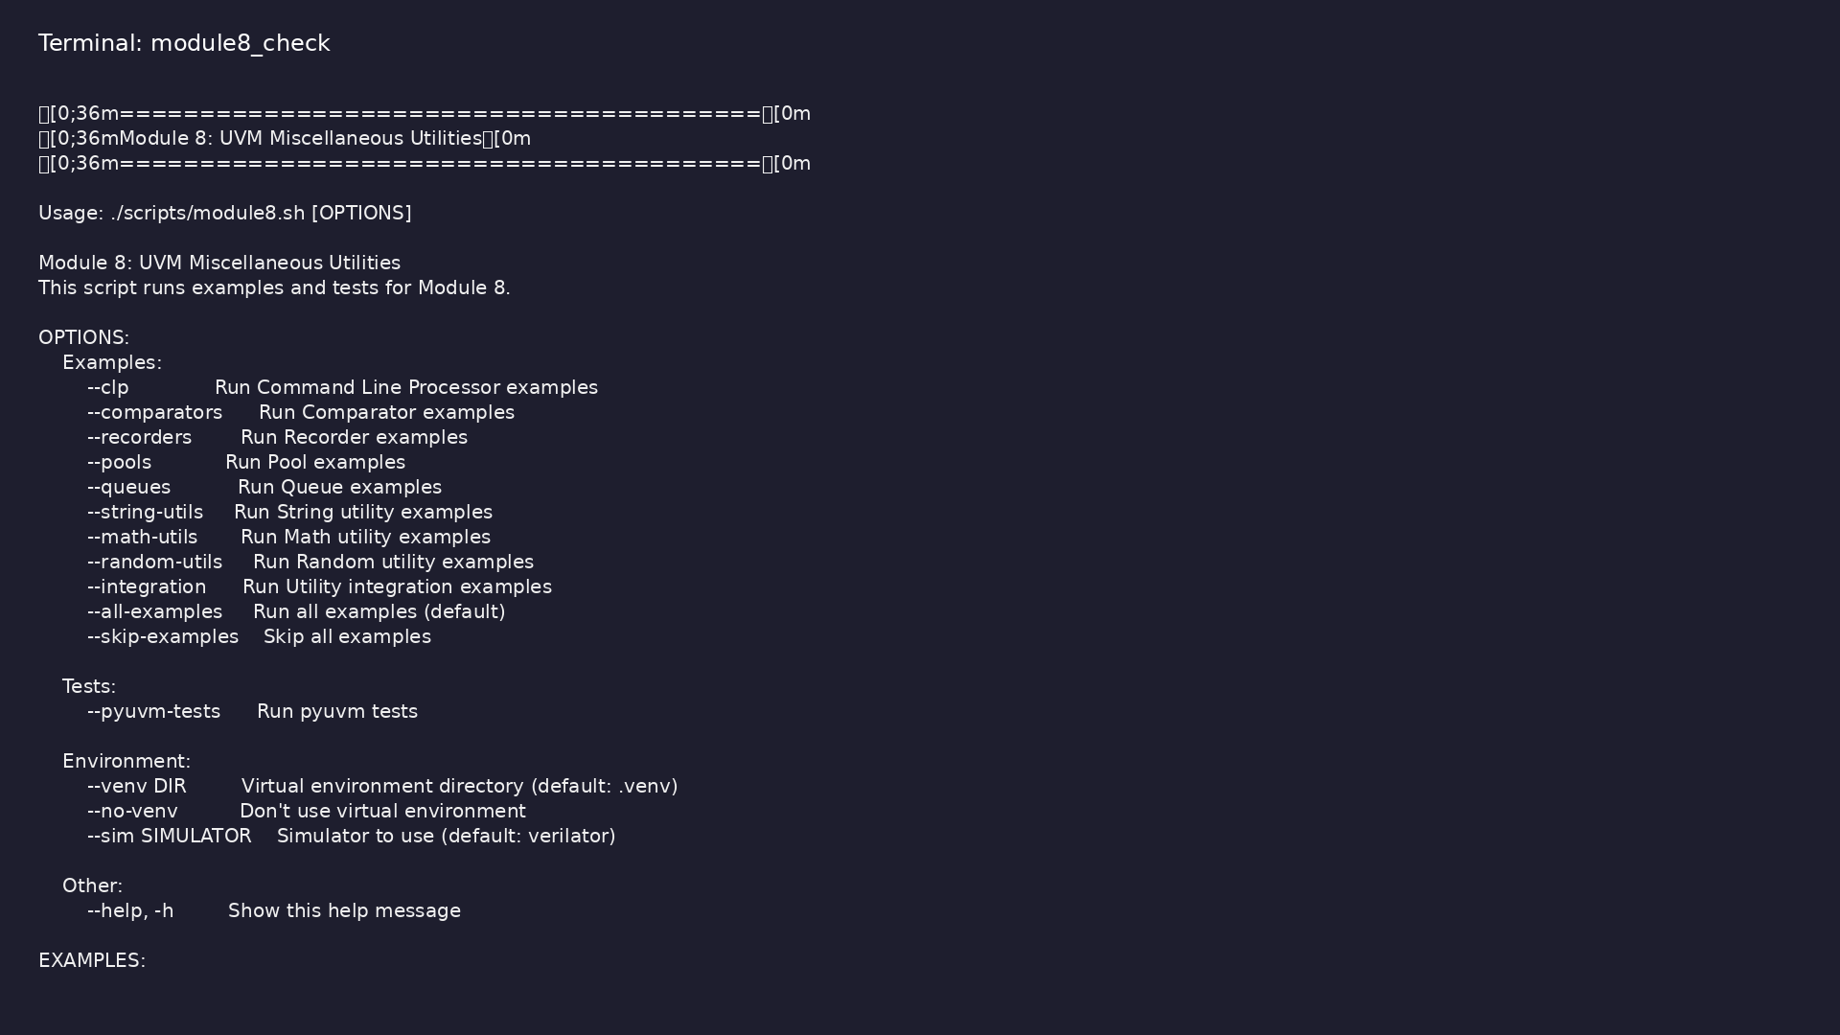
Module 8 orchestrator
$ ./scripts/module8.sh --help
learn_uvm_pyuvm / Module 8
Notes:
Run from course repository root.

Slide 70
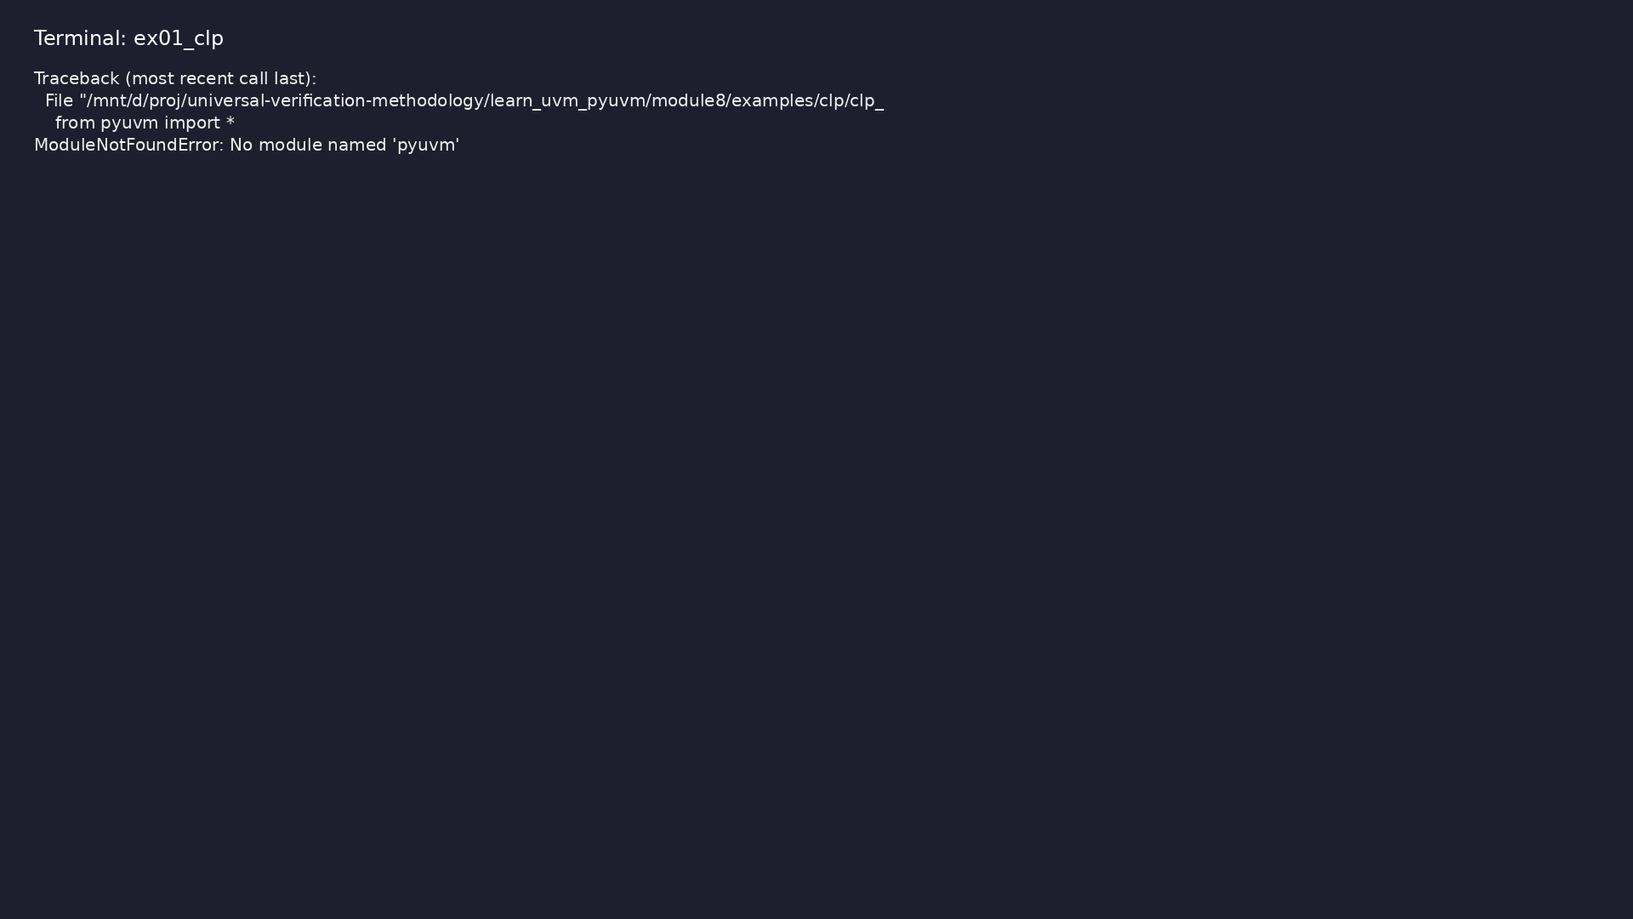
Demo: Command Line Processor
$ .venv/bin/python module8/examples/clp/clp_example.py
learn_uvm_pyuvm / Module 8
Notes:
Hands-on: module8/examples/clp/

Slide 71
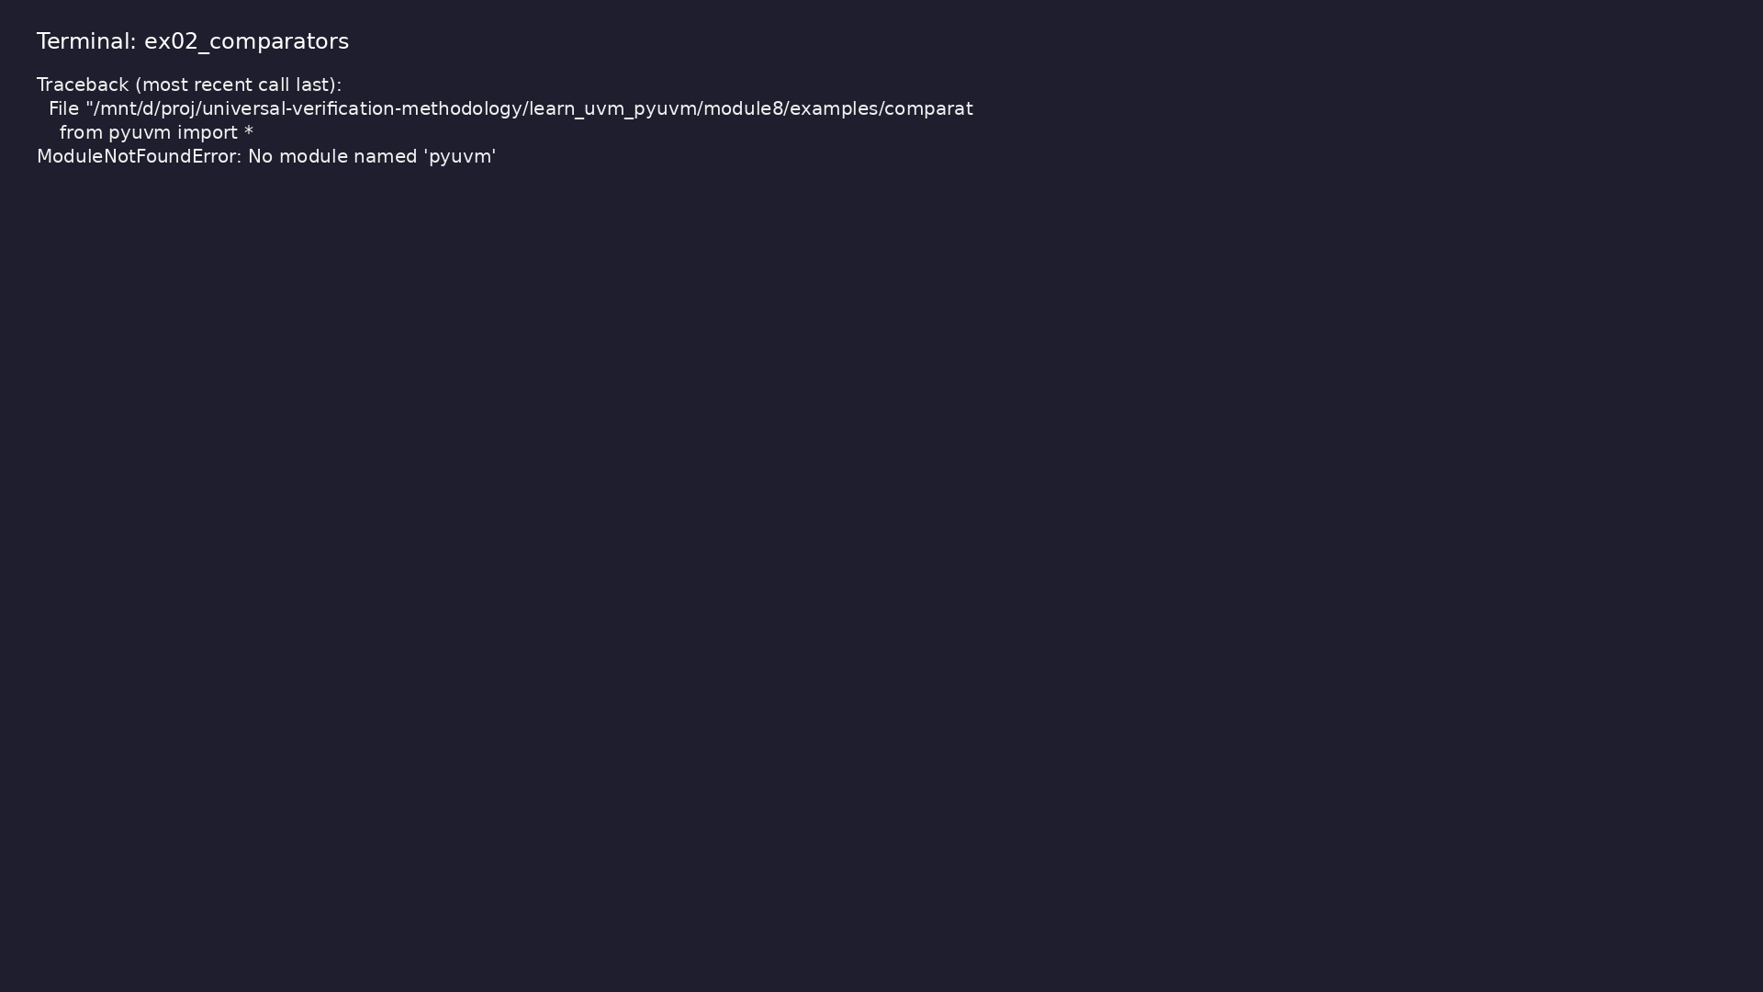
Demo: Comparators
$ .venv/bin/python module8/examples/comparators/comparator_example.py
learn_uvm_pyuvm / Module 8
Notes:
Hands-on: module8/examples/comparators/

Slide 72
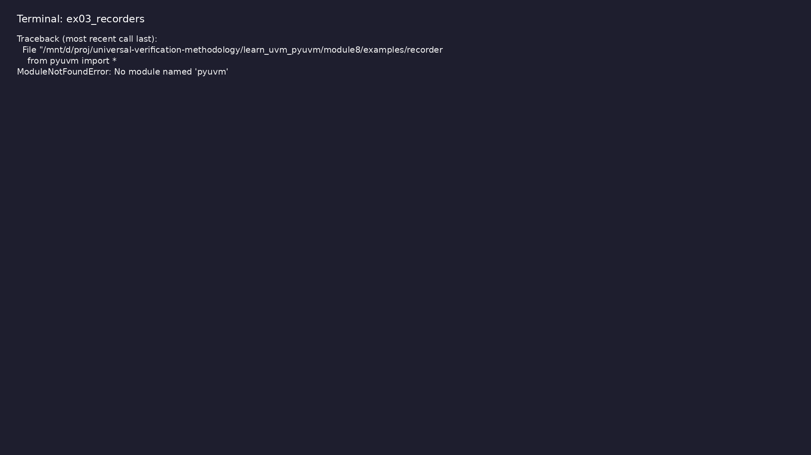
Demo: Recorders
$ .venv/bin/python module8/examples/recorders/recorder_example.py
learn_uvm_pyuvm / Module 8
Notes:
Hands-on: module8/examples/recorders/

Slide 73

Demo: Pools
$ .venv/bin/python module8/examples/pools/pool_example.py
learn_uvm_pyuvm / Module 8
Notes:
Hands-on: module8/examples/pools/

Slide 74

Demo: Queues
$ .venv/bin/python module8/examples/queues/queue_example.py
learn_uvm_pyuvm / Module 8
Notes:
Hands-on: module8/examples/queues/

Slide 75

Demo: String Utilities
$ .venv/bin/python
module8/examples/string_utils/string_utils_example.py
learn_uvm_pyuvm / Module 8
Notes:
Hands-on: module8/examples/string_utils/

Slide 76

Demo: Math Utilities
$ .venv/bin/python module8/examples/math_utils/math_utils_example.py
learn_uvm_pyuvm / Module 8
Notes:
Hands-on: module8/examples/math_utils/

Slide 77

Demo: Random Utilities
$ .venv/bin/python
module8/examples/random_utils/random_utils_example.py
learn_uvm_pyuvm / Module 8
Notes:
Hands-on: module8/examples/random_utils/

Slide 78

Demo: Utility Integration
$ .venv/bin/python module8/examples/integration/integration_example.py
learn_uvm_pyuvm / Module 8
Notes:
Hands-on: module8/examples/integration/

Slide 79
Practice & assessment
learn_uvm_pyuvm / Module 8

Slide 80
What you should know (1/3)
• Use UVM Command Line Processor
• Implement and use comparators
• Use recorders for transaction recording
• Use pools for object management
• Use queues for data structures
• Use string and math utilities
learn_uvm_pyuvm / Module 8
Notes:
From MODULE8 Learning Outcomes.

Slide 81
What you should know (2/3)
• Use random utilities effectively
• Integrate utilities into testbenches
• Apply utility best practices
• Choose appropriate utilities for tasks
• CLP usage
• Argument parsing
learn_uvm_pyuvm / Module 8
Notes:
From MODULE8 Learning Outcomes.

Slide 82
What you should know (3/3)
• Configuration via command line
learn_uvm_pyuvm / Module 8
Notes:
From MODULE8 Learning Outcomes.

Slide 83
Exercises
• Command Line Processor
• Comparator Implementation
• Recorder Usage
• Pool and Queue Usage
• Utility Integration
learn_uvm_pyuvm / Module 8

Slide 84
Assessment checklist
• Can use Command Line Processor
• Can implement and use comparators
• Can use recorders effectively
• Can use pools for object management
• Can use queues for data structures
• Can use string and math utilities
learn_uvm_pyuvm / Module 8

Slide 85
Summary & next steps
• Master UVM utility classes and helper functions
• Complete module8/CHECKLIST.md
• Review module8/EXAMPLES.md and run each lab
• Next: Next module in course
learn_uvm_pyuvm / Module 8

