Slide 1
Welcome to verification planning
Welcome to verification planning and management
learn_verification_planning_management — intro
Notes:
Welcome to verification planning and management. Protocol and UVM courses teach how to build tests and VIP. This path teaches the other half: how to plan what to verify, measure coverage and risk, triage regressions, and decide when you are ready to sign off.

Slide 2
What you’ll build toward
The arc is plan, coverage, regression, sign-off
VIP handoff deliverables
Deep VIP engines stay in protocol and UVM courses
learn_verification_planning_management — intro
Notes:
The arc is plan, coverage, regression, sign-off. You’ll practice a feature-to-scenario-to-coverage checklist, test taxonomy, a feature-by-scenario matrix, cover bins and closure ideas, risk priority, seed and tag replay cards, triage buckets, metrics bars, CI-to-farm flow, a sign-off gate, and VIP handoff deliverables. Deep VIP engines stay in protocol and UVM courses—here you learn the planning layer those courses point to.

Slide 3
Two tracks, one idea
Track A is planning docs you keep
Track B is the platform’s verification-planning boards
You may do either track, or both
A good rhythm is browser board first for vocabulary
learn_verification_planning_management — intro
Notes:
Track A is planning docs you keep: paper or markdown tables, optional templates in the legacy verification planning materials. Track B is the platform’s verification-planning boards—interactive checklists and matrices with challenges. You may do either track, or both. A good rhythm is browser board first for vocabulary, then a short written table you could paste into a real project plan.

Slide 4
Set up Track A
Open this course folder and skim the module READMEs
Keep a notebook or markdown file ready for small tables
Optional: browse the legacy planning materials for templates
From the course root, self-check scripts can grade checklist items when you want them
Helpful prereq
learn_verification_planning_management — intro
Notes:
Open this course folder and skim the module READMEs. Keep a notebook or markdown file ready for small tables. Optional: browse the legacy planning materials for templates. From the course root, self-check scripts can grade checklist items when you want them. Helpful prereq: one protocol course or basic UVM literacy—so the plan words map to tests you already understand.

Slide 5
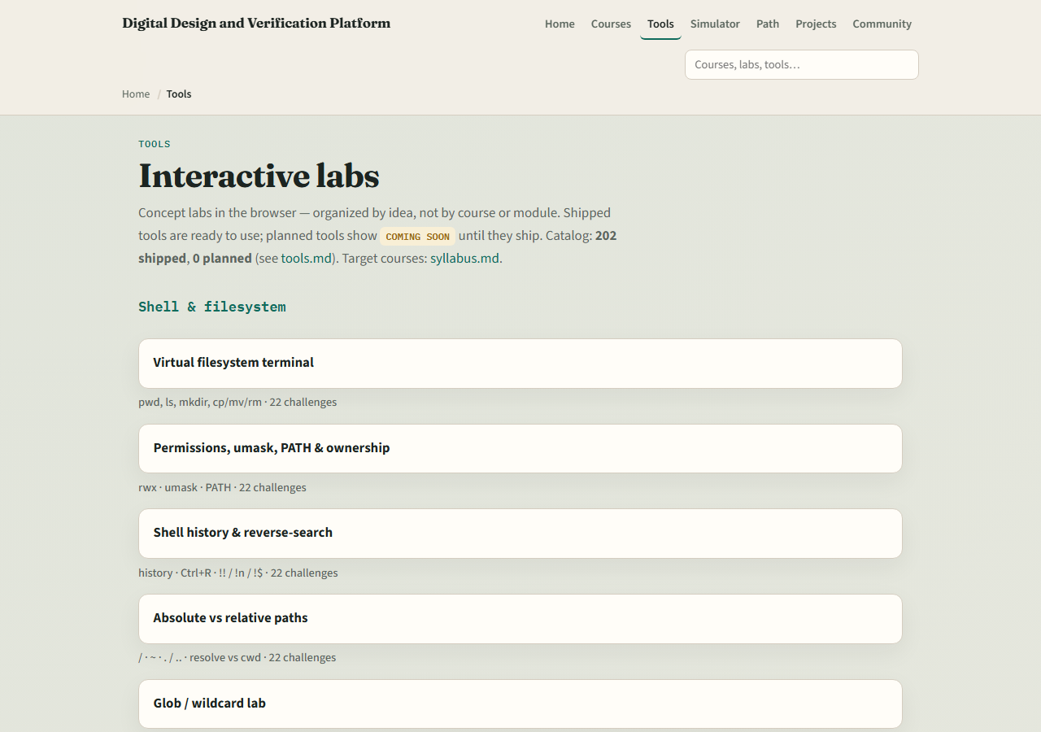
Set up Track B
From the monorepo
All twelve planning labs ship, from plan checklist through VIP handoff
If you prefer, use the published tools site instead
Confirm you can reach the index; the next module opens the coverage and plan checklist lab
learn_verification_planning_management — intro
Notes:
From the monorepo, serve the platform folder with a simple local web server, then open the tools index and jump to the verification-planning section. All twelve planning labs ship—from plan checklist through VIP handoff. If you prefer, use the published tools site instead. Confirm you can reach the index; the next module opens the coverage and plan checklist lab.

Slide 6
How to move through modules
For each module
Prefer Track B for graded board challenges
When you finish this intro checklist, continue to the coverage and plan checklist
learn_verification_planning_management — intro
Notes:
For each module, read the README for the outcome, pick a track—or both—then work the checklist. Prefer Track B for graded board challenges; prefer Track A for artifacts you can reuse at work. When you finish this intro checklist, continue to the coverage and plan checklist.

