Slide 1
Coverage / plan checklist
A verification plan is not a pile of test names
learn_verification_planning_management — verif plan check
Notes:
A verification plan is not a pile of test names. It is a traceability chain: a feature the product must do, a scenario that exercises it, and a coverage item that proves the scenario ran. If any link is missing, you cannot measure completion.

Slide 2
Feature, scenario, coverage
Feature means requirement or capability, say UART transmit
Scenario is the test story, send one byte
Coverage is the measurable proof
Complete means all three layers link
Incomplete means a gap: a scenario with no coverage, or coverage with no owning feature
learn_verification_planning_management — verif plan check
Notes:
Feature means requirement or capability—say UART transmit. Scenario is the test story—send one byte. Coverage is the measurable proof—a bin, coverpoint, or checklist item such as transmit-byte-done. Complete means all three layers link. Incomplete means a gap: a scenario with no coverage, or coverage with no owning feature.

Slide 3
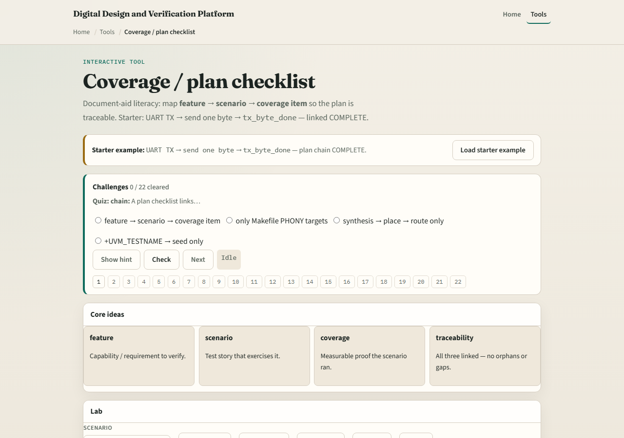
Browser lab
Lab starter
learn_verification_planning_management — verif plan check
Notes:
In the plan-check lab, load the starter: UART TX, send one byte, and transmit-byte-done linked—status complete. Try presets that drop coverage or orphan a bin, then rebuild the chain. Challenges quiz each layer and force you to restore a complete plan from gaps.

Slide 4
Planning docs practice
On paper or markdown, write one row with three columns: feature, scenario, coverage item
Use a tiny UART or SPI capability you know
Then deliberately delete the coverage cell and ask: how would I know this scenario ran?
That question is the whole module
learn_verification_planning_management — verif plan check
Notes:
On paper or markdown, write one row with three columns: feature, scenario, coverage item. Use a tiny UART or SPI capability you know. Then deliberately delete the coverage cell and ask: how would I know this scenario ran? That question is the whole module.

Slide 5
Pitfalls to watch
Do not treat the board as a live coverage database
Do not list coverage items with no feature owner, orphans lie
Do not stop at scenarios without a measurable proof
And do not confuse “we have a test file” with “we have a coverable claim.”
learn_verification_planning_management — verif plan check
Notes:
Do not treat the board as a live coverage database. Do not list coverage items with no feature owner—orphans lie. Do not stop at scenarios without a measurable proof. And do not confuse “we have a test file” with “we have a coverable claim.”

Slide 6
Your turn
Complete the checklist for at least one track, preferably both
In the browser, reach a complete three-layer chain
On paper, write one feature-scenario-coverage row you could paste into a real plan
When you are ready, take the short quiz, then continue to test taxonomy
learn_verification_planning_management — verif plan check
Notes:
Complete the checklist for at least one track—preferably both. In the browser, reach a complete three-layer chain. On paper, write one feature-scenario-coverage row you could paste into a real plan. When you are ready, take the short quiz, then continue to test taxonomy.

