Slide 1
Test taxonomy
Not every test should be the same shape
learn_verification_planning_management — test taxonomy
Notes:
Not every test should be the same shape. Taxonomy sorts intent: directed checks for known requirements, constrained-random for breadth, stress for long pressure, and corner or negative cases for illegal and boundary behavior. A balanced plan mixes tiers on purpose.

Slide 2
Four tiers
Directed means hand-crafted stimulus for a known scenario
Random means constrained-legal traffic to explore space
Stress means long-run, backlog, or concurrent pressure
Corner means illegal, framing, or rare edges
Open rows are untyped
learn_verification_planning_management — test taxonomy
Notes:
Directed means hand-crafted stimulus for a known scenario. Random means constrained-legal traffic to explore space. Stress means long-run, backlog, or concurrent pressure. Corner means illegal, framing, or rare edges. Open rows are untyped; skewed means one tier dominates; balanced means each tier has intentional coverage.

Slide 3
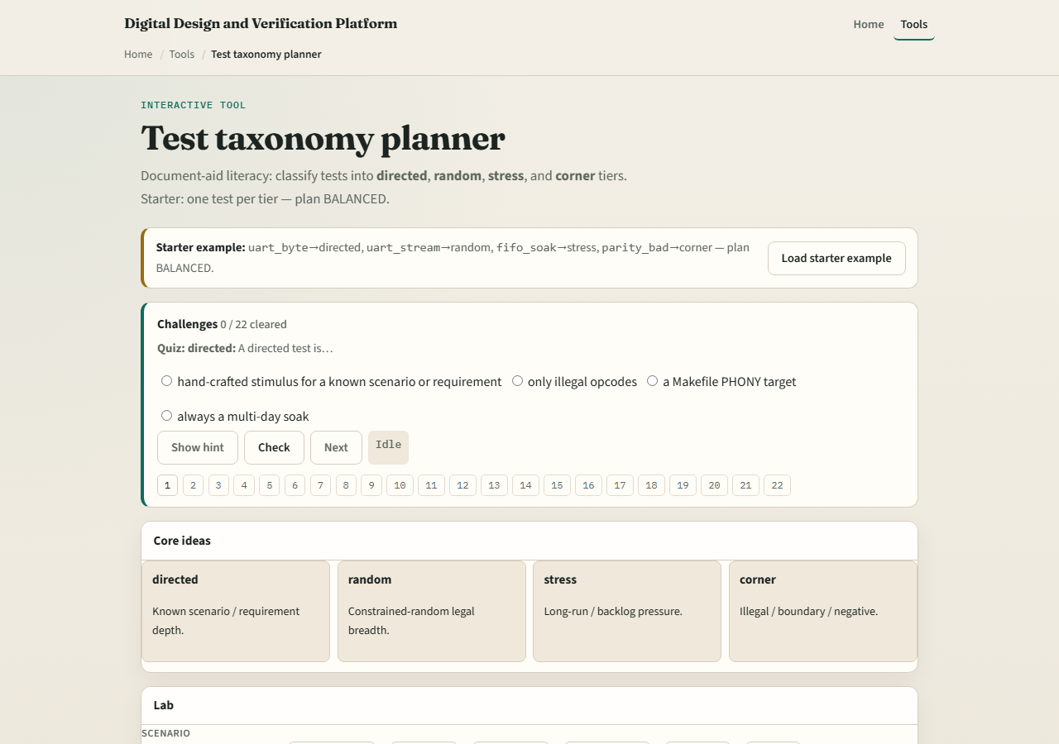
Browser lab
Lab starter
learn_verification_planning_management — test taxonomy
Notes:
In the taxonomy lab, load the starter with one test per tier until status reads balanced. Try an all-directed preset and watch skewed appear. Classify an open row, then scan the plan. Challenges lock in what each tier is for—not just cute names.

Slide 4
Planning docs practice
List four short test names for a UART-like block and tag each directed
If everything is directed, rewrite one as random and one as corner
Say in one sentence why the mix reduces escape risk
learn_verification_planning_management — test taxonomy
Notes:
List four short test names for a UART-like block and tag each directed, random, stress, or corner. If everything is directed, rewrite one as random and one as corner. Say in one sentence why the mix reduces escape risk.

Slide 5
Pitfalls to watch
Do not equate balanced taxonomy with one-hundred percent functional coverage
Do not leave tests untyped on a living plan
Do not hide negative cases because they are “hard.” And do not confuse a green CI job with
learn_verification_planning_management — test taxonomy
Notes:
Do not equate balanced taxonomy with one-hundred percent functional coverage. Do not leave tests untyped on a living plan. Do not hide negative cases because they are “hard.” And do not confuse a green CI job with a thoughtfully tiered suite.

Slide 6
Your turn
Complete the checklist for at least one track, preferably both
Classify a small set until it looks balanced
learn_verification_planning_management — test taxonomy
Notes:
Complete the checklist for at least one track—preferably both. Classify a small set until it looks balanced, then take the quiz and continue to the feature-by-scenario matrix.

